Slide 1


Service Tax

Slide 2

Reverse & Joint Charge Mechanism
Purpose
Meaning
Relevant Notification
Applicability of New Partial
Reverse Charge Mechanism
Special Points

Slide 3
Purpose of Reverse Charge Mechanism
To catch hold of assessee’s who are collecting service tax but but not paying it
Service Provider
Service Receiver
Govt. of India

Slide 4
Meaning of Reverse Charge Mechanism
Every person providing a taxable service is required to pay service tax at the prescribed rate.
However in certain cases the service recipient is made liable to pay service tax on the services received.
Since the person receiving services is made liable to pay service tax, the mechanism of collection of such tax is called as reverse charge (RCM)

Slide 5
Relevant Notification
Central Govt. has issued Notification No. 30/2012 dated 20/06/2012
Which specified where service Provided by in the manner so specified where the part of Service Tax Has to be paid by the Service Receiver
It also specifies the extent of STLthat has to be discharged by Service Receiver

Slide 6
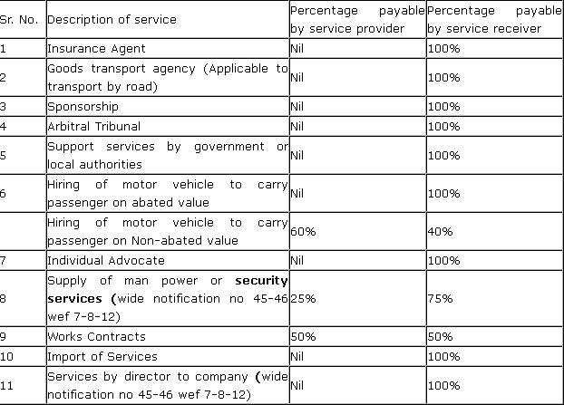
List of Services covered under 30/2012 Notification

Slide 7
Applicability of New Partial Reverse Charge Mechanism w.e.f 1.7.2012
It is Applicable to services provided or agreed to be provided by way of
Renting of Motor Vehicle Designed to carry Passengers on non abated Value to any person who is not engaged in any similar Business or
Service portion in execution of Work Contract
Supply of Manpower for any Purpose or

Slide 8
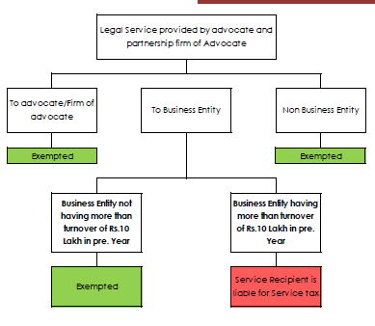
Special Points

Slide 9
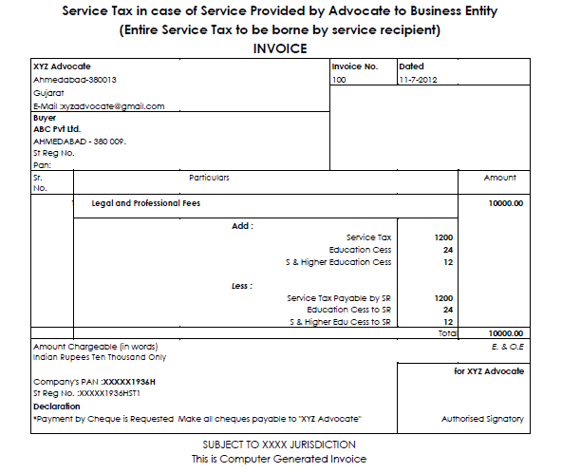
Invoice by Advocate 50:50

Slide 10
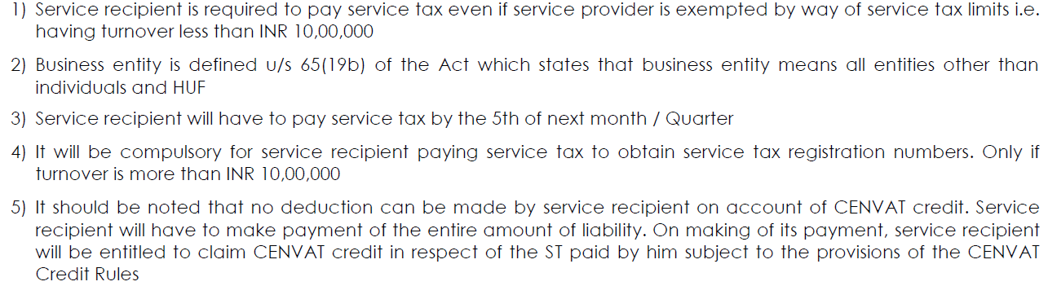
Special Points in case of SP is Advocate

Slide 11

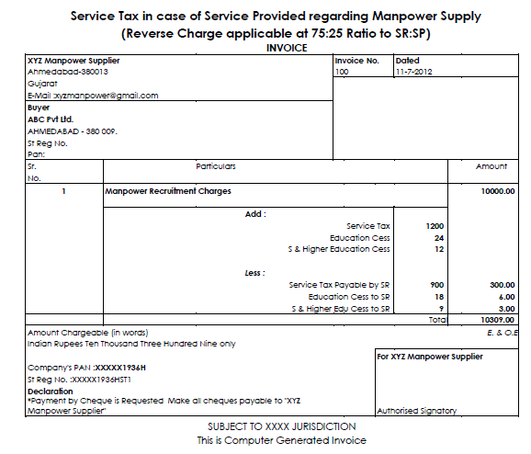
Invoice Format for Manpower Supplier

Slide 12
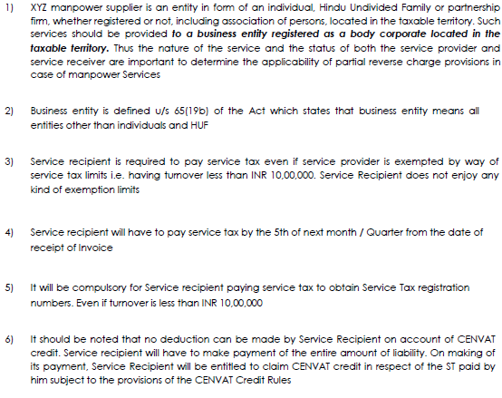
Notes on Manpower Supply

Slide 13

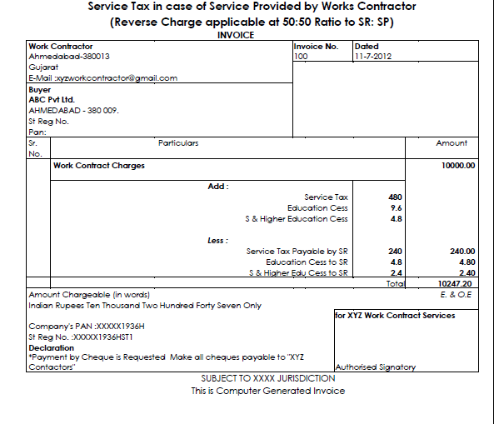
Invoice Format for Work
Contractor

Slide 14
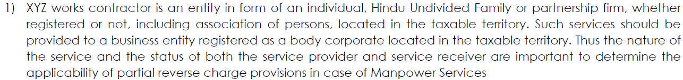
Special Notes on Work Contractor

Slide 15
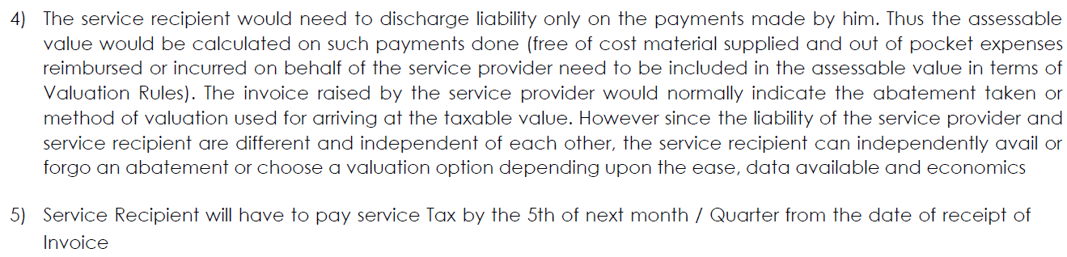
Continued……

Slide 16
Thank You

