Slide 1
SEMINAR ON RECENT CHANGES IN SERVICE TAX LAW
By
Krishna Agarwal
15th December, 2012

Slide 2
Background
From the date the Finance Bill 2012 was introduced on March 17, 2012 until date, there have been numerous amendments made in the service tax law.
The service tax law has undergone a complete overhaul and with these amendments. The most significant changes being the shift to the new system of taxation popularly known as “Negative List of Services” and the introduction of “Place of Supply Rules”.
Besides these two changes, there are certain changes in the service tax rules, CENVAT credit rules and valuation rules.

Slide 3
Coverage
Some of major changes in service tax law to the extent relevant to us are as under:
Section / Notification | Description of Section | Brief Description
Section 65B | Definitions | Important definitions include that of “service”, “taxable service”, “taxable territory”, “India”
Section 66B | Charging Section | This section says that all services will be taxed at 12% except those services as specified in the Negative List
Section 66D | Negative List | Services that would not be considered for service tax
Section 66E | Declared Services | This section deems certain types of contract to be deemed services

Slide 4
Notification No 30/2012 and Notification 36/2012 | Reverse Charge Mechanism | A list of services notified in which the Service Recipient is required to discharge the service tax liability in full, or both the service recipient and service provider has to discharge the tax liability as per the prescribed ratio.
Notification No. 25/2012and Notification No. 34/2012 | Exempted Services | A Single consolidated notification issued for exemptions. Called as the “Mega Exemption Notification”.
Notification No. 26/ 2012 | Abatement of Service tax | For the following notified services the levy of service tax. i.e. Service tax will be charged on the balance value after abatement.

Slide 5
Notification no. 24/2012 | Amendments to Service tax Valuation Rules | This Rule states how to determine the service portion in the execution of a works contract, supply of food and drinks in a restaurant or as outdoor catering, Demurrage charges, Interest on Delayed payments and Accidental damages not related to the service.
Notification No. 4/2012 | Amendments to Point of Taxation Rules | Once a POT is determined chargeability is decided; subsequent change will not change the chargeability.

Slide 6
DEFINATION OF SERVICE
Section 65B(44) defines ‘Service’ as:
  any activity carried out by a person for another for consideration
    And includes Declared Services
    Not to include:
  Mere Transfer of title in:
    Goods or Immovable property,
    -By way of sale/gift or in any other manner.

Slide 7
Not to include Continued…
  Services in the course of employment provided by an employee to employer,
  Performance of statutory duties is not service.
  - Any activity performed by a sovereign or public authority under law does not constitute taxable service.

Slide 8
Definition Taxable service
Any service on which service tax is leviable under section 66B ( Charging Section) .

Slide 9
Section 65B - Taxable territory and non taxable territory
The wordings of Charging section 66B are “ A Service is taxable only when it is provided or agreed to be provided in the taxable territory”.
As per Section 65B(52) taxable territory means the territory to which the provisions of Chapter V of the Finance Act , 1994 apply.
As per Section 64(1), Chapter V of the Finance Act , 1994 extends to the whole of India except the State of Jammu and Kashmir.
The essence of indirect taxation is that a service should be taxed in the jurisdiction of its consumption. This principle is more or less universally applied.

Slide 10
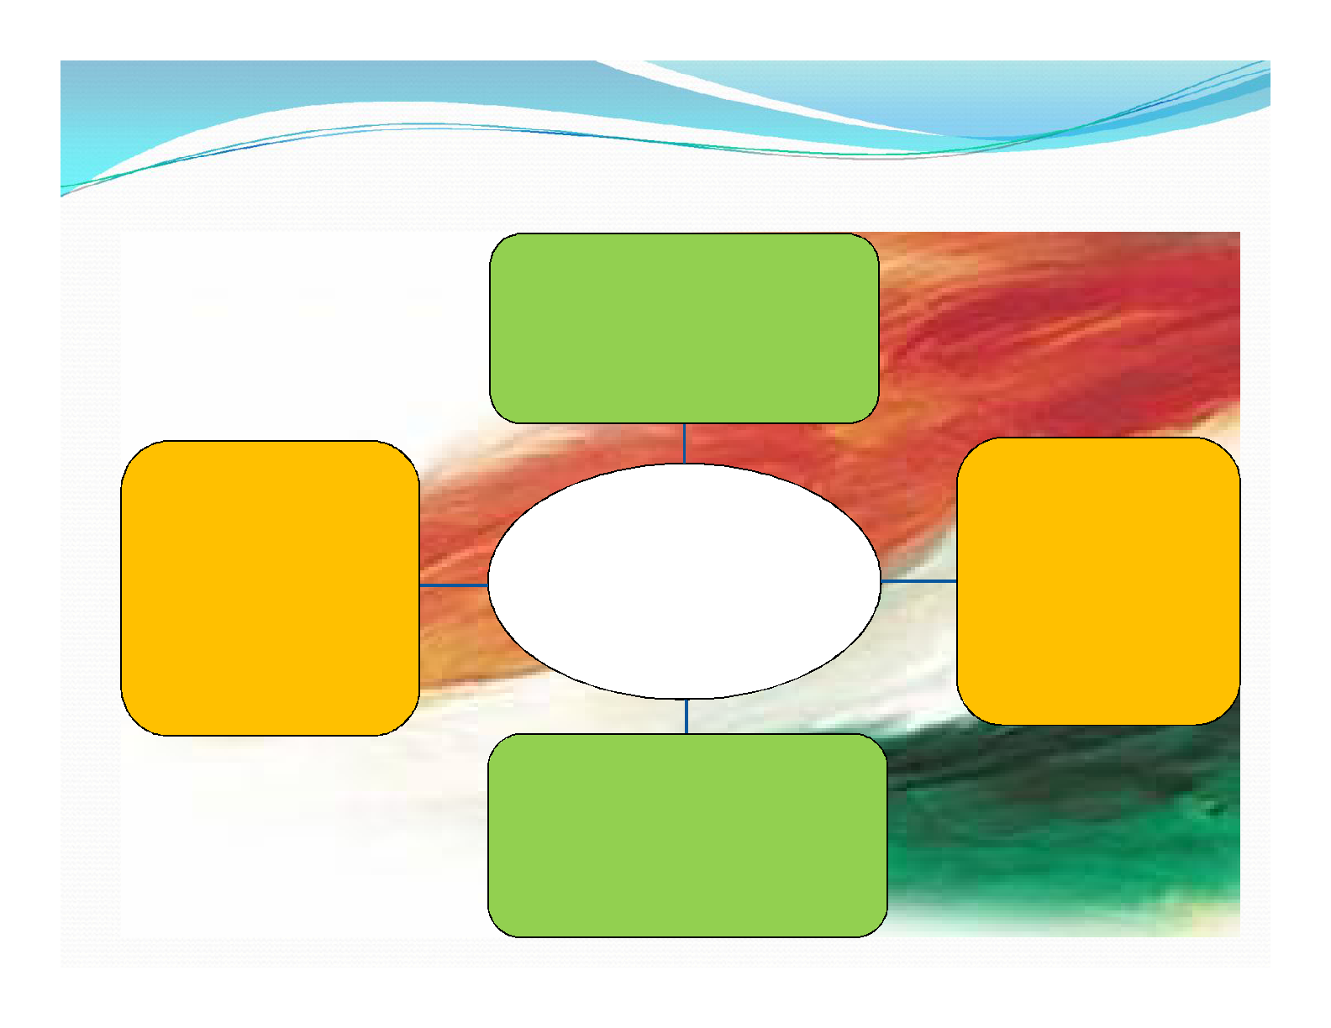
➢ TAXABLE TERRITORY = INDIA (200N.M INSIDE THE SEA) – JAMMU & KASHMIR
Air Space above territory and
territorial water
Installation, Structure
& Vessels located in
All States and Union
Continental Shelf or
Territories
Territorial Waters &
EEZ
Seabed and Subsoil
( Except Jammu &
under lying it
( for extraction of
Kashmir)
mineral oil & natural
gas)
Continental Shelf, EEZ & Other
Maritime Zone

Slide 11
Charging Section - Section 66B
Service tax to be levied at 12% on the value of all services, other than those specified in the negative list, provided or agreed to be provided in a taxable territory by one person to another.

Slide 12
Negative List
“Negative List" means the services which are listed in Section 66D as not liable to Service
Services covered Under Negative List are
Service | Comments
Services provided by Government Authorities, Excluding : Speed/Express Post, Life Insurance and other agency services Services in relation to aircraft/vessel in airport/port Transport of goods, passengers Other support services | In case of other support services, service receiver to pay taxes under reverse charge system
Services provided by Reserve Bank Of India (“RBI”)
Services provided by Foreign Diplomatic Mission
Agriculture and related activities ( including sale purchase of agricultural produce)
Trading of goods
Manufacturing
Sale of space or time for advertising ( other than radio and television)

Slide 13
Negative List
Service | Comments
Toll Charges
Games of chance ( betting, gambling and lottery)
Entertainment events and Amusement facilities | These are subject to state administered “Entertainment Tax”
Electricity Transmission and Distribution
Education ( pre-school, vocational and recognized qualifications)
Services by way of renting of residential dwelling for use as residence
Interest on loans and advances and interbank forex trading | Interest does not include any processing fee or other charges.
Public Transport (Stage carriage, railways ( except first class and AC coaches), Metro/trams, inland waterways, transport in a vessel of less than 15 tonnes ( other than for tourists), metered cabs, radio tax, auto-rickshaws.
Goods Transportation ( except goods transportation agency and courier agency)
Funeral Services

Slide 14
Declared Services
‘Declared Services’ are the services carried out by a person for another for consideration and declared as such under section 66E.
These section is basically a deeming section and deems the Following 9 activities also to be services as specified below :-
Services
Renting of immovable property
Construction of complex, building or structure or a part thereof except where entire consideration is received after issuance of certificate of completion.
Temporary transfer or permitting the use of enjoyment of any intellectual property right.
Development, design, programming, adaptation etc. of information technology software
Agreeing to the obligation to refrain from ,to tolerate, to do an act.
Transfer of goods by way of hiring, leasing, licensing without transfer of right to use.
Activity in relation to delivery of goods on hire purchase.
Service portion in execution of works contract.
Service portion in activity wherein food, other article of human consumption is supplied.

Slide 15
Reverse charge - Mechanism
‘Reverse charge’ means when liability to pay service tax has been shifted to service recipient in full or both the service recipient and service provider has to discharge the tax liability as per the prescribed ratio.
Existing cases under reverse charge are (100% liability of recipient):
  Service by insurance agent to person carrying on insurance business
  Transportation of goods by road by GTA
  Sponsorship services
  Service provided by a person from outside India
  Service by arbitral tribunal
  Service by govt. located in taxable territory
Additional services covered under Reverse charge mechanism are:
Services | Liability of service provider | Liability of service receiver
Rent a Cab services With abatement Without abatement | 100% 40% | Nil 60%
Supply of manpower | 75% | 25%
Works contract services | 50% | 50%

Slide 16
Exemption list
A Single consolidated notification issued for exemptions ,Called as the “Mega Exemption Notification”. It lists 39 services which will be exempted under service tax.
Consequential to the Mega list of exemptions, 81 exemption notifications issued in the past 18 years stand rescinded. There will now be only one single mega list of exemption from service tax.
The new exemption list is as follows :
New exemption list is as follows :
Service | Comments
Services provided to United Nations or specified International Organizations
Health care services by a clinical establishment, medical practitioner or Para- medics
Services provided by veterinary clinic
Services by a section 12AA entity for charitable purposes
Services by a person by way of Renting of a religious place for general public Conduct of religious ceremony
Fee charged by Advocates from non corporate including representation | Not covered under previous rules and hence no change is taxability
Services of technical testing of drugs by approved organization

Slide 17
Exemption list
Service | Comments
Training or coaching relating to arts, culture or sports
Services provided To educational inst. by way of catering To educational inst. for transportation or admission of students | Clause covers mid-day meals and transportation services
Services provided to recognized sports body | Exemption only to services provided by coaches, sportspersons , umpires etc and other sports bodies.
Services by way of sponsorship of tournament or championships | Only where the tournament has been organized by specified sports bodies
Services provided to govt. or local auth. by way of erection , construction, repair, alteration , renovation of civil structure, historical monument etc.
Services provided by way of erection , construction, repair, alteration , renovation of roads, bridge, tunnel , building owned by charitable organization, pollution control factory etc.
Temporary transfer of a copyright relating to original literary, dramatic, musical, artistic works or cinematograph films

Slide 18
Exemption list
Service
Services provided in relation to serving of food or beverages by units not having air-conditioning/heating or a license to serve alcoholic beverages
Services provided by way of transportation of 9 specified goods by railways or by a vessel. | As per Notification No. 8/2010-ST, dated 27.2.2010
Services provided by GTA by way of transportation of fruits, eggs, milk etc. where gross amount charged for single carriage does not exceed Rs 1500 and for a single consignee does not exceed Rs 750
Renting of motor vehicle meant to carry more than twelve passengers to state transport undertaking and, a means of transportation of goods to a goods transport agency
Transport of passengers by air terminating in an airport located in AP, Assam, Manipur, Meghalaya, Mizoram, Nagaland, Sikkim, or Tripura or WB or contract carriage for transportation of passengers
Services by way of motor vehicle parking to general public excluding leasing

Slide 19
Exemption list
Services
Services by performing artist in folk or classical art forms
Services of collecting and providing news rendered by independent journalists, Press Trust of India or United News of India
Services by way of renting hotels, inns or places meant for residential or lodging purposes. | Exemption available only to units with declared tariff below Rs 1000/day
Services provided by Sub broker , Member of commodity exchange , Mutual fund agent, Marketing agent of lottery tickets or A business facilitator
Process as job worker in relation to specified goods
Services by way of making telephone calls from PCO, Airport phones etc.
Services of slaughtering of bovine animals
Services received by govt. or charitable organization from service provider located in non-taxable territory.

Slide 20
Abatement of Service tax
Service tax will be charged on the balance value after abatement.
Abatement will be allowed at the following rates for the following services on the levy of service tax. i.e.
S.No | Description of Taxable Service | Abatement (standard Deduction of value)
1 | Financial leasing and Hire purchase | 10%
2 | Transport of goods in a vessel | 50%
3 | Transport of goods by road | 25%
4 | Transport of goods by rail | 30%
5 | Transport of passengers by rail | 30%

Slide 21
6 | Transport of passengers by air | 40%
7 | Renting of passenger vehicles | 40%
8 | Renting of hotels, guest houses | 60%
9 | Bundled service including food and hotel rent, convention center, etc. | 70%
10 | Tour operator | 10%, 25%, 40%
11 | Construction activity (per Section 66E) | 25%.

Slide 22
Changes in Valuation rules
Rule 2B inserted - This Rule states how to determine the service portion in the execution of a works contract.

Slide 23
Step 1 | Gross amount charged for work contract (excluding VAT , if any on transfer of goods) | xxxx
Step 2 Less : | Value of transfer of property in goods involved in the execution of work contract | xx
Step 3 ( step(1 -2)) | Value of work contract service. | xxx
Note : No cenvat credit of duty paid on goods , which do not form part of value of taxable services.

Slide 24
Changes in Valuation rules
Rule 2C inserted - Thus Rule states how to determine the service portion in supply of food and drinks in a restaurant or as outdoor catering.
As per this rule service tax is leviable only on charges pertaining to catering charges and value of good/food/beverage supplied is not taxable.

Slide 25
Changes in Valuation rules
Demurrage charges liable to service tax –
It is charge required as compensation for the delay of a ship/freight car /other cargo beyond its scheduled time for departure service.

Slide 26
Changes in Valuation rules
Other changes in valuation rules -
Accidental damages due to unforeseen action would no longer form part of value of service.
Interest on Delayed payments not liable for service tax.

Slide 27
Service Tax –POT
Definition of “Continuous service” extended to include where service is provided continuously or on recurrent basis, under a contract, for a period exceeding three months with an obligation for periodic payment.
Point of taxation is the date when the invoice for the service provided or agreed to be provided is issued. Where no invoice is issued within the time period of 30 days point of taxation will be the date of completion of service.
In case where service tax is payable under the Reverse charge mechanism, point of taxation will be the date on which the payment is made for the service, or six months.
In case of “associated enterprises” for import of services, the point of taxation shall be the date of debit in the books of account or date of payment, whichever is earlier.

Slide 28
Thank you
for your participation
in this discussion

