Slide 1
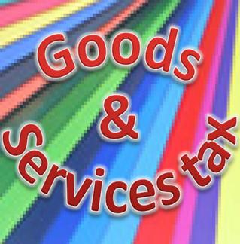
GOODS AND SERVICE TAX

Slide 2
INTRODUCTION
Goods and Service Tax is a tax on goods and services, which is leviable at each point of sale or provision of service, in which at the time of sale of goods or providing the services the seller or service provider can claim the input credit of tax which he has paid while purchasing the goods or procuring the service

Slide 3
A BRIEF
France was the first country to introduce this system in 1954. Today, it has spread to over 140 countries. Many countries have a unified GST system. However, countries like Brazil and Canada follow a dual system wherein GST is levied by both federal and state or provincial governments. In India, a dual GST is being proposed wherein a central goods and services tax (CGST) and a state goods and services tax (SGST) will be levied on the taxable value of a transaction.Although, the finance minister, Mr.P.Chidamabaram in his budget speech in 2006 had said that GST would be implemented from 1st Aprail 2010 but being a democratic country, it is yet to be implemented due to lack of consensus between various states and union government. Once again,it has been mentioned in Budget 2012 presented by Hon’ble Finance Minister on 16/03/2012 that it would be implemented from 01/08/2012 positively.

Slide 4
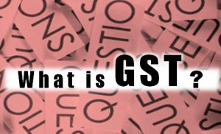
WHAT IS GST
The GST can be divided into following
sections to understand it better

Slide 5
Charging Tax
The dealers registered under GST (Manufacturers, Wholesalers and Retailers and Service Providers) are required to charge GST at the specified rate of tax on goods and services that they supply to customers. The GST payable is included in the price paid by the recipient of the goods and services. The supplier must deposit this amount of GST with the Government.

Slide 6

. Getting Credit of GST
If the recipient of goods or services is a registered dealer(Manufacturers, Wholesalers and Retailers and Service Providers), he will normally be able to claim a credit for the amount of GST he has paid, provided he holds a proper tax invoice. This “input tax credit” is setoff against any GST (Out Put), which the dealer charges on goods and services, which he supplies, to his customers.

Slide 7

Ultimate Burden of Tax on Last Customer
The net effect is that dealers charge GST but do not keep it, and pay GST but get a credit for it. This means that they act essentially as collecting agents for the Government. The ultimate burden of the tax falls on the last and final consumer of the goods and services, as this person gets no credit for the GST paid by him to his sellers or service providers.

Slide 8
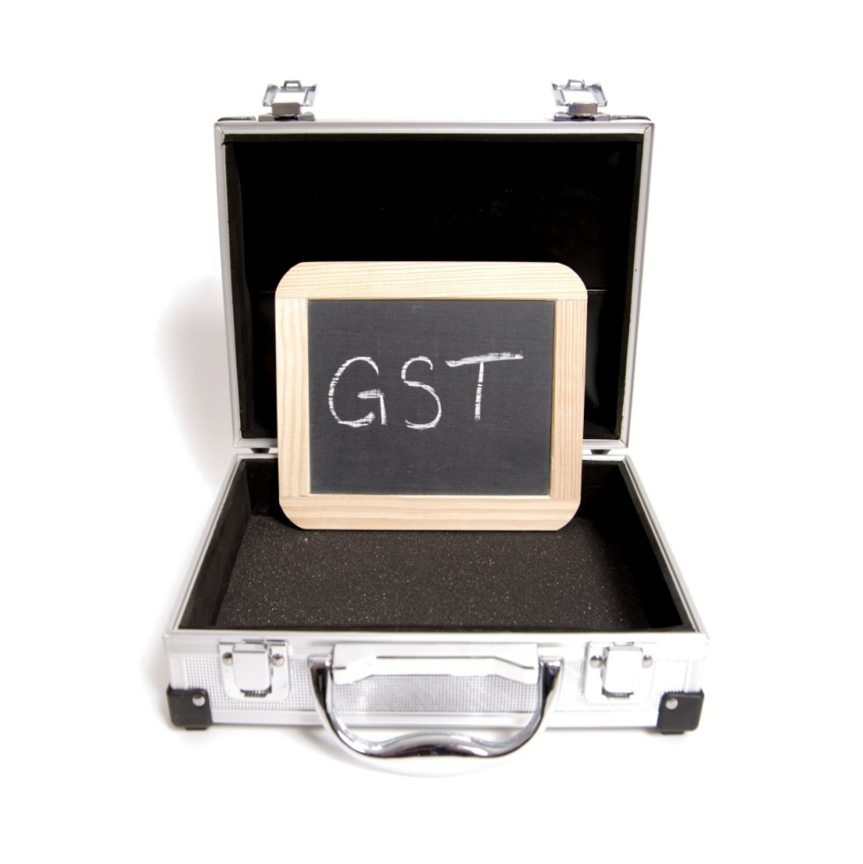
Registration
Dealers will have to register for GST. These dealers will include the suppliers, manufacturers, service providers, wholesalers and retailers. If a dealer is not registered, he normally cannot charge GST and cannot claim credit for the GST he pays and further cannot issue a tax invoice

Slide 9
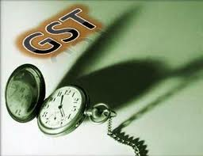
Tax Period
The tax period will have to be decided by the respective law and normally it is monthly and/or quarterly. On a particular tax period, which is applicable to the dealer concerned, the dealer has to deposit the tax if his output credit is more than the input credit after considering the opening balance, if any, of the input credit.

Slide 10
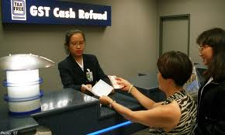
Refunds
If for a tax period the input credit of a dealer is more than the output credit then he is eligible for refund subject to the provisions of law applicable in this respect. The excess may be carried forward to next period or may be refunded immediately depending upon the provision of law.

Slide 11
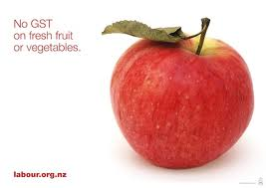
Exempted Goods and Services
Certain goods and services may be declared as exempted goods and services and in that case the input credit cannot be claimed on the GST paid for purchasing the raw material in this respect or GST paid on services used for providing such goods and services

Slide 12
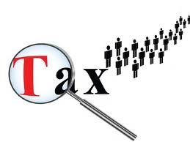
Zero Rated Goods and Services
Generally, export of goods and services are zero-rated and in that case the GST paid by the exporter of these goods and services is refunded. This is the basic difference between Zero rated goods and services and exempted goods and services.

Slide 13
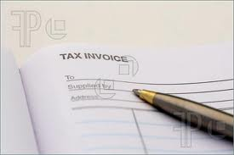
Tax Invoice
Tax invoice is the basic and important document in the GST and a dealer registered under GST can issue a tax invoice and on the basis of this invoice the credit (Input) can be claimed. Normally a tax invoice must bear the name of supplying dealer, his tax identification nos., address and tax invoice nos. coupled with the name and address of the purchasing dealer, his tax identification nos., address and description of goods sold or service provided.

Slide 14
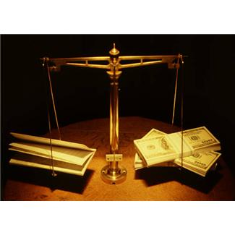
Effect on economy
In a speech which was given in October 2009, Dr Kelkar had estimated the gains of GST for Indian economy based on similar gains made in Canada.
“The Finance Commission had appointed a Task Force on GST as well as commissioned a study by NCAER to assess its impact on growth in GDP and exports. The preliminary results of the NCAER study indicate that the growth in GDP can be between 2-2.5 per cent with the implementation of a well designed GST. This pioneering study explores the impact of GST on growth through direct cost reduction as well as cost reduction of capital inputs. The increase in exports can be between 10-14 percent. If we use 3 per cent as a discount rate, and lower estimate of the GDP increase of 2 per cent accruing year after year, the net present value of the GST reform exceeds half a trillion dollars.”

Slide 15
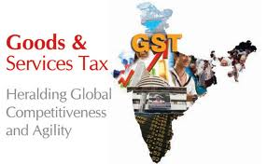
How will dual GST affect the fiscal health of states
Being a consumption-based tax, dual GST will result in better revenue collection for states with higher consumption of goods and services. The backward and less-developed states would see fall in collections. The Centre is expected to put in place a mechanism to compensate states for any revenue loss due to GST.The introduction of the GST system is by far the most important tax reform in India. Consensus and coordination among states is required for it to succeed. Before it can be introduced, the Centre and states have to sort out issues like agreement on GST rates, constitutional amendments empowering states to tax services, taxation on inter-state transactions of goods and services, drafting of CGST and SGST laws, consultation with all stakeholders including trade and industry associations before finalisation, administrative preparedness to implement the new tax regime and resolution of all other issues under discussion.

