Slide 1
INFORMATION TECHNOLOGY PROGRAMME
PROJECT REPORT
ON
SERVICE TAX
PREPARED BY :-
NAME -
REG. NO. -
BATCH NO.-

Slide 2
CONTENTS
HISTORICAL BACKGROUND
APPLICABILITY
WHO MUST OBTAIN REGISTRATION & TIME LIMIT
GENERAL EXEMPTION FROM SERVICE TAX (SEC.93)
TAX IS CALCULATED ON THE VALUE
WHO IS LIABLE FOR SERVICE TAX?
OTHER PROVISIONS RELATING TO SERVICE TAX
Provisional Payment of Service tax
Due dates for payment of service tax
DEFAULT & EXCESS PAYMENT OF SERVICE TAX
When will return be filed?
Other provisions relating to return
Some important forms
Penalty for late filing of return

Slide 3
HISTORICAL BACKGROUND
Service Tax is an Indirect Tax.
The provisions to levy tax on services are contained in the Financial Act, 1994.
Based on the recommendation of the Tax Reforms Committee headed
by Dr. Raja J. Chelliah
It was introduced in 1994 by the 10th Finance Minister Dr. Manmohan Singh.
Initially three services were identified and taxed.
TELEPHONE
STOCK BROKING
GENERAL INSURANCE

Slide 4
The legislations relating to service tax are the
Finance Act, 1994
Service Tax Rules, 1994
Notifications issued by CBEC
Circulars issued by CBEC
CENVAT Credit Rules, 2004

Slide 5
APPLICABILITY
Every person whether Individual or Sole Proprietor or Partnership or Company etc. are liable to pay service tax if provide any taxable services.
Sec 66 of the Finance Act, 1994 is the charging section.
Service Tax is levied to the whole of India except the state of
Jammu & Kashmir
from 24th February 2009 it is 10.3%. It is bifurcated by
Education cess i.e.2%
Secondary and higher education cess i.e. 1%
Service tax i.e. 10%

Slide 6
Who must obtain registration & time limit?
Person who liable to pay service tax
Within 30 days from the date on which charge of service tax is bought into force
Input Service distributor
Within a period of 30 days of the commencement of business or 16th June 2005 whichever is later
Small Service Provider
Within a period of 30 days of the date in FY on which the aggregate value of service exceeds Rs. 9 Lakh

Slide 7
General exemption from service tax (Sec. 93)
Services provided by united nation or an in international organizations
2. Service provided to developer or units of special economic zone
3. Goods & materials sold by service provider to recipient of service
4. Service provided by reserve bank of India
  5. The service provider whose turnover is less than 10 lakh in the previous year
  will be exempt from service tax up to Rs 10 lakh in next FY. They called
  small service providers

Slide 8
Exemption to technology business Incubator, Science and Technology
Entrepreneurship park (STEP) and Incubates
  Exemption is granted to incubates subject to following condition
    Incubates should be located within the premises of the incubator
    b)Total business turnover of incubates entrepreneurship does not exceed Rs. 50 Lakh during the preceding financial year.
    c)The exemption is avail to incubate for a period of 3 year.
7. Services provided by a digital cinema service provider.
8. Service provided by Residential welfare association
  Monthly contribution does not exceed Rs. 3000/Month
9. Drug & Medicine Produces

Slide 9
The tax is calculated on the value. following provisions are:-
a) If consideration is charged in money then the amount charged is the value.
b) If the consideration charged is either wholly or partly not in money then value shall be
equal to that part which is not in money also calculated in money value which shall be
deemed to be service tax.
c) A consideration is not ascertainable then the value on which the tax has to be
charge shall be the amount as prescribed under
Service Tax (Determination of Value) Rules 2006.
d) Where the amount charged by the service provider is inclusive of service tax then
the values will be treated as inclusive of tax.
e) The gross amount charged shall include any amount received towards the
taxable service either before or during or after providing such service.

Slide 10
Who is liable for service tax?
As per Sec 68(1) every person who is providing a taxable service to another person is liable to
pay service tax to the Government.
However Sub Section 2 of Section 68 empowers the Central Government to notify
any other class of person or persons who shall be liable to pay service tax.
The Central Government has notified such class of persons in rule 2(1d) of the
Service Tax Rules 1994. These notified persons are “Receivers of Taxable Services”.
a) General Insurance Business
b) Insurance Auxiliary Service
c) Transportation of goods by road
d) Distribution of mutual fund in business auxiliary service
e) Sponsorship Service
f) Services provided from outside India and received in India

Slide 11
Other provisions relating to service tax
When services are provided free of cost i.e. without receiving any
consideration in cash or in kind no service tax is paid.
Service tax has to be paid only when the value of taxable service is
realized by the service provider.
service provider should pay service tax on advances received also.
Where any person has collected any amount as service tax which is not suppose
to collect or where a person has collected an amount which is more than the tax
that is charged then he should immediately pay the amount so collected to the
credit of the Central Government.

Slide 12
Provisional Payment of Service tax
If assesses is unable to correctly estimate the amount of tax
payable by him, he can request in writing to the commissioner
of CBSE for payment of service tax on provisional basis.
In such cases, the assesses has to submit a memorandum
in form ST-3A giving detail of difference between service taxes
deposited and service tax to be paid for each month/Quarter.

Slide 13
Due dates for payment of service tax
Assessee is individual, partnership or proprietorship firm
Other than individual, partnership or proprietorship firm
5th of the month
succeeding the quarter
5th of the month succeeding the month
Last quarter & month of March tax has to be paid by 31st March itself.
through Internet ,Banking the due date is 6th instead of 5th.
Tax has to be paid by using a challan GAR-7.

Slide 14
Default in payment of service tax
Where tax is not paid on or before due date the assessee shall be liable to pay interest from the date after the due date till the actual date of payment of tax.
The current rate of interest is 13%.
If the assessee has paid excess service tax should that excess be refunded or can
the assessee adjust the excess against future liabilities.
If the assessee has paid excess amount as service tax than what is required to pay
then such excess can be adjusted only if the excess is due to return of the service
provided.
Excess payment of service tax

Slide 15
When will return be filed?
The return has to be filed for each half year
25 October for april-september
25 april for october –
march
The service tax return has to be filed in form ST-3.
If the assessee is providing more than one taxable service one return is sufficient
For all taxable services. filing nil return is also a must.

Slide 16
Other provisions relating to return
Where the assessee has not filed the return on or before the due date the return can be filed after paying late fee, which is prescribed by the Government.
Every return, which is filed, can be revised within 90 days from the date of filing.
Revised return cannot be filed if the revision is on account of any classification, value or cenvat credit.
filing the return is holiday the next working day will be treated as the due date.

Slide 17
Some important forms
Form ST-1 (application form for registration under Section 69)
Form ST-3 (return under Section 70)
Form ST-3A (Memorandum for provisional deposit
Form TR-6 (Service Tax Payment Challan)

Slide 18
Penalty for late filing of return
  Overall maximum limit is Rs. 2000
Delay
Penalty
Up to 15 Days
Rs. 500
15 to 30 Days
Rs. 1000
31 Days and On
Rs. 1000 to Rs. 100/day from 31st day onwards but the total penalty can not exceed Rs. 2000

Slide 19
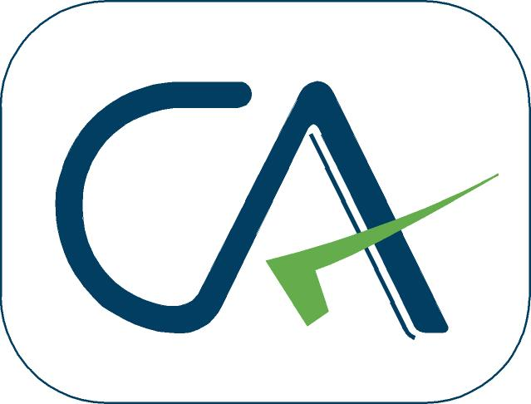
x
THANK YOU
FROM:-
NAME -
REG. NO. -
BATCH NO. -

