Slide 1
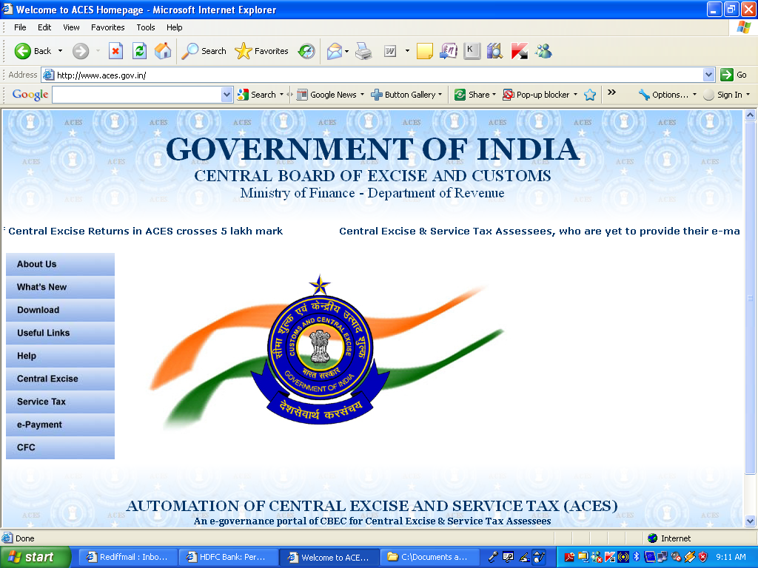
RAJVEER GUPTA
Email rajveergupta@rediffmail.com
CLICK HEAR FOR E.PAYMENT OF SERVICE TAX

Slide 2
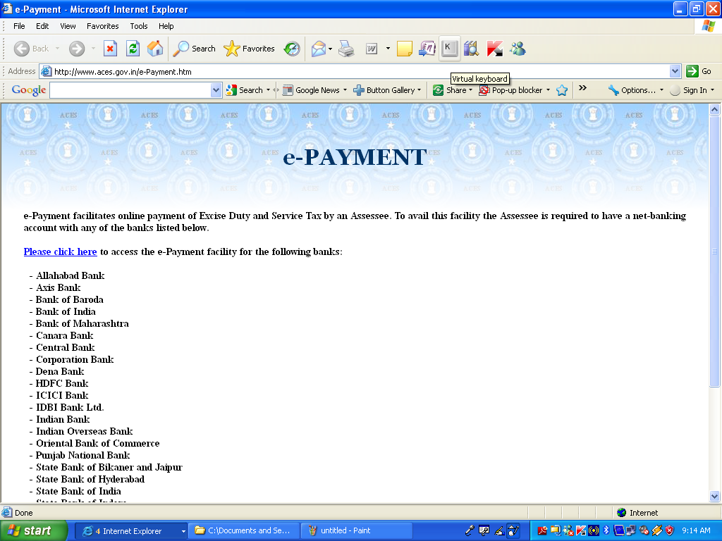
CLICK HEAR

Slide 3
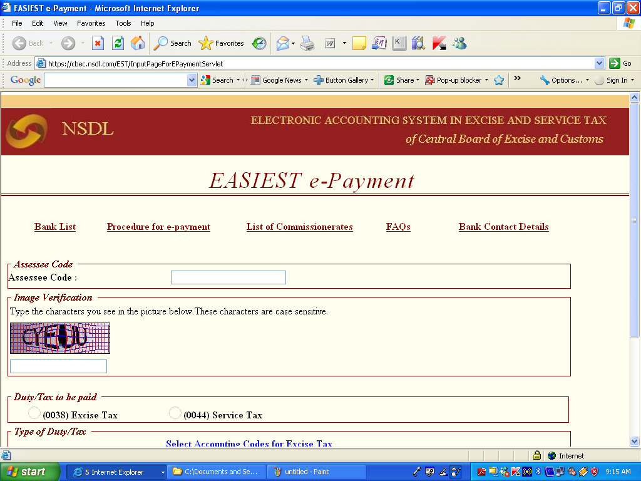
FILL HEAR YOUR ASSESSEE CODE

Slide 4
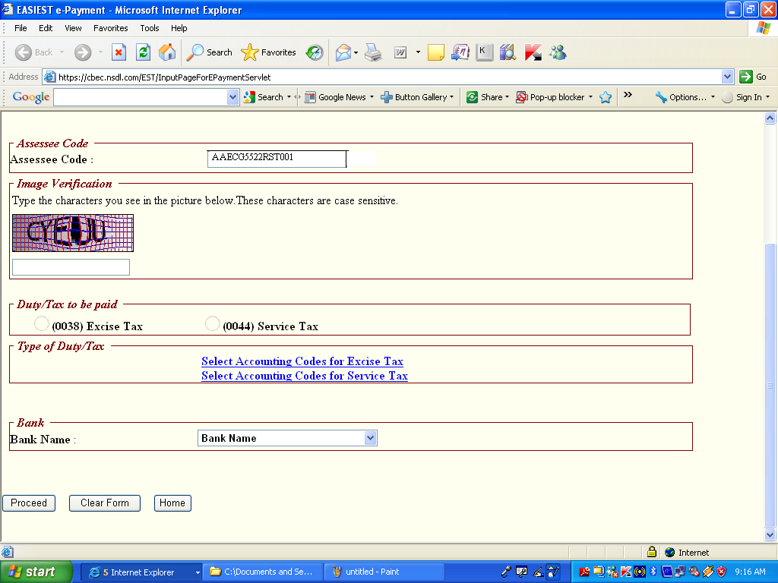
AFTER THIS TYPE THIS CHARACTER FROM PICTURE

Slide 5
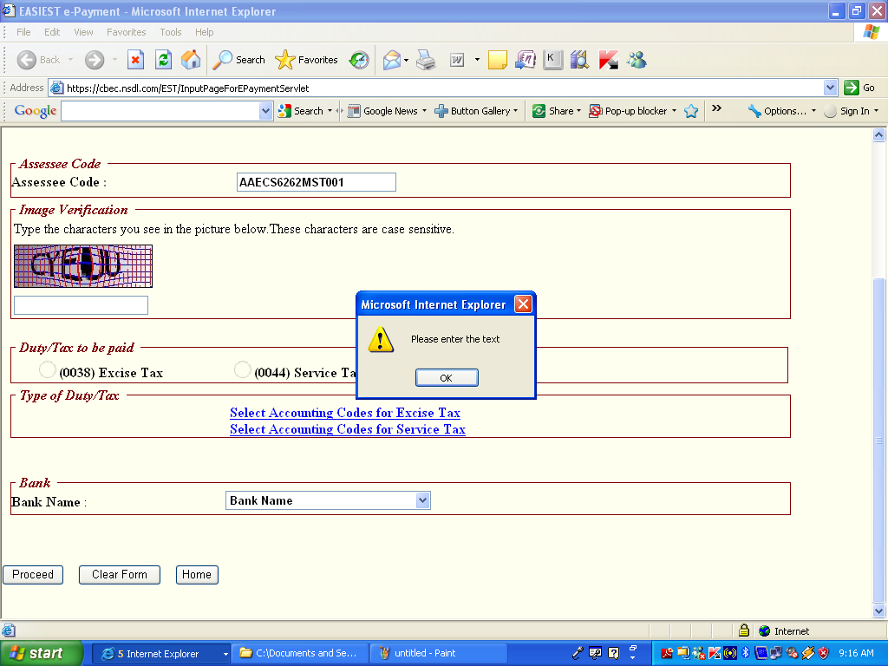
CLICK OK BUTTON

Slide 6

CLICK HEAR FOR PAYMENT OF SERVICE TAX

Slide 7
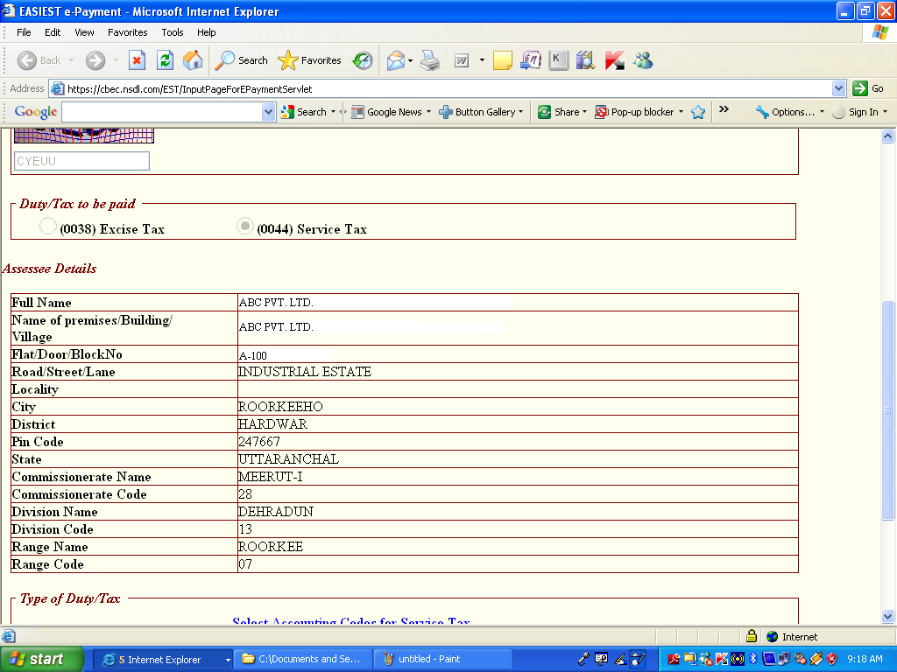
AFTER ABOVE YOU FOUND THIS WINDOW

Slide 8
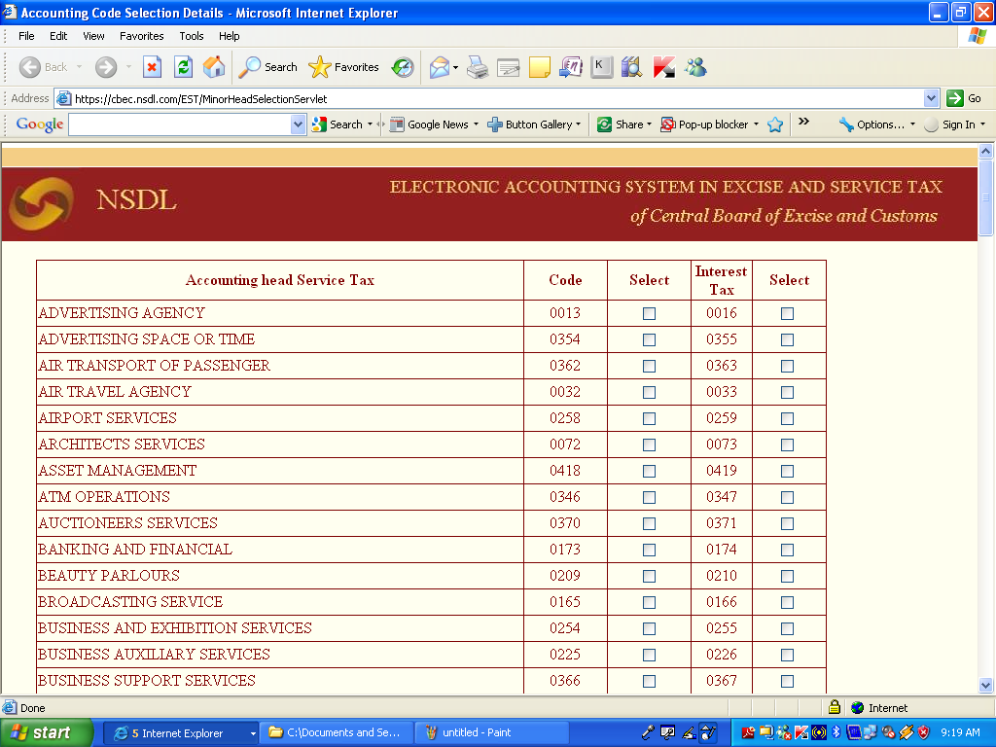
SELECT THE ACCOUNTING CODE

Slide 9
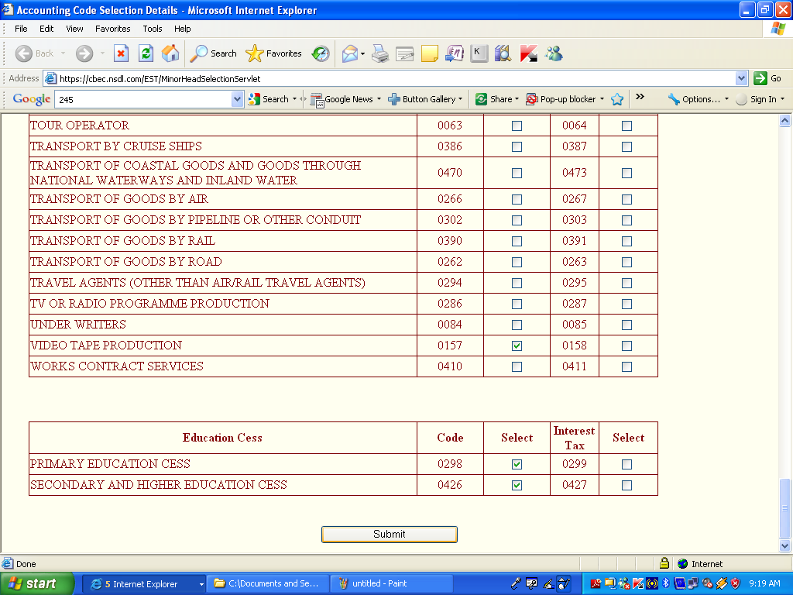
AFTER SELECT THE CODE CLICK SUBMIT BUTTON
CLICK HEAR

Slide 10
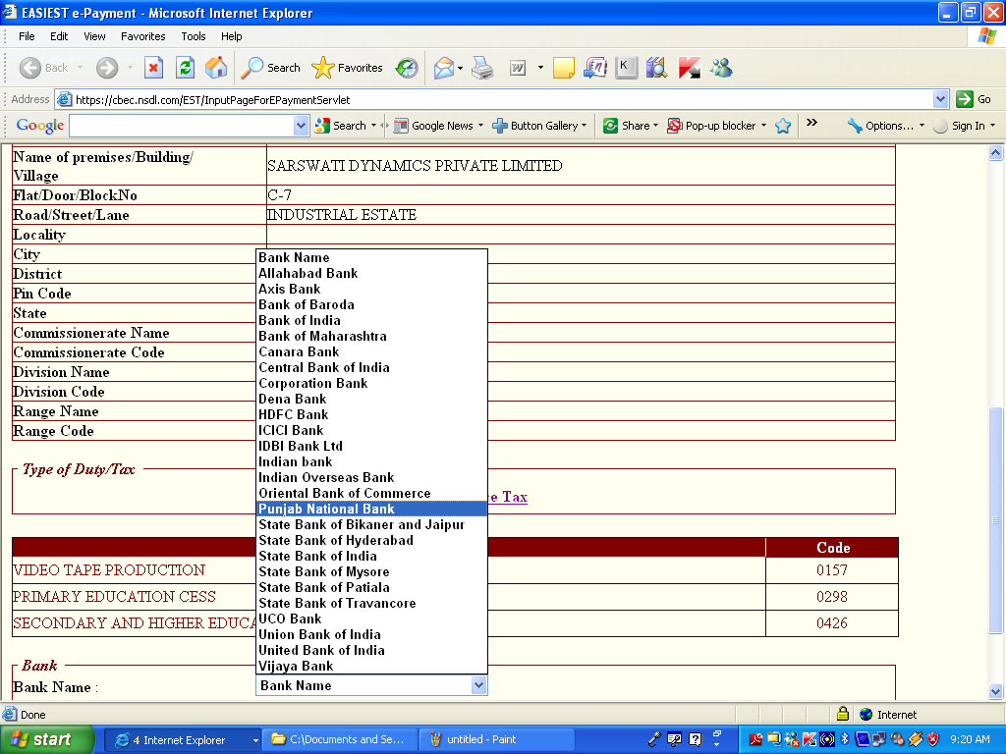
SELECT THE BANK

Slide 11
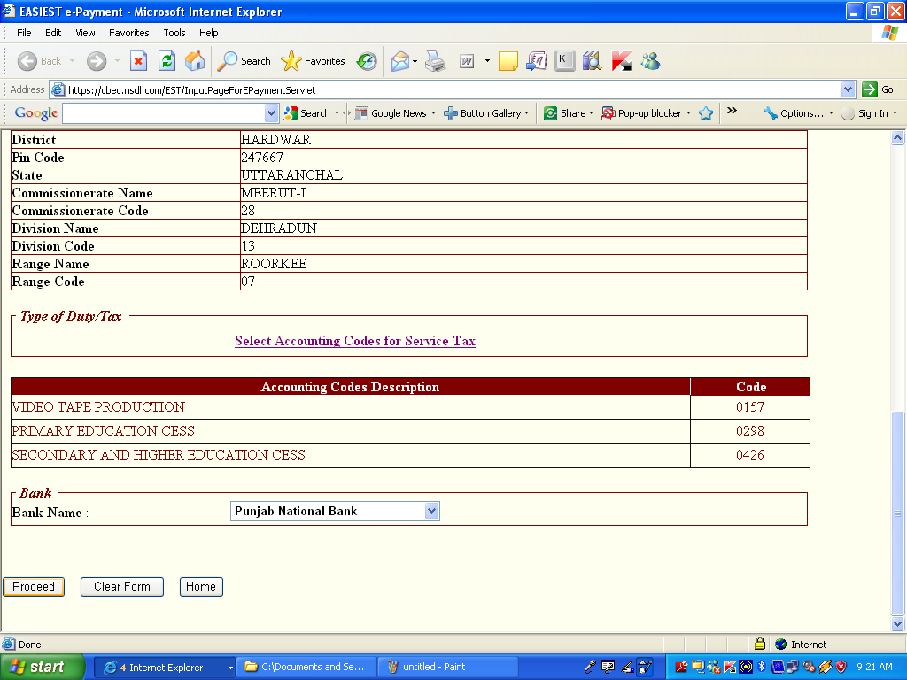
CLICK THE PROCCED

Slide 12
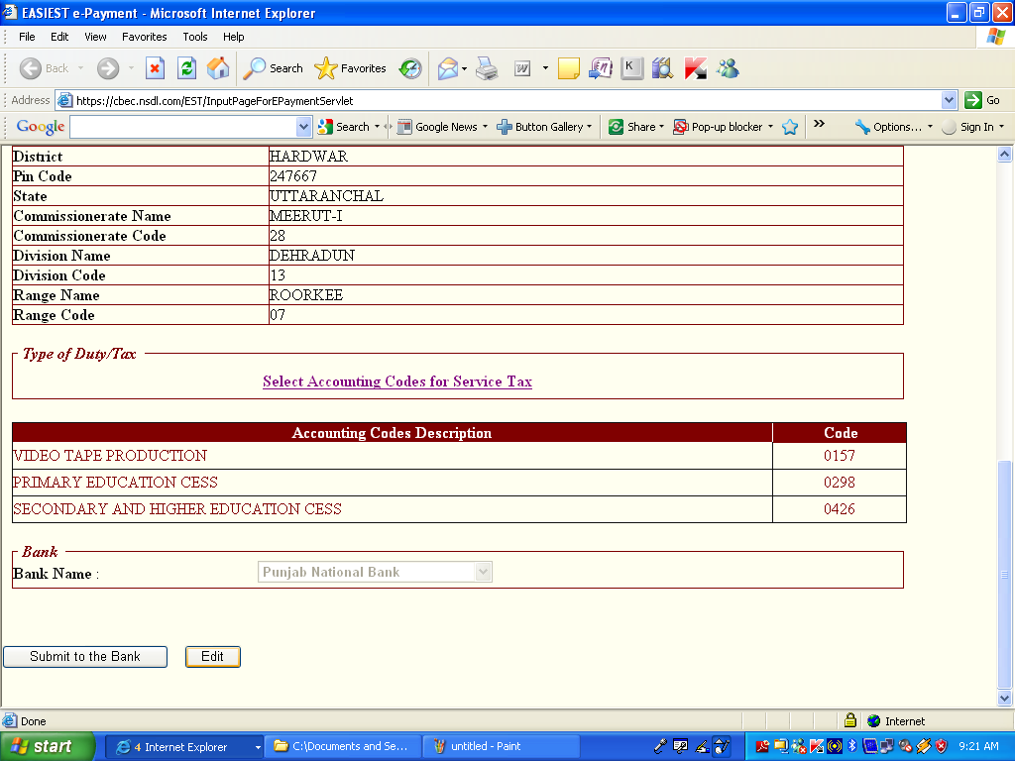
AFTER PROCEED CLICK SUBMIT THE BANK

Slide 13
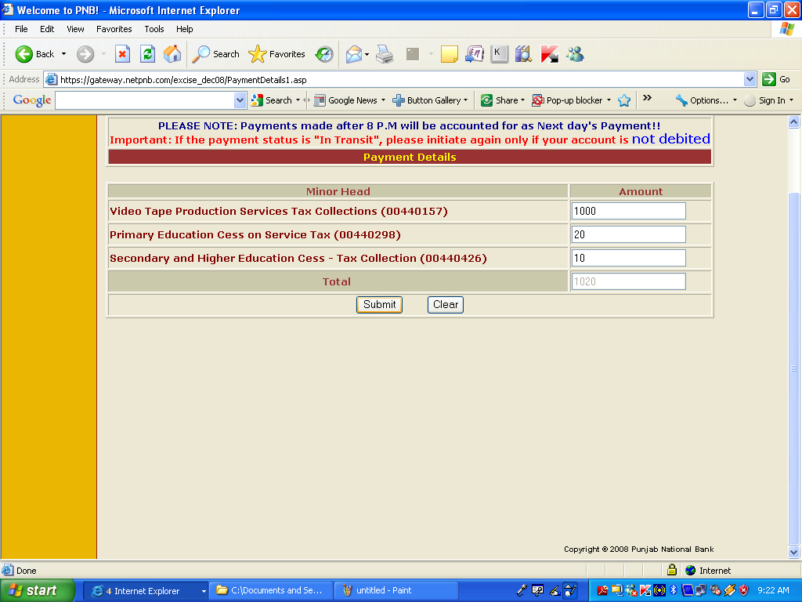
FILL THE AMOUNT OF TAX, E CESS, H & SEC.E.CESS AND CLICK SUBMIT BUTTON

Slide 14
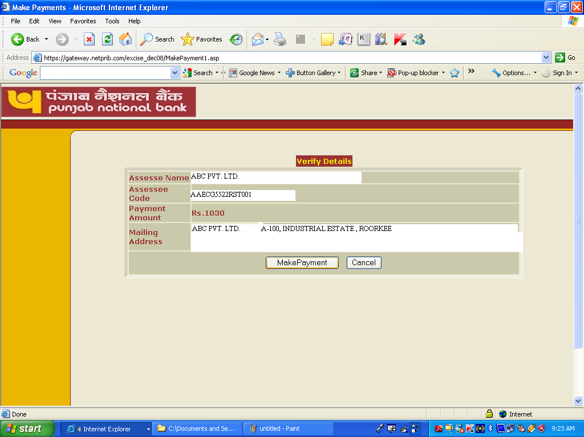
CLICK HEAR FOR PAYMENT OF SERVICE TAX

Slide 15
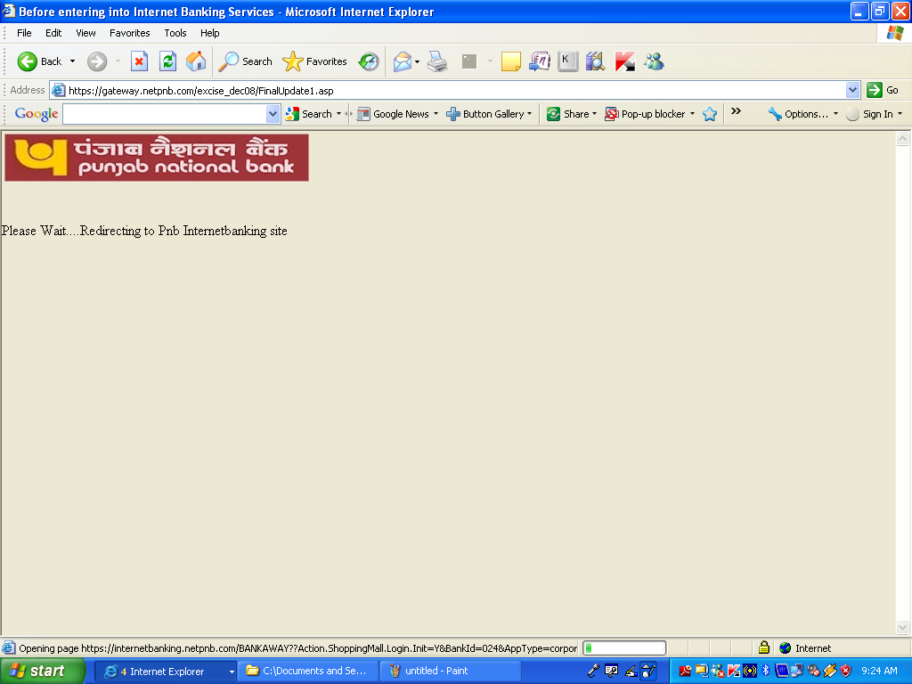
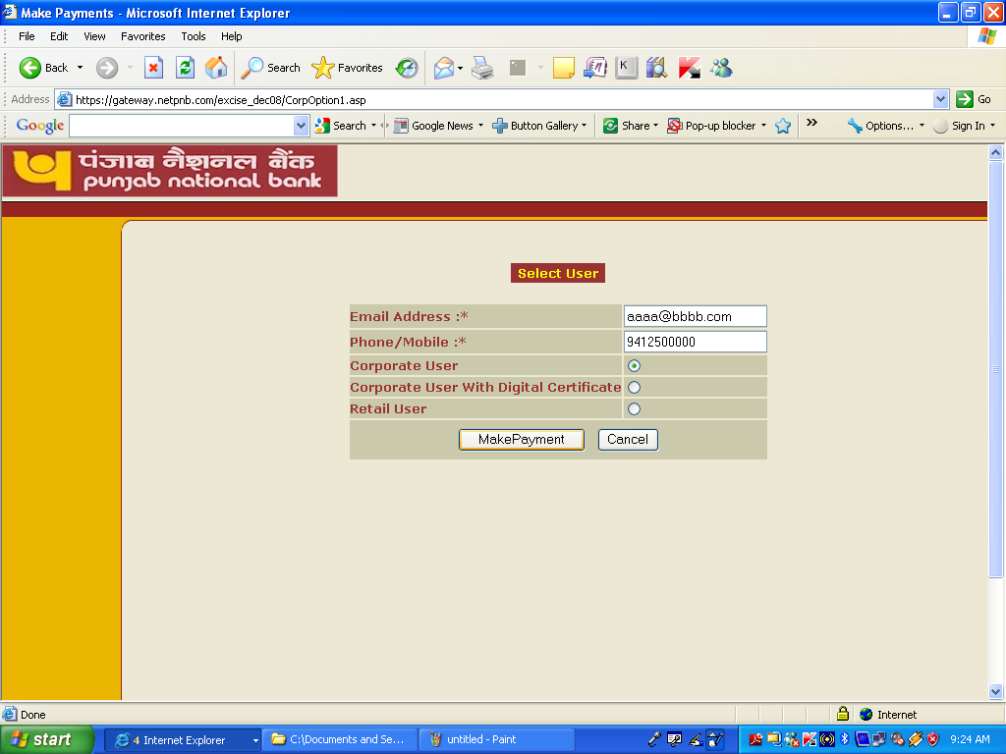
PLEASE WAIT FEW SECOND AND AFTER THIS FILL THE BANK PASSWORD FOR PAYMENT AND PRINT THE CHALLAN (GAR-7)

Slide 16

RAJVEER GUPTA
Email rajveergupta@rediffmail.com
Thanks & Regards
Rajveer Gupta
Email rajveergupta@rediffmail.com
rajveergupta97@gmail.com

