Slide 1



Procedural aspects under service tax
Presented by:
CA. Kamlesh Chauhan
B Sc, LL B, FCA, ISA(ICA)

Slide 2
SERVICE TAX PROCEDURES
TODAY’S COVERAGE
ON-LINE:
Registration
Amendment in registration Certificate
Surrender of Registration Certificate
E-filing procedure:
E-filing of ST-3 Return
E-payment of Service Tax

Slide 3
FREQUENTLY ASKED QUESTIONS
FAQ: Who needs Service Tax Registration?
Answer: Every person liable to pay service tax needs Service Tax Registration. Further, ‘Input Service Distributor’ is also required to obtain Service Tax Registration.

Slide 4
FREQUENTLY ASKED QUESTIONS Contd.
FAQ: Who is liable to pay service tax?
Answer: Followings are liable to pay Service Tax;
1. Service provider,
2. Service receiver under reverse charge [Importer of Service under Rule 2(1)(d) of the Service Tax Rules, 1994],
3. Service receiver in case of (vide notification number 36/2004);

Slide 5
FREQUENTLY ASKED QUESTIONS Contd.
(a) General Insurance or Life Insurance Business
w.r.t. Insurance Auxiliary Service (rendered
by agent)
(b) Mutual Funds (rendered by agents w.e.f.
1-3-2005)
(c) Asset Management Service (rendered by agent)
(d) Sponsorship service provided to Body corporate or firm ( F. No. 334/4/2006-TRU, dt-28-02-2006)

Slide 6
FREQUENTLY ASKED QUESTIONS Contd.
4. Goods Transport Agency Service:
(a) Who paid freight if consigner or consignee is covered under notification number 36/2004,
(b) GTA if service receiver is (i) unregistered individual trader (b) factory not governed under Factory Act, 1948 (c) Government / any of its department.

Slide 7
FREQUENTLY ASKED QUESTIONS
FAQ: Whether every service provider is required to obtain service tax registration?
Ans: No, Small service providers are exempted;
S.No. | Period | Service Tax exemption limit (Rs.) | ST Registration exemption limit (Rs.)
1 | 1/7/94 to 31/3/05 | Nil | Nil
2 | 1/4/05 to 31/3/07 | 4 Lacs | 3 Lacs
3 | 1/4/07 to 31/3/08 | 8 Lacs | 7 Lacs
4 | 1/4/08 onwards | 10 Lacs | 9 Lacs

Slide 8
FREQUENTLY ASKED QUESTIONS Contd.
FAQ: Whether assessee, in case of rendering a (continuous) service, can postpone billing indefinitely so as to manage/avoid himself from falling into taxable ambit/limit?
Answer: No, Under Rule 4A(1) of Service Tax Rules, 1994 is required to issue an invoice / bill / challan within 14 days from completion of taxable service or receipt of consideration towards such service.

Slide 9
FREQUENTLY ASKED QUESTIONS Contd.
FAQ: When should an prospective assessee should obtain registration?
Answer: Application for registration should be made within 30 days from the date on which Service Tax is levied or within 30 days from the date of commencement of business whichever is later.

Slide 10
REGISTRATION PROCEDURE
IMPORTANT ANNOUNCEMENT:
On-line registration has been made mandatory for all kind of assessees w.e.f. 30-09-2009 vide Trade Notice Number 14/ST/2009 dated 17-09-2009.
Software application is called Automation of Central Excise and Service Tax (ACES).
Related site: http://www.aces.gov.in

Slide 11
ON-LINE REGISTRATION PROCEDURE
Log on through internet at http://www.aces.gov.in
Choose Service Tax and click “New Users”.
Register yourself: Fill the chosen User-ID and Email-ID.
The system, ACES, will check the availability of chosen User-ID and generate password, if available.

Slide 12
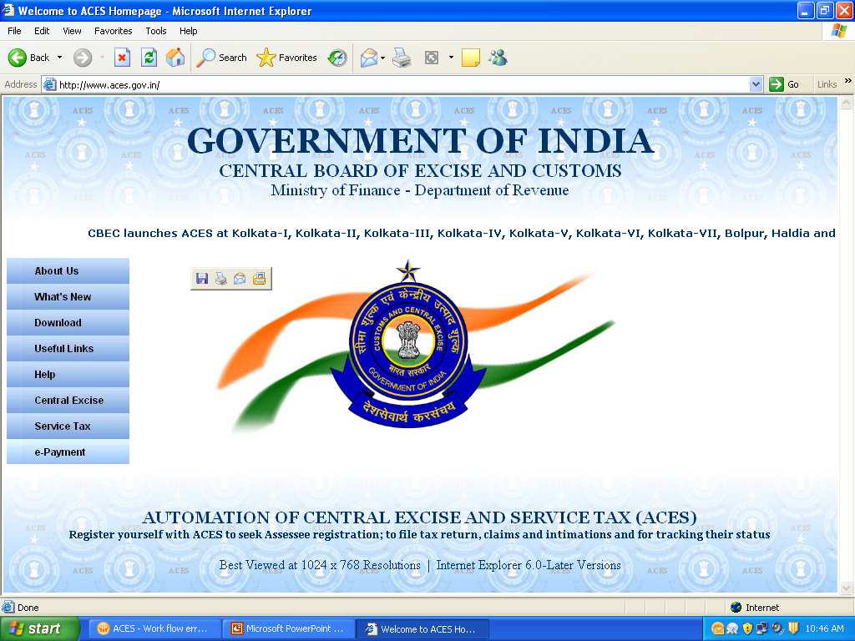
Login for Service Tax Assessee

Slide 13
Facilities available to Assessee
*
View ledger
account details
Amend registration
details
File refund claims
File returns
Intimations and
sundry applications
Assessees
Registration
File appeals
File export documents
Provisional
assessment
requests
Respond to show
cause notices
View audit reports

Slide 14
ON-LINE REGISTRATION PROCEDURE contd.
The system, ACES, will send the User-ID and password at user’s Email.
The user will, then, relog http://www.aces.gov.in
Click service tax button, login using the User-ID and password provided at user’s Email, click ‘Reg’ button in the menu bar appearing at the top of the screen, select new registration.

Slide 15
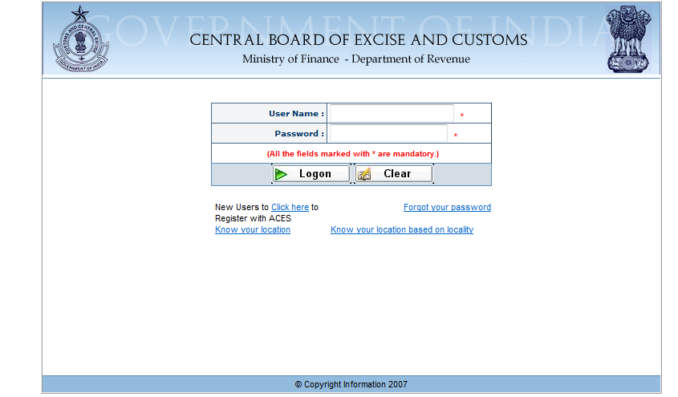

Slide 16
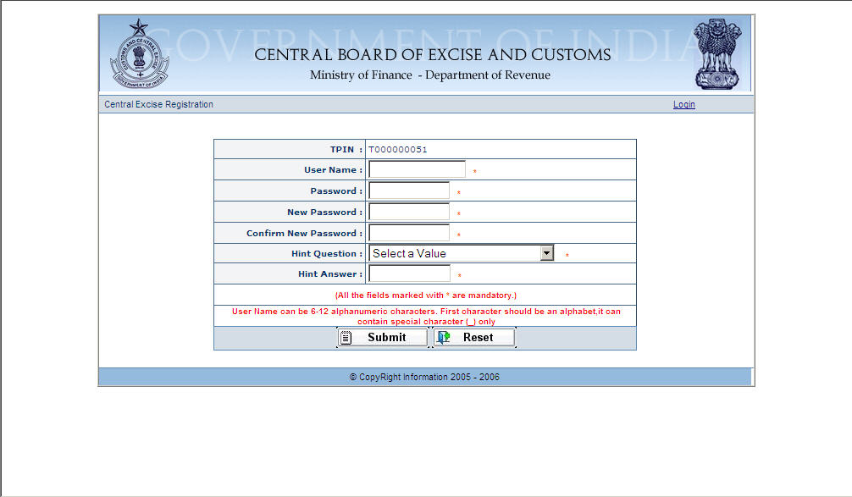

Slide 17
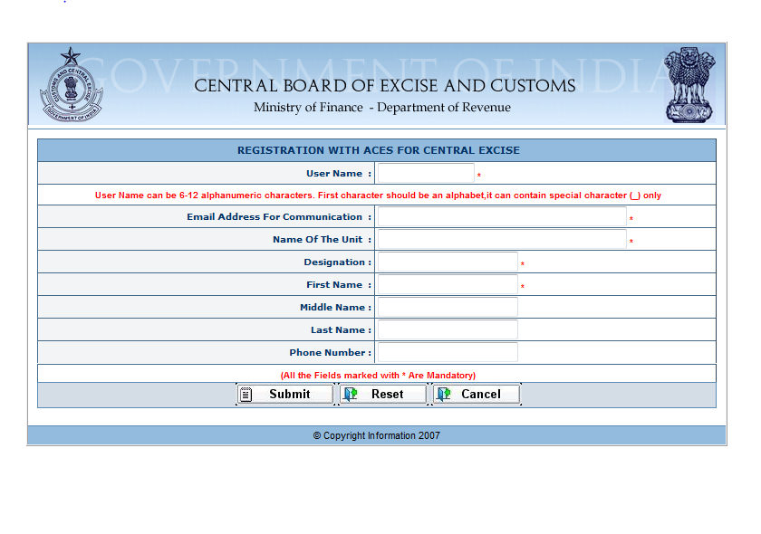
USER NAME CREATION IN ACES
Alphanumeric Name coined / given by the User
Email Id of the User for future correspondence from ACES

Slide 18
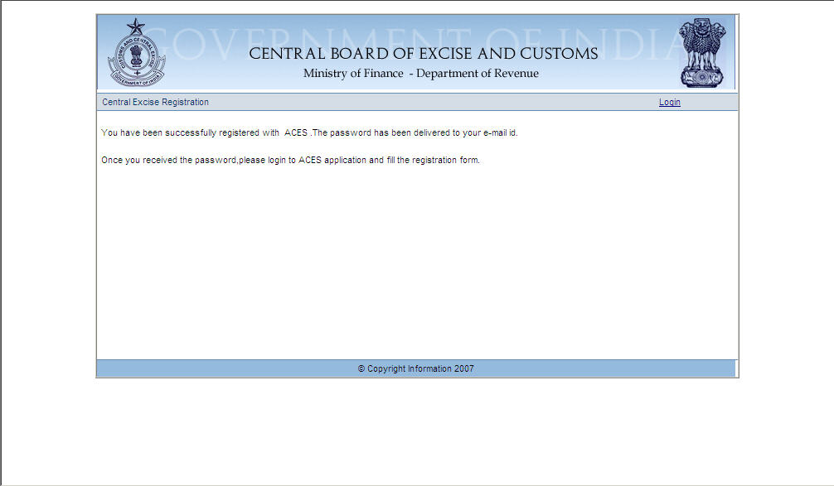

Slide 19
ON-LINE REGISTRATION PROCEDURE contd.
Fill up the Form ‘ST-1’ displayed therein, verify all the content and press ‘Submit’ button.
Assessee will instantly get acknowledgement of submission of ‘ST-1’ mentioned therein the acknowledgement number.
Assessee is now required to submit to the deptt. hard copy of ‘ST-1’ submitted online along with acknowledgement and annexures.

Slide 20
ON-LINE REGISTRATION PROCEDURE contd.
Following documents are required to be annexed along with the duly signed hard copy;
Copy of PAN card of the assessee,
Residential address of Proprietor/partners,
MOA, AOA & COI in case of company and Partnership Deed in case of partnership firm,

Slide 21
ON-LINE REGISTRATION PROCEDURE contd.
Power of attorney/Board Resolution for company’s authorized signatory, his name and address,
Proof of address of premises for which single/centralized registration is sought. (Refer Trade Notice No. 15/ST/2009, dated 22-09-2009 as modified dt. 06-10-2009)

Slide 22
ON-LINE REGISTRATION PROCEDURE contd.
Without receipt of pre-submitted hardcopy of ‘ST-1” along with the required annexures, the pre-submitted ‘ST-1’ on ACES shall be deemed not to be received. (Refer Trade Notice Number 17/ST/2009 dated 10-09-2009)
Once Registration procedure is completed, obtain from department Form ‘ST-2’.

Slide 23
AMMENDMENT IN ‘ST-2’
Amendment to ‘ST-2’ is required in following circumstances;
Addition/deletion of any service,
Change of address of registered premises, etc.
Now the process of amendment of ‘ST-2’ is also made online.

Slide 24
AMMENDMENT IN ‘ST-2’ contd.
Contact department, submit request seeking amendment in ST-2, they will revert back online through your Email sending TPIN number and an appropriate link to reach directly to ACES site.
Click ‘Reg’ button in the menu bar appearing at the top of the screen, select amend registration, fill it and submit it.

Slide 25
AMMENDMENT IN ‘ST-2’ contd.
Submit duly signed hard copy of acknowledgement and form generated by ACES to the department.
Obtain amended ‘ST-2 from department i.e. Registration Certificate.

Slide 26
SURRENDER OF ST-2
Surrender of ‘ST-2’ is required in following circumstances;
When assessee closed business operations,
When ‘ST-2’ obtained as Input Service Distributer is no more required,
When his gross value of rendering services is less then Rs. 9 lacs, which is cut-off limit to obtain and retain or surrender ‘ST-2’.

Slide 27
SURRENDER OF ST-2 contd.
Now the process of surrender of ‘ST-2’ has been also made online.
Contact department in writing, submit request seeking surrender of ST-2, they will revert back online through your Email sending TPIN number and an appropriate link to reach directly to ACES site.

Slide 28
SURRENDER OF ST-2 contd.
Click ‘Reg’ button in the menu bar appearing at the top of the screen, select surrender registration, fill it and submit it.
Submit duly signed hard copy of acknowledgement and form generated by ACES annexing therewith all the due ‘ST-3’ returns to the department.
After due process, deptt. will cancel ‘ST-2’.

Slide 29
E-FILLING OF ‘ST-3’ RETURN
Notification No. 01/2010-ST dated 19.02.2010 makes it mandatory for assessees who have paid total Service Tax of rupees ten lacs or more including the amount of tax paid by utilization of CENVAT credit in the preceding financial year to file the half-yearly return (ST-3), electronically under Rule 7(2) of the Service Tax Rules, 1994 and deposit the service Tax liable to be paid, electronically, through internet banking under Rule 6(2) of the Service Tax Rules, 1994.

Slide 30
E-FILLING OF ‘ST-3’ RETURN
The facility of e-filing of returns on the website (http://exciseandservicetax.nic.in), as provided in the CBEC Circular No.791/24/2004-CX. dated 1.6.2004, has been withdrawn and the assessees are required to file their returns online or by uploading the downloadable off-line return utilities to the new ACES website. (http://www.aces.gov.in)

Slide 31
E-FILLING OF ‘ST-3’ RETURN
Log on through internet at http://www.aces.gov.in
Download from the site of ACES ‘ST-3’ Excel utility.
Fill it for each service, complete it offline and submit it online after duly log-in using Customer ID and Password.

Slide 32
E-FILLING OF ‘ST-3’ RETURN
The excel utility can be used for creating the XML file for e-filing of your returns. The E-filling Excel Utility is an Excel Workbook that consists of one worksheet.
E-filing consist of two sub process firstly generation of XML file of the ST3 Return, and then upload of generated xml file to ACES application.

Slide 33
E-FILLING OF ‘ST-3’ RETURN
Make sure that you have downloaded the latest Excel Utility from ACES application to your system.
Please enable the Macros (if disabled) as per the following instructions, so that all the functionalities of E-filling Utility will work fine.
On the Tools menu, point to Macro, and then click Security.
Click on either Medium or Low to select the 'Security Level'.
On the Trusted Publishers tab, select the Trust all installed add-ins and templates check box.

Slide 34
E-FILLING OF ‘ST-3’ RETURN
E-filling ST3 consists of one worksheet initially i.e. "Return" name of which is displayed in the tab at the bottom of the worksheet.
The sheets for entering services payable data are added dynamically by the excel utility. The sheets are named as "Payable-Service (1)", "Payable-Service1 (2)" etc. The Utility will add new payable sheet when you select 'Taxable Service Provided' from the dropdown on sheet "Return". At the same time, the utility will add new sheets for Paid-Service, Challan-Service, CENVAT, Distributor etc.

Slide 35
E-FILLING OF ‘ST-3’ RETURN
Validating Sheets: Click on the ''Validate this sheet" button to ensure that the sheet has been properly filled and also data has been furnished in proper format. If there are some errors on the sheet, E-filing Utility will prompt you about the same.
Generate XML: After all the required fields have been filled properly and validated, clicking on ''Validate Return and Submit'' button will recheck all the sheets and XML will be generated.

Slide 36
UPLOADING ‘ST-3’ RETURN
Upload XML file to ACES application: For uploading the XML generated by the
E-filling Utility, login to ACES application and access menu option to upload generated XML file of Return. On Upload screen provide the required information and browse to select XML file and submit the form.

Slide 37
UPLOADING ‘ST-3’ RETURN
1. Login to ACES application and access menu option to upload generated xml file of ST3 Return.
2. On Upload screen fill in all the required fields like Return Month, Year and Return Type as ST3.
3. Click on browse to select XML file and submit the form.

Slide 38
UPLOADING ‘ST-3’ RETURN
4. After upload, system will validate the data. If data are found to be intact, the XML is successfully uploaded. In case the files are found corrupted, Application will reject the XML at the time of uploading itself.
5. After validating the data, system will process the xml and upload the XML data into ACES database.

Slide 39
UPLOADING ‘ST-3’ RETURN
6. The Confirmation view will be provided with Save, Submit and Modify buttons. Return with SAVE button option will not be treated as FILED and you can save the Return for a particular period multiple times, until any other Return is submitted for the same period for any of the premises. In case if you have saved the Return multiple times for the same period, the details of last data only will be considered for further Return processing.

Slide 40
VIEWING STATUS OF
‘ST-3’ RETURN
7. You can view the status of your E-filing return by accessing the menu E-filing, Status. There are three status:
a. UPLOADED: denotes that return is uploaded and under processing. Please view after sometime.
b. FILED: denotes that uploaded return is accepted by system.

Slide 41
VIEWING STATUS OF
‘ST-3’ RETURN
c. REJECTED: denotes that return could not be processed due to errors. This return needs to be corrected and uploaded again. If your Return is rejected than there will be hyperlink appearing to your Return number and you can see the errors by clicking the hyperlink.

Slide 42
REVISION OF ‘ST-3’ RTURN
ST3 can be modified within 90 days of filing the Return. You will be allowed to change the Return only once after you have submitted it. In case of Revision, Confirmation view will be provided with Submit only.

Slide 43
E-FILLING OF ‘ST-3’ RETURN
Central Board of Excise & Customs has entered into a Memorandum of Understanding (MOU) with the Institute of Chartered Accountants of India (ICAI) on 31st March, 2010 to set up ACES Certified Facilitation Centres (CFCs) across the country. These Centres will be setup by the Members of ICAI, who have valid certificate of practice issued by the ICAI.

Slide 44
E-PAYMENT OF SERVICE TAX
For e-payment, assessees should open a net banking account with one of the authorized banks (currently there are 28 banks), list of which is available on the EASIEST (Electronic Accounting System in Excise and Service Tax) website of CBEC, maintained by NSDL (https://cbec.nsdl.com/EST/).

Slide 45
E-PAYMENT OF SERVICE TAX
For effecting payment, assessees can access the ACES website (http://www.aces.gov.in/) and click on the e-payment link that will take them to the EASIEST portal (https://cbec.nsdl.com/EST/) or they can directly visit the EASIEST portal.

Slide 46
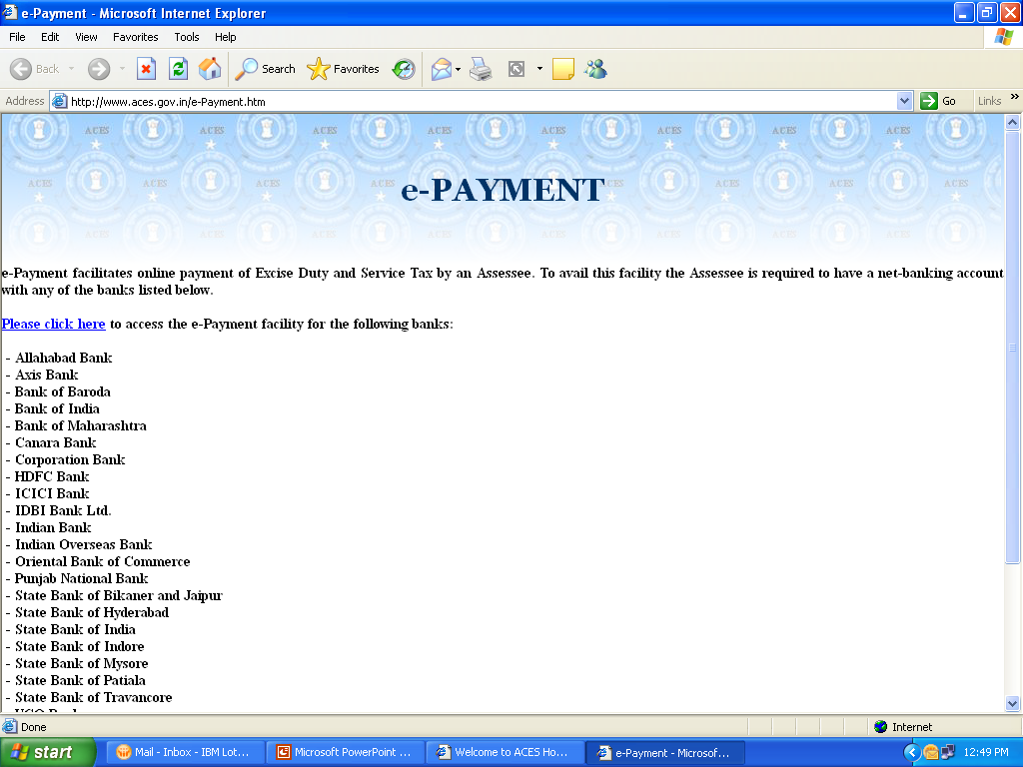
List of Banks for e-Payment

Slide 47
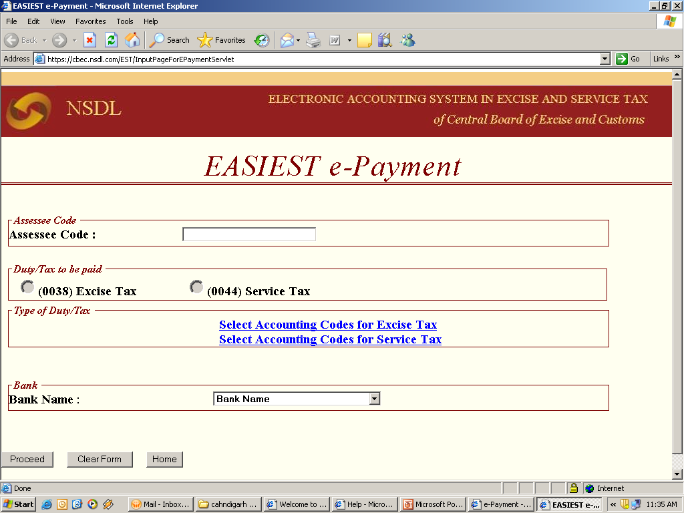

Slide 48
E-PAYMENT OF SERVICE TAX
1. Enter the 15 digit Assessee Code allotted by the department under erstwhile SACER/SAPS or the current application ACES.
2. There will be an online check on the validity of the Assessee Code entered.
3. If the Assessee code is valid, then corresponding assessee details like name, address, Commissionerate Code etc. as present in the Assessee Code Master will be displayed.

Slide 49
E-PAYMENT OF SERVICE TAX
4. Based on the Assessee Code, Service Tax to be paid will be automatically selected.
5.The assessee is required to select the type of duty / tax to be paid by clicking on Select Accounting Codes for Service Tax, depending on the type of duty / tax to be paid.
6. At a time the assessee can select up to six Accounting Codes.

Slide 50
E-PAYMENT OF SERVICE TAX
7. The assessee should also select the bank through which payment is to be made.
8. On submission of data entered, a confirmation screen will be displayed. If the taxpayer confirms the data entered in the screen, it will be directed to the net-banking site of the bank selected.

Slide 51
E-PAYMENT OF SERVICE TAX
9. The taxpayer will login to the net-banking site with the User ID/ Password, provided by the bank for net-banking purpose, and will enter payment details at the bank site.
10.On successful payment, a challan counterfoil will be displayed containing CIN, payment details and bank name through which e-payment has been made. This counterfoil is proof of payment made.

Slide 52

Procedural aspects under service tax
Presented by:
CA. Kamlesh Chauhan
B Sc, LL B, FCA, ISA(ICA)
THANX
THANX

