Slide 1



GST E-Invoicing Implementation :
2nd Release
By –
Vivek Jalan
[FCA, LL.M(Const. Law), LL.B, B.Com (H)]
E-Mail – vivek.jalan@taxconnect.co.in
Call - +91 98315 94980
​Website: www.taxconnect.co.in
​https://twitter.com/cavivekjalan
https://in.linkedin.com/in/cavivekjalan
www.facebook.com/cavivekjalan
[ MUMBAI BANGALORE KOLKATA DELHI]

Slide 2


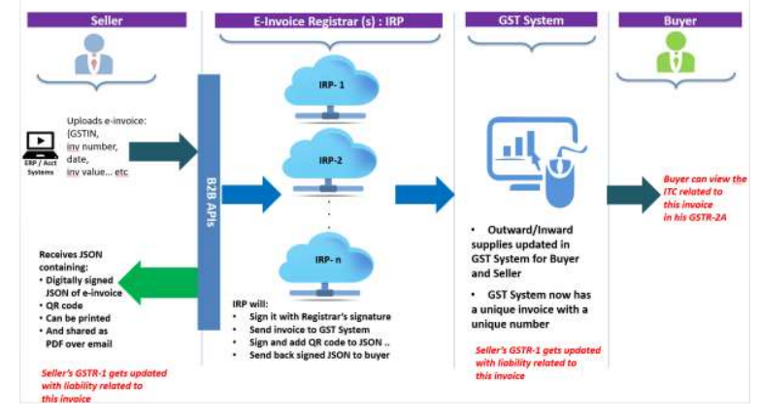
E Invoice Flow

Slide 3
Declaration for Amended Rule 48: Manner of issuing invoice
Therefore, from 1st October 2020 onwards, it is to be noted that, only an invoice complying with the new regulations (i.e., having IRN and QR code, wherever applicable) shall be considered as a valid invoice by ……. Ltd. and shall be processed in-line with the agreed payment terms without any delay. Unfortunately, if invoices submitted do not provide the mandated details, the invoice will be considered as an invalid document and will be rejected.
in case e-invoicing regulations are not applicable to your organisation, then as a safeguard measure, we request you to kindly provide us with a declaration on your letter head. The declaration format has been attached herewith.

Slide 4
B2C QR Code…
What is dynamic QR Code? Does it has any relevance for B2B e-invoicing?
Notification No. 14/2020-Central Tax dated 21st March, 2020 mandates entities with aggregate turnover > Rs. 500 crores in a FY to include QR code on their B2C invoices. It is also specified that a Dynamic Quick Response (QR) code made available to buyer through digital display (with payment cross-reference) shall be deemed to be having QR code. The purpose of this Notification is to enable and encourage digital payments. It has no relevance or applicability to the e-invoicing i.r.o B2B Supplies by notified class of taxpayers.

Slide 5
…B2C QR Code
QR Code is generated by supplier himself.
The purpose of this Notification is to enable and encourage digital payments where buyer can scan the dynamic QR code and make payment from mobile wallet directly
Today, many shops have static QR code at the payment counter which is scanned by the buyer but the buyer has to enter the amount to be paid to the shop (in the mobile payment App). The dynamic QR code, on the other hand, will have the payment details and thus ‘scan and pay’ in one go will be possible.
This requirement has no relevance or connection with e-invoicing mandated for B2B Supplies and Exports by notified class of taxpayers.

Slide 6
B2B QR Code
Q. What data is embedded in QR Code?
The QR code will consist of the following key particulars of e-invoice:
a. GSTIN of Supplier
b. GSTIN of Recipient
c. Invoice number, as given by Supplier
d. Date of generation of invoice
e. Invoice value (taxable value and gross tax)
f. Number of line items
g. HSN Code of main item (line item having highest taxable value)
h. Unique IRN (Invoice Reference Number/hash)

Slide 7
Query
Q. In the current situation, our Invoice at the time of generation is unpaid even in case of advance receipt also. Its status gets changed after we offset the same with its respective receipts. How then dynamic QR Code will work?
A. The Dynamic QR Code will only have a payment option. The offsetting against receivable generated by an invoice in the ERP will happen only after payment is received by the Supplier

Slide 8
Query
Q. Is is mandatory for Taxpayer to sign E-Invoice also?
Yes
Q. Is is required to capture supplier IRN for purchases?
A. Not as of now

Slide 9
Query
Q. What is the time limit to generate IRN after the Invoice is generated from ERP.
A. There is no time limit. However a Company SOP may be prepared
Q. Is is mandatory to generate E-Invoice as per Invoice Sl. No.?
A. No

Slide 10
Query
Q. Is E-Invoice required for Commercial Customer Credit Note / Debit Note, Delivery Challans, Branch Transfer Note for Intra State Branch Transfer?
A. No
Q. Is there any other process to carry out amendments / corrections on IRN Portal besides IRN Cancellation. Clarification is required for correction within the ambit of 24 hours and outside 24 hours both separately.
A. On IRP there is no option of correction. However amendment is possible in GSTR 1

Slide 11
Query
Q. Whether Part A of E Way bill also gets generated immediately / automatically after IRN. If Part A of E Way Bill gets generated at the time of IRN and our Customer also tries to generate E way while accepting Ex-WH delivery.
A. Generating Part A of E-Waybill will be optional with E-Invoice

Slide 12
Query
Q. Compliance of E - Invoice for ISD Invoice , Self Invoicing (RCM). Do we need to comply the same.
ISD- Yes; RCM – No
Q. Reconciliation of E Way Bill and IRN. Can we expect any integration between these two facilities and reconciliation query from GST Dept.
A. Yes

Slide 13
By –
Vivek Jalan
[FCA, LL.M(Const. Law), LL.B, B.Com (H)]
THANK YOU
E-mail-
Vivek.jalan@taxconnect.co.in
URL: www.taxconnect.co.in
https://twitter.com/cavivekjalan
https://in.linkedin.com/in/cavivekjalan
www.facebook.com/cavivekjalan
Call:
Call - +91 98315 94980;
​
[ MUMBAI BANGALORE KOLKATA DELHI]

