Slide 1
GST AUDIT

Slide 2
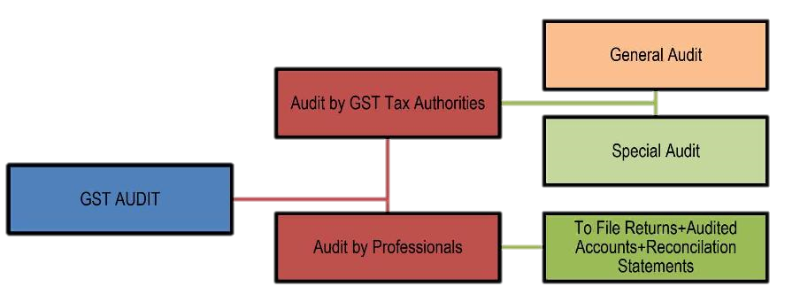
Types of Audit under GST

Slide 3
Audit in GST‐ Relevant Legal Provisions
Section/ Rule | Act/ Rules | Description
65 | CGST | Audit by tax authorities
66 | CGST | Special audit
35(5) | CGST | Audit of Accounts by Chartered/ Cost Accountant (Annual Audit)
20 | IGST | Application of provisions of CGST Act
21 | UTGST | Application of provisions of CGST Act
101 | Rules | Audit by Tax Authorities
102 | Rules | Special Audit
80(3) | Rules | Annual Return

Slide 4
Relevant Legal Provisions – Sec 35(5) + Rule 80(3)
Every Registered person
whose aggregate turnover during a FY exceeds the prescribed limit (INR 2 Crores)
shall get his accounts audited
by a CA or CMA and
shall submit
a copy of the audited annual accounts,
the reconciliation statement under Sec 44(2) in GSTR‐9C
and
such other documents in such form and manner as may be prescribed.

Slide 5
Relevant Legal Provisions – Sec 2(6)

Slide 6







Person Eligible to file Annual Return
ISD
Person paying tax under Sec 51 [TDS]
All Registered person to file Annual return u/s 44(1)
Excludes
E‐Commerce Operator [Sec 52]
Casual Taxable Person
Non Resident taxable person
To be Filed on or before the thirty‐first day of December of next Financial Year.
( As per the recent notification due date for F.Y. 2018-19 is 31/03/2020.)

Slide 7
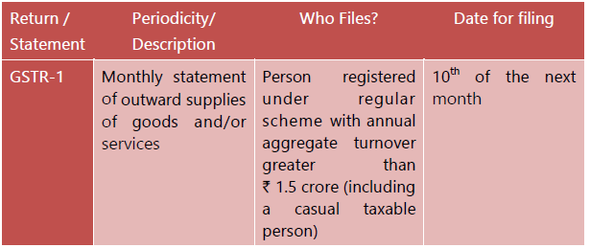
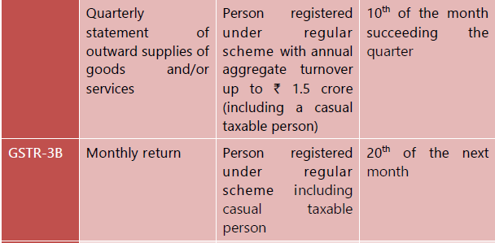

Slide 8

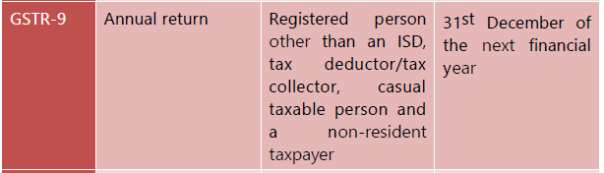
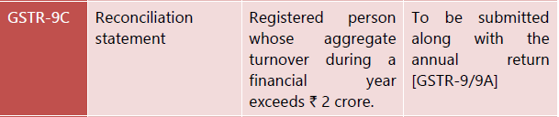

Slide 9
Annual Audit – Focus Areas
Input Credit
Ineligible
Books of Accounts & Returns
Frequent changes
Notification/ Circulars in GST to be Monitored
Credit Reversals
Reconciliation
Taxable Turnover with correct rate of tax
GST should be charged at the correct rate of tax as prescribed under the act

Slide 10
Match of the Data among Return Filed
S.No. | Description | Point No. in Form ‐ 3B | Point No. in GSTR‐1
1 | Outward taxable supplies other than zero rated, Nil rated and Exempted | 3.1a | 4, 5, 7 + 9 , 10
2 | Zero Rated Supplies | 3.1b | 6
3 | Nil rated and exempted Supplies | 3.1c | 8
4 | Non‐GST Outward supplies | 3.1e

Slide 11
Match of the Data among Return Filed
Description | Point No. in Form ‐ 3B | Match with
ITC Available
‐ Import of goods | 4A(1) | IEC Gate
‐ Import of Services | 4A(2) | 3.1d of Form‐3B [Inward supplies liable reverse charge]
‐ Inward Supplies liable to RCM | 4A(3)
‐ Inward Supplies from ISD | 4A(4) | GSTR ‐2A [ISD]
‐ All other ITC excluding ineligible | 4A(5) | GSTR ‐2A
Ineligible ITC | 4(D)

Slide 12
Sales Reconciliation
Sales Register to P&L
SALES REGISTER
CREDIT NOTE REGISTER
P&L to Duties and Taxes
ADVANCES RECEIVED
OTHER INCOME
Duties & Taxes to GSTR 1
WEBGST EXTRACTS
Duties & Taxes to GSTR 3B
ANY OTHER VOUCHER AFFECTING P&L SALES
SALE OF FIXED ASSETS
RCM LIABILITY
INVOICEWISE SALE, B2C SALE, EXPORT SALE, ZERO RATED SALE.
MONTHLY 3B WORKINGS

Slide 13
Purchase Reconciliation
Purchase Register to P&L
PURCHASE REGISTER
DEBIT NOTE REGISTER
P&L to Duties and Taxes
ADVANCES GIVEN
DIRECT EXPENSES
Duties & Taxes to GSTR 3B
CONSOLIDATED 3B.
GSTR 3B to GSTR 2A
ANY OTHER VOUCHER AFFECTING P&L PURCHASES
PURCHASE OF FIXED ASSETS
RCM LIABILITY
MONTHLY 3B WORKINGS
INDIRECT EXPENSES
MONTHLY 3B WORKINGS
WEBGST EXTRACTS
INVOICEWISE/PARTYWISE/MONTHWISE ITC DETAILS

Slide 14
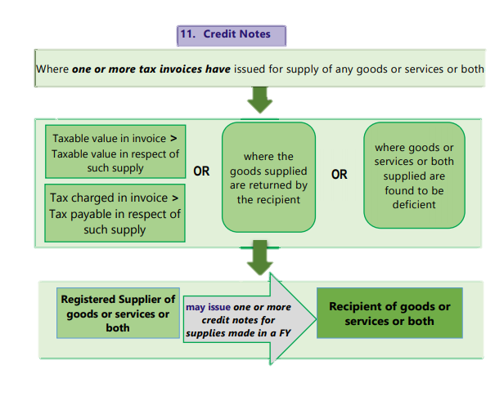
Credit Notes

Slide 15
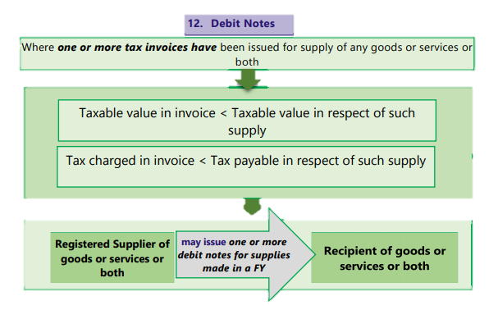
Debit Notes

Slide 16
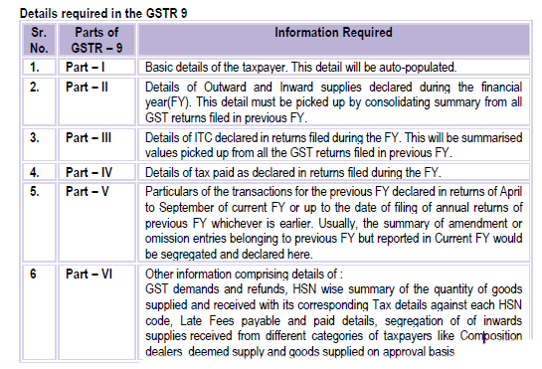

Slide 17
UDIN
“It is not done unless UDIN”

Slide 18
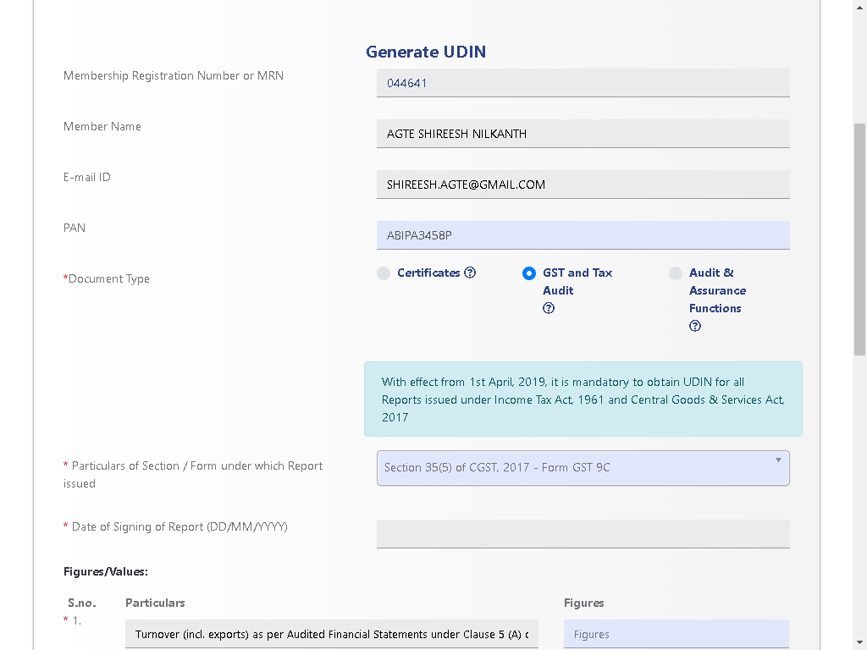

Slide 19
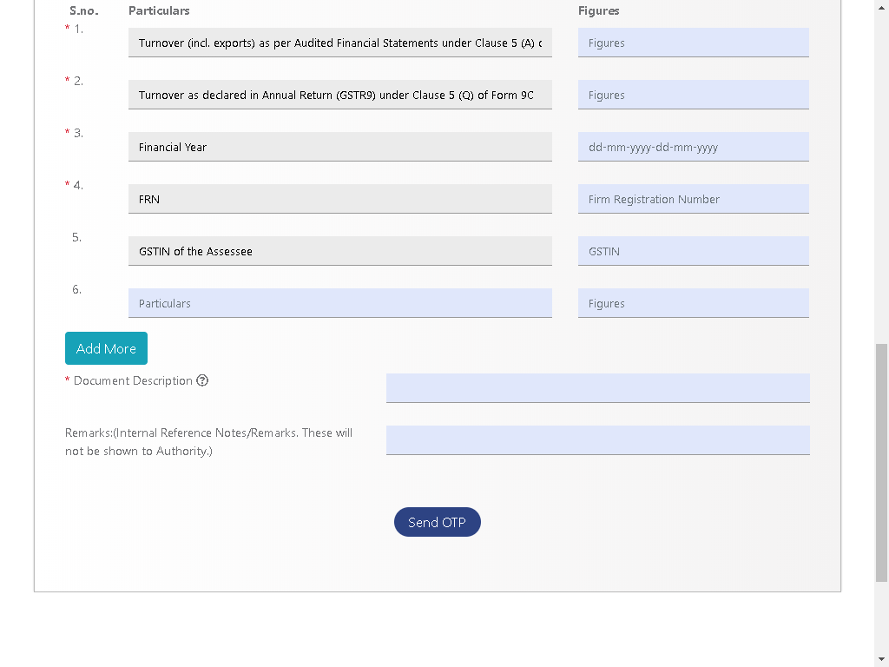

Slide 20
Checklist for Documentation
Clients | Signatory Details | Date of signing | GSTR-9 | GSTR-9C | UDIN
XYZ P. LTD | CA ABC | dd/mm/yyyy |  |  | 24014AAAAAAxxxxx

Slide 21
Prerequisites before commencing an Audit
Appointment Letter
Management Representation Letter.

Slide 22
Set Preparation
Cover Page
One Page Summary
Annual GST Calculation
Sales Reconciliation.
Purchase Reconciliation.
Tally Extracts of Sales Register and Purchase Register
Sales Accounts and Purchase Accounts
Duties and Taxes Ledger
Full Audited Financial Statements
GSTR 9
GSTR 9C

Slide 23
Thank You

