Slide 1
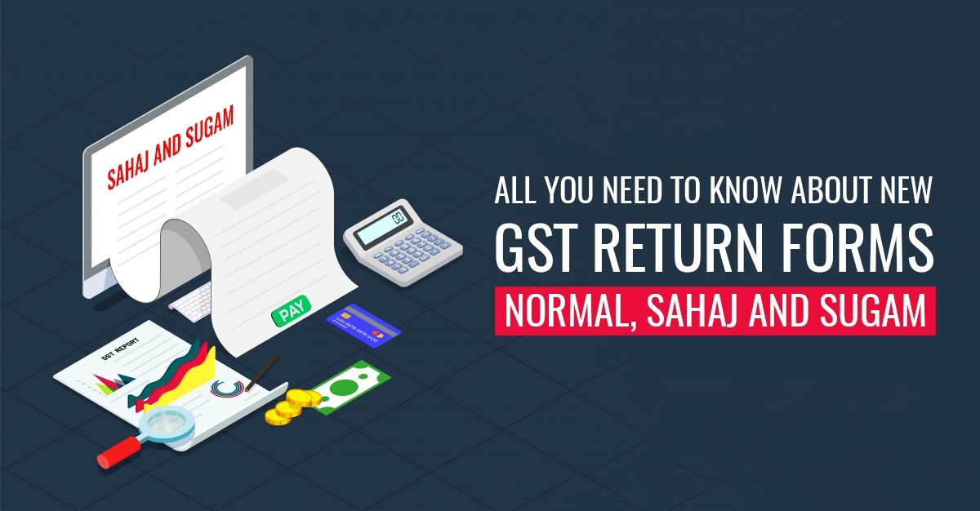
Vasoya Thumar & Associates

Slide 2
INTRODUCTON
New GST Return (GSTR) Forms have been announced by the Central Board of Direct Taxes, the apex authority for taxation in India. The new forms have been titled as GST Return (Sahaj), GST Return (Sugam) and GST Return (Normal).
These new forms will be available as part of a pilot project for use by GST filers from 1st April 2019.

Slide 3
WHAT’S new in the New GST Forms
The new GSTR forms are designed to simplify the process of filing GST especially in case of smaller businesses that have annual turnover of up to Rs. 5 crore.
After introduction of the three new forms – GSTR Normal, GSTR Sugam and GSTR Sahaj, registered .
Individuals/businesses will no longer need to file GSTR 1, GSTR 2 and GSTR 3 separately. The old GSTR 1 form was the primary form for submission of GST Returns while the GSTR 2 Form is a purchase return and the GSTR 3 Form is an input-output return form.
The GSTR 2 and GSTR 3 are complicated forms and no longer need to be submitted after introduction of the new GSTR forms – Normal, Sahaj and Sugam.

Slide 4
Benefits of New FOrms
The following are the expected benefits after introduction of the new forms:
Simplification of GST Return filing for tax payers
Simplified compliance for GST registered entities/persons
Easier matching of invoices between seller and buyer for the tax authorities

Slide 5
Types of Return
As per this format, taxpayers having a yearly turnover of up to Rs. 5 Crores and those who have opted for quarterly returns are free to choose any of the quarterly returns i.e. Sahaj, Sugam or Normal Quarterly Return to file them up.

Slide 6
Form GST Ret-1 or The Normal Return [Monthly/Quarterly Return]
The Normal Return or Form GST Ret-1 can be used to file tax on a Monthly or quarterly basis depending on the case. The Normal Return or Form GST Ret-1 can be used by a taxpayer reveal details of the outward supplies, inward supplies made by them during the particular tax period and claim a credit on missing invoices.
The Normal GST Return can be filed either monthly (for taxpayers with turnover more than Rs 5 crores) or quarterly (for taxpayers with turnover up to Rs 5 crores).

Slide 7
Form GST Ret-2 or The Sahaj Return [Quarterly Return]
Form GST Ret-2 or the Sahaj Return is the Quarterly Return which can be used to declare the Outward supply under the category of Business to Customer, i.e, B2C and the inward supplies attracting reverse charge only.
The Taxpayer filing Sahaj Return or Form GST Ret-2 would be deprived of taking credit on the missing invoices. He/she would also be unable to make any other type of inward or outward supplies.
The Sajah form is to be filed on a quarterly basis by B2C category taxpayers whose turnover is less than or equal to Rs 5 crores.

Slide 8
Sugam Return or Form GST Ret-3 [Quarterly Return]
Form GST Ret-3 or the Sugam Return is filed by the taxpayer to declare their Outward supply under B2B and B2C category and those inward supplies which attract reverse charge only.
The Taxpayer filing Sugam Return or Form GST Ret-3 would not be able to take credit on the missing invoices and would also be not allowed to make any other type of inward or outward supply.
The Sugam form is to be filed on a quarterly basis by B2C & B2B category taxpayers whose turnover is less than or equal to Rs 5 crores.

Slide 9


