Slide 1
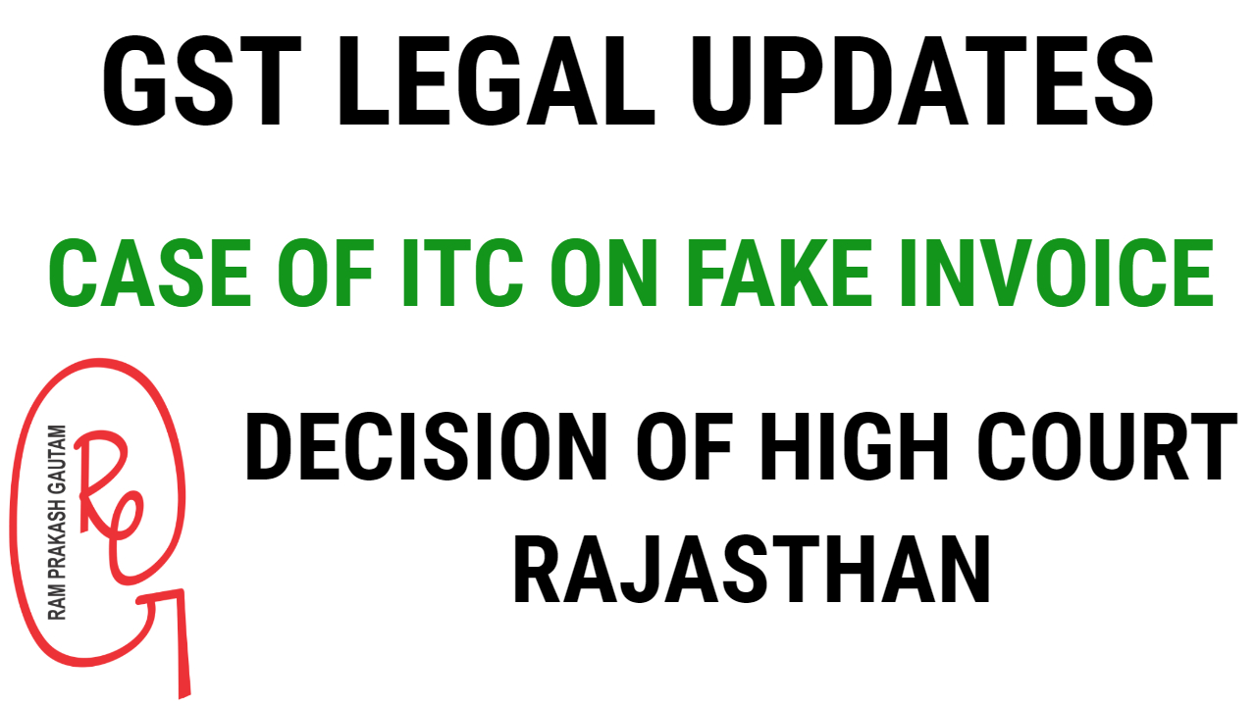

Slide 2
HIGH COURT OF JUDICATURE FOR RAJASTHAN BENCH AT JAIPUR S.B. Criminal Writ No. 76/2019
Input Credit based on Fake Invoices – Rajasthan HC dismisses WP and imposes cost of Rs.1 Lakh on the Petitioner.

Slide 3
Bharat Raj Punj S/o Late Brij Raj Punj, Managing Director, M/s Leel Electricals Limited, R/o B-20, Greater Kailash Part 1, New Delhi.
M/s Leel Electricals Limited, Corporate Office 159, Okhla Industrial Estate, Phase Iii, New Delhi, Through Managing Director Bharat Raj Punj, R/o B-20, Greater Kailash Part 1, New Delhi. ----Petitioners
Versus
Commissioner Of Central Goods And Service Tax Department, Jaipur, Ncr Building, Statue Circle, C Scheme, Jaipur.
Superintendent (AE) Central Goods And Service Tax Commissionerate Jaipur, Ncr Building, Statue Circle, C Scheme, Jaipur.
Commissioner Of Central Goods And Services Tax Department Alwar, Block A, Surya Nagar, Alwar.
Superintendent (AE), Central Goods And Service Tax Commissionerate Alwar, Block A, Surya Nagar, Alwar. ----Respondents
For Petitioner(s) : Mr. R.N. Mathur, Sr. Adv. with Mr. Vijay Choudhary, Mr. Aseem Chaturvedi, Mr. Anant Priya Jain
For Respondent(s) : Mr. Siddharth Ranka

Slide 4
HON'BLE MR. JUSTICE PANKAJ BHANDARI
Judgment / Order
12/03/2019
Facts
The Petitioner No.1 is the Managing Director of M/s Leel Electricals Limited,
Petitioner No.2. The CGST Department conducted a raid on 17.01.2019, at the premises of the Petitioners’ Company at Bhiwadi, Rajasthan. After recording of the statements of Officials of Company, they were arrested. As per the case of the Department, the Company had fraudulently availed input tax credit of Rs.40.53 crores by issuance of fictitious sale invoices and sister concerns of company and Petitioner-Company had fraudulently availed input tax credit of Rs. 328 crores.

Slide 5
Decision of High Court
The case set up by the Department is that the Petitioner has claimed input tax credit on fake invoices, which fact is not controverted by the Petitioner. Hence, Department has all rights to take any action permissible by law.
The contention that the tax is to be first determined under Section 73 & 74 of the Act does not have any force for the very reason that in an offence committed under Section 132 of the Act determination of tax is not required and the Department can proceed straight away by issuing summons or if reasonable grounds are available by arresting the offender. Since offence under Section 132 is made out and Senior Officials of Company are has the right to proceed under Section 69 and 70 of the Act. The HC did behind bars, Petitioner being Managing Director is responsible and Department not find any merit in Writ Petition and hence dismissed it with cost of Rs.1,00,000/- only.

Slide 6


By, Ram Prakash Gautam ram83prakash@gmail.com

