Slide 1
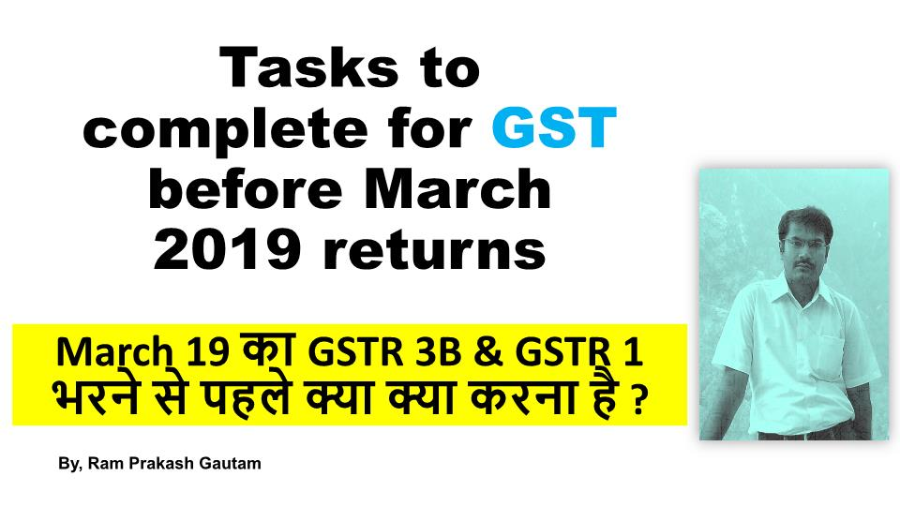

Slide 2
1. AMENDMENTS RELATED GSTR 1 FOR F/Y 2017-18 & 2018-19
If you have made export with payment of Taxes and IGST refund has not been received then You might need to amend your export details in TABLE 9A
If Vendor (Debtors) is not able to find our sales invoice in his GSTR 2A , then there might be chances that If you have filed GSTR 1 wherein you have shown sales in B2CS but it was actually B2B sales. , In such case amendment of B2CS is required and also you have to upload the bill in B2B afresh.
If mistakenly Nil or wrong or incomplete GSTR 1 is uploaded where invoices pertaining to some months not uploaded or uploaded to wrong GSTIN of buyer or you have uploaded on some of sheets of GSTR 1 , Then Amendments are required.

Slide 3
2. ADJUSTMENTS of GSTR 3B IN MARCH OF ANY PREVIOUS MONTHS
If mistakenly nil or wrong or incomplete GSTR 3B is uploaded for any previous months, then you can adjust differences in March GSTR 3B , so that , Your GSTR 3B can match with books of accounts in Annual summary . For that please check all your GSTR 3B of 18-19 from APRIL -18 TO FEB -19 with uploaded GSTR 3B on portal.
3. RECONCILIATION OF GSTR 2A FOR PENDING ITC OF 17-18
you have last chance of taking any Input Tax credit of 17-18 if not taken in any previous GSTR 3B of 17-18 or 18-19. Do check your GSTR2A of 17-18 & 18-19, if any input tax credit which is reflected in GSTR2A and you have not claimed credit in any previous GSTR3B then this is the last chance to avail benefit of pending ITC.
(NOTE- Pending ITC of 18-19 can be claimed upto Sept -19 GSTR 3B. But it will be better to take in March -19 GSTR 3B. For that, YOU SHOULD CHECK GSTR 2A of 18-19. )

Slide 4
4. RECONCILIATION OF GSTR 2A – IF YOUR SUPPLIER HAS NOT FILED THEIR GSTR 1 FOR FY 17-18 …LAST CHANCE TO FOLLOW UP.
Purchases from supplier will not be reflected in our GSTR-2A….in that case where you can’t find your purchases bill in GSTR 2A on the portal, your supplier has not filed GSTR 1 and so Purchases from such supplier will not be reflected in our GSTR-2A
In this case, you cant claim ITC .Therfore, You should call to such parties and tell them to file GSTR 1 & GSTR 3B as soon as possible.
This will be last chance to them to upload in his GSTR 1 upto March’19 GSTR 1. If he has mistakenly filed Nil or wrong or incomplete GSTR 1 or GSTR 1 is uploaded where invoices pertaining to some months not uploaded or uploaded to wrong GSTIN of buyer, Then for FY 17-18 , March GSTR 1 due date , will be last chance to update this.

Slide 5
5. FOR JOB WORKER ITC- 04 FROM JUL 17 TO DEC 18.
FORM ITC-04 must be submitted by the principal every quarter for the details of (1) Goods sent to job worker And (2) Goods received back from the job worker. Must include the details of challans in respect of the above.
Please file ITC 04 for quarters
Jul 17 to sept 17.
Oct 17 to dec 17.
JAN 18 TO MARCH 18.
APRIL 18 TO JUNE 18.
JUL 18 TO SEPT 18.
OCT 18 TO DEC 18.
6. FILE GSTR 1 UPTO FEB -19 (FOR MONTHLY) AND DEC – 18 (FOR QUARTERLY)if pending. FILE GSTR 3B UPTO FEB-19 if pending. (For composition dealers – GSTR 4 upto dec-18 should be filed)
That’s the most important tasks to avoid late fees & you will be out of danger of suo moto cancellation of registration by department.

Slide 6
7. TDS return to file for TDS deductors from Oct – 18 to Feb-19 before 31-03-2019 so that Counter party can receive TDS credit
Before filling their last GSTR 3B OF 18-19
8. LUT APPLICATIONFOR NEXT FINANCIAL YEAR 2019-20.
For all the exporters, who continue to export under LUT without payment of taxes.
9. APPLICATION TO COMPOSITION SCHEME FROM NORMAL. If registered Tax payer wants to convert to Composition scheme (Limit is Rs. 1.5 Crore now) from FY 19-20

Slide 7

By, Ram Prakash Gautam ram83prakash@gmail.com
FOLLOW ME ON FACEBOOK
https://www.facebook.com/ram.prakashgautam.96
FOLLOW ME ON YOUTUBE
https://www.youtube.com/channel/UChvCHgjynO4gI0negk2RW5g?view_as=subscriber

