Slide 1
Tax Deduction at Source

Slide 2
Tax deducted at source
Module Objectives
After completing this module, you will understand:
Applicability of Tax deduction at source
Application for TDS registration
Generation & Submission/Filing of GSTR-7
Amendments of GSTR-7
Payment of taxes
Notes:
Facilitation Notes: N/A

Slide 3
Applicability of Tax deduction at source

Slide 4
Tax deducted at source
Applicability of Tax deduction at source
On Whom Tax deduction at source is applicable?
> A department or establishment of the Central Government or State Government; or
> local authority; or
> Governmental agencies; or
> such persons or category of persons as may be notified by the Government on the recommendations of the Council

Slide 5
Applicability of Tax deduction at source-Notified Persons
Refer Notification No.33/2017-CGST
Following persons are notified as per the notification:-
  an authority or a board or any other body, -
    set up by an Act of Parliament or a State Legislature; or
    established by any Government,
    with fifty-one percent or more participation by way of equity or control, to carry out any function;
  society established by the Central Government or the State Government or a Local Authority under the Societies Registration Act, 1860 (21 of 1860);
  public sector undertakings

Slide 6
Tax deducted at source
Applicability of Tax deduction at source
What is the rate of Tax deduction at source?
For inter-State transactions TDS will be for IGST & rate will be 2% and for intra-State transactions,, it will be 1% each for CGST and SGST.

Slide 7
Tax deducted at source
Applicability of Tax deduction at source
When is this Tax deduction at source is applicable?
If the supplier’s total value of such supply “Not Invoice value”, under a contract, exceeds two lakh and fifty thousand rupees
Taxable Value shall not include central tax, State tax, Union territory tax, integrated tax and cess indicated in the invoice.

Slide 8
Application for TDS registration

Slide 9
Tax deducted at source
Registration requirement
Irrespective of turnover of Supply persons who are required to deduct tax under section 51, whether or not separately registered under this Act

Slide 10
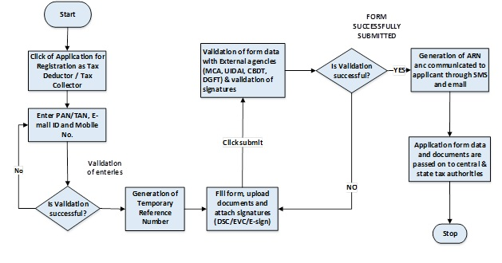

Slide 11
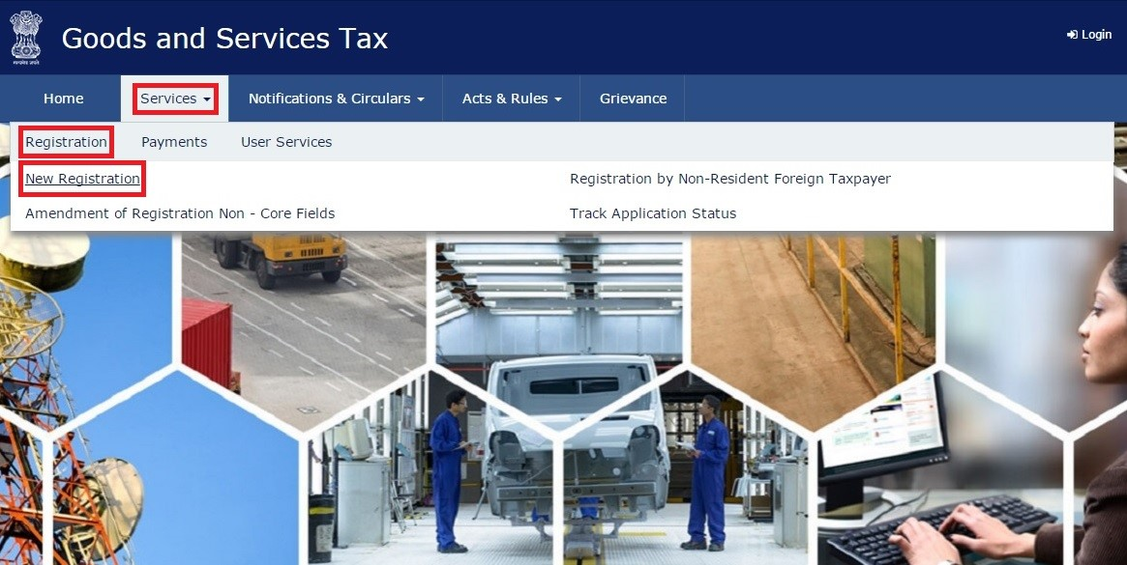
Tax deducted at source
Registration requirement

Slide 12
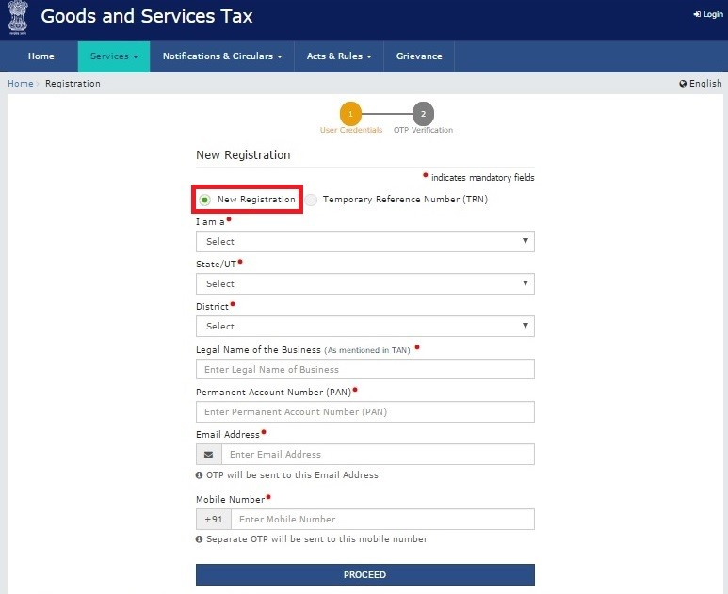
Tax Deducted at Source
Registration requirement

Slide 13
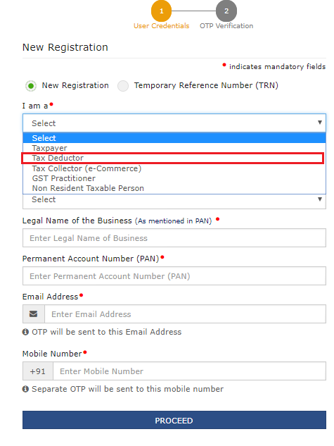
Tax Deducted at Source
Registration requirement

Slide 14
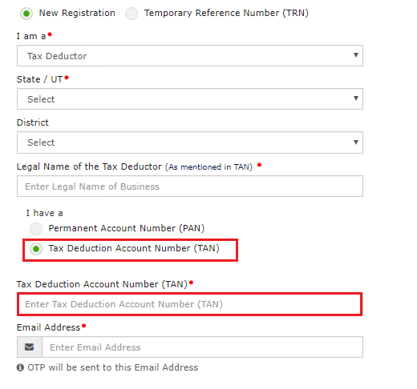
Tax Deducted at Source
Registration requirement

Slide 15
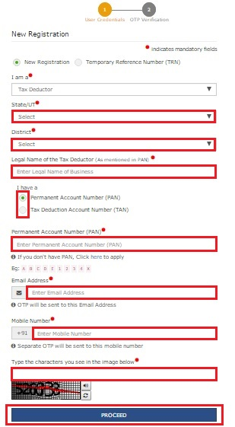
Tax Deducted at Source
Registration requirement

Slide 16
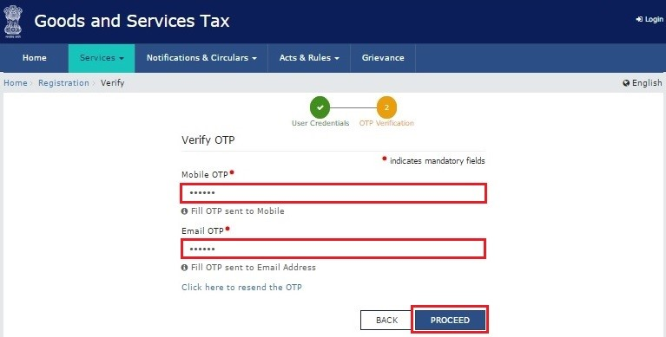
Tax Deducted at Source
Registration requirement

Slide 17
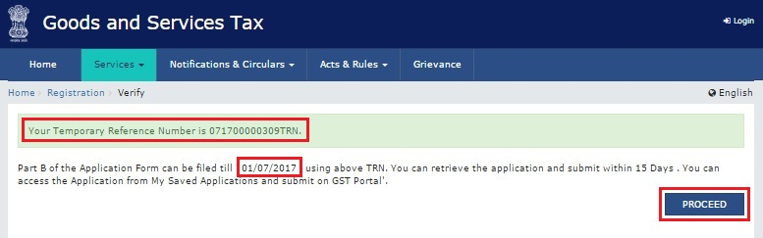
Tax Deducted at Source
Registration requirement

Slide 18
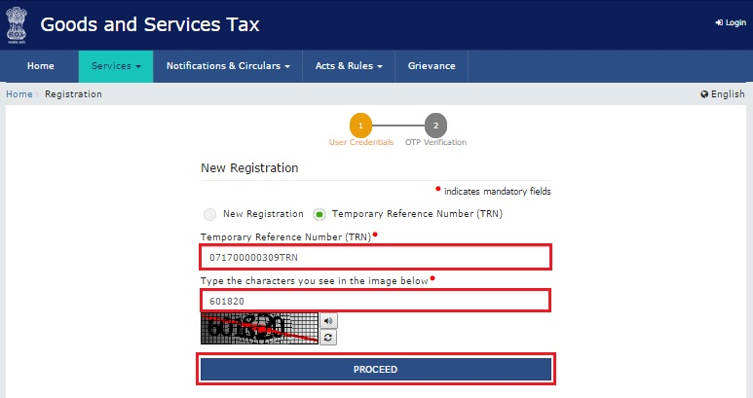
Tax Deducted at Source
Registration requirement

Slide 19
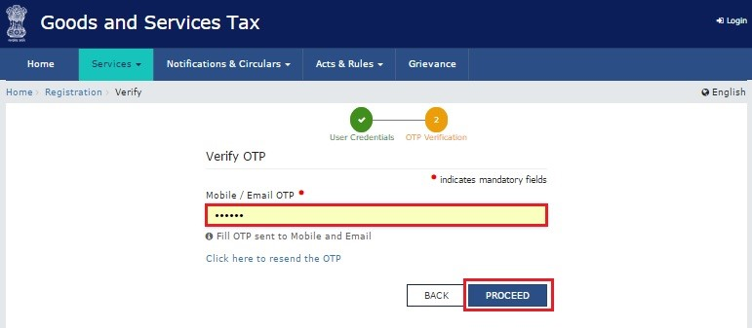
Tax Deducted at Source
Registration requirement

Slide 20
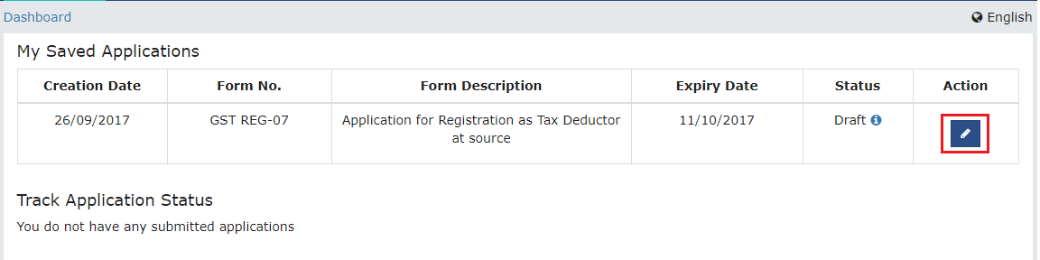
Tax Deducted at Source
Registration requirement

Slide 21
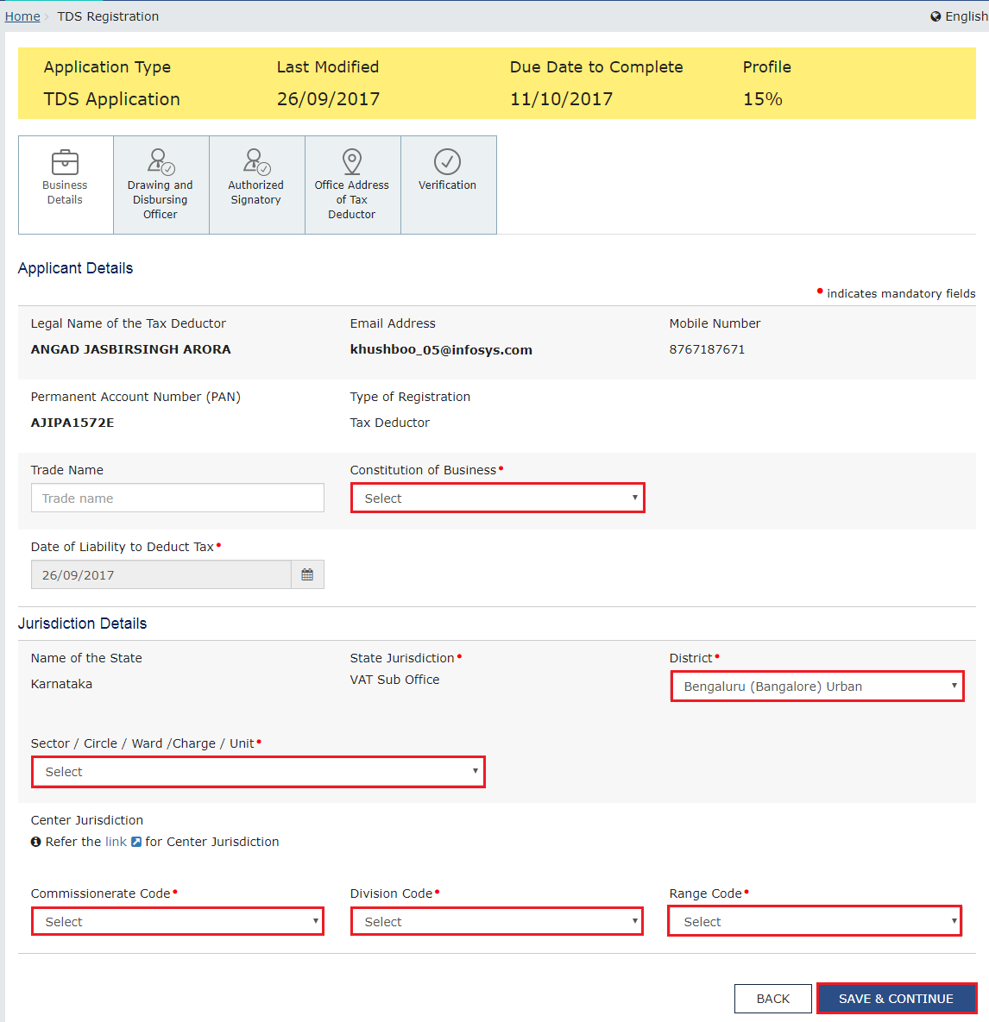
Tax Deducted at Source
Registration requirement

Slide 22
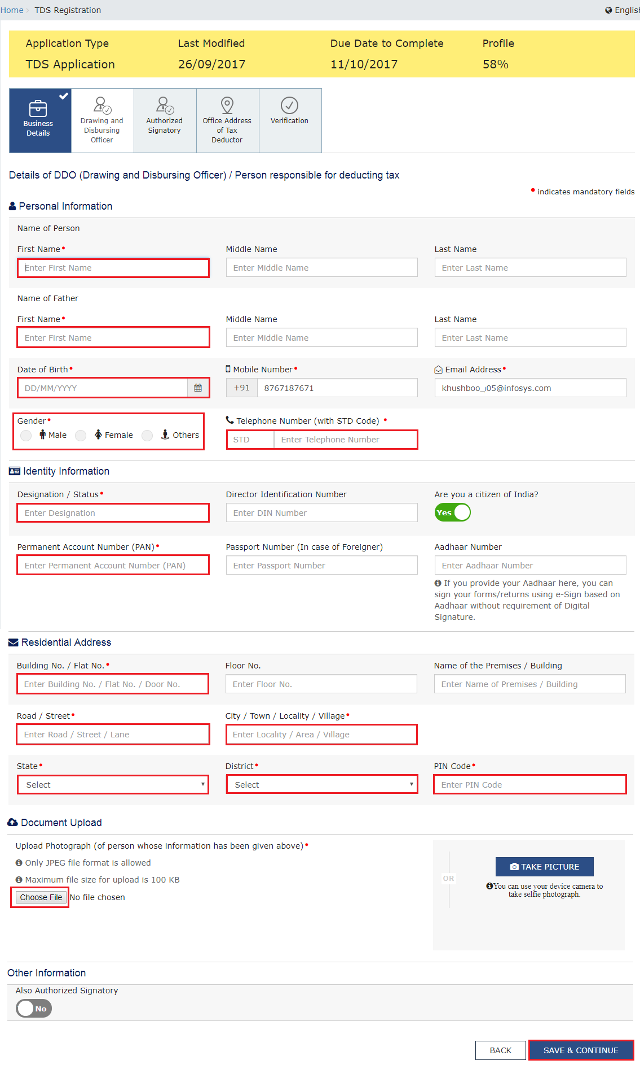
Tax Deducted at Source
Registration requirement

Slide 23
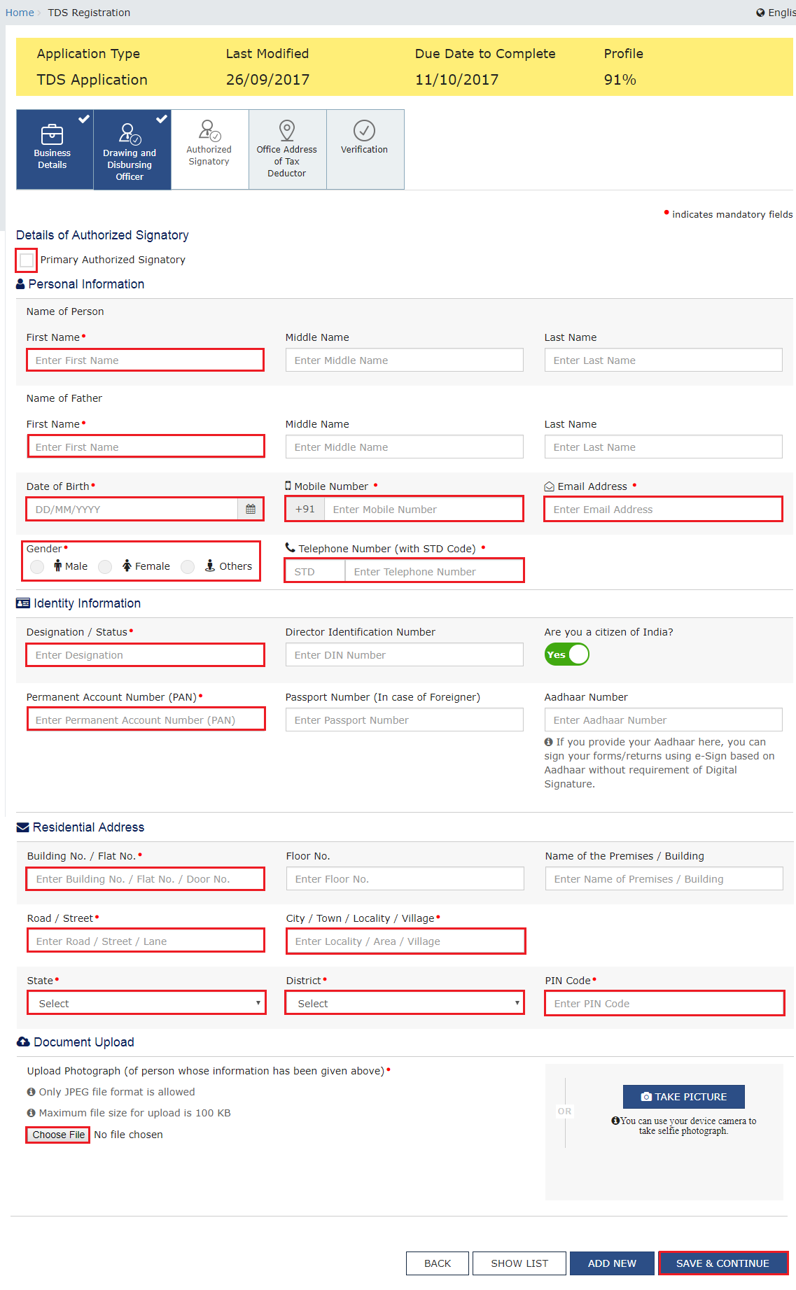
Tax Deducted at Source
Registration requirement

Slide 24
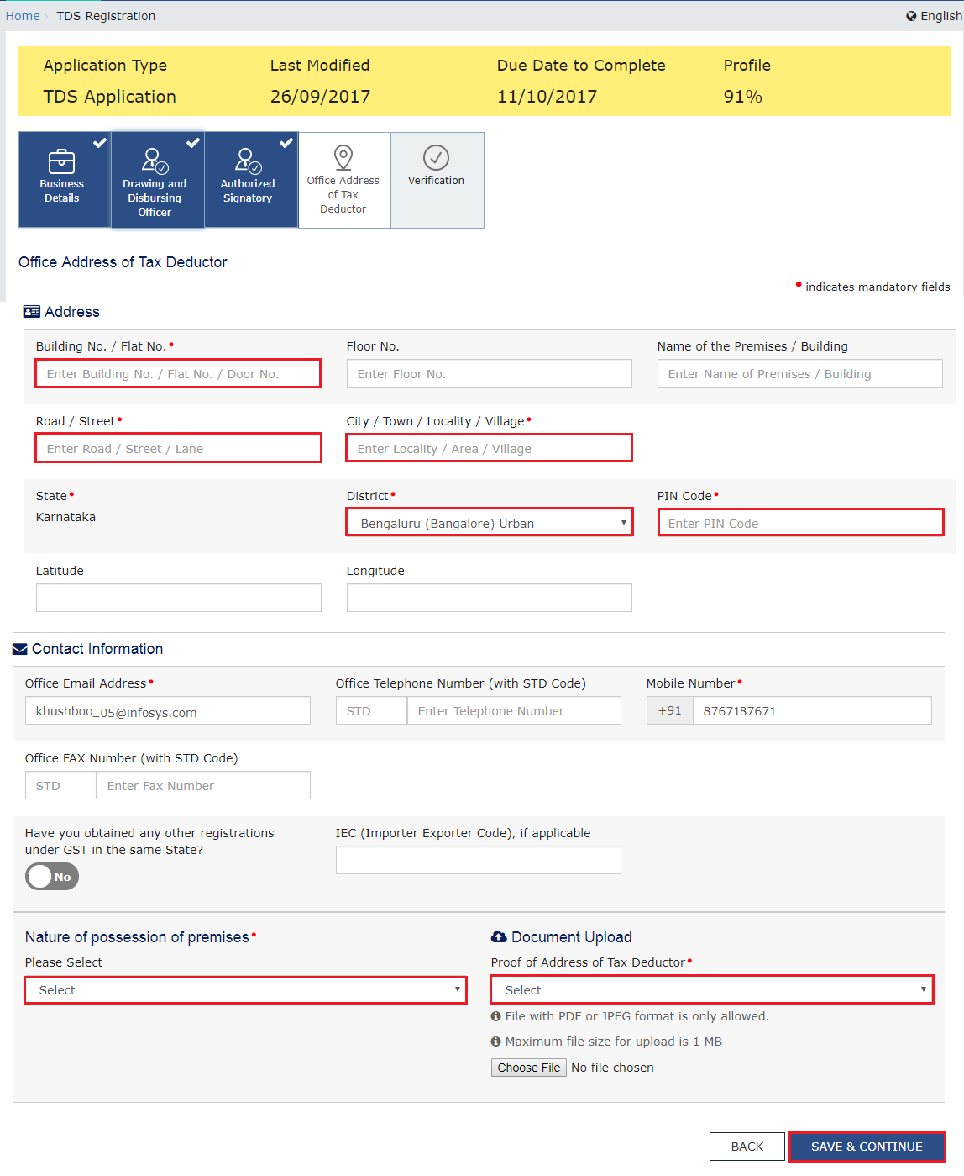
Tax Deducted at Source
Registration requirement

Slide 25
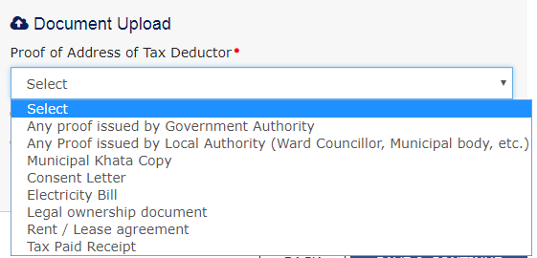
Tax Deducted at Source
Registration requirement

Slide 26
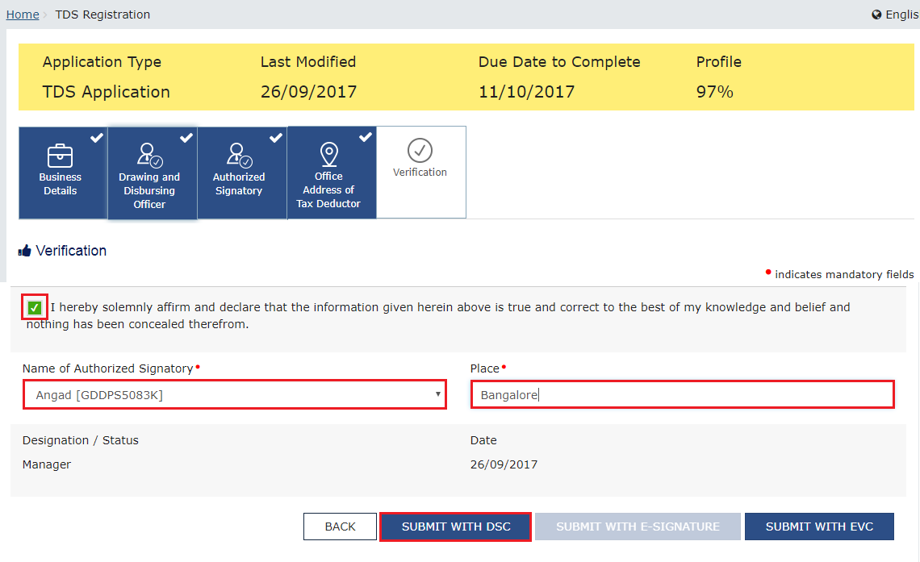
Tax Deducted at Source
Registration requirement

Slide 27
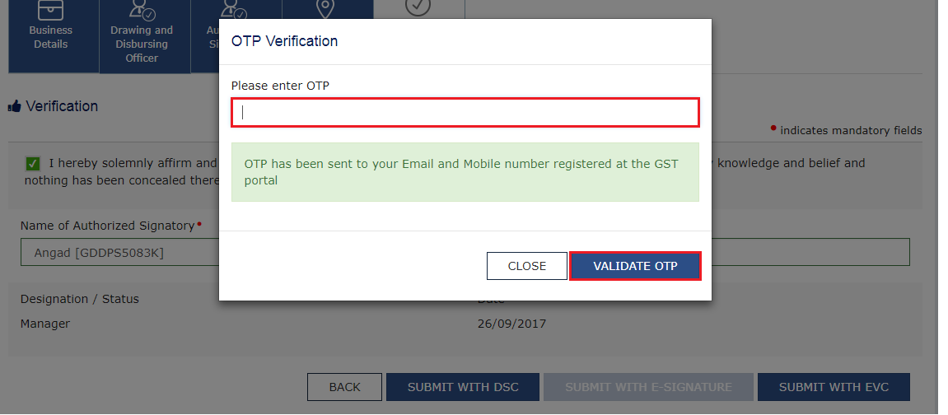
Tax Deducted at Source
Registration requirement

Slide 28
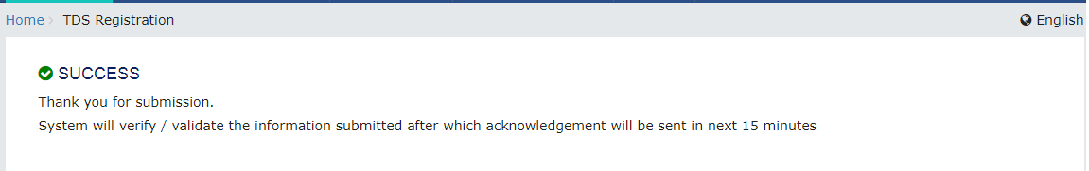
Tax Deducted at Source
Registration requirement

Slide 29
Generation & Filing of GSTR-7 along with Payment of taxes & Amendments

Slide 30
Tax Deducted at Source
Tax deduction at source-Return GSTR-07
When do we require to make the payment and file GSTR-07?
The amount deducted as tax under this section shall be paid to the Government by the deductor within ten days after the end of the month in which such deduction is made

Slide 31
Tax Deducted at Source
Tax deduction at source-Return GSTR-07
Do we require to issue TDS Certificate?
TDS Certificate in Form GSTR-07A will be downloadable from the portal by supplier after accepting the transactions uploaded by deductor.

Slide 32
Tax Deducted at Source
Tax deduction at source-Return GSTR-07
Is there any penalty for any default in issuing TDS Certificate?
If any deductor fails to furnish to the deductee the certificate, after deducting the tax at source, within five days of crediting the amount so deducted to the Government, the deductor shall pay, by way of a late fee, a sum of one hundred rupees per day from the day after the expiry of such five days period until the failure is rectified, subject to a maximum amount of five thousand rupees.

Slide 33
Tax Deducted at Source
Tax deduction at source-Return GSTR-07
Is there any penalty for any default in deducting tax?
If any deductor fails to pay to the Government the amount deducted as tax under sub-section (1), he shall pay interest in accordance with the provisions of sub-section (1) of section 50, in addition to the amount of tax deducted.
+
he shall be liable to pay a penalty of ten thousand rupees or an amount equivalent to the tax evaded or the tax not deducted under section 51 or short deducted or deducted but not paid to the Government, whichever is higher.

Slide 34
Tax Deducted at Source
Tax deduction at source-Return GSTR-07
How will the deductee claim this tax deducted?
There will be a TDS/TCS credit received table similar to table 9 of GSTR-2. Supplier has to take action on the transactions to accept/reject. Amount of TDS included in accepted transactions will be credited to the cash ledger of supplier.

Slide 35
Tax Deducted at Source
Tax deduction at source-Return GSTR-07
If we had deducted excess TDS, How can it be rectified?
The refund to the deductor or the deductee arising on account of excess or erroneous deduction shall be dealt with in accordance with the provisions of section 54 :
Provided that no refund to the deductor shall be granted, if the amount deducted has been credited to the electronic cash ledger of the deductee.

Slide 36
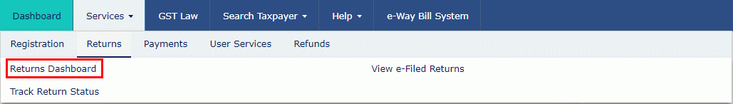
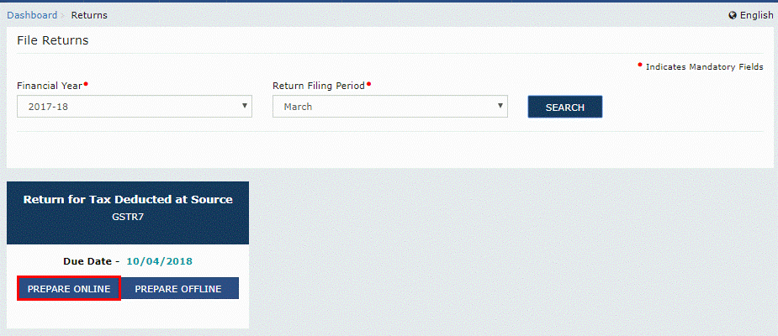
Tax Deducted at Source
Returns

Slide 37
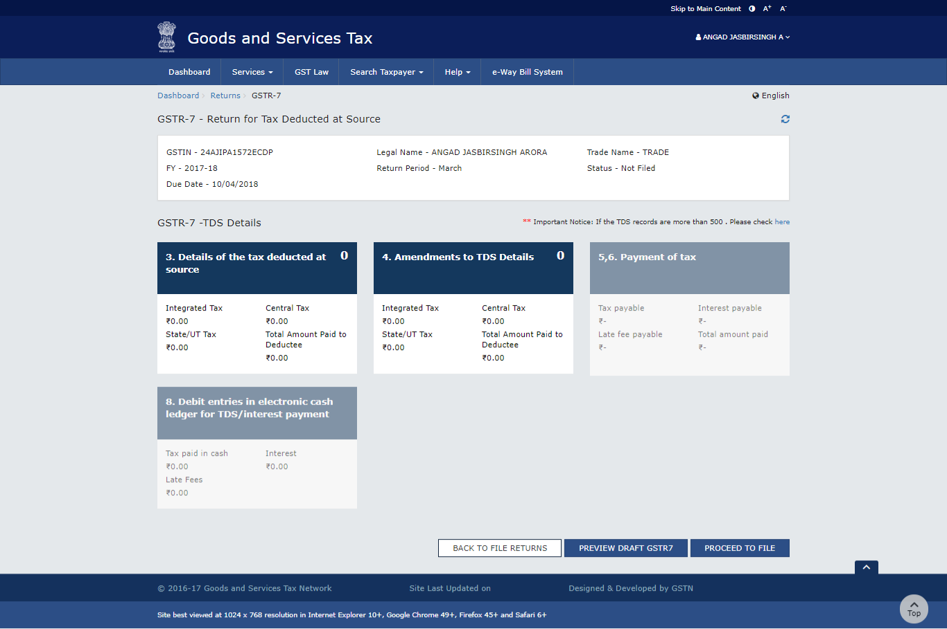
Tax Deducted at Source
Returns

Slide 38
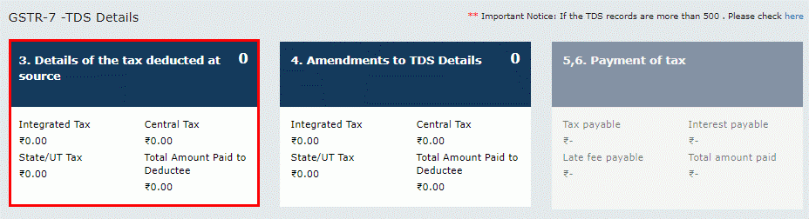
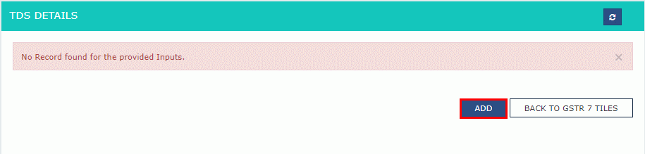
Tax Deducted at Source
Returns

Slide 39
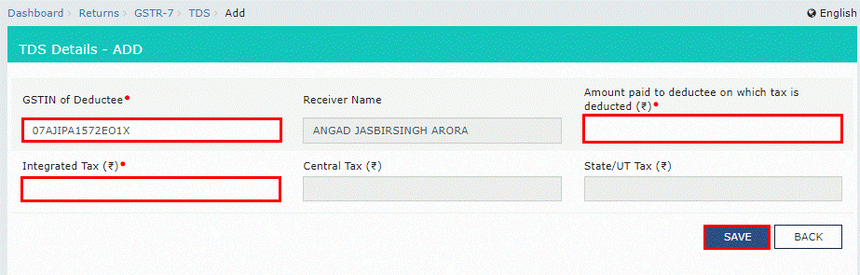
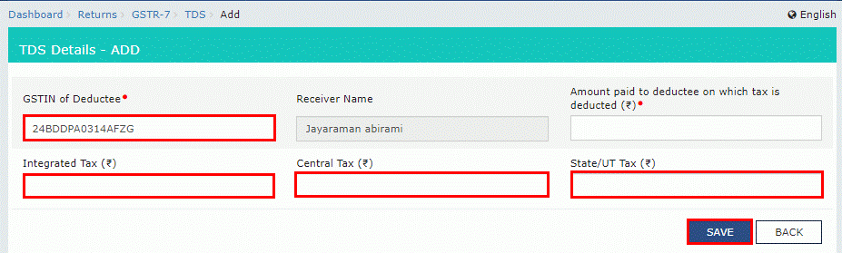
Tax Deducted at Source
Returns

Slide 40
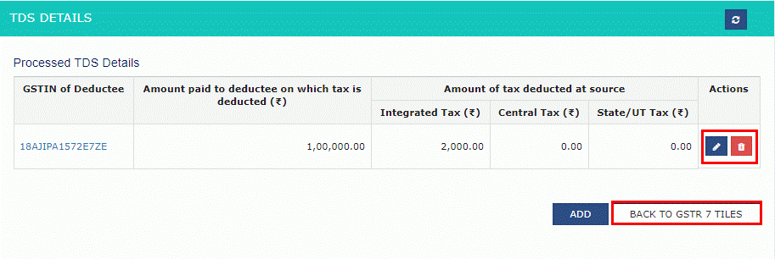
Tax Deducted at Source
Returns

Slide 41
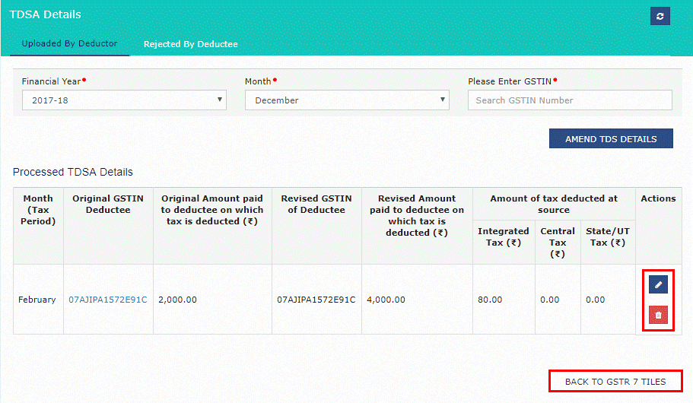
Tax Deducted at Source
Returns

Slide 42
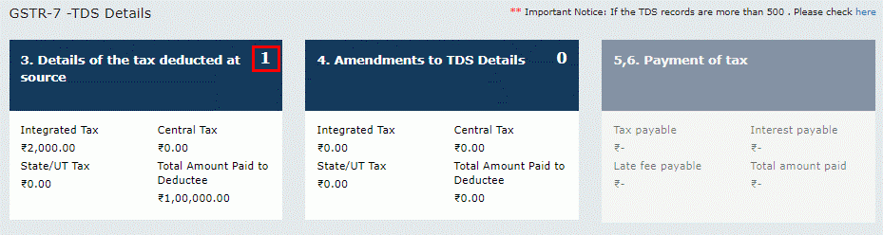
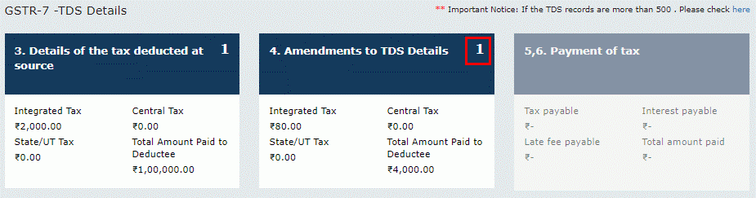
Tax Deducted at Source
Returns

Slide 43
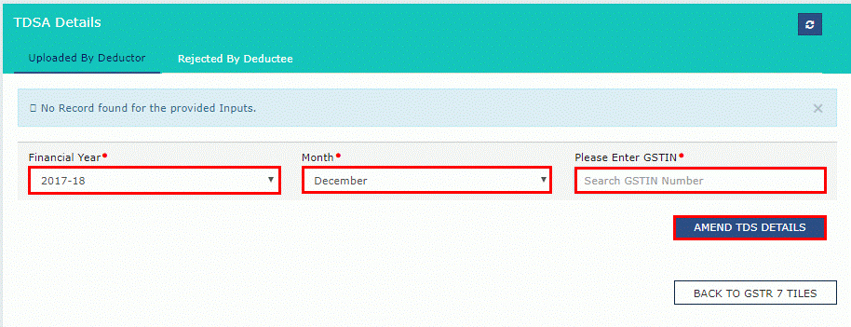
Tax Deducted at Source
Returns

Slide 44
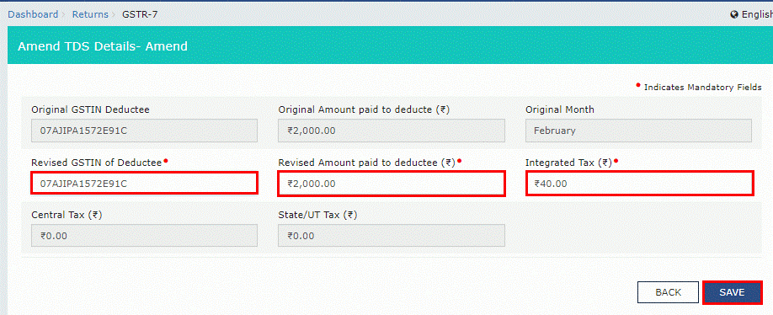
Tax Deducted at Source
Returns

Slide 45
Tax Deducted at Source
Returns

Slide 46
Tax Deducted at Source
Returns

Slide 47
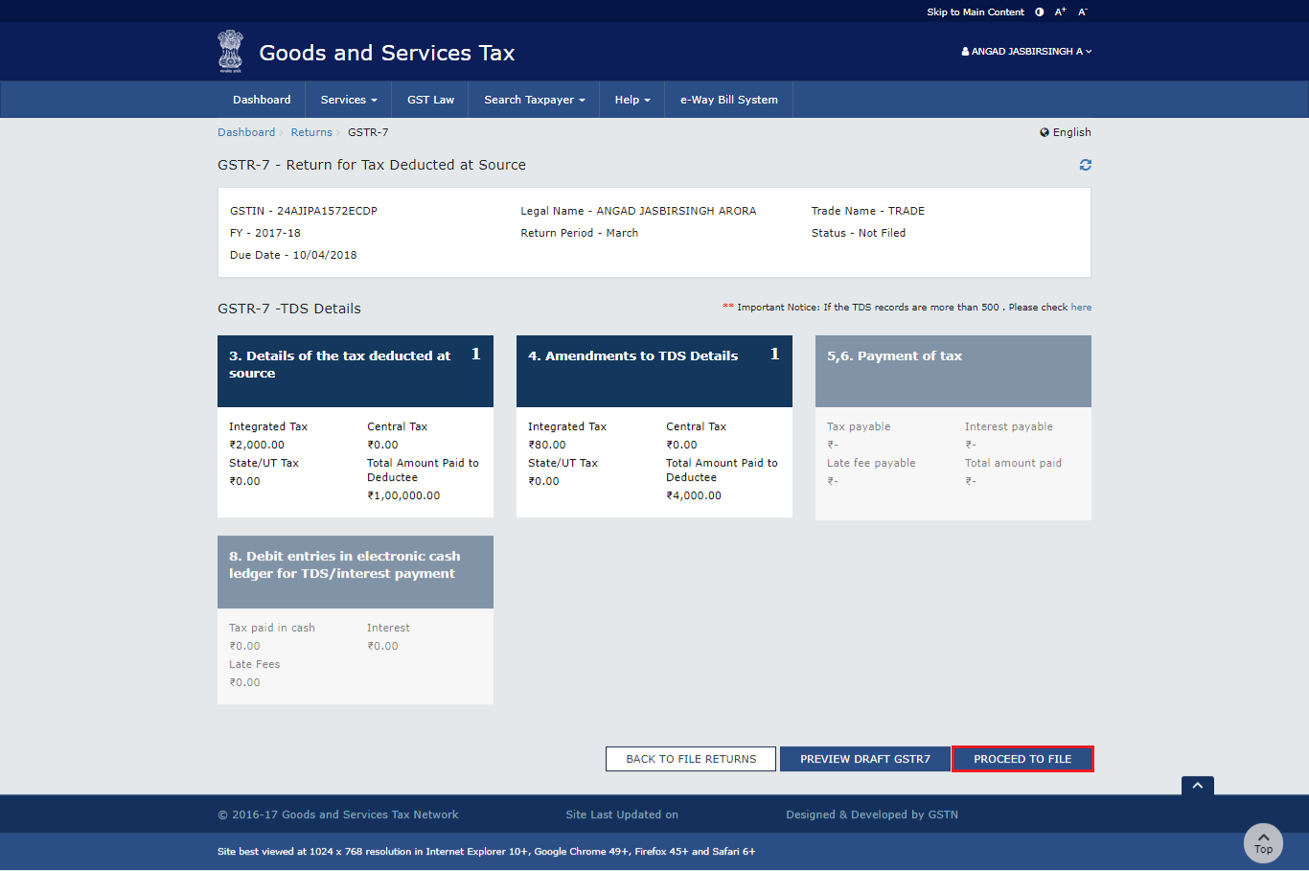
Tax Deducted at Source
Returns

Slide 48
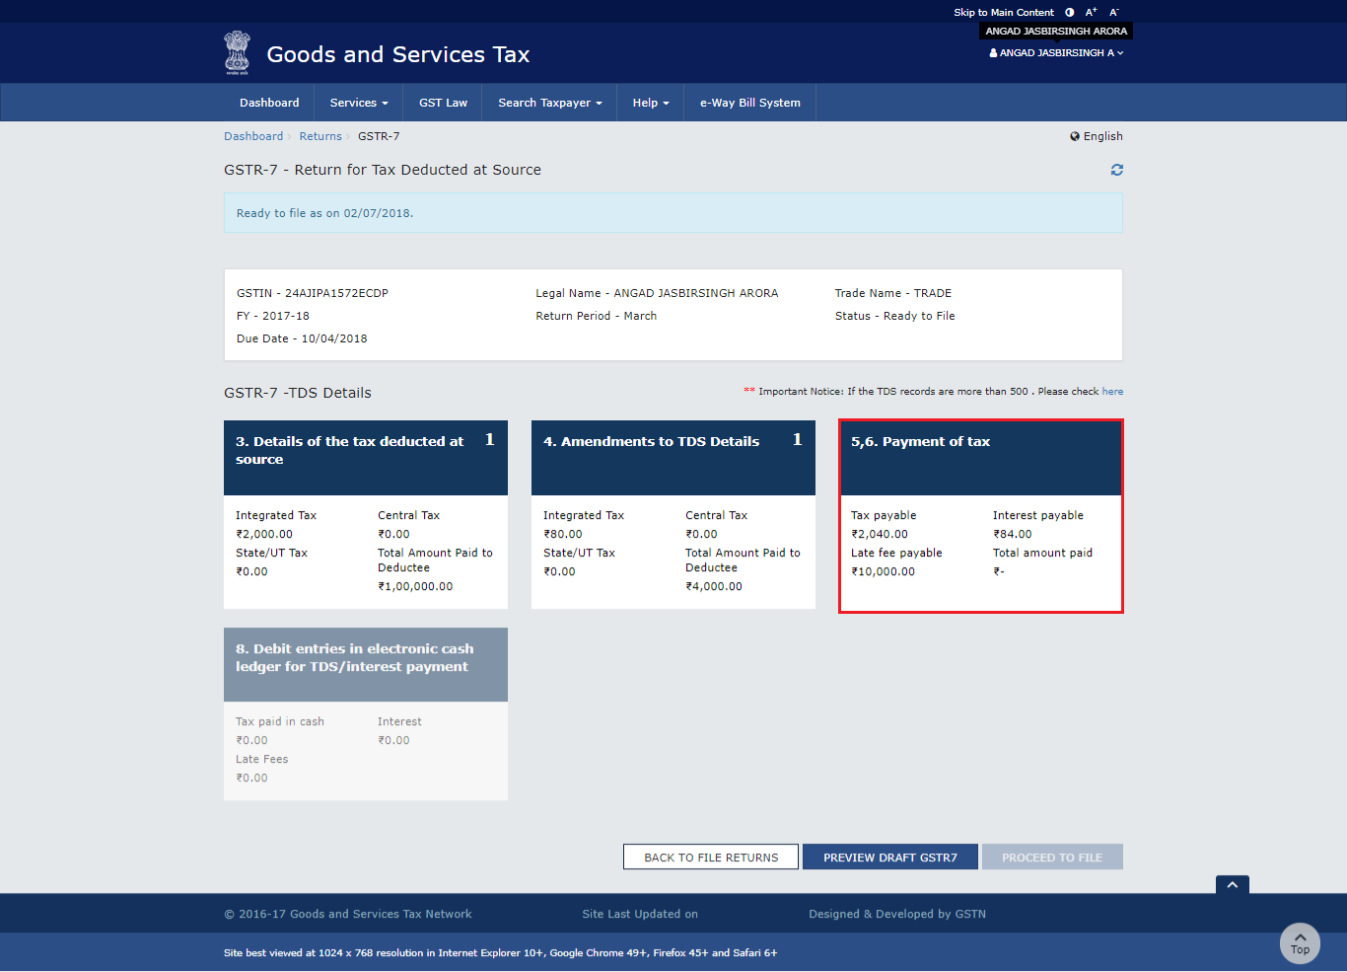
Tax Deducted at Source
Returns

Slide 49
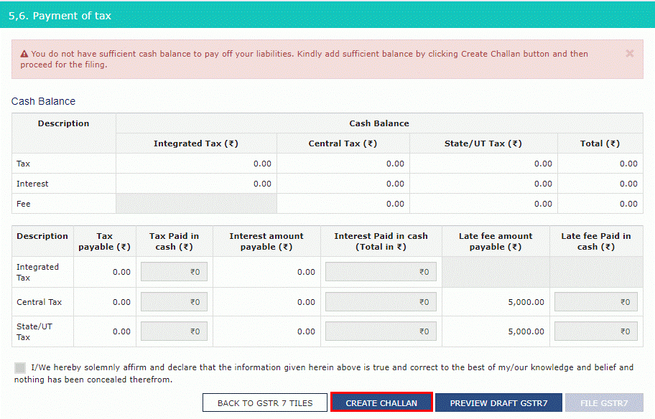
Tax Deducted at Source
Returns

Slide 50
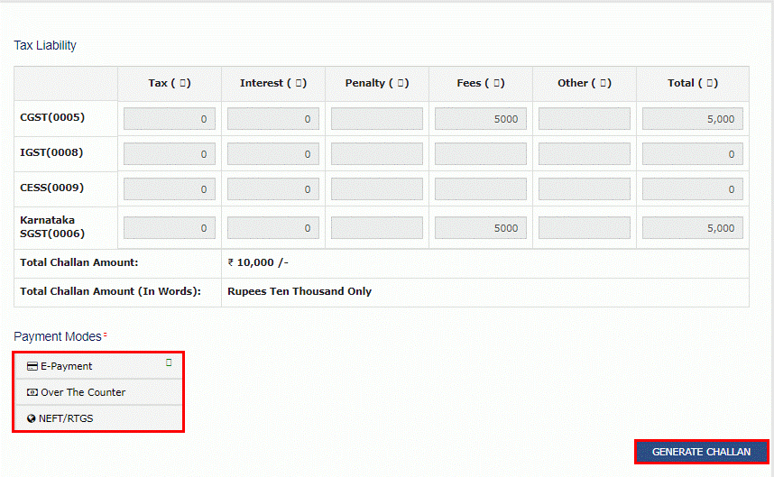
Tax Deducted at Source
Returns

Slide 51
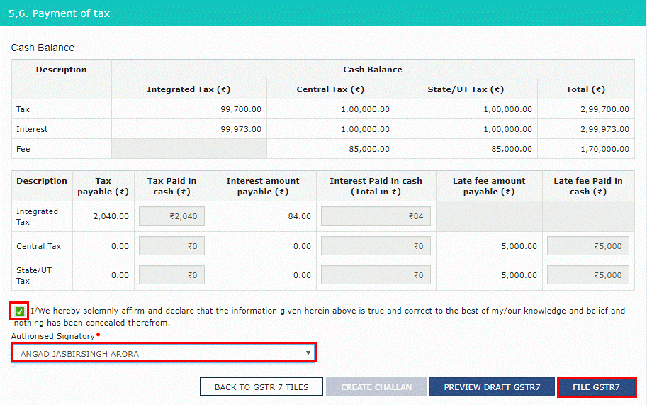
Tax Deducted at Source
Returns

Slide 52
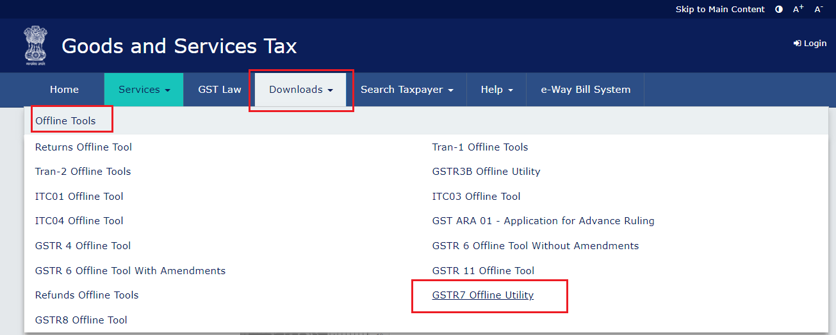
Tax Deducted at Source
Returns

Slide 53
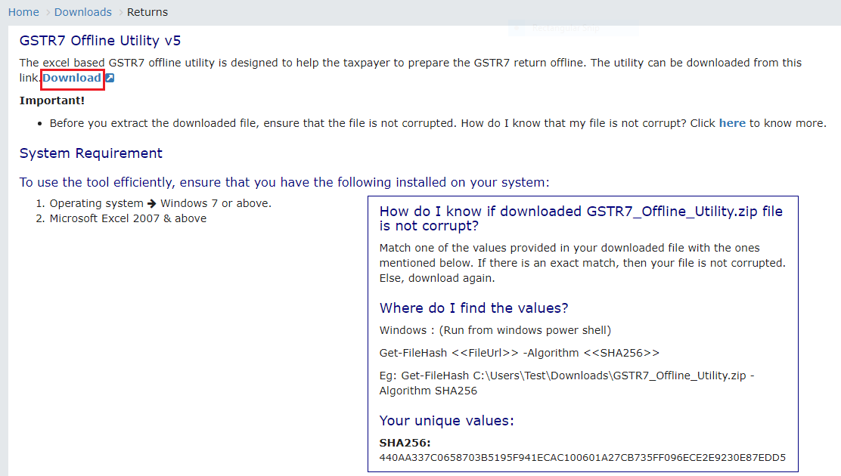
Tax Deducted at Source
Returns

Slide 54
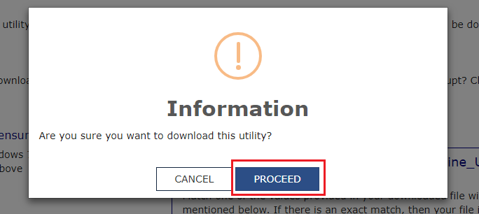
Tax Deducted at Source
Returns

Slide 55
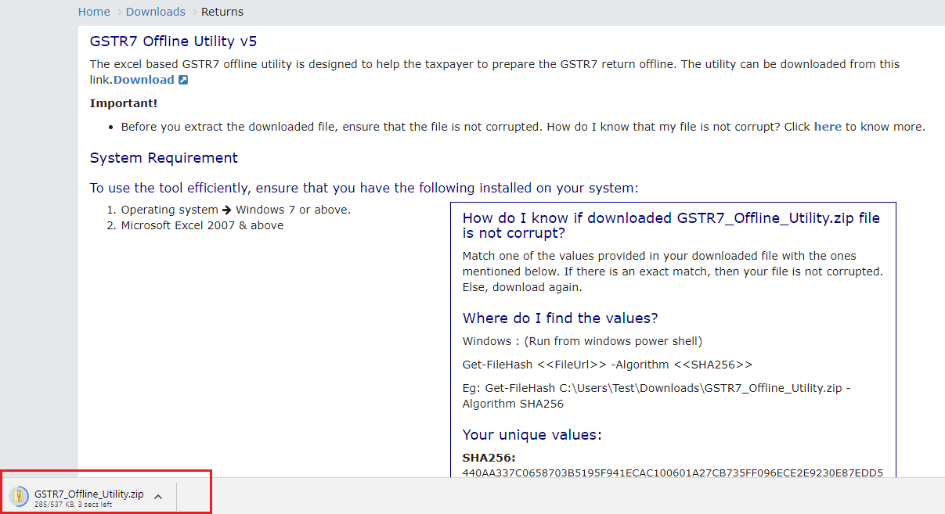
Tax Deducted at Source
Returns

Slide 56
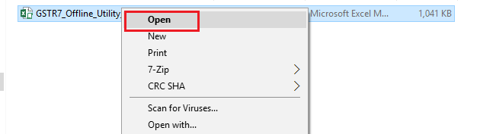
Tax Deducted at Source
Returns

Slide 57
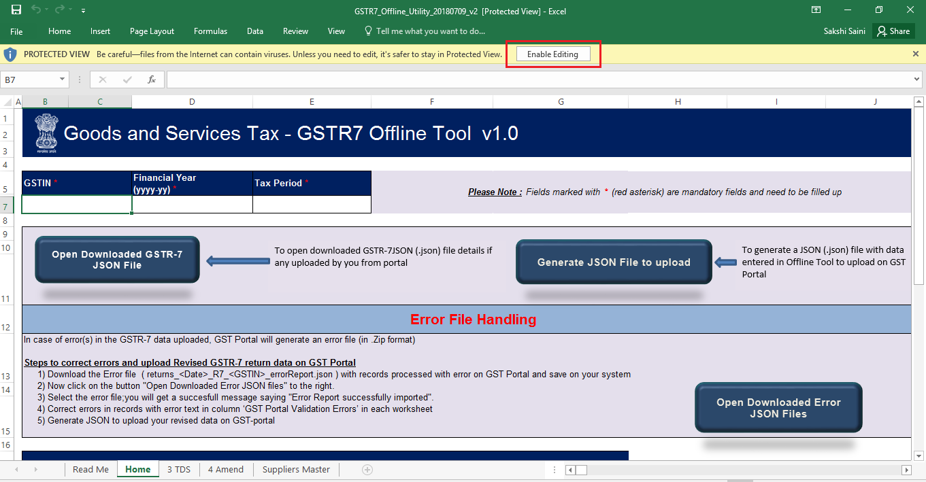
Tax Deducted at Source
Returns

Slide 58
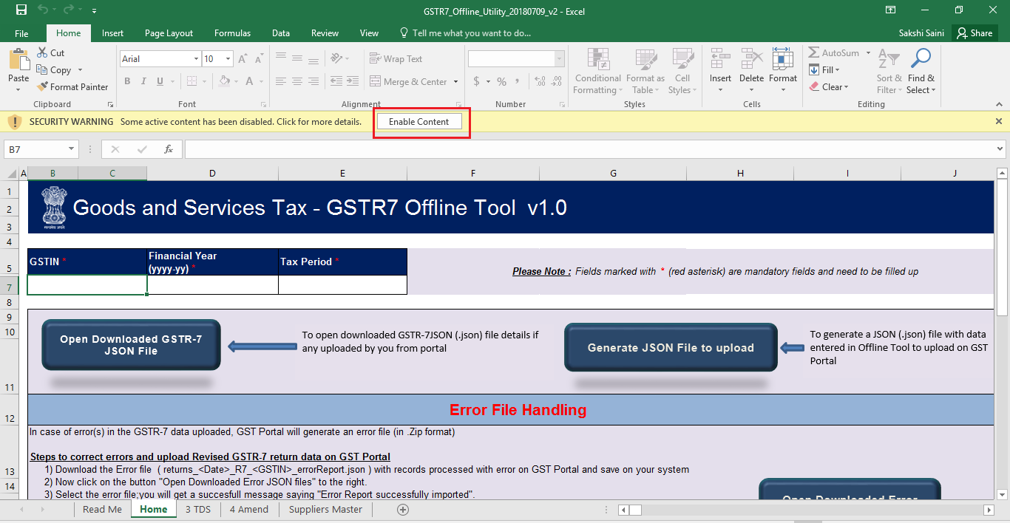
Tax Deducted at Source
Returns

Slide 59
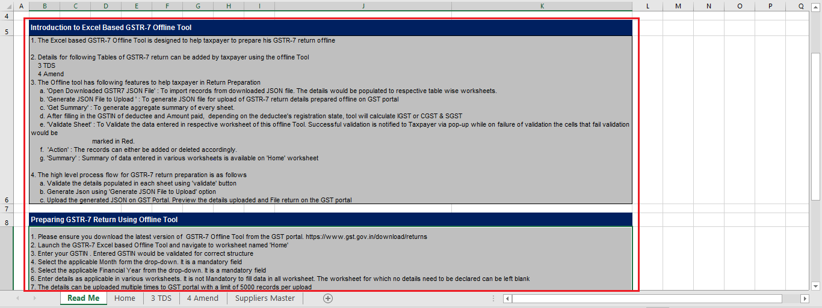
Tax Deducted at Source
Returns

Slide 60
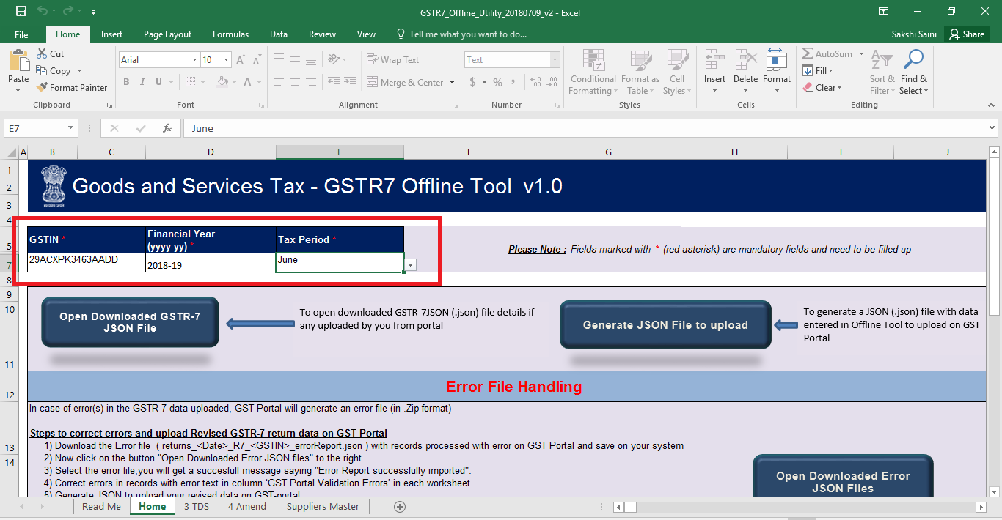
Tax Deducted at Source
Returns

Slide 61
Payment of taxes

Slide 62
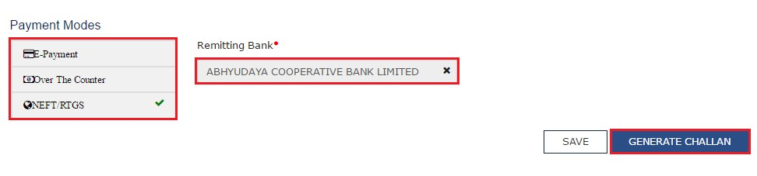

Slide 63
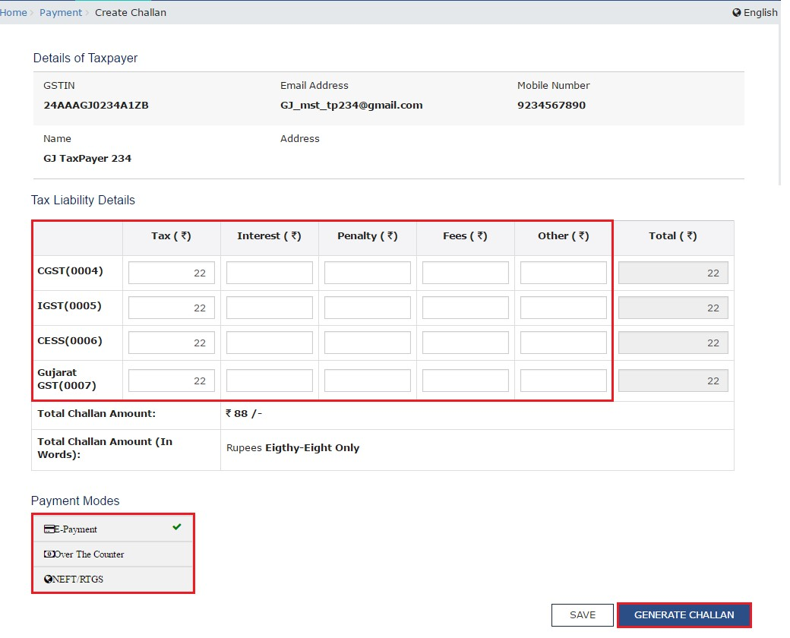

Slide 64
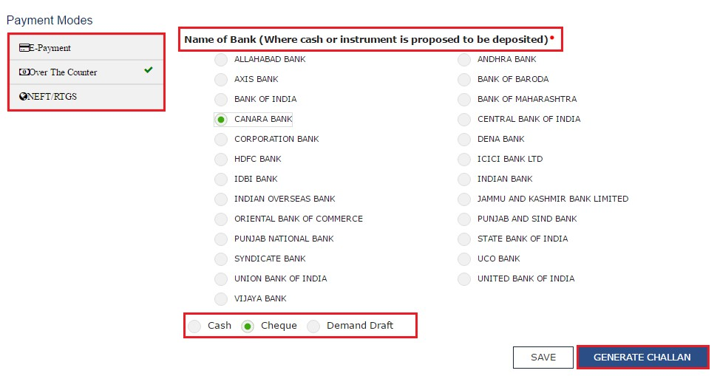

Slide 66
NEFT payments
Take a print out of the Challan and visit the selected Bank. Mandate form will be generated simultaneously.
Pay using Cheque through your account with the selected Bank/ Branch. You can also pay using the account debit facility.
The transaction will be processed by the Bank and RBI shall confirm the same within <2 hours>.
Once you receive the Unique Transaction Number (UTR) on your registered e-mail or mobile number, you can link the UTR with the NEFT/RTGS CPIN on the GST Portal. Go to Challan History and click the CPIN link. Enter the UTR and link it with the NEFT/RTGS payment.
Status of the payment will be updated on the GST Portal after confirmation from the Bank.
The payment will be updated in the Electronic Cash Ledger in respective minor/major heads

Slide 67
Over the Counter payments
Take a print out of the Challan and visit the selected Bank. Mandate form will be generated simultaneously.
Pay using Cash/ Cheque/ Demand Draft within the Challan’s validity period.
Status of the payment will be updated on the GST Portal after confirmation from the Bank.
The transaction will be processed by the Bank and RBI shall confirm the same within <2 hours>.
Status of the payment will be updated on the GST Portal after confirmation from the Bank.
The payment will be updated in the Electronic Cash Ledger in respective minor/major heads

Slide 68
TDS Certificates
&
TDS Credit Recivables

Slide 69
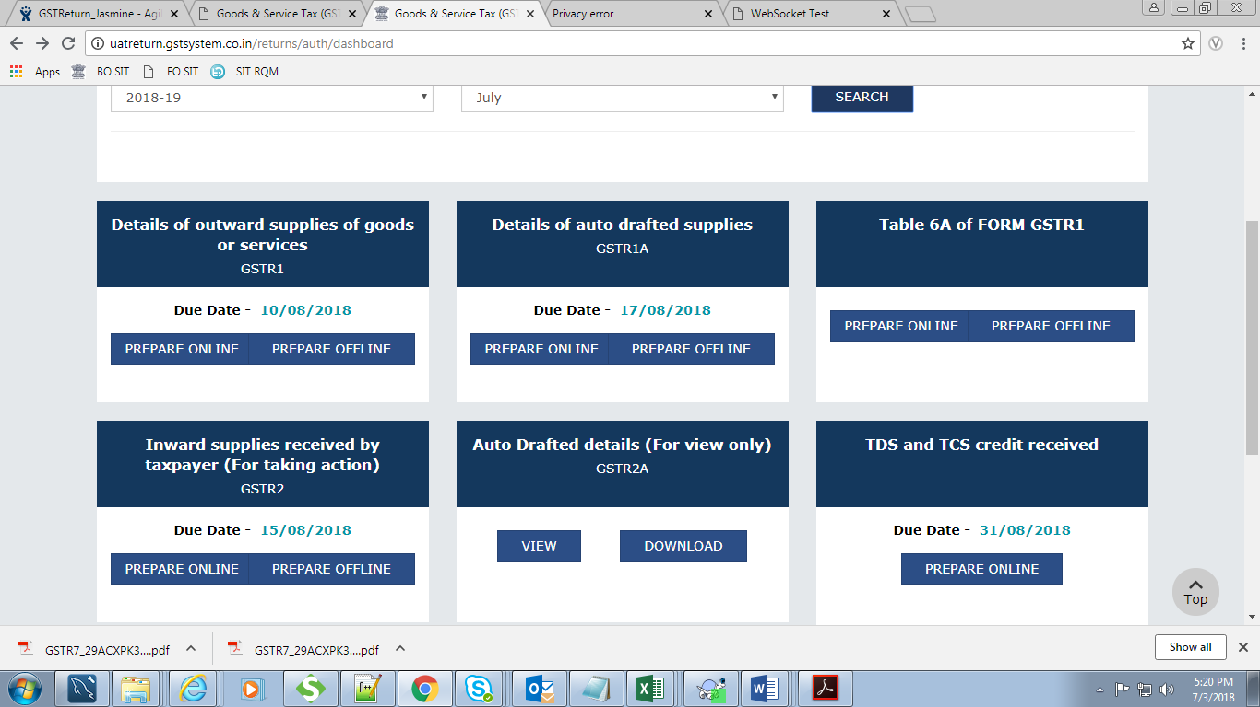
TDS TCS credit received Table

Slide 70

TDS TCS credit received Table

Slide 71

TDS TCS credit received Table

Slide 72

TDS TCS credit received Table

Slide 73

TDS TCS credit received Table

Slide 74

TDS TCS credit received Table

Slide 75

TDS TCS credit received Table

Slide 76

TDS TCS credit received Table

Slide 77

TDS TCS credit received Table

Slide 78

TDS TCS credit received Table

Slide 79


Slide 80

Tax Deducted at Source
TDS Certificates

Slide 81

Tax Deducted at Source
TDS Certificates

Slide 82

Tax Deducted at Source
TDS Certificates

Slide 83

Tax Deducted at Source
TDS Certificates

Slide 84

Tax Deducted at Source
TDS Certificates

Slide 85
Tax Deducted at Source
Some Issues?
Do we need to deduct TDS on advance payments?
Do we need to Deduct TDS, if there are several contracts from the same person, where each contract taxable value is less than 250000 but in total more than 250000
What if the supplier is issuing the invoice along with some reimbursements on which supplier is not charging GST? Do we need to deduct on Total payments or the taxable supply?

Slide 86
Tax Deducted at Source
Some Issues?
(Mr. A) supplier is supplying goods and services to Mr. B, throughout the year, now the value of supply has increased to 2,50,000 in the middle of year for which payment has already been done, now TDS need to be deducted on the whole of the supply ?
What will happen if the supplier is not registered and he is supplying goods and service for more than 2,50,000?
What will be TDS amount in case when Credit note or Debit note is issued, but the payment has already been done? Or there are some other discounts by which valuation and payment is different?

Slide 87
Tax Deducted at Source
Some Issues?
How to identify the amount of TDS as payment includes the tax amount or reimbursements as well?
What will happen in the scenarios where invoice is issued before applicability of TDS provisions but the payment is made after applicability?
Consequences where the place of supply or taxable value in the invoice is wrong and TDS is deducted accordingly.

Slide 88

Tax Deducted at Source
Your feedback will help us plan and perform better!

