Slide 1
ANTI-PROFITEERING
MECHANISM UNDER GST
A LAW TO CURB UNJUST PROFIT
Critical analysis
By Pankaj Kumar
pkjca999@gmail.com
8178369350

Slide 2
Profiteering
Profiteering is a pejorative term for the act of
making a profit by methods considered
UNETHICAL.

Slide 3
Anti-profiteering
Anti profiteering is a mechanism to curb profiteering
As the name suggests, it prevent entities from making excessive profits due to the GST.

Slide 4
Since GST, along with the input tax credit, is eventually expected to bring down prices, a National Anti-profiteering Authority (NAA) has been set up to ensure that the benefits that accrue to entities due to reduction in costs is passed on to the consumers. Also, entities that hike rates inordinately, citing GST as the reason, will be checked by anti-profiteering body.
It is not the first instance that India has met with Anti-Profiteering. West Bengal, passed Anti-Profiteering way back in 1958.

Slide 5
Why do we need anti-profiteering laws?
The need for setting up an Anti-Profiteering Authority arises because examples around the world have shown that the introduction of GST has led to inflation, with traders trying to keep their profit margins constant and the ultimate benefit not being passed on to the ultimate consumer.
A report of CAG named 'Lessons for Transition into Goods and Services Tax' in dealing with the impact of the introduction of VAT in India also highlights the need for an Anti-Profiteering Authority.
It states that the introduction VAT has led to an increase in prices of products and pocketing of almost 40 crores worth benefit by manufacturers and dealers in distribution chains instead of the consumers. These instances clearly show that any overhaul in the system to be successful, require a comprehensive anti-profiteering system
Notes:
CAG comments on Anti-profiteering

Slide 6

Legal perspective
A strict interpretation of Section 171 of the CGST Act, requires a registered taxable person to pass on the benefit of every rupee accruing on account of additional input tax credit or reduced tax rate, to the next level of supply chain.

Slide 7

Legal perspective
Section 171(2) of the CGST Act requires constitution of an Authority to examine whether input tax credits availed by any registered person or the reduction in the tax rate have actually resulted in a commensurate reduction in the price of the goods or services or both supplied by him.
So, CGST Rules are framed for the purpose of constituting the Authorities and providing the powers, duties, procedure, etc. of the Authority.

Slide 8
Legal perspective
Section 171(1) casts responsibility to pass on the benefit of GST to the recipient for following two aspects:
Reduction of Tax Rate in New Tax Regime
Benefit of Input Tax Credit

Slide 9
Reduction of Tax Rate in New Tax Regime
For example, eating out has become cheaper under GST (mostly 18% GST as compared to earlier 20.5%). This benefit must be passed on to the consumers.
Passing of benefit due to reduction of tax rate, in case of supplies exclusive of tax or for immediate services is not a big challenge. This is because the reduction in tax rate will directly be evidenced by invoices, and the recipient will get benefit of the rate reduction.

Slide 10
Benefit of Input Tax Credit
Almost all industries will be affected with respect to passing of benefit due to better credit chain. In most places, be it service sector, manufacturing, trading, or any specific industry, all are going to get advantage of better flow of input tax credit except sectors having zero-rated output supply. So overall the expectations of anti-profiteering provisions are commensurate reduction in prices of supplies.

Slide 11


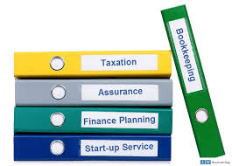
For example, CA firms earlier could not adjust the input VAT on office supplies with the output service tax payable. Now, ITC on all inputs can be adjusted against output tax. These benefits must be passed on by them.

Slide 12
Thus the crux of the anti-profiteering rules is-
If there is reduction in rate of tax on the supply of goods or services
or
Benefit of input tax credit is now available under GST
Then a registered person must pass on the benefit by reduction in prices.

Slide 13
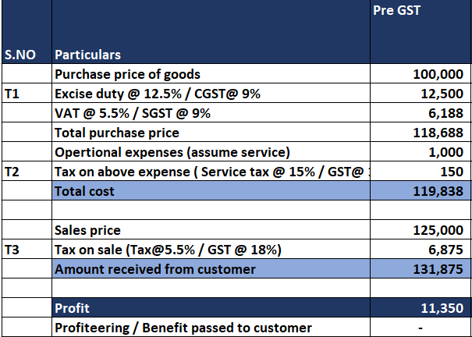
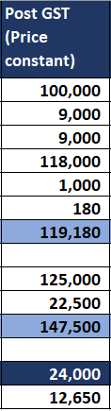
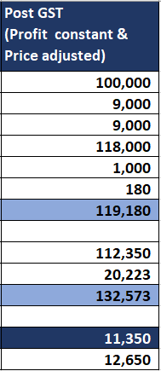
Illustration

Slide 14
Anti-Profiteering Structural Framework
Various authorities under GST law for anti-profiteering shall comprise of the following:
3. National Anti-Profiteering Authority
Add Contents Title
2. Standing Committee on Anti-Profiteering
1. State level Screening Committee

Slide 15
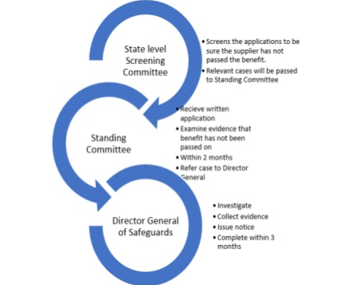
Procedure under Anti-Profiteering
All applications from interested parties on issues of local nature shall first be examined by the State level Screening Committee

Slide 16

The Screening Committee on being satisfied that the supplier has not passed on the
reduction in rate of tax on any supply of goods or services or
the benefit of input tax credit
on to the recipient by way of commensurate reduction in prices, will forward the application with its recommendations to the Standing Committee on Anti-profiteering.

Slide 17

If the Standing Committee is satisfied it shall refer the matter to the Director General of Safeguards for a detailed investigation.

Slide 18
The Director General of Safeguards will complete the investigation within a period of
three months or
within such extended period
The reasons for the same shall be recorded in writing as allowed by the Standing Committee.
And upon completion of the investigation, furnish to the Authority, a report of its findings along with the relevant records.

Slide 19
National Anti-Profiteering Authority in GST
National Anti-Profiteering Authority is a mechanism devised to ensure that prices remain under check and to ensure that businesses do not pocket all the gains from GST because profit is fine, but undue profiteering at the expense of the common man is not.

Slide 20
Duties of National Anti-Profiteering Authority
Determine whether the reduction in tax or the benefit of ITC has been passed by the seller to the buyer by reducing the prices.
Duties
Identify the taxpayers who has not passed on the benefit

Slide 21


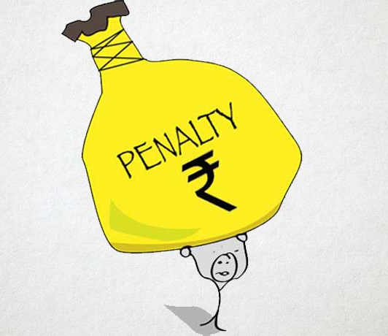

Powers of National Anti-Profiteering Authority
Passes on benefit to the buyer along with 18% interest
Cancellation
of
registration
Reduction
in
prices
Imposition
of
penalty

Slide 22
International perspective
Many countries that have adopted GST such as Singapore and Australia witnessed a spurt in inflation after implementation. Retail inflation in Australia, for instance, spurted from 1.9 per cent in the year before GST to 5.8 per cent in the year when the tax was rolled out. Initially Malaysia was able to avoid a similar surge in inflation by effectively implementing anti-profiteering rules.
A formula was laid down wherein the net profit margin in the period preceding GST was compared to the post-GST margins to see if inordinate gains had gone to the bottom- line. Gains were determined after taking in to account the supplier’s cost, costs incurred for furthering business, market conditions and other relevant issues.

Slide 23

Lesson from Malaysia : GST scrapped
Malaysia implemented the Goods and Services Tax (GST) from April 1, 2015 around 2 years before India. But due to rising inflation Malaysia scrapped GST on May 16, 2018.
Despite 18% of Government's revenue accruing from GST, Malaysia scraped the consumption tax to curb the rising inflation. This concerns Indian GST for effective implementation of Anti-profiteering.

Slide 24



Actions taken by Department
Out of the total number of 354 anti-profiteering applications, DG Safeguards sends investigation notices for GST profiteering in 53 cases including McDonald's, Honda and Hindustan Unilever Limited.

Slide 25
Contd.
HUL has earmarked Rs 119 crore in the December quarter to be paid to the government because it could not immediately lower prices after GST on several products. The company has offered to release the money to the Consumer Welfare Fund, run by the department of consumer affairs. In response, the authority has sought clarifications from HUL on the methodology used to arrive at Rs. 119 crore that the company offered to the government.

Slide 26
Conclusion
Profit is fine, profiteering is not.
Don’t let someone profiteer at your expense.

Slide 27
Thank you

