Slide 1




GST FREE CLASS FOR
By
CA Manish Sir
Valuation Rules under GST
For May/June 2018 Exam

Slide 2
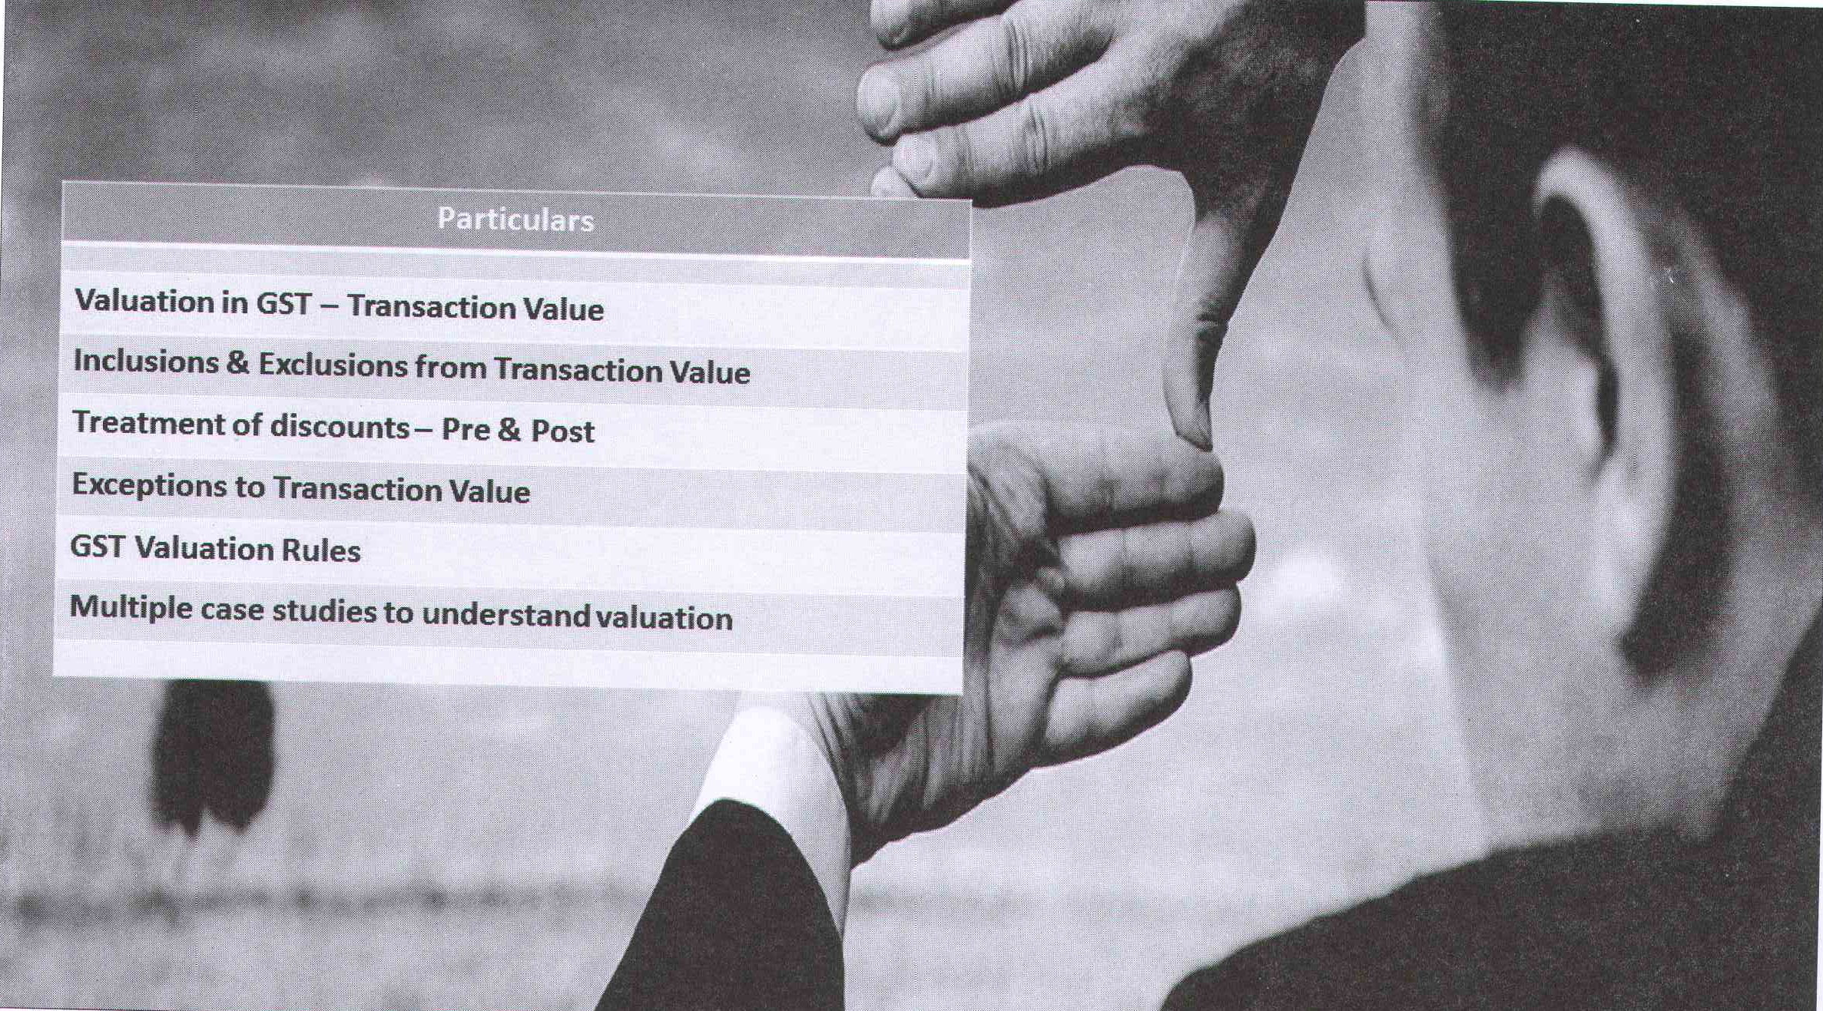

Slide 3
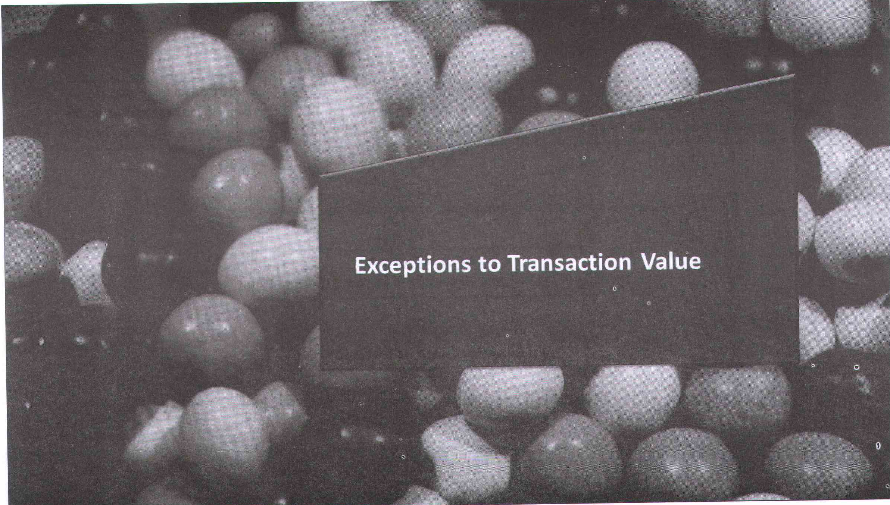

Slide 4
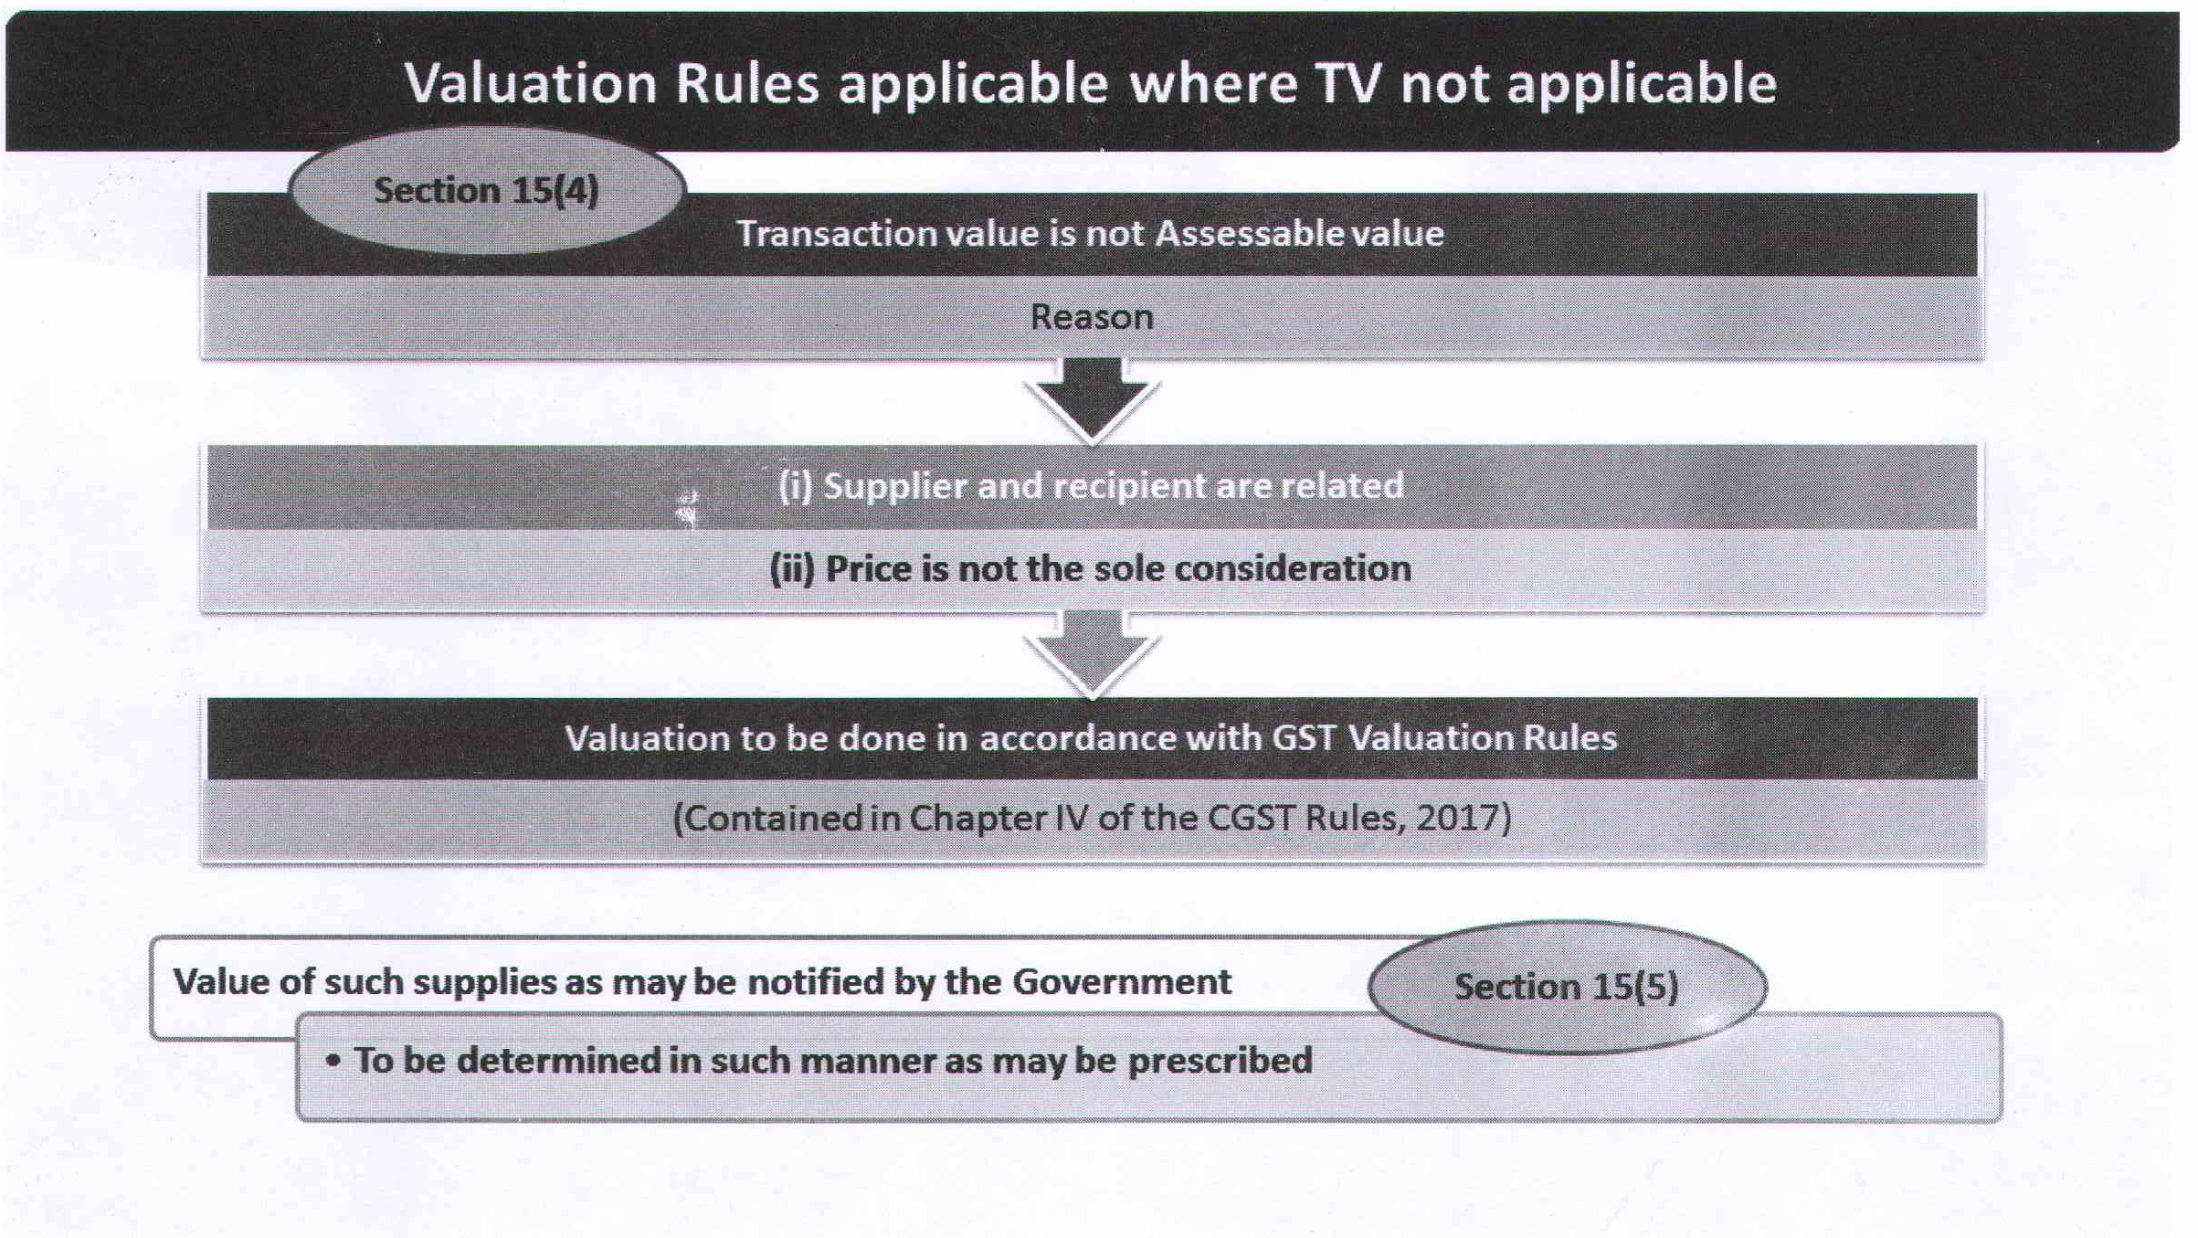

Slide 5
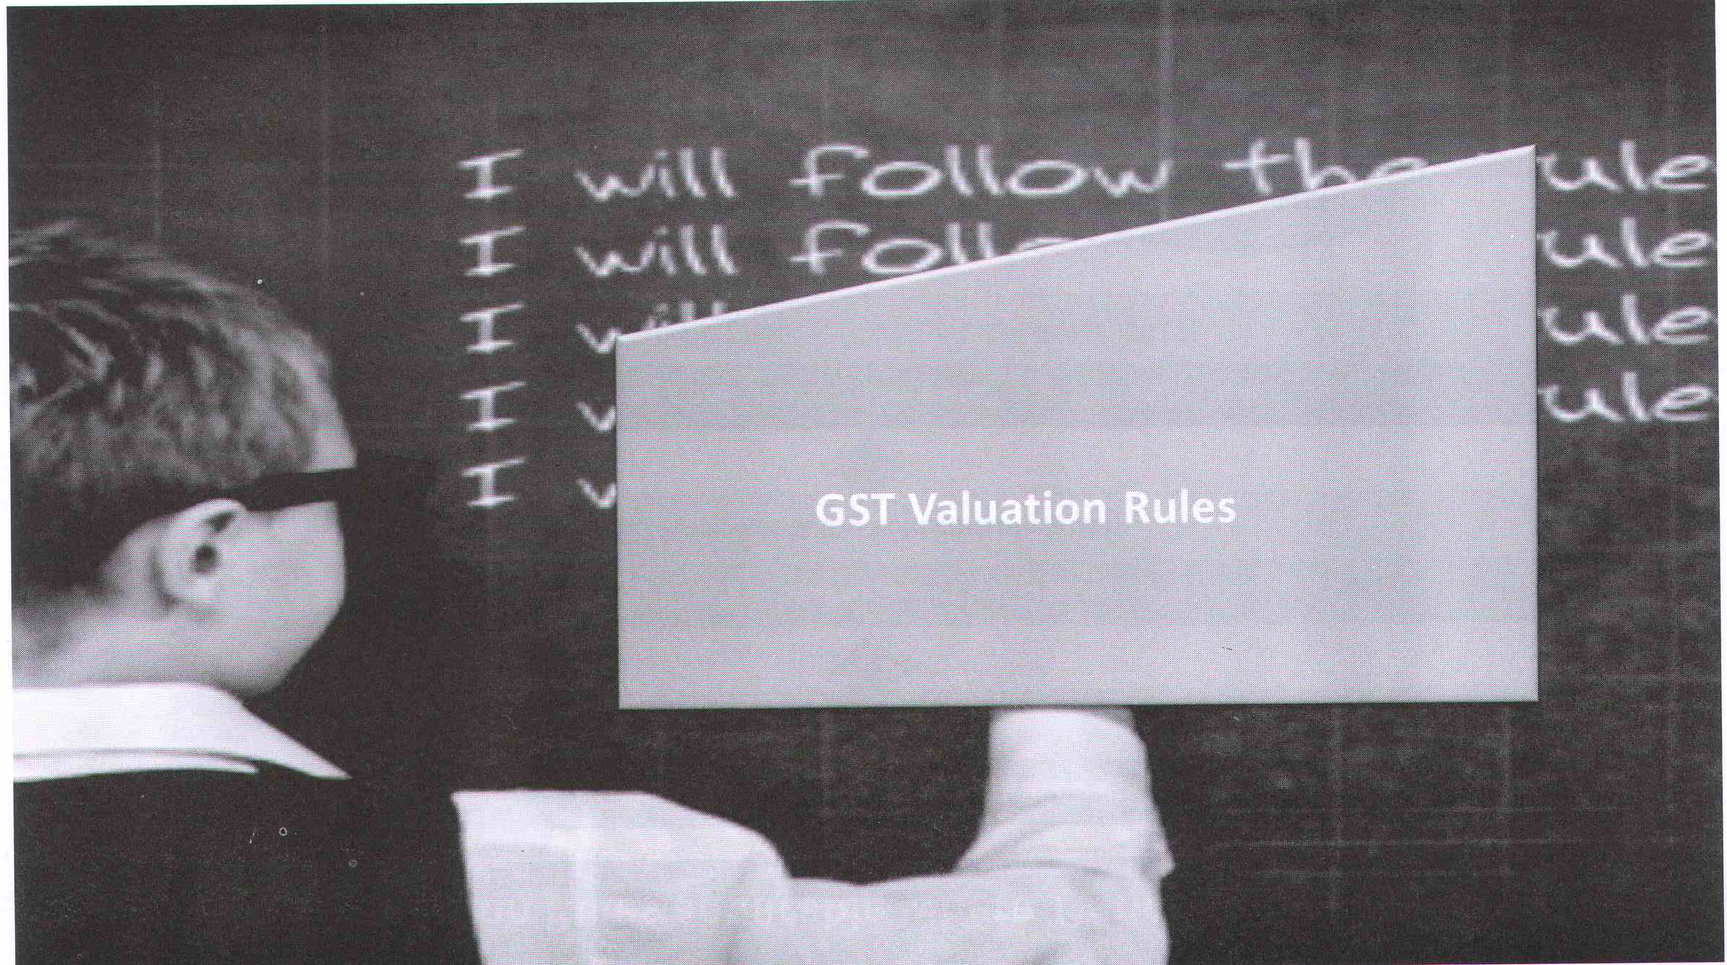

Slide 6
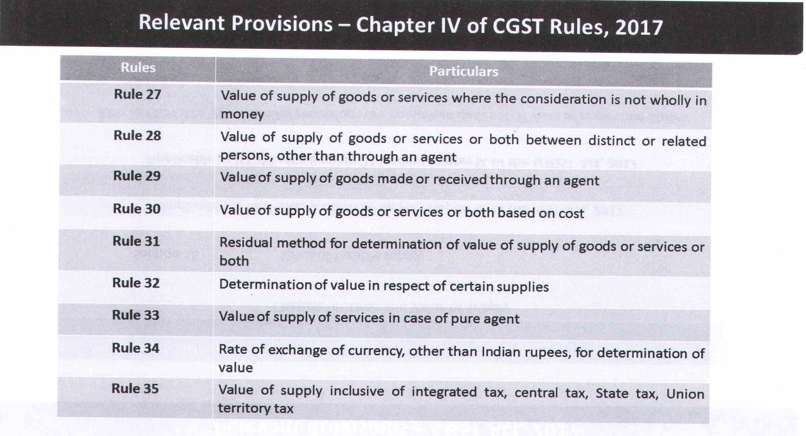

Slide 7
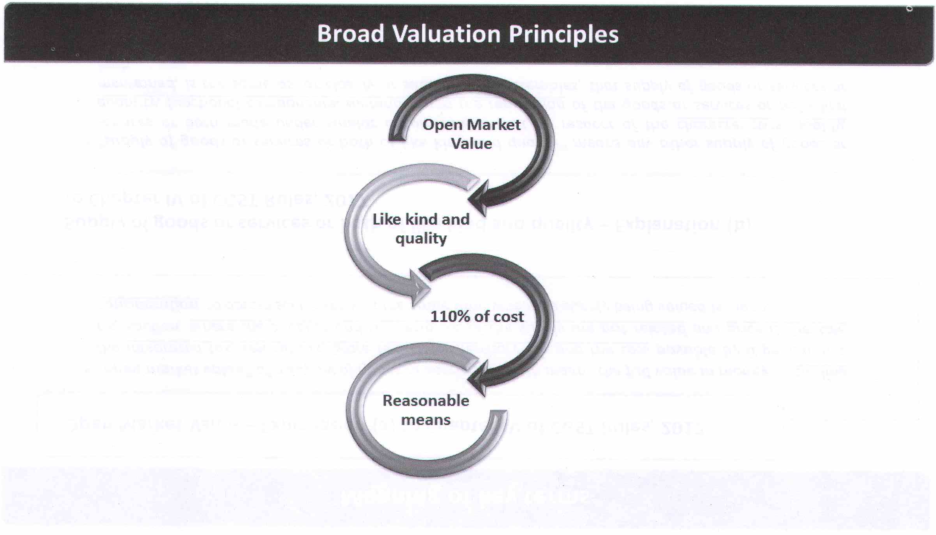

Slide 8
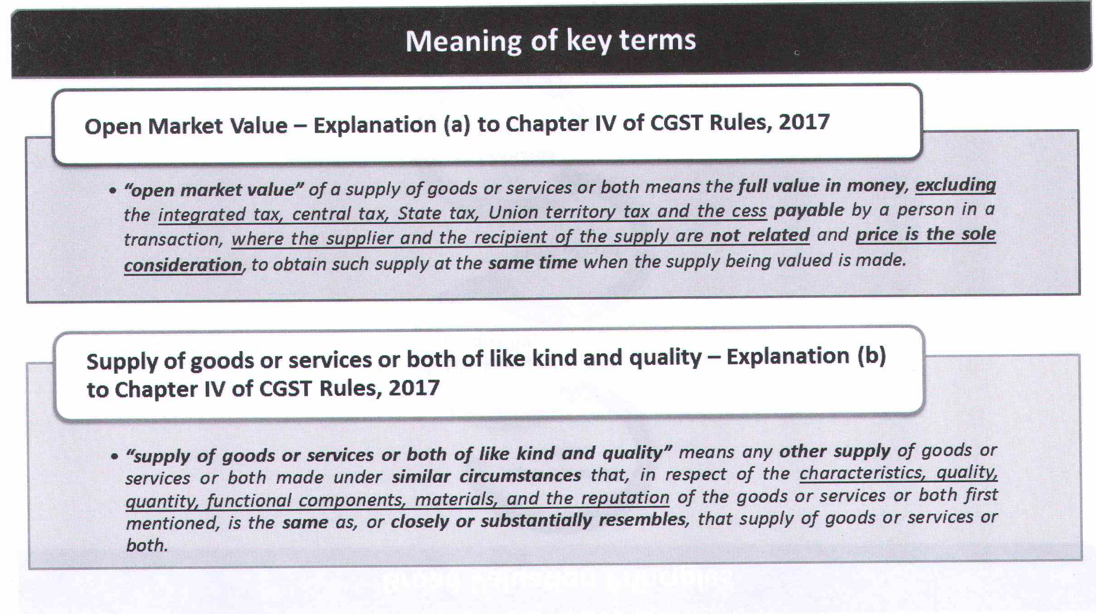

Slide 9
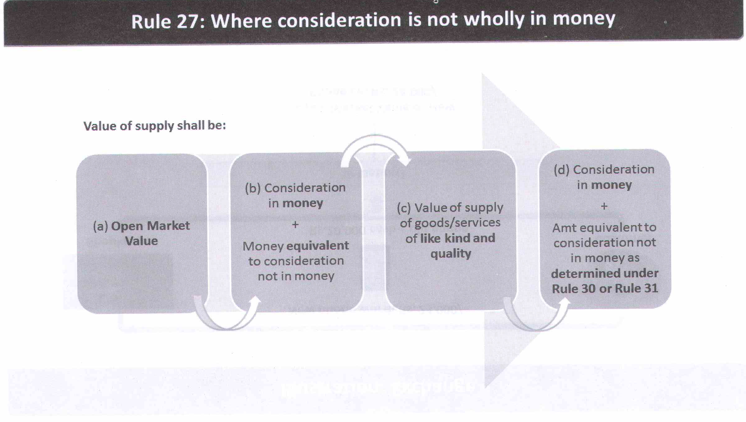

Slide 10
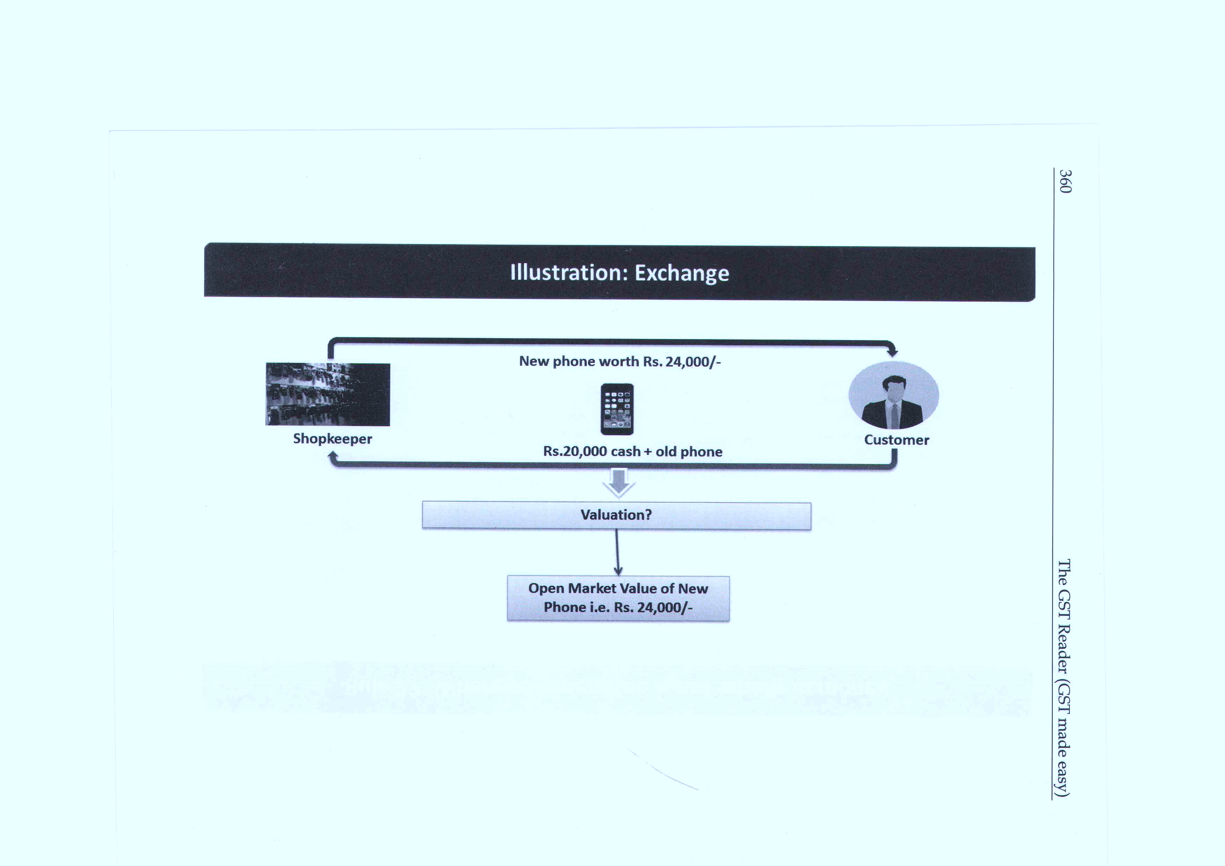

Slide 11
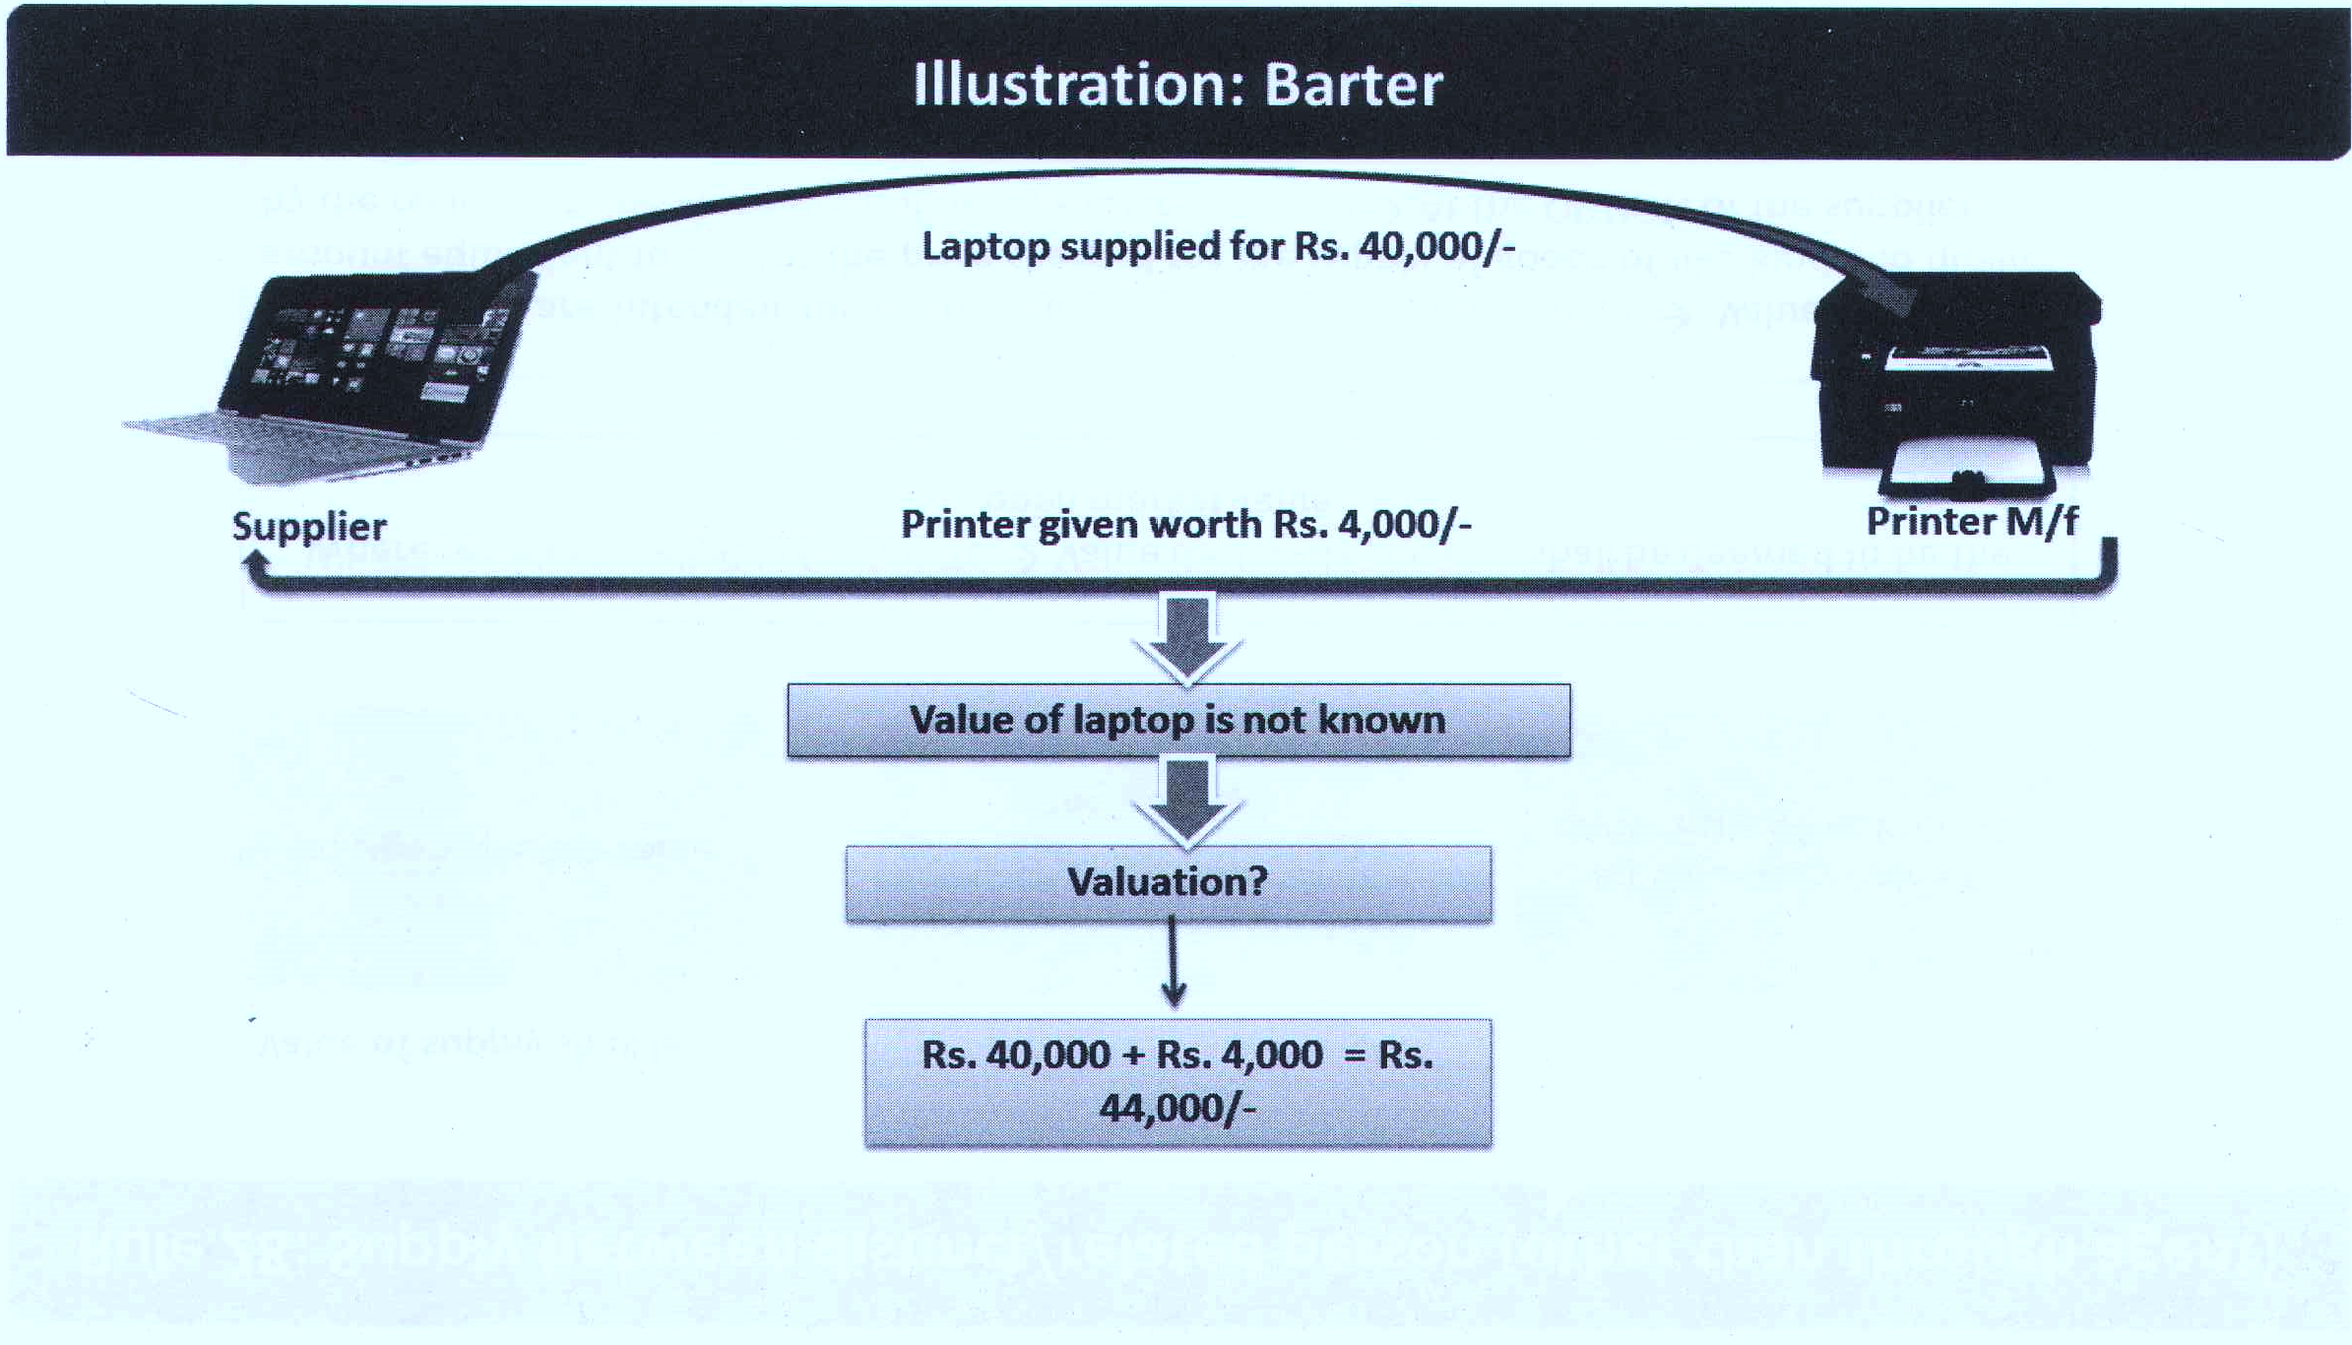

Slide 12
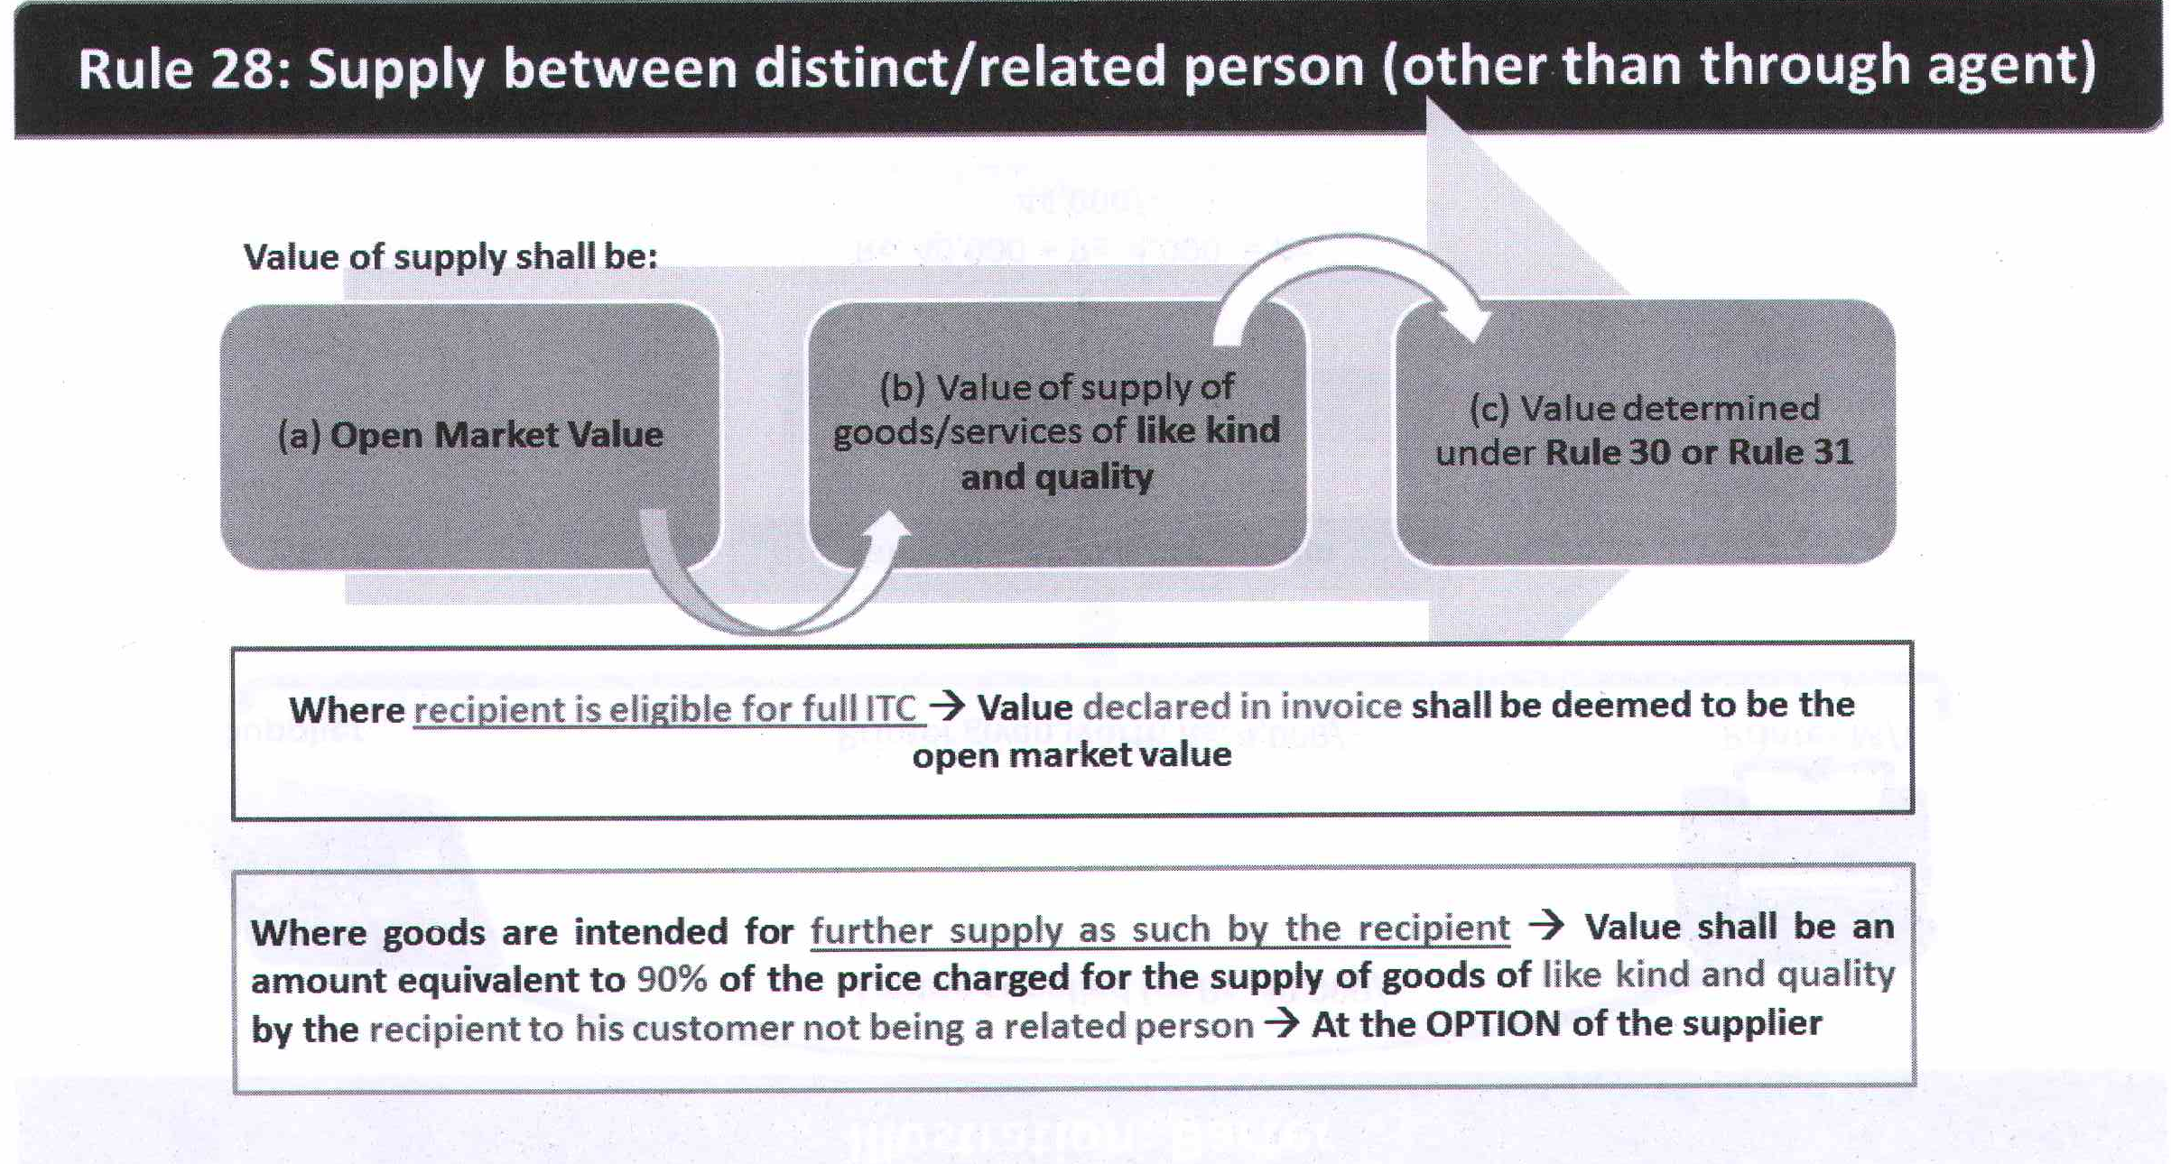

Slide 13
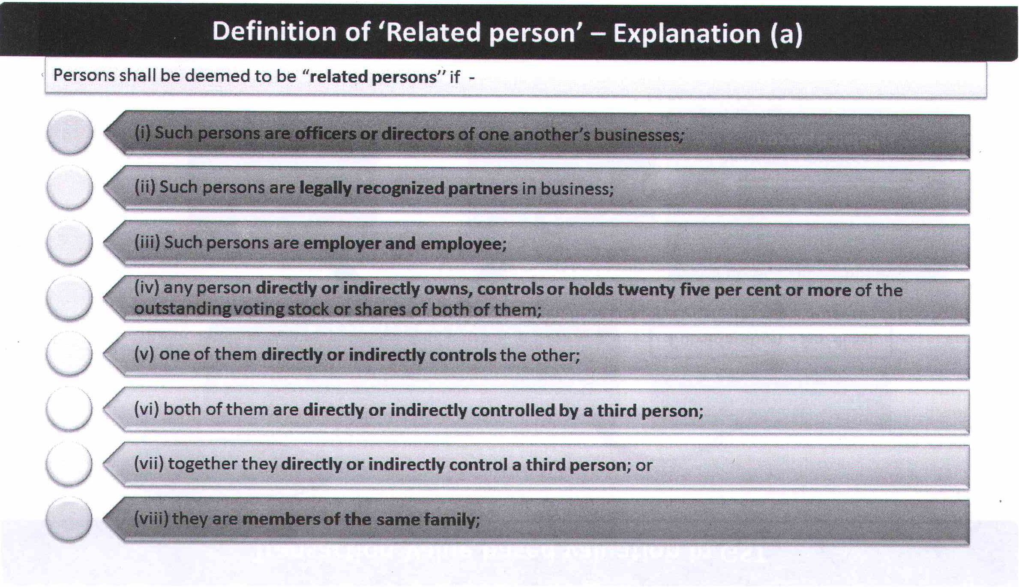

Slide 15
Illustration
X holds 25 per cent (or more) equity share capital in Y Ltd. (a computer manufacturer) as well as Z Ltd. (a paper manufacturer). Y Ltd. and Z Ltd. are “related persons”. On September 22,2017, Y Ltd. supplies a computer to Z Ltd. for Rs. 78,000. The same computer is offered by Y Ltd. to unrelated customers for Rs. 85,000. Z Ltd. is not entitled for input credit for this transaction. What is the value of taxable supply ?
Solution:
Value of supply of computer by Y Ltd. to Z Ltd. will be Rs. 85,000 (this is the case of supply of goods between related persons).

Slide 16
Illustration
Suppose in the above case, Y Ltd. supplies computer to Z Ltd. as a gift without charging anything. What is value of taxable supply ?
Solution:
Normally, if supply of goods/ services is made as a gift (without charging anything), GST is not applicable (if consideration is zero, GST is zero).
However, this rule is not applicable when supplier and recipient are related or when supplier and recipient are distinct persons.
In this case, Y Ltd. and Z Ltd. are related (X controls 25 per cent equity share capital in the two companies).
Value of supply will be Rs. 85,000.

Slide 17
Illustration
A Ltd. (a software development company) controls 25 per cent (or more) equity share capital in B Ltd. (a technical consultant). A Ltd. develops an accounting software for B Ltd. for Rs. 2,50,000. A similar accounting software is developed by A Ltd. for an unrelated customer for Rs. 3,80,000. B Ltd. is eligible for full input credit for this input supply. What is the value of taxable supply ?
Solution:
A Ltd. and B Ltd. are related persons.
B Ltd. is eligible for full input credit.
Therefore, value of supply will be the invoice price of Rs. 2,50,000.

Slide 19
Illustration
D Ltd. (a computer manufacturing company) holds 30 per cent equity share capital in E Ltd. (a computer distributor). On August 18,2017, D Ltd. supplies a computer to E Ltd. for Rs. 1,10,000. The same computer is supplied on the same day to an unrelated customer for Rs. 1,40,000. E Ltd. supplies similar computer to its retailers (not related to E Ltd.) for Rs. 1,50,000. What is the value of taxable supply ?
Solution:
D Ltd. and E Ltd. are related persons. Similar computer is supplied by D Ltd. to unrelated customers for Rs. 1,40,000/
Rs. 1,40,000 may be taken as value of supply of computer by D Ltd. to E Ltd.
Alternatively, at the option of D Ltd. it can be taken as 90 per cent of the price charged by recipient E Ltd. from its unrelated customers.
90 per cent comes to Rs. 1,35,000. Therefore, at the option of D Ltd. value of supply will be Rs. 1,35,000.

Slide 20
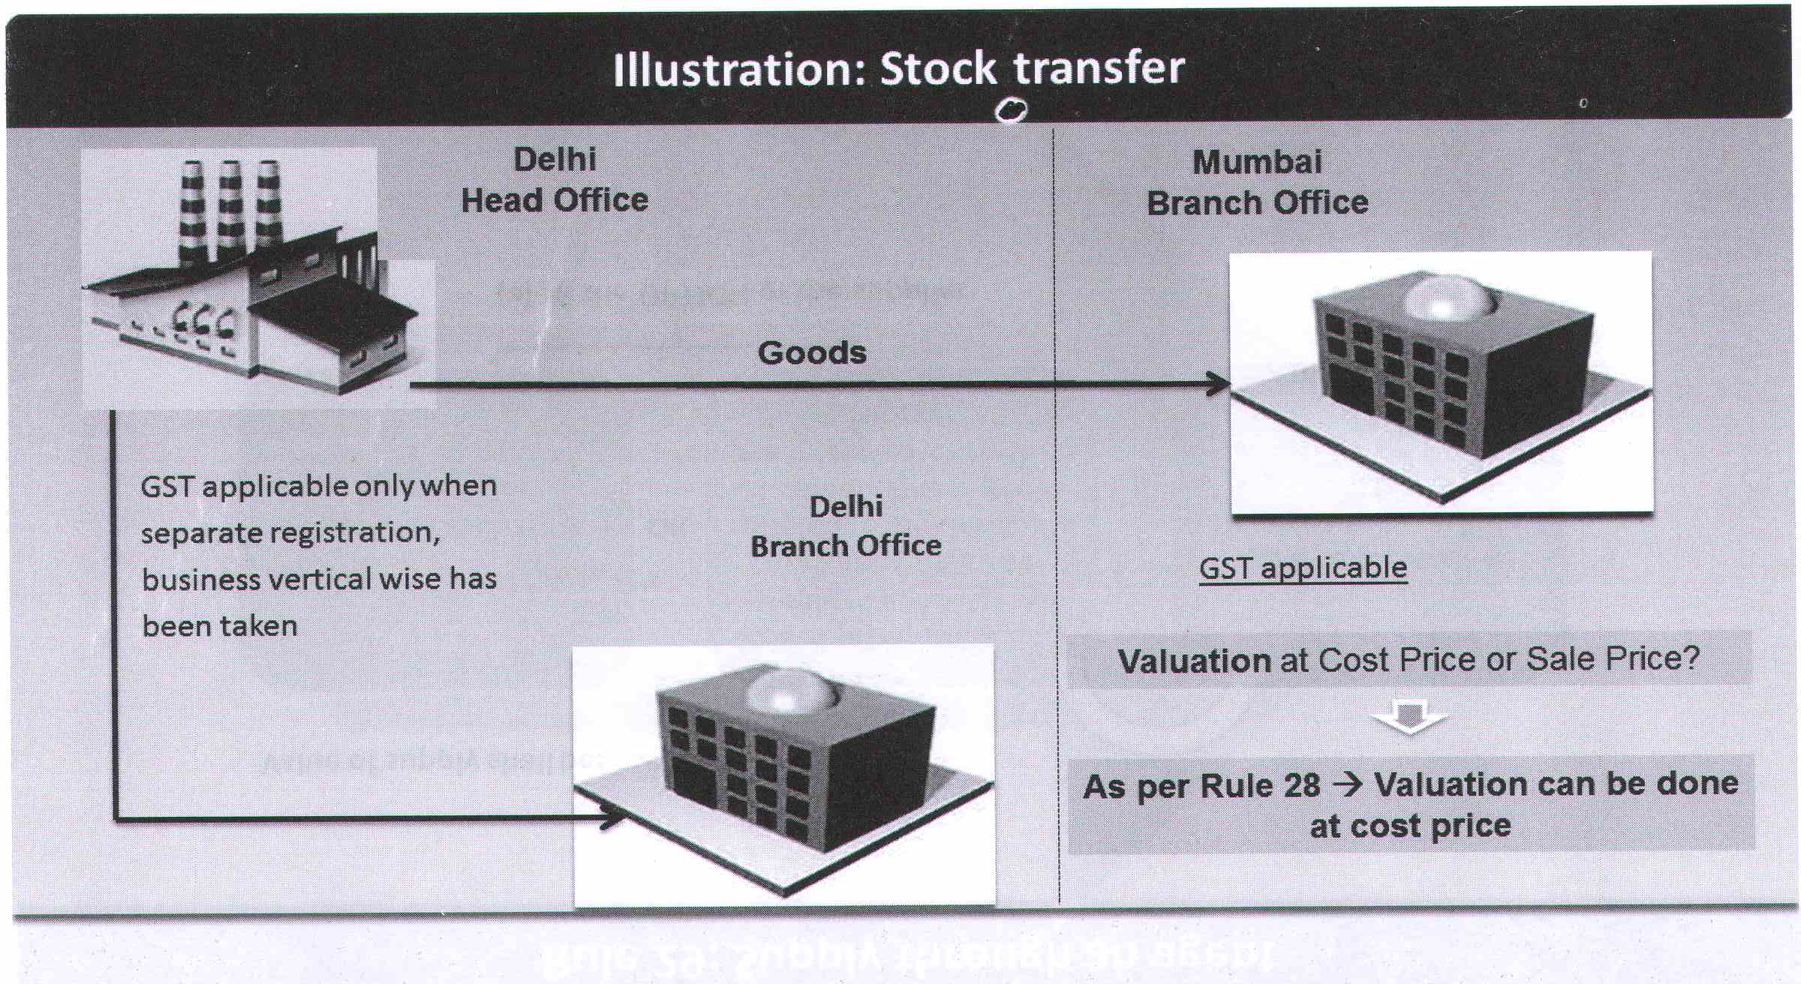

Slide 21
Illustration
M/s. Showmakerz an event management Co. for creation of large scale events & Occasions, owned by Mr. Shipu.
Kingdom of Dreams in Gurugram contracts with Showmakerz Company to arrange a celebrity concerts charging Rs. 8,00,000.
The company sub-contract the same work to Aura Mgt. Company which were also controlled and managed by Mr. Shipu for Rs. 6,00,000. M/s. Aura Mgt Co. charges Rs. 6,20,000 from market for the same work.
Solution: M/s Showmakerz and M/s. Aura Mgt. Company are managed and controlled by Mr. Shipu so the both business will be considered as related persons. The value of service will be the open Market Value being Rs. 6,20,000 rather than sub-contract price of Rs. 6,00,000.

Slide 22
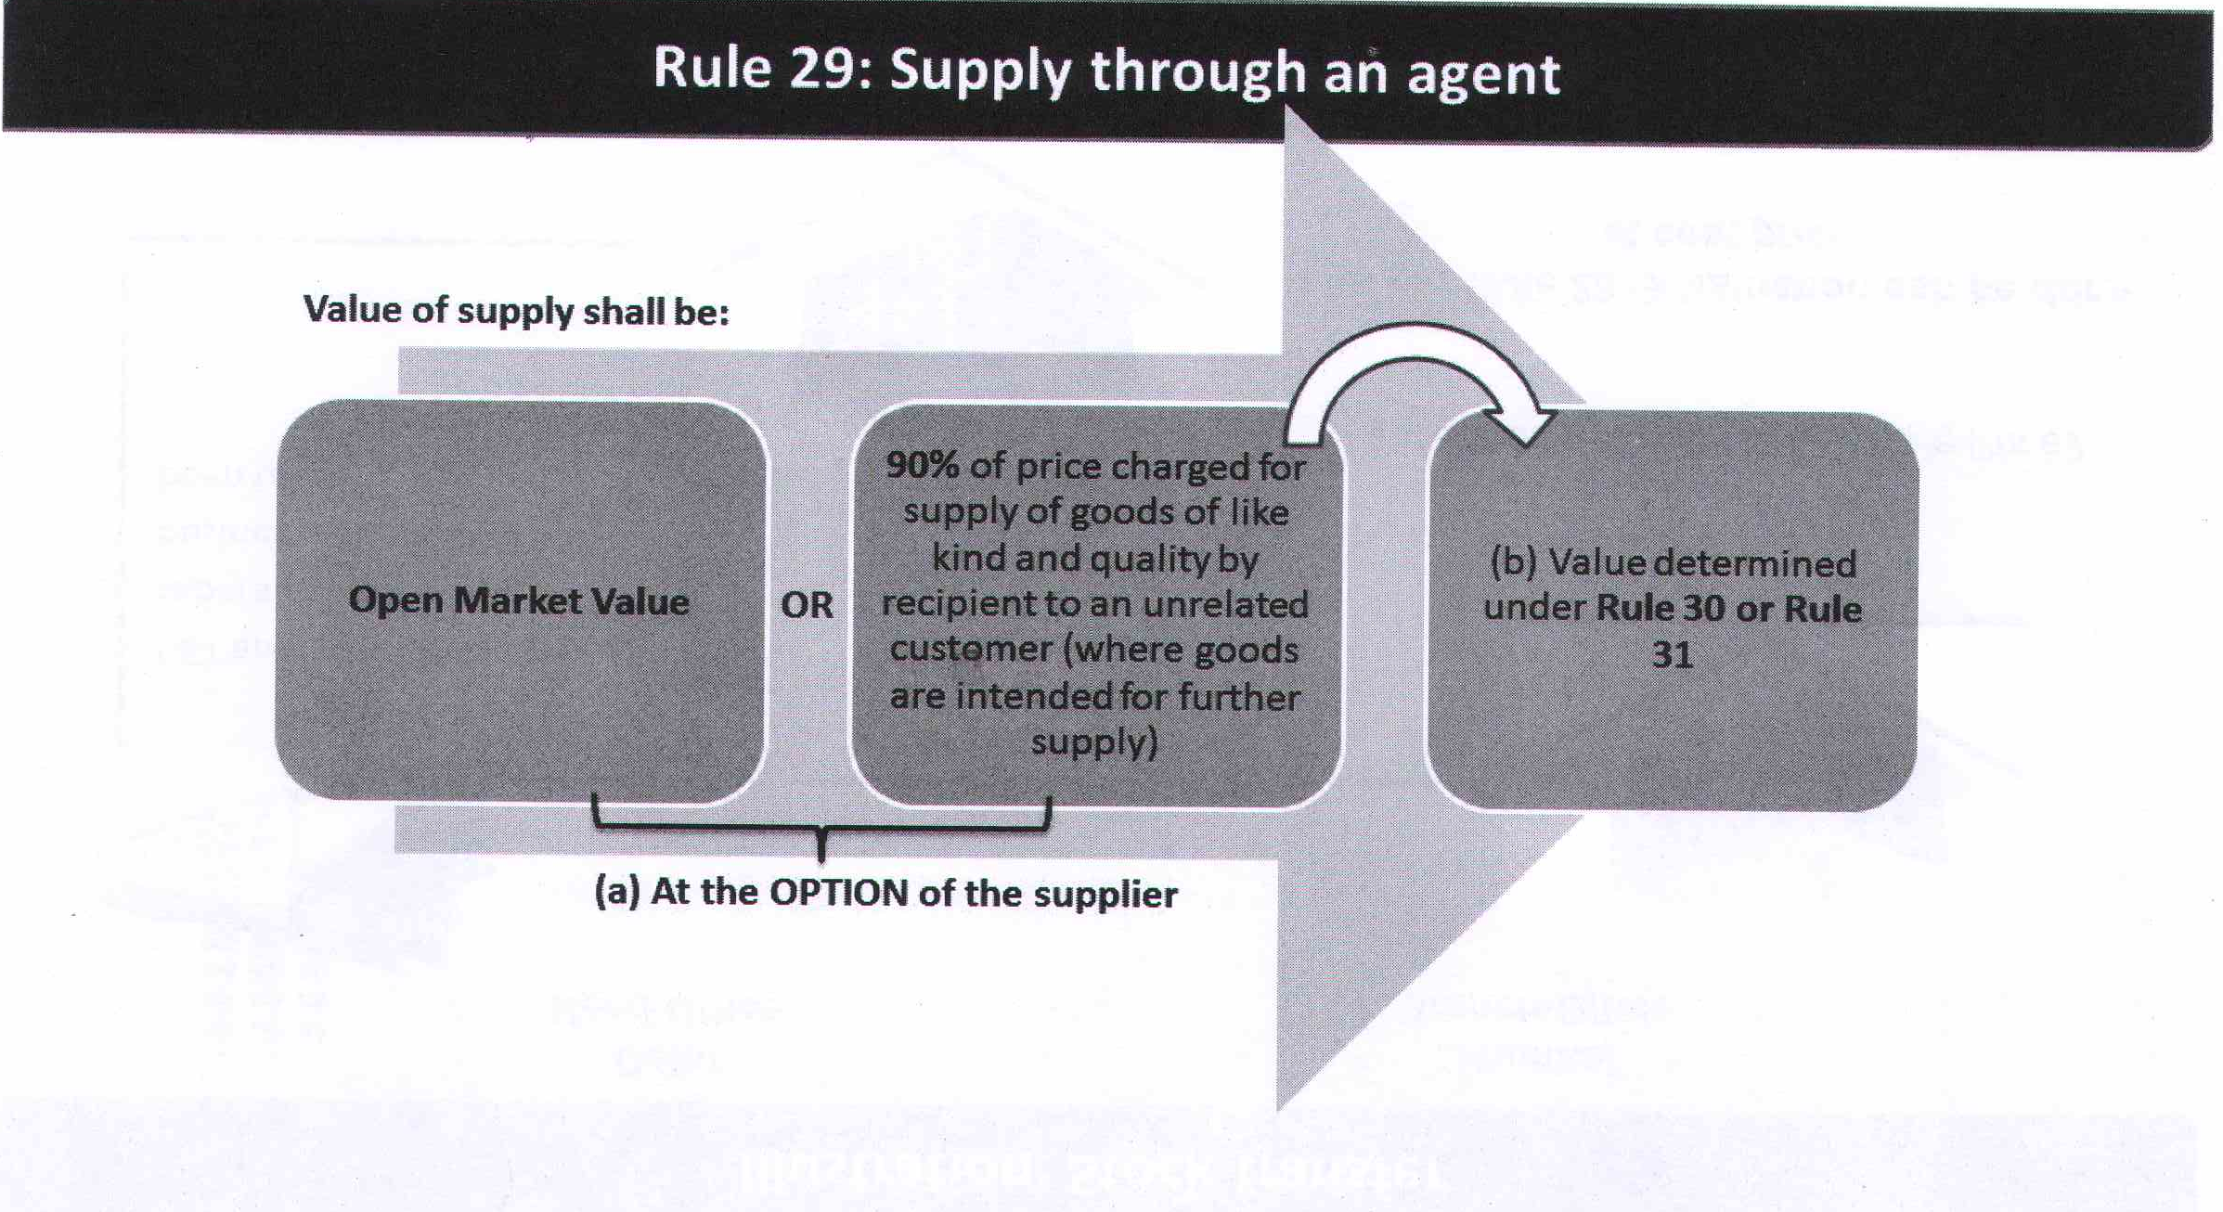

Slide 23
Example
A principal supplies groundnut to his agent and the agent is supplying groundnuts of like kind and quality in subsequent supplies at a price of Rs. 5,000 per quintal on the day of the supply.
Another independent supplier is supplying groundnuts of like kind and quality to the said agent at the price of Rs. 4,550 per quintal.
The value of the supply made by the principal shall be Rs. 4,550 per quintal or where he exercises the option the value shall be 90% of the Rs. 5,000 i.e. is Rs. 4500 per quintal.

Slide 24
Illustration
On January 5, 2018, X Ltd. supplies 100 quintals of dried turmeric to Y, its agent in Kanpur for Rs. 8,000 per quintal. On the same day, an independent supplier supplies 101 quintals of dried turmeric to Y at the rate of Rs. 8,500 per quintal. What is the value of taxable supply ?
Solution:
This is the case of supply of goods between principal and agent.
Open market value (i.e., Rs. 8,500 per quintal) will be taken as value of taxable supply of goods.

Slide 25
Illustration
Suppose in the above problem, Y supplies 98 quintals of the same quality of dried turmeric to his unrelated customers on the same day for Rs. 9,100 per quintal. Discuss whether this information can alter the aforesaid valuation.
Solution:
X Ltd. has an option. Value of supply of goods by X Ltd., to Y may be taken as 90 per cent of price charged by the recipient Y from his unrelated customers. Consequently, Rs. 8,190 (being 90 per cent of Rs. 9,100) may be taken as value of taxable supply.

Slide 26
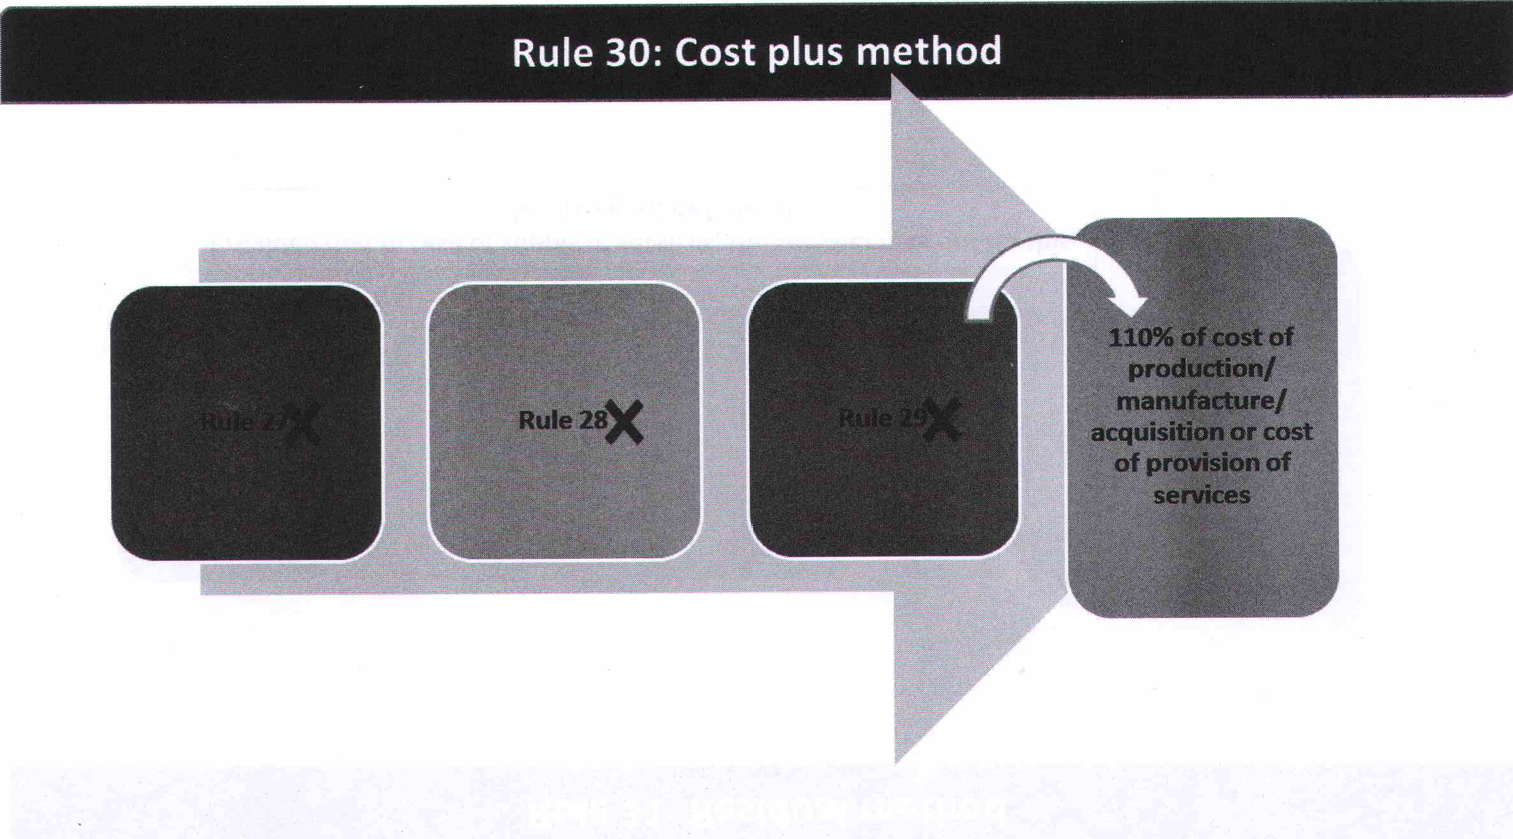

Slide 27
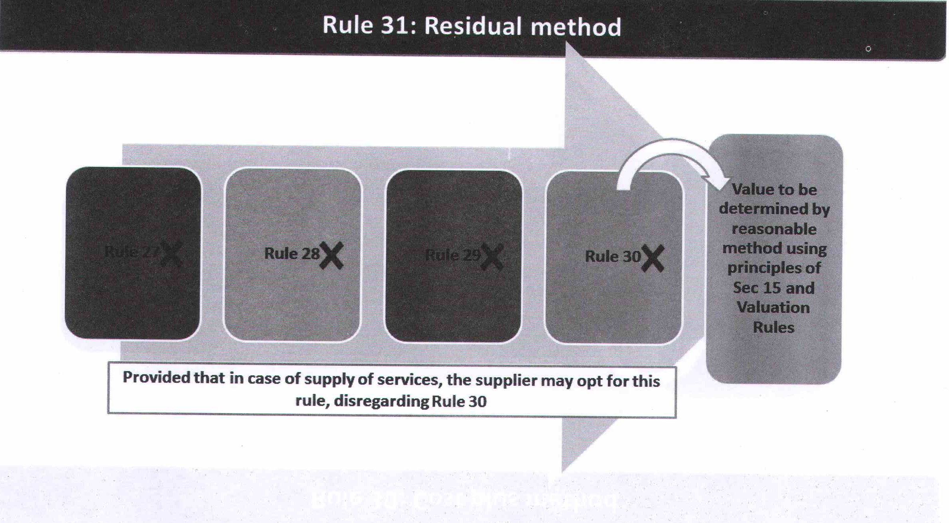

Slide 28
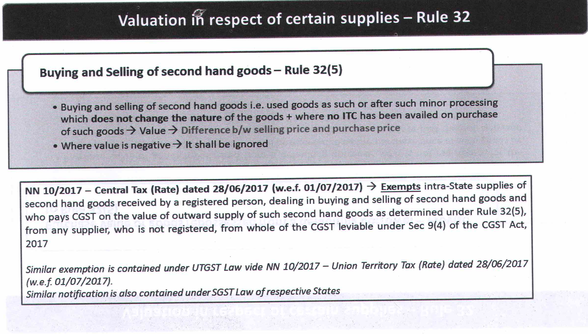

Slide 29
Illustration
X deals in buying and selling of secondhand goods. On August 5,2017, he purchases from B a second hand fridge for Rs. 14,000. X makes some minor changes. He sells the same fridge for Rs. 17,000 on August 10, 2017. He does not take any input tax credit on purchase of fridge from B (B will not issue any tax invoice to X). What is the value of taxable supply ?
Solution:
Taxable value of supply by X will be Rs. 3,000.
If, sale price is less than Rs. 14,000, value of taxable supply will be zero.

Slide 30
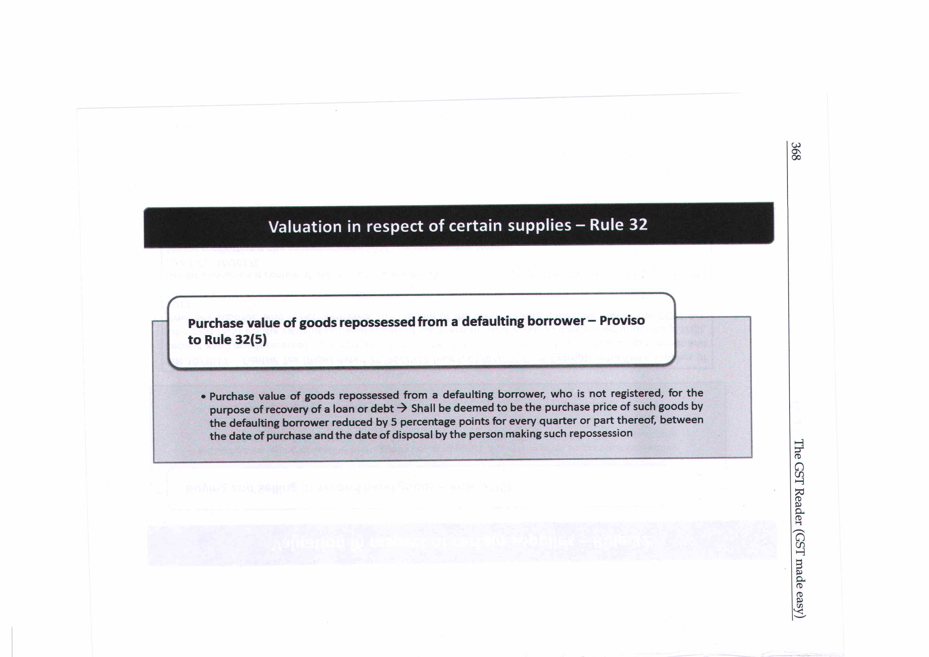

Slide 31
Illustration
Y purchases an air-conditioner for Rs. 80,000 on August 6,2017. It is financed by A Ltd. On Y's failure to pay EMls, air- conditioner is repossessed by A Ltd. on December 2,2017. Later on, A Ltd. sells the air-conditioner on February 10,2018 for Rs. 71,000. What is the value of taxable supply ?
Solution:
Value of taxable supply will be calculated as follows—

Slide 32
Sollution
 | Rs. | Rs.
Selling price |  | 71,000
Original purchase price on August 6, 2017 | 80,000
Less: Normal wear and tear @ 5% per quarter (number of quarters between August 6,2017 and February 10, 2018 : 3, amount deductible is 15% of Rs. 80,000) | 12,000
Purchase price (Rs. 80,000 - Rs. 12,000) |  | 68,000
Value of taxable supply — |  | 3,000

Slide 33
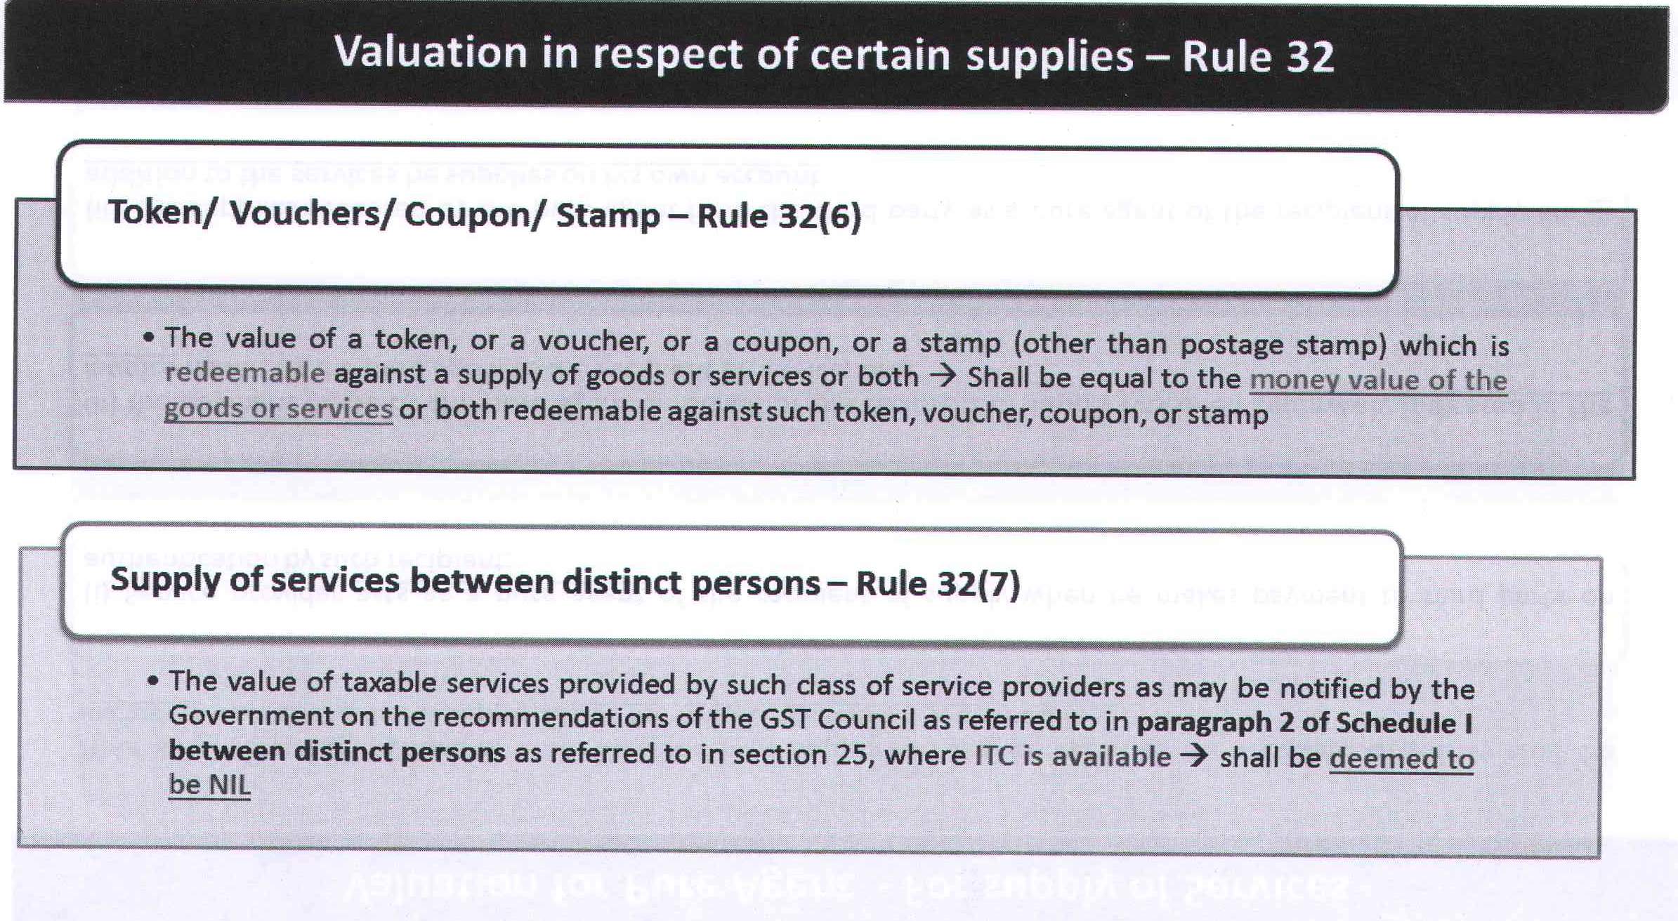

Slide 34
Illustration
Mr. & Mrs. Tiwari availed the membership of Crowne Plaza at Okhla. Hotel provide 20 vouchers of Aroma body massage & hair spa services costing Rs. 2500 each and 5 gift vouchers for Rs. 800 each. Compute the value of voucher.
Solution: Value of Voucher = 20*2500 + 800*5 = Rs. 54,000

Slide 35
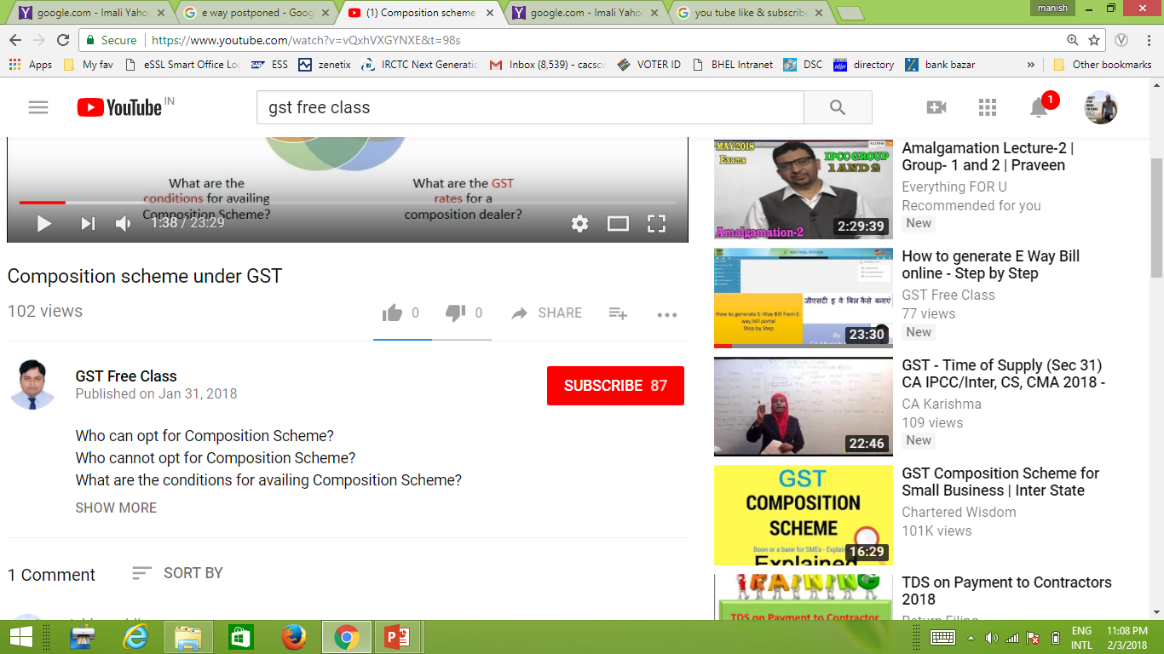


Slide 36


7678602089
gstfreeclass@gmail.com

Slide 37


