Slide 1




GST FREE CLASS FOR
Link for video lectures
https://www.youtube.com/watch?v=B3bDjh9gowU&t=14s
By
CA Manish Sir
Valuation Rules under GST
For May/June 2018 Exam

Slide 2
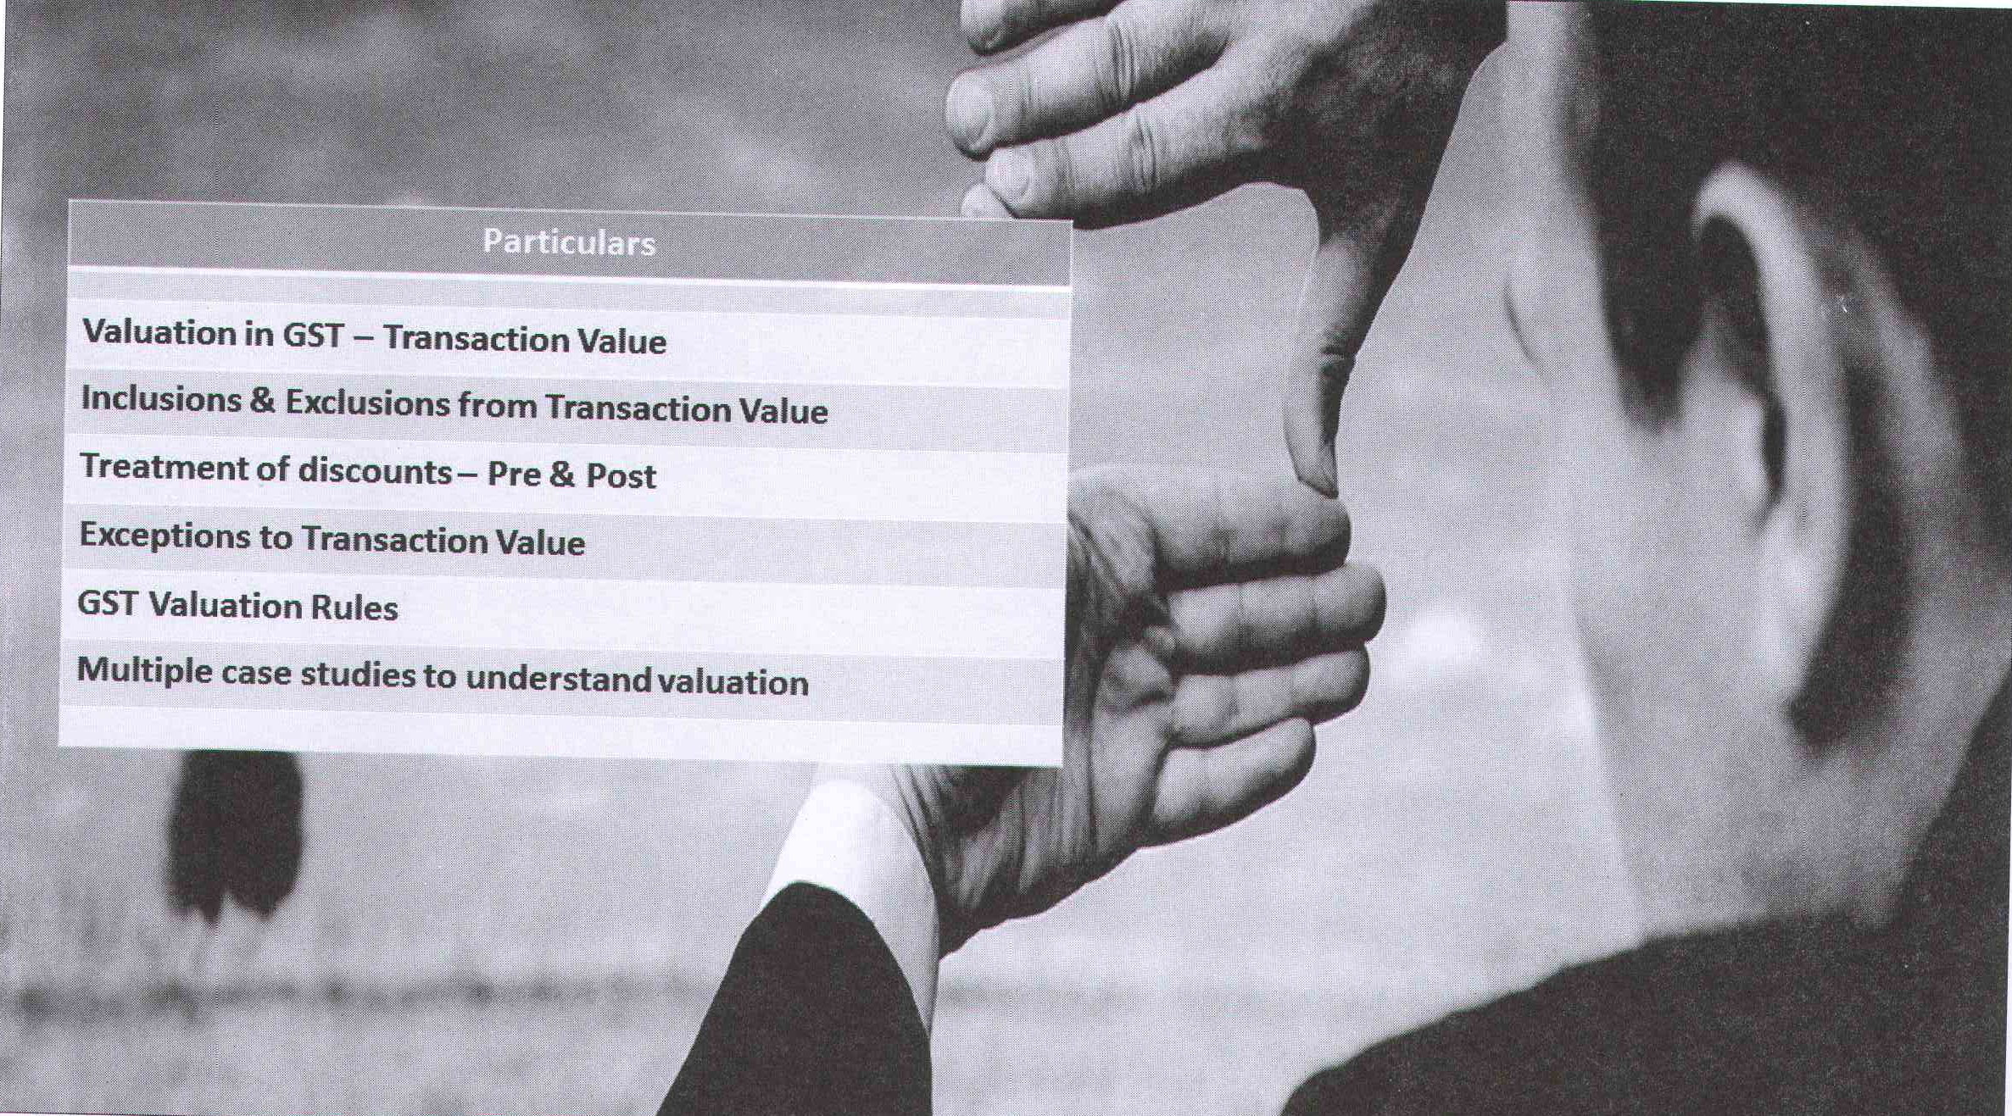


Slide 3
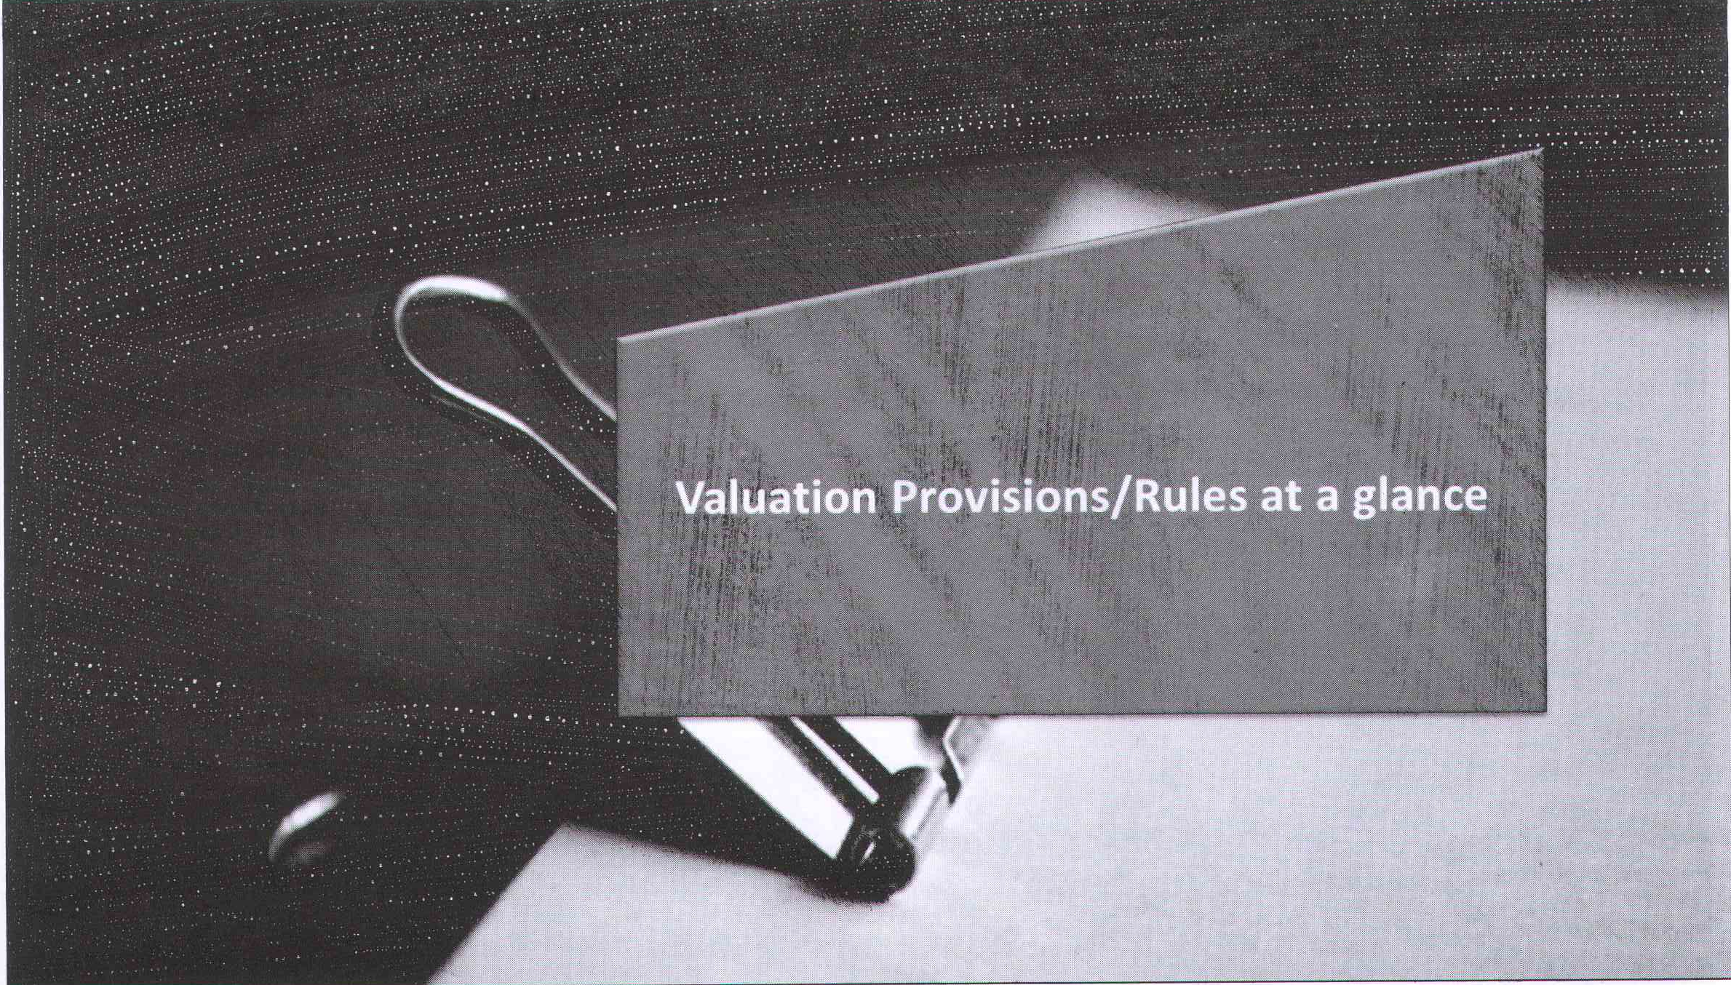

Slide 4
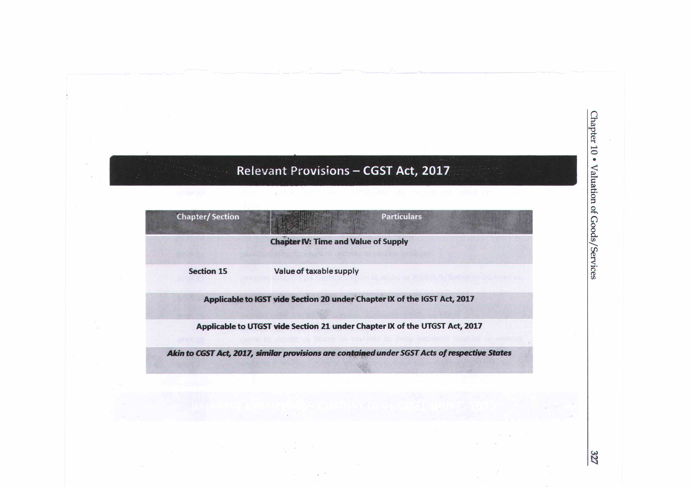

Notes:
[\[]\[]\

Slide 5
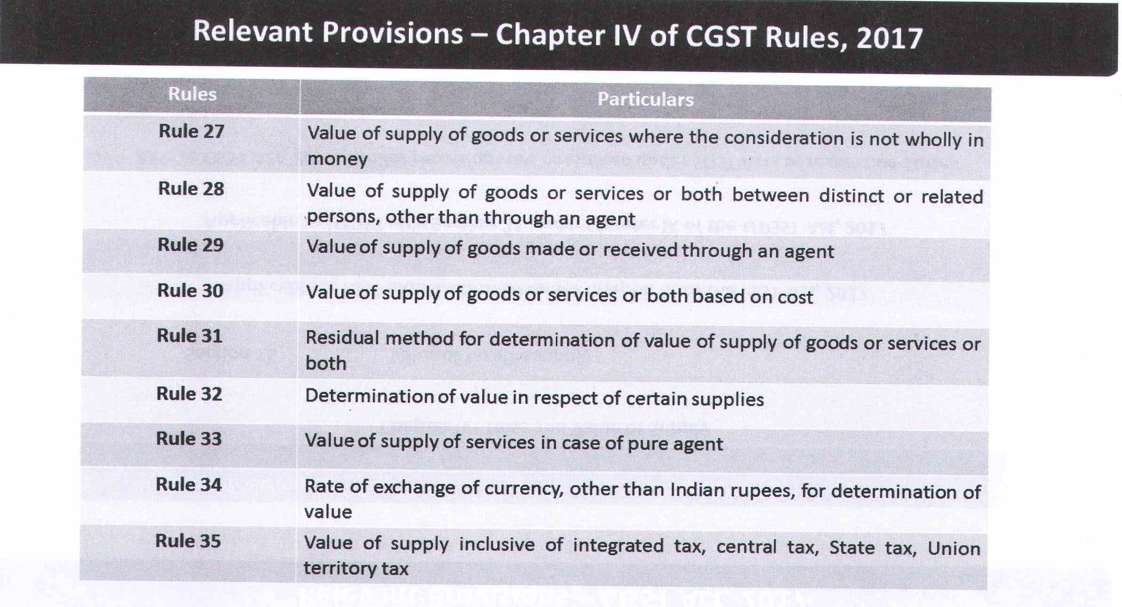


Slide 6
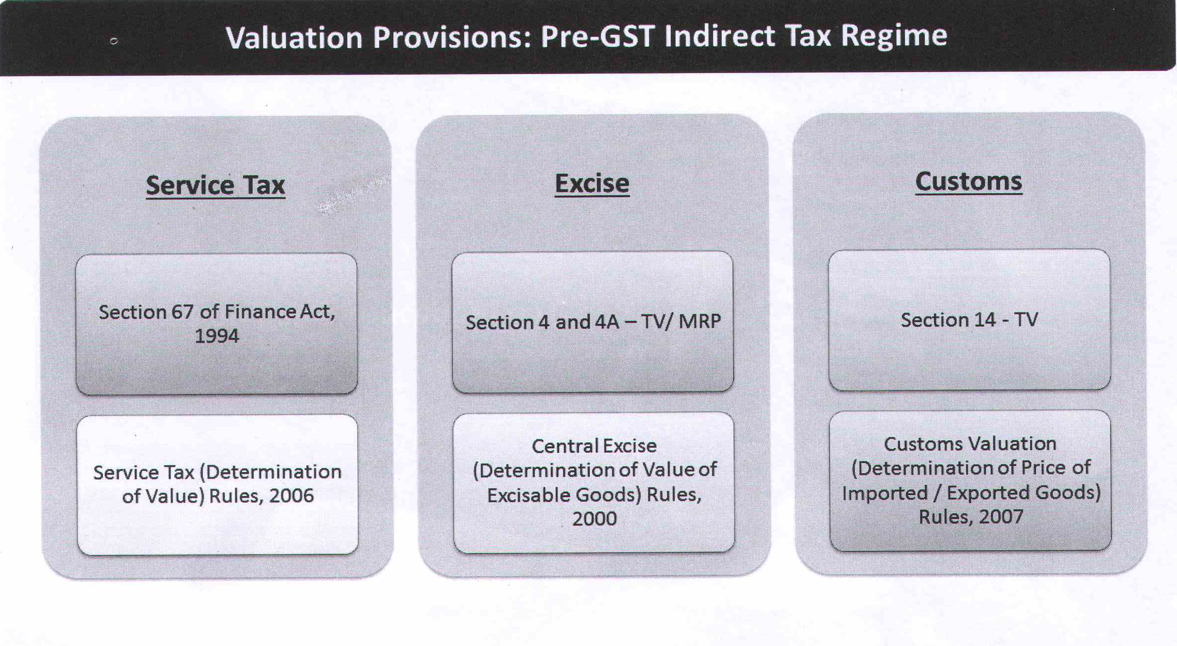


Slide 7
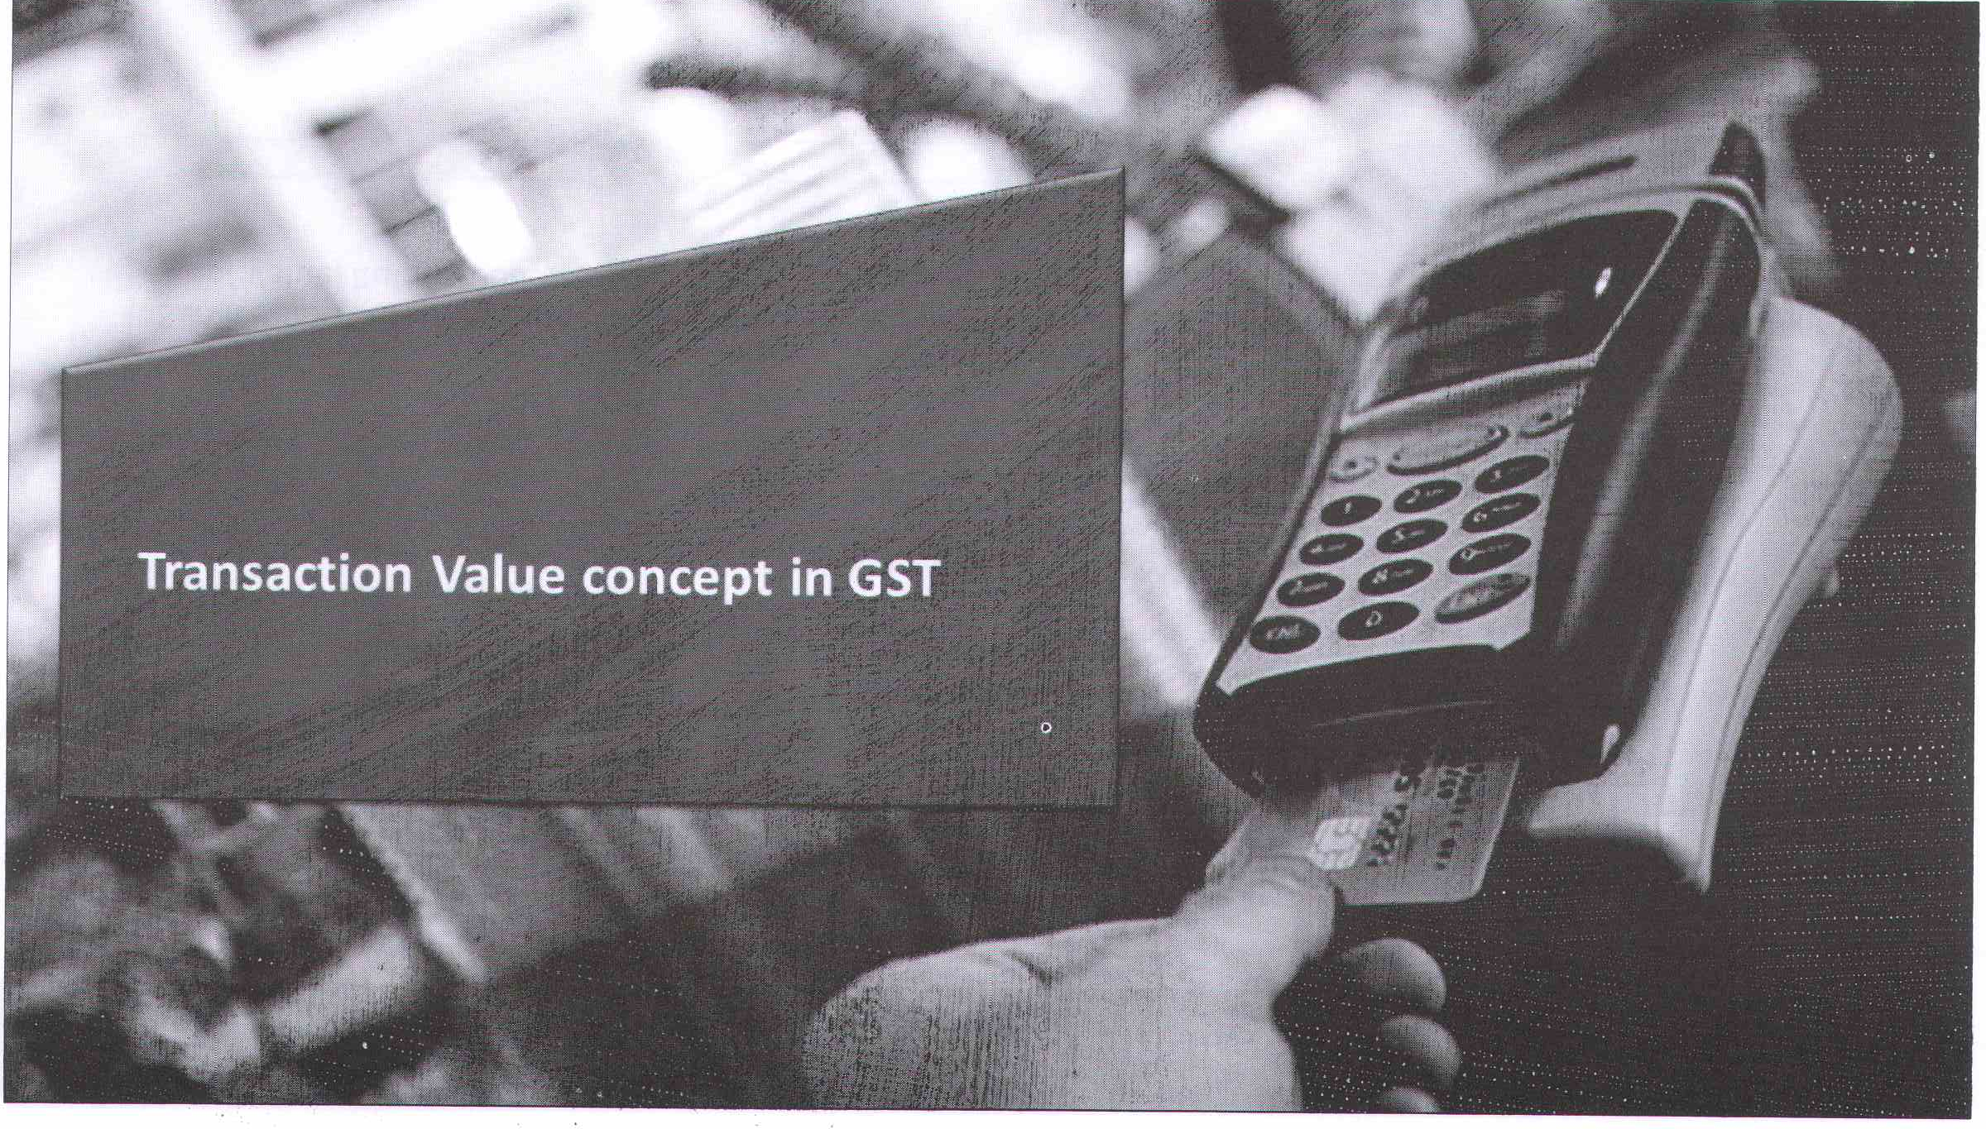


Slide 8
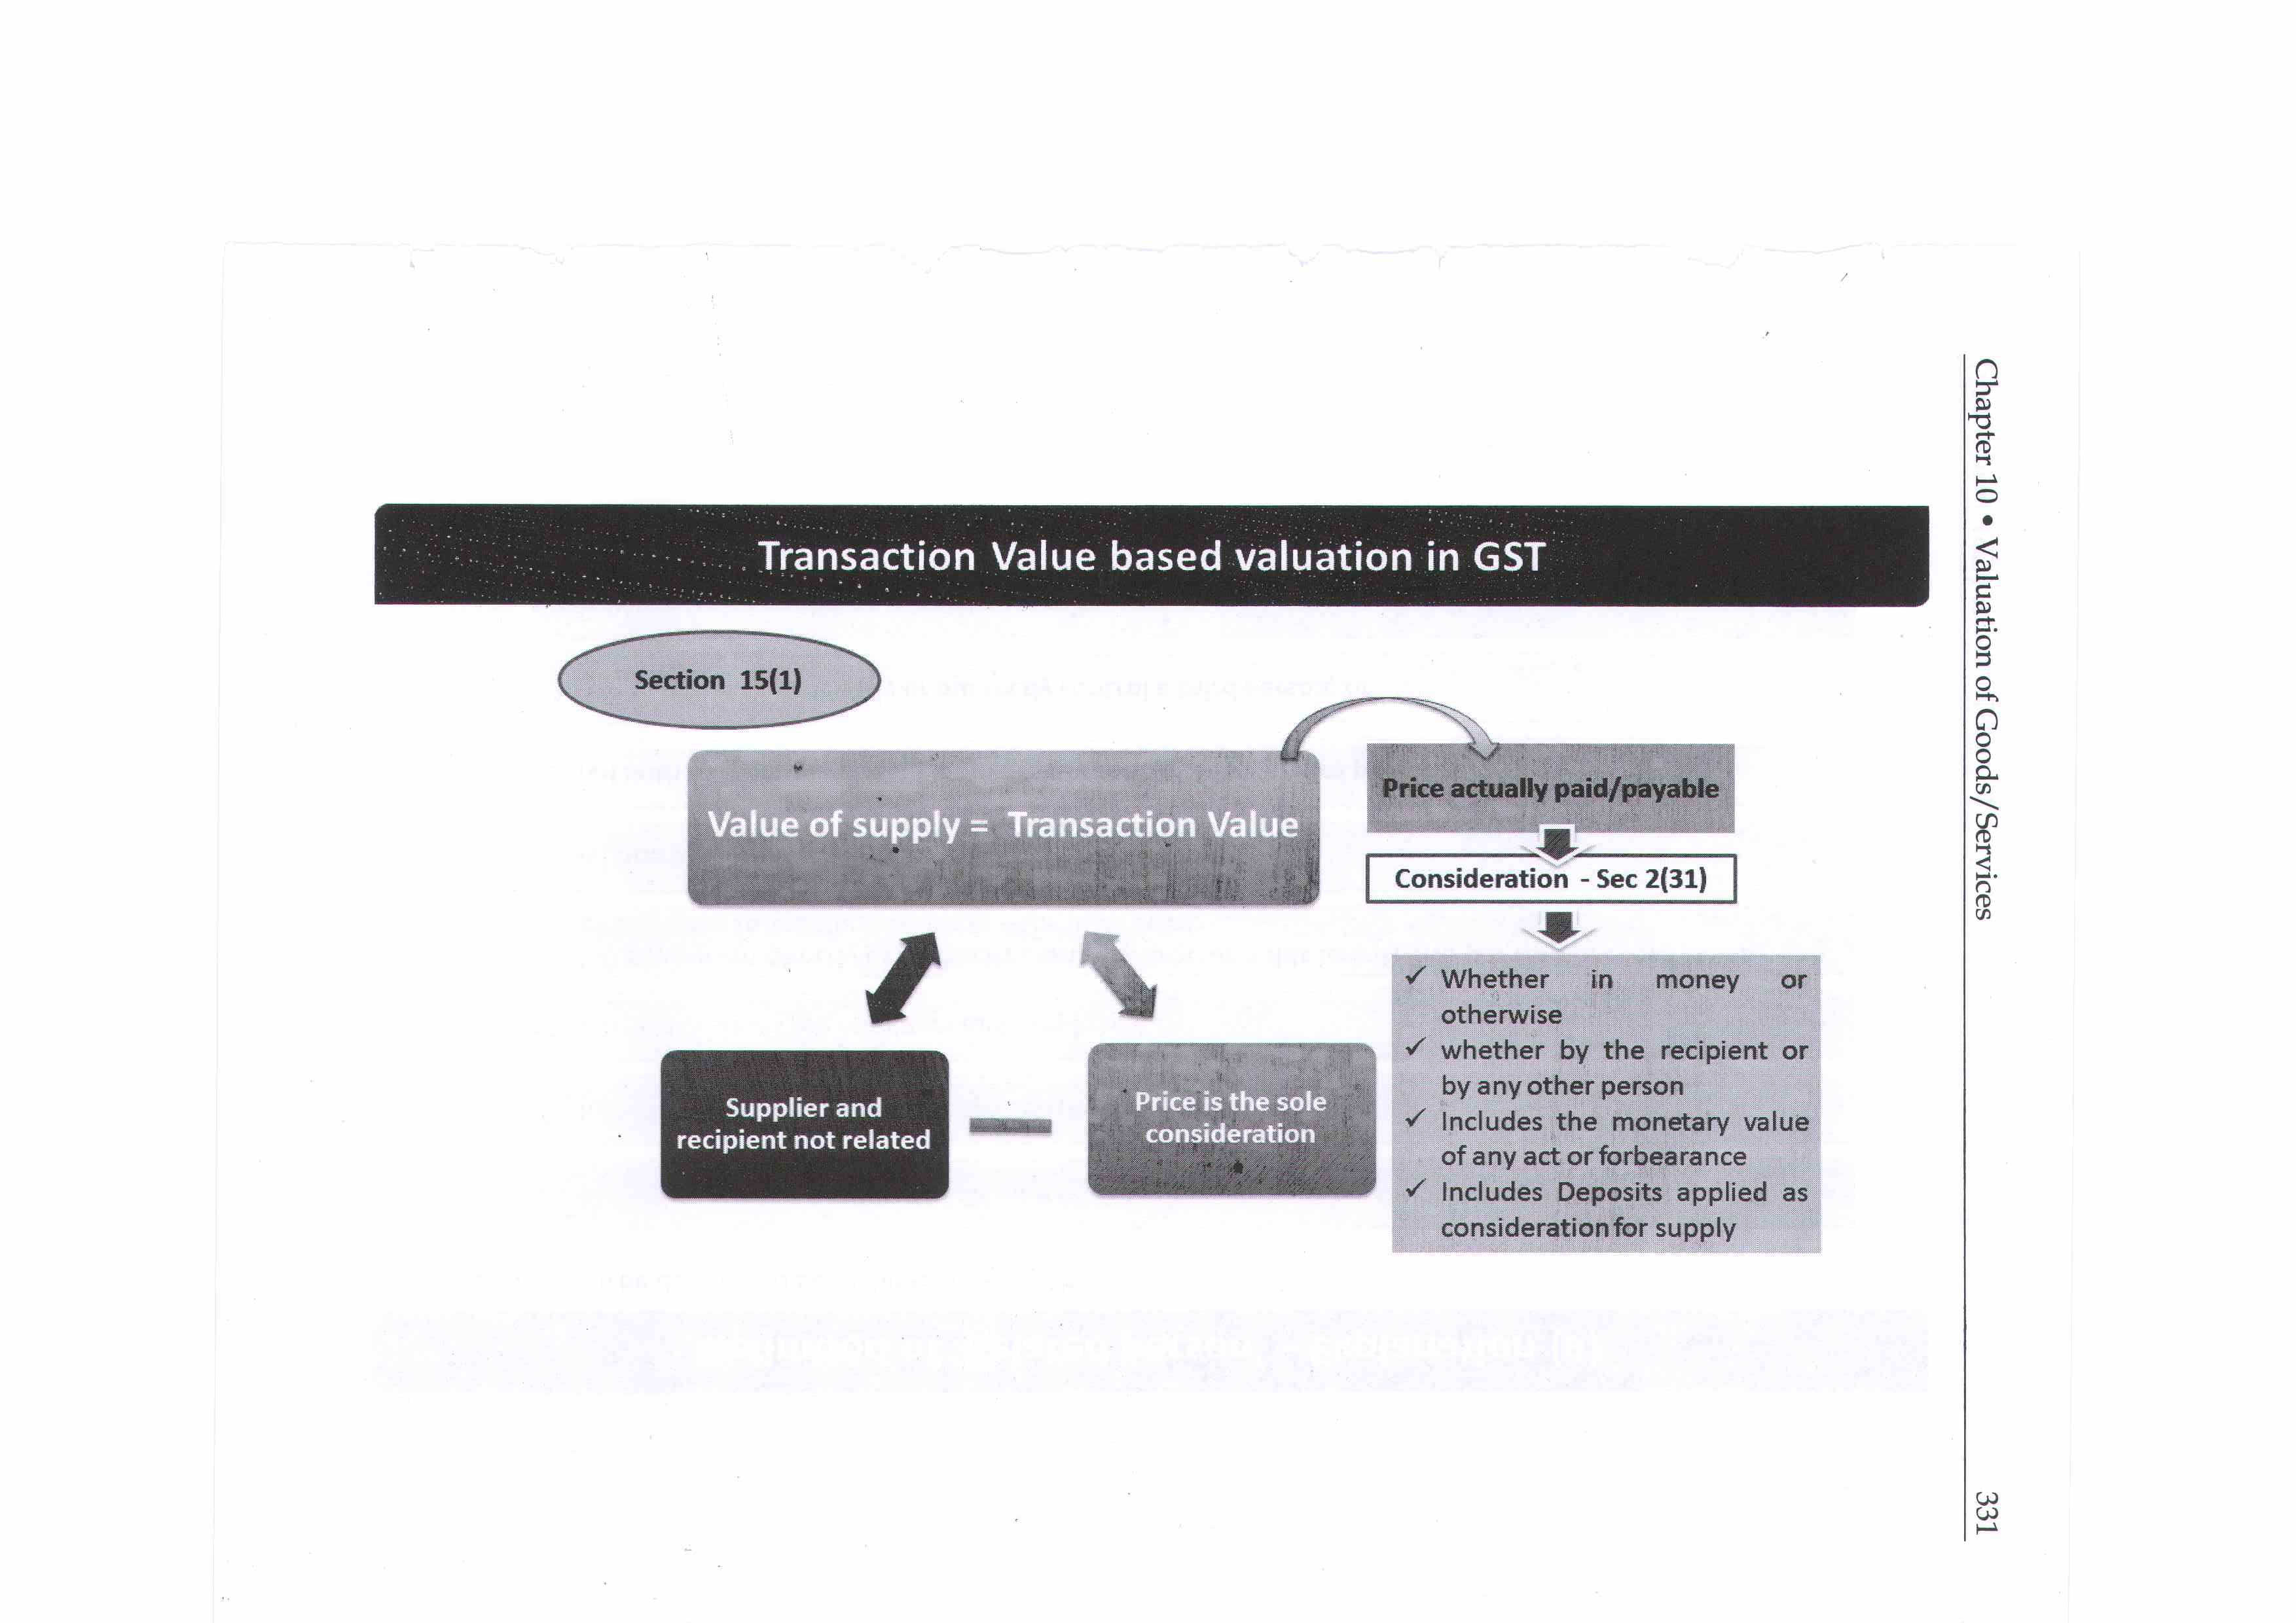


Slide 9
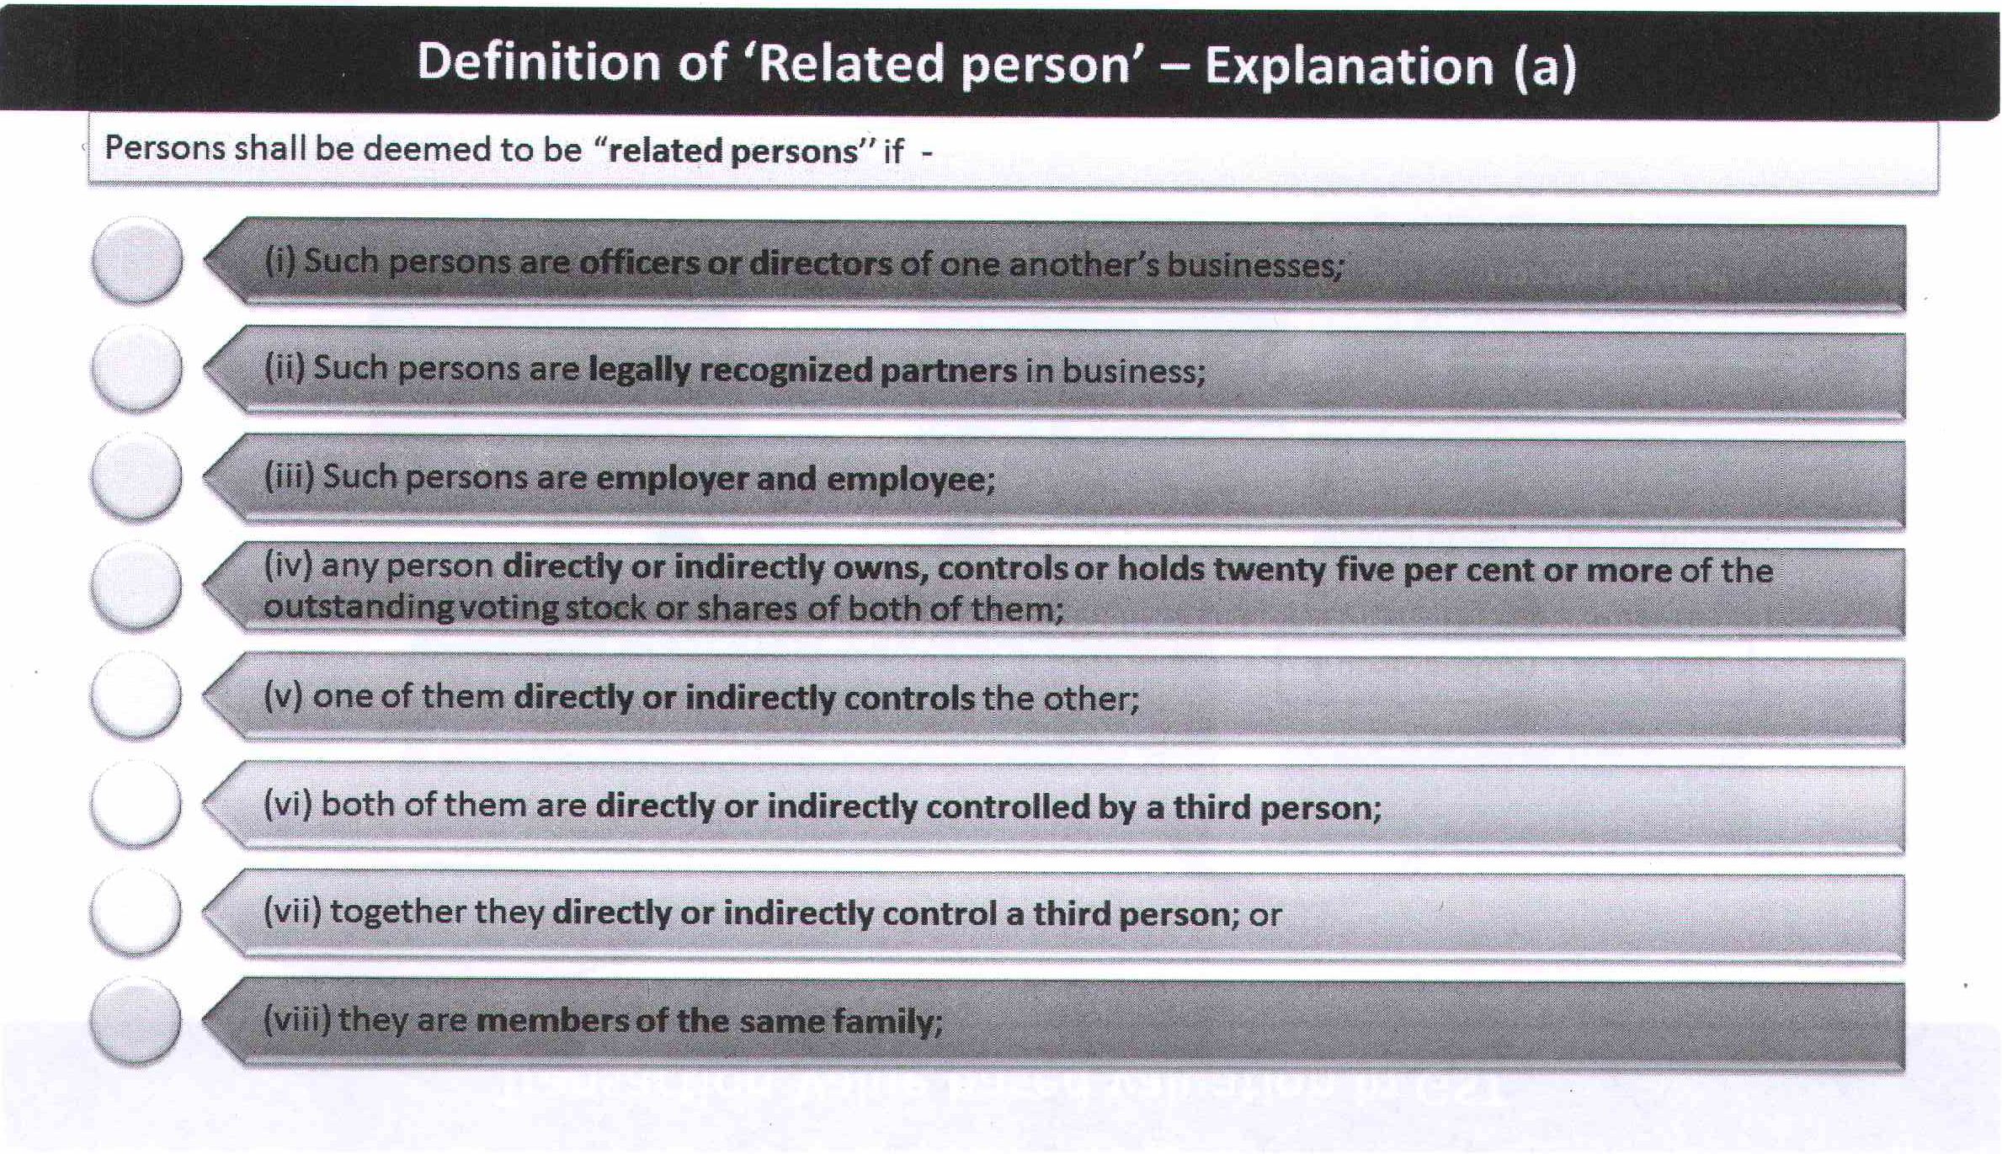
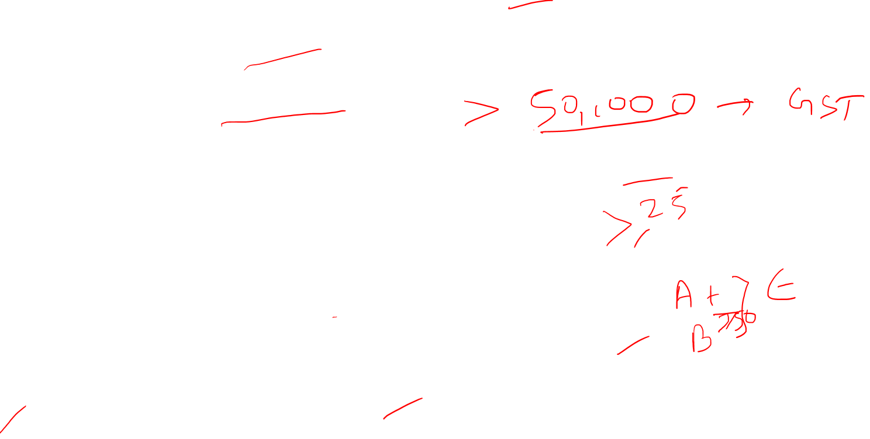

Slide 10

Family [Section 2(49)]:
Family means
the spouse and children of the person, and
(ii) the parents, grand-parents, brothers and sisters of the person if they are wholly or mainly dependent on the said person.

Slide 11
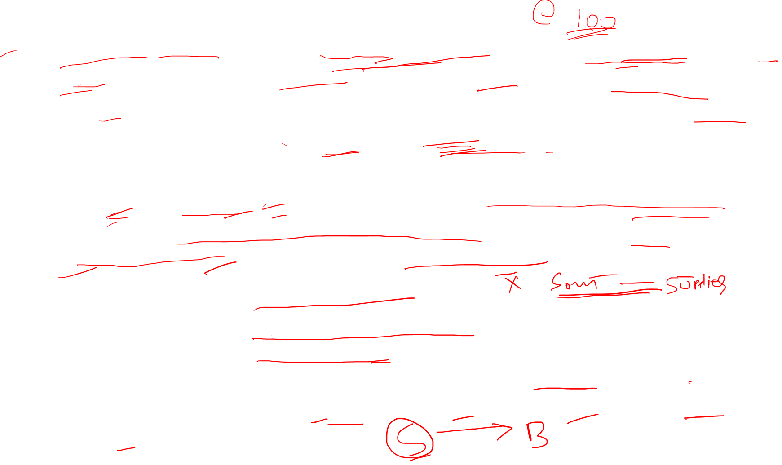
Illustration
Mr. X located in Jaipur purchases 2,000 drawing boxes for Rs. 2,00,000 from M/s. Stationers Ltd. (wholesalers) located in Delhi. Mr. X's son is an employee in M/s. Stationers Ltd. The price of each drawing box in the open market is Rs. 120. The supplier additionally charges Rs. 5,000 for delivering the goods to the recipient's place of business.
Solution: Mr. X and M/s. Stationers Ltd. would not be treated as related persons merely because the son of the recipient is an employee of the supplier, although such son and the supplier would be treated as related persons.(As they fall under deemed relationship of employer and employee).
Therefore, the transaction value will be accepted as the value of the supply. The transaction value includes incidental expenses incurred by the supplier in respect of the supply up to the time of delivery of goods to the recipient. This means, the transaction value will be : Rs. 2,00,000 + Rs. 5,000 i.e. Rs. 2,05,000. [Section 15(1) r/w Section 15(2)]

Slide 12

Illustration
Mr. Kohli residing in Noida, purchase 20,000 Markers @ Rs. 20 each from Ankita & Stationary, wholesalers at Delhi. Mr. Kohli's sister working as Manager in Ankita & Stationary. Open Market Value of Marker is Rs. 23. Ankita & Stationary additionally charges Rs. 10,000 for supplying markers to Kohli’s business place.
Solution: The transaction Value includes ancillary expenses borne by Ankita & Stationary in regard of supply till the time of delivery of goods to the recipient. The transaction value will be Rs. 4,00,000 (20000*20) +10,000 =4,10,000.
Mr. Kohli and Ankita & Stationary Wholesaler are not related persons solely as Kohli’s sister is an employee in Ankita & Stationary, whereas kohli’s sister and Ankita & Stationary not to be considered as related persons. Therefore, the transaction value taken as value of supply.

Slide 13
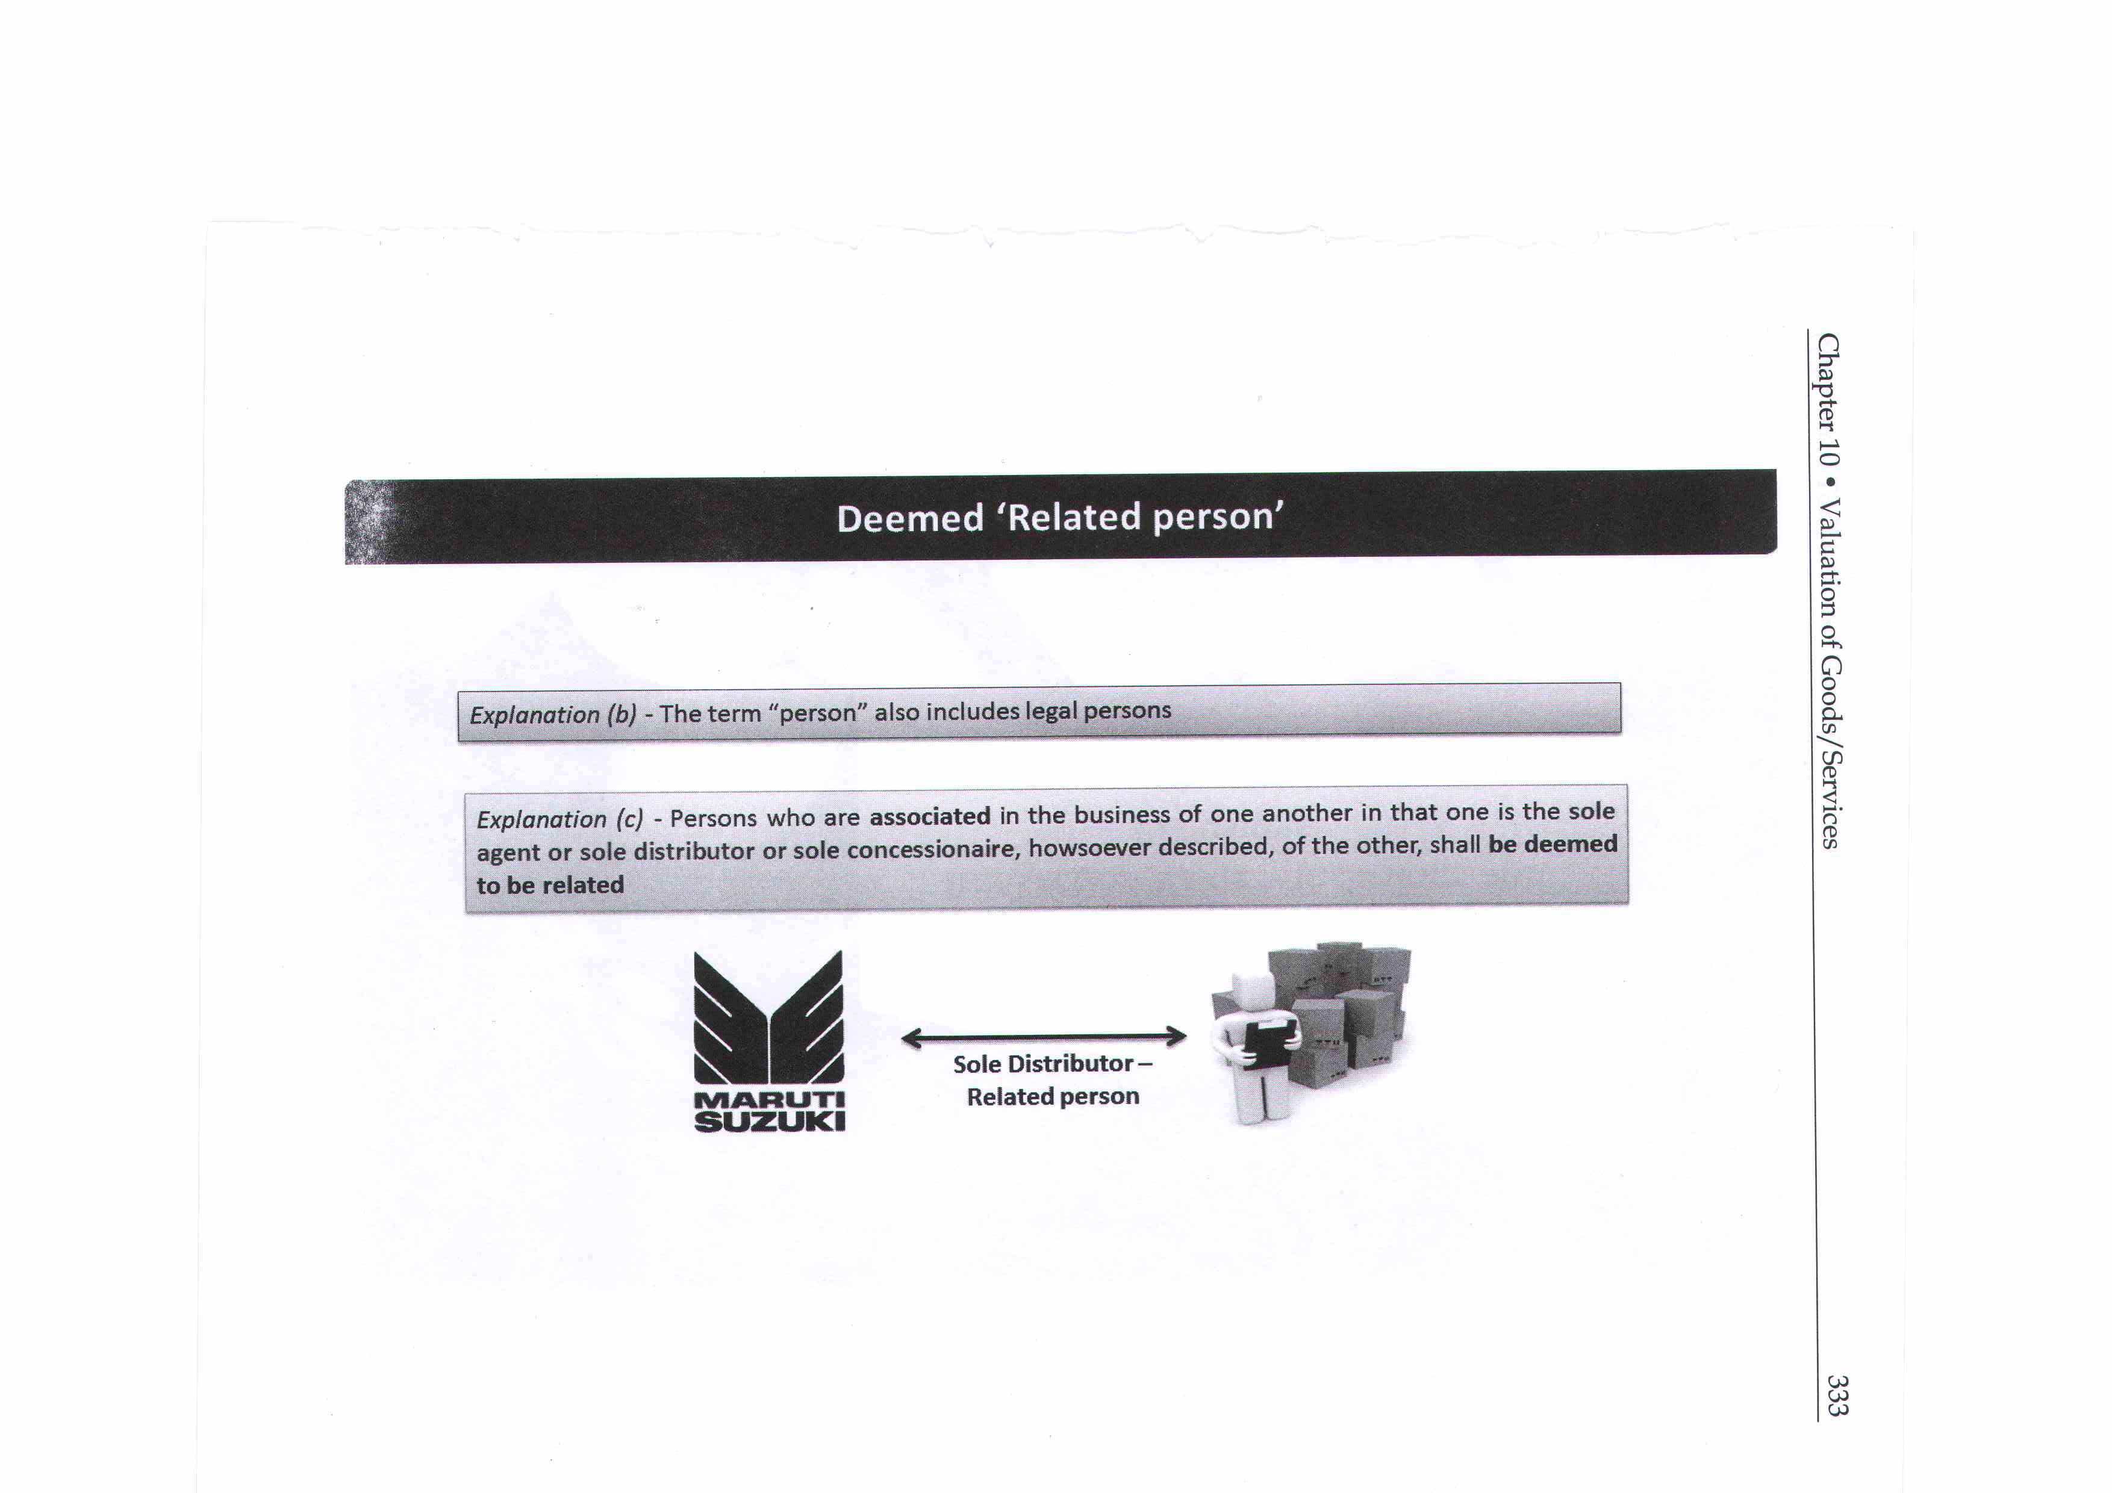
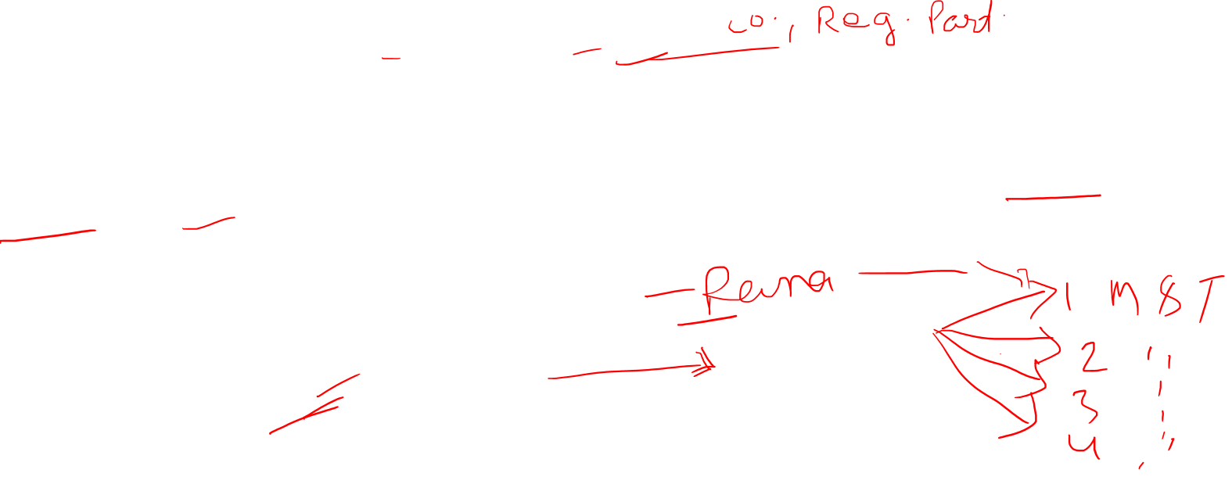

Slide 14
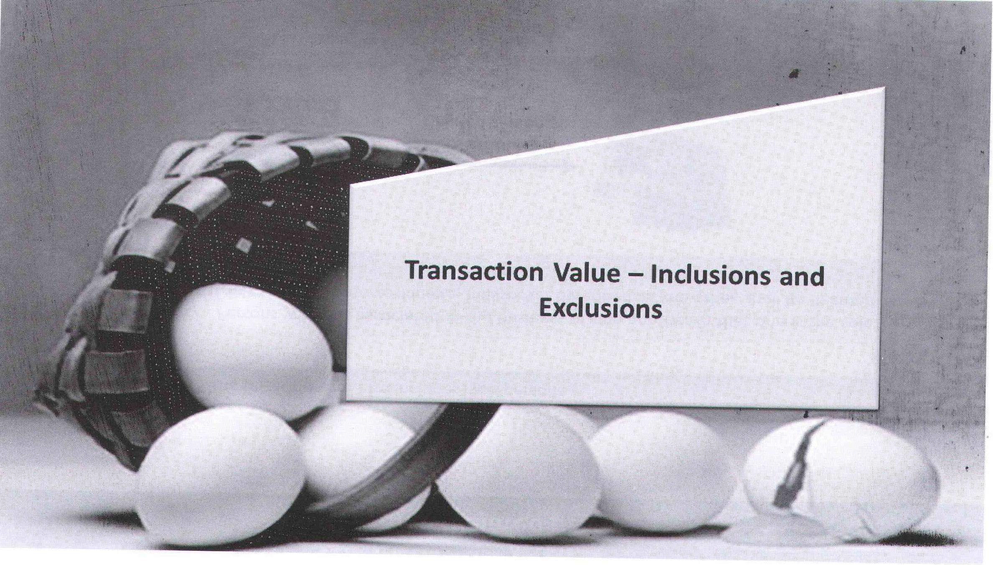

Slide 15
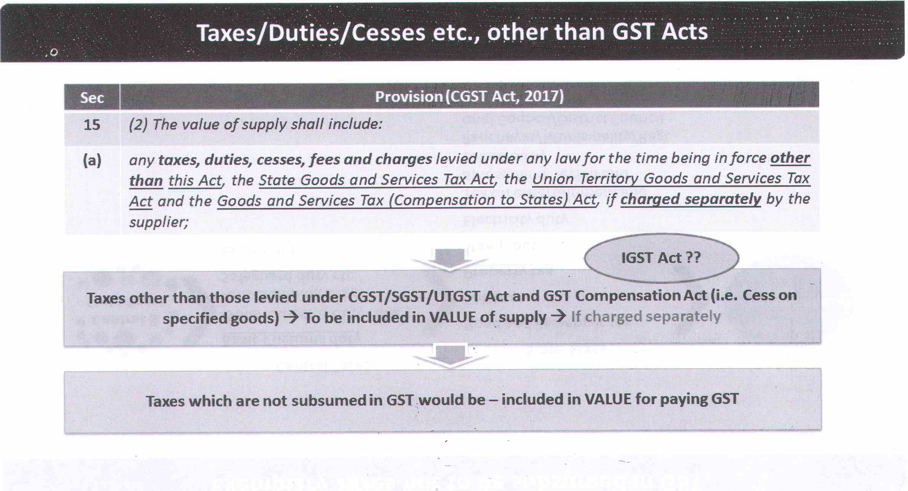


Slide 16
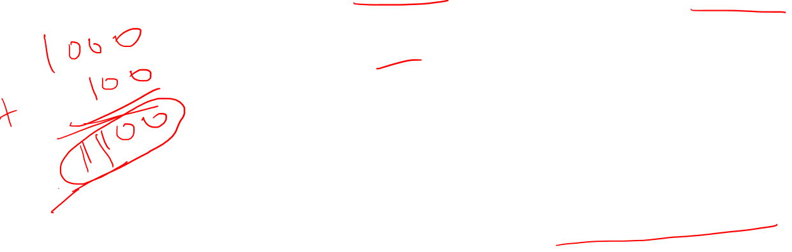
If Taxi owner charge Toll Tax in bill,
GST will be charge on the value including Toll Tax.
Example

Slide 17
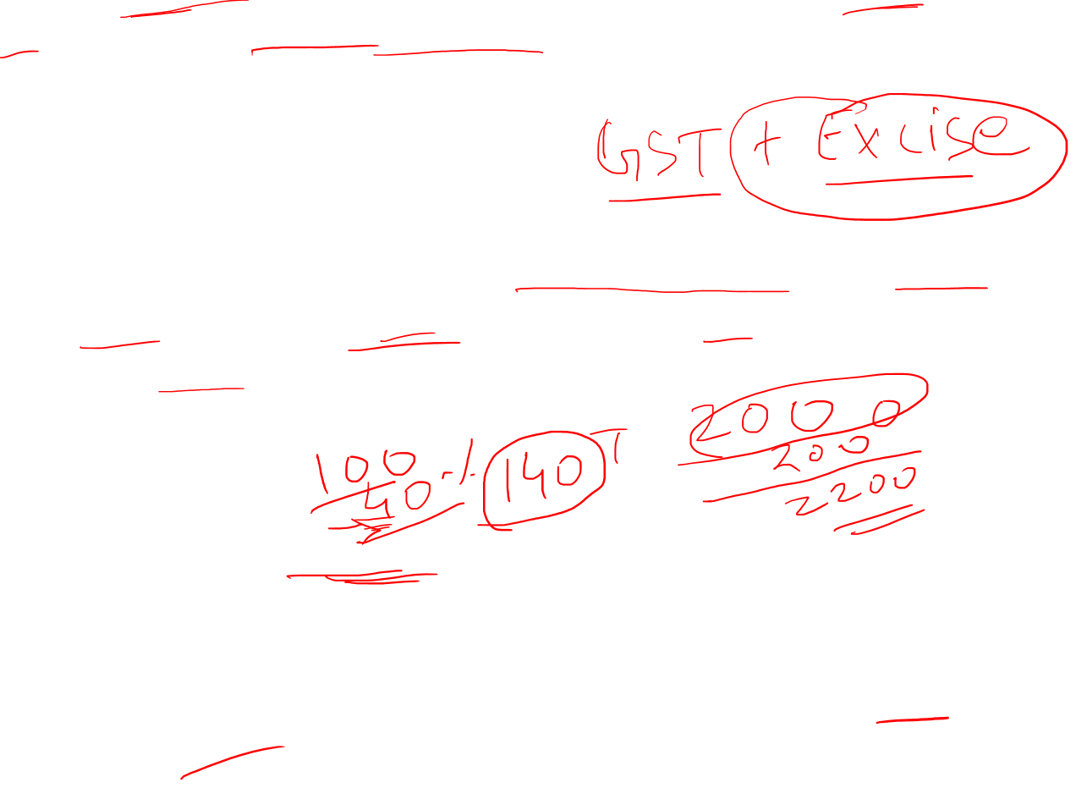
Example
(1) Central excise duty is leviable on manufactured tobacco along with GST, hence Central excise duty will be included in transaction value for supply of tobacco for chargeability of GST.
(2) In the rent contract, the tenant is required to pay municipal taxes either directly to the local body or to the owner of the premises. Such municipal taxes will form part of transaction value for the supply of renting service.
(3) Power to levy entertainment tax is still available with local bodies. The tickets purchased in any entertainment event will include the entertainment tax amount. However, as per the above provisions, entertainment tax included in the ticket will also form part of transaction value.

Slide 18

Illustration
X owns a commercial flat. It is given on rent to A Ltd. (rent being Rs. 2,50,000 per month). Besides rent, X recovers house tax of Rs. 90,000from A Ltd. Wlrnt is the value of taxable supply ?
Solution:
Taxable value of supply in this case will be Rs. 30,90,000 (i.e., rent: Rs. 30,00,000 + house tax: Rs. 90,000).
A theatre charges Rs. 10,000 per person for a musical programme (to be held in Chennai on January 1,2019). Besides, it collects 5 per cent entertainment tax imposed by Tamil Nadu Government. What is the value of taxable supply ?
Solution:
Taxable value of supply for levy of GST will be Rs. 10,500 (i.e., including entertainment tax).

Slide 19

Illustration
X owns a commercial flat. It is given on rent to A Ltd. (rent being Rs. 2,50,000 per month). Besides rent, X recovers house tax of Rs. 90,000from A Ltd. Wlrnt is the value of taxable supply ?
Solution:
Taxable value of supply in this case will be Rs. 30,90,000 (i.e., rent: Rs. 30,00,000 + house tax: Rs. 90,000).
A theatre charges Rs. 10,000 per person for a musical programme (to be held in Chennai on January 1,2019). Besides, it collects 5 per cent entertainment tax imposed by Tamil Nadu Government. What is the value of taxable supply ?
Solution:
Taxable value of supply for levy of GST will be Rs. 10,500 (i.e., including entertainment tax).

Slide 20
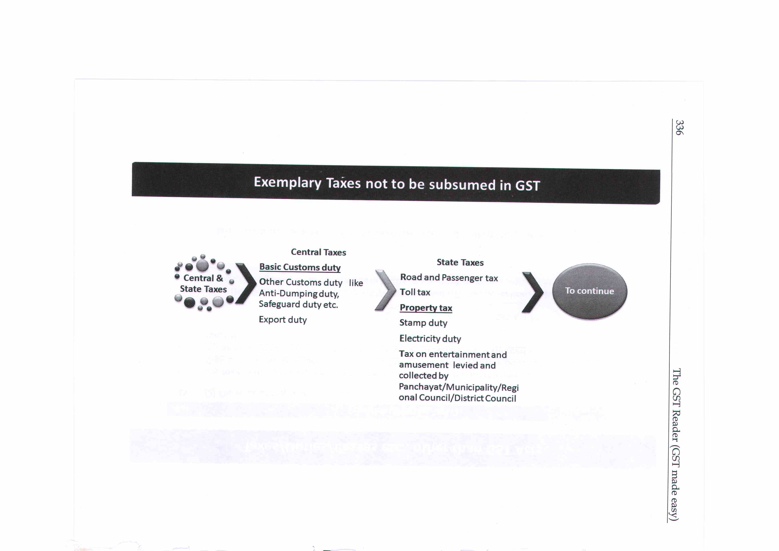
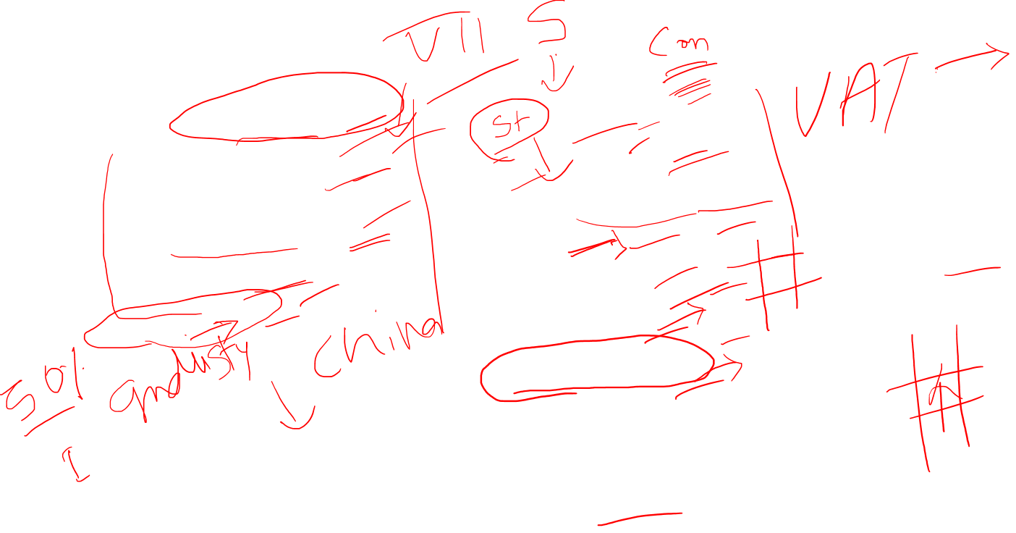

Slide 21
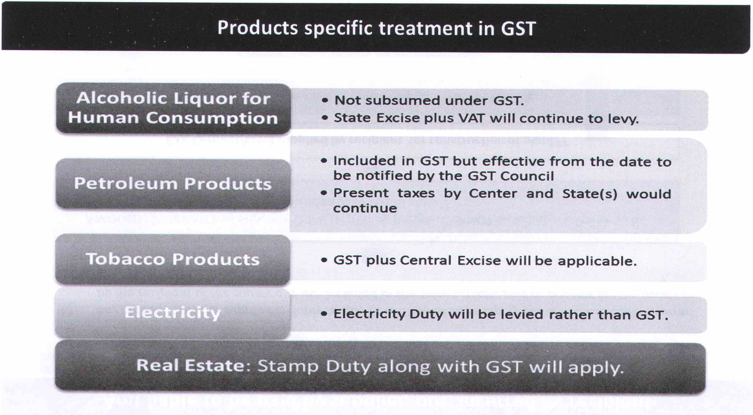
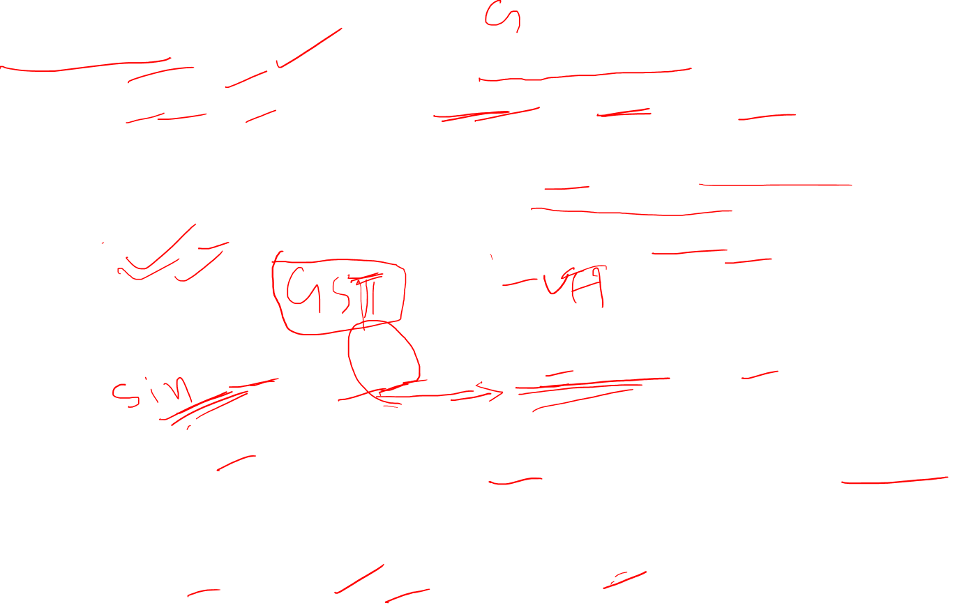

Slide 22
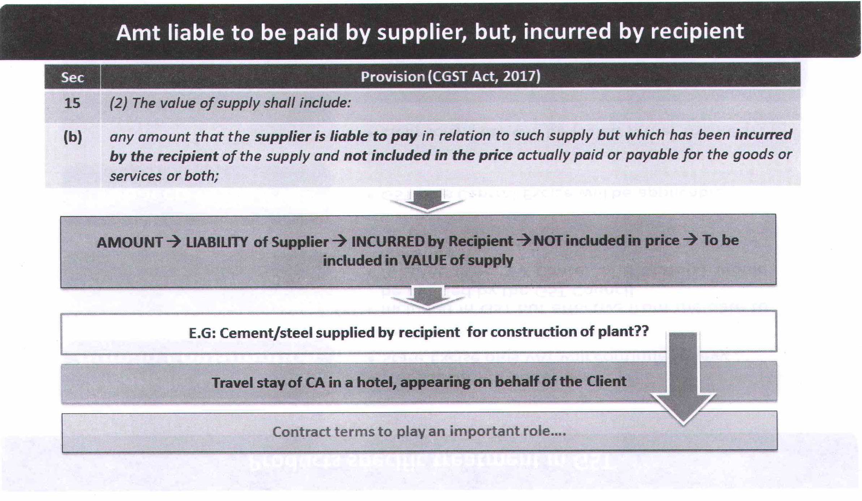


Slide 23

Example
ABC & Co. has placed order for supply of certain goods to Mr. Z.
As per the contract, Mr. Z is required to deliver the goods to the premises of ABC & Co.
Mr. Z hires a transporter for transportation of the goods. However, the lorry receipt indicates that the freight is payable by ABC & Co.
In this case, Mr. Z was required to make the payment to the transporter as it was the obligation of Mr. Z to deliver the goods to the premises of ABC & Co. As against Mr. Z making the payment to transporter, the payment is made by ABC & Co. Therefore, such payment will form part of transaction value of the goods supplied.
Thus, in a contract, the obligation undertaken by the supplier for supplying goods needs to be determined. All the expenses in respect of such obligation must be incurred by the supplier.
In case any amount has been incurred by the recipient of supply in connection with the supply, the same will be included in the transaction value.

Slide 24
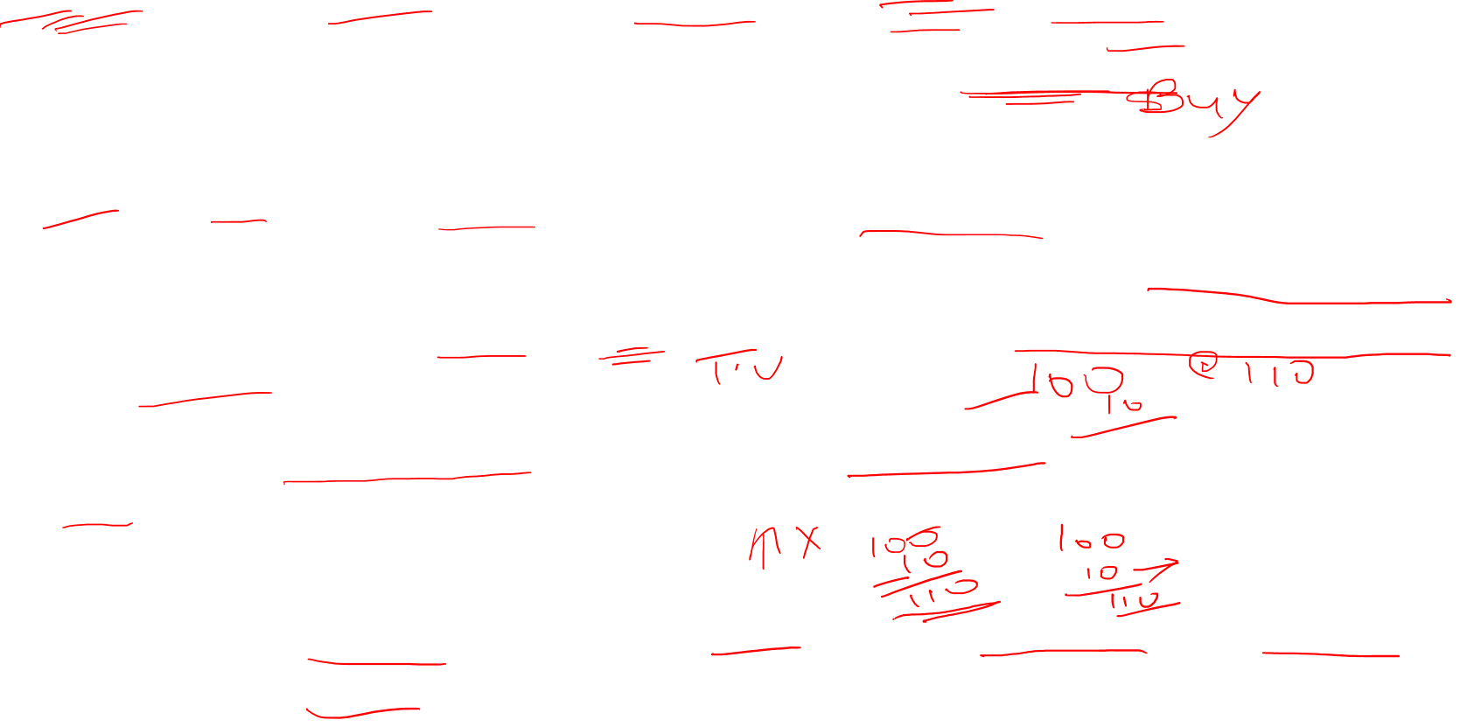
Example
XYZ Ltd., a supplier of goods has engaged Mr. X as selling agent.
The commission to Mr. X has been paid by the recipient of supply.
In this case the underlying obligation of payment of selling commission is of XYZ Ltd. as it has engaged the agent to identify prospective customers.
If the obligation to pay the agent (the amount towards selling commission) is passed on to the recipient (Mr. X), then the price paid to XYZ Ltd. does not reflect the true value of supply.
Had the recipient refused to pay this selling commission to the agent, then XYZ Ltd. would have paid Mr. X and made a corresponding increase in the price of the supply.
Thus, the selling commission paid by the recipient to Mr. X is to be included in the value of taxable supply.

Slide 25
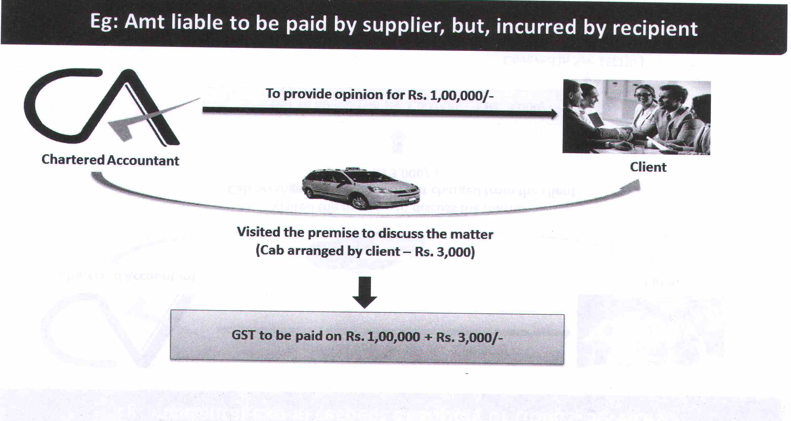
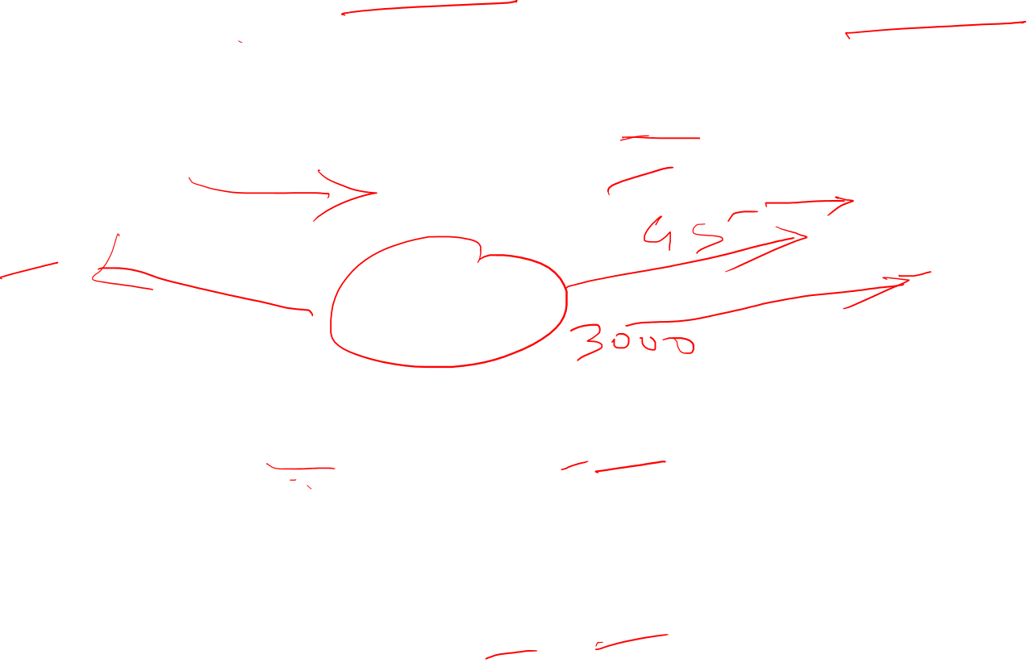

Slide 26
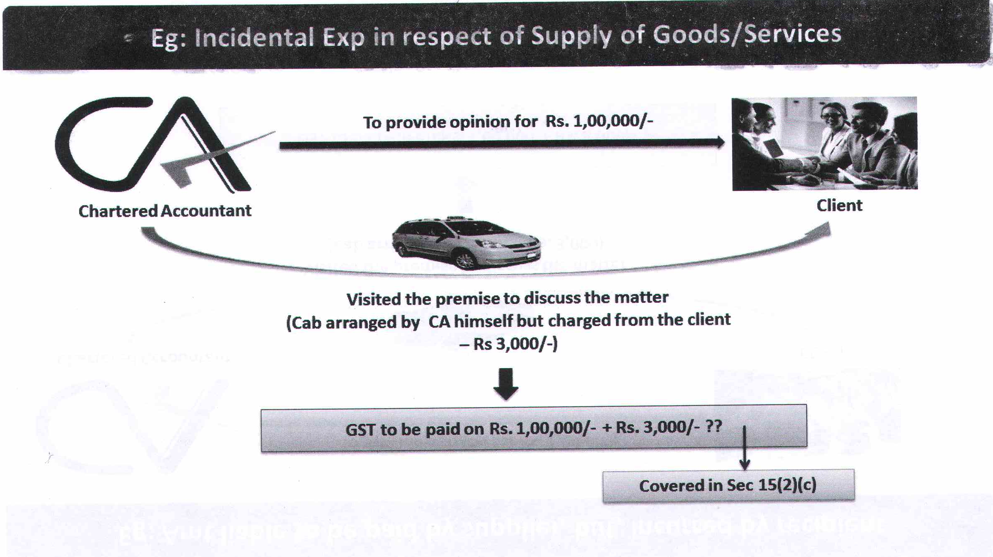
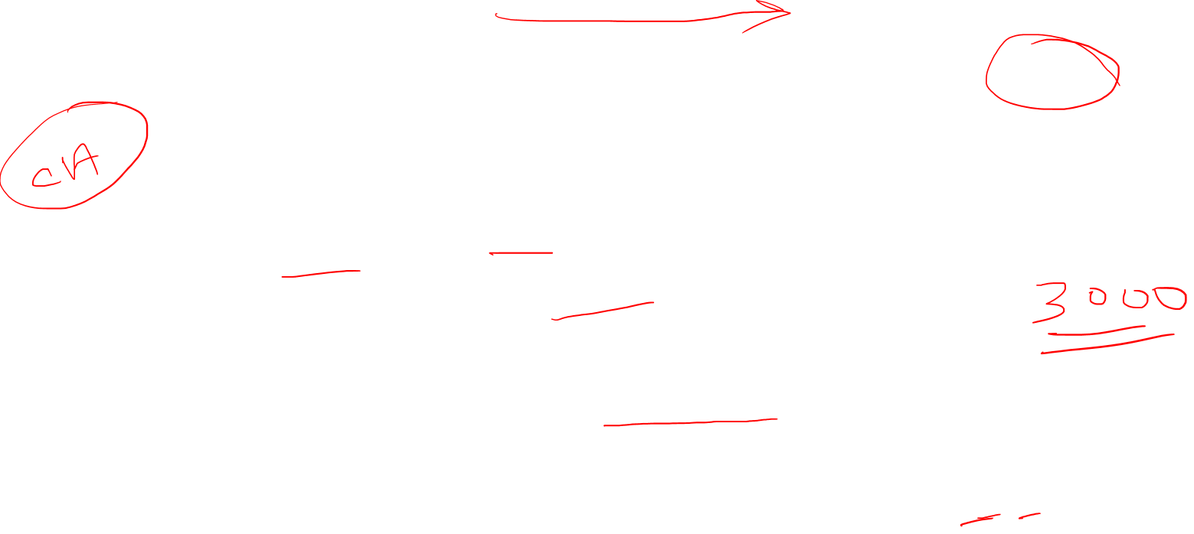

Slide 27
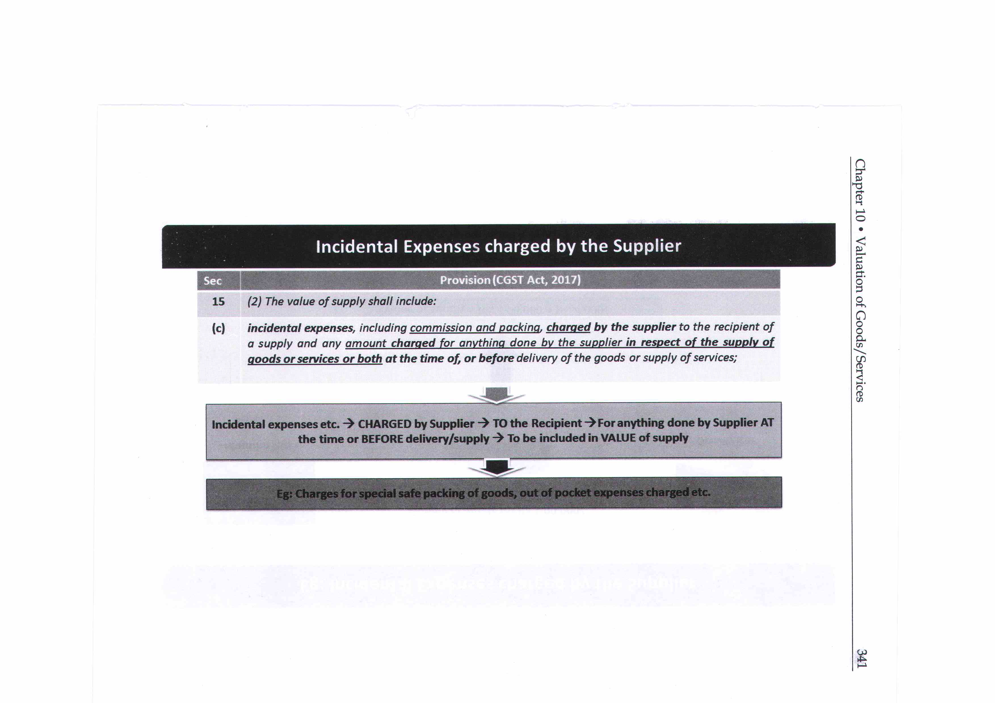


Slide 28
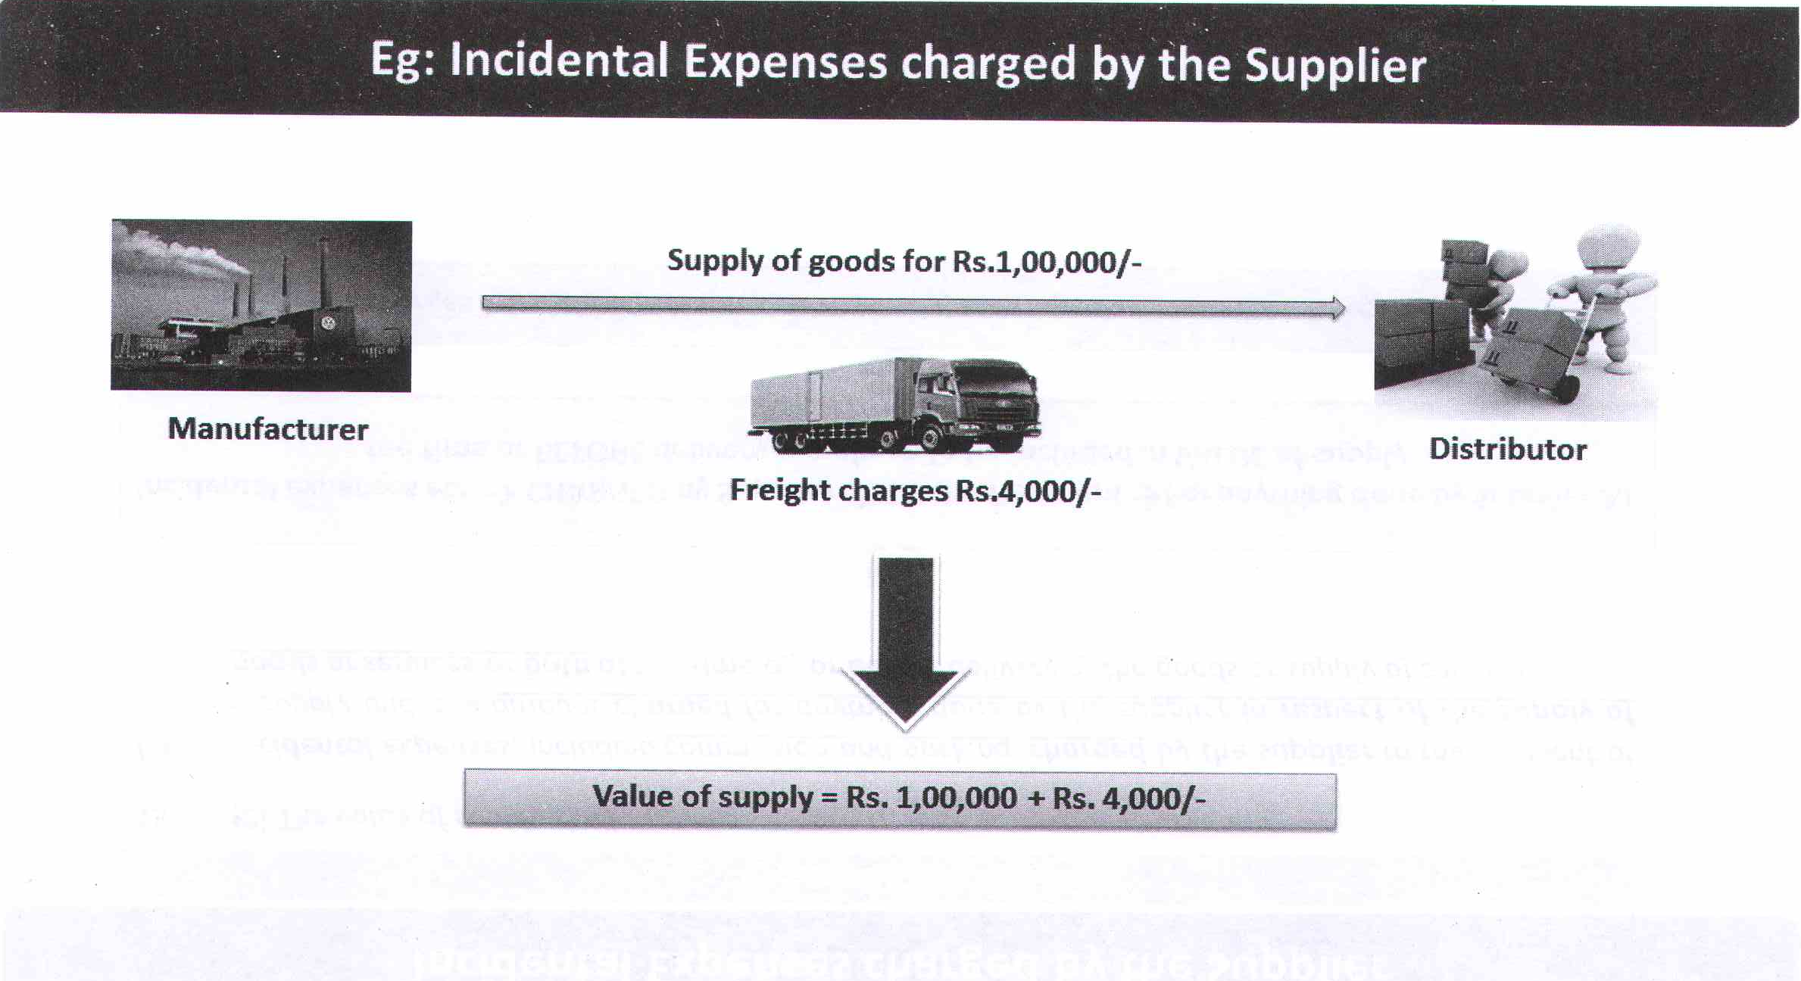
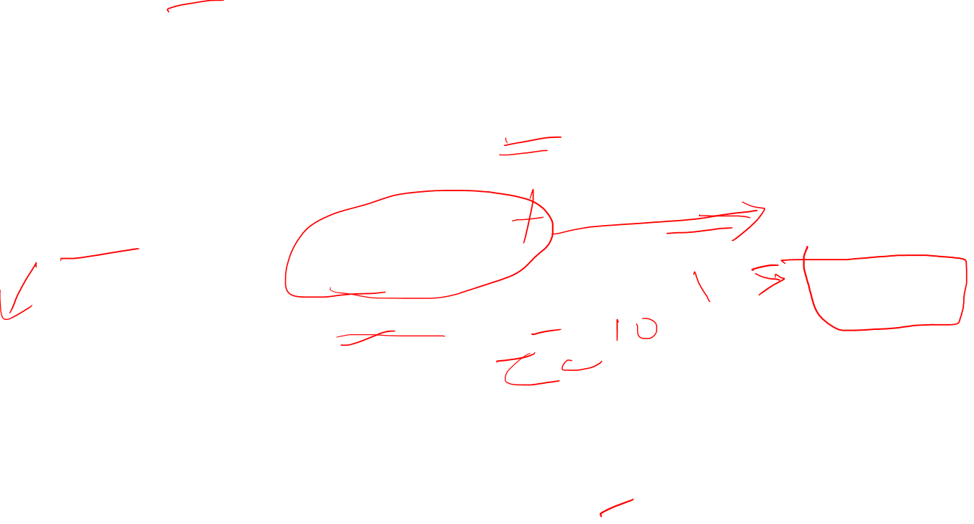

Slide 29
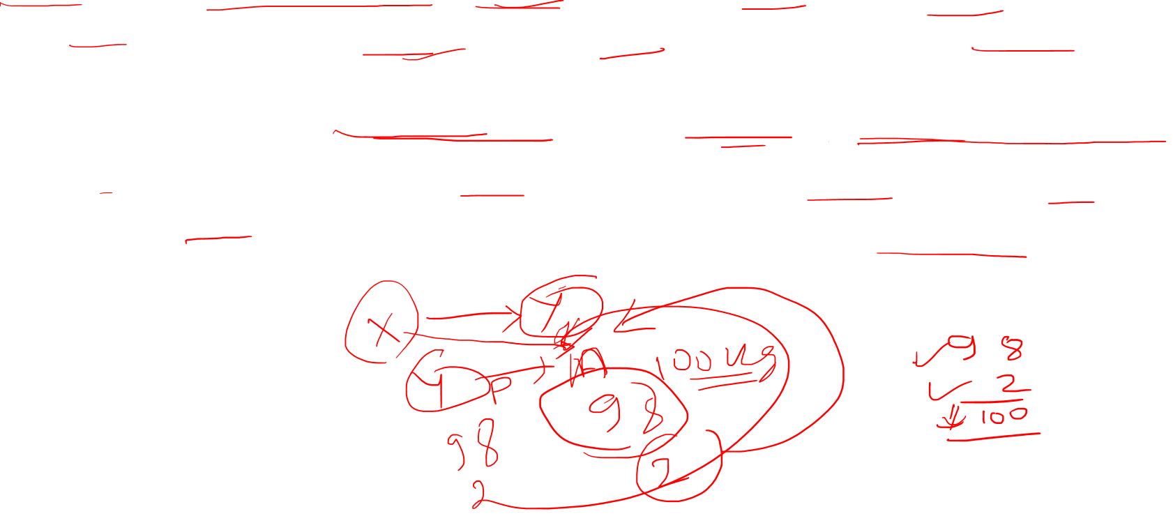
Example
Mr. X Company appoints agent Mr. Y to procure orders. Mr. Y procures orders from Mr. A for supply of 100 kg. of goods 'P' at a price of Rs. 100 per kg. Mr. X company supplies the goods to Mr. A and charges him only Rs.98 per kg. with the instruction to pay Rs. 2 per kg directly to Mr. Y. Payment by Mr. A to Mr. Y is in connection with the supply of goods made by Mr. X company to Mr. A.
Therefore, Rs. 2 per kg. will be considered as part of transaction value for the purposes of section 15 and GST will be payable on the commission amount paid by Mr. A to Mr. Y.

Slide 30
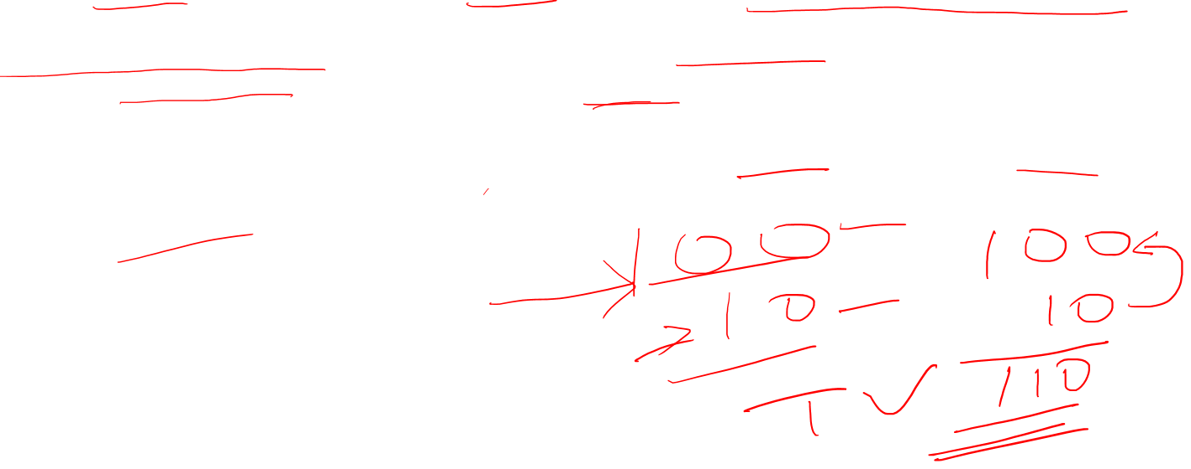
Example
Mr. X decided to gift an article to his friend. He requests the supplier to pack the goods in a particular packing to give it an attractive look. The amount for the special packing is separately paid by Mr. X to the supplier. The cost of such packing will be included in the value of goods being supplied even if it is separately paid by Mr. X.

Slide 31
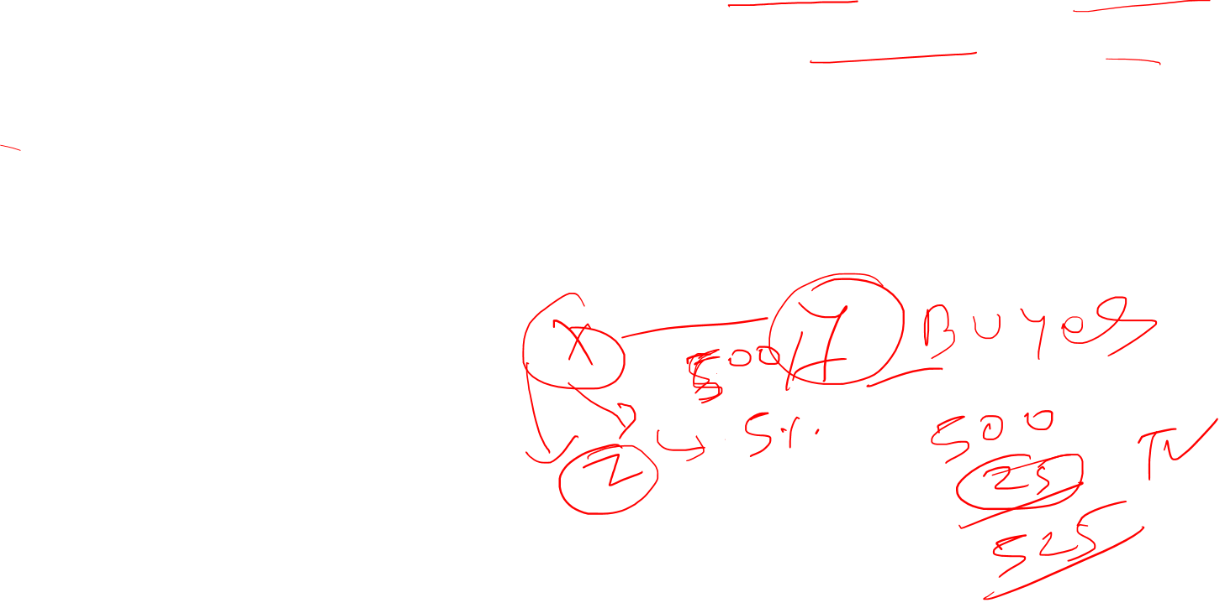
Illustration
X supplies artificial silk to Y at the rate of Rs. 500 per meter. X also collects broker's commission (which he has paid at the rate of 5 per cent to a broker to get input supply). What is the value of taxable supply ?
Solution:
Taxable value of supply of silk by X to Y will be Rs. 525 per meter (i.e., including broker's commission charged by X)

Slide 32
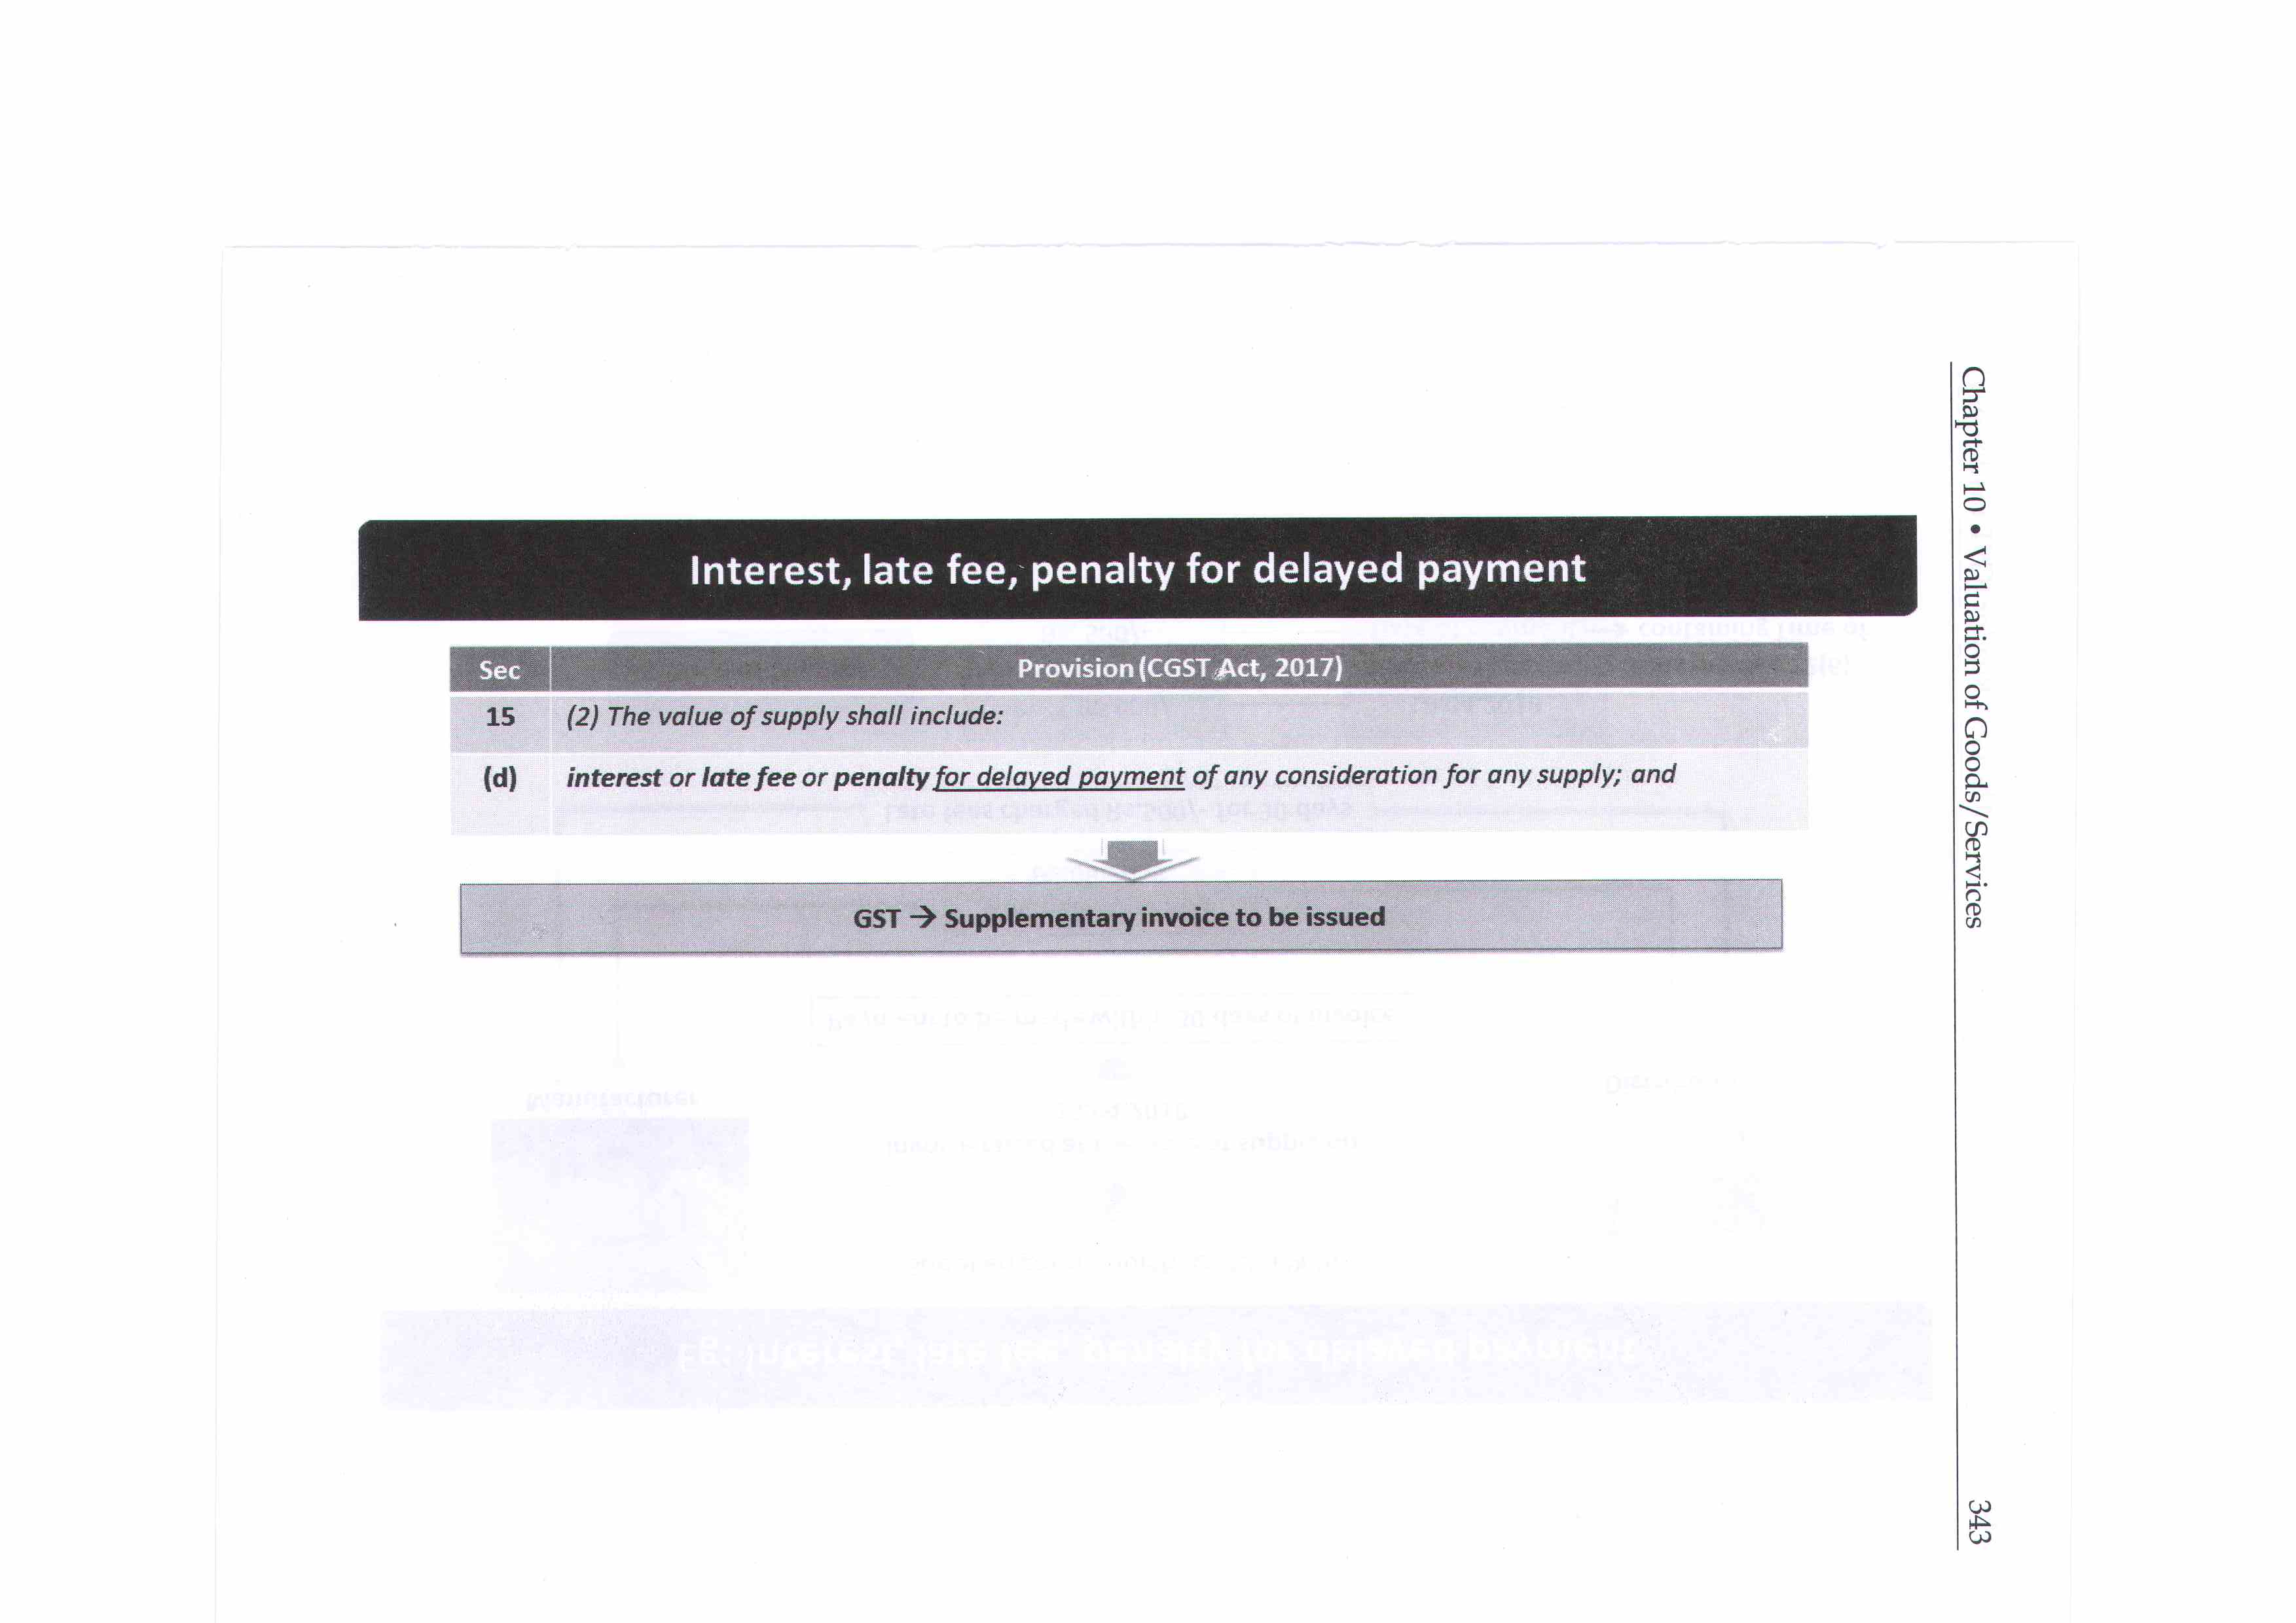
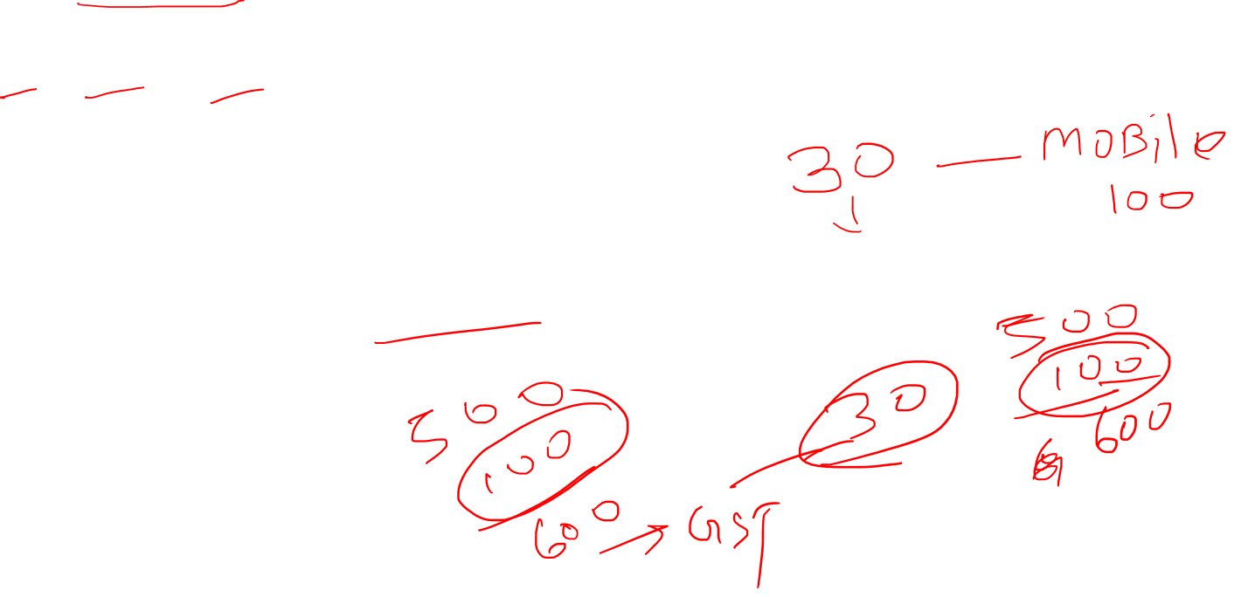

Slide 33
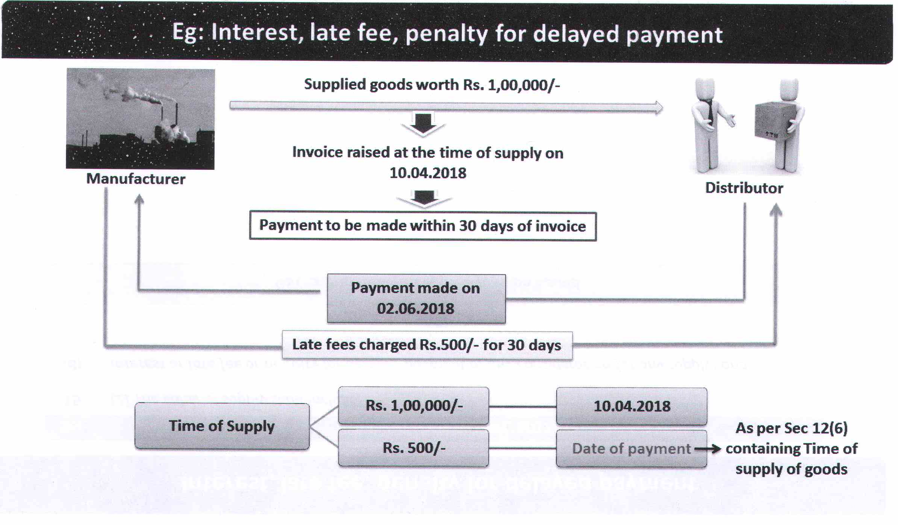
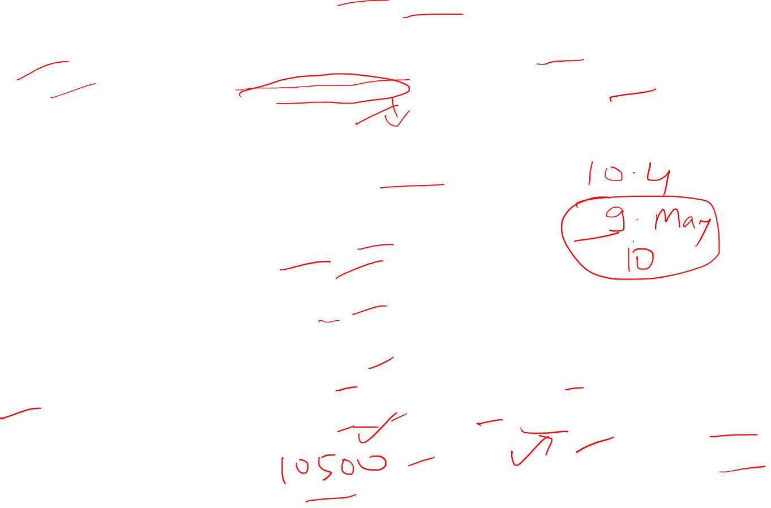

Slide 34
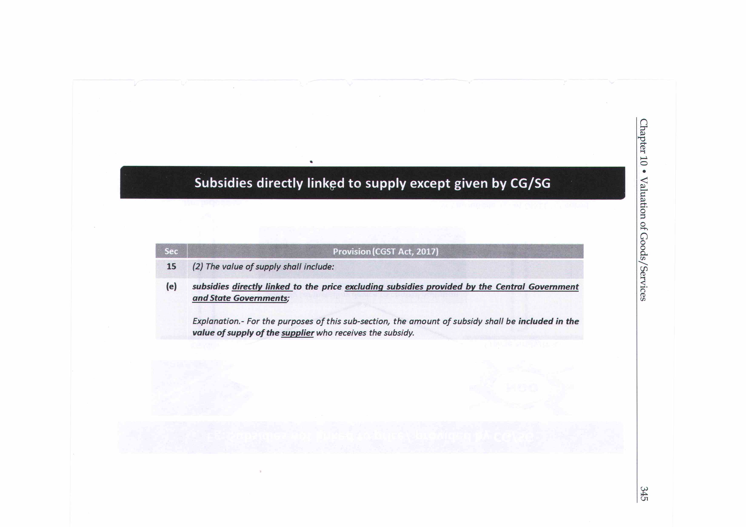


Slide 35
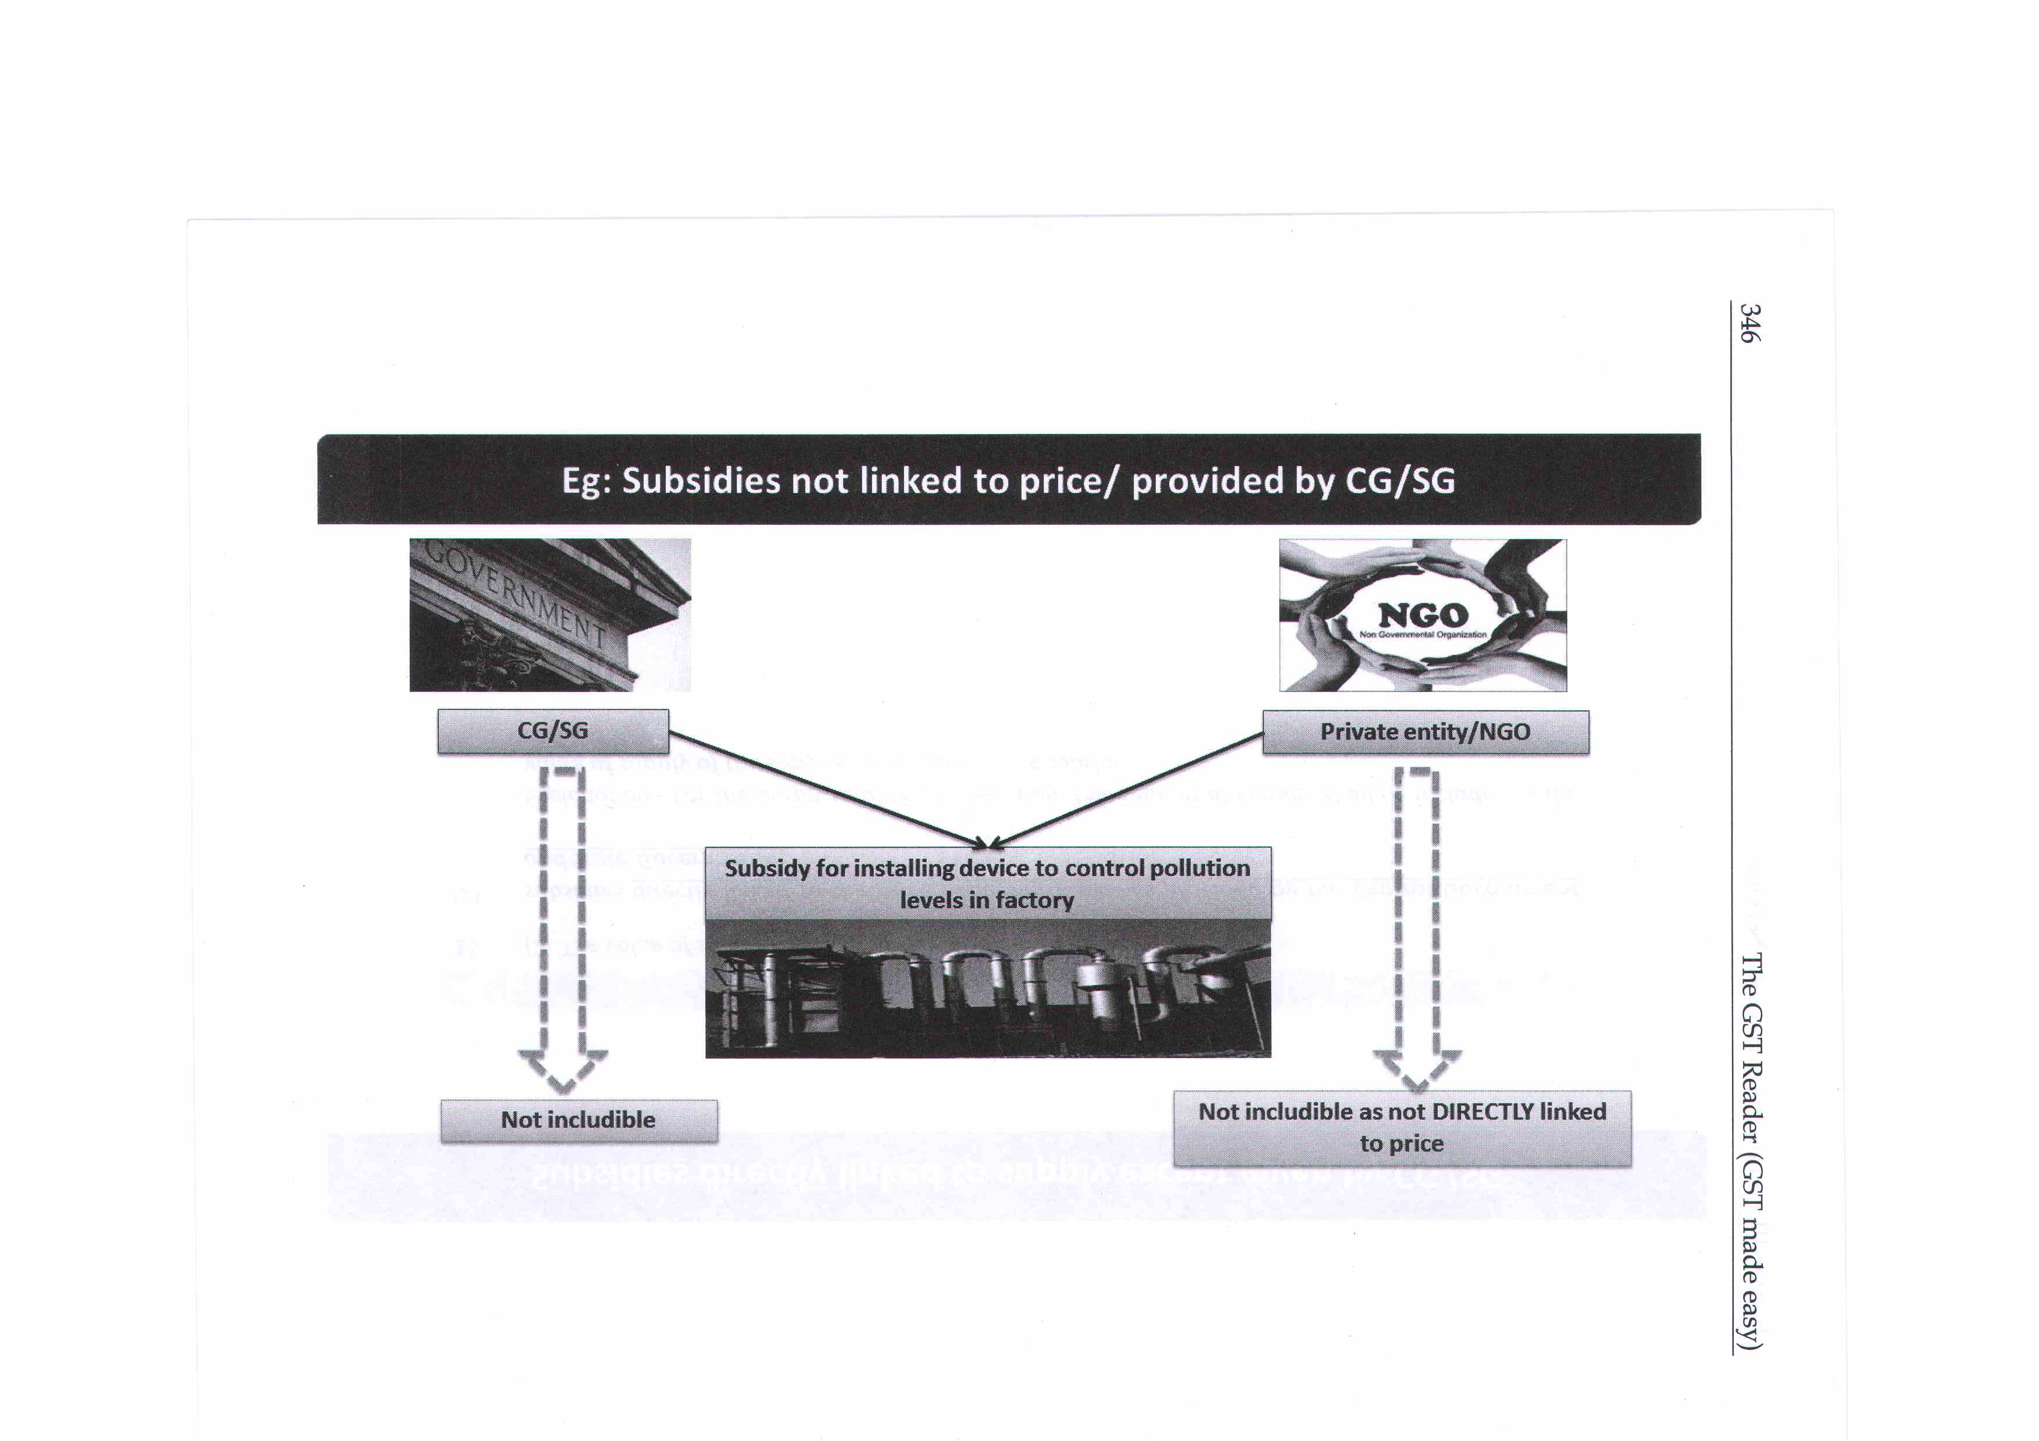


Slide 36
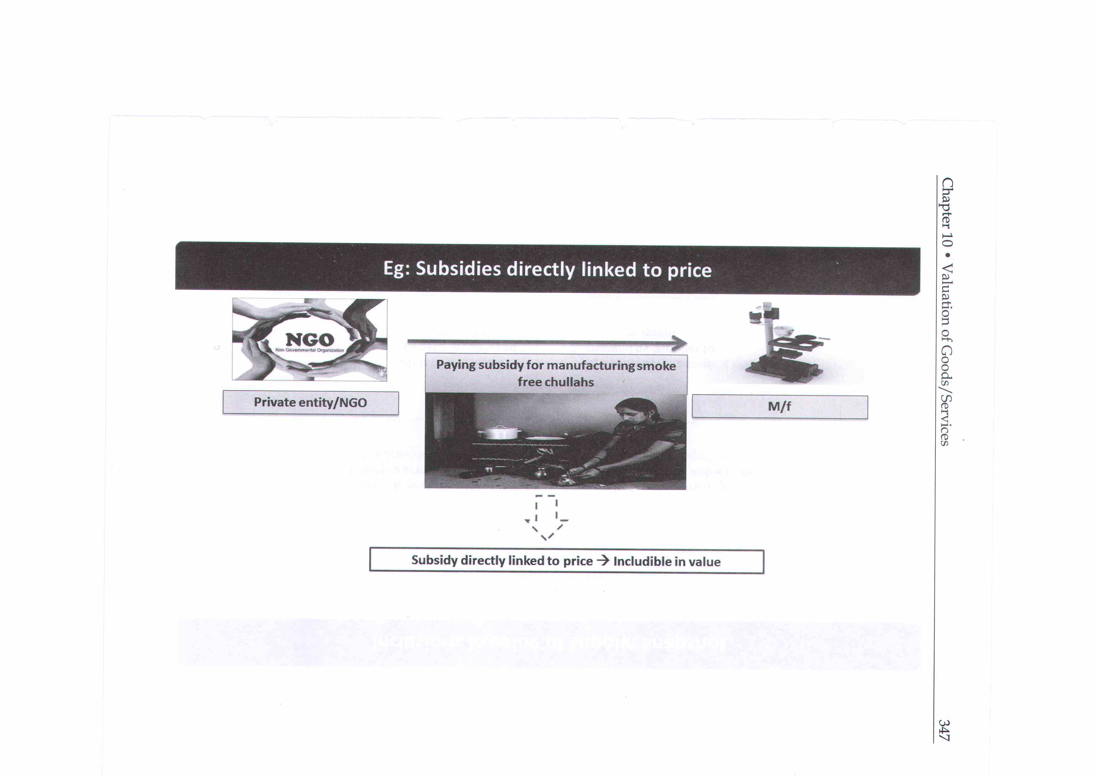
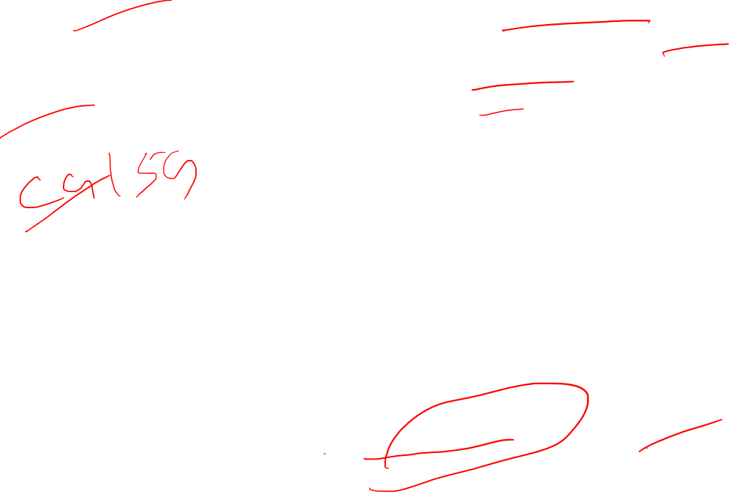

Slide 37
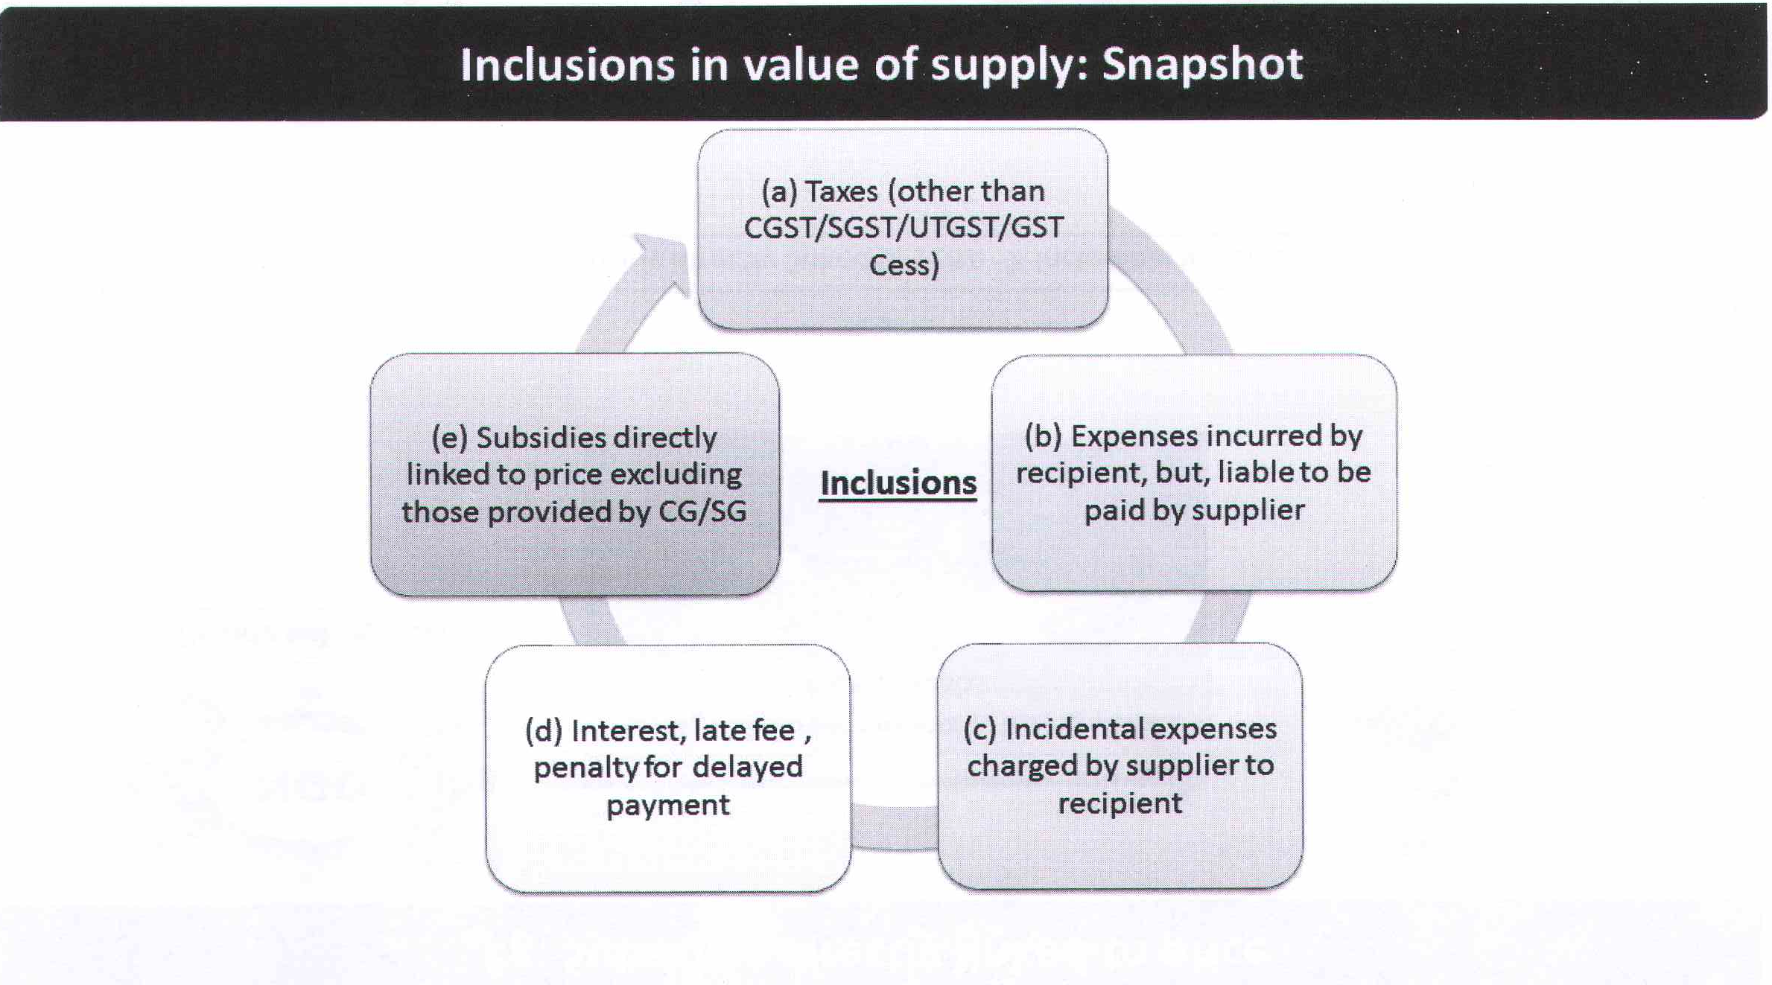
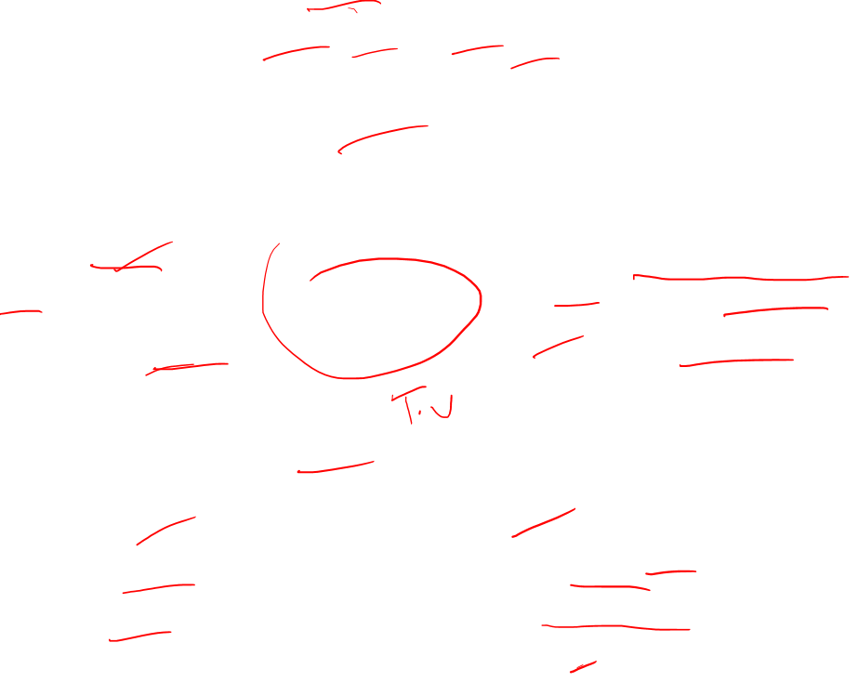

Slide 38
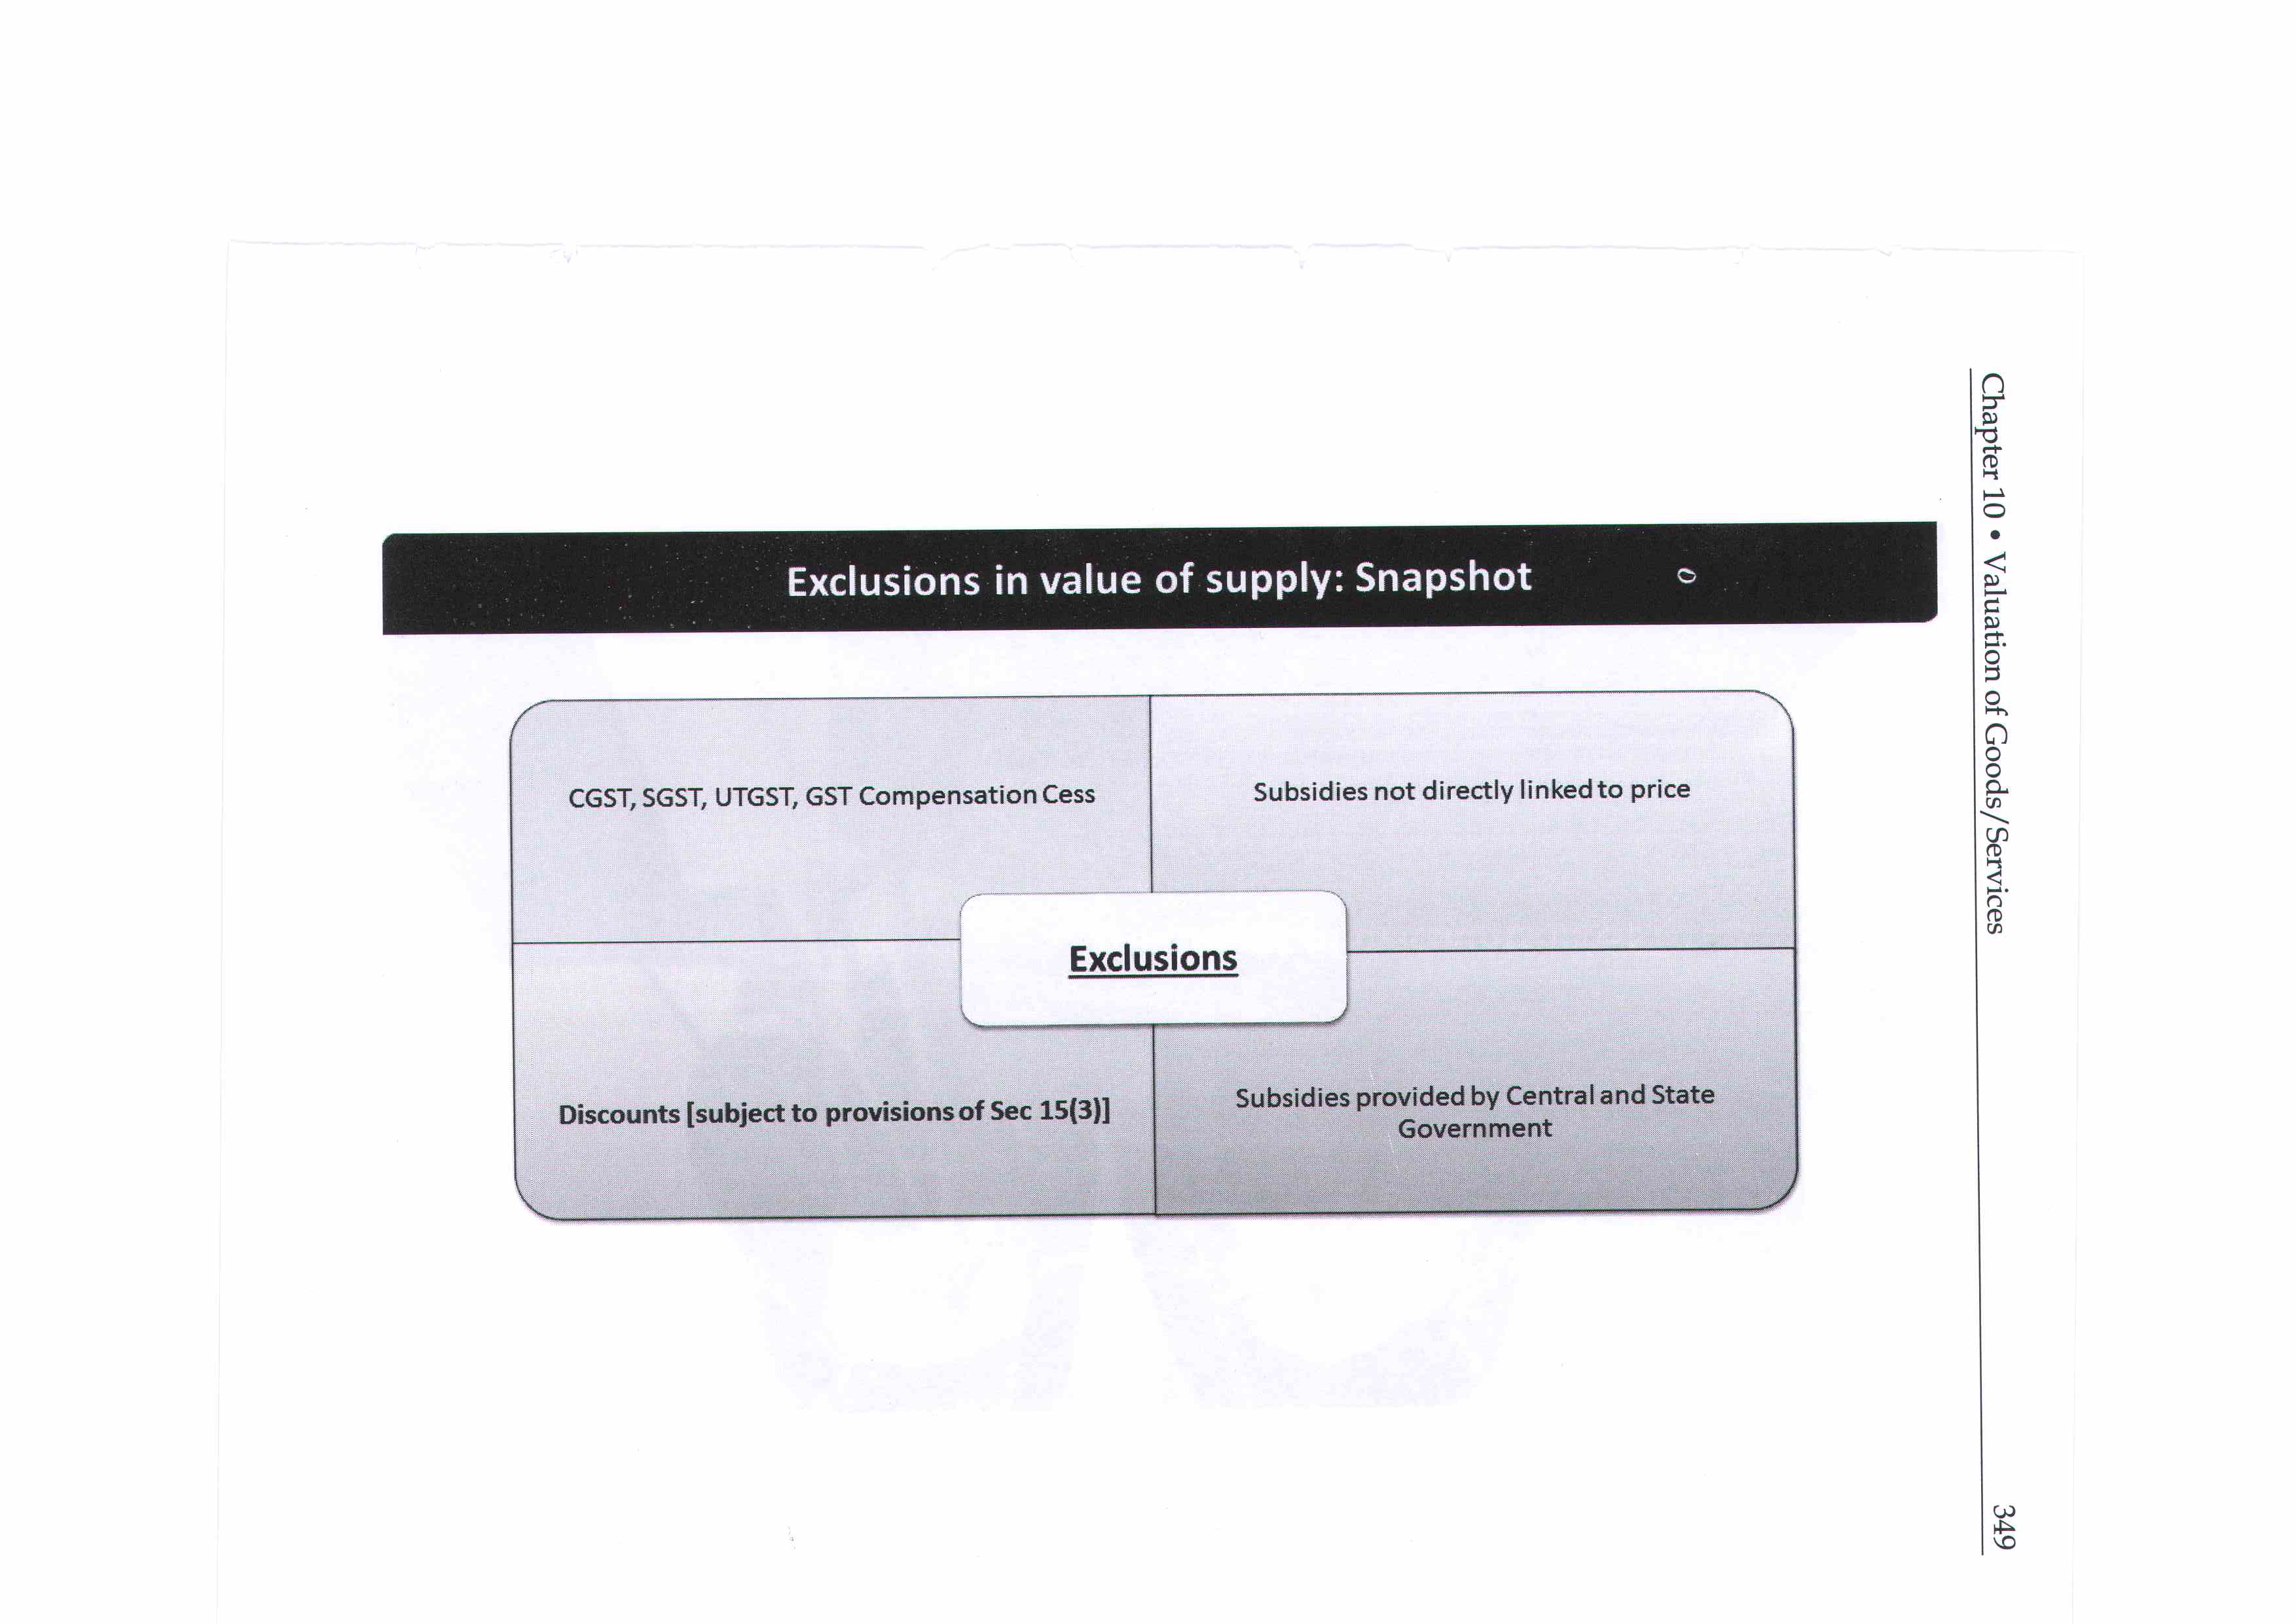


Slide 39
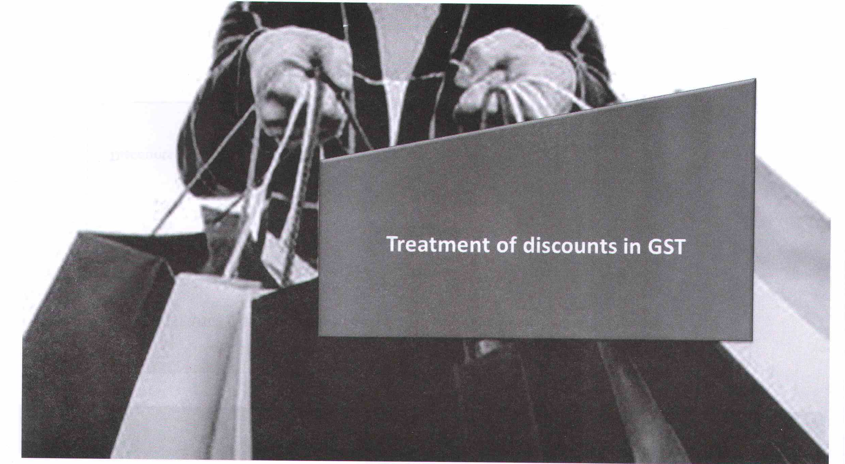

Slide 40
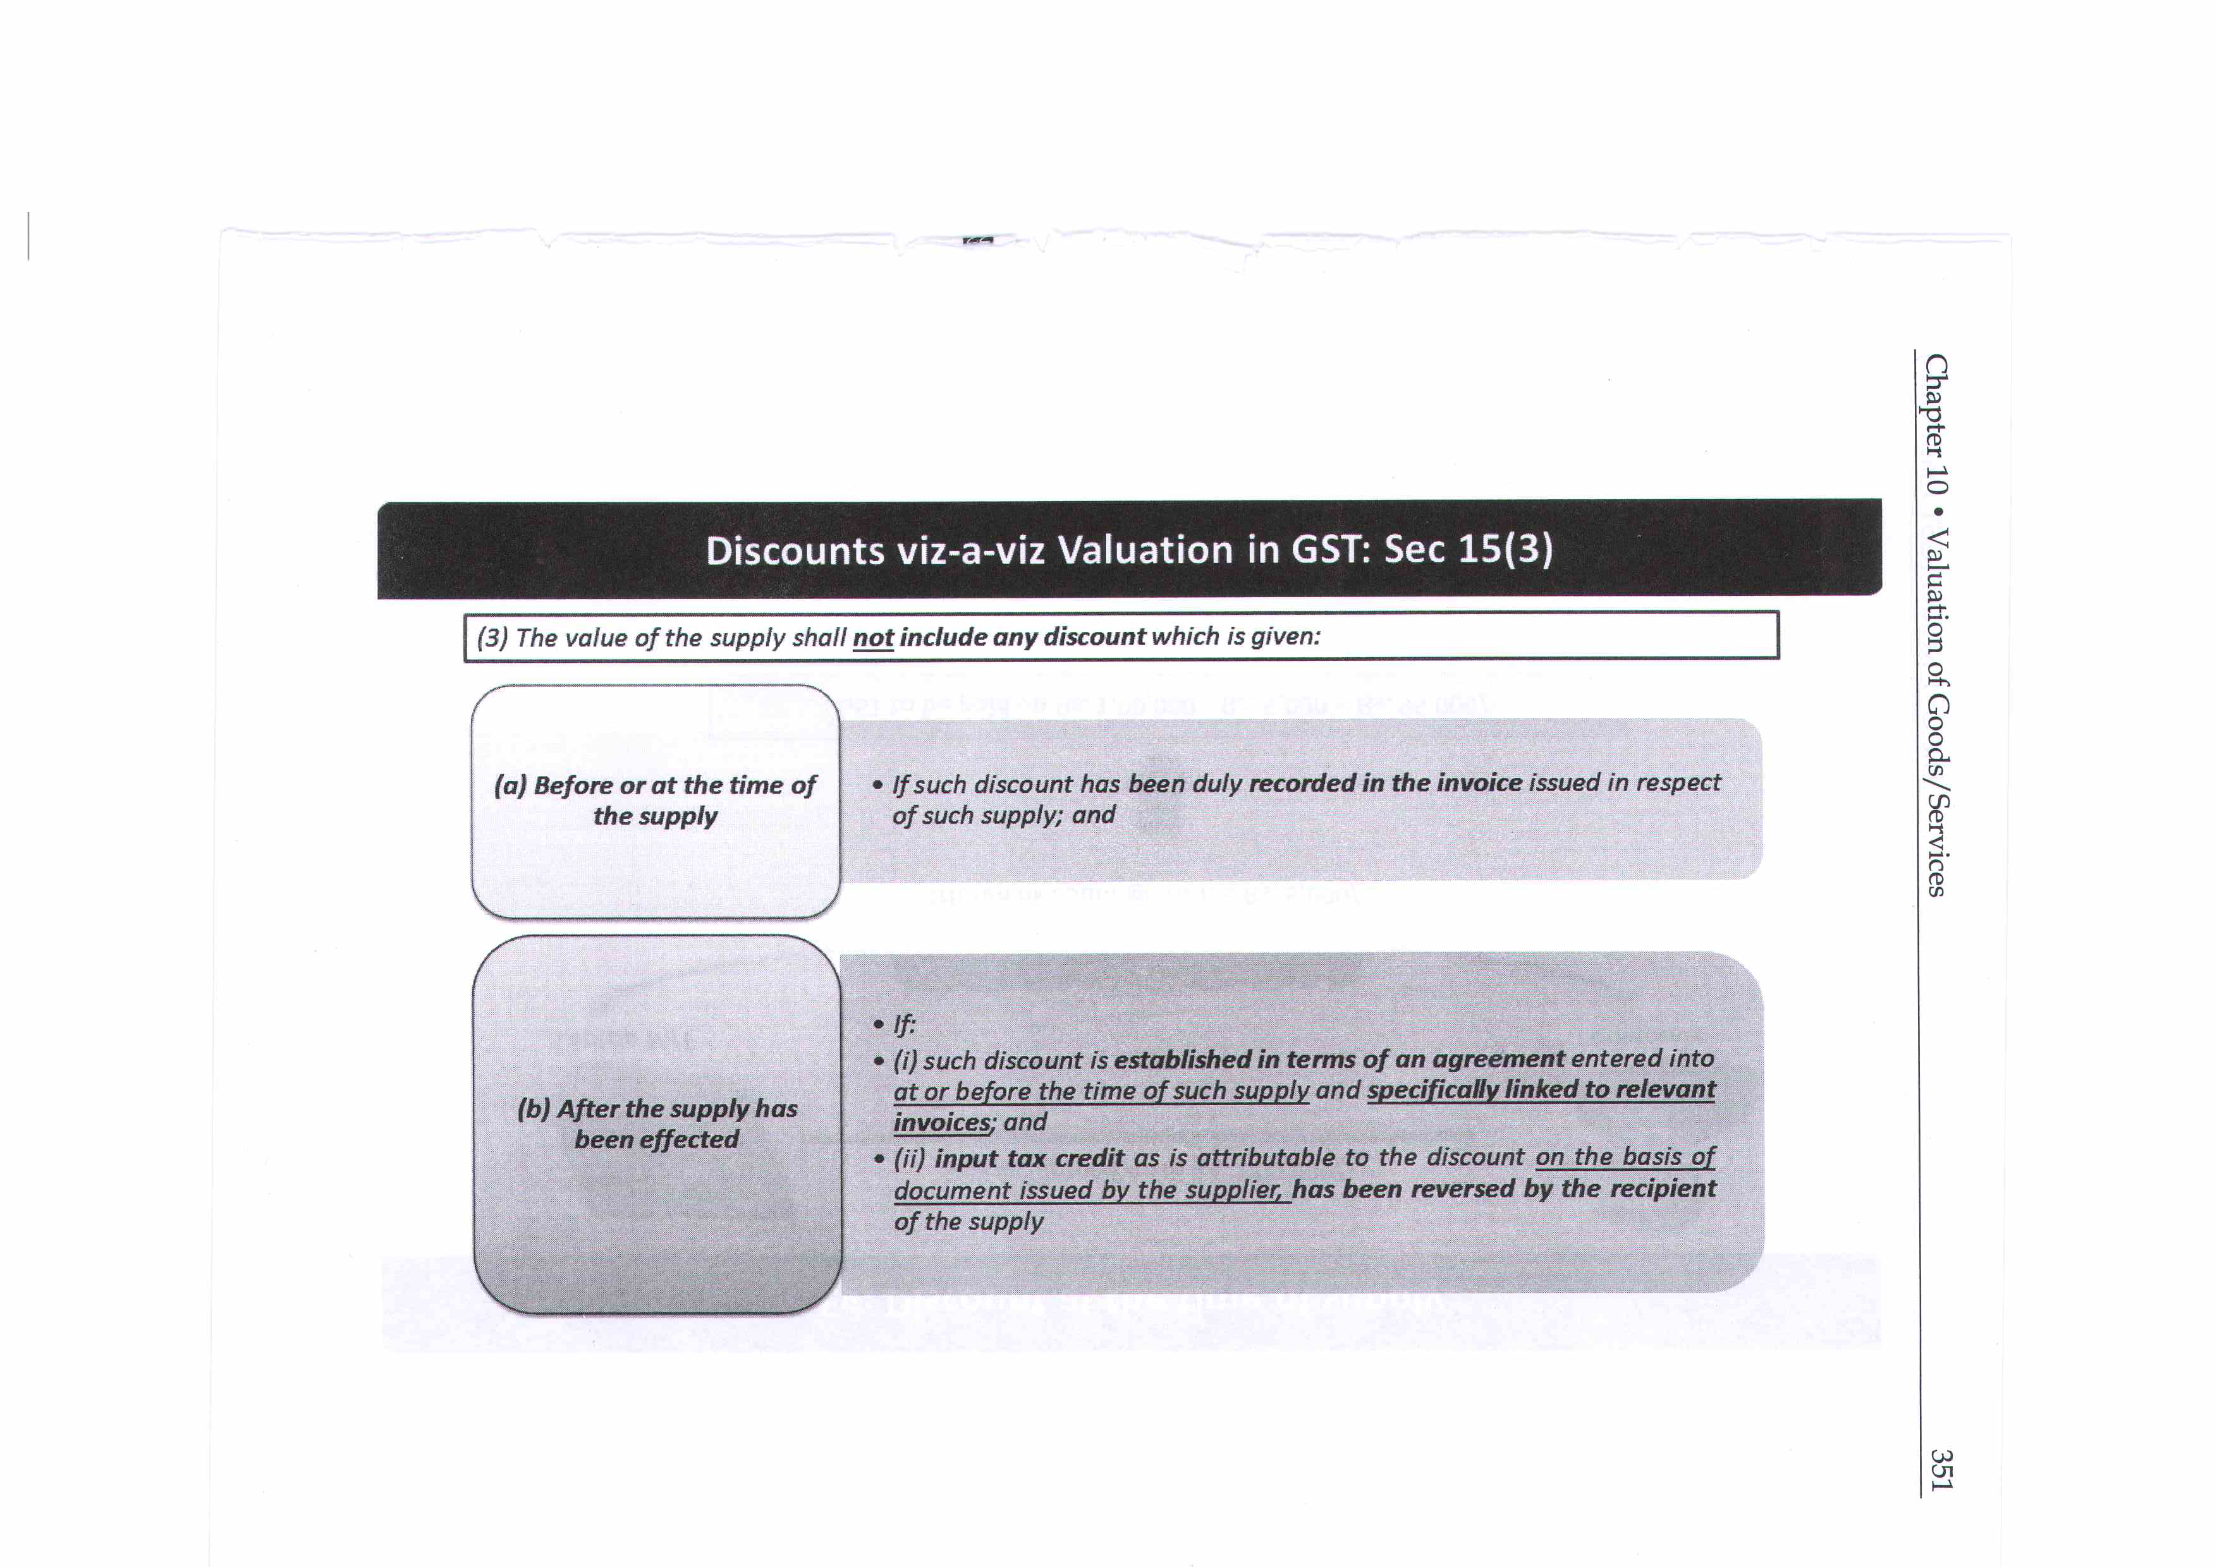


Slide 41
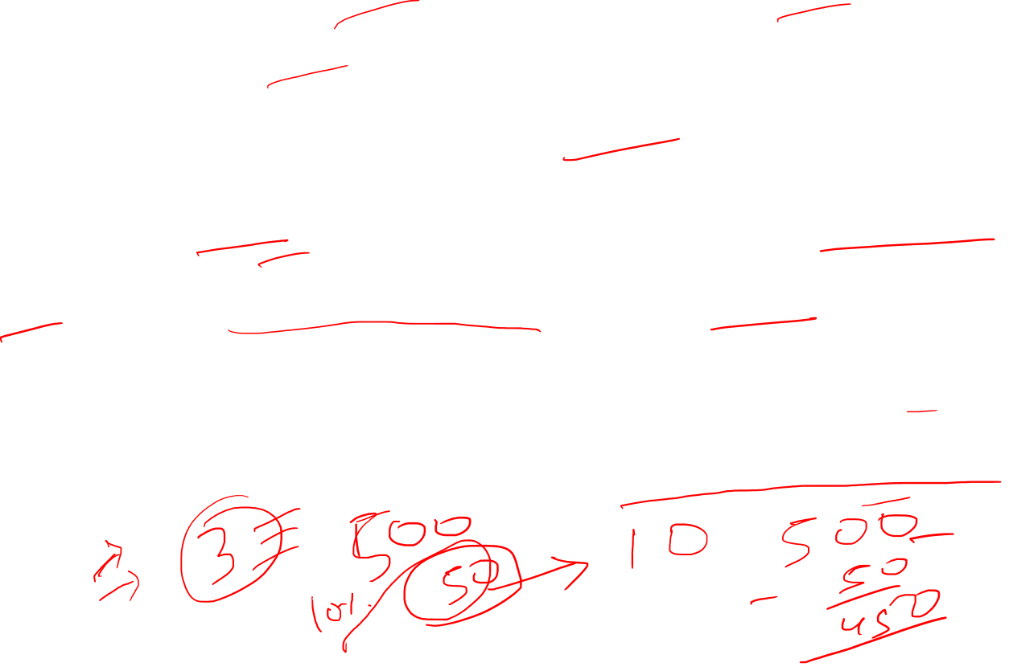
Example
Trade discount, cash discount, quantity discount, discount on meeting target if enter into the term of agreement then it shall be deducted from value.
Cash back by PAYTM, shall not be reduced from value because it is pass to buyer by third party.
Free service of car under warranty by dealer, billed to car manufacturer shall "amount to supply" to manufacturer.

Slide 42
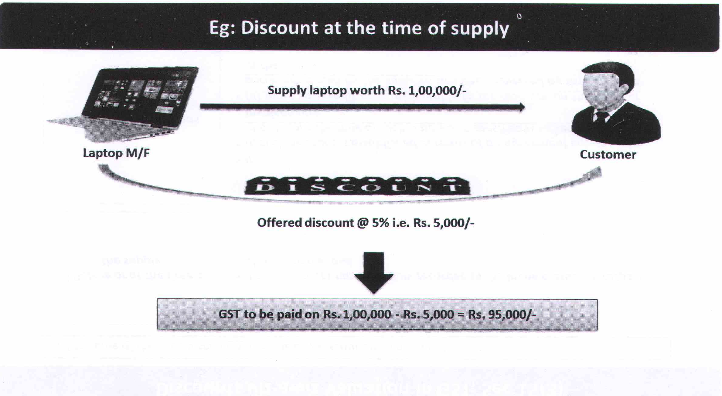
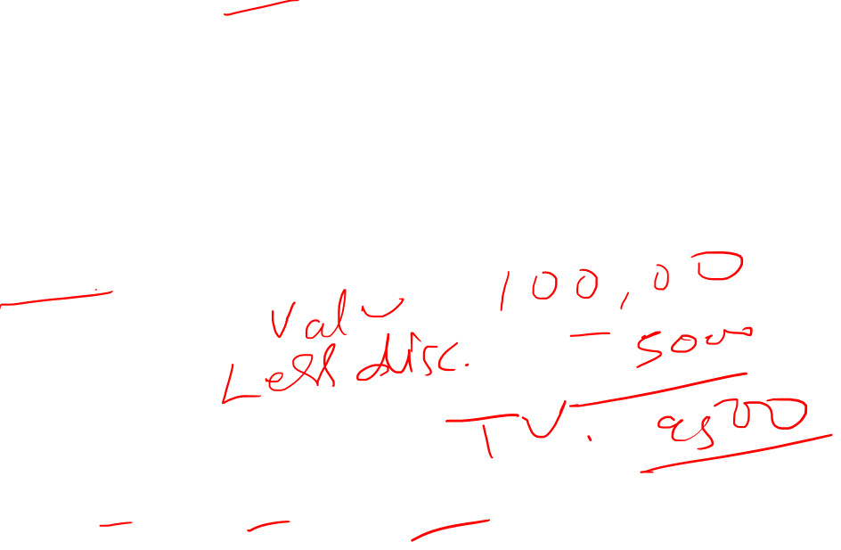

Slide 43
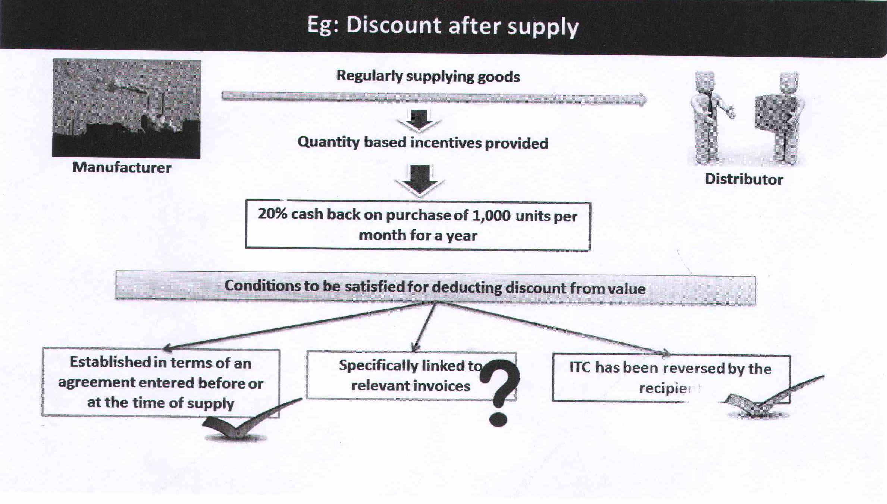
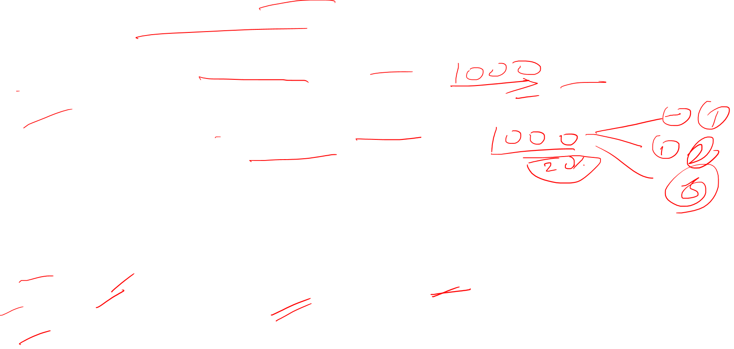

Slide 44

Illustration
From the following information determine the value of taxable supply as per provisions of Section 15 of the CGST Act, 2017?

Slide 45

Sollution
Computation of value of taxable supply of goods :

Slide 46

Working Notes
(1) As per Section 15(2)(c) of CGST Act, 2017,
cost of primary packing and protective packing at recipient's request for safe transportation charged by supplier from the recipient shall be included for determining the value of taxable supply. Since it is already included in the value, no treatment is required.
(2) As per Section 15(2)(c) of CGST Act, 2017,
any amount charged for anything done by the supplier in respect of the supply of goods at the time of, or before delivery of goods shall be included in the value of taxable supply.
Hence design and engineering charges shall also be included in the value of taxable supply. Since it is already included in the value, no treatment is required.

Slide 47

Working Notes
(3) As per Section 15(2)(b) of the CGST Act, 2017,
any amount that the supplier is liable to pay in relation to such supply but which has been incurred by the recipient of the supply and not included in the price actually paid or payable for the goods shall be included in the value of supply.
Thus, commission paid to agent by recipient on instruction of supplier and freight and insurance charges incurred by recipient on behalf of supplier shall form part of value of taxable supply.
(4) As per Section 15(2) (a) of the CGST Act, 2017,
value of supply shall not include any taxes or cesses levied under CGST Act, SGST Act, UTGST Act and the GST(Compensation to States) Act, if charged separately by the supplier.

Slide 48

Illustration
From the following information determine the value of taxable supply as per provisions of Section 15 of the CGST Act, 2017?

Slide 49

Working Notes
(1) As per Section 15(2)(a) of CGST Act, 2017,
any duty, taxes, cesses, fees and other charges, charged separately by supplier are to be included in value of taxable supply.
(2) As per Section 15(2)(c) of CGST Act, 2017,
any amount charged for anything done by the supplier in respect of the supply of goods at the time of, or before delivery of goods shall be included in the value of taxable supply.
Hence, weighment and loading charges, consultancy charges, testing charges and inspection charges shall also be included in the value of taxable supply.
(3) As per Section 15(2)(e),
the value of supply shall include subsidies directly linked to the price excluding subsidies provided by the Central Government and State Governments.
Hence, subsidy received from third party for timely supply of machine to recipient will be included in the value of taxable supply whereas subsidy received from Central government for setting up factory in backward region shall not be included in value of taxable supply.

Slide 50

Working Notes
(4) As per Section 15(3) (a)of the CGST Act, 2017
the value of the supply shall not include any discount which is given before or at the time of the supply if such discount has been duly recorded in the invoice issued in respect of such supply.
Hence, the same is deductible to arrive at value of taxable supply.
(5) As per Section 15(2)(a) of the CGST Act, 2017,
value of supply shall not include any taxes or cesses levied under CGST Act, SGST Act, UTGST Act and the GST (Compensation to States) Act, if charged separately by the supplier.

Slide 51

Sollution
Computation of value of taxable supply of goods :
/112

Slide 52

Illustration
Determine the value of taxable supply as per Section 15 of the CGST Act, 2017 and the Rules thereof:
A discount of Rs. 6,000 was given by the supplier at the time of supply of goods. CGST and SGST is levied @5%.

Slide 53

Working Notes
(1) 15(2) (c) of CGST Act, 2017,
any amount charged for anything done by the supplier in respect of the supply of goods at the time of, or before delivery of goods shall be included in the value of taxable supply.
Hence drawing and design charges, cost of packing (even at buyer's request) shall form a part of the transaction value of the supply.
Since these are already included in the value of the goods, hence, separate treatment is not required.
(2) Section 15(2)(a) of CGST Act, 2017
The value of supply shall include any taxes, duties, cess, fees and charges levied under any law for the time being in force
other than the CGST Act, the SGST Act, the UTGST Act and the GST (Compensation to States) Act, if charged separately by the supplier.
(3) Section 15(3)(a) of CGST Act, 2017
The value of supply shall not include any discount which is given before or at the time of supply.

Slide 54

Sollution
Computation of value of taxable supply of goods :

Slide 55

Illustration
Mr. Ramesh a manufacture furnish the following particular
Compute the value of machine when Ramesh has to deliver machine to factory of recipient.

Slide 56

Sollution
2%

Slide 57
Illustration
On July 5,2017, Z (of Chennai) supplies 25 tons of a chemical to B (of Madurai) at the rate of Rs. 80,000 per ton. Besides, he charges the following-
freight: Rs. 3,12,000, packing charges: Rs. 72,000, weighing charges: Rs. 30,000, inspection charges: Rs. 12,000,
cost of an instrument which is specially purchased by Z to manufacture this chemical: Rs. 1,10,000 (this instrument cannot be used for other purpose).
GST rate is 18 per cent.
Inspection charges are directly borne by B and not included in invoice.
State Government has paid a subsidy of Rs. 40,00,000 to Z to set up chemical manufacturing plant in Chennai. This subsidy was paid during 2016-17.
Z is required to make payment within 15 days of supply. However, payment is made in October 2017 and for late payment, Z charges interest of Rs. 11,000. Calculate GST. Z also wants to know due date of deposit of GST.

Slide 58
Sollution
 | Rs.
25 tons of chemicals (Rs. 80,000 × 25) | 20,00,000
Freight | 3,12,000
Packing charges | 72,000
Weighing charges | 30,000
Inspection charges (supplier's obligation met by recipient) | 12,000
Cost of special instrument | 1,10,000
Government subsidy (not linked to this supply; moreover, it is paid by Government) | -
Interest for late payment | 11,000
Value of taxable supply | 25,47,000
Add: GST-
- CGST (@ 9% of Rs. 25,47,000) | 2,29,230
- SGST (Tamil Nadu) (@ 9% of Rs. 25,47,000) | 2,29,230
Total | 30,05,460

Slide 59
Sollution
Note - GST should be paid on or before August 20,2017 (i.e., 20th day of succeeding month). However, the time of supply to the extent it relates to an addition in the value of supply by way of interest, shall be the date on which interest is received. Consequently, last date of GST payment will be as follows -
 | CGST Rs. | SGST Rs. | Due date of deposit
Value of taxable supply (excluding late payment interest) [9% of
(Rs. 25,47,000 - Rs. 11,000) | 2,28,240 | 2,28,240 | August 20,2017
Value of taxable supply (being late payment interest) [9% of Rs. 11,000] | 990 | 990 | November 20, 2017

Slide 60
Illustration
C Ltd. owns a coaching institute in Puri. The institute charges Rs. 18,000 per student for giving training in digital marketing.
However, this training programme is subsidized by different institutions as follows-
State Government of Orissa : Rs. 500 per student, PQ Charitable Trust :Rs. 200 per student and Government of Japan: Rs. 100 per student. Consequently, C Ltd. charges Rs. 17,200.
GST rate is 18 per cent. Calculate the amount of GST.

Slide 61
Illustration
In this case, subsidies given by different institutions are directly linked to the price charged by C Ltd. State Government subsidy can be excluded but subsidy paid by others will be included in taxable value. Consequently, value of taxable supply and GST will be calculated as follows-
 | Rs.
Transaction value | 17,200
Subsidy paid by PQ Charitable Trust | 200
Subsidy paid by Japan Government | 100
Value of taxable supply | 17,500
CGST @9% of Rs. 17,500 | 1,575
SGST@9% of Rs. 17,500 | 1,575
Total | 20,650
Note - Amount to be collected from students will be as follows:
Rs. 17,200 (transaction value) + CGST: Rs. 1,575 + SGST: Rs. 1,575.

Slide 62
Illustration
X Ltd. is a biscuit manufacturing company in Bhiwandi (Maharashtra). It generally gives a trade discount of 20 per cent in the list price when goods are purchased by a distributor. During December 2017, it offers Christmas Bonanza under which a special Christmas discount of 10 per cent is given on the list price of all products to its distributors in addition to normal discount of 20 per cent.
A Ltd., one of the distributors from Karnataka, purchases 1,000 packets of chocolate biscuits (list price Rs. 40 per packet of 118 gram) on November 30,2017 and 2,000 packets of the same biscuits on December 1,2017. GST rate is 18 per cent. Calculate amount of GST.
Solution:
GST may be calculated as follows—

Slide 63
Sollution
 | November 30, 2017 | December 1, 2017
1,000/2,000 packets of chocolate biscuits | 40,000 | Rs. 80,000
Less: Discount -
- Trade discount @ 20% | 8,000 | 16,000
- Christmas Bonanza discount @ 10% | - | 8,000
Taxable value of supply | 32,000 | 56,000
Add: GST - IGST @ 18% | 5,760 | 10,080
Total | 37,760 | 66,080

Slide 64
Illustration
Y Ltd. manufactures slow juicer (list price for supply to distributors: Rs. 15,000, GST rate : 28 per cent). It offers a special Diwali discount of 12 per cent to its distributors if more than 100 pieces are sold during October 2 017. This discount will be available, for supplies taken by distributors for November 2017. Z & Co. is one of the distributors in Solapur. It places an order of 70 pieces of juicer on October 30,2017 for retail sale for November 2017. As data for October 2017 is not available on October 30,2017, Y Ltd. issues invoice as follows
 | Rs.
Value of supply: 70 slow juicer (Rs. 15,000 * 70) | 10,50,000
Add: GST-
- CGST @ 14% | 1,47,000
- SGST @ 14% | 1,47,000
Total | 13,44,000

Slide 65
Illustration
Data for October is compiled on November 10, 2017. Total sale made by Z & Co. during October 2017 is more than 100 pieces. Consequently, Z & Co. is entitled for special Diwali discount of 12 per cent in the aforesaid transaction. Discuss whether this discount is available for GST purposes.
Solution:
Section 15(3) provides that the value of supply shall not include any discount which is given below -
Situation 1 - Discount which is allowed before (or at the time of) supply - This discount will not be included in value of taxable supply, if it is duly recorded in the invoice which is issued in respect of such supply.
Situation 2 - Discount that is allowed after the supply has been affected - This discount will not be included in value of taxable supply if the following two conditions are satisfied —
a. such discount is given under an agreement entered into at (or before) the time of such supply and specifically linked to relevant invoices; and
b. input tax credit (as is attributable to the discount on the basis of document issued by the supplier) has been reversed by the recipient of the supply.
In the given problem, Situation 1 is not applicable (discount is allowed after supply). Under Situation 2, one has to satisfy the two conditions given above. As the aforesaid two conditions are satisfied, discount of 12% will be allowed from the value of supply. Y Ltd. cannot issue revised invoice. It can give a credit note to this effect under section 34(2).

Slide 66




Slide 67



7678602089
gstfreeclass@gmail.com

Slide 68



