Slide 1
WHAT IS A RETURN
A return is a document containing details of income/sales/purchases etc. which a taxpayer is required to file with the tax administrative authorities. This is used by tax authorities to calculate tax liability.

Slide 2
CHAPTER-IX- RETURNS
CONSISTS OF 12 SECTIONS
25 RULES
23 FORMS

Slide 3
SECTIONS
S.37-Furnishing details of outward supplies
S-38-Furnishing details of inward supplies
S-39-Furnishing of Returns
S-40-First Return

Slide 4
SECTIONS
S.41-Claim of input tax credit and provisional acceptance thereof
S.42-Matching, reversal and reclaim of input tax credit
S-43-Matching, reversal and reclaim of reduction in output tax liability
S-44-Annual return-31st DEC

Slide 5
SECTIONS
S.45-Final return-closure
S-46-Notice to return defaulters
S-47-Levy of late fee-(GSTR-3B waived)
S-48-Goods and services tax practitioners

Slide 6
RULES
Rule 1-Form and manner of furnishing details of outward supplies
RULE 2-Form and manner of furnishing details of inward supplies
RULE-3-Form and manner of submission of monthly returns
RULE-4-Form and manner of submission of quarterly return by the composition supplier

Slide 7
RULES
Rule 5-Form and manner of submission of return by non-resident taxable person-The Goods and Services Tax Law has defined a ‘non-resident taxable person’ as any person who occasionally undertakes transactions involving the supply of goods or services, or both, whether as principal or agent or in any other capacity, but who has no fixed place of business or residence in India.
Rule 6-Form and manner of submission of return by ISD
RULE 7-Form and manner of return by person required to deduct tax at source
RULE 8-Form and manner of submission of statement of supplies effected through e-commerce

Slide 8
RULES
Rule 9- Notice to non-filers of returns
Rule 10 -Matching of claim of input tax credit
Rule 11-Final acceptance of input tax credit and communication thereof
RULE-12-Communication and rectification of discrepancy in claim of input tax credit and reversal of claim of input tax credit

Slide 9
RULES
Rule 13 -Claim of input tax credit on the same invoice more than once
Rule 14- Matching of claim of reduction in the output tax liability
Rule 15- Final acceptance of reduction of output tax liability and communication thereof
Rule 16 -Communication and rectification of
discrepancy in reduction in output tax liability
and reversal of claim of reduction

Slide 10
RULES
Rule 17 -Claim of reduction in output tax liability more than once
Rule-18-Refund of interest paid on reclaim of reversal
Rule-19-Matching of details furnished by e-commerce operator with the details furnished by supplier
Rule-20-Communication and rectification of discrepancy in details furnished by e-commerce operator and supplier

Slide 11
RULES
RULE-21-Annual return
RULE-22-Final return
RULE-23-Details of inward supplies of persons having Unique Identity Number (UIN)
RULE-24-Provisions relating to a GST Practitioners
RULE-25-Conditions for purposes of appearance

Slide 12
FORMS
GSTR-1-Details of outward supplies-10th of next month
GSTR-1A-Details of outward supplies as added, corrected or
deleted by recipient
GSTR-2-Details of inward supplies of taxable goods and/or
services claiming input tax credit-15th of next month
GSTR-2A-Details of inward supplies made available to the
recipient on the basis of FORM GSTR-1
GSTR-3- Monthly return-20th of next month

Slide 13
FORMS
GSTR-3A-Notice to a registered person who fails to furnish
return
GSTR-4-Quarterly Return for composition taxpayer-18th of
month next to quarter
GSTR-4A-Details of inward supplies made available to the
recipient registered under composition scheme
GSTR-5-Return for Non-Resident foreign taxable person-last
day of registration
GSTR-6- ISD return-13th of next month

Slide 14
FORMS
GSTR-6A-Details of inward supplies made available to the ISD recipient on the basis of FORM GSTR-1 furnished by the supplier
GSTR-7-TDS Return-10th of next month
GSTR-7A-TDS Certificate
GSTR-8-Details of supplies effected through e-commerce operator and the amount of TCS

Slide 15
GST MIS FORMS
GST-MIS-1-Communication of discrepancy of duplication of ITC claim to recipient
GST-MIS-2-Communication of discrepancy of duplication of ITC claim to supplier
GST-MIS-3-Communication of reduction in output tax liability to supplier
GST-MIS-4-Communication of reduction in output tax liability of recipient.

Slide 16
FORMS
GSTR-9- Annual return-By 31st December Of next FY
GSTR-9A-Simplified Annual return by Compounding persons registered under section 9
GSTR-9B-Reconciliation Statement
GSTR-10- Final return
GSTR-11-Details of inward supplies to be furnished by a person having UIN

Slide 17
GSTR-1 AND GSTR-2
S.37-Furnishing details of outward supplies AND Rule 1-Form and manner of furnishing details of outward supplies – GSTR-1
S-38-Furnishing details of inward supplies AND RULE 2-Form and manner of furnishing details of inward supplies-GSTR-2

Slide 18
GSTR-1 AND GSTR-2
1. Furnish details in GSTR-1 on or before 10th
2. Details of supplier made available to
recipient from 11th to 15th
in FORM GSTR-2A
RECIPIENT
SUPPLIER
4. Changes made by recipient are made
available to supplier in FORM GSTR-1A
3. Validate details of supplier in GSTR-2 to claim ITC after 10th but on or before 15th
5. Supplier may accept or reject changes made by recipient after 15th but before 17th
S.37 AND S.38 READ WITH RULE-1 AND 2

Slide 19
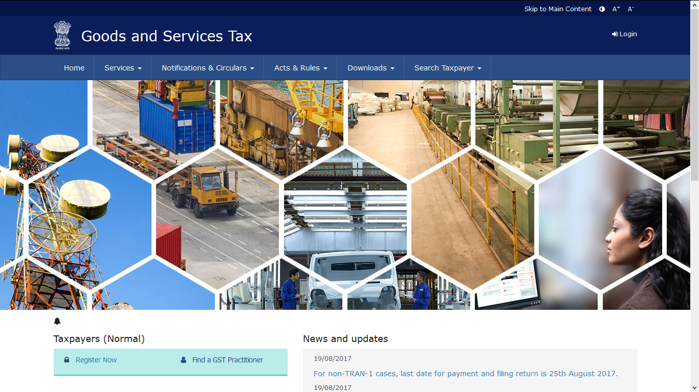
GST PORTAL
Notes:
h

Slide 20
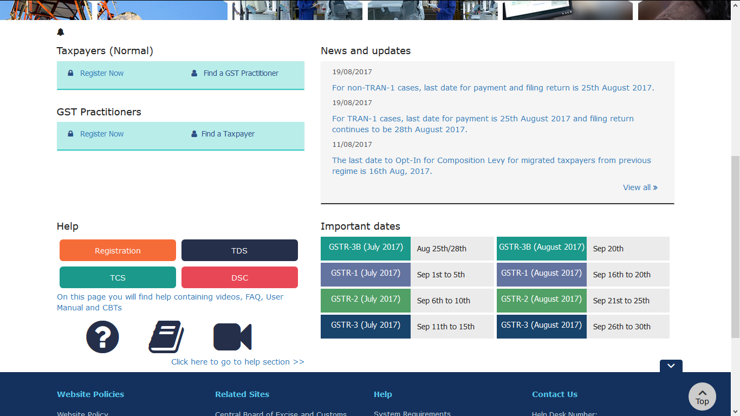
GST PORTAL

Slide 21
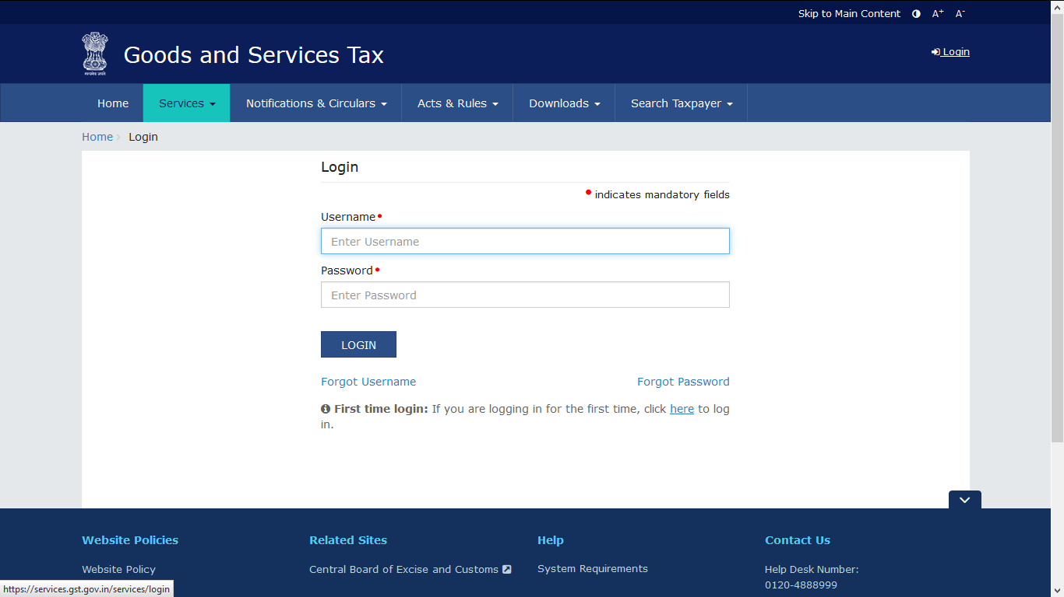
LOG IN

Slide 22
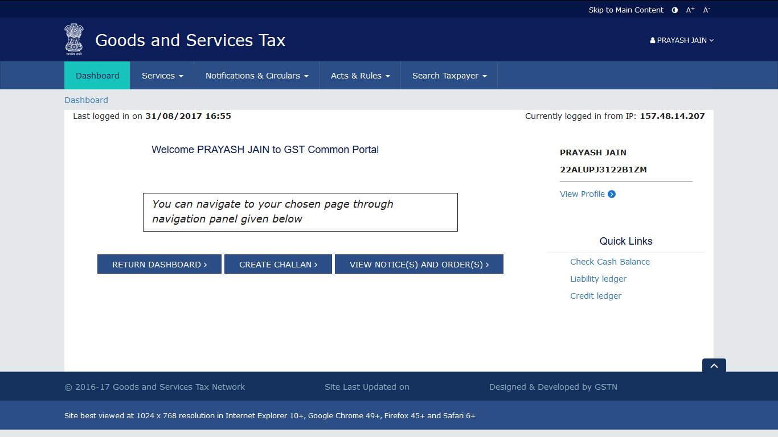
DASHBOARD

Slide 23
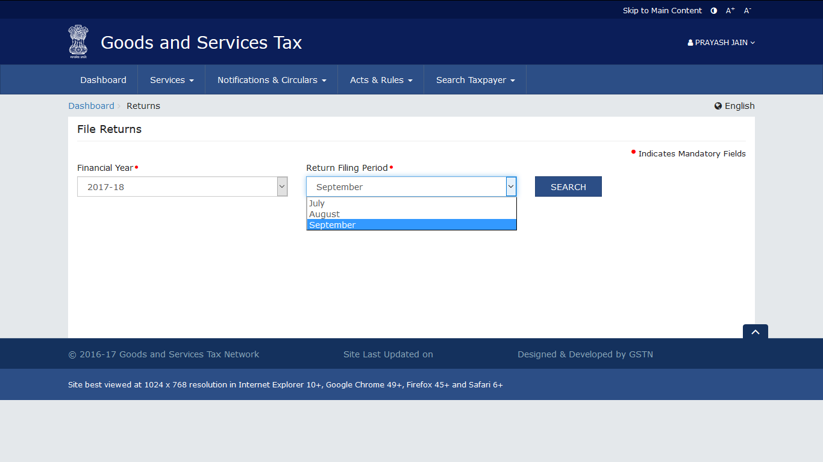
RETURN DASHBOARD

Slide 24
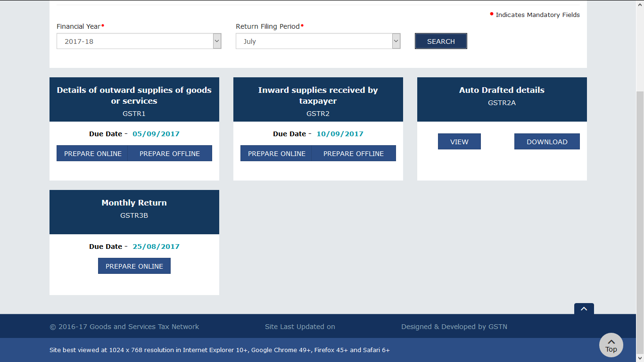
RETURN DASHBOARD-FORMS

Slide 25
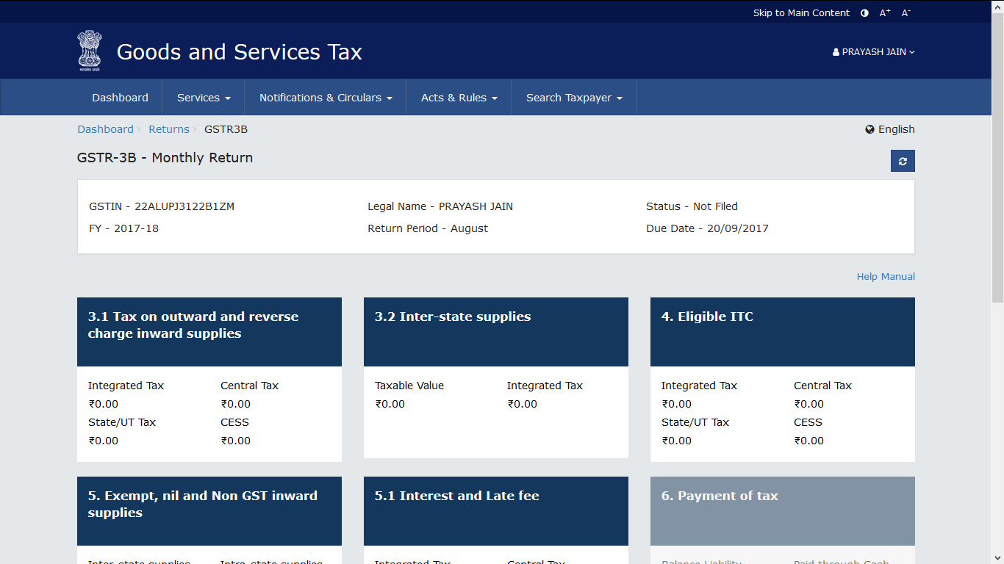
FORM GSTR- 3B

Slide 26
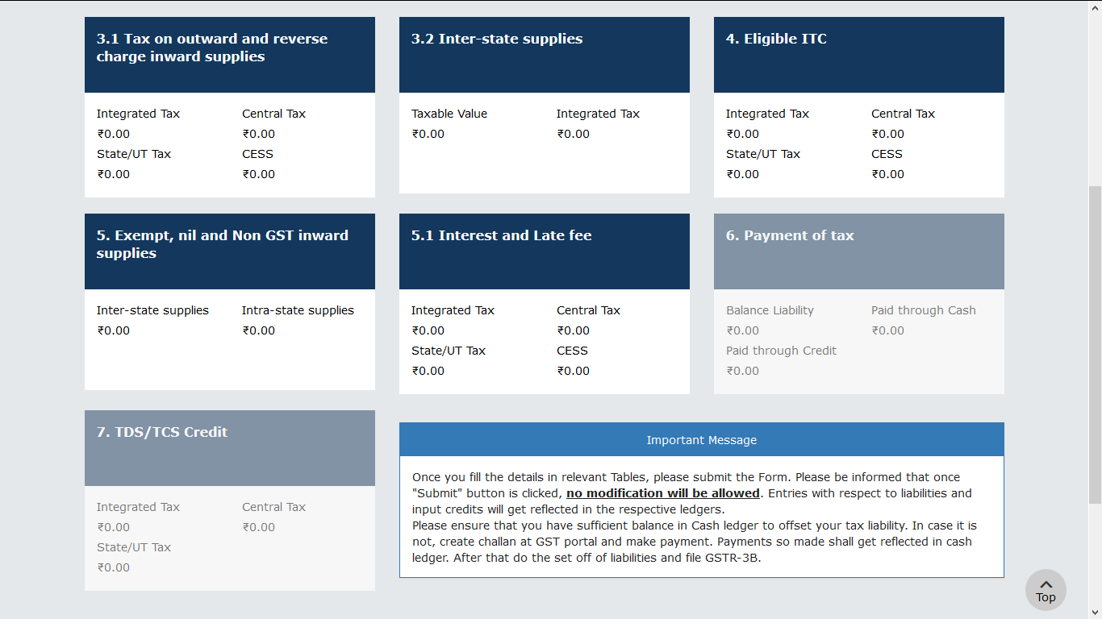
FORM GSTR-3B

Slide 27
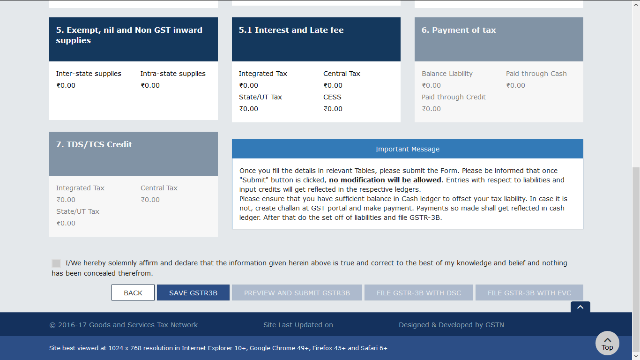
FORM GSTR-3B

Slide 28
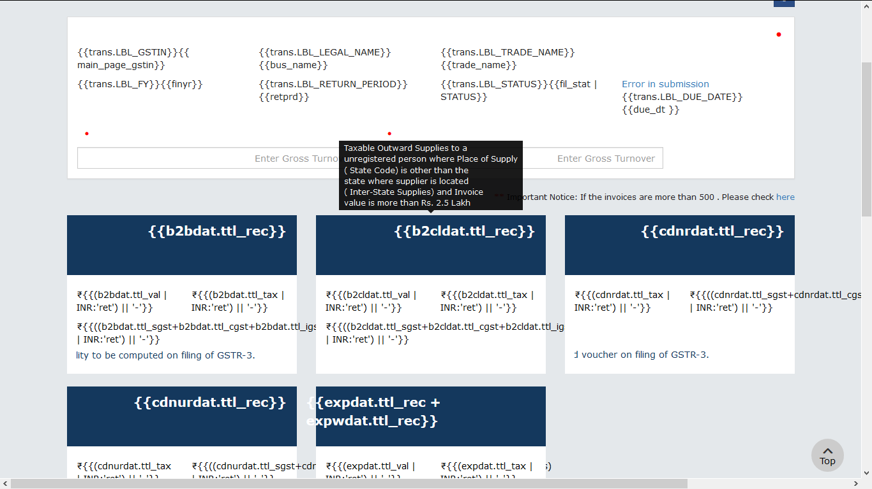
FORM GSTR-1

Slide 29
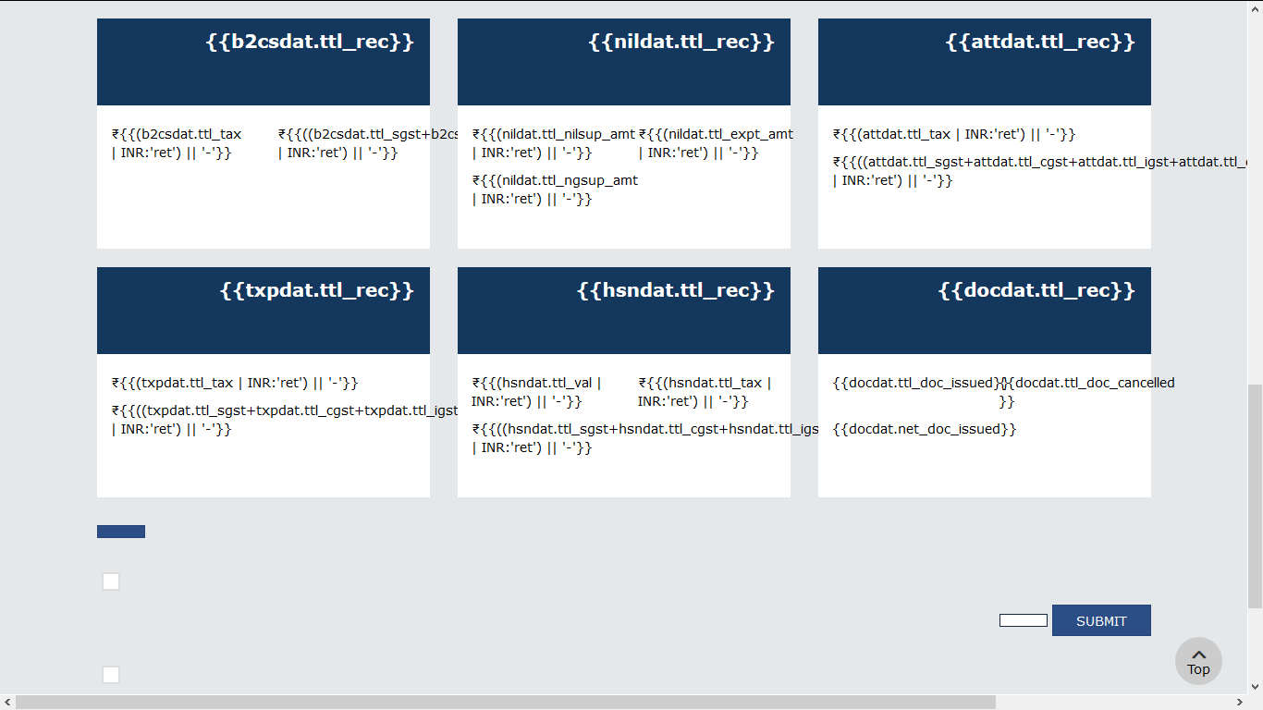
FORM GSTR-1

Slide 30
DETAILS INCLUDED IN FORM GSTR-2 (RULE 2)
FORM
GSTR-2
GSTR-1: Outward supplies
PART A OF FORM GSTR-2A
PART B OF FORM GSTR-2A
GSTR-6: ISD
GSTR-7: TDS Deductor
PART C OF FORM GSTR-2A
GSTR-8: TCS Collector
PART D OF FORM GSTR-2A

Slide 31
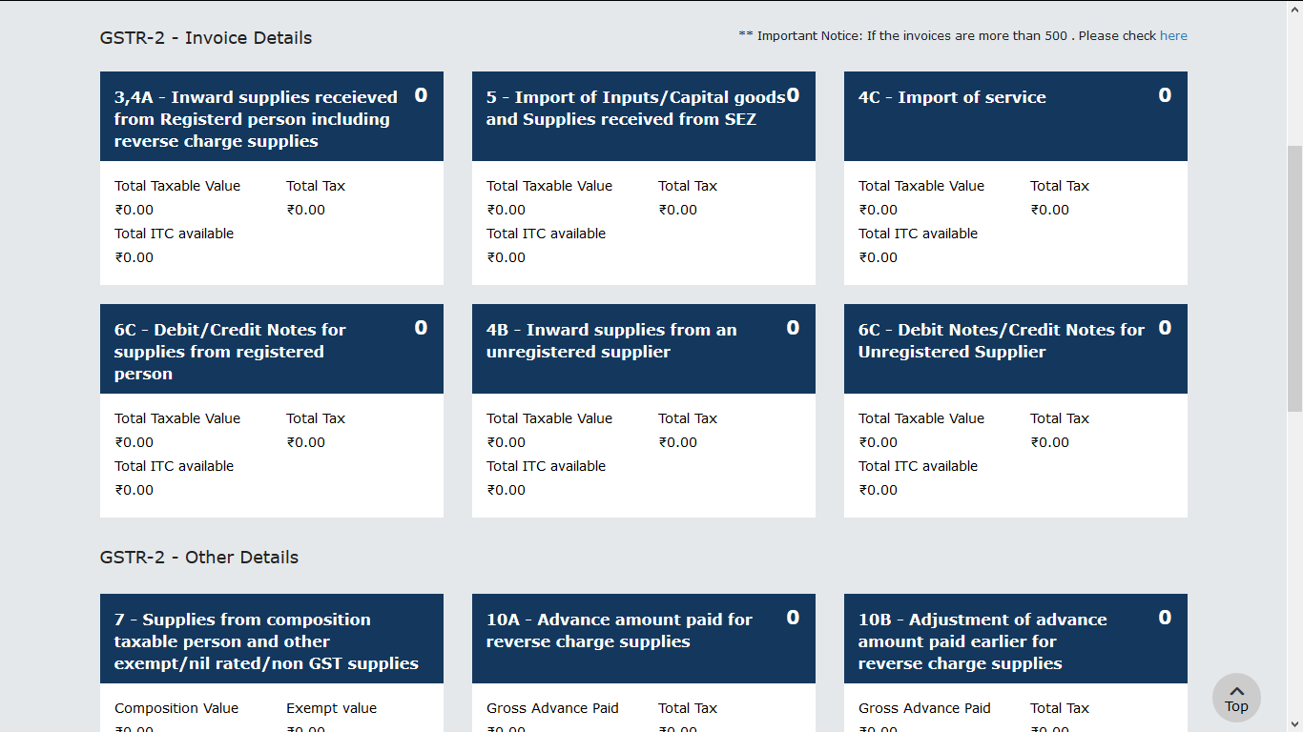
FORM GSTR-2

Slide 32
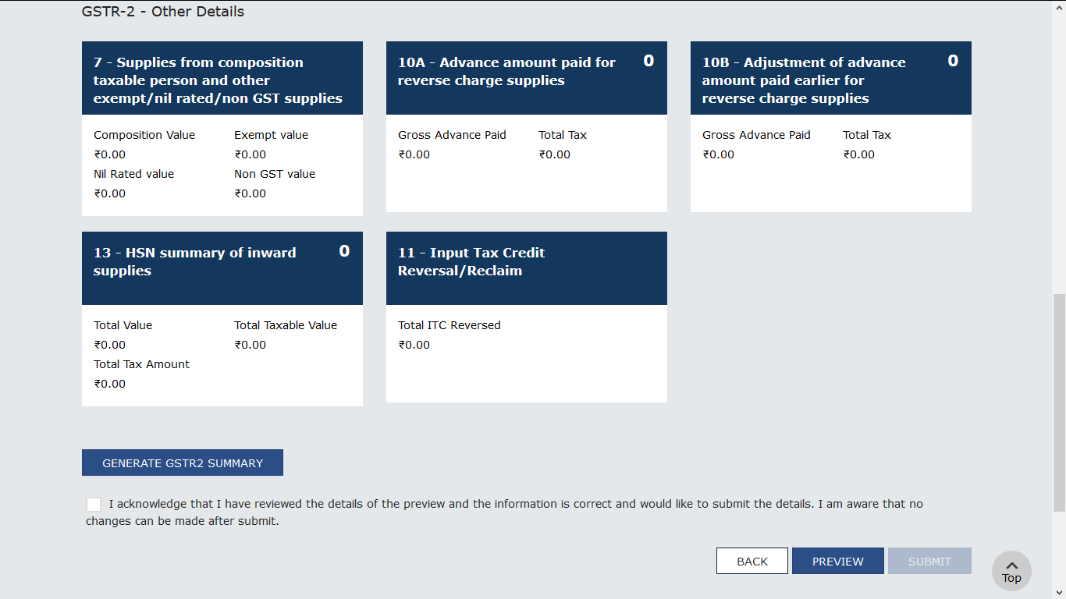
FORM GSTR-2

Slide 33
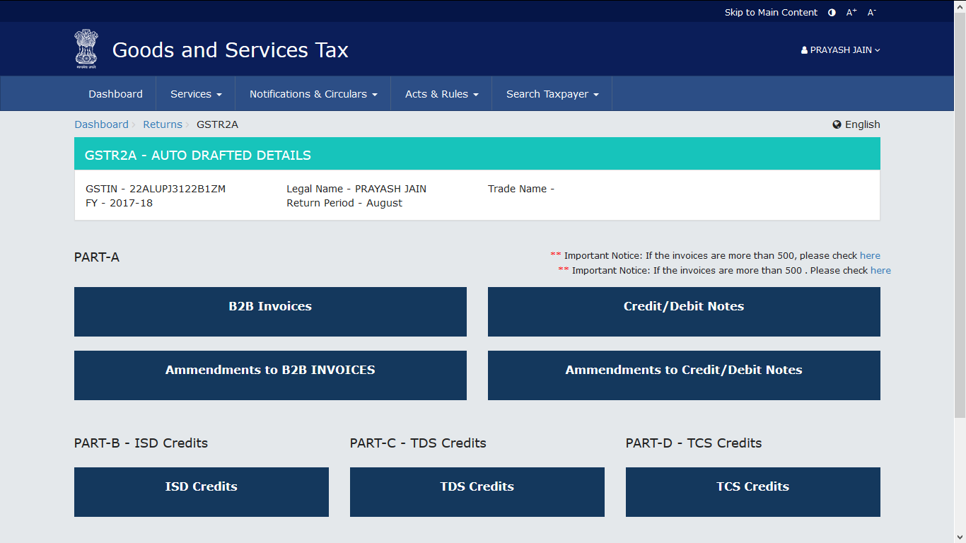
FORM GSTR-2A(AUTODRAFTED)

Slide 34
MONTHLY RETURN-GSTR-3
FORM GSTR-3
FORM GSTR-3
PART A
PART B
Every registered person to file monthly return on or before 20th of succeeding month
Auto populated on the basis of
GSTR-1 & 2
Tax, Interest or other dues
paid through credit/ cash ledger
Person can claim refund of balance in electronic cash ledger in PART B of FORM GSTR-3
(Deemed application for refund)

Slide 35
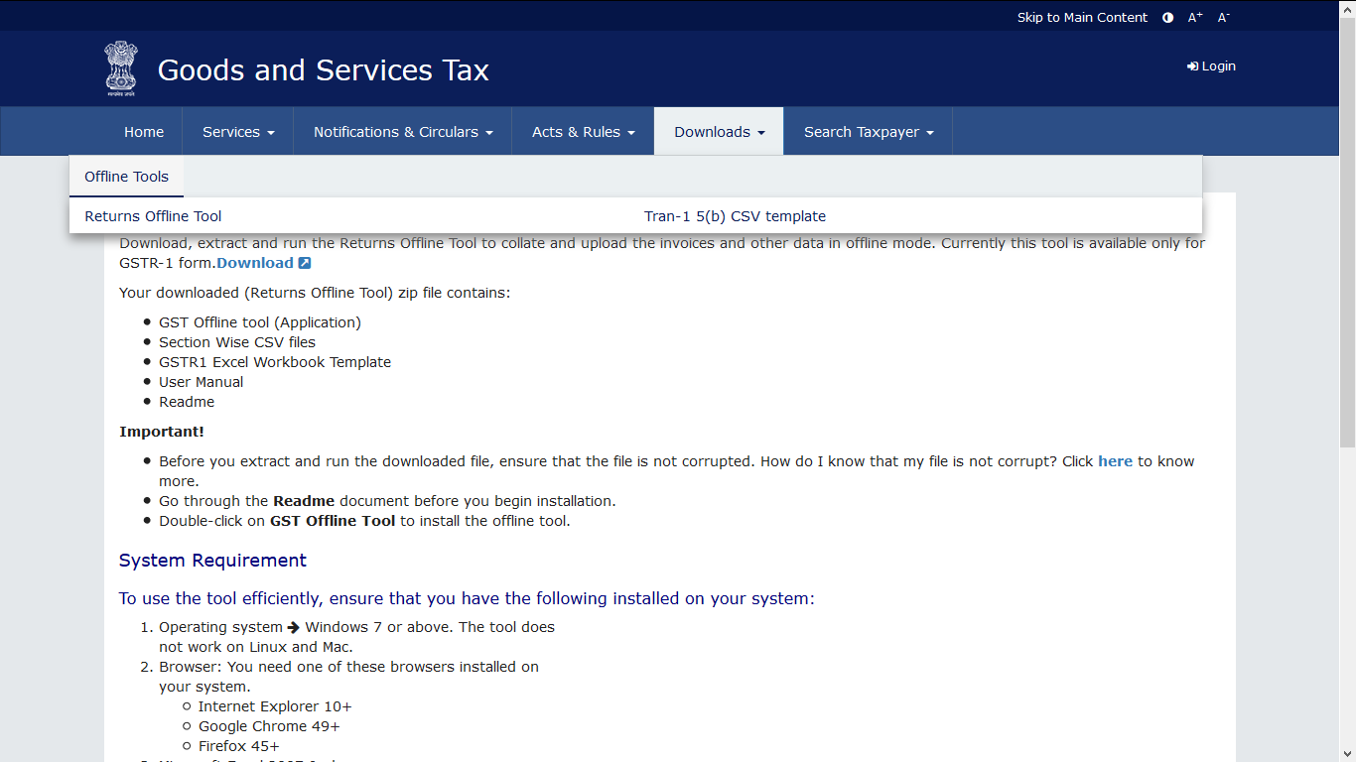
OFFLINE UTILITY

Slide 36
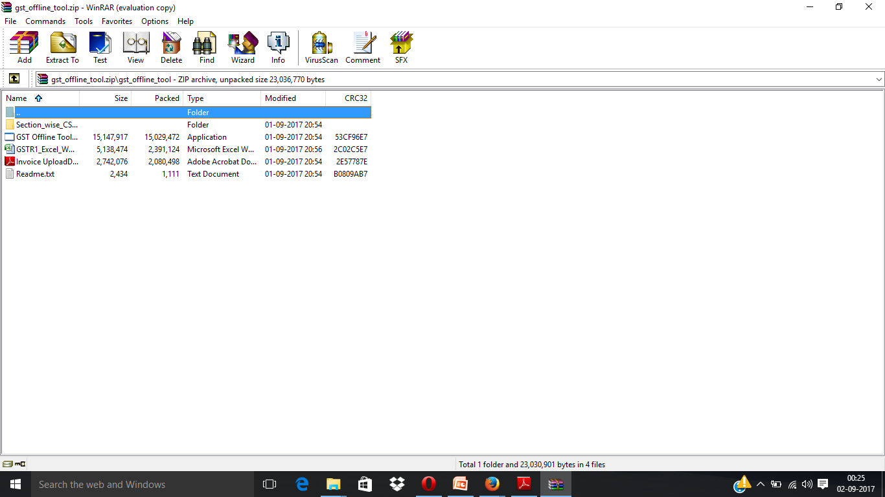
OFFLINE UTILITY

Slide 37
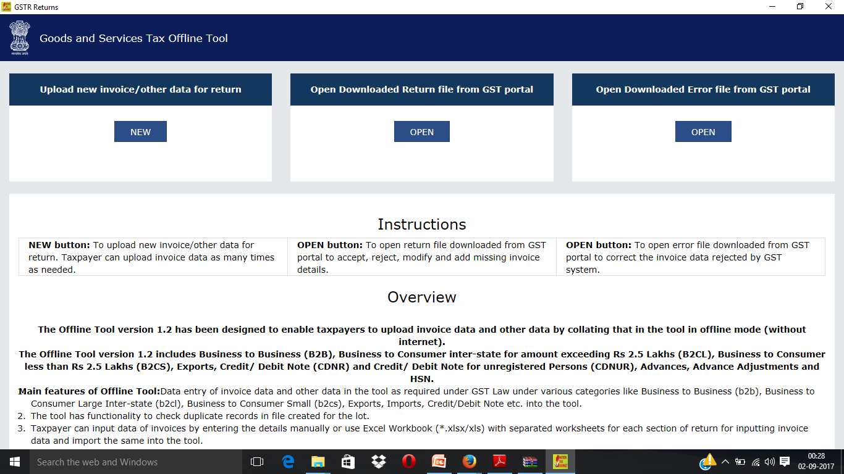
OFFLINE RETURN

Slide 38
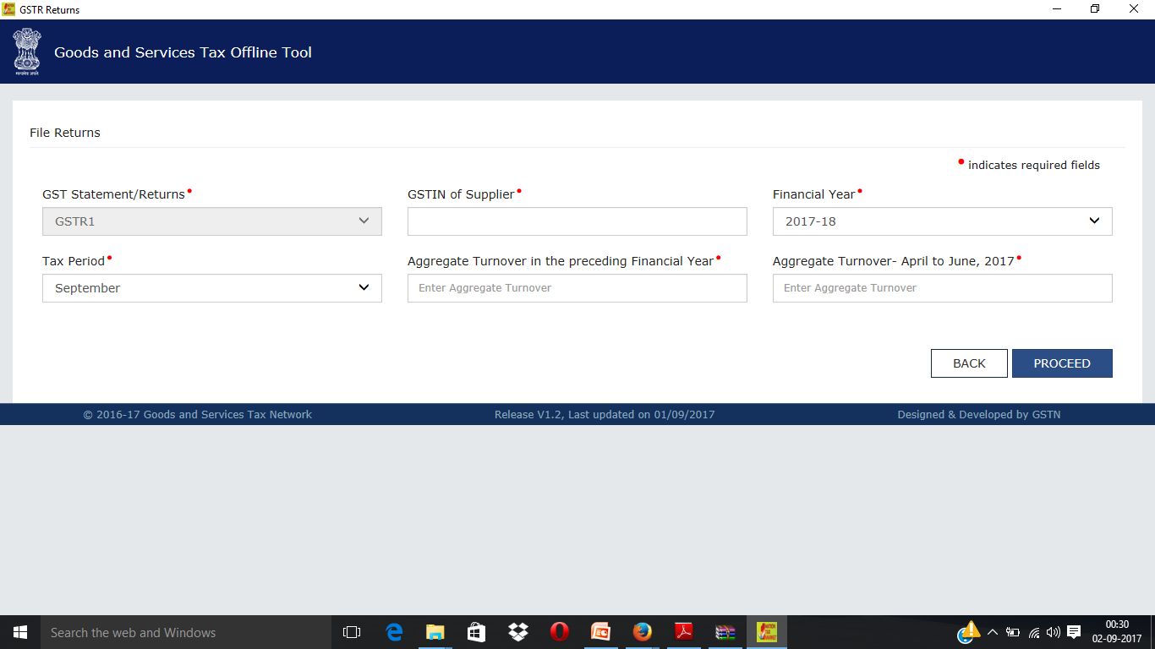
OFFLINE UTILITY

Slide 39
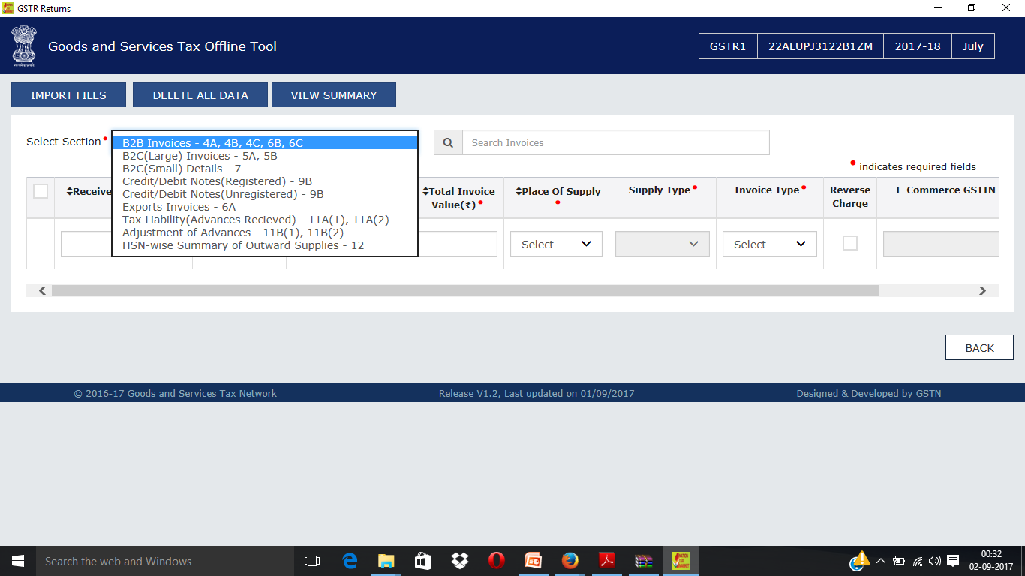
OFFLINE UTILITY

Slide 40
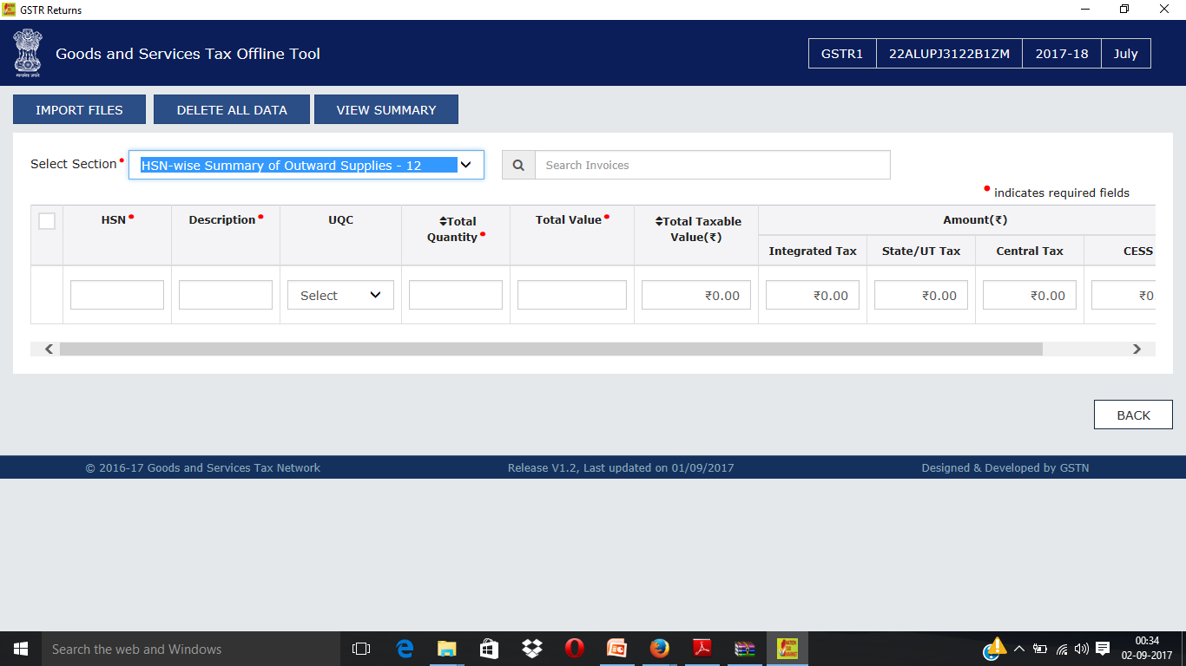
OFFLINE UTILITY

Slide 41
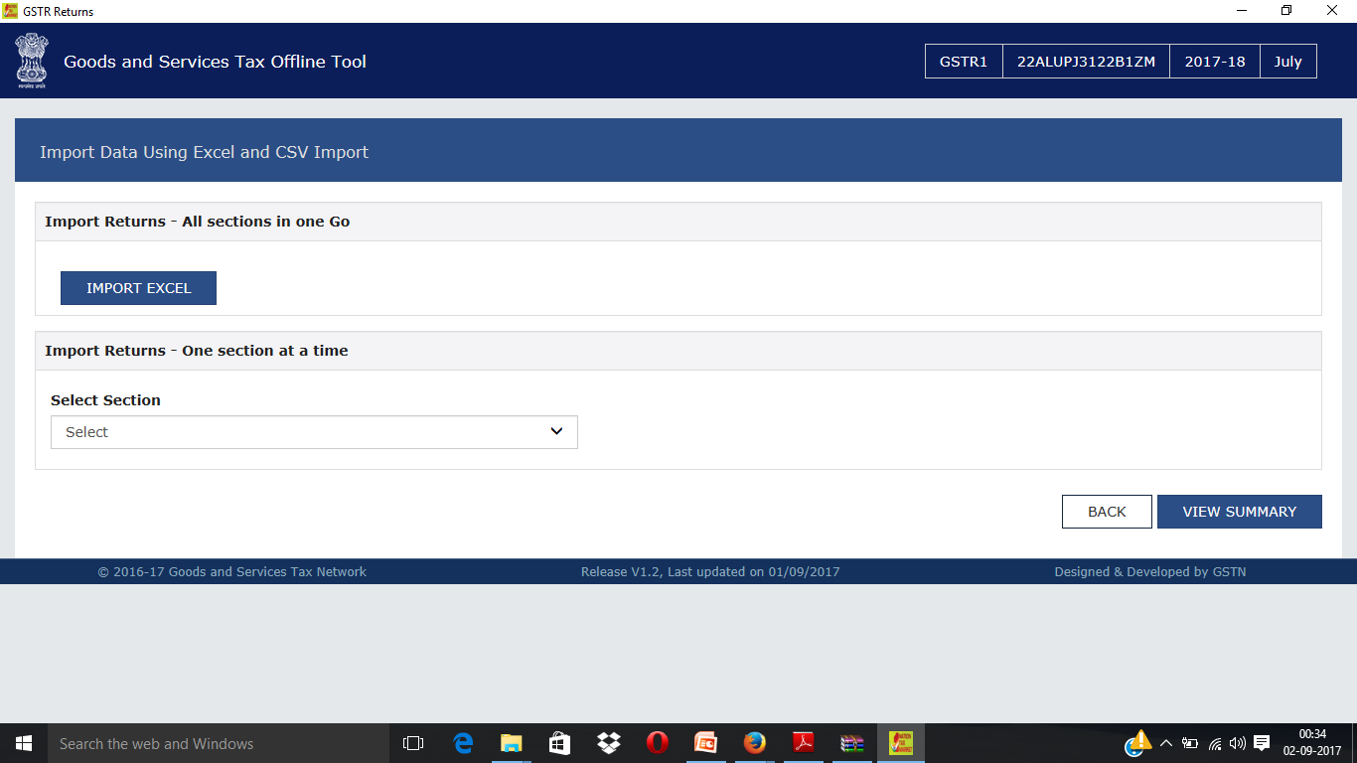
EXCEL UTILITY

Slide 42
OFFLINE UTILITY

Slide 43
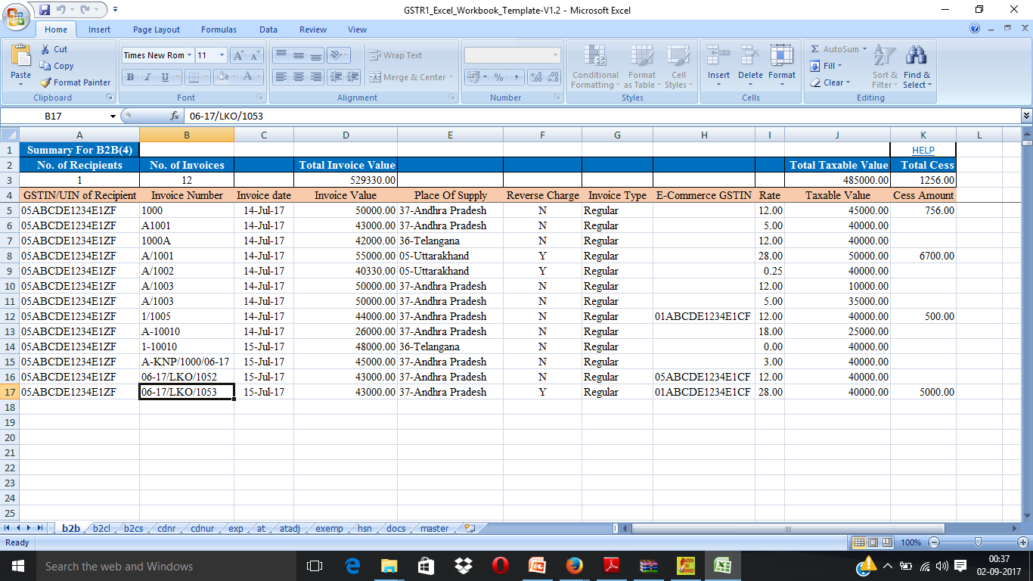
EXCEL UTILITY

Slide 44
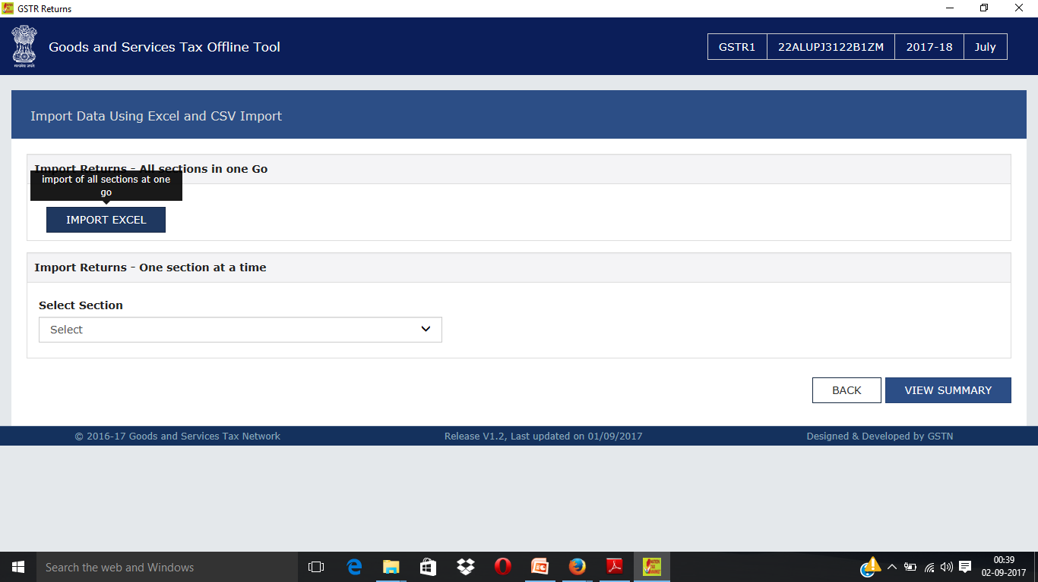
EXCEL UTILITY

Slide 45
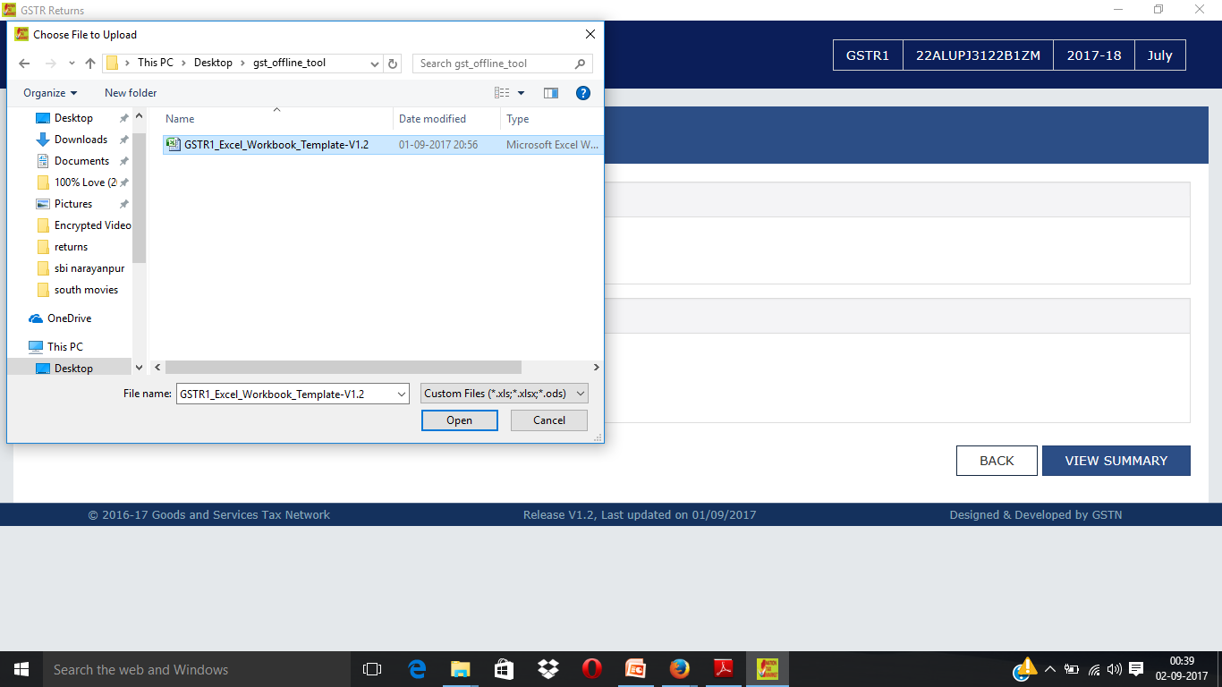
EXCEL UTILITY

Slide 46
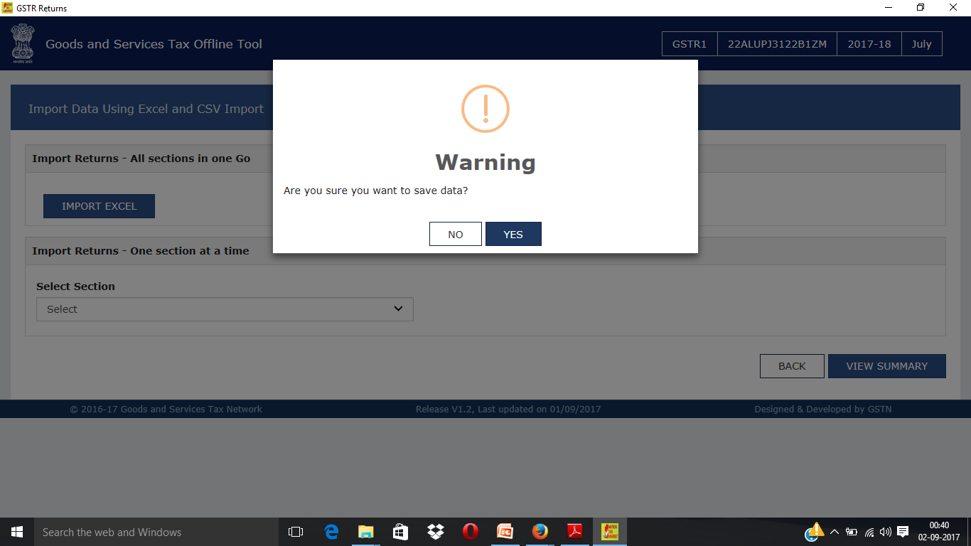
EXCEL UTILITY

Slide 47
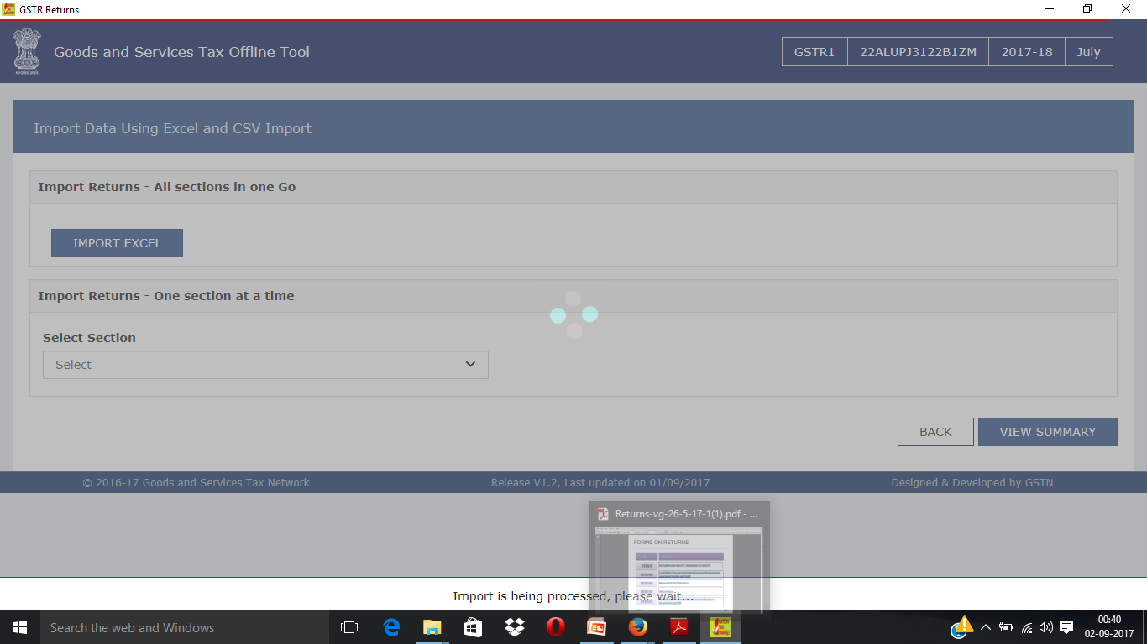
EXCEL UTILITY

Slide 48
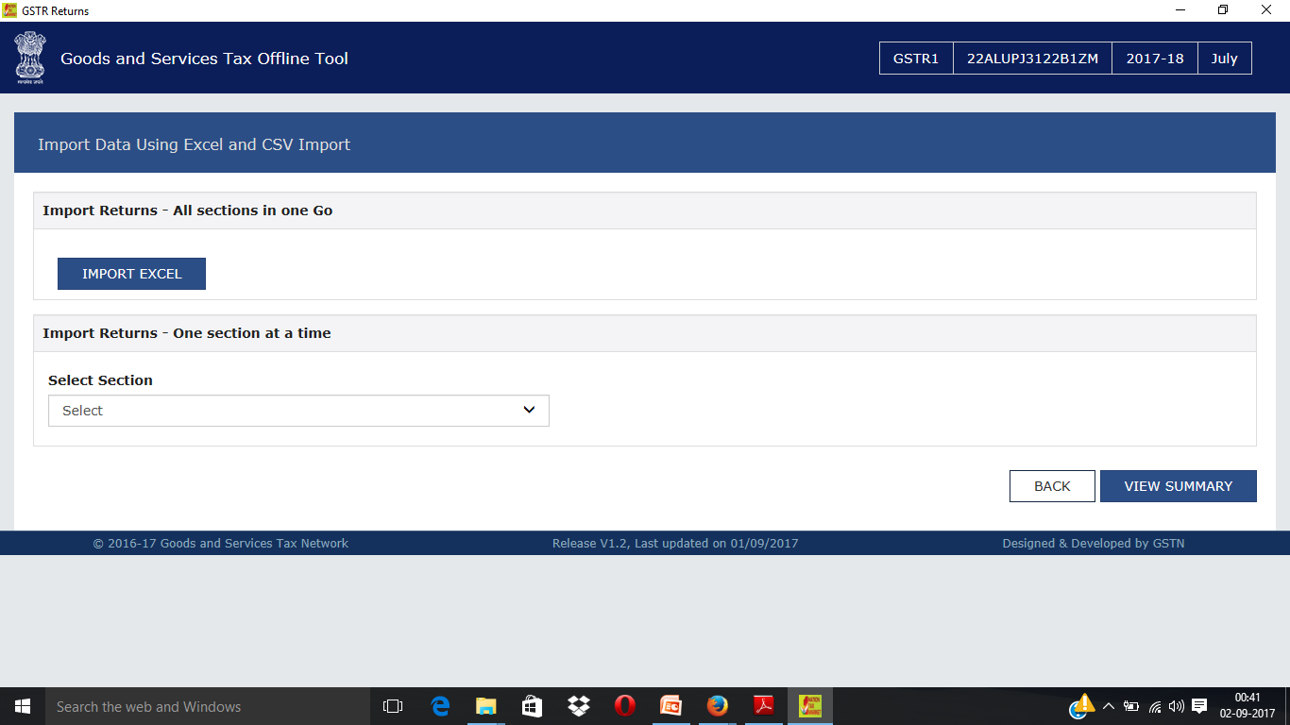

Slide 49
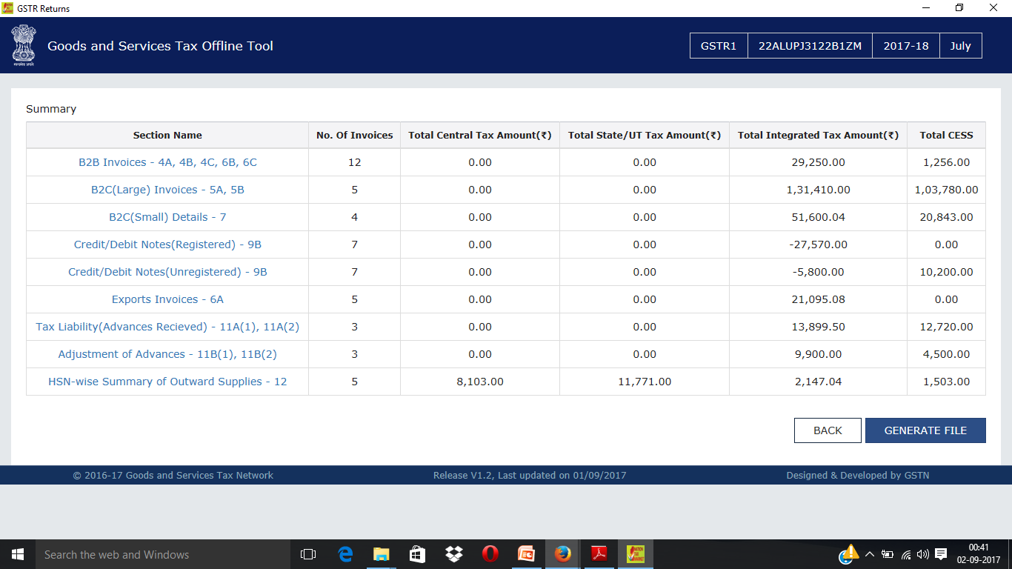

Slide 50
THANK YOU
CA PRAVESH JAIN

