Slide 1
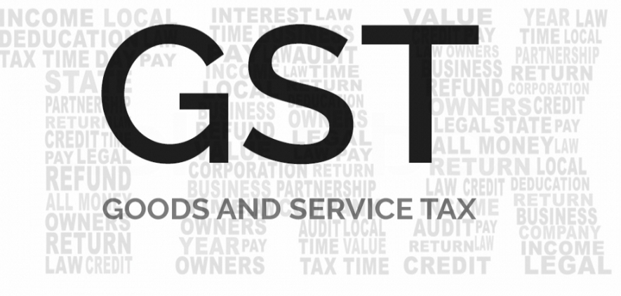
GST
Shashikant Sharma
shashikantsharma427@gmail.com

Slide 2
Introduction
The proposed GST law shall be a simple ‘ACT’ replacing all Acts relating to levy of indirect taxes.
Undoubtedly the most significant reform since the liberalisation in 1991, GST will transform India’s economic landscape.
Goods and service tax (GST) is a comprehensive tax levy on from manufacture to final consumption of goods and service at a national level.
GST would basically be a destination based tax will make life easier for businesses in India.
Companies will not have to file tax returns with multiple departments, but there will be just one web-based form to file tax returns.
The country will finally become one common market, with uniform pricing across states.

Slide 3
GST Global Scenario
Goods and service tax (GST) is globally known as VAT or a national level VAT
More than 140 countries have already introduced GST / National VAT.
To remove cascading effect of taxes and provide a common nation-wide market for goods and services, India is moving towards the introduction of GST.
Typically it is a single rate system but two/three rate systems are also prevalent.
France was the first country to introduce GST system in 1954.
India will be one of the very few countries with a dual GST regime alongside Canada and Brazil.
Standard GST rate in most countries ranges between 15-20%.

Slide 4
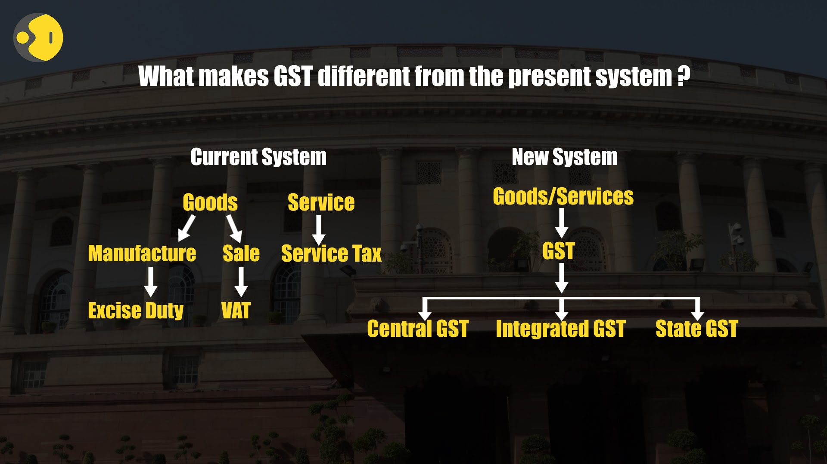

Slide 5
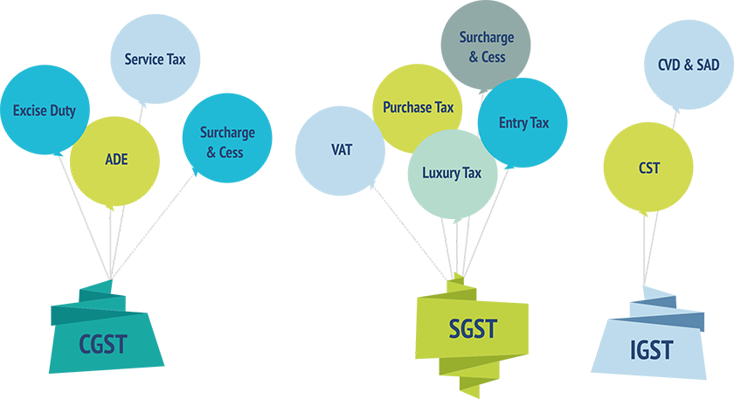
Taxes Subsumed in GST
GST replaced several existing
taxes and levies which include:
Central Taxes to Subsumed
Central excise duty
Services tax
Additional customs duty,
Surcharges & Cess
CVD & SAD
State Taxes to subsumed
State-level value added tax
Purchase Tax
Luxury Tax
Entry Tax
Octroi
Entertainment Tax

Slide 6






Model Of GST
GST Structure
Centre GST
State GST
IGST
GST to be levied
by the Centre
GST to be levied
by the State
GST to be levied by
the Centre and the
States concurrently

Slide 7
Levy & Collection
1: Subject
  Services
  Goods
  Both (Sch.-II)
Chapter-iii of cgst act
2: Supply
  Included
  Implied (Sch.- I)
  Excluded (Sch.-III)
3: Place
  Inter-State
  Intra-State
4: Time
  Specified for goods
  Specified for services

Slide 8
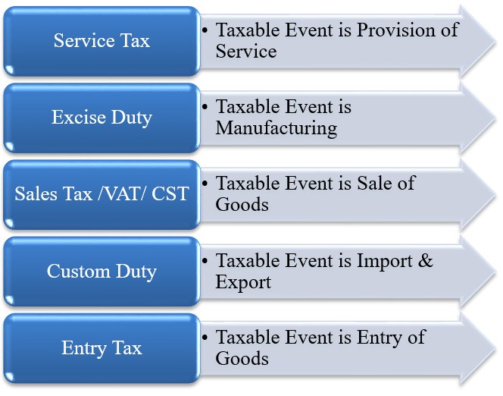
Taxable Event
Before GST tax event
In GST tax event
In GST, Tax levied on Supply of Goods / Services based on Place & Point of Supply

Slide 9
How will the goods and services be classified under GST regime?
FOR GOODS :
HSN (Harmonised System of Nomenclature) code shall be used for classifying the goods under the GST regime.
Taxpayers whose turnover is upto Rs. 1.5 crores are not required to mention HSN Code in their invoices.
Taxpayers whose turnover is above Rs. 1.5 crores but below Rs. 5 crores shall use 2 digit code and
The taxpayers whose turnover is Rs. 5 crores and above shall use 4 digit code.
Here turnover means : annual turnover of preceding financial year .
FOR SERVICES :
Services will be classified as per the Services Accounting Code (SAC)
And mention code related provision same as goods and other provision same as goods as given above.
N.N.-12/2017-Central tax

Slide 10
What is covered in Supply ?
Supply includes :- all forms of supply of goods or services or both such as sale, transfer, barter, exchange, licence, rental, lease or disposal made or agreed to be made for a consideration by a person in the course or furtherance of business;
Import of services for a consideration whether or not in the course or furtherance of business;
The activities specified in Schedule I, made or agreed to be made without a consideration; and
The activities to be treated as supply of goods or supply of services as referred to in Schedule II.
Sec.7 of CGST Act

Slide 11
Supplies specified To be treated as Supplies made without a consideration
Permanent transfer/disposal of business assets for which ITC availed on such assets
Goods sent on job work or goods sent for testing or goods sent for certification would not qualify as ‘supply’ under this clause since there is no permanence in transfer.
Typically, donation of business assets or scrapping or disposal in any other manner (other than as a sale – i.e., for a consideration) would qualify as ‘supply’ under this clause, where input tax credit has been claimed on the same.
Supplies between related persons/ distinct persons (as specified in section 25) in the course or furtherance of business.
Supply of goods by principal (or agent) to agent (or principal).
Import of service from a related person in the course or furtherance of business.
Schedule-I

Slide 12
Place of Supply
Why ,we are required to determine the Place of Supply :-
GST is understood as a ‘destination based consumption tax’ but there is no provision that declares this fact.
This missing declaration is more than adequately supplied by the principle being embodied in the provisions of ‘Place of Supply’.
Concept of destination based tax on consumption is, tax would accrue to the taxing authority which has jurisdiction over the place of consumption which is also termed as Place of supply.
Place of supply is important to determine, When the location of supplier and the place of supply are in two different States within India, then it will be an Inter-State supply and IGST applies.

Slide 13
Place of Supply
Intra-State Supply
Rajasthan
Inter-State Supply
Gujarat
CGST-SGST
‘From’ Banswara
‘To’ Jaipur
‘To’ Surat
IGST
Dual tax – CGST-SGST
Registered office not relevant; location of goods is relevant
Intra-State supply, if ‘from’ and ‘to’ in one State
One tax – IGST
Movement for ‘delivery’ relevant;
even stock-transfer taxable
Imports – basic customs + IGST

Slide 14
Place of Supply
Determination Place of supply of goods and/or services as Intra-State supply/ Inter-State supply :-
CRITICAL factors: Where the below 2 are in the SAME STATE
Location of the supplier and
Place of supply determined u/s 7,8, 9 or 10 of IGST Act
Specific EXCLUSIONS:
  Supply of goods in the course of import, till they cross the customs frontiers of India
  Supply of services in the course of import
  Supply when place of supply is outside India but supplier is in India
  Supply to or by a SEZ developer or an SEZ unit
Section 4 of IGST Act

Slide 15
Place of Supply
The place of supply of goods, other than supply of goods imported into, or exported from India, shall be as under:
Where the supply involves movement of goods: Movement of goods terminates for delivery to the recipient.
Where the goods are delivered by the supplier to a recipient or any other person on the direction of a third person before or during movement of goods :- either by way of transfer of documents of title to the goods or otherwise ,it shall be deemed that the said third person has received the goods and the place of supply of such goods shall be the principal place of business of such third person;
It is important to identify the two supplies involved – by supplier to third party and by third party to recipient. This provision deals only with the first limb of supply, that is, supply by supplier to third party.
Sec.10 of igst act

Slide 16
Place of Supply
Where the supply does not involve movement of goods : The location of such goods at the time of the delivery to the recipient.
Where the goods are assembled, or installed at site : The place of such installation or assembly.
Where the goods are supplied on board a conveyance, including a vessel, an aircraft, a train or a motor vehicle : The location at which such goods are taken on board.
Place of Supply of Goods Imported into, or Exported from India :
Imported into India shall be the location of the importer;
Exported from India shall be the location outside India.
SeC.10 OF igst aCT
SeC.11 OF igst aCT

Slide 17
Place of Supply
Place of supply of Services :-
Where supplier & recipient in India :
Supply of
Service directly in relation to :
i. Immovable property construction,use,accommodation, letting out,architect,etc.
ii. Boat,Vessel,Lodging,Club,etc.
iii. Ancillary service to the above
Place of supply : Sec.12(3)
Location of Property/boat/
Vessel located
i. Restaurant and catering
ii. Personal grooming
iii. Fitness
iv. Beauty treatment
v. Health service including
Cosmetic & plastic surgery
Place of supply : Sec.12(4)
Location of actual performance of services
Notes:
Sec.12

Slide 18
Place of Supply
S. 12(5): Supply of Services of Training and Performance Appraisal
Registered recipient:
Location of recipient
S. 12(6): Supply of Services for admission to:
a) Cultural & artistic
b) Sporting
c)Scientific & educational
d) Entertainment event
e) Amusement Park
f) Services ancillary to above
Venue of event/ park
Unregistered recipient:
Place of actual performance
S. 12(7): Supply of:
a) Organising cultural, arts, sports, educational, scientific, entertainment, conference, fair, exhibition or similar events
b) Services ancillary to above
Registered recipient:
Location of recipient
Unregistered recipient:
Venue of event

Slide 19
Place of Supply
Supply of services of:
Sec 12(8): Transportation of goods, including by mail or courier
Sec 12(9): Passenger Transportation Service (Return journey treated as separate journey)
Registered Recipient: Location of registered Recipient
Unregistered Recipient: Location where goods handed over for their transportation.
Registered Recipient: Place of Registered Recipient
Unregistered Recipient: Place where passenger embarks on the conveyance for a continuous journey
Sec 12(10): Services on board conveyance like vessel, aircraft, train, motor vehicle
First scheduled point of departure of that conveyance for that journey

Slide 20
Place of Supply
Supply of:
Sec 12(12) Banking and Other Financial Services including Stock Broking
Location of recipient in suppliers records
(If not available, location of supplier)
Sec 12(13) Insurance Services
Registered recipient: Location of recipient
Unregistered recipient: Location of recipient in supplier’s records
Sec 12(14) Advertisement Services to Government, etc.
Place is State of dissemination in proportion

Slide 21
Place of Supply
For Supply of any other Service,
Place of supply is:
Section 12(2)(a): Registered recipient: Location of recipient
Section 12(2)(b): Unregistered recipient: Recipient address in
supplier’s records
Section 12(2)(b): Unregistered recipient: Location of supplier if address not available

Slide 22
Place of Supply
Where supplier or recipient is outside India:
Service i.r.o. goods required to be made physically available by recipient & Services requiring physical presence of receiver/ person acting on his behalf - Location where services actually performed Sec.13(3)
Services supplied directly in relation to immovable property - Location of such immovable property Sec.13(4)
Service by way of admission to/organising an event, etc. and ancillary services - Place where the event is actually held Sec.13(5)
Where any service referred to in subsection (3),(4)&(5) is supplied more than one location, including a taxable territory:- Shall be the location in taxable territory.
Banking services to account holders, intermediary services, hiring of means of transport (other than aircraft & vessels) upto 1 month :-
Location of supplier
Sec.13 of IGST

Slide 23
Place of Supply
Where supplier or recipient is outside India:
Transportation of goods (other than by way of mail/courier) :- Destination of the goods.
Passenger transportation service :- Place where passenger embarks on the conveyance for a continuous journey.
Service provided on board a conveyance :- First scheduled point of departure of that conveyance for that journey.
Online information and database access or retrieval services :- Location of recipient
Residuary :- Location of the recipient, If not available in the ordinary course of business, location of supplier.
Sec.13 of IGST

Slide 24
Time of supply
Why ,we are required to determine the Time of supply :-
The liability to pay tax on goods shall arise at the time of supply.
Provided that- where the supplier of taxable goods receives an amount up to one thousand rupees in excess of the amount indicated in the tax invoice – Time of supply for such part of excess payment is the date of issue of invoice in respect of such excess amount.
In case of Reverse charge
The time of supply shall be the earliest of the following dates :-
The date of the receipt of goods; or
The date of payment (enter in Books of A/c of recipient or debited in
his bank account, whichever is earlier)
The date immediately following 30/60 (in case of service) days from the date of issue of invoice.
Sec.12 of CGST

Slide 25
Time of supply
Where it is not possible to determine the time of supply under the provisions of act, time of supply shall—
in a case where a periodical return has to be filed, be the date on which such return is to be filed; or
in any other case, be the date on which the tax is paid.
Time of Supply – Special Charges
Special Charges means any charges (eg. Interest etc.) imposed for delay in payment of consideration, in such cases time of supply - date of receipt of the charges imposed.

Slide 26
Time of supply
Time of Supply of Goods :
As per Section 12(2) of CGST ACT, time of supply of goods shall be earlier of invoice/ payment, i.e., –
Date on which payment is credited to the supplier’s bank a/c (PAYMENT)
Date on which payment is entered in the books of supplier (PAYMENT)
Due date for issue of invoice by the supplier [Section 31]:
- Supply involves movement: Time of removal of goods
for supply
- Other cases: Delivery of goods/ making available to the
recipient or (INVOICE)
Actual date of issue of invoice by the supplier (INVOICE)

Slide 27
Time of supply
Time of supply of services :
As per Section 13(2) of CGST ACT, time of supply of services shall be earlier of invoice/payment i.e., –
Date on which payment is credited to the supplier’s bank a/c
Date on which payment is entered in the books of supplier
Due date for issue of invoice by the supplier [Section 31*]:
- Before/ after the supply of service, but within 30 days
Actual date of issue of invoice by the supplier
*Where payment is received in advance, the Supplier shall issue a receipt voucher, and NOT a tax invoice

Slide 28
Time of supply
Continuous Supply of Services :
  Continuous supply of services :- means a supply of services which is:
  provided, or agreed to be provided, continuously or on recurrent basis,
  under a contract, for a period exceeding three months with periodic payment obligations and other govt. notified services.
  Section 28(5) prescribes due date for issue of invoice in case of continuous supply of services:
Where the due date of payment is ascertainable from the contract:
Within 30 days of recipient becoming liable for payment
Where the due date of payment is not ascertainable from the contract, time of supply shall be earliest of-
Within 30 days of receipt of each payment
Where the payment is linked to the completion of an event:
Within 30 days of completion of event

Slide 29
Goods / Services- Reverse Charge
Time of supply
Where tax liable to be paid on reverse charge basis, the time of supply of goods/services shall be earliest of–
Date on which payment is entered in the books of recipient
Date on which payment is debited to the recipient’s bank a/c
31st day (in case
of goods, and 61st day in case of services) from the date of issue of invoice by supplier
Note: This factor is not relevant in case of services from a supplier being an associated enterprise outside India
Where it is not possible to determine time of supply in the 3 other cases: Date of entry in the books of account of the recipient

Slide 30
Invoice under GST
Tax Invoice
Delivery Challan
Every Registered Taxable person who Supplies Taxable Goods shall issue a tax Invoice Before/at the time of:-
Removal of Goods, if supply involves movement of goods
Delivery of Goods/making available to recipient, if supply doesn't involves movement of goods
Issuance of successive statements accounts, if supply is a continuous supply of goods
When recipient approves or 6 months from the date of removal, if supplied is on approval basis.
Transportation of goods without issue of invoice for the purpose of :-
Transportation of goods for job work
Transportation of goods for reasons other than by way of supply
Supply of liquid gas where the quantity at the time of removal from the place of business of the supplier is not known
Such other supplies as may be notified by the Board,
sec. 31 of CGST

Slide 31
Credit Note
Debit Note
A credit note can be issued:-
The goods supplied are returned by the recipient;
The tax charged in the invoice exceeds the tax payable on the supply;
The taxable value shown in the invoice exceeds the taxable value of the supply;
Where there is no change in the taxable value/ tax amount, a credit note need not be issued.
Credit note should be declared by the supplier in the return of the month of the issue of credit note.
If credit note not declared in that month, it can be declared in Any return prior to Sept. of the following the year in which the original tax invoice was issued or Filling of Annual Return, which ever is earlier.
A debit note should be issued :-
The taxable value shown in the invoice is lesser than the taxable value of the supply;
The tax charged in the invoice is less than the tax payable on the supply.
No change in the taxable value/ tax amount, a debit note need not be issued;
The details of the debit note have to be declared by the supplier in the return of the month of the issue of debit note;
Debit note includes a supplementary invoice.
sec. 34 of CGST

Slide 32
Other vouchers and doc. Required
Receipt Voucher
A registered person shall, on receipt of advance payment with respect to any supply of goods or services or both, issue a receipt voucher or any other document,
Refund Voucher
Where on receipt of advance payment with respect to any supply of goods or services or both the registered person issues a receipt voucher, but subsequently no supply is made and no tax invoice is issued in pursuance thereof, the said registered person may issue to the person who made the payment, refund voucher against such payment.
Payment Voucher
A registered person who is liable to pay tax under section 9(3) (4) shall issue a payment voucher at the time of making payment to the supplier.
sec. 31 of CGST

Slide 33
Other vouchers and doc. Required
Invoice(i.e. Tax Invoice)
A registered person who is liable to pay tax as per Sec. 9 (3)/(4) shall issue an invoice in respect of goods or services or both received by him from the supplier who is not registered on the date of receipt of goods or services or both.(Reverse charge 9(3) & Unregistered Person 9(4))
Revised Invoice
A registered person may, within one month from the date of issuance of certificate of registration, issue a revised invoice against the invoice already issued during the period beginning with the effective date of registration till the date of issuance of certificate of registration to him.
sec. 31 of CGST

Slide 34
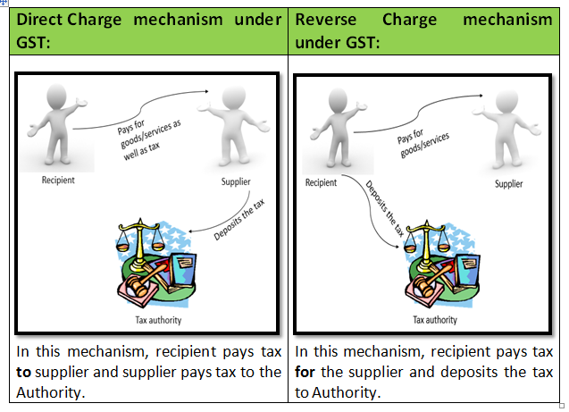
Reverse charge mechanism (RCM)
The scope of the RCM under the present law has become very wide as it does not only cover services but goods too.
The enforceability as well as the
compliance will be one of the key concern.
Normally, the supplier of goods/Service provider is liable to pay the tax.
But In case of RCM Buyer/ Service receiver is liable to pay tax.

Slide 35
Reverse charge mechanism (RCM)
RCM applicable for Both Goods and Service. Goods under reverse charge :-
Silk Yarn (From - Any person who manufactures silk yarn from raw silk
or silk worm cocoons for supply of silk yarn) (HSN Code- 5004 to 5006 )
Cashew nuts (From-Agriculturist)
Bidi wrapper leaves (From-Agriculturist)
Tobacco leaves (From-Agriculturist)
Supply of Lottery (From-SG,UT,LA)
Other than above goods Reverse charge also apply in case of - if supplier of goods is an un-registered person and recipient is registered.
Exceptions :-
Where the aggregate value of such Intra-State supplies of goods or service or both received by a registered person from any or all the suppliers, who is or are not registered, exceeds five thousand rupees in a day"
N.N.-4/2017-Central tax (R)
N.n.-08/2017-Central Tax (R)

Slide 36
Services under Reverse Charges Mechanism
S.No. | Services Under Reverse Charge Mechanism | Recipient of Service or any person liable to pay tax
1. | Taxable services provided or agreed to be provided by any person who is located in a non-taxable territory and received by any person located in the taxable territory | Person who located in taxable territory
2. | Service provided by GTA | Reg. entity, Casual taxable person
3. | Services provided or agreed to be provided by an individual advocate or firm of advocates | Any business entity
4. | Services provided or agreed to be provided by an arbitral tribunal | Any business entity
5. | Sponsorship services | Anybody corporate or partnership firm.
6. | Services provided or agreed to be provided by Government or local authority (other than those Specifically excluded) | Any business entity.
7. | Services provided or agreed to be provided by a director of a company or a body corporate. | A company or a body corporate
8. | Services provided or agreed to be provided by an insurance agent to a insurance co. | Insurance Company
9. | Services provided or agreed to be provided by a recovery agent to a banking company/NBFC/FC | Banking company /NBFC/FC
10. | Services by way of transportation of goods by a vessel from a place outside India up to the Custom Station in India | Importer
11. | Transfer or permitting the use or enjoyment of a copyright relating to original literary, dramatic, musical or artistic works | Publisher, Music company, Producer
12. | Radio taxi or Passenger Transport Services provided through electronic commerce operator | Any person (100% by Electronic Commerce Operator)
N.n.-13/2017-Central tax (R)

Slide 37
Reverse charge mechanism (RCM)
Invoice and documents required to issued at the time of transaction with unregistered person/specified category of person :
a registered person who is liable to pay tax shall issue an invoice in respect of goods or services or both received by him.
a registered person who is liable to pay tax shall issue a payment voucher at the time of making payment to the supplier.
Can one use input tax credit for payment of tax under reverse charge basis?
No, Definition of output tax specifically excludes tax payable under reverse charge basis. Therefore, input tax credit cannot be used for payment of tax under reverse charge basis.
sec. 31(3) of CGST
Sec.2(82)of CGST

Slide 38
Reverse charge mechanism (RCM)
Time of Supply :- in case of goods
The time of supply shall be the earliest of the
following dates :-
The date of the receipt of goods; or
The date of payment (enter in Books of A/c of recipient or debited in his bank account, whichever is earlier)
The date immediately following 30 days from the date of issue of invoice.
in case of Service :-
The date of the receipt of goods; or
The date of payment (enter in Books of A/c of recipient or debited in his bank account, whichever is earlier)
The date immediately following 60 days from the date of issue of invoice.

Slide 39
Services under RCM and applicable Rate | Services on which ITC not avail and applicable rate (mention in ITC rule) | Services on which ITC available only on Input service and applicable Rate | Service on which no ITC available and applicable Rate (mention in service rate schedule)
Service provided by GTA @ 5% No ITC | Works contract services @18% | Transport of passengers by rail in Ist class & AC @5% | Transport of passengers, by AC contract carriage /stage carriage/Radio taxi;@5%
Legal services @ 18% | Construction service@12% | Transport of passengers by air in economy class /RCS @5% | Renting of motorcab@5%
Sponsorship services @ 18% | Renting of motorcab @5% No ITC | Transport of goods by rail@5% | Services of GTA in relation transportation of goods@5%
Transport of goods in a vessel@ 5% with ITC of input services | Supply of food/drinks in restro not AC and central heating @12% | Transport of goods in a vessel@5% | Supply of tour operators services@5%
 | Outdoor catering@18% | Leasing of aircrafts by a scheduled airlines @ 5%
 |  | Services provided by foreman of chit fund@12%
Notes:
RCS- regional connectivity scheme

Slide 40
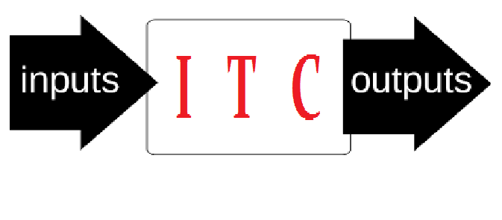
Input Tax Credit
Input credit means that at the time of paying tax on output the tax paid in inputs can be reduced.
Every registered person shall be entitled to take credit of input tax charged on any supply of goods or services or both to
him which are used or intended to
be used in the course or furtherance of his
business, subject to such conditions and
restrictions specified in section 49.
Registered person shall be entitled to take ITC on the basis of following documents :-
Invoice issued or debit note
Bill of entry
Document issued by ISD
Invoice prepared in respect of reverse charge
Rule 36 of cgst Rules

Slide 41
Conditions for availment of ITC
Input tax credit is available only if –
Goods or services or both are used or intended to be used in the course or in the furtherance of his business;
He is in possession of tax invoice/ debit note / tax-paying document issued by a supplier registered
He has received the said goods or services or both subject to job-work facilities and restrictions relating to input tax credit in Section 19;(if goods/assets supplied by principal to the job worker not received back in such period 1/3 year as the case may be, it shall be deemed that such inputs had been supplied by principal to the job worker on the day when the said inputs were sent out).
The supplier has paid the said amount of tax (as charged in the invoice) to appropriate Government in cash or by way of utilization of input tax credit, as admissible.

Slide 42
Conditions for availment of ITC
He – claimant of input tax credit – has furnished return under section 39 in FORM-GSTR 2.
Goods received in Instalment against a single invoice - credit can be taken upon receipt of last instalment of goods.
Capital goods on which depreciation is
claimed : Claim of depreciation on tax
component disqualifies a recipient of
Capital goods from availment of
input tax credit.
Cost of assets- Rs.100
Tax@10%- Rs.10
-----------
Total Cost- Rs.110
If Deprecation charged on Rs.100
ITC AVAILABLE
If Deprecation charged on Rs.110
ITC NOT AVAILABLE
Sec.16 of cgst Act

Slide 43
Conditions for availment of ITC
Time limit to avail the input tax credit
Registered person is entitled to take input tax credit on invoice/ debit
notes :-
  whichever is earlier of the following :-
1. After due date of furnishing of the return the month of September of the subsequent financial year
or
2. Relevant Annual return.
Sec.16 of cgst Act

Slide 44
Condition in which a portion ITC cease
Where the goods or services or both are used by the registered person partly for the purpose of business and partly for other purposes, the amount of credit shall be restricted to so much of the input tax as is attributable to the purposes of his business.
Where the goods or services or both are used by the registered person partly for taxable supplies including zero-rated supplies and partly for exempt supplies credit shall be restricted to so much of the input tax as is attributable to the said taxable supplies including zero-rated supplies.
Use of input tax credit: Partly for
Taxable Supplies
Zero-rated Supplies
Non-taxable Supplies
Exempt Supplies
ITC Available
ITC not available
Nil-rated Supplies
ITC Available
ITC not available
ITC not available

Slide 45
ITC not available
Works contract services when supplied for construction of immovable property, (other than plant and machinery).
Goods or services or both received by a taxable person for construction of an immovable property (other than plant and machinery) on his own account, including when such goods or services or both are used in the course or furtherance of business;
“Construction” includes re-construction, renovation, additions or alterations or repairs, to the extent of capitalization.
Goods or services or both on which tax has been paid under composition scheme (section 10 ). (goods/service received from person who avail composition scheme)
Sec.17(5)

Slide 46
ITC not available
Goods lost, stolen, destroyed, written off or disposed of by way of gift or free samples;
Goods or services or both used for personal consumption.
Travel benefits extended to employees on vacation such as leave or home travel concession
Rent-a-cab, life insurance, health insurance except where :-
Services which are obligatory for an employer to provide to its employees under any law for the time being in force, or
Service provide to person who carrying same business.
Sec.17(5)

Slide 47
ITC not available
Motor vehicles and other conveyances except when they are used –
for transportation of goods, and other , for supplies of :
(i) further supplies of such vehicles to a person,
(ii) Transportation of passengers,
(iii) imparting training on driving, flying such vehicles or conveyances;.
Food and beverages, outdoor catering, health services.
Goods or services or both received by a non-resident taxable person except on goods imported by him; (casual taxable person)
Membership of a club, health and fitness centre, beauty treatment, cosmetic and plastic surgery.
Any tax paid in accordance with the provisions of sections 74(demand order in case of short payment etc.), 129(Detention, seizure and release of goods and conveyances in transit) and 130(penalty in case of confiscation of goods/conveyances).
Sec.17(5)

Slide 48
Tax liability on supply of Second hand capital goods/Machinery on which input tax credit is taken
The registered person shall:
Pay an amount equal to input tax credit taken on such capital goods
Reduced by percentage points as prescribed or
Tax on the transaction value of such capital goods, whichever is higher.
Supply of Capital goods on which ITC had been taken earlier
Pay tax on higher of
Reduced % of deduction as may be specified
Or
Tax on transaction Value

Slide 49
Manner of utilisation of ITC
In GST regime, the amount of credit to be available will be auto-populated by the GST system based on the Outward supply returns filed by the vendors. Thus, effectively the availment and utilisation of credit will be through electronic ledger. The manner of utilization, conditions and time lines would be prescribed.
The Electronic Credit Ledger has only three Major Heads of Credit, cross-utilization of credit is available only as below in that order
Input tax | Output tax
IGST | IGST CGST SGST
CGST | CGST IGST
SGST | SGST IGST
UTGST | UTGST IGST
Notes:
Electronic Credit Ledger : self-assessed Input Tax Credit as per return filed by a taxable person shall be credited to its Electronic Credit Ledger.

Slide 50
Manner of utilisation of ITC
The main restriction is that the CGST credit cannot be utilized for payment of SGST or UTGST and vice versa.
Provides that the balance in the cash or credit ledger after payment of tax, interest, penalty, fee or any other amount may be refunded in accordance with the provisions of Sec.54(6).
Order of discharge of tax
the liability of a taxable person must be discharged in the chronological order-
Self-assessed tax and other dues arising out of returns for previous tax periods must be discharged first.
Self-assessed tax and other dues relating to the return of the current tax period.
Any other amount payable under the Act/Rules (liability arising out of demand notice or adjudicated proceedings etc).

Slide 51
Returns in GST
Different types of return required to be filled in GST as per given below :-
GSTR-1 :
The “Details of outward supplies”(ie. sales, goods return etc.) shall include details of Invoices, debit notes, credit notes and revised invoices issued in relation to outward supplies made during any tax period. This e-return shall be filed within 10 days from the end of the tax period.
In case of late filing of the above details, the person who defaults shall pay a sum of ₹ 100 for every day of continuing default subject to a maximum to ₹ 5,000 only.
The present process of return filing envisages that the recipient of the supply shall be Provided an opportunity to accept, reject, amend or delete the details in a two-way communication process.

Slide 52
Returns in GST
The details Provided by the supplier shall be auto – populated and available electronically to the recipient, for matching purposes, in a FORM GSTR- 2A
In case any error or omission is discovered in the course of matching, rectifications of the same shall be effected, tax and interest, if any as applicable shall be paid on such corrections by the person responsible for filing the return of outward supplies.
Such rectification, however, is not permitted after filing of annual return or the return for the month of September of the following financial year to which the details pertain whichever is earlier.

Slide 53
Returns in GST
GSTR-2
Every registered taxable person will be required to verify/modify, electronically the details of inward supplies of goods and/or services, during a tax period on or before the 15th day of the month succeeding month.
In respect of the return for outward supplies filed by the supplier of goods / services the receiver is required to match his receipts with the details of supplies filed by the supplier.
The details of outward supplies as filed by the supplier, shall be made available to the recipient of such supply in Part A of FORM GSTR-2A after the 10th day of the subsequent month. The receiver is required to – verify, validate, modify or even delete, if necessary – the details furnished by the suppliers.
Part B, Part C and Part D of the above Form GSTR-2A shall contain respectively details relating to ISD,TDS & TCS.

Slide 54
Returns in GST
Details will be validated by the recipient with reference to their records Now, these details as accepted by the recipient will be filed by them in the Format i.e. FORM GSTR-2 for inward supplies of the recipient.
Any modification, deletion or inclusion of inward supplies by the receiver in his inward return i.e. FORM GSTR-2 shall be communicated to the Outward supplier which will be visible to them as GSTR 1A.
Any modification is not allowed after the annual return or month of Sept. following F.Y, whichever is earlier.

Slide 55
Returns in GST
GSTR3
Every registered person shall furnish a return in FORM GSTR-3 electronically through the common portal within 20 days after the end of such month.
Part A of the return shall be electronically generated on the basis of information furnished through FORM GSTR-1, FORM GSTR-2 and based on other liabilities of preceding tax periods.
Every registered person furnishing the return shall, discharge his liability by debiting the electronic cash ledger or electronic credit ledger and include the details in Part B of the return in FORM GSTR-3.

Slide 56
Returns in GST
A registered person, claiming refund of any balance in the electronic cash ledger , may claim such refund in Part B of the return in FORM GSTR-3 and such return shall be deemed to be an application filed under section 54 (Refund).
(Refund application u/s 54 is Part B of the GSTR-3,as per deeming fiction).
Where the time limit for furnishing of details in FORM GSTR-1 and in FORM GSTR-2 has been extended and the circumstances so warrant, return in FORM GSTR-3B, in lieu of FORM GSTR-3, may be furnished in such manner and subject to such conditions as may be notified by the Commissioner.

Slide 57
Returns in GST
Annual return
Every registered person shall furnish an annual return electronically in FORM GSTR-9 through the common portal on or before the 31st December following the end of such financial year.
Every registered person whose aggregate turnover during a financial year exceeds two crore rupees shall get his accounts audited and furnish a copy of audited annual accounts and a reconciliation. statement, duly certified, in FORM GSTR-9C, electronically through the common portal either directly or through a Facilitation Centre notified by the Commissioner.
“Aggregate turnover”:- the aggregate value of all taxable supplies, exempt supplies, exports of goods or services or both and inter-State supplies of persons having the same PAN, to be computed on all India basis but excludes central tax, State tax, Union territory tax, integrated tax and cess & job work .
sec.2(6) of CGST Act

Slide 58
Steps for Return Filing
Step 1:
The taxpayer will upload the final FORM GSTR-1 return in the Common Portal or by uploading the file containing the said FORM GSTR-1 return with in 10th day of month succeeding the month during which supplies has been made. The supplier would not be allowed to include any missing invoices on his own after 10th day of the month.
Step 2:
GST Common Portal will auto-populate FORM GSTR-2A of the registered person based on the supply invoice details reported by the counter-party registered person (supplier) on a near real-time basis.
Step 3:
Recipient will accept / reject/ modify such auto-populated FORM GSTR-2A.

Slide 59
Steps for Return Filing
Step 4:
Recipient will also be able to add additional purchase invoice details in his FORM GSTR-2 which have not been uploaded by counter-party registered person (supplier) as described in Step 1 and 2 above, provided he is in possession of valid invoice issued by counter-party registered person and he has received such supplies.
Step 5:
Recipient will have the option to do reconciliation of inward supplies with counter-party registered person (supplier) during the next 7 days by following up with their counter-party registered person for any missing supply invoices in the FORM GSTR-1 of the counter-party registered person, and prompt them to accept the same as uploaded by the Recipient.
All the invoices would be auto-populated in the ITC ledger of Recipient. The Recipient would, however, indicate the eligibility / partial eligibility for ITC in those cases where either he is not entitled or he is entitled for partial ITC.

Slide 60
Steps for Return Filing
Step 6:
The registered person will finalize their FORM GSTR-1 and FORM GSTR-2 by using online facility at Common Portal, determine the liability on their supplies, determine the amount of eligible ITC on their purchases and then generate the net tax liability from the system for each type of tax.
Cash details as per personal ledger/ carried forward from previous tax period, ITC c/f from previous tax period, ITC reversal and associated Interest/Penalty, taxes paid during the current tax period etc. would get auto-populated in the FORM GSTR-3.
Step 7:
Taxpayers will pay the amount as shown in the draft FORM GSTR-3 return generated automatically at the Portal post finalization of activities mentioned in Step 6 above.
Step 8:
Taxpayer will debit the ITC ledger and cash ledger and mention the debit entry no. in the FORM GSTR-3 return and would submit the same.

Slide 61
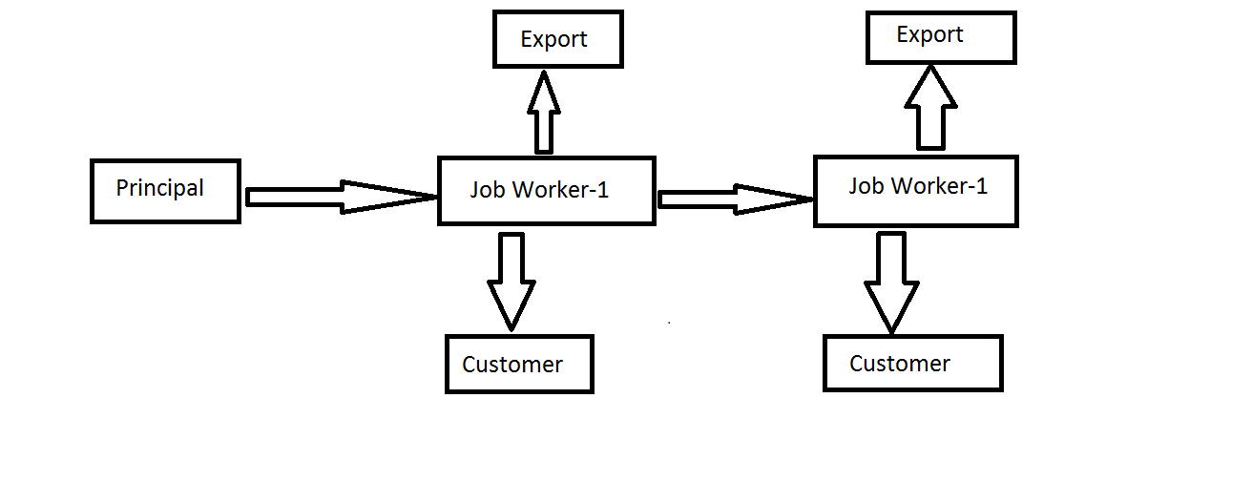
Job work
Supply of goods without payment of tax
Supply of goods without payment of tax
Supply of input/capital goods without payment of tax
Supply of input/capital goods without payment of tax
Supply of goods on payment of tax
Supply of goods on payment of tax

Slide 62
Job work
A registered person may under intimation and subject to such conditions as may be prescribed, send any inputs or capital goods, without payment of tax, to a job worker for job work and from there subsequently send to another job worker and likewise.(Sec.143)
Definition:- Any treatment or process undertaken by a person on goods belonging to another registered person. Define in Sec.2(68).
job-working must not be confused with repair or maintenance:-Job-working creates the functionality of an article but repair or maintenance restores or improves the functionality already created and possessed by that article or thing.
Is this Supply of goods or service:- Job work- supply of services, as per entry 3 of the Schedule II.

Slide 63
Job work
Entitlement to credit on input goods :
The credit of inputs can be taken even if inputs are sent directly to job-worker’s premises without bringing it to principal’s place of business.
The inputs, after completion of job-work, are received back by the principal within 1 year of their being sent out.
In case of direct supply :-the period of 1 year shall be reckoned from the date the job worker receives such inputs
The principal can take credit of input goods even if such input goods are sent directly to job-worker’s place without bringing to principal’s place of business.
If the inputs are not received back within 1 year:- it shall be deemed that such inputs had been supplied by principal to the job worker on the day when the said inputs were sent out.

Slide 64
Job work
Entitlement to credit on capital goods(other than moulds and dies, jigs and fixtures, or tools): -
The principal can take credit of input tax on capital goods sent to job-worker subject to the fulfilment of the following conditions:
The capital goods, after completion of job-work, are received back by him within 3 years of their being sent out.
In case of direct supply :-the period of 3 year shall be reckoned from the date the job worker receives such inputs
The principal can take credit of capital goods even if such capital goods are sent directly to job-worker’s place without bringing to principal’s place of business.
If the capital goods are not received back within 3 years - it shall be deemed that such capital goods had been supplied by principal to the job worker on the day when the said capital goods were sent out.

Slide 65
Job work
All challans issued in respect of inputs sent to job-worker and those received back are to be reported in GSTR-1.
Provided that the principal shall not supply the goods from the place of business of a job worker in accordance with the provisions of this clause unless the said principal declares the place of business of the job worker as his additional place of business except in a case—
where the job worker is registered; or
where the principal is engaged in the supply of such goods as may be notified by the Commissioner.
Waste and scrap generated during the job work :- may be supplied by the job worker directly from his place of business on payment of tax, if such job worker is registered and not reg. than by the Principal. Sec.143 of CGST

Slide 66
Transitional provisions in Job Work
  Input and WIP Input Goods
Inputs, as such, or partially processed inputs which are sent to a job-worker prior to introduction of GST under the provisions of existing law and
if such goods are returned within 6 months from the appointed day no tax would be payable.
If such goods are not returned within prescribed time, the input tax credit availed on such goods will be liable to be recovered.
The manufacturer and the job-worker are required to declare the details of such goods sent/received for job-work in prescribed format GST TRAN-1, within 90 days of the introduction of GST.

Slide 67
Transitional provisions in Job Work
        Manufactured Goods
If the manufactured goods are removed, prior to the appointed day, without payment of duty for testing or any other process which does not amount to manufacture, and
such goods are returned within 6 months from the appointed day, then no tax will be payable.
If such goods are not returned within prescribed time, the input tax credit availed on such goods will be liable to be recovered.
The manufacturer and the job-worker are required to declare the details of such goods sent/received for job-work in prescribed format GST TRAN-1, within 90 days of the introduction of GST.

Slide 68
Advance payment/received in GST
Advances taxable or not in GST:- Yes taxable because it’s covered in the definition of outward supply.
Statutory Provision:-
Sec.2(83) define “outward supply” in relation to a taxable person, means supply of goods or services or both, whether by sale, transfer, barter, exchange, licence, rental, lease or disposal or any other mode, made or agreed to be made by such person in the course or furtherance of business.
“agreed to be made”:- under this part of definition cover advance payment as a outward supply.
On which date is liable to pay tax : The date on which the supplier receives the payment with respect to the supply (Entry in books or received in bank, whichever is earlier).

Slide 69
Advance payment/received in GST
Is tax invoice required for advance payments received for goods or services?- No, the recipient of payment required to issue a receipt voucher for receipt of payment.
A person shall, on receipt of advance payment with respect to any supply of goods or services or both, issue a receipt voucher .
Where on receipt of advance payment with respect to any supply of goods or services or both the registered person issues a receipt voucher, but subsequently no supply is made and no tax invoice is issued in pursuance thereof, the said registered person may issue to the person who made the payment, refund voucher against such payment;
The details of advances for outward supplies of goods or services or both furnished in FORM GSTR-1.

Slide 70
Accounting entries in case of Advances
Step-1 : Advance received from customers :-
Assume we received from customer Rs.56 Lac as a advance :-
Bank A/c Dr. 56
To Party name A/c 56
Step-2 : Let’s assume our goods is taxable @12% (Using Reverse Tax Calculation formula ie.Rs.6 lacs ) :
Advances income Clearing A/c Dr. 6
To CGST output payable A/c 3
To SGST output payable A/c 3
Step-3 : Next, stage is Payment of output tax or set-off against the input credit.
CGST output Payable A/c Dr. 3
SGST output payable A/c Dr. 3
ITC Ledger/IT Cash A/c 6

Slide 71
Accounting entries in case of Advances
Step-4 : When invoice is received in respect of which advances was received, Assume we supplied the goods Rs. 100 on which duty payable@12% total amount of tax invoice is Rs.112 (100+12) :-
Party A/c Dr. 112
  To Sales 100
  To CGST output payable A/c 6
To SGST output payable A/c 6
Step-5 : Now we close the Advance income clearing A/c :-
CGST output payable A/c Dr. 3
SGST output payable A/c Dr. 3
To Advance income clearing A/c 6
Step-6 : Rest duty paid through Bank / ITC :
CGST output payable A/c Dr. 3
SGST output payable A/c Dr 3
To Bank A/c 6

Slide 72
Casual taxable person
Who is Casual taxable person
A person who occasionally undertakes transactions involving supply of goods or services or both in the course or furtherance of business, whether as principal, agent or in any other capacity, in a State or a Union territory where he has no fixed place of business; As per Sec.2(20)
A trader, businessman, service provider, etc. undertaking occasional transactions like supplies made in trade fairs would be treated as a ‘casual taxable person’ and will have to obtain registration in that capacity and pay tax.
Example :- A jeweller carrying on a business in Mumbai, who conducts an exhibition-cum-sale in Delhi where he has no fixed place of business, would be treated as a ‘casual taxable person’ in Delhi.
Notes:
Sec.27

Slide 73
Casual taxable person
  Aspects need to be noted
The threshold limits for registration would not apply and he would be required to obtain registration irrespective of his turnover. Compulsorily required to obtain registration.
He is required to apply for registration at least 5 days prior to commencement of business;
The registration would be valid for 90 days or such period as specified in the application, whichever is shorter;
An advance deposit of the estimated tax liability is required to be made along with the application for registration.

Slide 74
Input Service Distributer (ISD)
An Input Service Distributor (ISD) to distribute the credit in respect of input services (and not inputs) received in its name.
Generally, the head office of the person, or the corporate office, would be the location to which the services would be billed. There is no implication by law that an ISD must be the head office.
ISD
(Unit)
ITC
(Unit-1)
ITC
(Unit-2)
ITC
(Unit-3)

Slide 75
Input Service Distributer (ISD)
To distribute the credit of input services, the ISD would be required to follow the manner prescribed by the rules, including:
Issue of an ISD invoice to each recipient of credit on every distribution.
Recipients of credit to are those taxable persons to whom it is attributable, being persons having the same PAN as that of the ISD.
ISD is located in a State other than that of the recipient of credit :-the aggregate of Central tax, State tax and Union territory tax, as integrated tax. [ie.SGST as a IGST not a SGST of other state]
ISD is located in the same State as that of the recipient:-the Central tax and State tax (or Union territory tax) should be distributed as the Central tax and State tax (or Union territory tax), respectively.
Each type of tax must be distributed through a separate ISD invoice, but no requirement to issue ISD invoice at an invoice level.

Slide 76
Input Service Distributer (ISD)
Credit of tax paid on input service used by more than one location who are operational is to be distributed to all of them based on the pro rata basis of turnover.
Manner of Distribution of Credit by Input Service Distributor:-
Credit available with ISD | Recipient unit is located in same state as that of ISD | Recipient unit is located in different state than that of ISD
Central Tax | CGST | IGST
State Tax | SGST | IGST
UT Tax | UTGST | IGST
Integrated Tax | IGST* | IGST
*It’s important to note that, section 20 permits distribution of Integrated Tax either as IGST or CGST or SGST. However, Rule 39(1)(e) permits distribution of ITC of integrated tax as IGST only.

Slide 77
TRANSITIONAL PROVISIONS
If any contrary contained in GST Act, the ITC on account of any services received prior to the appointed day by an ISD shall be eligible for distribution as credit.
Even if the invoices relating to such services are received on or after the appointed day.
Sec. 140(7) of cgst

Slide 78
Accounts and Records
Every registered person shall keep and maintain, at his principal place of business a true and correct account of the following:
Production or manufacture of goods;
Inward supply of goods or services or both;
Outward supply of goods and/or services or both
Stock of goods;
Input tax credit availed;
Output tax payable and paid.
In case of multiple places of business :- the accounts relating to each place of business shall be kept at the respective places of business
concerned. Hence, all records are to be maintained at each place of business.
Registered assessee may keep and maintain such accounts and other particulars in the electronic form in such manner as may be prescribed.

Slide 79
Refund in GST
Who can claim refund under GST :- any person in respect of –
any tax (which was excess paid);
interest paid on such tax; or
any other amount paid (which is not required to have been paid);
input tax relating to goods and/or services that are exported out of India;
tax on inputs or input services “used” in the goods and/or services exported out of India including zero rated supply;
tax on the supply of goods regarded as deemed exports;
When the application for refund shall be made :-
before the expiry of two years from the relevant date, in such form and manner as may be prescribed;
Time limit not apply :- the time limit of two years will not apply where tax / interest / or any other amount has been paid under protest or otherwise.
In case of taxable person claiming refund of any balance in the electronic cash ledger, it can be claimed in the return furnished under section 39.
Sec.54 of CGST act

Slide 80
Refund in GST
Relevant date in case of refund :-
Situation of Refund | 2 years from below Relevant Date
On account of excess payment | Date of payment of GST
On account of Export of Goods | Date on which proper officer gives an order for export known as “LET EXPORT ORDER
On account of Export of Services | Date of BRC (Bank realization certificate)
On account of finalization of provisional assessment | Date of the finalization order
In pursuance of an appellate authority’s order in favour of the taxpayer | Date of communication of the appellate authority’s order
On account of no/less liability arising at the time of finalization of investigation proceedings | Date of communication of adjudication order or order relating to completion of investigation
On account of accumulated credit of GST in case of a liability to pay service tax in partial reverse charge cases | Date of providing of service
On account of refund of accumulated ITC due to inverted duty structure | Last day of the financial year

Slide 81
Refund in GST
  In case of refund arising from earlier law, it will be adjudicated as per earlier law.
  No refund shall be granted if the amount is less that Rs.1000/-
  Documents Required for Application of Refund :-
  Copy of proof of deposit of tax & invoices & Documents evidencing export.
  A CA Certificate may be called for evidencing that the tax burden has not been passed on to the buyer.
  Interest on Refund :-
  Refund application to be processed within 60 days from the date of
  application.
  For refunds made after 60 days from date of application – interest at the rate as may be recommended by the GST Council.
Sec.54 of CGST act

Slide 82
Export of goods
“Export of goods”:- means taking goods out of India to a place outside India.
Export of goods will be treated as ‘zero-rated supplies’. Accordingly, while no tax would be payable on such supplies, the exporter will be eligible to claim the corresponding input tax credits.
The movement of goods is alone relevant and not the location of the exporter/ importer.
The exporter will be eligible to claim refund under the following situations:-
He may export the goods under a Letter of Undertaking, without payment of IGST and claim refund of unutilized input tax credit; or
He may export the goods upon payment of IGST and claim refund of such tax paid.
Sec. 2(5) of IGST Act

Slide 83
Export of goods
“Export of services”:- means the supply of any service when,-
the supplier of service is located in India;
the recipient of service is located outside India;
the place of supply of service is outside India;
the payment for such service has been received by the supplier of service in convertible foreign exchange; and
the supplier of service and the recipient of service are not merely establishments of a distinct person in accordance with Explanation 1 in section 8.
Explanation 1 in section 8 :- an establishment in India and any other establishment outside India (for the purpose of Intra-State Supplies shall be treated as a distinct person, but in case of export not treated as a distinct person).
Sec. 2(6) of IGST Act

Slide 84
Zero rated supply
Zero rated supply :- means any of the following supplies of goods or services Zero rated or both –
export of goods or services or both; or
supply of goods or services or both to a Special Economic Zone developer or a Special Economic Zone unit.
Zero Rated Supply
Export
Supply to SEZ/SEZ Dev.
SEC.2(23) OF Igst act

Slide 85
Procedure of Export
Any person making zero rated supply (i.e. any exporter) shall be eligible to claim refund under either of the following two options, namely: -
Under bond or Letter of Undertaking :- Supply goods or services or both under bond or LUT, subject to such conditions, safeguards and procedure as may be prescribed, without payment of integrated tax and claim refund of unutilized input tax credit.
Under this option, procedure to file refund has been outlined in the CGST Rules, 2017.
The exporter claiming refund of unutilized input tax credit will file an application electronically through the Common Portal.
circular 26/2017-Custom

Slide 86
Procedure of Export
Application for refund shall be filed only after the export manifest or an export report.
The formats for furnishing bond or LUT for export of goods have been separately notified under CGST Rules, 2017.
  Files an export Manifest by the carrier
  Confirmation of export
Process the claim for refund
circular 26/2017-Custom

Slide 87
Procedure of Export
On payment of tax :-Supply goods or services or both, on payment of integrated tax and claim refund of such tax paid on goods or services or both supplied.
The procedure is that a person shall not be required to file any application for refund of IGST paid on supply of goods for exports.
The shipping bill, having inter-alia GST invoice details, filed by an exporter shall be deemed to be an application for refund .
Such application shall be deemed to have been filed,
Only when the person in charge of the conveyance carrying the export goods duly files an export manifest or an export report covering the number and the date of shipping bills or bills of export and
circular 26/2017-Custom

Slide 88
Procedure of Export
The applicant has furnished a valid return in FORM GSTR-3.
Receipt of information regarding furnishing of valid return in FORM
GSTR-3 from the common portal,
The Customs system shall process the claim for refund and
An amount equal to the integrated tax paid in respect of each shipping bill or bill of export shall be electronically credited to the bank account of the applicant mentioned in his registration particulars.
Shipping Bill
Form GSTR-1 Filed
Form GSTR-3 filed
circular 26/2017-Custom

Slide 89
Valuation of taxable Supply
Value of supply of goods and/or services on which CGST/SGST is to be discharged shall be the ‘Transaction Value’, where
Supplier and recipient of supply are unrelated
Price is actually paid/ payable – AND price is the sole consideration for the supply
Value of Taxable Supply
Section 2(84) of the CGST Act deems the persons below to be “related persons”:
Officers / Directors of one another’s business
Partners in business
Employer – employee
A person directly/ indirectly owns/ controls/ holds 25 of shares of both the persons
One directly/ indirectly controls the other
Both are directly/ indirectly controlled by a third person
Together, they directly/ indirectly control a third person
Members of the same family
Sole agent / distributor of the other

Slide 90
Valuation of taxable Supply
Transaction Value INCLUDES:
Amounts charged by supplier to recipient in respect of any taxes, duties, cesses, fees and charges levied under any statute, other than taxes paid under GST regime;
Amount incurred by Recipient which is liable to be paid by the Supplier;
Charges by Supplier to Recipient being:
  Incidental expenses (e.g.: packing, commission)
  Charges for anything done by the Supplier at the time or before the supply, in respect thereof
  Interest/ late fee/ penalty for delayed payment of consideration
  Subsidies directly linked to price – for supplier receiving the subsidy (excluding Central and State Govt. subsidies; i.e., Government subsidies will not be included in transaction value)

Slide 91
Valuation of taxable Supply
Transaction Value EXCLUDES discount:
Before/ at the time of supply
  Single condition: Such discount is duly recorded in the invoice
After the supply: Cumulative conditions:
  Agreement establishing discount entered into before/ at the time of supply
  Discount specifically linked to relevant invoices
  ITC reversed by the recipient to the extent of discount

Slide 92
Registration
Person liable for Registration :-
Every supplier shall be liable to be registered, from where he makes a taxable supply of goods or services or both, if his aggregate turnover in a financial year exceeds twenty lakh rupees.
Special category States, he shall be liable to be registered if his aggregate turnover in a financial year exceeds ten lakh rupees.
Every person who, on the day immediately preceding the appointed day, is registered.
Where a business carried on by a taxable person is transferred, whether on account of succession or otherwise, to another person as a going concern, the transferee or the successor.
Transfer pursuant to sanction of a scheme or an arrangement for amalgamation, demerger of two or more companies pursuant to an order of a High Court, Tribunal or otherwise, the transferee shall be liable to be registered.
sec.22 of CGST

Slide 93
Registration
Persons not liable for registration
The following persons shall not be liable to registration, namely: –
any person engaged exclusively in the business of supplying goods or services or both that are not liable to tax or wholly exempt from tax
an agriculturist, to the extent of supply of produce out of cultivation of land.
The Government may, specify the category of persons who may be exempted from obtaining registration under this Act.
Compulsory registration
The following categories of persons shall be required to be registered under this Act:-
persons making any inter-State taxable supply;
casual taxable persons making taxable supply
sec.23 of CGST

Slide 94
Registration
Compulsory registration
Persons who are required to pay tax under reverse charge;
Non-resident taxable persons making taxable supply;
Persons who make taxable supply of goods or services or both on behalf of other taxable persons whether as an agent or otherwise;
ISD, whether or not separately registered under this Act;
Every electronic commerce operator;
Every person supplying online information and database access or retrieval services from a place outside India to a person in India, other than a registered person; and
sec.24 of CGST

Slide 95
Transitional Provision

Slide 96
Transitional Provisions
  Migration of existing Tax Payers to GST :- Every registered
  person under the earlier law having valid PAN will be issued a provisional
  registration certificate (PRC) on and from the appointed day.(Sec.139)
  Existing taxpayer – i.e. registered under any of earlier laws on the day
  immediately preceding the appointed day, is registered or holds a licence
  under an existing law, shall be liable to be registered under this Act with
  effect from the appointed day. (Sec.22)
  Documents required for registration :-
  Proof of Constitution of Business
  Photograph of Promoters/ Partners/ Karta of HUF
  Proof of Appointment of Authorized Signatory
  Photograph of Authorized Signatory
  Opening page of Bank Passbook (Containing Bank A/c no.)

Slide 97
Carry forward of CENVAT Credit
Registered taxable person other than composition dealer
Allowed carry forward of Input tax/ CENVAT credit – through a return
Such credit must be eligible under earlier law and GST law
Credit can be taken in the electronic credit ledger(CGST)
Excess credit taken will be recovered as arrears of tax under GST law

Slide 98
Unavailed CENVAT Credit on Capital goods
A registered taxable person, other than composition dealer, shall be eligible to take the credit
In the electronic credit ledger
Unavailed Credit on Capital Goods (as per Rule 2(a) CENVAT Credit Rule,2004) not carried forward in a return
Unavailed Credit = (Total eligible credit – credit availed) under the earlier law
Such credits must be eligible under the earlier law AND under GST law
Excess claim shall be recovered as arrears of tax under GST law
Sec.140(2) of cgst

Slide 99
Credit of eligible duties and taxes on input held in stock
A registered taxable person who was engaged in the manufacture of exempted and non-exempted goods under Central Excise will be entitled to take the following amounts of CENVAT credit in his electronic credit ledger:-
  Amount c/f in return furnished under earlier law
  Amount of eligible duties contained in inputs held in stock and inputs contained in semi-finished goods/ finished goods held in stock on the appointed day relating to exempted goods/ services
Form in which the credit would be availed under the GST Law :-FORM GST TRAN-1 (To be submitted electronically within 60 days of the appointed day).
Sec. 140(4) of CGST

Slide 100
TAX has been paid in existing law and invoice not issued
A registered person shall be entitled to take, ITC in respect of inputs or input services received on or after the appointed day
but the duty or tax in respect of which has been paid by the supplier under the existing law,
Subject to the condition that the invoice or tax paying document of the same was recorded in the books of account of such person within a period of thirty days from the appointed day:
Thirty days may, on sufficient cause being shown, be extended by the Commissioner for a further period not exceeding thirty days:
Provided further that said registered person shall furnish a statement, in such manner as may be prescribed, in respect of credit that has been taken.
Sec. 140(5) of cgst

Slide 101
ITC of Centralised registration under earlier law
Where a registered person having centralised registration under the existing law has obtained a registration under this Act,
such person shall be allowed to take, in his electronic credit ledger, credit of the amount of CENVAT credit carried forward in a return, furnished under the existing law by him,
in respect of the period ending with the day immediately preceding the appointed day.
Person shall not be allowed to take credit unless the said amount is admissible as input tax credit under this act.
Credit may be transferred to any of the registered persons having the same PAN for which the centralised registration was obtained under the existing law.
Sec. 140(8)

Slide 102
Reversal of ITC
Where any CENVAT credit availed for the input services provided under the existing law has been reversed due to non-payment of the consideration within a period of three months,
Such credit can be reclaimed subject to the condition that the registered person has made the payment of the consideration for that supply of services within a period of three months from the appointed day
Sec. 140(9)

Slide 103
Credit of eligible duties and taxes on input held in stock
Person eligible for input tax credit
Credit available on
Condition
  Person not liable to be registered under the earlier law.
  Person engaged in manufacture/sale of exempted goods, provision of exempted services
  Person providing works contract service and availing abatement under notification no. 26/2012.
  First/ Second stage dealer, importer
  Inputs held in stock and inputs contained in semi-finished goods or finished goods held in stock as on appointed day.
  Above benefit not available for input services.
  Such credit can be taken in the electronic credit ledger
  Goods must be used or intended to be used for taxable supply.
  The taxable person passes on the benefit of such credit to recipients by way of reduced prices.
  Eligible to take the credit under GST law.
  Such person should be in possession of invoice or other prescribed doc.
  Invoice or other document should be within 12 months from the appointed day.
Sec. 140(3) of Cgst

Slide 104
Inputs removed for Job work and returned on or after the appointed day
Tax not payable when
Goods were removed/ dispatched as such or after partial processing for job work under the earlier law prior to appointed day;
Tax payable when and by whom
Goods are liable for payment of taxes under GST; and
Such goods are returned after six month from the appointed day;
Applicability of the exemption
Manufacturer and Job worker should declare details of inputs held in stock by the job worker on behalf of the manufacturer on the appointed day
Such goods are returned within six months or within the extended period (2 months) from the appointed day to the said factory/to the said place of business
Tax shall be payable by job worker, if goods are returned after six months or after the extended period;
Tax shall be payable by manufacturer , if goods are not returned within six months or within the extended period
Sec. 141 of cgst

Slide 105
Semi-finished goods removed for Job work and returned on or after the appointed day
Tax not payable when
Semi-finished goods were removed/dispatched for processing under the earlier law prior to appointed day; and;
Such goods are returned within six months or within the extended period (2 month) from the appointed day to the said factory/to the said place of business
Tax payable when and by whom
Goods are liable for payment of taxes under GST
Such goods are returned after six month or extended period from the appointed day
Applicability of the exemption
Manufacturer and Job worker should declare details of inputs held in stock by the job worker on behalf of the manufacturer on the appointed day
Tax shall be payable by person returning the goods, if the goods are returned after a period of six months or extend period
Tax shall be payable by manufacture / person dispatching the goods, if the goods are not returned within six month or extended period.
Sec. 141 of cgst

Slide 106
Finished goods removed for carrying out certain processes and retuned on or after the appointed day
Tax not payable when
Finished goods were removed without payment of duty /dispatched for processing under the earlier law prior to appointed day; and
Such goods are returned within six months or within the extended period from the appointed day
Tax payable when and by whom
Goods are liable for payment of taxes under GST;
Such Goods are returned after six month or extended period from the appointed day; and;
Dispatches of goods from other premises
Manufacture or person dispatching the goods may transfer goods from such other place within six month on payment of taxes in India or export without payment of tax.
Tax shall be payable by person returning the goods
Sec. 141 of cgst

Slide 107
Duty paid goods returned to the place of business on or after the appointed day
Tax not payable when
Duty paid goods were removed/ sold under the earlier law not being prior to six month from appointed day;
Such goods are returned to the said place of business within six months from the appointed day; and
Such goods are identifiable to the satisfaction of proper officer.
Tax payable when and by whom
Goods are liable for payment of taxes under GST;
Such goods are returned after six month from the appointed day.
Register person shall be eligible for refund of the duty paid under existing law.
Sec. 142(1) of CGST

Slide 108
Where price is revised in pursuance of a contract
Contract entered prior to the appointed day and price of goods and / or services is revised on or after the appointed day
Upward revision in the price
Issue of supplementary invoice or debit note within 30 days from such revision
Downward revision in the price
Issue of supplementary invoice or credit note within 30 days from such revision
Note - Taxable person shall be allowed to reduce his tax liability, if the recipient of invoice or credit note has reduced his input tax credit corresponding to such reduction of tax liability
sec.142 (2)of CGST

Slide 109
Progressive or periodic supply of goods or services
Tax Shall not be payable if
Consideration is received prior to the appointed day
Duty or tax payable has been already paid under the earlier law

Slide 110


