Slide 1
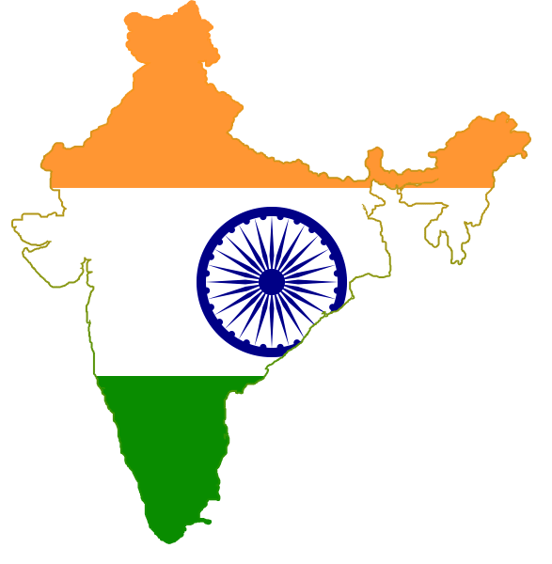
GOODS AND SERVICES TAX
-ONE NATION ONE TAX
GST INDIA

Slide 2
Present and Proposed Tax Structure
Present Tax Structure | Proposed Tax Structure
1. Levied By Central Government Excise on manufacturing of goods. Service tax , KKC & SBC on services. CVD and SAD on import of goods. 2. Levied By State Government VAT on Sale of goods within State CST on Sale of goods outside State Entry Tax ,Octroi Duty, luxury tax etc | Levied By Central Government CGST on Intra-State supply of goods or services or both. IGST on Inter-State supply of goods or services or both. IGST on import of goods in lieu of CVD and SAD 2. Levied By State Government SGST on Intra- State supply of goods or services or both.

Slide 3
WHAT IS GOODS AND SERVICES TAX?
To understand GST in layman language, it can be stated that GST is a destination based consumption tax levied at multiple stage of production and distribution of goods and services.
It’s a Dual GST Model i.e. it will comprise of Central GST (CGST) and State GST (SGST). The centre will administer CGST and the individual states will administer their respective SGST. Both of these will apply on supply of goods as well as services within the state. However, in respect of inter-state supply of goods and services, a third stem of the GST called Integrated GST (IGST) will apply, which will be the sum total of CGST and SGST. IGST model would take care of the share of States and the SGST component would accrue to the destination state. The IGST would be administered by the centre.

Slide 4
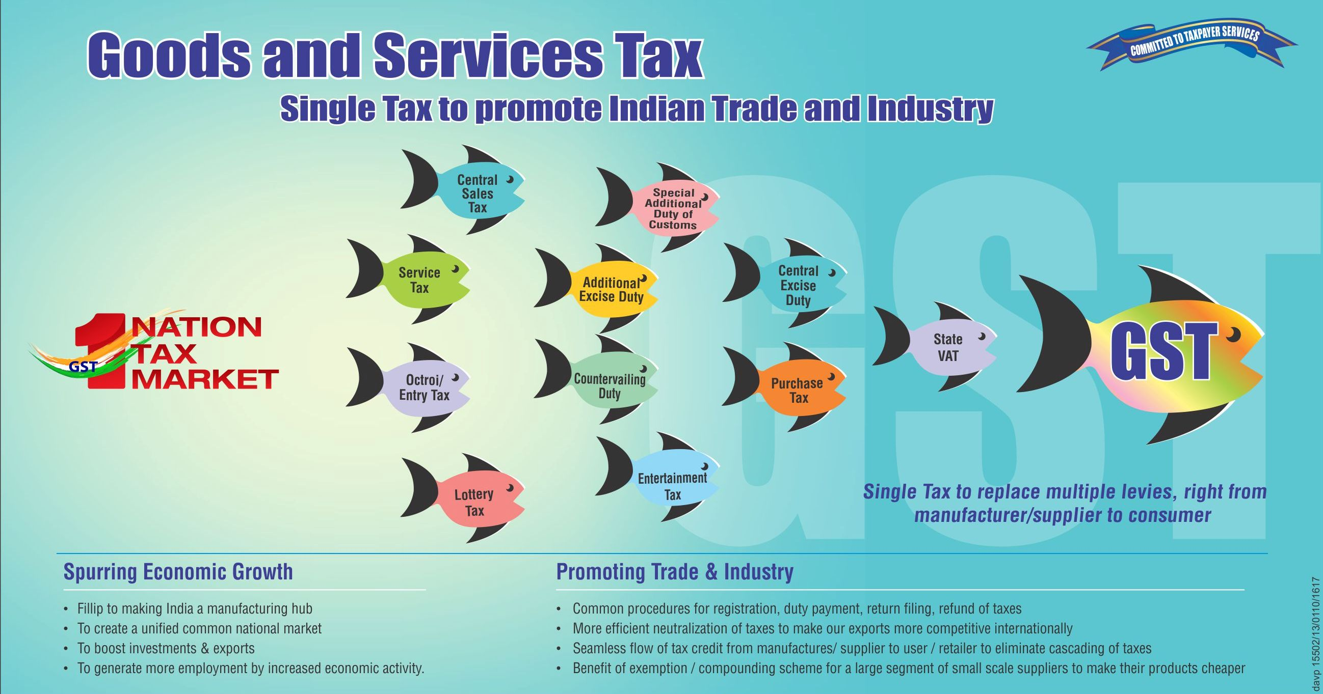
Taxes Subsumed into GST

Slide 5
COMPONENT OF GST
The Central Goods and Services Tax Act 2017
  3 Schedules
  174 Sections divided into 21 Chapters
  CGST Rules 2017
The Integrated Goods and Services Tax Act 2017
  25 Sections divided into 9 Chapters
The Goods and Services Tax (Compensation to the States) Act 2017
  1 Schedule
  14 sections
The Union Territory Goods and Services Tax Act 2017
  26 Sections divided into 9 Chapters
Respective State Goods and Services Tax Act

Slide 6
GST RATES
There are 5 slab of Rates of GST. These are as follows-
  0%
  5%
  12%
  18%
  28%
Gold Rate is 3%.

Slide 7
Meaning and Scope of Supply
Under GST regime, point of taxation is "Supply" . Section 7 of CGST Act 2017,
speaks about the meaning and scope of supply. This definition can be explained under two head-
Supply with Consideration
All form of supply such as lease , rental, sale, barter, exchange, license, transfer or disposal made or agreed to be made in the course or furtherance of business;
Import of services whether or not in the course or furtherance of business.

Slide 8
Supply without Consideration
Permanent transfer or disposal of business assets where ITC has been availed on such assets; (for ex- transfer of RM, consumables or Cap Goods)
Supply of goods or services or both between related or distinct person when made in the course of business; (for ex- transfer of WIP or FG to other unit)
Provided that gifts not exceeding fifty thousand rupees in value in a financial year by an employer to an employee shall not be treated as supply of goods or services or both.
3. Import of services by a taxable person from a related person or from any of his other establishments outside India, in the course or furtherance of business.

Slide 9
Other Types of Supply
Composite Supply- Section 2(30)
“composite supply” means a supply made by a taxable person to a recipient consisting of two or more taxable supplies of goods or services or both, or any combination thereof, which are naturally bundled and supplied in conjunction with each other in the ordinary course of business, one of which is a principal supply;
Illustration.— Where goods are packed and transported with insurance,
the supply of goods, packing materials, transport and insurance is a composite
supply and supply of goods is a principal supply;
* Rate of Tax in case of composite supply = Rate of Tax of Principal Item (as per section 8)

Slide 10
Mixed Supply -Section 2(74)
“mixed supply” means two or more individual supplies of goods or services, or any combination thereof, made in conjunction with each other by a taxable person for a single price where such supply does not constitute a composite supply. i.e. which are not naturally bundled supply.
Illustration— A supply of a package consisting of canned foods, sweets, chocolates, cakes, dry fruits, aerated drinks and fruit juices when supplied for a single price is a mixed supply. Each of these items can be supplied separately and is not dependent on any other. It shall not be a mixed supply if these items are supplied separately;
* Rate of Tax in case of mixed supply = Rate of Tax of Item which attracts the highest rate of tax. (as per section 8)

Slide 11
Works Contract -Section 2(119)
“works contract” means a contract for building, construction, fabrication, completion, erection, installation, fitting out, improvement, modification, repair, maintenance, renovation, alteration or commissioning of any immovable property wherein transfer of property in goods (whether as goods or in some other form) is involved in the execution of such contract;

Slide 12
Time of Supply
Time of Supply of Goods - (Section 12)
1. Under Normal Charge Mechanism
Time of Supply shall be earliest of the following date-
  Date of Invoice
  Date of payment
2. Under Reverse Charge Mechanism
Time of Supply shall be earliest of the following date-
  Date of receipt of goods
  Date of payment
  The date immediately following thirty days from the date of issue of invoice by the supplier.

Slide 13
  3. In case of supply of vouchers by a supplier
  The time of supply shall be—
  (a) the date of issue of voucher, if the supply is identifiable at that point; or
  (b) the date of redemption of voucher, in all other cases.
  4. In case of Addition in the Value of Supply- The time of supply to the extent it relates to an addition in the value of supply by way of interest, late fee or penalty for delayed payment of any consideration shall be the date on which the supplier receives such addition in value.
  Time of Supply of Services - (Section 13)
1. Under Normal Charge Mechanism
If invoice is issued within 30 days from the date of supply of services, date of issue of invoice or date of payment received- whichever is earlier.
If invoice is not issued within 30 days from the date of supply of services, date of provision of service or date of payment received- whichever is earlier.

Slide 14
2. Under Reverse Charge Mechanism
Time of Supply shall be earliest of the following date-
  Date of payment
  The date immediately following sixty days from the date of issue of invoice by the supplier.
  Provided that where it is not possible to determine the time of supply under point (1) or (2), the time of supply shall be the date of entry in the books of account of the recipient of supply:
  3. In case of supply of vouchers by a supplier
  The time of supply shall be—
  (a) the date of issue of voucher, if the supply is identifiable at that point; or
  (b) the date of redemption of voucher, in all other cases.
  4. In case of Addition in the Value of Supply- The time of supply to the extent it relates to an addition in the value of supply by way of interest, late fee or penalty for delayed payment of any consideration shall be the date on which the supplier receives such addition in value.

Slide 15
Valuation- Section 15
Type of Supply | Value of Supply
Direct Sales- FG/Scrap | If both the following conditions are satisfied, then Value of Supply = Transaction Value Supplier and Recipient are not related Price is the sole consideration
FG Transfer to SOF /Depot/ Sample Distribution | Value of Supply = Open M.V of such supply
WIP Transfer to other Plant | Value of Supply = 110% of Cost of Production

Slide 16
Input Tax Credit
This topic can be read in 5 parts-
  Condition and Eligibility to take credit.
  List of Supplies on which Credit is NOT eligible to avail.
  Manner of Utilization of Credit
  Reversal of Credit in Special cases.
  Definitions

Slide 17
1. Condition and Eligibility for taking Credit
  Goods or Services or both used or intended to be used in the course of business
  Possession of Tax Invoice or Debit Note issued by registered supplier
  Goods or services or both has been received
  Tax charged on invoice has been actually paid to the government by supplier
  Return has been filed u/s 39 by receiver (GSTR-2)
  Where the registered person has claimed depreciation on the tax component of the cost of capital goods and plant and machinery under the provisions of the Income-tax Act, 1961, the input tax credit on the said tax component shall not be allowed.

Slide 18
  Time limit to avail the credit- Earlier of the following-
    Due date of furnishing of return for the month of September of the subsequent F.Y (i.e. 20th Oct of the subsequent F.Y) or
    Due date of furnishing of Annual Return (31st Dec of the subsequent year F.Y)
For example: Invoice date or Debit Note date - 21.03.2017. i.e. relating to F.Y 2016-17. Credit for this invoice can be taken up to-
  due date of furnishing return for month of September 2017. i.e. 20.10.2017
  due date of furnishing Annual Return for F.Y 2016-17. i.e. 31.12.2017
  -whichever is earlier. i.e. 20.10.2017
  Payment to the supplier shall be made within 180 days from the date of invoice. And where the recipient fails to pay within 180 days, the amount equal to input tax credit availed shall be added to the output tax liability, along with interest thereon.

Slide 19
2. Credit Not Eligible for the following Supplies
Motor Vehicles and other conveyances except when used for transportation of goods or passengers or for imparting training on driving.
Food and beverages or outdoor catering except when used for providing taxable supply of same category of goods or services.
Beauty treatment, health services, cosmetic and plastic surgeries.
Membership of a club, health or fitness centre.
Rent a cab, life insurance and health insurance except when used for providing taxable supply of same category of goods or services.
goods or services or both received by a taxable person for self construction of an immovable property (other than plant or machinery).

Slide 20
works contract services when supplied for construction of an immovable property (other than plant and machinery) except where it is an input service for further supply of works contract service.
Explanation.––For the purposes of point (6) and (7), the expression
“construction” includes re-construction, renovation, additions or alterations or repairs, to the extent of capitalisation, to the said immovable property;
goods or services or both on which tax has been paid under Composite Scheme.
goods or services or both used for personal consumption.
goods lost, stolen, destroyed, written off or disposed of by way of gift or free samples.
Tax paid under sections
  - Section 74 – Fraud or wilful misrepresentation
  - Section 129 – Detention, seizure and release
  - Section 130 – Confiscations and levy of penalty

Slide 21
3. Manner of Utilisation of Credit
Credit Available | Manner of Utilisation
CGST | First, against the CGST liability of tax. Then, against the IGST liability of tax.
SGST | First, against the SGST liability of tax. Then, against the IGST liability of tax.
IGST | First, against the IGST liability of tax Second, against the CGST liability of tax Then, against the SGST liability of tax

Slide 22
4. Reversal of Credit under Special Circumstances
In case of non-payment of consideration
    Payment to the supplier shall be made within 180 days from the date of
    invoice. And where the recipient fails to pay within 180 days, the amount
    equal to input tax credit availed shall be added to the output tax liability,
    along with interest thereon.
  In case of Supply of Capital Goods after put to use
    The input tax credit involved in the remaining useful life in months shall
    be computed on pro-rata basis, taking the useful life as five years.
    Illustration
    Capital goods have been in use for 4 years, 6 month and 15 days.
    The useful remaining life in months= 5 months ignoring a part of the
    month
    Input tax credit taken on such capital goods= Ç
    Input tax credit attributable to remaining useful life= C multiplied by 5/60

Slide 23
5. Definitions
1. What is Business? -Sec 2(17)
“business” includes––
(a) any trade, commerce, manufacture, profession, vocation, adventure,
wager or any other similar activity, whether or not it is for a pecuniary benefit;
(b) any activity or transaction in connection with or incidental or ancillary
to sub-clause (a);
(c) any activity or transaction in the nature of sub-clause (a), whether or
not there is volume, frequency, continuity or regularity of such transaction;
(d) supply or acquisition of goods including capital goods and services in
connection with commencement or closure of business;
(e) provision by a club, association, society, or any such body (for a
subscription or any other consideration) of the facilities or benefits to
its members;

Slide 24
(f) admission, for a consideration, of persons to any premises;
(g) services supplied by a person as the holder of an office which has been
accepted by him in the course or furtherance of his trade, profession
or vocation;
(h) services provided by a race club by way of totalisator or a licence to
book maker in such club ; and
(i) any activity or transaction undertaken by the Central Government, a
State Government or any local authority in which they are engaged as public
authorities;
2. What is Capital Goods? -Sec 2(19)
“capital goods” means goods, the value of which is capitalised in the books
of account of the person claiming the input tax credit and which are used or intended to be used in the course or furtherance of business;

Slide 25
3. What is Composite Supply? -Sec 2(30)
“composite supply” means a supply made by a taxable person to a
recipient consisting of two or more taxable supplies of goods or services
or both, or any combination thereof, which are naturally bundled and
supplied in conjunction with each other in the ordinary course of business,
one of which is a principal supply;
4. What is Input? -Sec 2(59)
“input” means any goods other than capital goods used or intended to be
used by a supplier in the course or furtherance of business;
5. What is Input Service? -Sec 2(60)
“input service” means any service used or intended to be used by a supplier
in the course or furtherance of business;

Slide 26
6. What is Composite Supply? -Sec 2(62)
“input tax” in relation to a registered person, means the central tax, State tax,
integrated tax or Union territory tax charged on any supply of goods
or services or both made to him and includes—
the integrated goods and services tax charged on import of goods;
(b) the tax payable under the provisions of sub-sections (3) and (4) of
section 9;
(c) the tax payable under the provisions of sub-sections (3) and (4) of
section 5 of the Integrated Goods and Services Tax Act;
(d) the tax payable under the provisions of sub-sections (3) and (4) of
section 9 of the respective State Goods and Services Tax Act; or
(e) the tax payable under the provisions of sub-sections (3) and (4) of
section 7 of the Union Territory Goods and Services Tax Act, but does
not include the tax paid under the composition levy;

