Slide 1
Goods & Service Tax (GST)
By CMA.Sameer Epari
For Private Circulation only

Slide 2
Purpose of this PPT
To have a fair understanding of the New Law & Structure.
List of Current Taxes to be replaced by GST.
GST Tax rates.
Tax Credits and Utilization
IGST Model
CGST & SGST Model

Slide 3
Basics of GST
Single tax rate for a product or service in any part of the country (except J&K)
Seamless flow of credit across the value chain.
Removal of cascading effect
Dual GST (Central GST & State GST ) and Integrated GST (IGST)
Better compliance for trade and industry sector.

Slide 4
Basics of GST
Taxable Event
OLD SCENARIO | UNDER GST
Excise Duty –Manufacturing (Removal of Goods) | SUPPLY (GST is a Destination Based Tax)
VAT/CST – Sales
Service – Provision of Service
Threshold exemption limit : Rs 20 lakhs

Slide 5
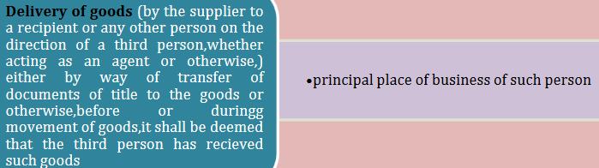

Place of Supply of Goods

Slide 6
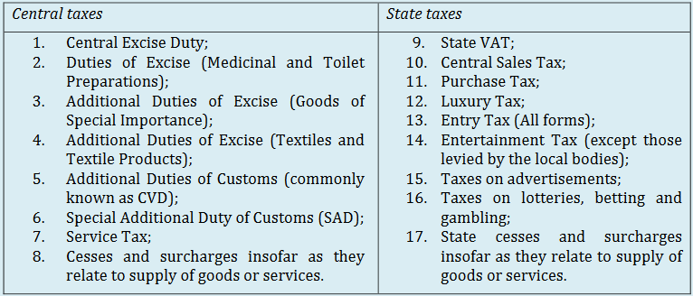
Taxes will be Subsumed under GST

Slide 7
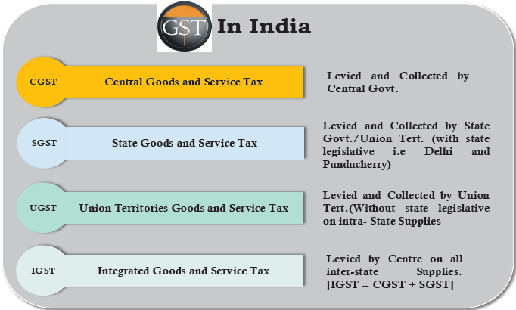
Structure of GST in India

Slide 8
Tax Rates Under GST
Notified Rates {CGST/SGST/UTGST}
  5%
  12%
  18%
  28%
IGST Rates : CGST+SGST
Note: Maximum CGST Rate 20% & IGST Rate 40%

Slide 9
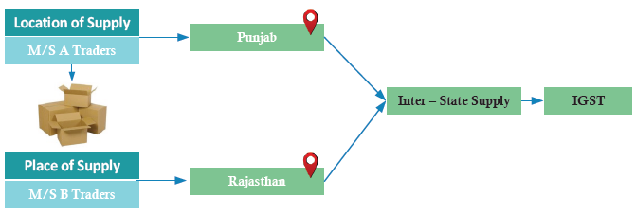
IGST- Inter State
{State to State/ State to UT/UT to UT}
No Other Taxes other than IGST will be levied in case of Inter State Supply of Goods or Services
Supply between States or Union Territories will be covered here

Slide 10
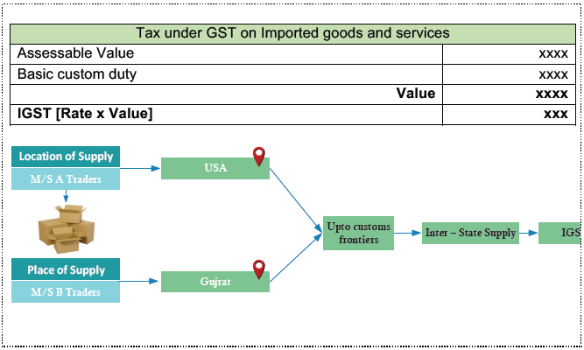
IGST- Imported
{Imported into the Territory of India }
Imports will be treated as Inter State Supply under GST. IGST will be levied in place of CVD
Basic Customs duty & Anti Dumping Duties will be remain unchanged even under GST

Slide 11
CGST & SGST/UTGST-Intra State
(With in a State or UT)
Note : Delhi & Puducherry are having State Legislature hence SGST will be levied for Intra State Supplies
No IGST will be levied for Intra State Supply of Goods or Services or Both.
CGST & SGST or UTGST will be levied on Intra state supplies.
Note:
Supply of Goods to or by SEZ will not be treated as intra State, this will be treated as Inter State & IGST will be levied accordingly.

Slide 12
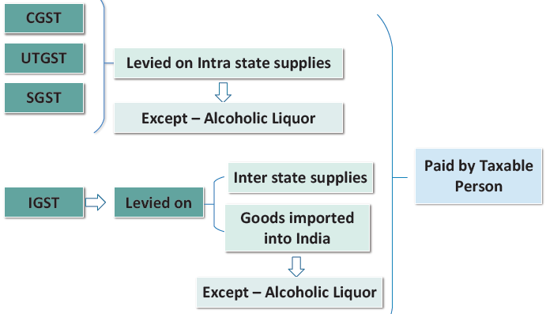
Summary – Levy & Collection

Slide 13
ITC -Input Tax Credit
Tax Credit(ITC) | IGST | CGST | SGST
IGST Credit | YES (1st) | YES (2nd) | YES (3rd)
CGST Credit | YES (2nd) | YES (1st) | NO
SGST Credit | YES (2nd) | NO | YES (1st)
Cross Utilization of CGST & SGST is not available

Slide 14
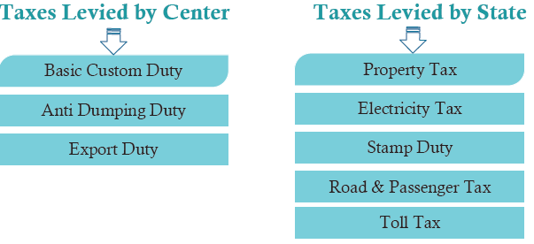
Taxes not to be Subsumes under GST (Will be Inforce)

Slide 15

Folks,
We are all know that there are lot many things to know about GST law, I have just gone through the basics from some sources and summarized in a PPT. any questions/doubts in this please write back to us. We will discuss with experts/consultants and get it cleared.
Regards
CMA.Sameer Epari (sameerepari@ymail.com)

