Slide 1

KAMAINDIA PVT. LTD.
까마인디아
^{7th} Presentation
Goods and Service tax (GST)
Shashikant Mishra

Slide 2

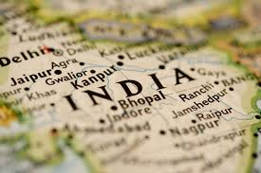
INDEX
ABOUT GST
REPLACEMENT OF TAXES
EXPORT & IMPORT
REGISTRATION & APPLICABILITY
ITC
TRANSITION
REGISTRATION DOCUMENT
PENALTY
RATES OF TAXES
GST RETURN
INPUT WORKING IN GST
DIFFERENT TAX RATES
REFUND
MIGRATION OF INPUT

Slide 3
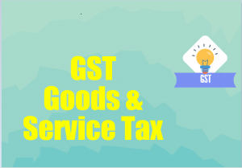
GST : ONE NATION ONE TAX

Slide 4
GST
GST :- WHAT IS GST
Goods and Services Tax (GST) is a comprehensive indirect tax on manufacture, sale and consumption of goods and services throughout India to replace taxes levied by the central and state governments. The cost of GST will be borne by last consumer.
This method allows GST-registered businesses to claim tax credit to the value of GST they paid on purchase of goods or services as part of their normal commercial activity. Administrative responsibility would generally rest with a single authority to levy tax on goods and services.^{[1]} GST is a consumption based tax i.e. the tax should be received by the state in which the goods or services are consumed and not by the state in which such goods are manufactured
the biggest advantage would be in terms of a reduction in the overall tax burden on goods, which is currently estimated at 25%-30%, free movement of goods from one state to another without stopping at state borders for hours for payment of state tax or entry tax and reduction in paperwork to a large extent.

Slide 5
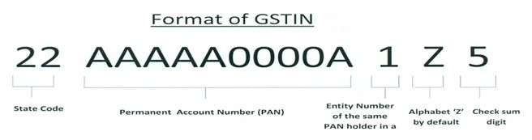
What is Goods and Services Identification number (GSTIN)?
As we can see from the image above
The first 2 digits of the 15 digit GSTIN will represent the state code.
The next 10 digits will be the PAN number of person or firm engaged in Business.
As proposed the State Code as defined under the Indian Census 2011 would be adopted In the GSTIN. As per the terms of the Indian Census 2011, every State has been allotted a unique two digit code. For 01 for Jammu and Kashmir, 02 for Himachal Pradesh, 03 for Punjab.
The 13th would represent the number of registrations an entity has with in a state under the same PAN. It will be an alpha-numeric number (first 1-9 and then A-Z) and will be assigned on the basis of a number of registrations a legal entity (having the same PAN) in the same state.

Slide 6
WHY GST CAME INTO FORCE
A) To Traders
Reduction in multiplicity of taxes
Mitigation of cascading/ double taxation
More efficient neutralization of taxes especially for exports
Development of common national market
Simpler tax regime
I) Fewer rates and exemptions
II) Distinction between Goods & Services no loner required
B) To Consumers
Simpler Tax system
Reduction in prices of goods & services due to elimination of cascading of taxes
Uniform prices throughout the country
Transparency in taxation system
Increase in employment opportunities

Slide 7
TAXES TO BE SUBSUMED UNDER GST
Central Levies
Central excise duty
Additional excise duties
Central Sales Tax (CST)
ED under the Medicinal & Toiletries Preparation Act
Service tax
Additional Customs Duty s(CVD)
Special additional duty (SAD)
Surcharges and cesses relating to supply of goods and services.
State Levies
VAT/Sales tax
Entertainment tax (other than levied by local bodies)
Octroi and Entry tax
Purchase tax
Luxury tax
Taxes on lottery, betting, gambling
State surcharges, cesses relating to supply of goods and services
GST

Slide 8
TAXES - NOT SUBSUMED UNDER GST
Basic Customs Duty
Excise Duty / VAT on Petroleum Products for five years
Excise Duty on Tobacco Products
Electricity Duty by state
  Entertainment tax levied by local bodies
  State excise on Alcoholic Beverages
  Property tax, Stamp Duty and taxes on immovable properties
  Royalty on minerals, Environmental / regulatory taxes- e.g. vehicles tax
GST

Slide 9
GST REGISTRATION DATE
From 1st July, 2017 Goods and Services Tax will replace Central and State level indirect taxes like VAT, Service tax, Excise etc. Businesses that are registered under VAT or Service Tax need to migrate to Goods & Services tax as per the enrolment plan of State Governments.
It is applicable to you if your annual turnover is Rs. 20 lakh or above. In case of North Eastern states (Arunachal Pradesh, Assam, Manipur, Meghalaya, Mizoram, Nagaland, and Tripura) and hilly regions i.e. Himachal Pradesh, Uttarakhand, Jammu & Kashmir and Sikkim, the threshold limit is Rs. 10 lakh.
GST APPLICABILITY

Slide 10
Migration to GST
All existing Central Excise and Service Tax assesses and VAT dealers will be migrated to GST. To migrate to the new tax system, assesses would be provided a Provisional ID and Password by CBEC/State Commercial Tax Departments.
https://www.gstseva.com/login/
Steps to complete Provisional Registration Step 1: Enter the Username (Provisional ID) and Password provided to you by your State VAT / Central Excise / Service Tax Authority
Step 2: Enter Mobile Number and Email Address of the authorized signatory of the business entity All future correspondence from the GST portal will be sent on this registered Mobile Number and Email Address
Step 3: Enter OTP sent on Mobile Number and Email Address provided by you
Step 4: Enter information and upload scanned images as mentioned in provisional registration form
The assessees need to use this Provisional ID and Password to login to the GST Common Portal (https://www.gst.gov.in) where they would be required to fill and submit the Form 20 along with necessary supporting documents.

Slide 11
GST REGISTRATION DOCUMENT
GST REGISTRATION COMPANY
PAN card of the company
Registration Certificate of the company if registered in other TAX
Memorandum of Association (MOA) /Articles of Association (AOA)
Copy of Bank Statement
Declaration to comply with the provisions
Copy of Board resolution
PAN and ID proof of directors
Copy of electricity bill/landline bill, water Bill
No objection certificate of the owner
Rent agreement (in case premises are rented)
2 Photo of All directors

Slide 12
GST REGISTRATION INDIVIDUAL
PAN card and ID proof of the individual.
Copy of Cancelled cheque or bank statement.
Declaration to comply with the provisions.
Copy of electricity bill/landline bill, water Bill
No objection certificate of the owner
Rent agreement (in case premises are rented)
PAN card of the Partnership
Partnership Deed
Copy of Bank Statement
Declaration to comply with the provisions
PAN and ID proof of designated partners
Copy of electricity bill/landline bill, water Bill
No objection certificate of the owner
Rent agreement (in case premises are rented)
GST REGISTRATION PARTNERSHIP

Slide 13
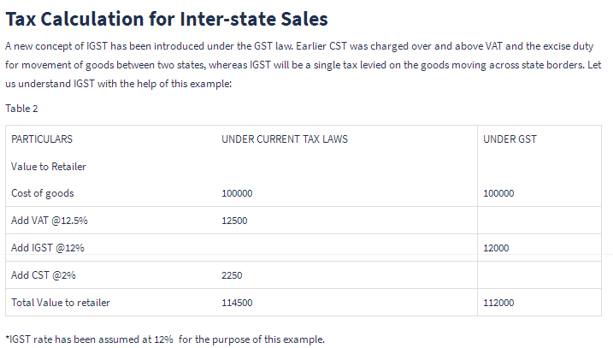
CST VS GST

Slide 14
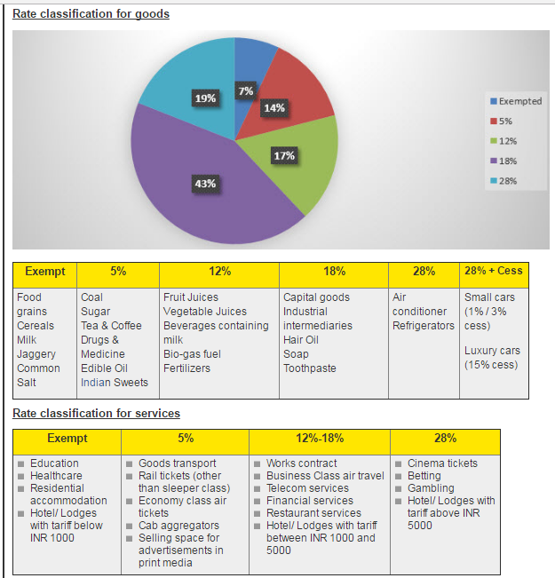
RATE FOR EXAMPLE

Slide 15
GST RATES ON GOOFDS
GST Nil rate (0%):
No tax will be imposed on items like fresh meat, fish chicken, eggs, milk, butter milk, curd, natural honey, fresh fruits and vegetables, flour, besan, bread, prasad, salt, bindi. Sindoor, stamps, judicial papers, printed books, newspapers, bangles, handloom etc.
GST 5% Items List
Items such as fish fillet, cream, skimmed milk powder, branded paneer, frozen vegetables, coffee, tea, spices, pizza bread, rusk, sabudana, kerosene, coal, medicines, stent, lifeboats will attract tax of 5 percent.
GST 12% Items list
Frozen meat products , butter, cheese, ghee, dry fruits in packaged form, animal fat, sausage, fruit juices, Bhutia, namkeen, Ayurvedic medicines, tooth powder, agarbatti, colouring books, picture books, umbrella, sewing machine, and cellphones will be under 12 per cent tax slab.
GST 18% Items List
Most items are under this tax slab which include flavoured refined sugar, pasta, cornflakes, pastries and cakes, preserved vegetables, jams, sauces, soups, ice cream, instant food mixes, mineral water, tissues, envelopes, tampons, note books, steel products, printed circuits, camera, speakers and monitors.
GST 28% Items list
Chewing gum, molasses, chocolate not containing cocoa, waffles and wafers coated with choclate, pan masala, aerated water, paint, deodorants, shaving creams, after shave, hair shampoo, dye, sunscreen, wallpaper, ceramic tiles, water heater, dishwasher, weighing machine, washing machine, ATM, vending machines, vacuum cleaner, shavers, hair clippers, automobiles, motorcycles, aircraft for personal use, and yachts will attract 28 per cent tax – the highest under GST system

Slide 16
GST RATES ON SERVICES

Slide 17
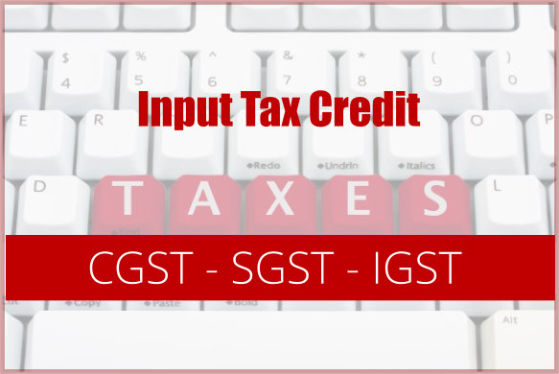
INPUT TAX CREDIT
Manner of taking input tax credit (Section 16)
  ITC as self-assessed in the return of a taxable person shall be credited to his electronic ledger to be maintained in the GST portal.
Credit shall be utilised in the following manner:
IGST | CGST | SGST/UTGST
IGST utilised in the priority specified: IGST CGST SGST/UTGST | CGST utilised in the priority specified CGST IGST | SGST/UTGST utilised in the priority specified SGST/UTGST IGST

Slide 18
HOW INPUT WORK IN GST (CGST & SGST)
You have Input tax credit of 1,20,000 each against CGST and SGST.
You have Liability of 1,26,000 each against CGST and SGST.
As prescribed by Law, Input Tax Credit of CGST 1,20,000 to set off CGST liability of 1,26,000. After this adjustment, CGST liability is 6,000 (1,26,000 – 1,20,000).
Later, SGST input credit of 1,20,000 is set off against SGST liability of 1,26,000. After setting off SGST input credit, 6,000 (1,26,000 – 1,20,000) is the SGST liability.
Any input credit balance of CGST, after setting off tax liability towards CGST, cannot be used to set off against SGST. The balance of ITC under CGST (post set off of CGST liability) will be carried over to the next period.
Similarly, the SGST balance after set off of SGST liability will be carried over to the next period.
CGST ITC cannot be used for SGST liability
SGST ITC can not be utilized for payment of CGST or vice versa.

Slide 19
HOW INPUT WORK IN GST ( IGST )
You have have IGST Input tax credit of 40,000 and tax liabilities of IGST 12,000, CGST 24,000 and SGST 24,000.
As prescribed by Law, IGST Input credit needs to be utilized first to set off IGST tax liability. The remaining ITC can be used to set off CGST and then against the SGST liability, in that order.
You first utilized IGST ITC to set off IGST liability of 12,000.
Remaining IGST ITC credit 28,000 (40,000 – 12,000) is used to set off CGST liability of 24,000.
Post this adjustment, the remaining IGST ITC of 4,000 is used to set off SGST liability to the extent of 4,000.
Now, after utilization of Input credit available, the SGST liability of Super Cars Ltd. is 20,000.

Slide 20
Accounting entries under GST
Example 1: Intra-state Mr. X purchased goods Rs. 1,00,000 locally (intrastate) He sold them for Rs. 1,50,000 in the same state He paid legal consultation fees Rs. 5,000 He purchased furniture for his office for Rs. 12,000 Assuming CGST @8% and SGST@8%
Purchase A/c ………………Dr. 1,00,000 Input CGST A/c ……………Dr. 8,000 Input SGST A/c ……… …Dr. 8,000 To Creditors A/c 1,16,000 | Debtors A/c ………………Dr. 1,74,000 To Sales A/c 1,50,000 To Output CGST A/c 12,000 To Output SGST A/c 12,000
Legal fees A/c ………..……Dr. 5,000 Input CGST A/c ……………Dr. 400 Input SGST A/c ……………Dr. 400 To Bank A/c 5,800 | Furniture A/c ………..……Dr. 12,000 Input CGST A/c ……………Dr. 960 Input SGST A/c ……………Dr. 960 To ABC Furniture Shop A/c13,920
Output CGST A/c ……………Dr. 12,000 Output SGST A/c ……………Dr. 12,000 To Input CGST A/c 9,360 To Input SGST A/c 9,360 To Electronic Cash Ledger A/c 5,280 Thus due to input tax credit, tax liability of Rs. 24,000 is reduced to only Rs.5,280. Also, GST on legal fees is also adjusted which was not possible in current tax regime. If there had been any input tax credit left it would have been carried forward to the next year. | Total Input CGST=8,000+400+960= Rs. 9,360 Total Input SGST=8,000+400+960= Rs. 9,360 Total output CGST=12,000 Total output SGST=12,000 Therefore Net CGST payable=12,000-9,360=2,640 Net SGST payable=12,000-9,360=2,640

Slide 21
Accounting entries under GST
Example 2: Inter-state -Assuming CGST @8% and SGST@8% Mr. X purchased goods Rs. 1,50,000 from outside the State He sold Rs. 1,50,000 locally He sold Rs.1,00,000 outside the state He paid telephone bill Rs. 5,000 He purchased an air cooler for his office for Rs. 12,000 (locally)
Purchase A/c ………………Dr. 1,50,000 Input IGST A/c ……………Dr. 24,000 To Creditors A/c 1,74,000 | Debtors A/c ………………Dr. 1,74,000 To Sales A/c 1,50,000 To Output CGST A/c 12,000 To Output SGST A/c 12,000
Debtors A/c ………………Dr. 1,16,000 To Sales A/c 1,00,000 To Output IGST A/c 16,000 | Telephone Expenses A/c ..…Dr. 5,000 Input CGST A/c ………………..Dr. 400 Input SGST A/c …..……………Dr. 400 To Bank A/c 5,800
Office Equipment A/c.…..Dr. 12,000 Input CGST A/c ……………Dr. 960 Input SGST A/c ……………Dr. 960 To ABC Furniture Shop A/c 13,920 | Total CGST input =400+960=1,360 Total CGST output =12,000 Total SGST input =400+960=1,360 Total SGST output =12,000 Total IGST input =24,000 Total IGST output =16,000

Slide 22
Accounting entries under GST
Particulars | CGST | SGST | IGST
Output liability | 12,000 | 12,000 | 16,000
Less: Input tax credit
CGST | 1,360
SGST |  | 1,360
IGST | 8,000 |  | 16,000
Amount payable | 2,640 | 10,640 | NIL
Any IGST credit will first be applied to set off IGST and then CGST. Balance if any will be applied to setoff SGST. So out of total input IGST of Rs. 24,000, firstly it will be completely setoff against IGST. Then balance Rs.8,000 against CGST. From the total Rs.40,000, only Rs. 13,280 is payable. So the setoff entries will be-

Slide 23
So the setoff entries will be
Setoff against CGST output 1Output CGST ………………Dr. 9,360 To Input CGST A/c 1,360 To Input IGST A/c 8,000 | Setoff against SGST output Output SGST ………………Dr. 1,360 To Input SGST A/c 1,360
Setoff against IGST output Output IGST ………………Dr. 16,000 To Input IGST A/c 16,000 | Final payment Output CGST A/c ……………Dr. 2,640 Output SGST A/c ……………Dr. 10,640 To Bank A/c 13,280

Slide 24
INPUT TAX CREDITS BE ADJUSTED BETWEEN STATES AND CENTRE
HOW WILL INPUT TAX CREDITS BE ADJUSTED BETWEEN STATES AND CENTRE?
Suppose goods worth Rs. 10,000 are sold by manufacturer A in Maharashtra to Dealer B in Maharashtra. B resells them to trader C in Rajasthan for Rs. 17,500. Trader C finally sells to End User D in Rajasthan for Rs. 30,000.
Suppose CGST= 9%, SGST=9%. Therefore, IGST=9+9=18%
Since A is selling this to B in Maharashtra itself, it is an intra-state sale and both CGST @9% and SGST@9% will apply.
B (Maharashtra) is selling to C (Rajasthan). Since it is an interstate sale, IGST@18% will apply.
C (Rajasthan) is selling to D also in Rajasthan. Once again it is an intra-state sale and both CGST @9% and SGST@9% will apply.

Slide 25
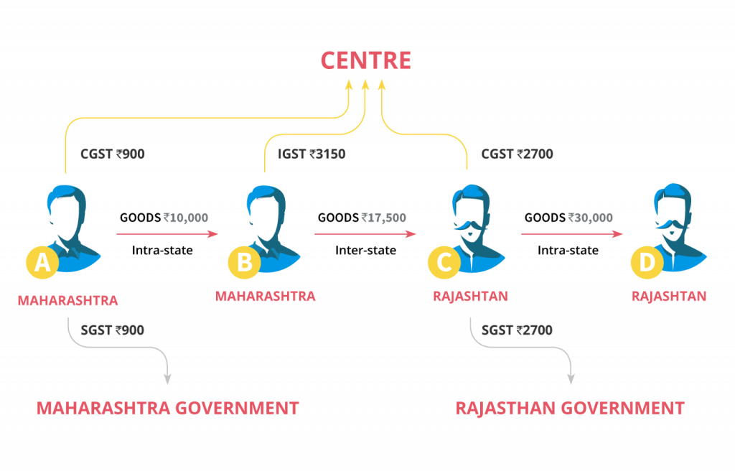
Cont…

Slide 26
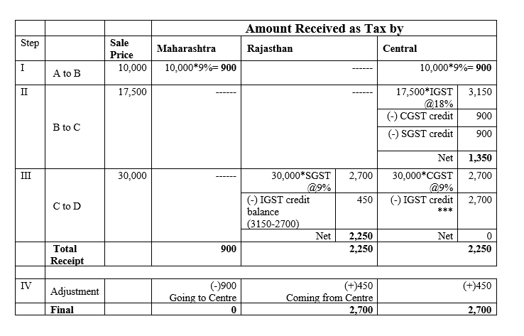
Cont..

Slide 27
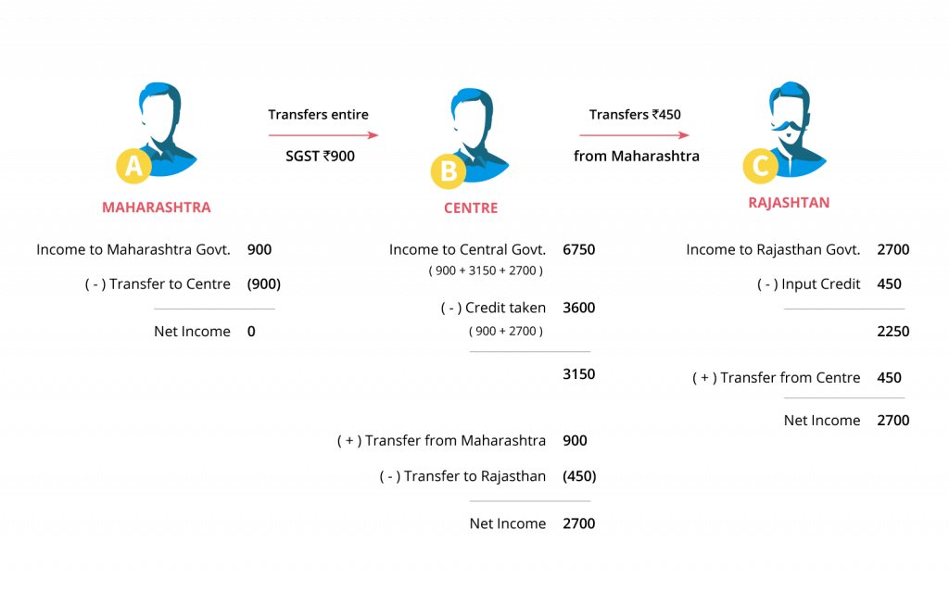
Cont..

Slide 28
Items on which credit is not allowed
Works contract service for construction of an immovable property (except plant & machinery or for providing further supply of works contract service)
Goods and/or services for construction of an immovable property whether to be used for personal or business use
Goods and/or services where tax have been paid under composition scheme
Goods and/or services used for personal use
Goods or services or both received by a non-resident taxable person except for any of the goods imported by him.
Goods lost, stolen, destroyed, written off or disposed of by way of gift or free samples
ITC will not be available in the case of any tax paid due to non payment or short tax payment, excessive refund or ITC utilized or availed by the reason of fraud or willful misstatements or suppression of facts or confiscation and seizure of goods.
Sale of membership in a club, health, fitness centre.
food and beverages, outdoor catering, beauty treatment, health services, cosmetic and plastic surgery

Slide 29
Input Tax Credit under GST – Conditions To Claim
A registered person will be eligible to claim Input Tax Credit (ITC) on fulfillment of the following conditions:
Possession of a tax invoice or debit note or document evidencing payment
Receipt of goods and/or services
goods delivered by supplier to other person on the direction of registered person against a document of transfer of title of goods
Furnishing of a return
Where goods are received in lots or installments ITC will be allowed to be availed when the last lot or installment is received.
Failure to the supplier towards supply of goods and/or services within 180 days from the date of invoice, ITC already claimed will be added to output tax liability and interest to paid on such tax involved. On payment to supplier, ITC will be again allowed to be claimed
No ITC will be allowed if depreciation have been claimed on tax component of a capital good
If invoice or debit note is received after
the due date of filing return for September of next financial year Or filing annual return whichever Is later No ITC will be allowed

Slide 30
GST ON EXPORT & IMPORT
Under the GST Law, export of goods or services are treated as Zero rated supplies, therefore, GST will not be charged on the export of goods or services. The credit on inputs used for making export supplies will be available to the exporter. The exporters have two options either to export goods under Bond and claim refund of input credit or to export goods under rebate claim and claim the refund of output tax.
Import of Goods
Basic Custom Duty and IGST will be applicable. As discussed above, the Basic Custom Duty is not going to end. This is also necessary to protect the interest of domestic industries. So in case of import of goods, the Basic Custom Duty and IGST will be charged.

Slide 31
PENALTIES UNDER GST
For cases with no intention of fraud or tax evasion
An offender not paying tax or making short payments has to pay a penalty of 10% of the tax amount due subject to a minimum of Rs. 10,000.
For cases of fraud
An offender has to pay a penalty amount of tax evaded/short deducted etc., i.e., 100% penalty, subject to a minimum of Rs. 10,000.
Not only the taxable person but any person who-
Helps any person to commit fraud under GST
Acquires/receives any goods/services with full knowledge that it is in violation of GST rules
Fails to appear before the tax authority on receiving a summons
Fails to issue an invoice according to GST rules
Fails to account/vouch any invoice appearing in the books
or cases of fraud, additional penalties as follows-
Tax amount involved | 100-200 lakhs | 200-500 lakhs | Above 500 lakhs
Jail term | Upto 1 year | Upto 3 years | Upto 5 year
Fine | In all three cases

Slide 32
TAXES UNDER GST
CGST : Central GST
SGST : State GST
IGST : Integrated GST
UGST : Union Territory GST
For e.g.: – A dealer in Maharashtra sold goods to the consumer in Maharashtra worth Rs. 10,000. The GST rate is 18% comprising of CGST rate of 9% and SGST rate of 9%, in such case the dealer collects Rs. 1800 and Rs. 900 will go to the central government and Rs. 900 will go to the Maharashtra government.
Now, if the dealer in Maharashtra had sold goods to a dealer in Gujarat worth Rs. 10,000. The GST rate is 18% comprising of CGST rate of 9% and SGST rate of 9%. In such case the dealer has to charge Rs. 1800 as IGST. This IGST will go to the Centre Govt.

Slide 33
GST RETURN
A return is a document that a taxpayer is required to file as per the law with the tax administrative authorities. Under the Goods & Services Tax law, a normal taxpayer will be required to furnish three returns monthly and one annual return. Similarly, there are separate returns for a taxpayer registered under the composition scheme, taxpayer registered as an Input Service Distributor, a person liable to deduct or collect the tax (TDS/TCS).
HSN (Harmonized System of Nomenclature code
With GST taking control most of the business owners will have to take up two to four or eight digits HSN (Harmonized System of Nomenclature code) codes for their goods and services depending on their turnover for a year.
Dealers with turnover less than 1.5crores will not have to use it.
Dealers who have a turnover of Rs 1.5 crores up to 5 crores will have to use two digit HSN code.
The dealers who crosses the 5 crores margin will have to use 4 digit HSN codes.
In case of business that deals with import and export they will have to use 8 digit code which will be compulsory.

Slide 34
SAN(SERVICE ACCOUNTING CODE)
When it comes to being under GST the majority of the dealers will need to adopt two- four or eight digit HSN codes for their commodities, depending on their turnover the previous year.
Business with turnover less than 1.5 crores will not require SAC codes for their goods and commodities.
Businesses with turnover between Rs. 1.5 crores and Rs 5 crores shall be required to use two digit SAC codes for their commodities.
Business that have a turnover of 5 crores and above will require to use 4 digit SAC codes.
In case of imports and exports the SAC codes will be 8digits.
The small dealers under composition scheme will not require to mention SAC codes in their invoices.
The codes will be mentioned in invoice and in the GST tax return details which will be uploaded on the GST portal.
The small business under composition scheme will not be required to mention SAC codes in their invoice.

Slide 35
Return Form | What to file? | By Whom? | By When?
GSTR-1 | Details of outward supplies of taxable goods and/or services effected | Registered Taxable Supplier | 10th of the next month
GSTR-2 | Details of inward supplies of taxable goods and/or services effected claiming input tax credit. | Registered Taxable Recipient | 15th of the next month
GSTR-3 | Monthly return on the basis of finalization of details of outward supplies and inward supplies along with the payment of amount of tax. | Registered Taxable Person | 20th of the next month
GSTR-4 | Quarterly return for compounding taxable person. | Composition Supplier | 18th of the month succeeding quarter
GSTR-5 | Return for Non-Resident foreign taxable person | Non-Resident Taxable Person | 20th of the next month
GSTR-6 | Return for Input Service Distributor | Input Service Distributor | 13th of the next month
GSTR-7 | Return for authorities deducting tax at source. | Tax Deductor | 10th of the next month
GSTR-8 | Details of supplies effected through e-commerce operator and the amount of tax collected | E-commerce Operator/Tax Collector | 10th of the next month
GSTR-9 | Annual Return | Registered Taxable Person | 31st December of next financial year
GSTR-10 | Final Return | Taxable person whose registration has been surrendered or cancelled. | Within three months of the date of cancellation or date of cancellation order, whichever is later.
GSTR-11 | Details of inward supplies to be furnished by a person having UIN | Person having UIN and claiming refund | 28th of the month following the month for which statement is filed

Slide 36
GSTR
  GSTIN of customer– Local sale or Intra state sale (CGST +SGST/UTGST or IGST)
  POS / Reverse Charge for each supply required to be identified for purpose of filing returns
  HSN and line item wise reporting for each Tax Rate also a requirement
  HSN means Harmonized System of Nomenclature code used for classifying the goods under the GST, Goods and Service Tax.
  The SAC code means Services Accounting Code under which services fall under GST are classified.
  GSTR 3,2,1,4 or 9

Slide 37
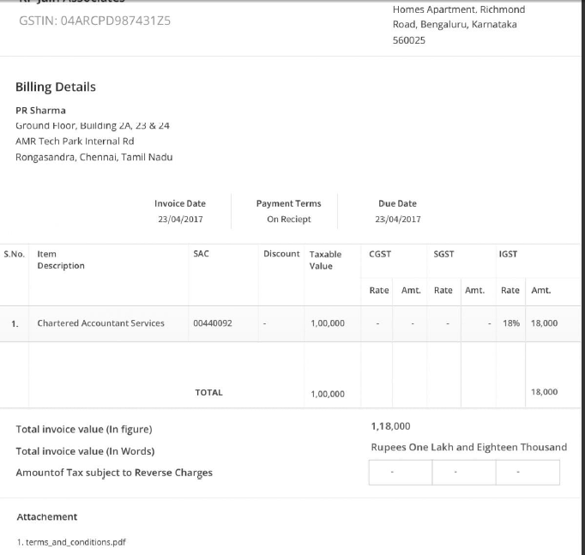
INVOICE FORMAT

Slide 38
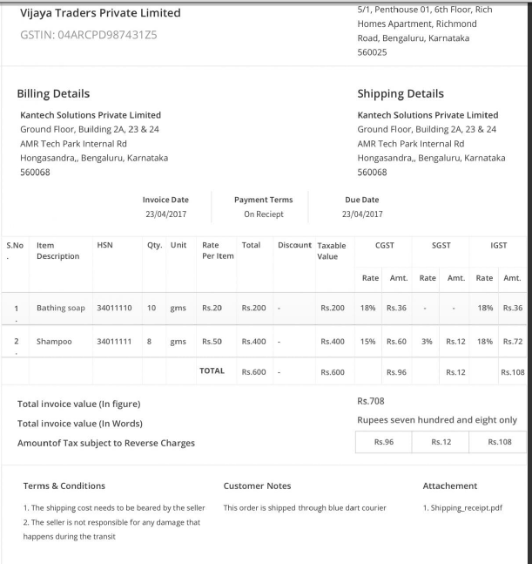
INVOICE FORMAT

Slide 39
How many copies of Tax Invoices are to be issued?
When goods are supplied, the supplier is required to issue three copies of the invoice– Original, Duplicate, and Triplicate invoice.
Original invoice: When a buyer makes the purchase he gets the first copy of invoice, marked as ‘Original for recipient’.
Duplicate copy: The duplicate copy is issued to the transporter( carrier of goods) to present as evidence as and when required, and is marked as ‘Duplicate for transporter’. The transporter doesn’t need to carry the invoice if the supplier has obtained an invoice reference number.
Note: How to generate “Invoice Reference Number”?
The supplier can obtain an Invoice reference number from the common portal (GSTN) by uploading a tax invoice issued by him. The invoice reference number will be valid for 30 days from the date of uploading.
Triplicate copy: This copy is retained by the supplier for his own record.

Slide 40
GST : INVOICE
Based on GST Invoice Rules (Rule 5), 2016 issued by the Central Government, two kinds of invoices can be issued under GST namely tax invoice and bill of supply
In case of supply of services the invoice has to be issued issued within 30 days(45 days in case of banks and NBFCs) of supply of services.
As per the revised GST Model Law section 28(3a) revised tax invoices can be issued by registered taxable person within one month
It is very important to understand the term ‘place of supply’ for determining the right charge of tax on ‘supply’. The model GST Law lays down the criteria to determine the place of supply. Based on these criteria, you can treat the supply of goods or services as either Intra-State (within the State) or Inter-State (Outside the State).
GST : TIME LIMIT OF ISSUE OF INVOICE
GST : REVISE OF INVOICE
GST : PLACE OF SUPPLY

Slide 41
CONDITIONS FOR AVAILING CREDIT
7
1
GST under RCM to be paid on purchases from unregistered suppliers
*** ITC to be availed on any invoice prior to filing of return for the month of September following end of FY or filing relevant annual return, whichever is earlier.
No Credit beyond specified period ***
Valid document
6
Buyer has filed
his returns
Limiting
factors
Receipt of Goods/ Services*
2
* Except in cases involving Bill to Ship to (BTST) model of delivery.
** If recipient fails to pay supplier of goods / services within 6m of date of invoice, credit availed should be reversed along with interest from first day
Buyer has paid supplier of goods &
services**
ITC on last Lot/ Installment
5
Supplier has paid tax
3
No depreciation on the tax component is being claimed on capital goods under Income Tax Act, 1961
4

Slide 42
GST : COMPOSITION SCHEME
Composition scheme is available for tax payers whose turnover is not more than 50 Lakhs in the preceding financial year pay tax at a rate not less than 2.5% fo a manufacturer and 1% for others.
Merits of the Scheme:-
Limited Compliance: Lesser compliance w.r.t. furnishing of returns, maintenance of books of records, issuance of invoices more focus on business.
Limited Tax Liability: on comparison with regular taxpayers, person taxed under Composite Scheme will be liable to pay tax at a rate not less than 2.5% for manufacturer and 1% in any other cases instead of a standard rate of 18%
High Liquidity: Unlike normal tax payers, tax payers under Composite Scheme will be liable to pay taxes at a lower rate resulting in lesser chunk on his working capital
Demerits of the Scheme:-
No Credit of Input Tax
No Collection of Tax:
Not applicable to the supplier supplying goods through E-commerce
Penal Provision: As per the Model GST Law, if the taxpayer who has previously been given registration under composition scheme is found to be not eligible to the composition scheme or if the permission granted earlier was incorrectly granted, then such taxpayer will be liable to pay the differential tax along with a penalty

Slide 43
GST : TAX RATES
The GST Council, appointed by the government of India has decoding the rates under GST.
According to the latest recommendation from the committee, the rate should be fixed around 18%. Currently, there are four different tax rates expected under GST depending on the type of good/service.
The four rates are
5%,12%,18%, and 28%.

Slide 44
GST : REFUND
Currently, the refund for the excess of VAT/CST paid is claimed annually. Refund on the excess of excise duty paid is paid through the duty drawback scheme. There are a lot of delays under the current system in providing the refund for excise/VAT/CST.
GST would improve the system of calculation, application, and processing of the refund. Refunds would be calculated for each major head (CGST, SGST, IGST) separately. An application form has to be filed on the GSTN portal for claiming the refund. Since all the data will be uploaded electronically, calculation of refunds would become automated.
As stated in the GST Model Law, “If any tax ordered to be refunded under section 48 to any applicant is not refunded within sixty days from the date of receipt of application under sub-section (1) of that section, interest at such rate as may be specified in the notification issued by the Central or a State Government on the recommendation of the Council shall be payable in respect of such refund from the date immediately after the expiry of sixty days from the date of receipt of application under the said subsection till the date of refund of such tax”. The processing time for a refund application has been kept as sixty days under GST model law but it could be as early as two weeks.

Slide 45
GST : HOW TO MIGRATE EXISTING INPUT CREDITS
As per the recent forum organized by the Institute of Chartered Accountants of India and have to do with how input credits will be transferred from one VAT or Service Tax to GST.
According to the model GST Law, a taxable person can accumulate credits of taxes paid and carry them forward in a return. With the introduction of the GST, the last set of credits will have to be transferred. To do this, you must furnish proof of his/her last return filed under the old regime. You will, therefore, need to make sure that all input taxes paid are included in it; by doing so, you will be claiming th
For example, let’s consider Sep 1, 2017 as the appointed day for the GST rollout. The taxpayer must make sure that he/she has taken into account all the stock lying on Oct 31, 2017 and claim input credit during the filing of returns for the period ending Oct 30, 2017. The taxpayer, thus, must ensure that all such goods and services are eligible for such a credit under the new GST law . credit of the same under the new regime.

Slide 46
Service Tax
As of today, a service provider is liable for registration if his/her aggregate value of taxable services crosses Rs. 10 lakh. Mentioned below are the type of service tax levied on various services:
1. Service tax at the rate of 14% is set off against service tax and excise liability.
2. Swachh Bharat cess at the rate of 0.5%
3. Krishi Kalyan Cess at the rate of 0.5%; set off against Krishi Kalyan Cess liability.
Now, an input tax credit is available on service tax and on Krishi kalyan cess. Such a credit is not available on Swachh Bharat cess.
A service provider needs to file his/her half yearly return in Form ST-3. The closing balance of service tax input credit will be carried forward as CGST input tax credit.
Again, taking XYZ Pvt Ltd as an example, let us assume that the company, under ST-3, has disclosed the CENVAT closing balance to be Rs 35,000. Yes, this can be carried forward by the firm if XYZ lets the CENVAT closing balance reflect in its return, and also makes sure that the same is eligible under GST.

Slide 47
VAT
A business entity registered under VAT needs to file its returns on a monthly and quarterly basis, depending on the state they work out of. The input VAT credit in the return forms is carried forward as SGST input tax credit.
Let’s again take XYZ Pvt Ltd as an example. Their VAT Form 100 shows credit/excess amount carried forward (as on 31st March, 2017) to be Rs 5,000. This implies that XYZ Pvt Ltd’s input VAT credit balance stands at Rs 5,000.
Now, can this be carried forward? The answer is yes, if XYZ Pvt Ltd fulfils some conditions. First that input VAT of Rs 5,000 must be shown in the returns and secondly GST approves of the same as input tax credit. If the above are satisfied, the input VAT will be carried forward as SGST credit.

Slide 48
Thank you

Slide 49
KAMAINDIA PVT. LTD.
까마인디아
대표자: 노 영 진
국내연결: 070-4067-9911, 070-7518-9435
본사: 546A, 3rd Floor, Hanuman Mandir Road, Chirag Delhi, New Delhi-110017, India
지점: G-45, 1st Floor, Green Park, opp. Main market, New Delhi-110016, India
휴대폰: +91-9810760090
홈페이지: www.kamaindia.net

