Slide 1

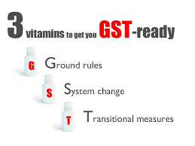
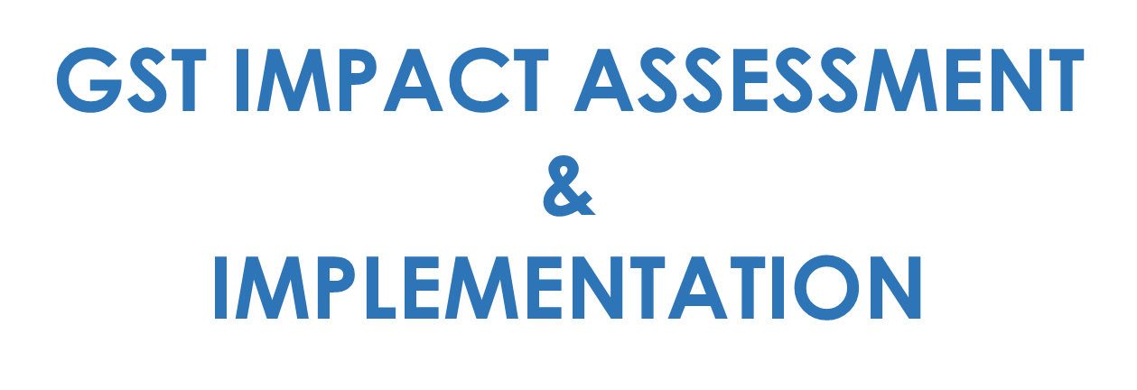

Slide 2


PROGRESS SO FAR
GST
IN INDIA
FEATURES OF GST
BROAD ARCHITECTURE
GST IMPACT AREAS

Slide 3

PROGRES SO FAR
GST implementation from April 2017 a possibility…
#3
PRESIDENT’S
ASSENT
#4
CONSTITUTION AMENDMENT BILL PASSED
#1
#2
RATIFICATION
BY STATES
GST COUNCIL
#5
GST
ROLL-OUT
#7
ENACTMENT BY
PARLIAMENT
#6
STATE SPECIFIC
GST
#8
LAUNCH OF
GSTN

Slide 4


DECENTRALIZED CREDIT MECHANISM
Destination Based Tax
Tax leviable on ‘Supply’
Decentralized registration
Monthly returns for each registration
Local Supply – CGST plus SGST
& Interstate Supply – IGST
Exports zero rated; Imports subject to IGST
Three rate structure:
Standard rate - %
Concessional rate - %
Demerit rate - %
CGST credit for
SGST credit for
CGST
SGST
IGST
IGST
Note: CGST credit not allowed against SGST and vice versa
IGST
IGST credit for
SGST
CGST

Slide 5


GST IMPACT AREAS
SUPPLY
CHAIN
COMPLIANCES
CASH FLOW
GST
IT SYSTEM
PRICING
ACCOUNTING
LEGAL CONTRACTS
CREDIT

Slide 6
BROAD ARCHITECTURE
INTANGIBLES,
ACTIONABLE CLAIMS, ETC.
TO BE TREATED
AS SERVICE
CONCEPT
OF POINT
OF TAXATION INTRODUCED FOR GOODS AS WELL
SEPARATE
PLACE OF
PROVISION FOR GOODS &
SERVICES
STATE WISE REGISTRATION
AND
COMPLIANCES
FREE OF COST SUPPLIES OF GOODS/
SERVICE TO BE TAXABLE
INTER-STATE BRANCH
TRANSFERS INCLUDED IN
SUPPLY
IGST
INPUT
TAX
CREDIT ALLOWED
TRANSITIONAL
PROVISIONS
ON CENVAT CREDIT, PENDING LITIGATIONS, ETC.
TRANSITIONAL
PROVISIONS ON CENVAT CREDIT, PENDING LITIGATIONS, ETC.

Slide 7





PHASE-1
UNDERSTANDING THE BUSINESS

Slide 8
STAGE I:
GAINING KNOWLEDGE OF BUSINESS
1
2
Understanding transactions related to all goods;
Understanding the MIS and other business reports generated by the IT System;
3
Understanding transactions related to all goods;
4
UNDERSTANDING
THE BUSINESS
Understanding the existing supply chain mechanism;
Understanding the existing supply chain mechanism;
Understanding the existing tax points;
Collating information on current tax compliances including record keeping, documentation, filing of statutory returns and processes followed;
Understanding outsourcing processes, export incentives, regional duty exemptions and intra-group transactions;
Collating information on current tax compliances including record keeping, documentation, filing of statutory returns and processes followed;
The understanding phase will be in four stages –
1. Gaining knowledge of
business
Understanding how existing contracts with clients and vendors are drafted and making note of the tax clauses; and
Understating of various locations/ warehouses and product/ services sold/rendered from there;
Understating of various locations/ warehouses and product/ services sold/rendered from there;
2.
Current Structure
3.
Impact of GST on Existing Model
Finally, mapping the entire business model under the existing tax regime
Up-dation basis changes introduced
Understand the processes followed to avail and utilise input tax credits;
Understand the processes followed to avail and utilise input tax credits;
4.

Slide 9


1
STAGE II:
CURRENT TAX STRUCTURE
4
2
Understanding the taxes charged by the Company under existing regime;
Understanding the process of recording, accumulation and utilization of credits permissible to the Company;
3
UNDERSTANDING
THE BUSINESS
Understanding input credit system of the business and recording whether the same is done manually or electronically;
Mapping of taxes which are currently becoming cost to the Company; and
The understanding phase will be in four stages –
Identifying the areas where the Company is paying tax under reverse charge mechanism;
Understanding the computation procedure followed to determine the existing Indirect tax liabilities
Gaining Knowledge of Business
.
1.
Current Tax Structure
2.
Mapping net tax liability;
.
4 .
Impact of Existing Tax
Model
Review of check points that determine tax obligations;
5 .
Up-dation basis changes introduced

Slide 10
1
STAGE III:
IMPACT OF GST ON EXISTING BUSINESS MODEL
Basis understanding of the business (Stage I) and how taxes are paid and credits accumulated (Stage II), the current business model will be extrapolated with scenarios proposed under the model GST law
4
2
3
This activity will assist IBA identify certain areas (mentioned below) that will get impacted by GST:
UNDERSTANDING THE BUSINESS
BUSINESS MODEL:
Margin Analysis
Cash Flow Planning
The understanding phase will be in four stages –
Own vs B2B
IT SYSTEMS:
1. Gaining knowledge of
business
Tax Codes/ Masters
Credit Matching
Sale Invoices
Purchase Orders
2 Current Tax Structure
CONTRACT RE-NEGOTIATION:
3. Impact of Existing Tax
Model
Vendor Contracts ✓ Sales / works Contracts
COMPLIANCES:
4. Up-dation basis
changes introduced
Registrations
Returns
Payment of tax
Credit register
Sales reports
Purchase reports

Slide 11
STAGE IV:
UPDATING IMPACT ANALYIS BASIS CHANGES INTRODUCED
1
4
2
3
Study of changes/ notifications introduced in proposed law in light of business process;
UNDERSTANDING THE BUSINESS
Analysis of business-wide impact of such changes;
The understanding phase will be in four stages –
Performing ‘what if’ for the Company in respect of the overall changes in proposed law; and
1. Gaining knowledge of
business
Discussions with the management to apprise of the modifications and consequent impact on the Company
2 Current Tax Structure
3. Impact of Existing Tax
Model
4. Up-dation basis
changes introduced

Slide 12



PHASE-II
PREPARING IMPLEMENTATION &
TRANSITION ROADMAP

Slide 13
PREPARING IMPLEMENTATION &
TRANSITION ROADMAP
Upon identifying key actionable items requiring transition under the GST, IDT shall suggest the best possible business model that is both ‘tax efficient’ and ‘pragmatic’. We shall work closely with various stake- holders to prepare the ‘implementation and transition roadmap’
Basis impact analysis, IBA would assist Company understand the key actionable items requiring transtion under GST;
Proposed business models will be accompanied with the attached pros and cons;
Proposed business model will be presented to the business heads, supply chain team, IT team for its feasibility;
Meetings with business heads, supply chain team, IT team to help identify the best possible scenarios for Company’s operations/ business divisions;
Post approval, IBA would prepare a road-map for transition and implementation of the proposed business model; and
Basis discussions, IBA will formulate best possible solutions resulting in the most tax efficient model;
Special focus would be provided to exposure areas to mitigate the risks

Slide 14
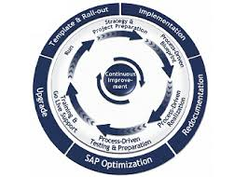
PHASE-III
IMPLEMENTATION ASSISTANCE

Slide 15
Operational Assistance
Agreements/Contracts Re-Working
IMPLEMENTATION
Credit Chain Optimization
The implementation phase
will involve actual ground
level execution of the
IT System Implementation
actionable items identified
(under Phase II) for
Final Touch
transition under the GST

Slide 16
OPERATIONAL ASSISTANCE
Updating master data, recording mechanism,
reporting requirements, etc
The operational assistance shall be the back-bone for GST implementation where IBA will
handhold the Company in entirety, until the transition to the new regime
Mapping accounting/ charge/ tax codes in the SAP system
Suggest formats for recording supply, procurement and related data as per requirements of the new law;
Assist Company obtain registrations in different states (if applicable)
Preparation of process manual for routine accounting operations
Setting up procedure to correctly capture Point Of Taxation and Place of Supply for each supply

Slide 17
OPERATIONAL ASSISTANCE
Setting up process to capture correct tax charged on different types of supply
The operational assistance shall be the back-bone for GST implementation where IBA will
handhold the Company in entirety, until the transition to the new regime
Ensuring smooth payment mechanism
Assistance in transferring of existing credits under current regime to the proposed regime
Assistance with respect to transfer of stock-in-hand/ capital goods credit from current regime in to the proposed regime
Assistance in movement of goods on the implementation date of the new regime
Assistance in practical challenges to be faced on ground level for implementation of new regime

Slide 18
AGREEMENT RE-WORKING
IBA would review the existing contracts with vendors and customers to enable the tax clauses are correctly amended
It will be imperative for the Company to review existing contracts, both on the output side (customers) as well as the input side (vendors)
IBA would assist in providing relevant tax clause for future agreements
IBA would assist in identifying the vendors wherein the Company should renegotiate basis added benefit to the vendor
This review is critical to ensure no unnecessary tax obligations arise on the Company upon its transition to GST and at the same time ensuring no added tax benefits are missed
IBA would assist in procuring necessary details from vendors and customers which will be essential for GSTN network
IBA will assist in mitigating risk of any future liability by way of safe-guarding it through contract
IBA will suggest wherever necessary to inseret relevant penalty clauses inter se agreements with vendors should they default in uploading informaiton and credits on GSTN

Slide 19
IT SYSYTEM IMPLEMENTATION
Setting up of process through which system provides correct information with respect to taxability
The system configurations will have to undergo modifications as a result of compliance and process requirements. Planning and migration of systems is a key focus area for GST implementation. IT system assistance will be restricted to taxes only
Setting up of process to capture details of vendors and clients correctly in the system for smooth credit movement
Business charge codes mapping based on Place of Supply and Time of Supply provisions provided under Model GST Law in the IT System
Integrating appropriate reporting procedure for filing multiple statutory returns and its annexures under GST
Assistance in enabling system for accumulation and utilization of credit under IGST, CGST and SGST
Discussions with the IT implementation team to ensure that the requirements of GST are correctly captured in the IT system

Slide 20
FINAL TOUCH
Test runs on the new system
After the system configurations and processes in place, it is imperative that continuous test
runs are done to ensure error free system
Identifying lacunas and rectifying them
Preparing FAQs for the users and helping them get an ease on the system
Preparing SOPs for the Company
Special training for the senior management to help them understand routine implications
Further equal focus is required for providing trainings to the team who would be executing the work on daily basis

Slide 21

PHASE-4
ON-GOING ASSISTANCE

Slide 22
ON-GOING
ASSISTANCE
Review and replying of day to day routine queries for one month
Validation of periodic returns and other compliances for first month
Assistance in implementation of GST regime is a continuous process and we believe in being available at every hour of need
Training and providing assistance for ompletion of implementation process
Providing GST
updates and advising the business on impact of same

Slide 23


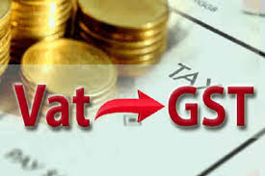
Sr. Manager – Indirect Taxation
Montecarlo Limited

