Slide 1
GST
GST overview
Enrollment guidelines
Online Registration/Migration help guide

Slide 2
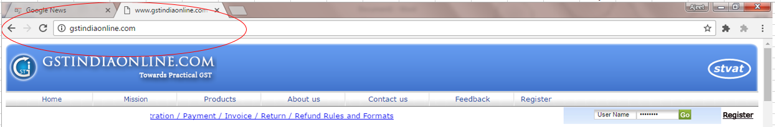
Login site
Gstindiaonline.com

Slide 3
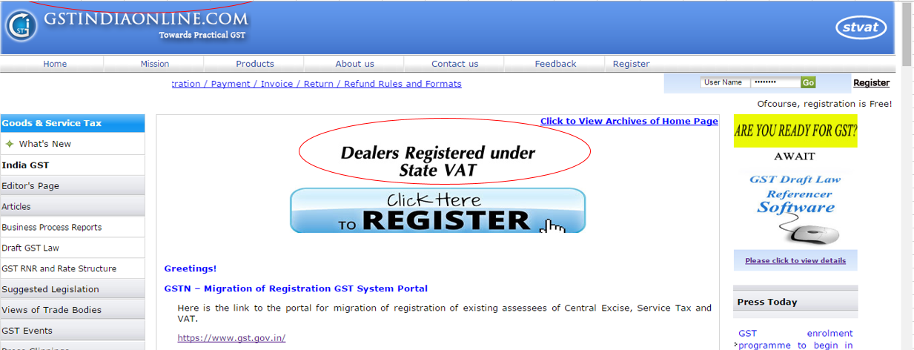
Click on “Dealer Registered Under State VAT”

Slide 4
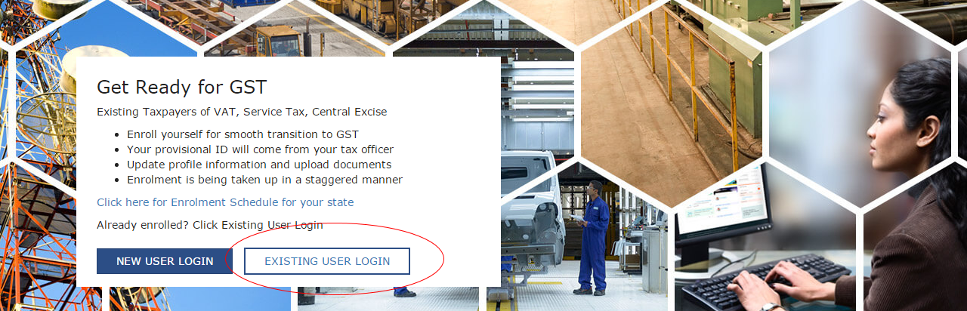
Select “Existing User Login”

Slide 5
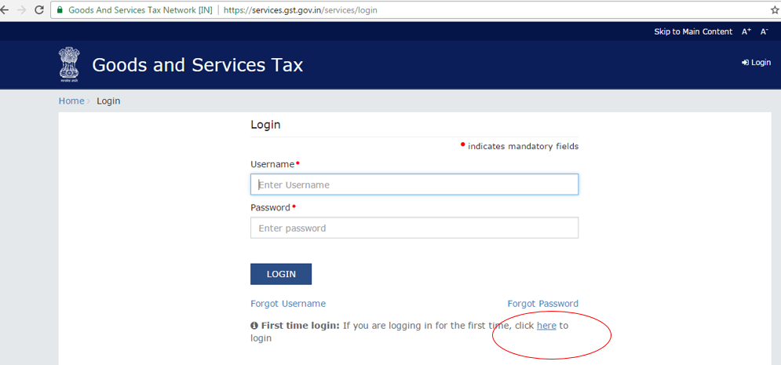

Slide 6
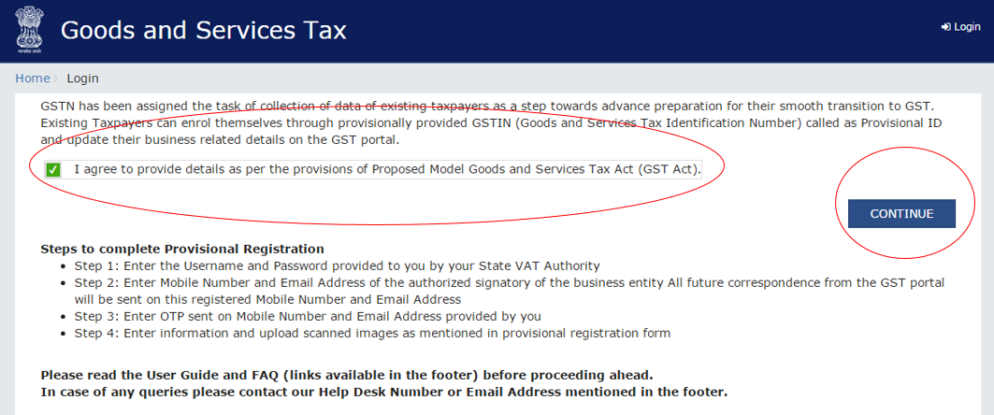

Slide 7
