Slide 1

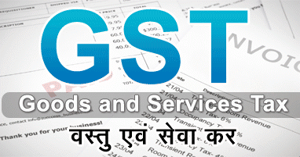
COMPOSTION SCHEME
Compo
UNDER

Slide 2

Model GST Act, 2016, has put public domain on 14th June 2016
This is Dual System of GST and based on the concept “One India-One Tax”
This Act is applicable to India as a whole including Jammu & Kashmir.
This will turn around the entire system of Indirect Taxes, therefore considered the biggest reforms since Independence.
The whole system of Ministry of Finance at Central and State Level is busy in making it implemented by 1st April 2017.
This Act will remain a Model Act till it get passed in parliament in upcoming winter session.
In next few slides I will explain it’s specific area as related to Composition Scheme of the Act.
Section-8, of Draft GST Act deals with Composition Scheme.

Slide 3
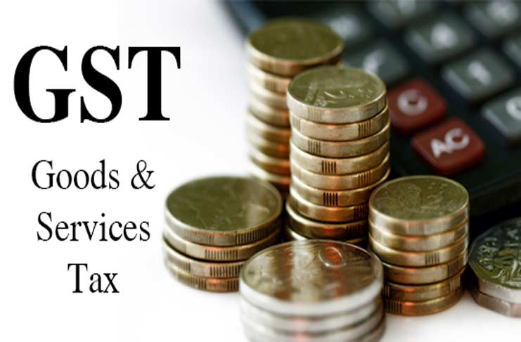
Model/Draft GST Act, 2016
Some Information

Slide 4

Model/Draft GST Act, 2016, is based on the report of Sub-Committee II [Empowered Committee of State Finance Minister] Now has been put to public domain on 14th June 2016.
Introduction of GST Law is the biggest reform in Indirect Taxes since Independence , it’s path became clear after the 122nd Constitutional Amendment Bill 2014, passed by Lok Sabha on 6th May 2015, and by Rajya Sabha on 3rd Aug 2016.
Exercising the power conferred by Article 279A of Constitution, President has approved to constitute a GST Council within 60 Days from 12th Sept 2016 which will recommend on Rules, Regulations, Systems, Procedures, Tax Rates, Exempted Goods, Threshold Limits etc
This Long awaited GST Bill is likely to be passed in upcoming Winter Session of Parliament which is to be started somewhere in 3rd week of Nov 2016 and most likely to be implemented w.e.f. 1st April 2017.

Slide 5
Composition Scheme
Section – 8 of Model/Draft GST Act, 2016

Slide 6

Scheme is meant for Whom ?
To Protect the Interest of Small & Local Suppliers
This is an Optional Scheme for a Registered Taxable Person who is not engaged in Inter-State Supply. [Vide Sec 19, for Rgn]
Whose Aggregate Turn-Over is not more than [50 Lacs] Rupees “Aggregate turnover” means the aggregate value of all taxable and non-taxable supplies, exempt supplies and exports of goods and/or services of a person having the same PAN, to be computed on all India basis and excludes taxes, if any, charged under the CGST Act, SGST Act and the IGST Act, as the case may be;
Explanation.- Aggregate turnover does not include the value of supplies on which tax is levied on reverse charge basis and the value of inward supplies. [Vide Sec 2(6), GST Act 2016]

Slide 7


What is the Scheme ?
Tax is to be calculated on Aggregate Turn-Over i.e. He has to pay Tax on Exempted Turn Over also
On the Rate prescribed by GSTC
Payment of Tax and Submission of Return
Tax is to be paid on monthly basis
GSTR-4 is to be filed on Qtrly basis by 18th of NQTR.
Later You can opt for Compounding Scheme
Normal Registration Procedure
Registration
Tax Calculation
Switch-Over is possible
But in any case not Less than 1%
GSTR-8 is to be filed on Annual Basis.

Slide 8

Certain Restrictions !!!
ITC
Can not claim ITC on Inward Supplies.
Vide : Section 16(9)(e)
Tax Invoice
Can not issue a Tax Invoice.
Can issue only Supply Invoices.
Intra-State Sales Only
Can not supply out-side State (Section-8, GST Act,2016)
Tax is to be paid on Non-Table/Exempted Supplies also.
Import of Goods & Services is possible.
Purchase from Unregistered Suppliers is possible.
Tax Payable under RCM is not available under this scheme.

Slide 9
Few Points
Existing Tax Payer who are not under the Compounding Scheme may opt for this Scheme, if he is eligible, he can make an application, on approval he shall be entitle for composition scheme only from the Next Financial Year.
Switch-Over from Compounding to Normal is possible only for once in a Year i.e. He can not switch-over to Compounding again within the same Financial Year.
A Taxable Person can not enjoy both status i.e. He can be either Normal Supplier or a Compounding Supplier.
If a Compounding Supplier becomes Normal Supplier, than he shall be entitled to claim ITC on the Stock available on the Date just preceding the Date on which he becomes a Normal Supplier. [Vide Section 16 (3)]
If switch-over from Normal to Compounding Supplier, he has to reverse the ITC on Stock lying on the Date preceding the date from which he becomes a Compounding Supplier [Vide Section 16 (12)]

Slide 10
Model GST Law, 2016
Section-8 Govern the provisions of Composition Scheme.
Contents of Section-8
1) Notwithstanding anything to the contrary contained in the Act but subject to Sub Section (3) of Section 7, on the recommendation of the Council, the proper officer of the Central or a State Government may, subject to such conditions and restrictions as may be prescribed, permit a registered taxable person, whose aggregate turnover in a financial year does not exceed [fifty lacs rupees], to pay, in lieu of the tax payable by him, an amount calculated at such rate as may be prescribed, but not less than one percent of the turnover during the year

Slide 11
Provided that no such permission shall be granted to a taxable person who effects any inter-State supplies of goods and/or services.
Provided further that no such permission shall be granted to a taxable person unless all the registered taxable persons, having the same PAN as held by the said taxable person, also opt to pay tax under the provisions of this sub-section.
2) A taxable person to whom the provisions of sub-section (1) apply shall not collect any tax from the recipient on supplies made by him nor shall he be entitled to any credit of input tax.
3) If the proper officer has reasons to believe that a taxable person was not eligible to pay tax under sub-section (1), such person shall, in addition to any tax that may be payable by him under other provisions of this Act, be liable to a penalty equivalent to the amount of tax payable as aforesaid:
Provided that no penalty shall be imposed without giving a notice to show cause and without affording a reasonable opportunity of being heard to the person proceeded against.

Slide 12
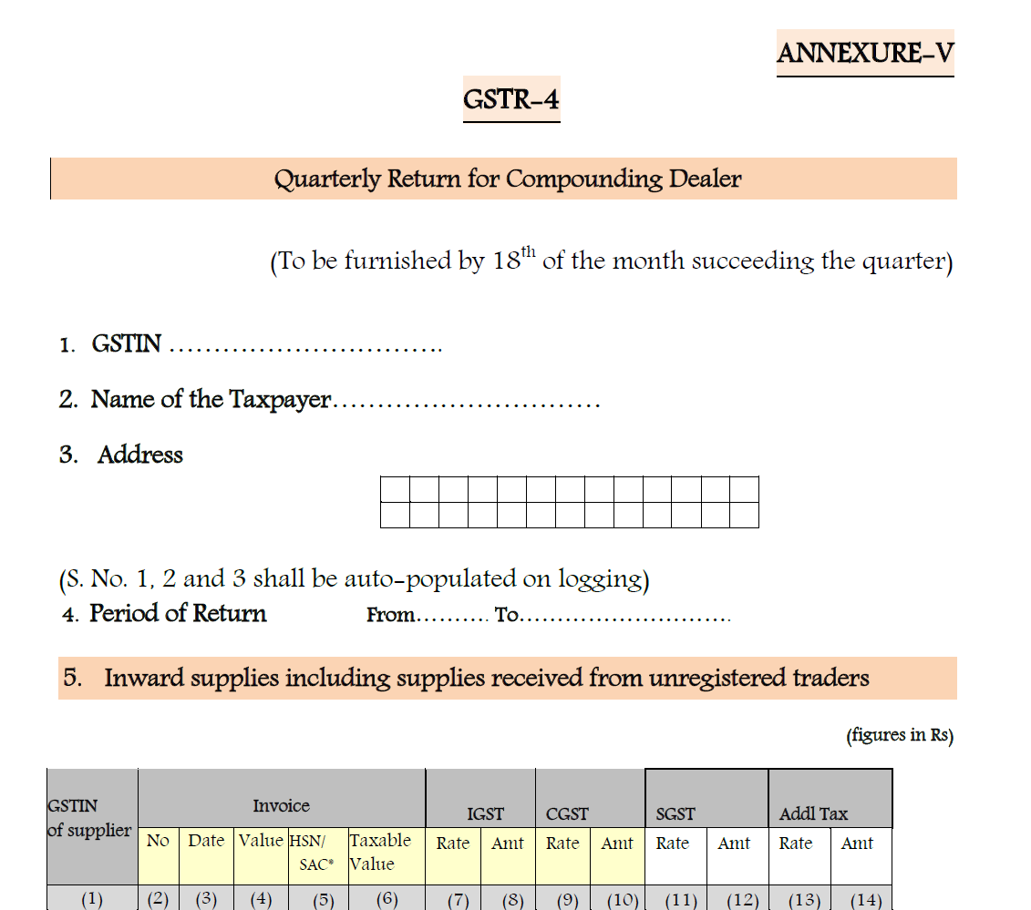

Slide 13
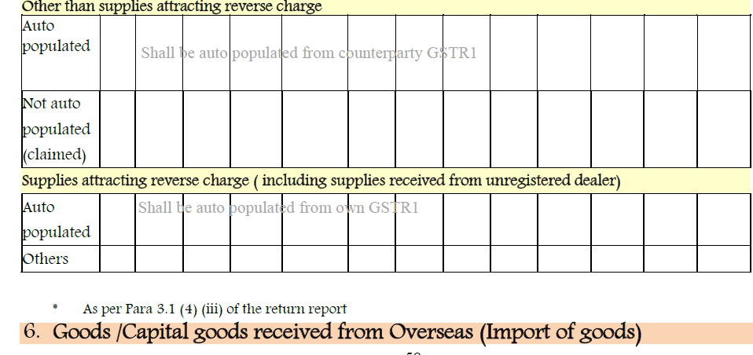

Slide 14
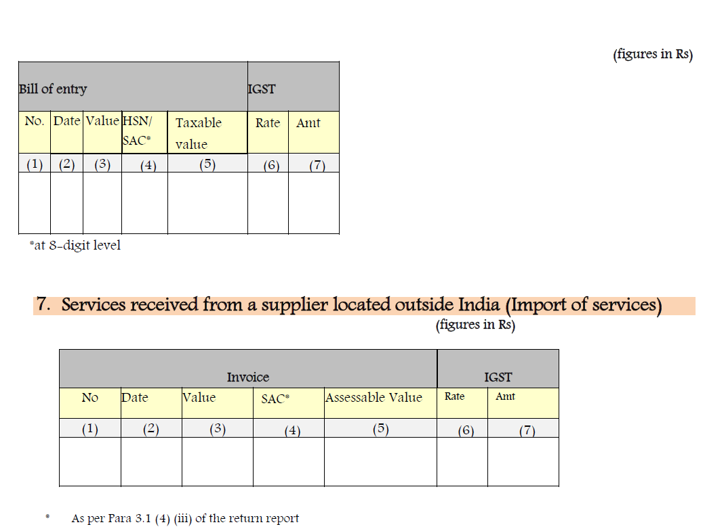

Slide 15
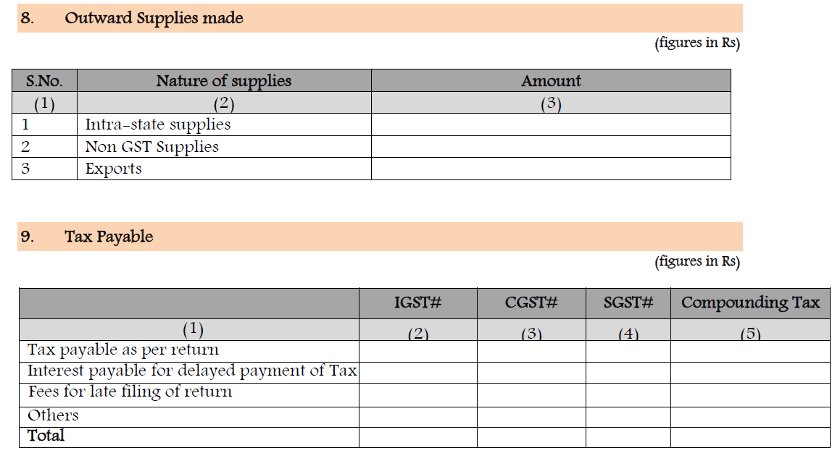

Slide 16
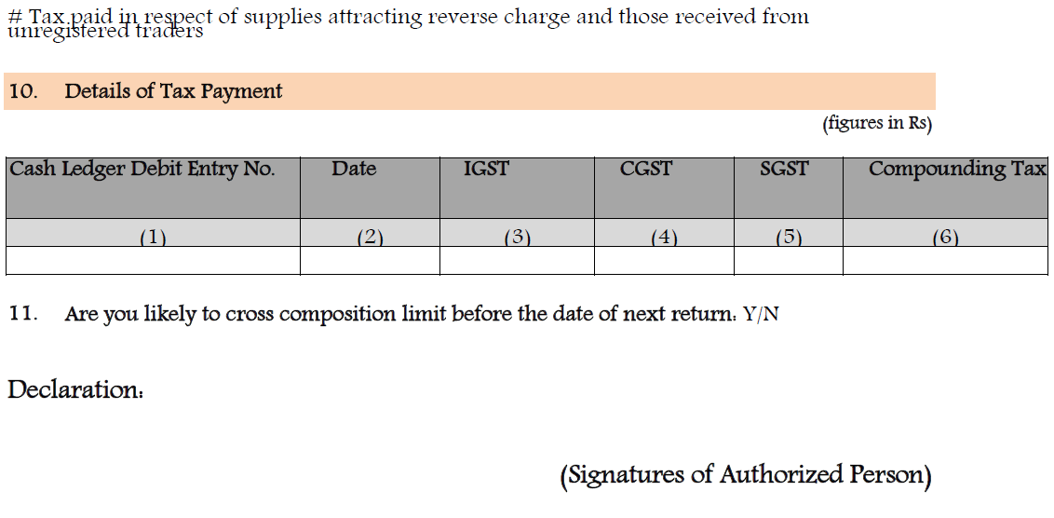

Slide 17
Thank You Very Much

