Slide 1

PROPOSED
GOODS & SERVICE TAX
IN INDIA
CA. UDIT JAIN
9811235657
cauditjain9811@gmail.com

Slide 2
WHAT IS GST ? ? ?
GST is Goods and Service Tax
Comprehensive Levy on Manufacture, Sale & Consumption
Tax on VALUE-ADDITION at each stage
Destination based tax
Dual Taxation Structure
- CGST
- SGST
ITC will be allowable tax wise

Slide 3
NEED OF GST !!!
Reduction in MULTIPLICITY OF TAXES
Mitigation of Cascading Effect
Incremental GDP of around 2%
Bring Transparency
Uniformity in Taxation Regime
Reduction in Multiple Taxable Events

Slide 4

PRESENT V/s PROPOSED
STRUCTURE
OF
GOODS & SERVICE TAX
MULTIPLE
TAXES
SINGLE
TAX

Slide 5
PRESENT INDIRECT TAX STRUCTURE OF INDIA
UNION LIST
-EXCISE DUTY
-SERVICE TAX
-CUSTOM DUTY
STATE LIST
-VAT
-CST
-ENTRY TAX
-ENTERTAINMENT TAX
-OCTROI

Slide 6
TAXES TO BE SUBSUMED !!!
S. NO | SUBSUMED UNDER CGST | SUBSUMED UNDER SGST
1. | Central Excise Duty | VAT / Sales Tax
2. | Additional Excise Duties | Entertainment Tax
3. | Excise Duty – MTP Act | Luxury Tax
4. | Service Tax | Taxes on Lottery etc
5. | Additional CVD | Entry Tax
6. | SAD of Customs | State cess & surcharge

Slide 7
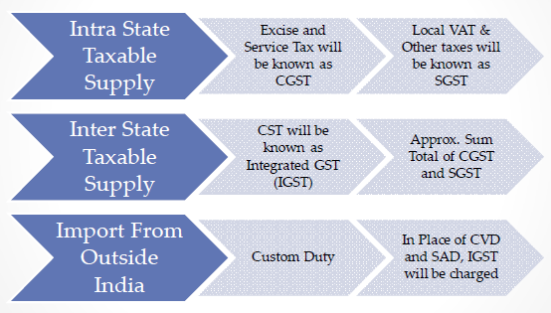
PROPOSED INDIRECT TAX STRUCTURE OF INDIA

Slide 8
ELIMINATION OF MULTIPLE TAXABLE EVENTS
Statute | Point of levy
Central Excise | Manufacture & Removal
Service Tax | Provision of Service
VAT & CST | Sale & Movement of Goods
Entertainment Tax | Admission / Sale of ticket
Entry Tax | Entry of Goods into Local Area
GST | Supply

Slide 9
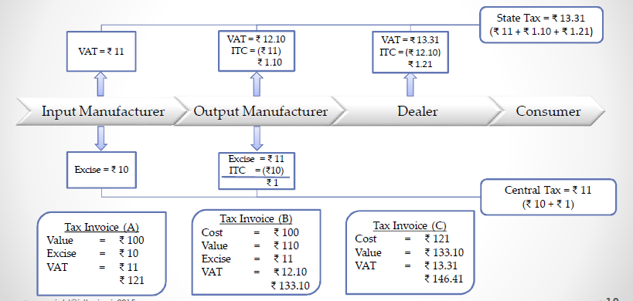
PRESENT TAX STRUCTURE

Slide 10
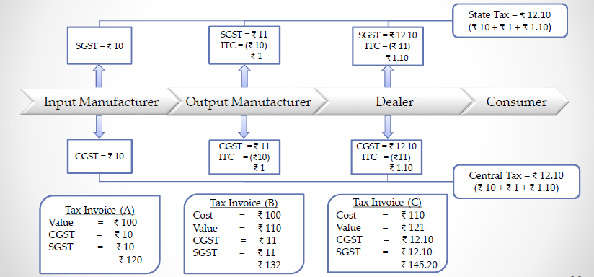
PROPOSED TAX STRUCTURE

Slide 11
MODEL OF GST
For INTRASTATE SUPPLY : DUAL TAXATION MODEL
- CGST
- SGST
For INTERSTATE SUPPLY - IGST
GST is a Destination Based Tax
GST model similar to VAT
ITC allowable – Inter Transfer Prohibited
CGST & SGST to be paid SEPERATELY

Slide 12
APPLICABILITY OF GST
APPLICABLE ON ALL TRANSACTIONS OF SUPPLY
EXCEPT
  Petroleum Products
  Alcoholic Products
  Stamp Duties on Immovable Properties
  Entry Taxes – Municipalities & Panchayats
  Electricity Duties
  Taxes on lottery and betting

Slide 13
RATE & CLASSIFICATION OF GST
HSN Codes for Classification
Present Accounting Code for services
Expected Rate – 17% to 18%
Model GST based on 4 rates
  Merit Rate for essential goods & services
  Standard Rate in general
  Special Rate for precious metals
  Nil Rate

Slide 14
REGISTRATION UNDER GST
PAN based registration – 15 digit GSTIN
State Code |  | PAN |  |  |  |  |  |  |  |  |  | Entity Code |  | Check Digit
1 | 2 | 3 | 4 | 5 | 6 | 7 | 8 | 9 | 10 | 11 | 12 | 13 | 14 | 15
If Turnover >= 9 Lakh registration mandatory
For every state separate registration
Separate registration possible for different verticles

Slide 15
RETURNS UNDER GST
For each month separate return
Return submit to both Centre & State
For each registration separate returns
Types of returns
- GSTR 1 : Outward Supplies
- GSTR 2 : Inward Supplies
- GSTR 3 : Monthly Return
- GSTR 6 : Input Service Distributor
Accounts audited by CA or Cost Accountant

Slide 16

GST COUNCIL
Constituted within 60 days of ACT
Votes required – 3/4th of vote cast
Voting Share – Centre 1/3rd
- State 2/3rd
Functions of Council
- Recommend taxed to be subsumed
- Scope of GST
- Threshold Limits & Rates
- Principles of Levy
- Dispute resolution mechanism

Slide 17
Some more provisions . . .
Composition Scheme for 50 Lakhs – 1%
Transitional Provisions regarding
- Registrations
- Carry forward of ITC
- Treatment of Goods return
- Pending Refund and Assessments
GST & Information Technology Interface

Slide 18
INDUSTRY EXPECTATION FROM GST
Seamless flow of Input Credit
Simple business processes
Minimal ITC Refund Cases
Exemptions instead of exclusions
Low compliance cost
e-registrations, e-returns, e-payment

Slide 19
ROLE OF PROFESSIONALS
Implementation Assistance – Transitional Provisions
Post Implementation Support
Tracking GST development
Tax Planning
Record Keeping

Slide 20
ROLE OF PROFESSIONALS
Litigation Support
Registrations and Returns Compliances
Departmental Audit
Resolving Industrial Issues regarding GST
Review final legislation and impact analysis

Slide 21


