Slide 1

TAX RETURN PREPARER SCHEME(TRPS)
BY CCAA . SAYANTAN BASU BBY CA. SAYANTAN BASU

Slide 2
TRPS
The Income Tax Department, brings an opportunity for the unemployed/partially employed graduates to become self-employed professionals through first-of-its-kind initiative called Tax Return Preparer Scheme (TRPS).
It offers training to 5000 graduates across the country through different computer training institutes .

Slide 3
TRPS
1. The cost of training will be borne by the Income Tax Department.
2. Graduates who complete the training successfully will be issued a certificate and a unique identification number which will authorize them under the Income Tax Act, 1961 to work as self employed Tax Return Preparers.
3. The scheme authorizes the self-employed Tax Return Preparers to prepare and file the tax-returns of small and marginal individual and HUF tax payers.
4. So, avail the opportunity to be a proud professional, work from your home town and help your people

Slide 4
TRPS
Government Support to TRPs (Tax Return Preparers)
The government will assist the TRPs through:
1. Arranging for their training by NIIT and other computer institutes
2. Post training, web-based advanced learning to upgrade their skills
3. 24/7 Helpdesk to clarify TRPs' doubts pertaining to their work.
4. Monitoring and coordinating their activities and providing logistical support through a Resource Centre

Slide 5
TRPS
Eligibility Criteria for Tax Return Preparer
1. Qualification:- Candidates should possess a bachelor's degree from a recognized university in any of the following subjects: -
* Law (LLB)
* Economics (B.A. / B.Sc.)
* Statistics (B.A. / B.Sc.)
* Mathematics (B.A. / B.Sc.)
* Commerce (B.Com.)
* Management/ Business Administration (BBA / BBM)

Slide 6
TRPS
2. Age:
Candidates between the age of twenty-one (21) and thirty-five (35) years as on 01/10/2006, shall be eligible to apply

Slide 7
TRPS
Procedure to become a Tax Returns Preparer
1. Detailed information about the scheme can be viewed from website.
2. Application form can be filled from this website or collected from income tax departments
3. Application forms would also be published in various newspapers.
4. Candidates are required to enclose a demand draft of Rupees One Hundred (Rs 100/-) in favour of “TRPSCHEME" A/c. along with the application form.
5. Training of 5,000 candidates will be carried out at 100 centres across the country.
6. Selection of the candidates for the training shall be made for each centre separately.
7. A maximum of 500 candidates per centre shall be short listed out of the applications received on the basis of the marks obtained in the bachelor's examination. Only short listed candidates will be called for enrolment test.
8. An applicant is allowed to apply for 3 centres, clearly indicating the centre preferences in the application form. Selection will be made centre wise.

Slide 8
TRPS
9. In case a candidate is short listed at more than one training centre for enrolment test, s/he would be allotted the training centre according to her/his order of preference filled in the application form.
10. The result of the enrolment test shall be posted on this website.

Slide 9
TRPS
11. Successful candidates will make a security deposit of Rupees One Thousand (Rs 1000/-) with INCOME TAX DEPARTMENT . This deposit will be refunded only on successful completion of training.
12. The successful candidates will go through a rigorous training program, including web based and classroom based training program. Study material will be provided to the successful candidates. After the training Program, the candidates will go through an assessment examination and will be certified as 'Tax Return Preparers'. They will also get subsequent help through a web based Knowledge Portal and help desk to file returns.
13. The scheme only offers free training to the candidates. Arrangement for stay and transportation has to be made by the candidates themselves.

Slide 10
TRPS
REMUNERATION OF TRPS

Slide 11
TRPS
Tax Return Preparers (TRPs) will receive 3% of the tax paid on the returns prepared & filed for every new assessee in the 1st year, 2% in the second year and 1% in the third year and Rs. 250 for the returns prepared & filed for the old assessees.

Slide 12
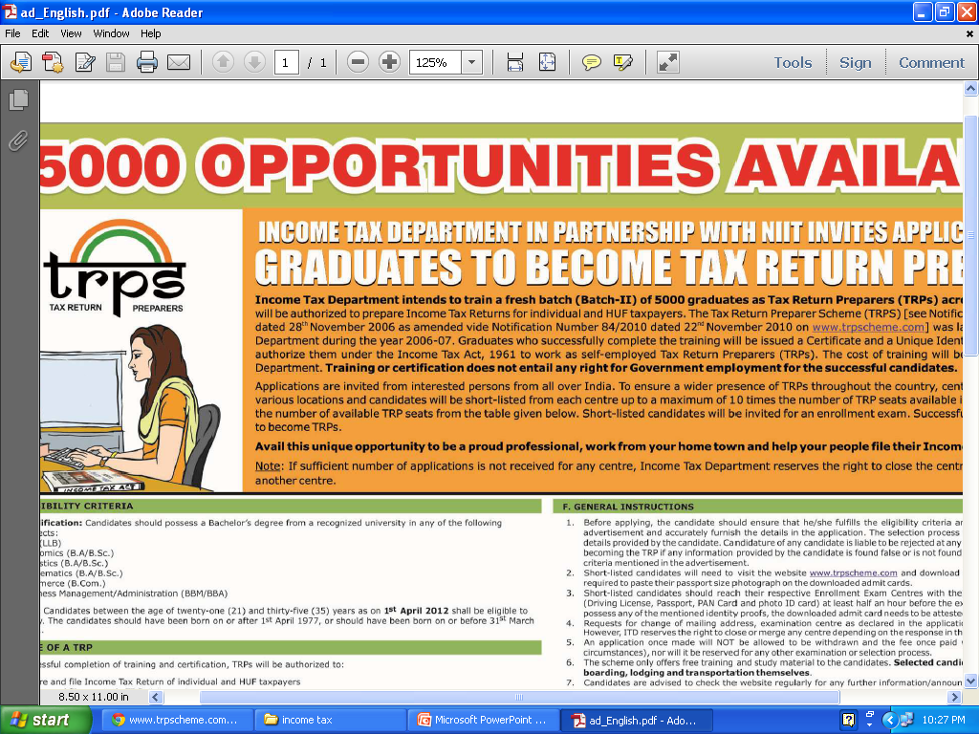
TRPS

Slide 13
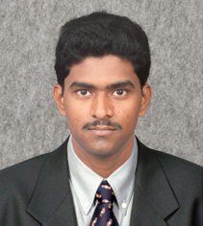
Successful TRPS
Successful TRPs
Sreenivasa Reddy S
TRP ID: T002000107
The first step I took was to inform all my friends, colleagues and neighbours about myself as a TRP and what this service is all about. I distributed pamphlets informing general public about the scheme. I did this near all commercial and IT hubs, places where more number of people converge during their break times.
Like every service or business, beginning is always bumpy but I never lost courage and just went ahead with my decision.
First year, I filed only an odd 200 returns but with my continuous good service, I crossed the 1400 mark the very next year and now controlling a client base of over and above 2200.
Regards,

Slide 14
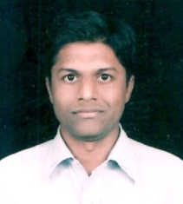
Successful
TRPS
Shiva Kumar Uppula
T002002307
I feel so happy for being declared as a successful TRP from Hyderabad. I share following few lines regarding my success with you. I had filed 812 Income tax returns for Assessment Year 2009-10, 25 Service tax registrations and 8 Service tax returns, manually and electronically. I had given priority in quality in documentation and filing tax returns rather than the number of returns in my work.
I have been endeavoring in getting fresh clients i.e. who files the tax return for the first time and also I explain the benefits of filing tax returns to non-filers and stop-filers and get them motivated to file the returns.
I have been attending to the Re-fresher classes regularly and various seminars organized by the Income tax Department and update my knowledge time to time.
I had availed the loan given exclusively to TRPs under Canara Guide from Canara Bank. Apart from taxation work I have also been doing Firm registrations and Accounting services to various clients.
Now I am planning to organize meetings and awareness programmes to general public by giving various suggestions and tax planning with support from my TRP colleagues and local Income tax Department. This year I am trying to add more clients on e-tds and Service tax.

Slide 15
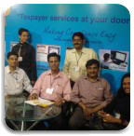
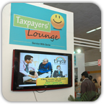
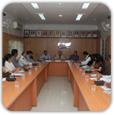
TRPS
Mumbai
Tax Mahotsava
Top : Income Tax E-filing in Pune and Mumbai

Slide 16
TRPS
SO ARE YOU READY ????

Slide 17
TRPS
                THANK YOU

