Slide 1
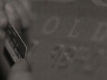



INSTITUTE OF CHARTERED ACCOUNTANTS OF INDIA
THANE IT TRAINING CENTER
THANE BRANCH OF WIRC OF CODE NO.WI020
STUDENT PROFILE
Name : Kirti K. Hattimattur Address : 303, Nav-Vinit, Ramchandranagar, Thane(w)400604 Contact No. : 9987536139 I.C.A.I. Reg.No. : WRO-0308693 Batch : JULY 2009 Batch no. : 07/09/28 Topic : TAXES

Slide 2

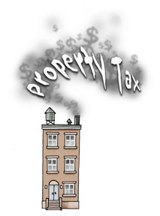
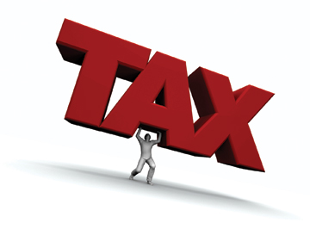
A
PRESENTATION
ON
TAXES

Slide 3

TAXES
DIRECT
INDIRECT
INCOME TAX
WEATH TAX
CENTRAL EXCISE
CENTRAL SALES TAX
CUSTOM DUTY
SERVICE TAX
OCTROI ETC

Slide 4
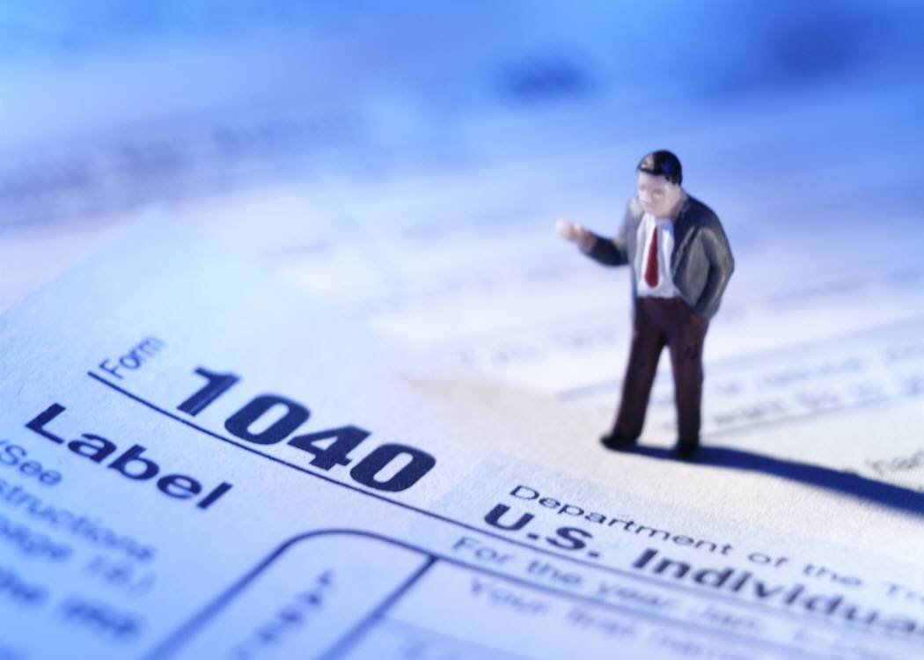
SOURCES
COLLECTION OF INFORMATION FROM FOLLWING WEB SITES:-
www.google.com
www.mahavat.gov.in
www.servicetax.gov.in
www.incometaxindia.gov.in
Images from :-
www.google.com and from Magazines and Journals.

Slide 5

TAXES
Direct tax is a kind of charge, which is imposed directly on the taxpayer. The examples of direct tax include property tax and income tax. Alternatively, it can be said that a direct tax is one that is taken away from one's salary or wages. When the tax is imposed by the government upon the property, then it is called property tax, which is also a direct tax.
Indirect taxes are the charges that are levied on goods and services. Some of the significant indirect taxes include VAT (Value Added Tax), sales tax, excise tax, stamp duties and expenditure tax.

Slide 6



Income tax
HOME

Slide 7
Defination of income tax
According to Income Tax Act 1961, every person, who is an assessee and whose total income exceeds the maximum exemption limit, shall be chargeable to the income tax at the rate or rates prescribed in the finance act. Such income tax shall be paid on the total income of the previous year in the relevant assessment year.
HOME

Slide 8
Modern History of Income Tax
The Income Tax history in modern India dates back to 1860. In this year first Income Tax Act was introduced and which remained in force for a period of 5 years. This Act lapsed in 1865. Thereafter Act-II of 1886 was in force. This Act of 1886 was the improved version. It introduced the definition of agricultural income and the exemption it granted in respect of agricultural income has continued to be a feature of all subsequent legislations.
HOME

Slide 9
The total income of an individual is determined on the basis of his residential status in India.
Residence Rule
An individual is treated as resident in a year if present in India
for 182 days during the year or
for 60 days during the year and 365 days during the preceding four years. Individuals fulfilling neither of these conditions are nonresidents. (The rules are slightly more liberal for Indian citizens residing abroad or leaving India for employment abroad.)
Non-Residents and Non-Resident Indians
Residents are on worldwide income. Nonresidents are taxed only on income that is received in India or arises or is deemed to arise in India. A person not ordinarily resident is taxed like a nonresident but is also liable to tax on income accruing abroad if it is from a business controlled in or a profession set up in India.
HOME

Slide 10
Taxability of individuals is summarised in the table below
Status | Indian Income | Foreign Income
Resident and ordinarily resident | Taxable | Taxable
Resident but not ordinary resident | Taxable | Not Taxable
Non-Resident | Taxable | Not Taxable
HOME

Slide 11
Income Tax - Taxable Heads of Income
SALARIES
INCOME FROM HOUSE PROPERTY
PROFITS AND GAINS OF BUSINESS OR PROFESSION
CAPITAL GAINS
INCOME FROM OTHER SOURCES
HEADS OF INCOME
SECTION 14
HOME

Slide 12
Salaries
Income is taxable under the head “SALARIES”, only if there exists ‘EMPLOYER-EMPLOYEE RELATIONSHIP’ between the payer and payee. The following are some important features of employer-employee relationship:-
Employer –employee relationship is “Contract of Service” (where employee is bound to work for his employer) as against “Contract for Service” (where a person offers his services for charges).
Employer-employee relationship is similar to master-servant relationship wherein the master(i.e. employer) has a control over the work and working mechanism of the servant(i.e. employee).
It is distinct from principal-agent relationship, as the agent is generally free to carry out his principal’s instructions according to his own discretion without direct control and supervision of the principal.
HOME

Slide 13
Tax upon Income from house property
The annual value of property, consisting of any buildings or lands appurtenant thereto of which the assessee is the owner, other than such portions of such property as he may occupy for the purposes of any business or profession carried on by him, the profits of which are chargeable to income tax, shall be chargeable to income tax under the head "Income from House Property".
HOME

Slide 14
Tax upon Income from Business or Professions
For charging the income under the head "Profits and Gains of business," the following conditions should be satisfied:
There should be a business or profession
The business or profession should be carried on by the assessee.
The business or profession should have been carried on by the assessee at any time during the previous year.
HOME

Slide 15
Tax upon Income from Capital Gain
Capital asset means property of any kind held by an assessee whether or not connected with his business or profession.
Tax upon income from Other Sources
Income of every kind, which is not chargeable to income tax under the heads
salary
income from house property,
profits and gains of business and profession,
capital gains can be taxed under the head "income from other sources".
However such income should also not fall under income not forming part of total income under the IT Act.
HOME

Slide 16
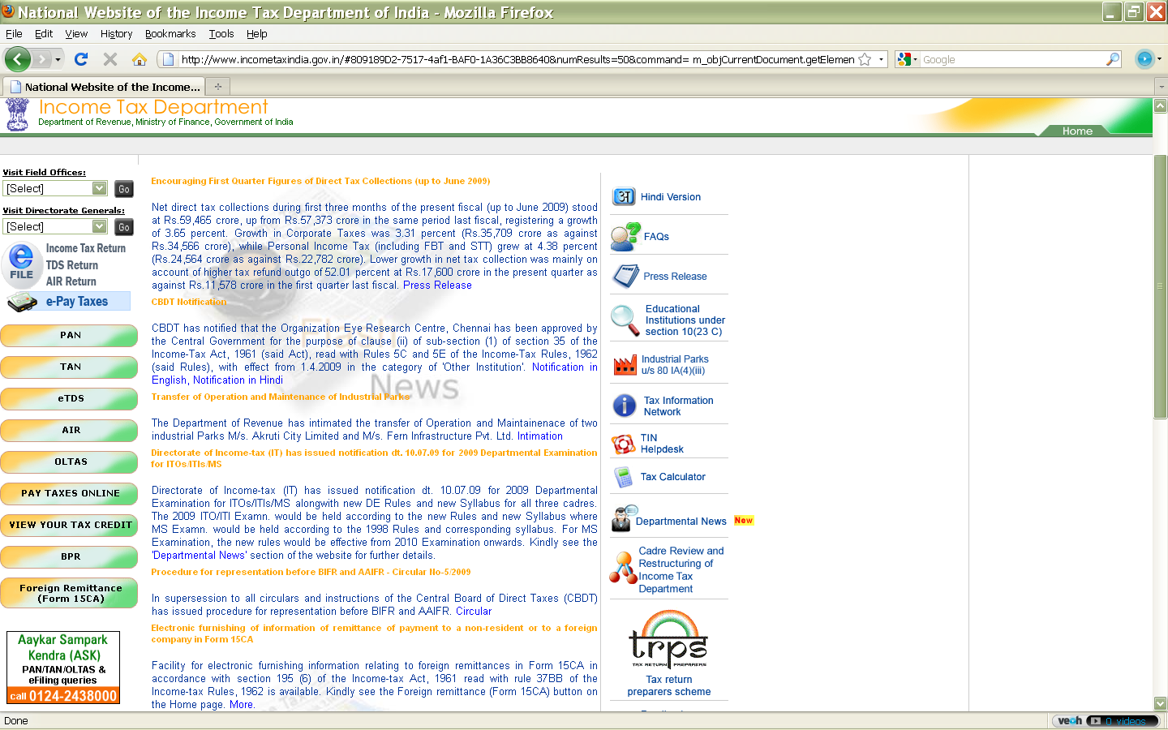
www.incometaxindia.gov.in

Slide 17
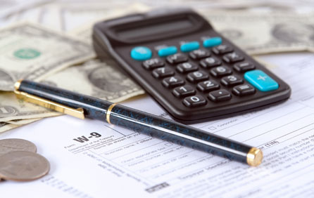


Wealth tax
HOME

Slide 18
Charge of Wealth-tax
Subject to the other provisions (including provisions for the levy of additional wealth-tax) contained in this Act, there shall be charged for every assessment year commencing on and from the first day of April, 1957 but before the first day of April, 1993, a tax (hereinafter referred to as wealth-tax) in respect of the net wealth on the corresponding valuation date of every individual 24 , Hindu undivided family and 25 company at the rate or rates specified in Schedule I.
Subject to the other provisions contained in this Act, there shall be charged for every assessment year commencing on and from the 1st day of April, 1993, wealth-tax in respect of the net wealth on the corresponding valuation date of every individual, Hindu undivided family and company, at the rate of one per cent of the amount by which the net wealth exceeds fifteen lakh rupees.
HOME

Slide 19

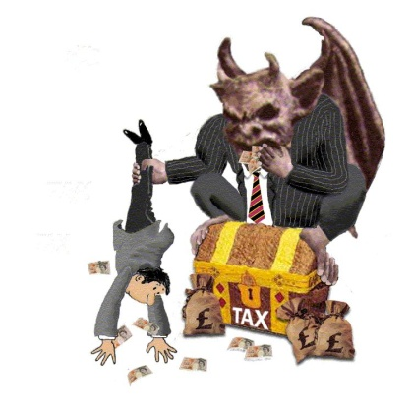
Central excise
HOME

Slide 20
The Customs Act was formulated in 1962 to prevent illegal imports and exports of goods. Besides, all imports are sought to be subject to a duty with a view to affording protection to indigenous industries as well as to keep the imports to the minimum in the interests of securing the exchange rate of Indian currency.
Duties of customs are levied on goods imported or exported from India at the rate specified under the customs Tariff Act, 1975 as amended from time to time or any other law for the time being in force. For the purpose of exercising proper surveillance over imports and exports, the Central Government has the power to notify the ports and airports for the unloading of the imported goods and loading of the exported goods, the places for clearance of goods imported or to be exported, the routes by which above goods may pass by land or inland water into or out of Indian and the ports which alone shall be coastal ports.
HOME

Slide 21
In order to give a broad guide as to classification of goods for the purpose of duty liability, the central Board of Excises Customs (CBEC) bring out periodically a book called the "Indian Customs Tariff Guide" which contains various tariff rulings issued by the CBEC. The Act also contains detailed provisions for warehousing of the imported goods and manufacture of goods is also possible in the warehouses.
For a person who do not actually import or export goods customs has relevance in so far as they bring any baggage from abroad.
HOME

Slide 22
Liability to pay Central Excise Duty
Section 3 of the Central excises and Salt Act,1944 provides that there shall be levied and collected in such manner as may be prescribed, duties of excise on all excisable goods other than salt which are produced or manufactured in India at the rates set forth in the schedule to the Central excise Tariff Act,1985.it is therefore clear that as soon as the goods in question are produced or manufactured, they will be liable to payment of Excise duty. However for convenience duty is collected at the time of removal of the goods. While Section 3 of the Central Excises and salt Act,1944 lays down the taxable event, Rules 9 and 49 of the Central excise Rules,1944 provides for the collection of duty.
HOME

Slide 23

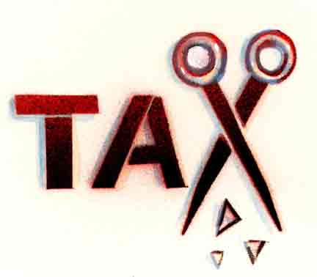
Central sales tax
HOME

Slide 24
Sales Tax?
Sales Tax is a tax, levied on the sale or purchase of goods. There are two kinds of Sales Tax i.e. Central Sales Tax, imposed by the Centre and Sales Tax, imposed by each state.
When is Sales Tax payable?
Central Sales tax is generally payable on the sale of all goods by a dealer in the course of inter-state Trade or commerce or, outside a State or, in the course of import into or, export from India.
HOME

Slide 25
To whom is Sales Tax payable? By whom is it payable?
Sales tax is payable to the sales tax authority in the state from which the movement of goods commences. It is to be paid by every dealer on the sale of any goods effected by him in the course of inter-state trade or commerce, notwithstanding that no liability to tax on the sale of goods arises under the tax laws
of the appropriate state.
The power to levy Sales tax
No state can levy sales tax on any sale or purchase where such sale or purchase takes place
  outside the state and
  in the course of import of goods into or export of goods outside India.
Only the parliament can levy tax on inter-state sale or purchase of goods
HOME

Slide 26
Main principles in state sales tax laws
1.A sale or purchase of goods is said to take place when the transfer of property in the existing goods or future goods takes place for consideration of money.
The goods have been divided into different categories and different rates of sales tax are charged for different categories of goods.
In most of the cases related to the sales tax, the tax on the sale or purchase of goods is at single point.
Under the provisions of some state laws the assesses are divided into several categories such as manufacturer, dealer, selling agent etc. and such as assess is required to obtain a registration certificate to that effect. The sales tax or the purchase tax is levied on that assessee on the basis of his category such as dealer, manufacturer etc. on production of certain forms or certificates (and differential rates of sales tax are levied).
HOME

Slide 27
Generally , a quarter return of sales or purchases is insisted upon and the assessee is required to furnish the return in the prescribed form.
At the time of assessment, the assessee has to furnish all the documentary evidence and satisfy the concerned sales tax / commercial tax officer.
The sales tax laws of the states prescribe the procedure to be followed in case an assessee prefers to make an appeal.
Every dealer should apply for registration and obtain a registration certificate to that effect. The registration certificate number should be quoted in all the bill / cash memos.
HOME

Slide 28

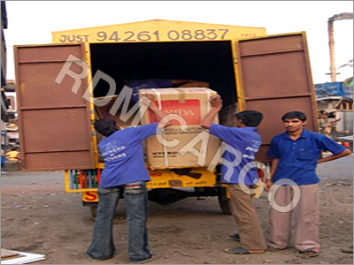

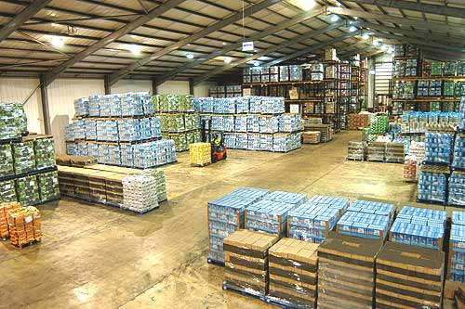
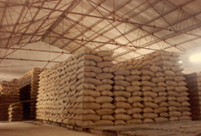
Godowns
HOME

Slide 29
Value Added Tax (VAT)
The much awaited Value Added Tax
(VAT) has been introduced in Indian Taxation System from April 1, 2005. Now India is a part of other 123 countries following VAT which was leaded first time by UK in 1973. It is said that 4 years is very short period in introducing VAT in the country as compared to 10 years on an average by other countries.
HOME

Slide 30
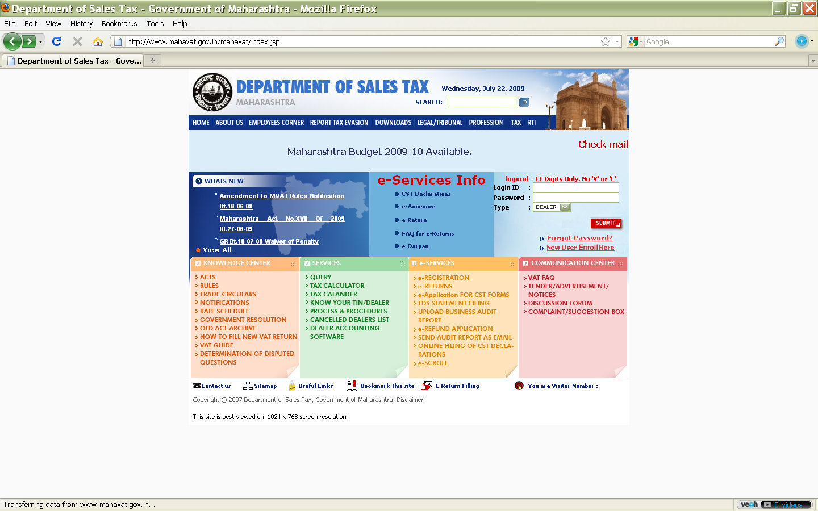
www.mahavat.gov.in

Slide 31

Custom duty
HOME

Slide 32

Introduction
As per AY 2009-10
Customs duty of 5% to be imposed on Set Top Box for television broadcasting.
Customs duty on LCD Panels for manufacture of LCD televisions to be reduced from 10% to 5%.
Full exemption from 4% special CVD on parts for manufacture of mobile phones and accessories to be reintroduced for one year.
List of specified raw materials/inputs imported by manufacturer-exporters of sports goods which are exempt from customs duty, subject to specified conditions, to be expanded by including five additional items.
List of specified raw materials and equipment imported by manufacturer-exporters of leather goods, textile products and footwear industry which are fully exempt from customs duty, subject to specified conditions, to be expanded.
Customs duty on unworked corals to be reduced from 5% to Nil.
Customs duty on 10 specified life saving drugs/vaccine and their bulk drugs to be reduced from 10% to 5% with Nil CVD (by way of excise duty exemption).
HOME

Slide 33
Customs duty on specified heart devices, namely artificial heart and PDA/ASD occlusion device, to be reduced from 7.5% to 5% with Nil CVD (by way of excise duty exemption).
Customs duty on permanent magnets for PM synchronous generator above 500 KW used in wind operated electricity generators to be reduced from 7.5% to 5%.
Customs duty on bio-diesel to be reduced from 7.5% to 2.5%.
Concessional customs duty of 5% on specified machinery for tea, coffee and rubber plantations to be reintroduced for one year, upto 06.07.2010.
Customs duty on â€˜mechanical harvesterâ€™ for coffee plantation to be reduced from 7.5% to 5%. CVD on such harvesters has also been reduced from 8% to nil, by way of excise duty exemption.
Customs duty on cotton waste to be reduced from 15% to 10%.
Customs duty on wool waste to be reduced from 15% to 10%.
Customs duty on rock phosphate to be reduced from 5% to 2%.
HOME

Slide 34
Customs duty on serially numbered gold bars (other than tola bars) and gold coins to be increased from Rs.100 per 10 gram to Rs.200 per 10 gram. Customs duty on other forms of gold to be increased from Rs.250 per 10 gram to Rs.500 per 10 gram. Customs duty on silver to be increased from Rs.500 per Kg. to Rs.1000 per Kg. These increases also to be applicable when gold and silver (including ornaments) are imported as personal baggage.
CVD exemption on Aerial Passenger Ropeway Projects to be withdrawn. Such projects will now attract applicable CVD.
Customs duty exemption on concrete batching plants of capacity 50 cum per hour or more to be withdrawn. Such plants will now attract customs duty of 7.5%.
On packaged or canned software, CVD exemption to be provided on the portion of the value which represents the consideration for transfer of the right to use such software, subject to specified conditions.
Customs duty on inflatable rafts, snow-skis, water skis, surf-boats, sail-boards and other water sports equipment to be fully exempted.
HOME

Slide 35
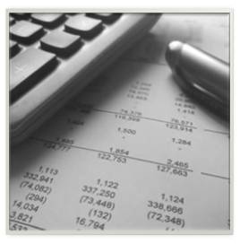
Service tax
HOME

Slide 36






Call Centers
Hotel Services
Airlines
Hospitals

Slide 37
Service tax
Service tax is a tax levied on services rendered by a person and the responsibility of payment of the tax is cast on the service provider. It is an indirect tax as it can be recovered from the service receiver by the service provider in course of his business transactions. Service Tax was introduced in India in 1994 by Chapter V of the Finance Act, 1994 (External website that opens in a new window). It was imposed on a initial set of three services in 1994 and the scope of the service tax (-1 MB) (PDF file that opens in a new window) has since been expanded continuously by subsequent Finance Acts. The Finance Act, extends the levy of service tax to the whole of India, except the State of Jammu & Kashmir.
HOME

Slide 38

NEED FOR A TAX ON SERVICES
Now a days, service sector has been growing phenomenally all over the world. The growing importance of this sector can be gauged from the ever increasing contribution made by the service sector to GDP, thereby pushing back the contribution of traditional contributors like agriculture and manufacturing sectors.
Hence, the Government's argument is that substantial revenue should come from the service sector.
With these objectives in mind, service tax was introduced in India in 1994.
HOME

Slide 39
SERVICE TAX LAW
SERVICE TAX LAW
FINANCE ACT
NOTIFICATIONS
ORDERS
TRADE NOTICE
RULES
CIRCULARS OR OFFICE LETTERS
HOME

Slide 40
EXTENT, COMMENCEMENT & APPLICATION
The Finance Act, 1994 came into force from 1.7.1994. By section 64(1), the Act extends to the whole of India except the state of Jammu and Kashmir, and by section 64(3), the levy applies to “taxable services provided”. Thus, services provided in the State of Jammu and Kashmir are not liable to service tax.
Service provided within the territorial waters will be liable to service tax.
Indian territorial waters extend upto 12 nautical miles from the Indian land mass.
HOME

Slide 41

ADMINISTRATION OF SERVICE TAX
MINISTRY OF FINANCE
CENTRAL BOARD OF EXCISE & CUSTOM
CENTRAL EXCISE ZONES HEADED BY CHIEF COMMISSIONERS
DEPARTMENT OF REVENUE
CENTRAL EXCISE COMMISIONERATES HEADED BY COMMISSIONERS
DIRECTOR GENERAL OF SERVICE TAX (CO-ORDINATOR)
HOME

Slide 42
WHAT IS SERVICE TAX?
Service tax is a tax on services.
This is not a tax on profession, trade, calling or employment but is in respect of service rendered.
As per Webster’s Concise Dictionary, ‘service’ means a useful result or product of labor, which is not a tangible commodity.
However, usage of some goods during the course of rendering the service would not mean that there is no ‘service’.
HOME

Slide 43
VALUATION OF TAXABLE SERVICES (SECTION 67)
The gross amount charged for the taxable service shall include any amount received towards the taxable service before, during or after the provision of such service. Thus, not even advance but any other amount recovered after the completion of provision of service shall form part of the gross amount charged for the taxable service.
Money includes any currency, cheque, promissory note, letter of credit, draft, pay order, travellers cheque, money order, postal remittance and other similar instruments but does not include currency that is held for its numismatic value.
Gross amount charged includes payment by cheque, credit card, deduction from account and any form of payment by issue of credit notes or debit notes and book adjustment.
HOME

Slide 44
PERSON LIABLE TO PAY SERVICE TAX
PERSON LIABLE TO PAY SERVICE TAX
SERVICE PROVIDER
SPECIFIED PERSONS AS PER RULE 2(1)(d) OF SERVICE TAX RULES, 1994
HOME

Slide 45
DUE DATE FOR PAYMENT OF SERVICE TAX
Rule 6(1) provides that service tax on the value of taxable services received:
by an individual or a proprietary firm or a partnership firm during any quarter is payable by the 5th of the month immediately following the said quarter,
in other cases (company and HUF) during any calendar month is payable by the 5th of the month immediately following the said calendar month.
The due dates for payment of service tax in case of different assessees are tabulated below:-
HOME

Slide 46
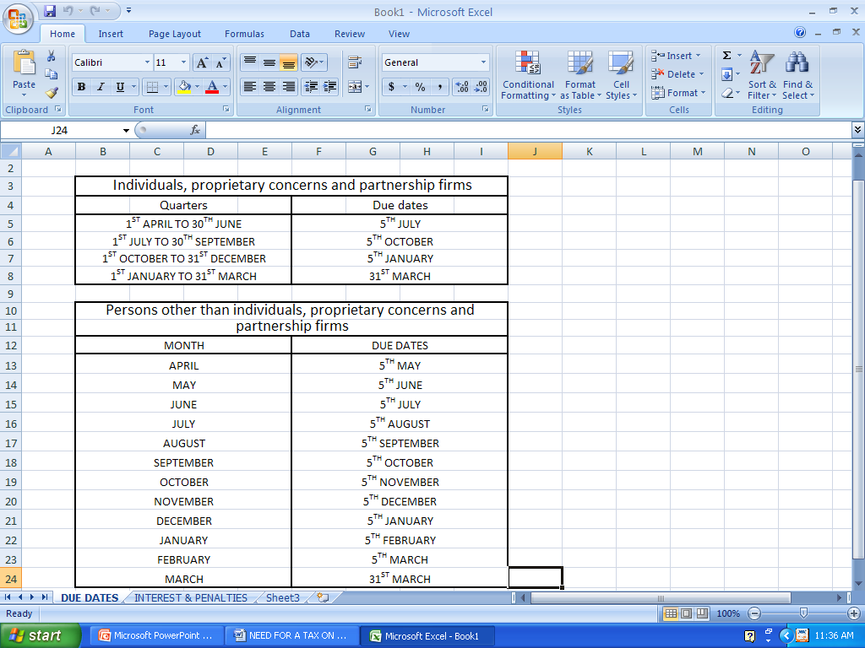
HOME

Slide 47
SPECIAL PROVISION FOR PAYMENT OF SERVICE TAX IN CASE OF LIFE INSURER CARRYING ON LIFE INSURANCE BUSINESS
An insurer carrying life insurance business who is liable for paying service tax has the option to pay an amount calculated at 1% of the gross amount of premium charged by him towards the discharged of service tax liability instead of paying service at 12%
HOME

Slide 48
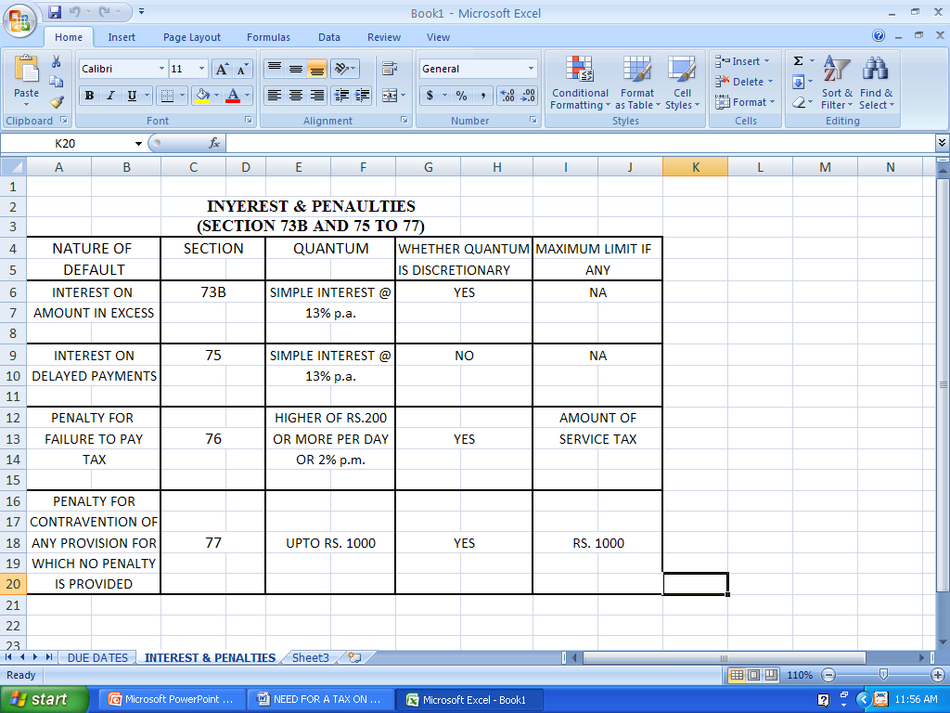
HOME

Slide 49
Service Tax Exemptions
The Central Government can grant partial or total exemption by issuing an exemption notification. But it cannot be granted by the Government with retrospective effect. The general exemptions are :-
Small service providers whose turnover is less than Rs 4 lakhs per annum are exempt from service tax.
There is no service tax on export of services.
Services provided to UN and International Agencies and supplies to SEZ(Special Economic Zones) are exempt from service tax.
Service tax is not payable on value of goods and material supplied while providing services. Such exclusion is permissible only if Cenvat credit on such goods and material is not taken.
Source: National Portal Content Management Team, Reviewed on: 14-03-2008
HOME

Slide 50
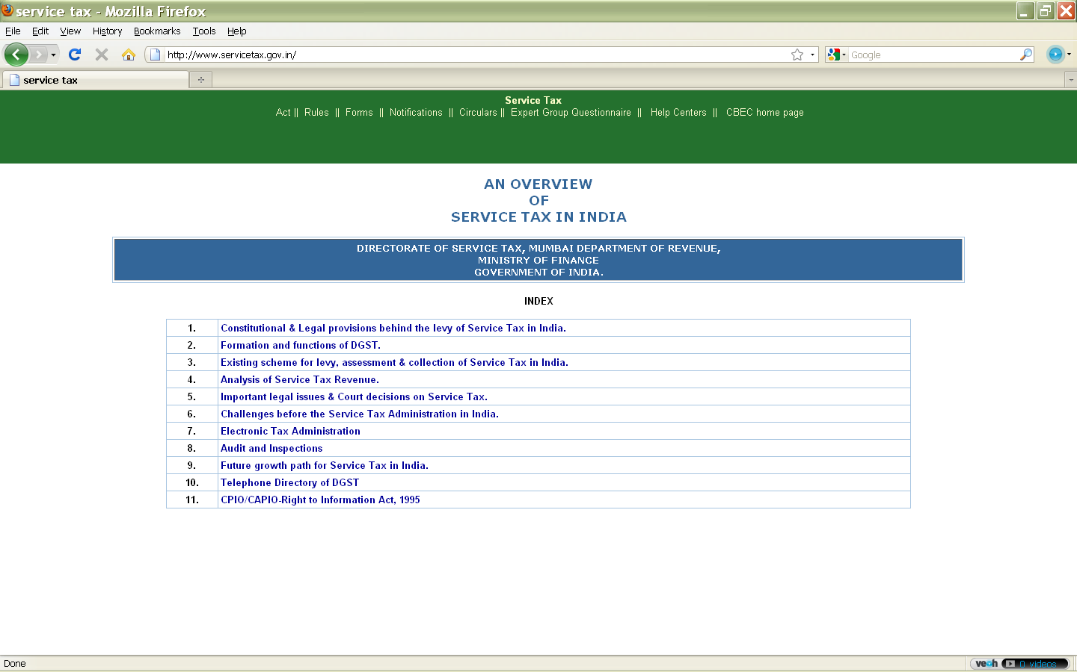

Slide 51
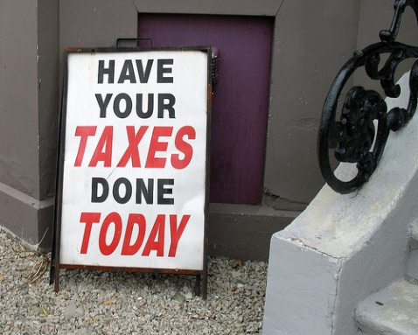
CONCLUSION
HOME

Slide 52

HOME

