Slide 1

RETURN ANNEXURE PREAPARATION

Slide 2
TRANSACTIONS
SALES TO REGISTERED DEALER
SALES TO UNREGISTERED DEALER/CONSUMER
BRANCH TRANSFER/CONSIGNMENT

Slide 3
INVOICE
MULTIPLE SALES IN A SINGLE INVOICE
TAX PAID SEPARATELY
INCLUSIVE OF TAX
COMPOSITION
TAX FREE
EXEMPTED
LABOUR CHARGES
OTHER CHARGES

Slide 4
FORM 231
POSSIBLE SALES COMBINATION
TAX PAID SEPARATELY
INCLUSIVE OF TAX
COMPOSITION
TAX FREE
EXEMPTED (u/s 41 & 8)
LABOUR CHARGES
OTHER CHARGES

Slide 5
FORM 232
POSSIBLE SALES COMBINATION
TAX PAID SEPARATELY
INCLUSIVE OF TAX
COMPOSITION
TAX FREE
EXEMPTED
LABOUR CHARGES
OTHER CHARGES

Slide 6
FORM 233
POSSIBLE SALES COMBINATION
TAX PAID SEPARATELY
INCLUSIVE OF TAX
COMPOSITION
TAX FREE
EXEMPTED (u/s 41 & 8)
LABOUR CHARGES
OTHER CHARGES

Slide 7
FORM 234
POSSIBLE SALES COMBINATION
TAX PAID SEPARATELY
INCLUSIVE OF TAX
COMPOSITION
TAX FREE
EXEMPTED (u/s 8(4))
LABOUR CHARGES
OTHER CHARGES

Slide 8
FORM 235
POSSIBLE SALES COMBINATION
TAX PAID SEPARATELY
INCLUSIVE OF TAX
COMPOSITION
TAX FREE
EXEMPTED (u/s 41 & 8)
LABOUR CHARGES
OTHER CHARGES

Slide 9
STEPS FOR FILING OF RETURN
Step 3
Prepare Sales and Purchases Annexure
Step 5
Manual Input in Preview Return
Step 1
Download Annexure Template
Step 4
Validate annexure and preview return
Step 2
Copy file and rename by TIN & Period

Slide 10
STEPS FOR FILING OF RETURN
Step 6
Validate and create file for upload
Step 8
Step 10
Verify Draft Return
Step 9
Verify ITC
Submit Return with Payment
Step 7
Upload text file

Slide 11

Download Annexure Template
Download template from www.mahavat.gov.in

Slide 12

Save as and rename file by TIN & Period
For future reference save file by TIN and Period

Slide 13
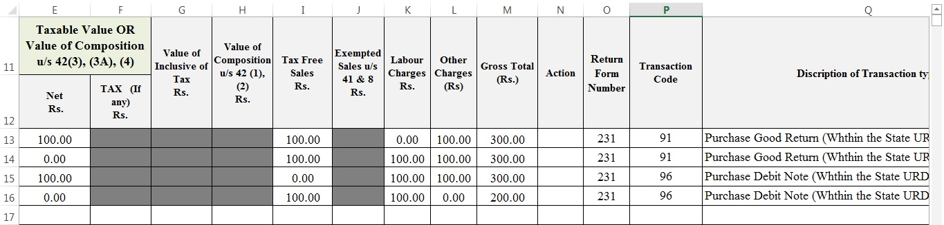
Prepare Sales and Purchases Annexure
Prepare sales and purchase annexure with help guide

Slide 14

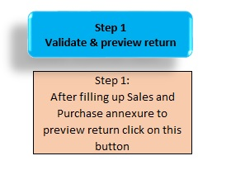
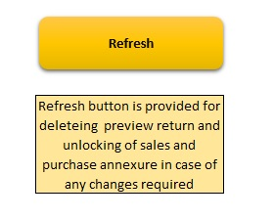
Validate annexure and preview return
Step1- Validate annexure and preview return

Slide 15

Manual Input in Preview Return
Manual input of tax rate wise sales and purchases
Retention, Denial of Set-off

Slide 16
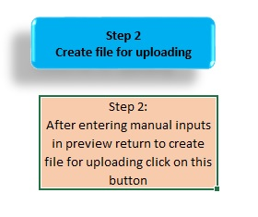
Validate and create file to upload
Step2- Validate and prepare .txt file to upload

Slide 17
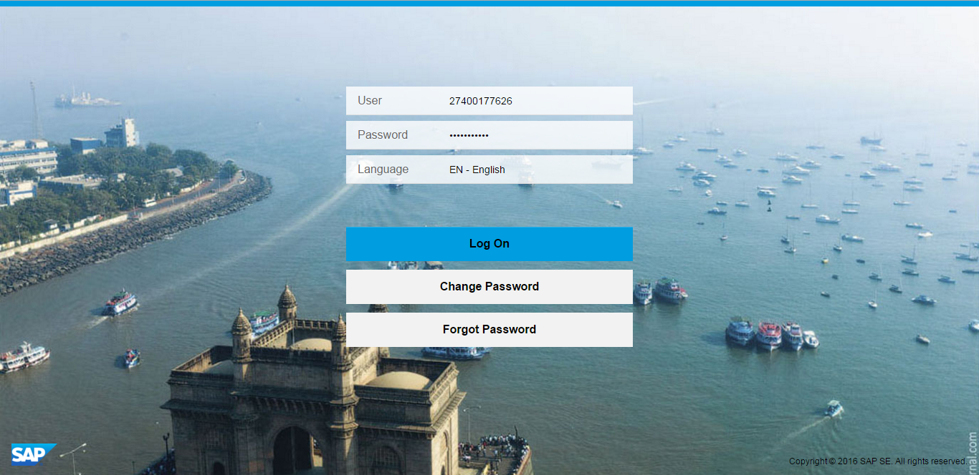
Login with credentials
User: Enter TIN number without suffix
(E.g 27XXXXXXXX)
Enter Password and click on LOG ON

Slide 18
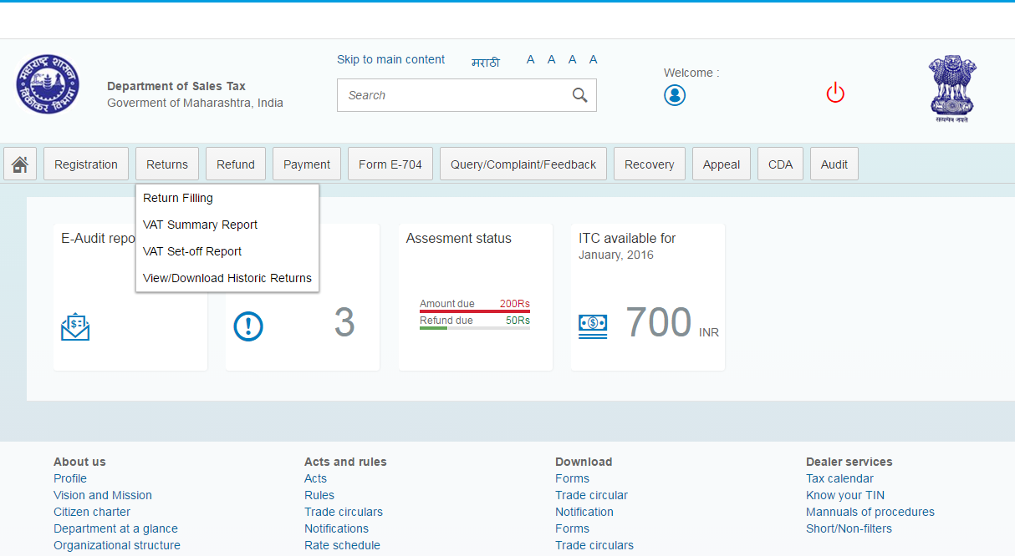
Select Returns
Select “Return Filing’’

Slide 19
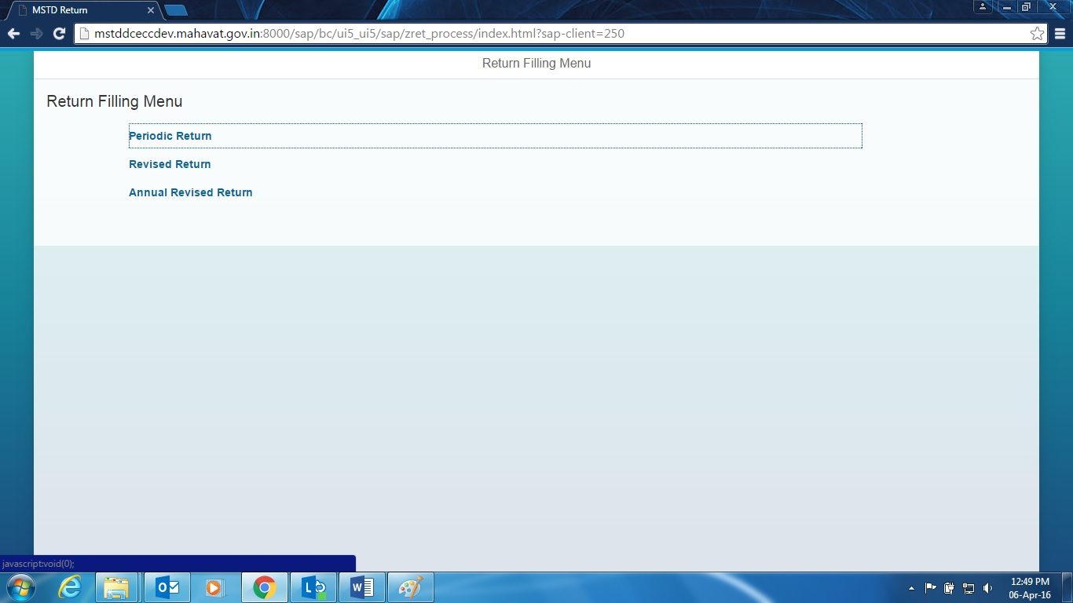
Select Periodic Return
Click on ‘’Periodic Return’’

Slide 20
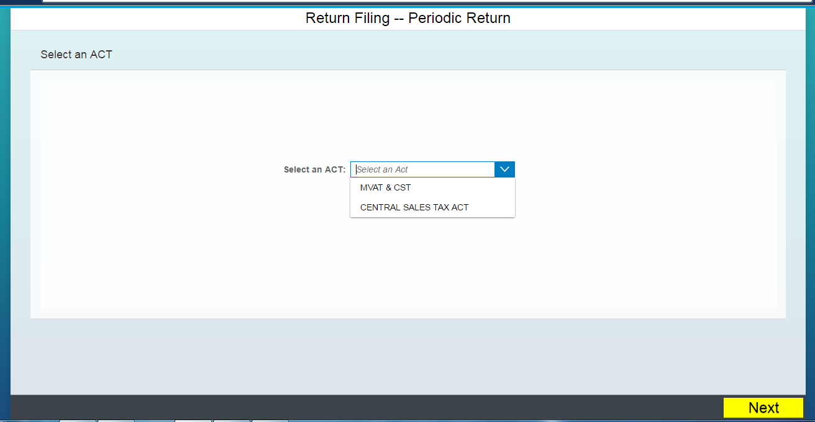
Select Act
Select VAT/CST from dropdown. E.g VAT/CST
2. Click on ‘’NEXT’’

Slide 21
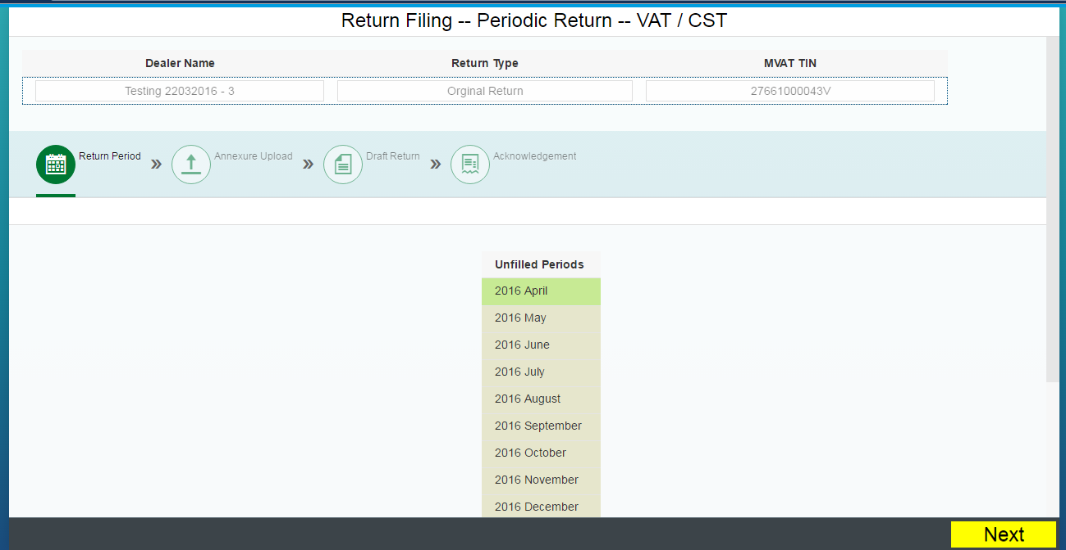
Unfiled Periods will be displayed
Unfiled Periods
Click on NEXT

Slide 22
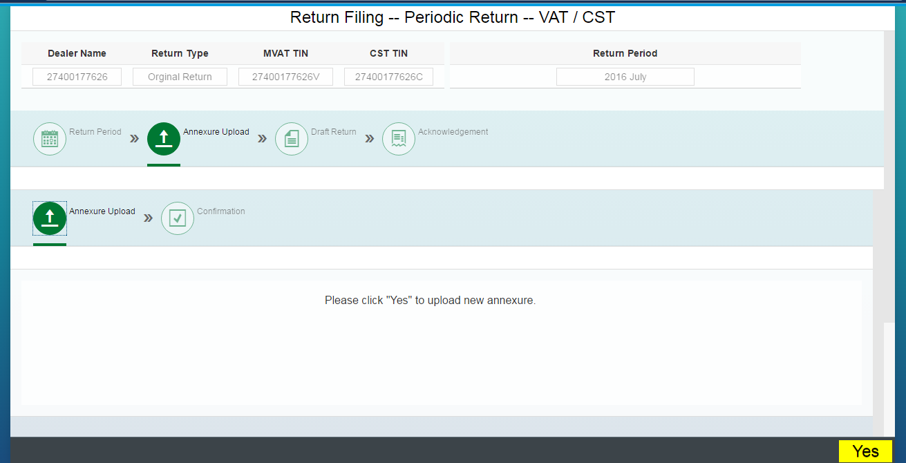
You will be asked to upload New File
Click on ‘’YES’’

Slide 23
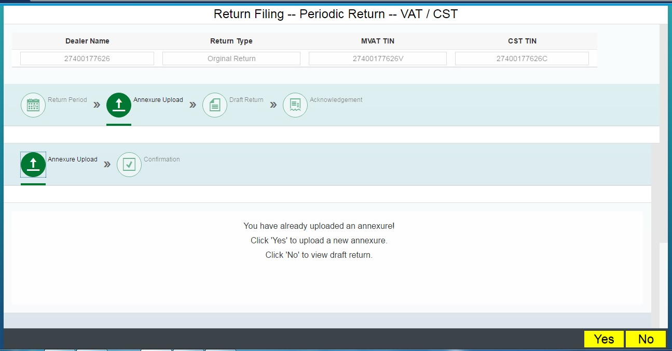
Already uploaded annexure and not submitted Return
Click ‘’NO’’ to view Draft Return
Click ‘’YES’’ to upload new Annexure

Slide 24
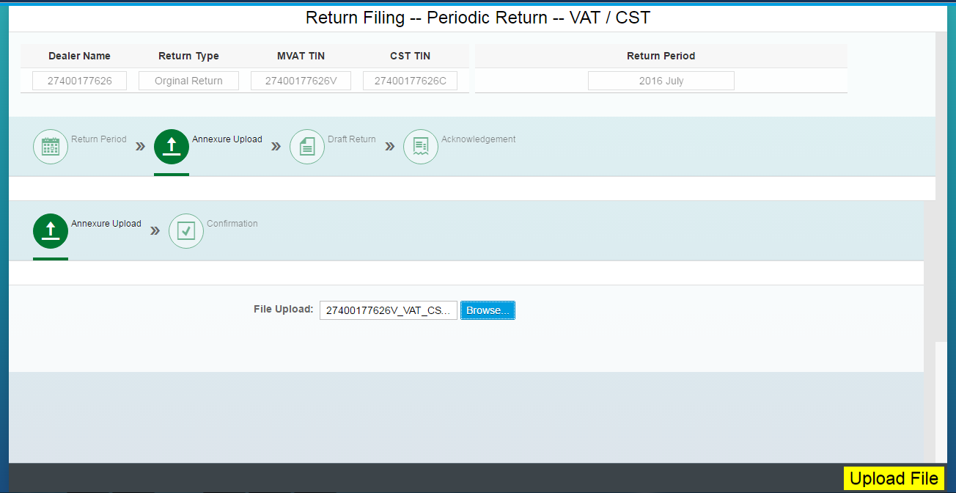
Upload File
Click on Browse to select .txt (Annexure)
Click on ‘’UPLOAD FILE’’

Slide 25
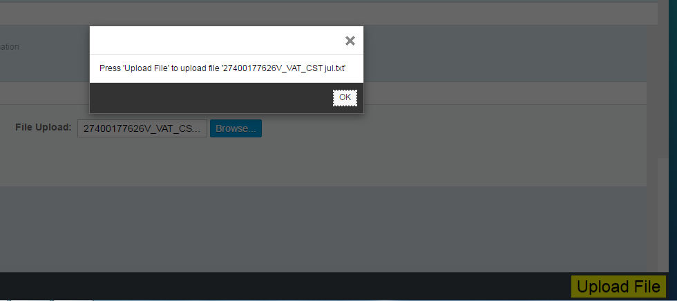
Click OK
Click on ‘’OK’’

Slide 26
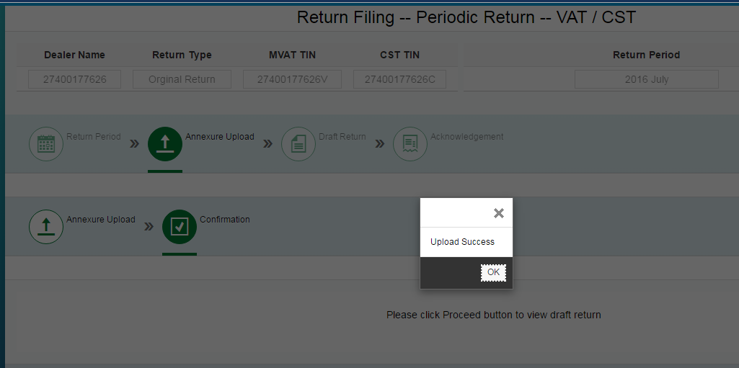
Confirmation Message
Click on ‘’OK’’

Slide 27
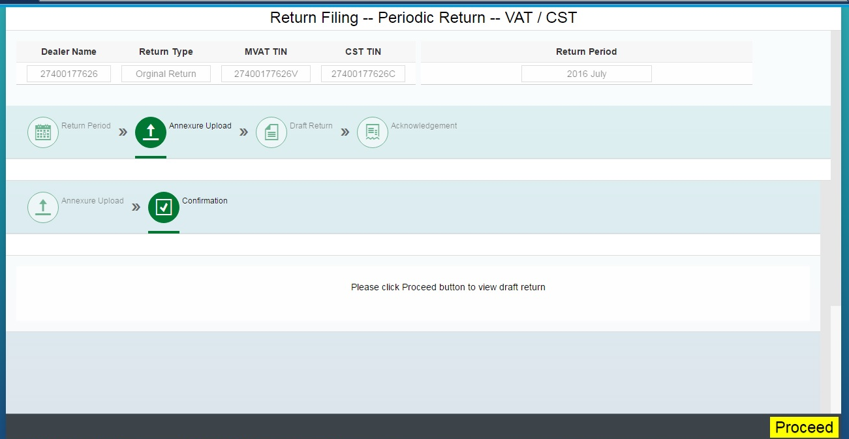
Click on Proceed to view draft return
Click on PROCEED

Slide 28
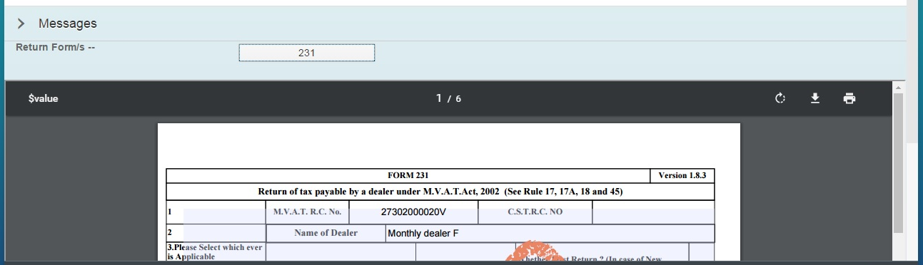
View Draft Return
Click on Form (E.g 231) to view Draft
Download button
Print option

Slide 29
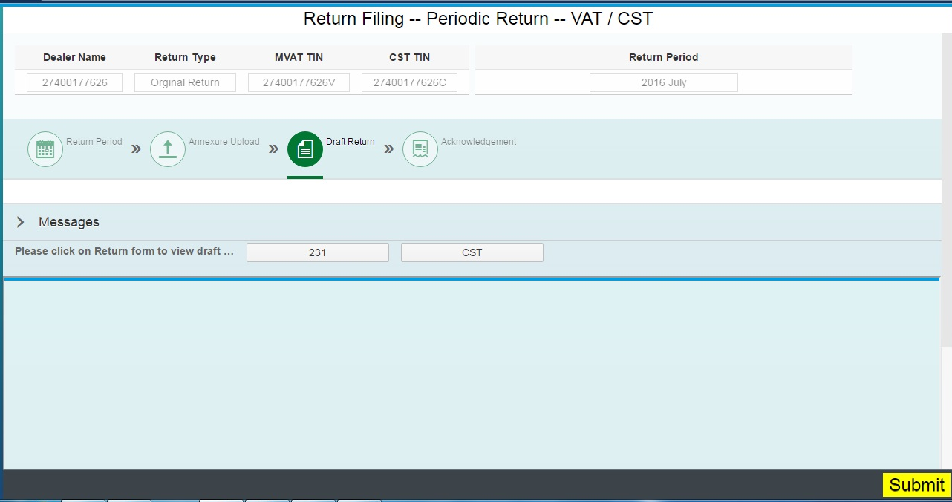
‘’SUBMIT’’ to file Return
Click on SUBMIT to file Return

Slide 30
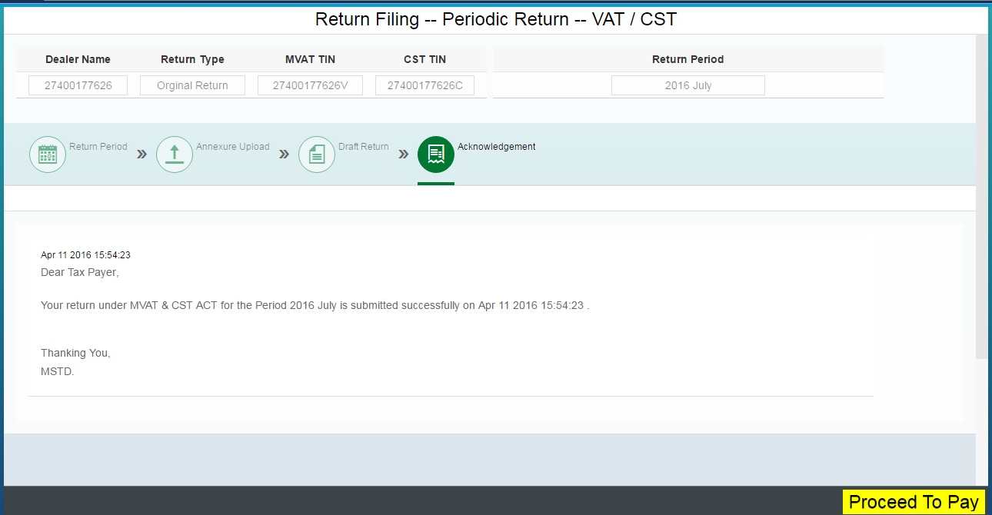
Acknowledgement

Slide 31
Acknowledgement
Once dealer Submit the Return, dealer will receive Acknowledgement on the MSTD Portal screen.
Return and Acknowledgement will be sent to dealer on registered mail id
Acknowledgement message also will be sent on registered mobile number.

Slide 32
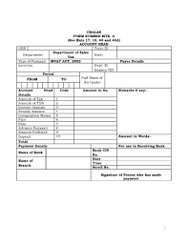
Chalan MTR-6
Chalan in MTR-6 shall be prepared by system

Slide 33

Payment
Dealer shall be directed to payment gateway

Slide 34

THANK YOU

