Slide 1
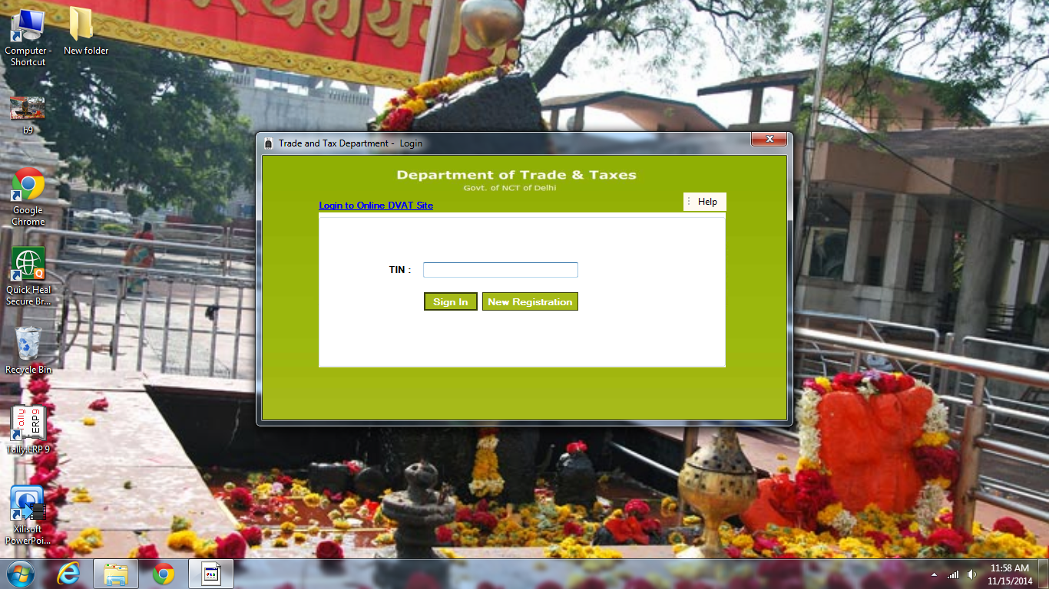
STEP 1-OPEN D-VAT OFFLINE SOFTWARE
STEP 2- FILL YOUR COMPANY TIN NUMBER FOR STARTING OFFLINE DVAT RETURN FILLING
STEP-3- CLINCK ON NEW REGISTRATION

Slide 2
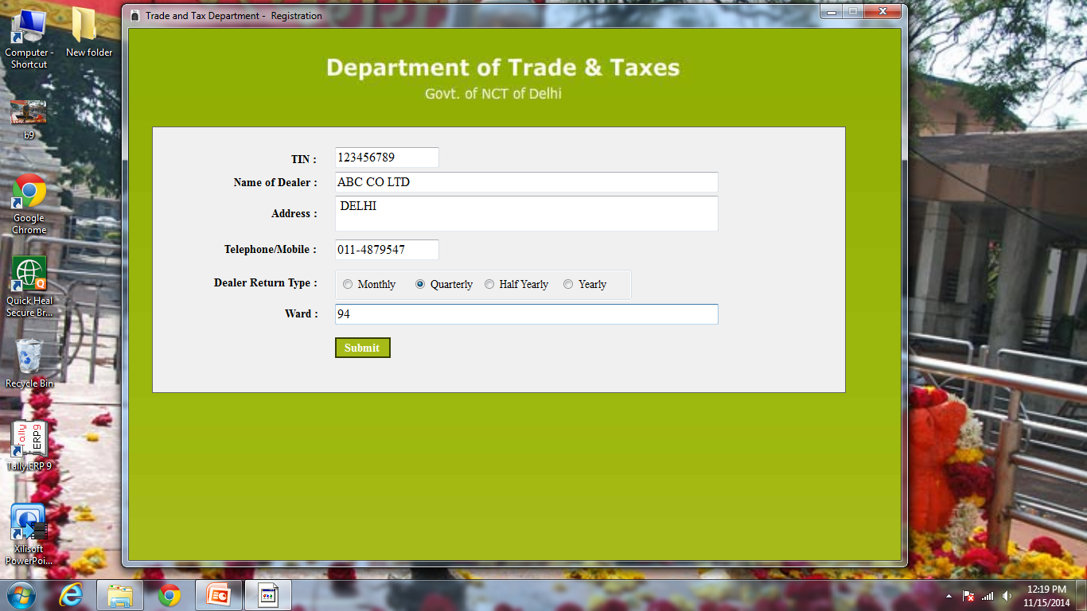
* TIN NUMBER SHOULD BE 11 DIGIT
* CLICK ON QUARTELY , IF YOU TDS RETURN FILE QUARTELY.
STEP 4-FILL UP ALL DETAILS
STEP-5- SUBMIT
STEP-6-ONE DIALOG BOX WILL OPEN, PRESS OK.

Slide 3
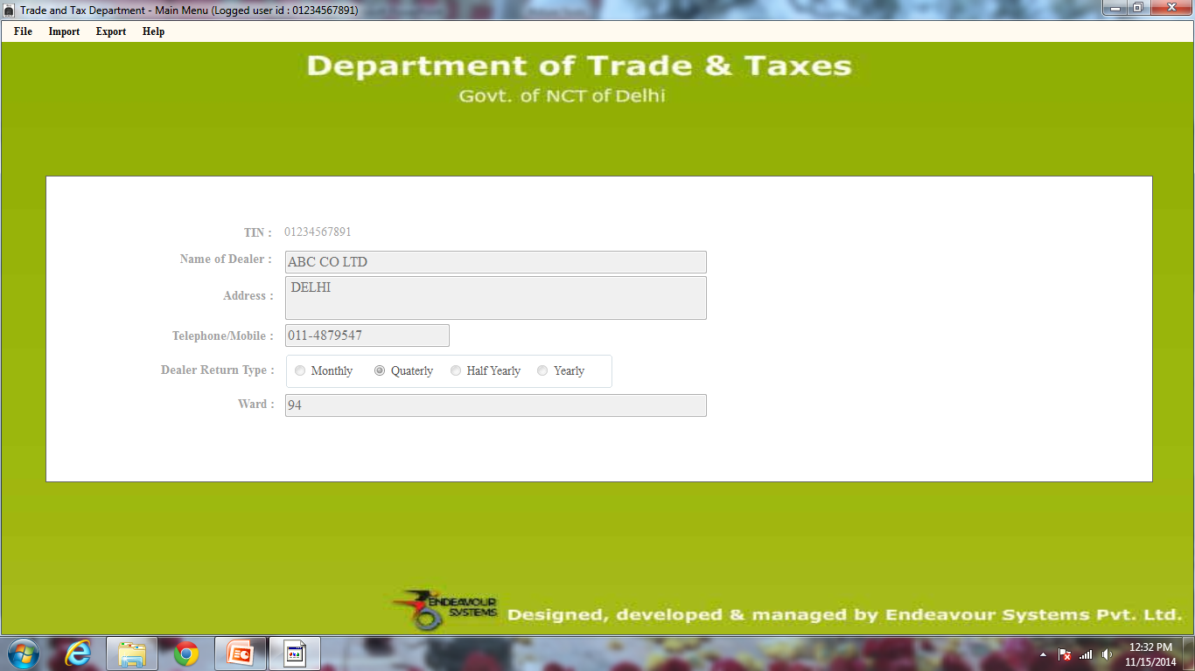
* HELP MENU WILL GUIDE YOU ANY DOUBT.
STEP 7 :- NOW GO TO FILE MENU AND CLICK ON FORM DVAT16A- 2A AND 2B
(2A & 2B FOR ONLY PUT DETAIL OF SALE & PURCHASE)

Slide 4
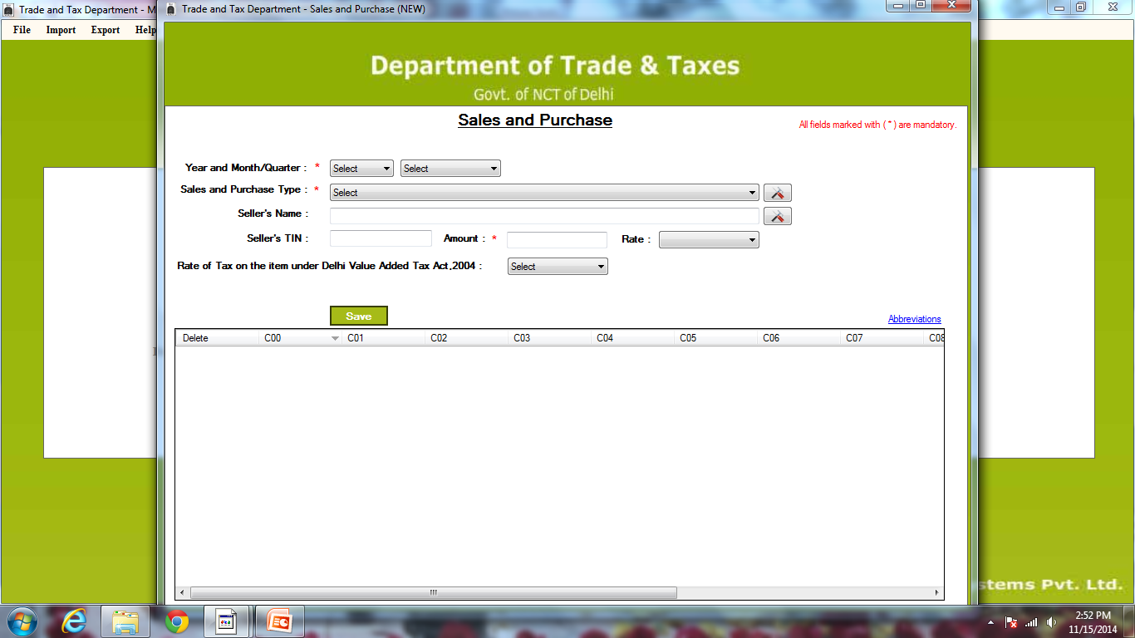
STEP 8 :- SUCH TYPE SCREEN WILL OPEN THAN YOU HAVE TO PUT DETAIL SALE AND PURCHASE GRADUALLY.
SELECT – YEAR AND QUARTER.
AND WHICH TYPE SALES AND PURHCASE YOU HAVE DONE IN THIS QUARTER , YOU HAVE TO SELECT CORRECT TYPE. NEXT DIALOG BOX WILL ASSIST YOU.

Slide 5
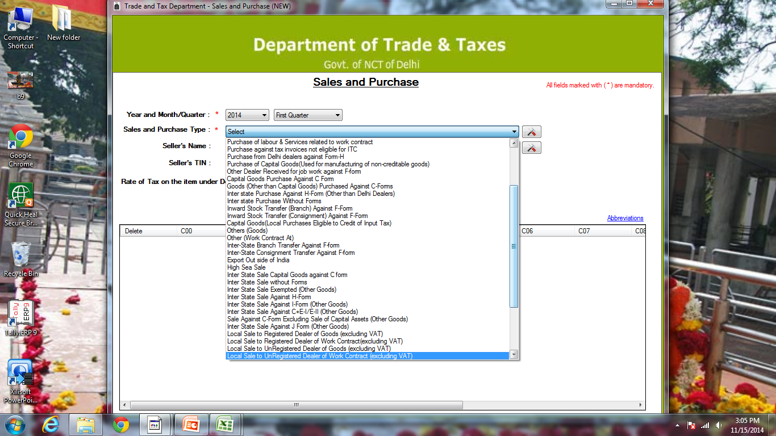
STEP 9 :- PURCHASE :- LOCAL PURCHASE - SELECT- OTHER (GOODS TAXABLE AT)
INTERSTATE PURCHASE- SELECT- GOODS (OTHER THAN CAPITAL GOODS)
MATERIAL INWARD FROM OUTSIDE AS BRANCH TRANSFER = THAN SELECT = INTER-STATE CONSIGNMENT TRANSFER AGAINST F-FORM PURCHASE AGST C- FORM

Slide 6
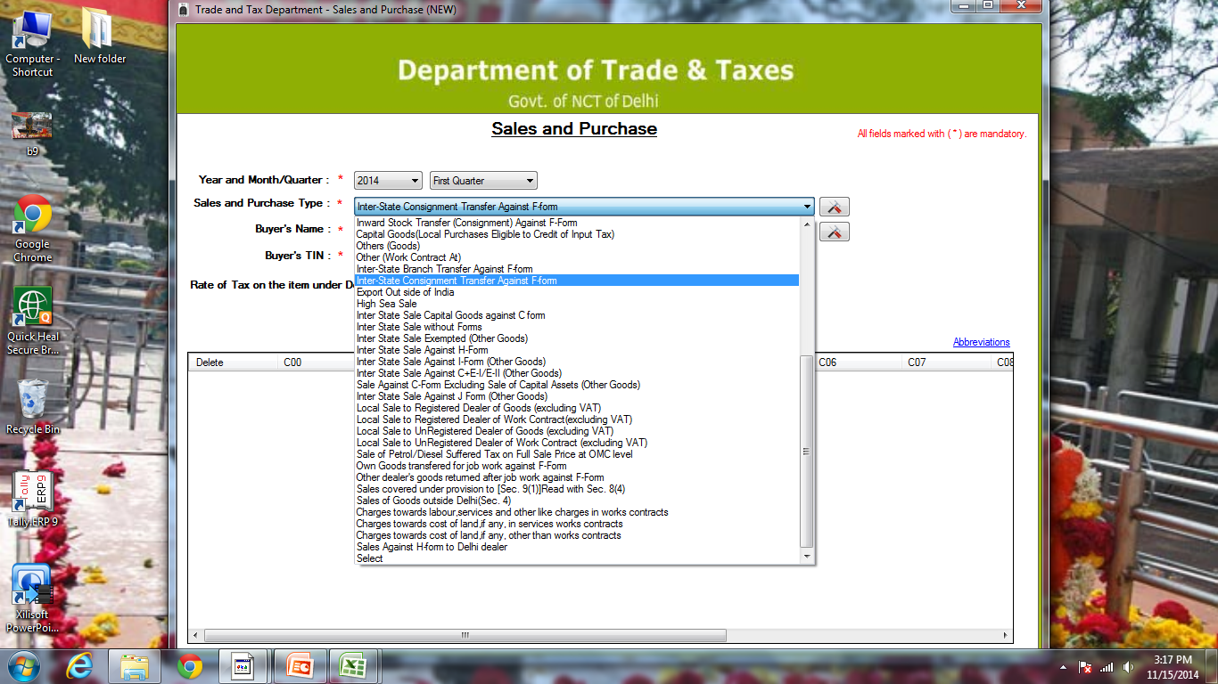
STEP 10:-SALE -LOCAL SALE= SELECT= LOCAL SALES TO REGISTERED DEALER- GOODS (EXCLUDING VAT)
CENTERAL SALE = SELECT= SALE AGAINST C-FORM EXCLUDING SALE OF CAPITAL ASSETS (OTHER GOODS)
BRANCH TANSFER (WITH F FORM)= SELECT = INTER-STATE BRANCH TRANSFER AGAINST F-FORM

Slide 7
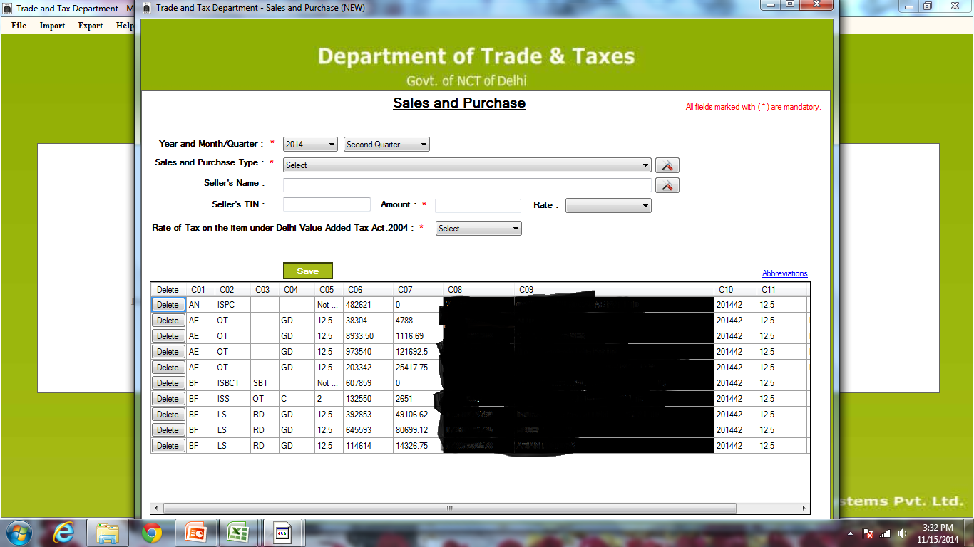
STEP 11 :- AFTER FILLING SALE & PURCHASE DETAIL. SUCH TYPE SCREEN WILL SHOW YOU. AND AFTER THAT CLICK ON SAVE BUTTON.
(AN-ISPC)=STAND FOR INTERSTATE PURCHASE, (AE - OT )= STAND FOR LOCAL PURCHASE, (BF-ISBCT )= STAND FOR BRANCH TRANSFER, (BF-LS)= STAND FOR LOCAL SALE, (BF-ISS)= STAND FOR CENTRAL SALE.

Slide 8
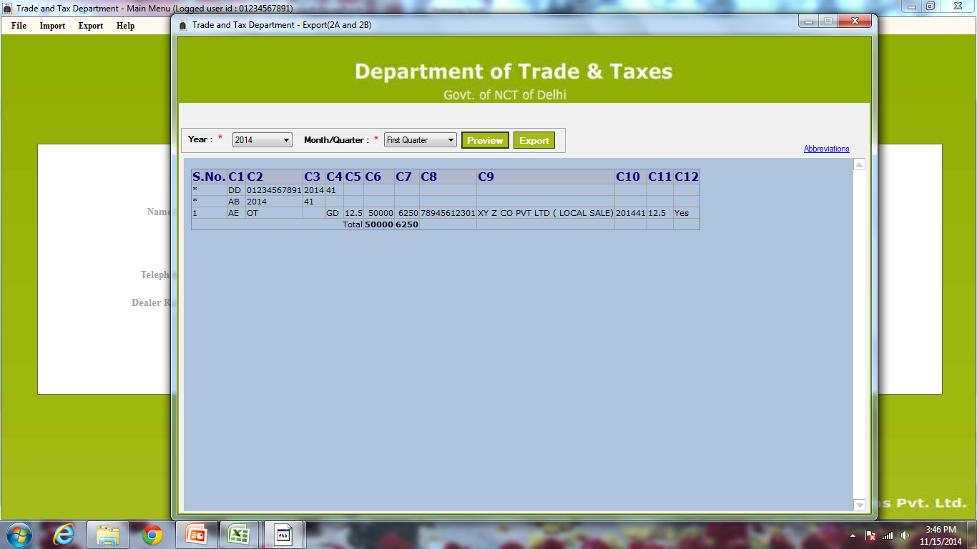
STEP 12 :- AFTER SAVE, YOU HAVE TO GO EXPORT MENU – CLICK ON EXPORT FORM DVAT 16 -2A & 2B.
YOU WILL SEE SUCH TYPE SCREEN
STEP 13:- AFTER PREVIEW (OPTIONAL), YOU HAVE TO CLICK ON EXPORT BUTTON AND ONE XML FILE WILL GOT GENERATED ON YOUR PC.
STEP 14 :- NOW YOU HAVE TO GO WWW.DVAT.GOV .IN

Slide 9
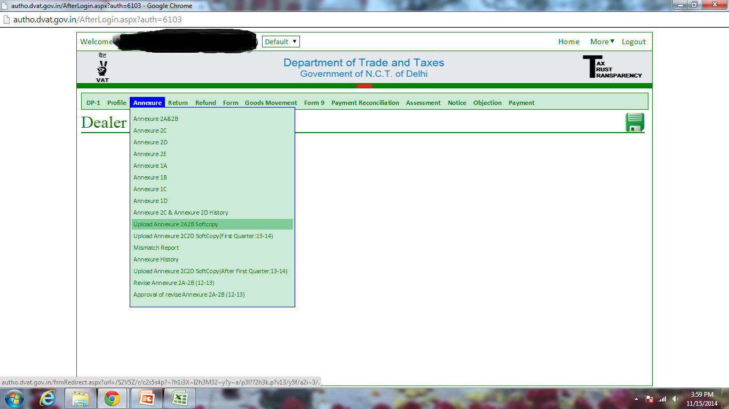
STEP 15 :- UPLOAD XML FILE FROM YOU PC.

Slide 10
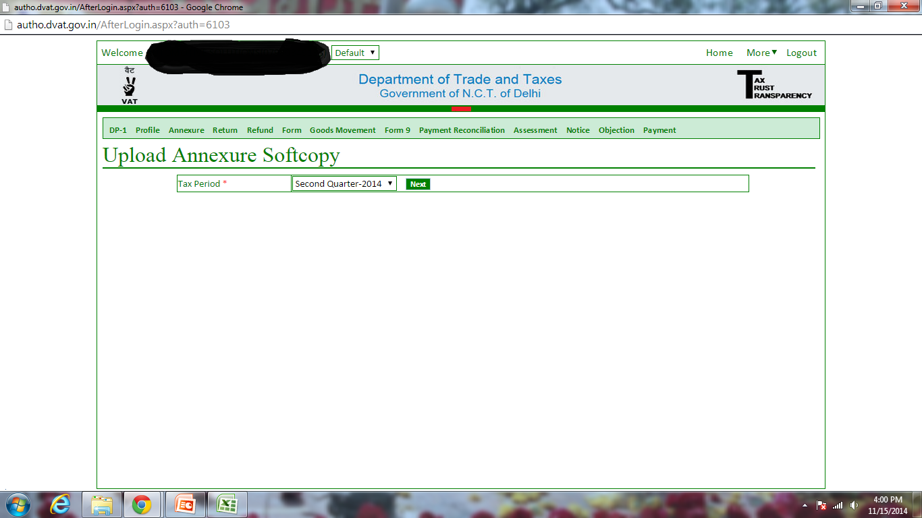
STEP 16 :- YOU HAVE TO SELECT QUARTER 2014.

Slide 11
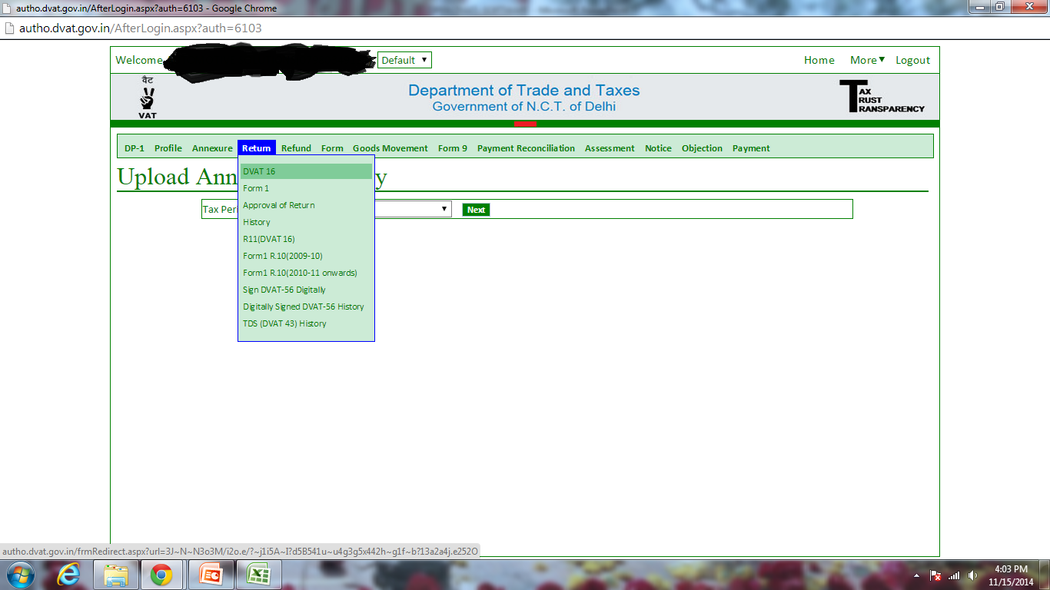
STEP 17 :- AFTER UPLOAD DATA . CLICK ON RETURN TAB. AFTER THAT CLICK ON DVAT-16 AND FORM -1. AND CHECK INSIDE GRADULALLY -WHAT DATA UPLOADED IN OFFLINE SOFTWARE THAT DATA IS SHOWING IN YOUR DVAT-16 FORM AND FORM-1 ONLINE.
STEP 18 :- AFTER COMPLETING STEP 17, YOU HAVE TO CLICK ON APPROVAL OF RETRUN.

Slide 12
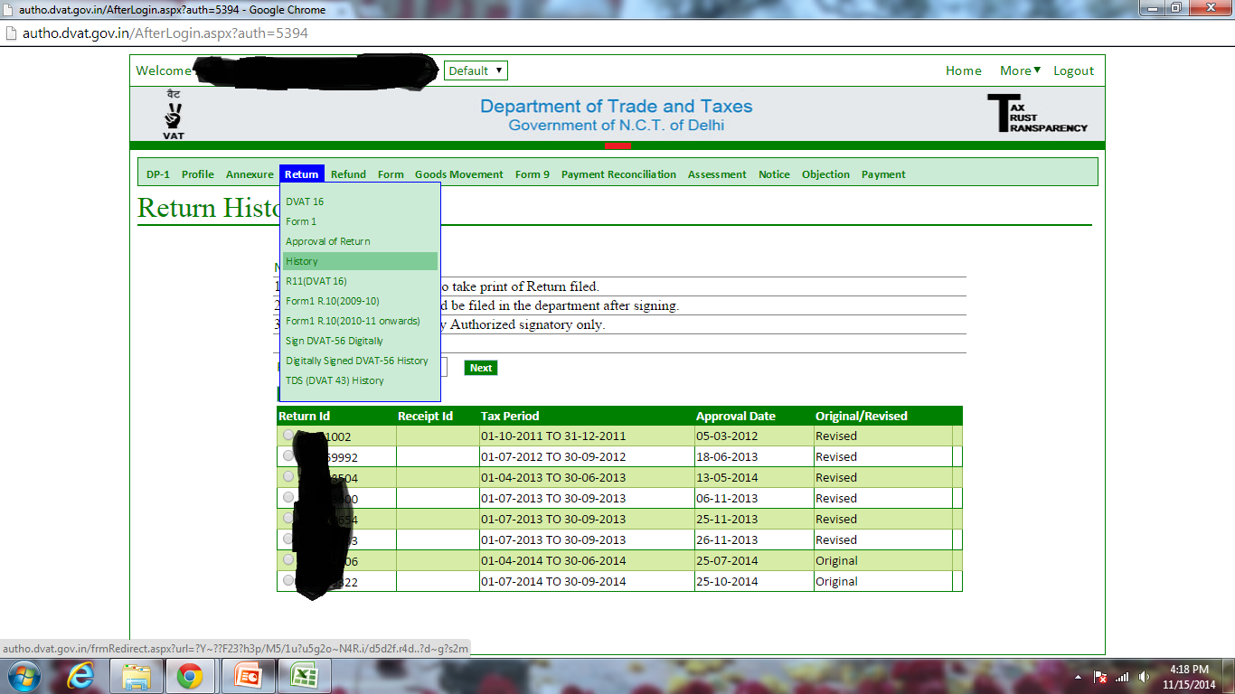
STEP 19 :- YOU CAN TAKE SOFTCOPY OF DVAT -16 FROM HISTORY BUTTON.
I HOPE IT HELP YOU.
THANKS

