Slide 1
M-vat audit
& e-704
GMCS MARCH, 2013 (IMS-DADAR)
26th March, 2013
(Speakers : Devang, Shabbir, Rushabh, Dinesh, Aashish, Harish, Nikunj, Burhanuddin, Kuldeep and Yashwant)

Slide 2
INTRODUCTION
MVAT Act 2002 substituted Bombay Sales Tax Act 1959 W.E.F. 01-04-2005

Slide 3
Vat returns
Who are required to file VAT Returns?
Mandatory E- Payment of Taxes.
Mandatory E-Filling of Returns.
Periodicity of Returns with Tax Liability:-
  Monthly
  Quarterly
  Half Yearly

Slide 4
Due Date & Type of Returns
Due Dates of Payment of VAT/CST
Is Grace Period given for Returns?
What are the Type of Returns applicable to different types of Dealers?
Who are those Dealers?

Slide 5
Revised Return, Interest & Penalty
Revised Returns to be filled under three different sub sections (a), (b) & (c).
Interest to be charged @ 15% p.a for delay in payment.
Penalty of Rs.5,000 for late filling of VAT Returns.

Slide 6
VAT Audit V/S TAX Audit
T.O. of sales > 60 lakhs (1 crore for the financial year 2012-13) for tax audit
T.O. of sale or purchase > 60 lakhs for VAT audit
A chartered accountant can sign only 45 Statutory/Tax Audit but there is no limit for VAT Audit

Slide 7
Who Is Liable For VAT Audit(section-61)
T.O. of sales or purchase exceeds 60 lakhs
Holder of Liquor license
Package scheme of incentive unit (W.E. 1/5/10)

Slide 8
Sales And Purchase Include
Sale / Purchase for
  Local
  Inter state
  In the course of export
  In the course of import
Works contract and processing jobs
Lease transaction
Purchase/sale of capital asset

Slide 9
Sales And Purchase Include (cont…)
Disposal of scrapes and waste
Recovery from employees for meal
Sale of confiscated goods by bank/ financial institutions
Disposal of salvage by insurance companies
Royalty for Technical Know-how, Patents, Trademarks, Copyrights
Purchase of Patent , Trademark, Copyrights

Slide 10
issues
If Dealer “A” is having turnover of purchase worth Rs. 61 lacs & his turnover of sales is Rs.50 lacs whether the dealer is liable for VAT Audit?
If Dealer is holding liquor license & his turnover of sales is Rs. 25 lacs and his turnover of purchase is Rs 49 lacs. Whether he is liable for VAT Audit?

Slide 11
Engagement of VAT auditors
Client should issue appointment letter to the VAT auditor
Appointment by:
Companies- Board resolution or by an officer authorized by the board
Co-operative societies & trust- Governing body
Partnership firm- Partner or person authorized
Proprietorship- Proprietor or person authorized

Slide 12
Engagement of VAT auditors (cont…)
Appointment letter should specify the terms of engagement, scope, fees and details of branch or joint auditors

Slide 13
Preparation of VAT audit
Knowledge of business and industry
Major accounting policies
Evaluation of internal control
Knowledge of applicable provisions

Slide 14
Audit procedures
Use of professional skill and expertise
Follow generally accepted audit practices
Apply audit and assurance standards
Apply test checks
Apply concept of materiality
Reliance on experts opinion

Slide 15
Documentation
List of suitable documents for and during the conduct of audit:
An appointment letter
Last years VAT audit report
Statutory/tax Auditor Report with Balance sheet Set
Management representation letter

Slide 16
Details of preparation to be made by dealer prior to commencement of VAT audit
Copy of MVAT and CST return
Month wise summary of sale/purchase set off claimed & tax working
Prepare month wise consolidation of MVAT Returns & CST Returns file
Copies of challans for tax paid for 12 months under MVAT and CST

Slide 17
Details of preparation to be made by dealer prior to commencement of VAT audit
Reconciliation of Sales & Purchases between Sales/Purchase Register and ledger .
Prepare details of Dr./ Cr. Note for goods Returns with original Invoice Details under MVAT & CST separately.
Prepare details of Dr./ Cr. Note for Rebate / Discount Recd./ Paid under MVAT /CST Separately.

Slide 18
Details of preparation to be made by dealer prior to commencement of VAT audit
Details of Branch/Consignment Transfers
Details of TDS deducted on works contract
Details of Reduction in set-off U/R 53

Slide 19
Audit program
(what auditor is expected to do during the audit)
Check consolidation of MVAT & CST returns as per returns filed
Vouching and verification of sales bill with sales register
Check month wise sales summery with register and returns filled
Inclusion in G.T.O. of sales

Slide 20
Audit program
(what auditor is expected to do during the audit)
Vouching & verification of purchase bills with purchase register
Check month wise purchase summery as per register and returns filled
Checking of setoff claimed on purchase as well as on expenses debited to P&L and on capital assets
Inclusion in G.T.O. of Purchases
Check working of Tax Liability and set-off claimed & payment of Tax with copies of Challan.

Slide 21
Filing of audit report
VAT Audit reports can be signed by Chartered accountants only
The due date of filing the report is within 8 months form the end of the year i.e. 15th january 2013 for the F.Y 2012-13
The responsibility of filing report is of the dealer and not Chartered accountant

Slide 22
FORM “e-704”
(See rule 65 and sub-rule (1) and (2) of Rule 17A)
The Audit Report under the Maharashtra Value Added Tax Act, 2002.
This form is to be used in respect of all accounting periods starting on or after 1st April 2008.
The Audit Report is to be submitted by all the dealers to whom the provisions of Section 61 of the MVAT Act, 2002 apply. Non-filing of Audit Report within prescribed time is an offence.

Slide 23
E-704 is divided in three parts:
Part-1
It is related to verification and certification, computation of tax liability and recommendations to the dealer.
Part-2
It is related to general information about the dealer under audit.
Part-3
It is about the various Schedules and Annexure.

Slide 24
Part -1 form -704 under MVAt Act,2002
Part -1 is mainly devided in five parts as under :-
1. Table -1
a) Dealer is required to file return :- Monthly/Quarterly/Half Yearly
b) Dealer has filed return :- Y/N
c) The schedules Applicable to dealer :- Sche I to VI
d) The Annextures Applicable to dealer:- Annextures A to K
2. Table -2
a) Computation of Tax Liability under MVAT Act,2002.
3. Table -3
a) Computation of Tax Liability under CST Act,1956.
4. Table -4
a) Cumulative Quantum of Benefits Availed
5. Table -5
a) Classifiaction of Additional dues with calculation of Tax and interest thereon
24

Slide 25
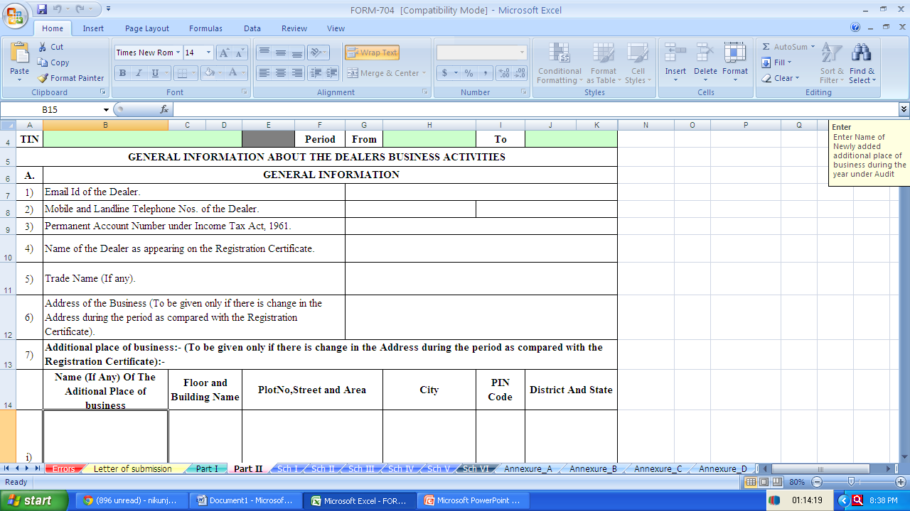
Part -2 form -704 under MVAt Act,2002
25

Slide 26
Acknowledgment submission
An Acknowledgment will be generated in case of successful uploading of this Audit Report. It will show the Transaction Id and Date of uploading along with some other fields.
The dealer is required to submit a print of this Acknowledgment to the Deputy Commissioner, Desk Audit Cell in case of Mumbai and in case of places other than Mumbai to the Office of The Joint Commissioner of Sales Tax, VAT(ADM) along with Letter of Submission, Part-1 & Part-2.
Letter of Submission is Dealer's statement regarding submission of the Form-704 and acceptance of Auditor's recommendations.
Unless the dealer submits signed Acknowledgment along with required attachments, on or before the due date, the audit Report even if electronically uploaded shall not be deemed to be filed.

Slide 27
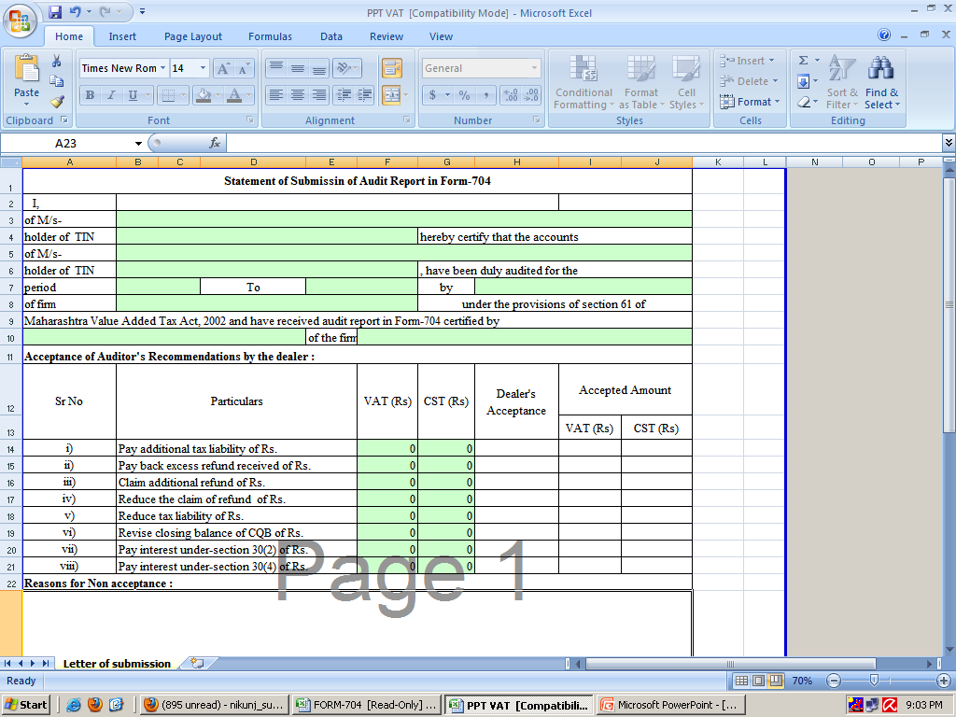

Slide 28
Relevant Schedules Applicable, As Per Type Of Return:
Form-231
Schedule -I
Form-232
Schedule -II
Form-233
Form-234
Form-235
Form III E (CST)
Schedule -III
Schedule -IV
Schedule -V
Schedule -VI
Dealer filing different
types of returns (as
mentioned in Form-231
to Form-235)
Different combinations of Schedules as applicable depending upon the types of returns filed Schedules as applicable depending upon the types of returns filed.

Slide 29
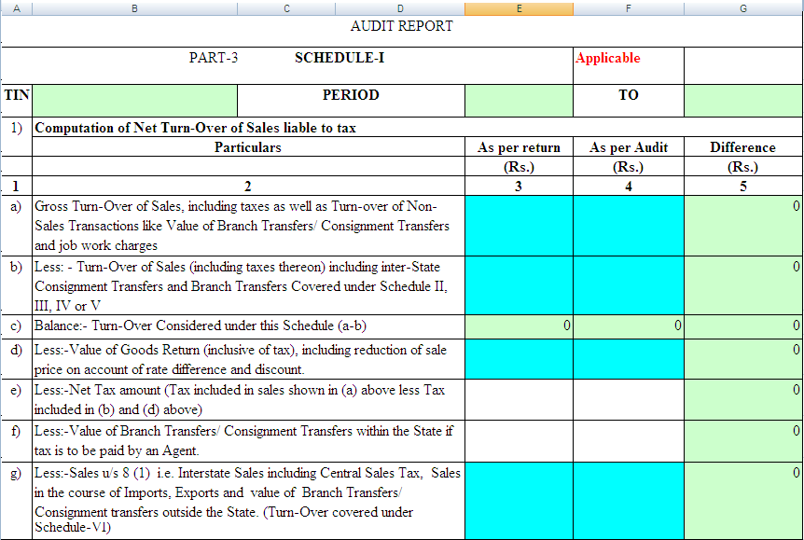
Schedule I

Slide 30
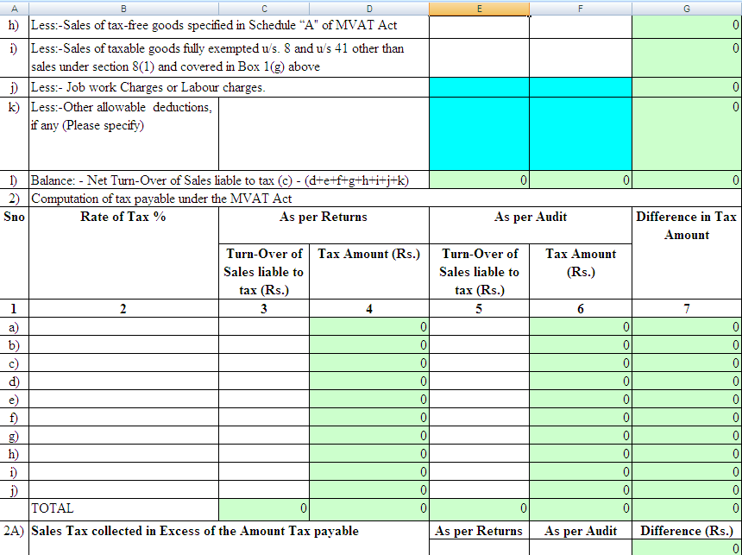

Slide 31
Annexure-A
Is details of amount of tax paid as per returns /chalan and interest paid u/s 30(2) of MVAT Act are to be filled. The details of Refund Adjustment Order issued and amount adjusted against the tax payable for the period under Audit are also to be filled in this annexure.
Annexure-B
Is details of amount of tax paid as per returns /chalan and interest paid u/s 9(2A) of CST Act are to be filled. The details of Refund Adjustment Order issued and amount adjusted against the tax payable for the period under Audit are also to be filled in this annexure.

Slide 32
Annexure-C
Annexure-D
Is details of TDS certificates received by the dealer are to be filled.
Is details of TDS certificates issued by the dealer are to be filled.

Slide 33
ANNEXURE-E
COMPUTATION OF SET-OFF CLAIM ON THE BASIS OF TAX PAID PURCHASES EFFECTED FROM REGISTERED DEALERS.
Annexure ‘E’ deals with the computation of Net Set-Off available to Dealer.
Section 1: Total tax paid purchases effected from the Local Supplier during the period under Audit (incl. Capital Assets)
Section 2: Details of Tax paid purchases on which Set-off is not admissible U/R 54 (Out of Section 1)
Section 3: Details of Tax paid purchases of Capital Assets on which full set-off is available (Out of Section-1)

Slide 34
ANNEXURE-E
COMPUTATION OF SET-OFF CLAIM ON THE BASIS OF TAX PAID PURCHASES EFFECTED FROM REGISTERED DEALERS (Cont….)
Section 4: Details of Tax paid purchases on which Set-off is admissible after reduction u/r 53
Section 5: Details of Total Tax paid purchases Effected from Registered Dealers on which Full Set-off is calculated and allowed as per Rule 52.
Section 6: Amount of Total Set-off Available to Dealer

Slide 35
Annexure F
Financial Ratios for the year under audit and other information
here various financial ratios for the period under audit and other information are to be filled in. If a dealer has multi State activities, then the ratios related to gross and net profit may be given for entire business entity and other ratios should be given for within the State activities.

Slide 36
ANNEXURE-G
Details of CST Declaration / Certificates received
Sr. No. | Name of Dealer who has issued Declarations or Certificates | TIN /RC No. (Put CST TIN) | Declaration/ Certificate Type |  | Issuing State | Declaration No. | Gross amt as per Invoice, covered by Declaration (Net of goods returned) | Amt for which Declaration recd
1 |  |  | C/F/H/I/J/ E-I/E-II
2
3
…. | Enter (value wise) Top 999 entries sep. & put total of others on 1000th row.
998
999
1000 | Remaining Transactions Total

Slide 37
Annexure H
Details of Form-H not received for local sales
Sr. No. | Name of the Dealer who has not issued Declarations or Certificates | TIN, if applicable (Put Mvat TIN) | Invoice No. | Date of Invoice | Taxable Amt (Rs.) (Net) | Rate of Tax applicable (Local Rate) | Tax Liability (Rs.)
1 |  |  |  |  |  |  | 0
2 |  |  |  |  |  |  | 0
… | Enter (value wise) Top 199 entries sep. & put total of others on 200th row.
…. |  |  |  |  |  |  | 0
… |  |  |  |  |  |  | 0
200 | Remaining transaction Total
 | Total |  |  |  | 0 |  | 0

Slide 38
Annexure I
Pending CST Forms (Other then Local H Forms)
Sr. No. | Name of the Dealer who has not issued Declarations or Certificates | CST TIN, if any | Decl/ Certif type | Invoice No. | Invoice Date |  | Taxable Amt (Rs.) (Net) | Tax Amt (Rs.) | Rate of Tax applicable (Local Rate) | Amt of tax (Column 7*9*%) | Diff Tax Liab (Rs.) (Col 10-Col 8)
1 | 2 | 3 | 4 | 5 | 6 |  | 7 | 8 | 9 | 10 | 11
1 |  |  |  |  |  |  |  |  |  | 0 | 0
2 | Enter (value wise) Top 999 entries sep. & put total of others on 1000th row.
…. |  |  |  |  |  |  |  |  |  | 0 | 0
… |  |  |  |  |  |  |  |  |  | 0 | 0
1000 | Remaining transaction Total |  |  |  |  |  |  |  |  | 0 | 0
 | Total |  |  |  |  | 0 |  | 0 |  | 0 | 0

Slide 39
ANNEXURE –J
(Section 1)
CUSTOMER-WISE VAT SALES
TIN |  | Period
Enter Vat amount wise Top 999 Separately in descending order and put total of Remaining in 1000th row
Sr. No. | TIN of Customer | Net Taxable Amount Rs. | VAT Amount Rs. | Gross Total Rs.
1 | 2 | 3 | 4 | 5
1
2
3
4
5
ANNEXURE –J
(Section 2)
SUPPLIERS WISE VAT PURCHASES
TIN |  | Period
Enter Vat amount wise Top 999 Separately in descending order and put total of Remaining in 1000th row
Sr. No. | TIN of Supplier | Net Taxable Amount Rs. | VAT Amount Rs. | Gross Total Rs.
1 | 2 | 3 | 4 | 5
1
2
3
4
5

Slide 40
ANNEXURE –J
(Section 3)
CUSTOMER WISE DEBIT NOTE OR CREDIT NOTE
TIN |  | Period
Enter Vat amount wise Top 499 Seperatly in descending order and put total of Remaining in 500th row
Sr. No. | TIN of Customer | Net Taxable Amount Rs. | VAT Amount Rs. | Gross Total Rs.
1 | 2 | 3 | 4 | 5
1
2
3
4
5
ANNEXURE –J
(Section 4)
SUPPLIER WISE DEBIT NOTE OR CREDIT NOTE
TIN |  | Period
Enter Vat amount wise Top 499 Seperatly in descending order and put total of Remaining in 500th row
Sr. No. | TIN of Supplier | Net Taxable Amount Rs. | VAT Amount Rs. | Gross Total Rs.
1 | 2 | 3 | 4 | 5
1
2
3
4
5

Slide 41
ANNEXURE –J
(Section 5)
CUSTOMER WISE TRANSACTIONS OF DIRECT EXPORT AND HIGHSEAS SALES UNDER CST ACT, 1956
TIN |  | Period
Enter Gross Total wise Top 199 Seperatly in descending order and put total of Remaining in 200th row
Sr. No. | Name of Customer | TIN of Customer (if any) | Transaction Type | Gross Total Rs. | Major Commodity
1 | 2 | 3 | 4 | 5 | 6
1
2
3
4
5
ANNEXURE –J
(Section 6)
SUPPLIER WISE TRANSACTIONS UNDER CST ACT, 1956
TIN |  | Period
Enter Gross Total wise Top 999 Seperatly in descending order and put total of Remaining in 1000th row
Sr. No. | Name of Supplier | TIN of Supplier (if any) | Transaction Type | Any other cost of purchase | Gross Total Rs.
1 | 2 | 3 | 4 | 5 | 6
1
2
3
4
5

Slide 42
ANNEXURE-K
Determination of Gross Turnover of Sales and Purchases along with reconciliation with Profit and Loss Account, Trial Balance/ Sales and Purchase register.”
GROSS TURNOVER OF SALES = NET VAT SALES + SALES U/S. 5 + SALES U/S. 8 + BRANCH STOCK TRANSFER-OUT + TAX AMOUNT
GROSS TURNOVER OF PURCHASES = LOCAL PURCHASES FROM RD/URD + IMPORTS + CST PURCHASES + BRANCH STOCK TRANSFER-IN + TAX AMOUNT
vs
FIGURES AS PER P&L AND SALES/PURCHASE REGISTER

Slide 43
THANK YOU!

