Slide 1
Online Submission of Form T-2
If you are planning to receive goods from a State other then Delhi, Now it is mandatory to file Form T-2 online with effect from 01-10-2012.
This Form has to be filled for all kind of Stock transfers, Import and Purchase before goods reaches to the physical boundary of Delhi.
With effect from FY 2012-13, Form C, F, H shall be issued online without help of your ward officials.
Online submission of Form T-2 will reduce the data entry required at the time of asking form C, F, H.
The Information shall be filled for all the Invoices and Goods Receipt Note in respect of all the goods received from outside Delhi.
How to file Form T-2 :-
Online Return Filing
Online Login at Dealer Login Page
Goods Movement
Goods movement details ( Form-2)

Slide 2
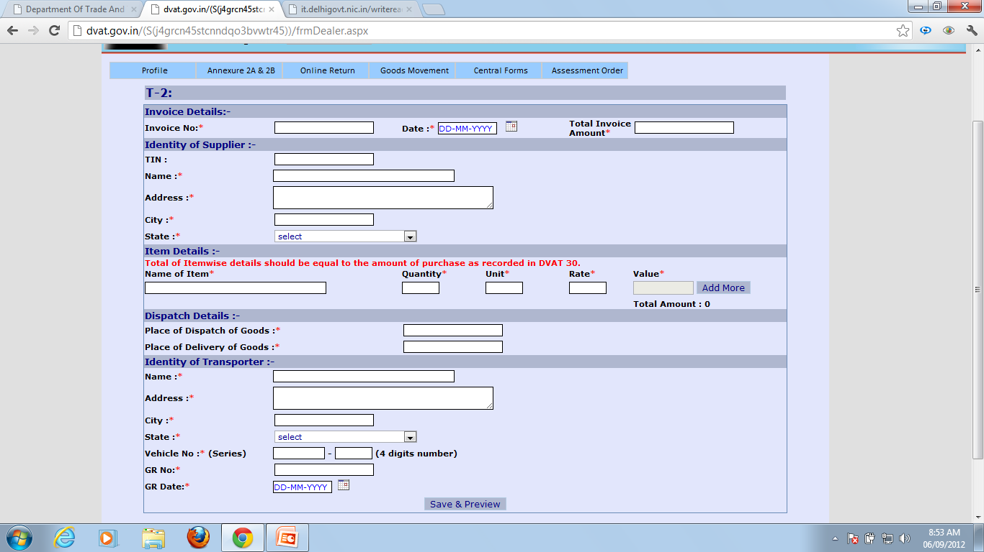

Slide 3
Thanks for GIVING your valuable time

