Slide 1
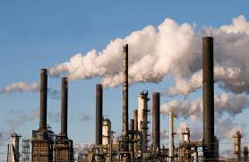
Compliances under
Factories Act 1948
P C Agrawal
B.Com., LL.B., CAIIB, FCS
cs.pcagrawal@gmail.com
10th January 2018

Slide 2
Contents
Approval for expansion
No. of workers
Miscellaneous provisions
Welfare of workers
Health of workers
Safety of workers
Working hours

Slide 3
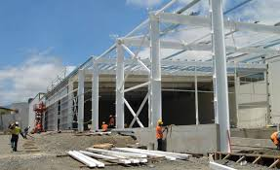
Approval for expansion

Slide 4
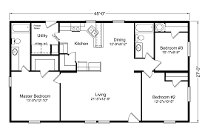
Approval of plans (Rule 3)
Approval required for | Site on which factory is to be situated Construction or extension of factory (Previous approval required in case of hazardous factory)
Application to be made to | Chief Inspector of Factories

Slide 5
Stability certificate (Rule 3A)
When required | Before carrying out manufacturing process in any premises
Coverage | Every work of engineering construction (i.e. any building, tank silo, seafold, platform, chimney, bridge, supporting structural work retaining wall or any similar structure)
Validity | 5 years (to be taken afresh every 5 years)
Issuing authority | A member or associate member of Institute of Civil Engineers A member of Institute of Structural Engineers A full member or associate member of Institute of Engineers (India), in the branch of civil engineering or structural engineering A civil engineer of public works, not below the rank of executive engineer.

Slide 6

Number of workers

Slide 7

Definition of ‘worker’ [Sec.2(l)]
 | ‘worker’ means a person employed, directly or by or through any agency (including a contractor) with or without the knowledge of the principal employer, whether for remuneration or not, in any manufacturing process, or in cleaning any part of the machinery or premises used for a manufacturing process, or in any other kind of work incidental to, or connected with, the manufacturing process, or the subject of the manfacturing process, but does not include any member of the armed forces of the Union.
 | Section 14 of Apprentices Act 1961: 14. Health, safety and welfare of apprentices.—Where any apprentices are undergoing training in a factory, the provisions of Chapters III, IV and V of the Factories Act, 1948 (63 of 1948), shall apply in relation to the health, safety and welfare of the apprentices as if they were workers within the meaning of that Act….

Slide 8

Working hours

Slide 9
Working Hours[Sec.51 to 66]
Max. normal working hours in a day | 09
Max. normal working hours in a week | 48
When overtime applicable (at double rate) | If working hours exceed 09 or 48 as the case may be.
Max. working hours in a day (including overtime) | 10

Slide 10

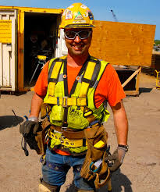
Safety of workers

Slide 11

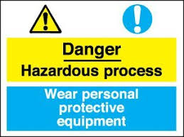
Hazardous processes
(First Schedule)
No. | Industry
1 | Ferrous metallurgical industries Integrated iron & steel Ferro alloys Special steels
2 | Non-ferrous metallurgical industries - Primary metallurgical industries, namely, zinc, lead, copper, manganese and aluminium
3 | Foundries (ferrous and non-ferrous) - Castings and forgings including cleaning or smoothening/ roughening by sand and shot blasting
4 | Coal (including coke) industries Coal lignite, coke, etc. Fuel gases (including coal gas, producer gas, water gas)
5 | Power generating industries
6 | Pulp and paper (including paper products) industries
7 | Fertiliser industries _ Nitrogenous - Phosphatic Mixed
8 | Cement industries - Portland cement (including slag cement, puzzolona cement and their products)
9 | Petroleum industries Oil refining Lubricating oils and greases

Slide 12
Hazardous processes (Contd.)
(First Schedule)
No. | Industry
10 | Petro-chemical industries
11 | Drugs and pharmaceutical industries - Narcotics, drugs and pharmaceuticals
12 | Fermentation industries (Distilleries and breweries)
13 | Rubber (Synthetic industries)
14 | Paints and pigments industries
15 | Leather tanning industries
16 | Electro-plating industries
17 | Chemical industries Coke oven by-products and coaltar distillation products Industrial gases (nitrogen, oxygen, acetylene, argon, carbon dioxide, hydrogen, Sulphur dioxide, nitrous oxide halogenated hydrocarbon, ozone, etc.) Industrial carbon Alkalies and acids Chromates and dichromates Lead and its compounds Electrochemicals (metallic sodium, potassium and magnesium, chlorates, perchlorates and peroxides) Electroathermal produces (artificial abrasive, calcium carbide) Nitrogenous compounds (cyanides, cyanamides, and other nitrogenous compounds) Phosphorous and its compounds Halogens and halogenated compounds (chlorine, fluorine, bromine and iodine) Explosives (including industrial explosives and detonators and fuses)

Slide 13
Hazardous processes (Contd.)
(First Schedule)
No. | Industry
18 | Insecticides, fungicides, herbicides and other pesticides industries
19 | Synthetic resin and plastics
20 | Man-made fibre (cellulosic and non-cellulosic) industry
21 | Manufacture and repair of electrical accumulators
22 | Glasses and ceramics
23 | Grinding or glazing of metals
24 | Manufacture, handling and processing of asbestos and its products
25 | Extraction of oils and fats from vegetable and animal sources
26 | Manufacture, handling and use of benzene and substances containing benzene
27 | Manufacturing processes and operations involving carbon di-sulphide
28 | Dyes and dyestuff including their intermediates
29 | Highly flammable liquids and gases

Slide 14
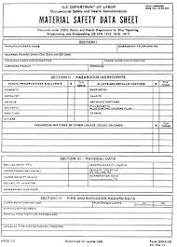
Material Safety Data Sheet (MSDS)
Applicability | Every hazardous substance
Format | As per Schedule to Rule 73-M
Copies to be sent to | District Emergency Authority (Rule 73Q) Chief Inspector (Rule 73-R)
Disclosure of information to general public (Rule 73-O)
Contents | As per Rule 73-O(1)
Language | Regional language; and English or Hindi
Review | Once in every calendar year

Slide 15

Permissible level of chemicals & toxic substances
(Second Schedule)
 | Permissible levels of chemical and toxic substances in manufacturing process (whether hazardous or not)
Decontamination facilities in hazardous processes (Rule 73-Y)
No. of drenching showers required | Upto 50 workers | 2
 | 51-200 | 2 + 1 for every additional 50 or part thereof
 | 201-500 | 5 + 1 fo for every additional 100 or part thereafter
 | 501 & above | 8 + 1 for every additional 200 or part thereafter
Eye wash bottle | filled with distilled water or suitable liquid | Sufficient numbers

Slide 16
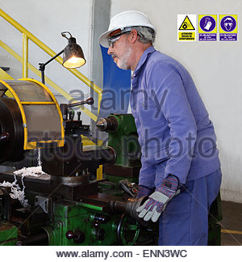
Dangerous operations
(Section 87 and Rule 114)
Sch. | Operation | Sch - Copy
I | Manufacture of aerated waters and processes incidental thereto
II | Electrolytic plating or oxidation of metal articles by use of an electrolyte containing chromic acid or other chromium compounds
III | Manufacture and repair of electric accumulators
IV | Glass manufactures
V | Grinding or glazing of metals and processes incidental thereto
VI | Manufacture and treatment of lead and certain compounds of lead
VII | Generation of gas from dangerous petroleum as defined in clause (b) of Section 2 of the Petroleum Act 1934
VIII | Cleaning or smoothening, roughening etc. of articles by a jet of sand, metal shot or grit or other abrasive propelled by a blast of compressed air or steam [Blasting Regulations]

Slide 17
Dangerous operations contd…
(Section 87 and Rule 114)
Sch. | Operation | Sch - Copy
IX | Liming and tanning of raw hides and skins and processes incidental thereto
X | Manufacture of chromic acid or manufacture or recovery of the bichromate of sodium, potassium or ammonium
XI | Manufacture or manipulation of nitro or amino compounds
XII | Handling and manipulation of corrosive substances
XIII | Manufacturing of bangles and other articles from cinematograph film and toxic and inflammable solvents
XIV | Processes involving manufacture, use or evolution of carbon disulphide and hydrogen sulphide
XV | Manufacture and manipulation of dangerous pesticides
XVI | Compression of oxygen and hydrogen produced by electrolytic process or by steam iron process
XVII | Handling and processing of asbestos, manufacture of any article of asbestos and any other process of manufacture or otherwise in which asbestos is used in any form

Slide 18
Dangerous operations
(Section 87 and Rule 114)
Sch. | Operation
XVIII | Manufacture or manipulation of manganese and its compounds
XIX | Carbon di-sulphide plants
XX | Benzene
XXI | Process of extracting oils, wax and fats from vegetable and animal sources in solvent extraction plants
XXII | Manufacture or manipulation of carcinogenic dye intermediates
XXIII | Highly flammable liquids and flammable compressed gases
XXIV | Operations involving high noise levels
XXV | Handling and processing of cotton
XXVI | Fire works and match factories
XXVII | Manipulation of stone or other material containing free silica

Slide 19
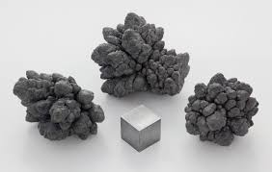
Manufacture & treatment of lead and certain compounds of lead (Schedule VI)
Appointment of Medical Practitioner | Minimum 4 hours every day in ambulance room (Chief Inspector can reduce this period if <500 workers)
General | Woman prohibited from working in the operation
Medical examination | Medical examination every 3 months
PPE to be used | Protective clothing Head coverings
Washing facilities | A trough with waste pipe to allow min. 60 centimetres for every 10 persons employee; OR Min.1 wash basin for every 10 persons employed Sufficient supply of nail brushes, soap or other cleansing material and clean towels
Canteen | Mess room or canteen with facility of warming food unless hot meal is provided

Slide 20
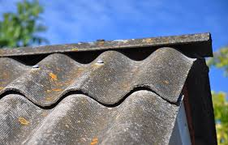
Asbestos (Schedule XVII)
Air monitoring | Monitoring of asbestos fibre in air at least in every shift and record maintained
Medical examination | Radiologically examined (X-Ray plate to be submitted to Inspector) Such further examination/treatment by specialist as may be advised
Medical facilities | Part time qualified medical practitioner Min. 4 hours every day in ambulance room Clean room furnished with a screen, a table with stationery, chairs and other facilities and instruments including X-ray arrangement Medical record to be maintained for 40 years from employment or 15 years from retirement, whichever is later.
Control of dust | Exhaust draught/ventilation equipment to be provided Asbestos bearing dust to be collected in receptacles or filter bags Ventilation system to be examined every week and tested by competent person in 12 months. Cleaning to be done by vacuum cleaning equipment otherwise respiratory protective equipment and protective clothing to be used.
PPE | Approved breathing apparatus (to be disinfected) Protective clothing (to be de-dusted & washed) Separate accommodation for personal clothing
Notice | Cautionary notice to be displayed in local language Mess room to be provided for such workers

Slide 21
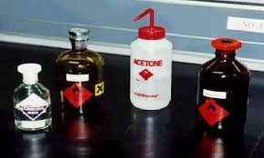
Corrosive substances (Schedule XII)
Flooring | Of impervious, corrosion and fire resistant material
PPEC | Aprons Face shields Chemical safety goggles Suitable respirator
Water facilities | At a height of 2 metres Secured from pipe of 25 mms. Dia and fitted with quick acting valve; or safety tank having dimension not less than 200 cms. In length, 129 cms in breadth and 60 cms in depth full of clean water
Others | Cautionary notice as per given text to be displayed Containers to be clearly labelled as such Tilting or lifting devices to be used for emptying jars etc. Not to be handled by bare hands Flange joints on lines carrying under pressure to be provided with guards Container having storage capacity of 20 litres or more to be examined every year Adequate No. of suitable types of fire extinguishers

Slide 22
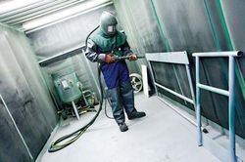
Shot Blasting (Schedule VIII)
Blasting enclosure | Separating apparatus to be with exhaust draught arrangement to extract and remove dust Ventilating plant to be kept in continuous operation
Inspection | Blasting enclosure to be inspected for detecting leakages once in a week by competent person All 3 parts to be thoroughly examined and ventilating plant to be tested once in every 3 months Blasting chamber, separating apparatus and ventilating plant to be thoroughly inspected every 6 months for detecting any defect
PPE | Protective helmets (of a type approved by Chief Inspector) carrying distinguishing mark indicating person (to be disinfected for others) with air not less than 6 cubic ft. per minute Gauntlets, overalls, dust-proof goggles and boots All PPE to be cleaned every weekday Vacuum cleaner to be used for removing dust
General | No woman to be allowed for this work Medical examination every 12 months (also x-ray if advised)

Slide 23
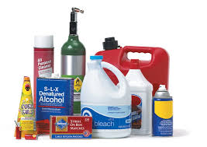

Highly flammable liquids and flammable compressed gases (Schedule XXIII)
Coverage | Highly inflammable liquids – flammable vapours at <32 deg.C. Flammable compressed gas – gas 13% or less of which when mixed with air forms flammable mixture or whose flammable range with air is >12%.
Precautions | To be stored in fire resistant construction always closed clearly marked in bold letters ‘Danger – HFL or FCG’ To be conveyed within factory in totally enclosed system Footwear having exposed ferrous materials not to be allowed Fire fighting equipments as per Rule 71-B. Electrical apparatus preferably excluded from area of risk

Slide 24

Operations involving high noise levels
(Schedule XXIV)
Continuous noise – permissible level | Sound pressure level in dBA 8 hours per day – 90 dBA 6 hrs – 92 4 hrs – 95 3 hrs - 97 | 2 hrs – 100 dBA 1 ½ hrs – 102 ¾ hr - 107 ½ hr – 110 ¼ - 115 (maximum allowed)
Impulsive or inspect noise – permissible exposure | Peak sound pressure in dB 140 (maximum allowed) 135 130 125 120 | Permitted impulses or impact per day 100 315 1,000 3,160 10,000
Measures | Practical engineering control and administrative measures to be applied to control noise Suitable ear protector to be provided to workers Still if noise level is high, noise exposure period to be reduce Transfer them to relatively less level if so required Auditory examination by doctor every 12 months in areas where noise exceeds permissible level

Slide 25
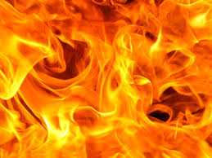
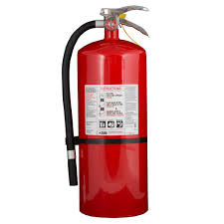
Fire fighting equipments (Rule 71-B)
Equipment | Specifications | Number required
Fire buckets | Min. 9 litre capacity as per IS Specfn., full of water, sand etc. as necessary | 2 for every 100 sq.m. of floor area (Min. 4 buckets on each floor)
Power-driven trailer pump (with equipments as per Sch.A) | As per IS Specfn. Of adequate capacity , if water required is 550 litres or more per minute
Vehicles with towing attachment | Where area is such as cannot be reached by manhauling of trailer pumps within reasonable time | 1 for every 4 trailer pumps (Minimum 1)
Portable extinguishers | Combustible materials other inflammable liquids, electrical equipment and ignitable metals | 1 for every 500 sq.mt. of area (Not more than 30 metres apart)
 | Inflammable liquids or grease or paint | 1 for every 500 sq.mt. of area (consisting of foam carbon tetrachloride, dry powder, carbon dioxide, chlorobrome methane or other equivalent type
 | Electrical equipments | 1 for every 500 sq.mt. of area (consisting of carbon dioxide, dry powder, carbon tetrachloride or equivalent types.
 | Magnesium, aluminium or zinc dust or shavings of other ignitable metals | Ample supply of clean, fine dry sand, stone dust or other inter material (Use of liquids, carbon dioxide and foam type extinguishers to be prohibited)
Spare charges for fire extinguishers |  | For each type of fire extinguishers. (Minimum 12)

Slide 26

Fire exits [Rule 70(9)]
Minimum No. of exits in a room | To be calculated considering: Unit exit width : 50 cm Occupants per unit width : 50 for stairs and 75 for doors Occupant load : Actual or 10 sq.mt. per person, whichever is more Or 2, whichever is more. (marked in common language and illuminated and openable at all times without key)
Fire resisting doors or roller shutters | At appropriate places , particularly at entrance of lifts or stairs
Max. travel distance to exit | 30 metres (22.5 metres in case of high hazard material)
Size of exit doorway | Width : Min.100 cm Height : Min.200 cm
Size of landing at doorway | Min. 1.5 m x 1.5 m

Slide 27


Safety Officers
Subject | Rule | Provision in brief
Applicability | Sec.40B | 1,000 or more workers
No. of Safety Officers required | Notif. No. FAC.1081/ 8511/Lab.4 dated 2.8.1982 | 1,000 to 2,000 – 1 2,001 to 5,000 -2 5,001 to 10,000 – 3 Above 10,000 -4
Qualifications [Both (A) and (B) are mandatory] | Rule 3 | Basic qualification: Possesses a degree in any branch of engineering or technology and practical experience of working in any factory in a supervisory capacity for not less than 2 years, or experience of not less than 5 years in training education, consultancy or research in accident prevention in any industry; OR Possesses a degree in physics or chemistry or a diploma in any branch of engineering or technology and practical experience of working in any factory in a supervisory capacity for not less than 5 years; and Possesses adequate knowledge of Marathi language. (B) Industrial safety qualification: Diploma in industrial safety Or obtains such qualifications or diploma within period of not more than 3 years from the appointed day.

Slide 28
Safety Officers contd…
Subject | Rule | Provision in brief
Duties | Rule 8 | 13 duties specified in the Rule
Manner of appointment | Rule 5 | Advertisement in min. 2 newspapers including one in English Selection to be made by a Committee Appointment when made to be notified to the Chief Inspector of Factories
Vacancy | Rule 6 | To be notified to the Chief Inspector of Factories To be filled up within 3 months
Position | Rule 7 | Head of Department to work directly under control of the Chief Executive of the factory

Slide 29
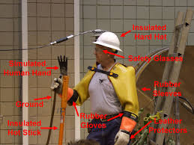
Electrical Safety Officers
Subject | Rule | Provision in brief
Regulation |  | Central Electricity Authority (Safety Requirements for Construction, Operation & Maintenance of Electric Plants and Electric Lines) Regulations 2011
Responsibility | 6(1) | Owner which owns or operates or maintains electric plants or electric lines. [‘Owner’ means a company or body corporate or association or body of individuals, whether incorporated or not, or artificial judicial person, which owns or operates or maintains electrical plants or electric lines and includes Occupier under Factories Act.]
Applicability | 6(1) | No. of employees (including contract workers) is: >500 employees – One Qualified Safety Officer Upto 500 – Suitable officer to be designated as Safety Officer
No. of Electrical Safety Officers required | 6 | 501 to 1,000 employees – 1 Qualified Safety Officer >1,000 – 1 more Safety Officer for every additional 1,000 employees
Qualifications | 6(1)(b) | As per Sec.40B of Factories Act (as above); OR As per Sec.38(2) of BOCW Act 1996
When to be appointed | 6(1)(d) | Before start of construction activity

Slide 30
Electrical Safety Officers
Central Electricity Authority (Measures relating to Safety and Electric Supply) Regulations 2010
(as amended on 13.4.2015)
Subject | Rule | Provision in brief
Applicability | 5(4) | Factory with >250 kW electrical load connected
No. of Electrical Safety Officers required | 5(4) | 1
Qualifications | 5(2) | Electrical engineering degree holder with min. 5 years of experience in operation and maintenance of electricity installations.
Duties | 5(4) | Ensuring observation of safety provisions laid under the Act and Regulations; Carry out recommended periodic tests as per relevant standards; periodically inspect the installations at intervals not exceeding one year; Keep a record thereof in Form I or II or III, as the case may be, of Schedule IV; Test reports and register of recommendations in regard with safety duly acknowledged by owner; To make available such records to the Electrical Inspector when required.

Slide 31

Medical facilities
 | Occupational Health Centre | Ambulance Room or Dispensary
Section/Rule | Rule 73W | Section 45(4); Rule 78
Applicable to | All factories having hazardous process irrespective of number of workers | Factories having more than 500 workers
Area requirement | Upto 50 workers: Not specified. 51 to 200 workers: Min.1 room with min. floor area of 15 sq.m. Above 200 workers: Min.2 rooms each with min. floor area of 15 sq.m. Floors and walls should be made of smooth and impervious surface and adequate illumination & ventilation. | Floor area of min.24 sq.m. Smooth, hard and impervious walls and floors and adequately ventilated and lighted by both natural and artificial means. Adequate supply of wholesome drinking water shall be laid on.

Slide 32
Medical facilities contd…
 | Occupational Health Centre | Ambulance Room or Dispensary
Medical staff required No. of workers Upto 50 | 1 Factory Medical Officer (FMO) (on retainer-ship basis) Min. 5 persons trained in first aid | Not applicable
51 to 200 | 1 FMO (on part-time basis) 1 Dresser-cum-compounder | Not applicable
201 to 500 | 1 FMO (on full time basis) 1 Dresser-cum-compounder 1 Sweeper-cum-ward boy | Not applicable
501 to 1500 | 2 FMO (on full time basis) 1 Dresser-cum-compounder 1 Sweeper-cum-ward boy | 1 qualified medical practitioner 1 qualified nurse Subordinate staff (as may be directed by Chief Inspector)
1501 to 2500 (& so on… 1 FMO for every addl. 1000 or part thereof) | 3 FMO (on full time basis) 1 Dresser-cum-compounder 1 Sweeper-cum-ward boy
Qualification of medical practitioner | As per Schedules in Indian Medical Degrees Act 1916 or Indian Medical Council Act 1956 2) Certificate of training in industrial health of min.3 months from State Govt recognized institution | As per Schedules in Indian Medical Degrees Act 1916 or Indian Medical Council Act 1956

Slide 33

Medical check-up
Regulations | Central Electrical Authority (Safety Requirements for Construction, Operation and Maintenance of Electrical Plants & Electric Lines) Regulations 2011 [Regulation 10(5)]
Coverage | All employees
Pre-employment | To ascertain physical fitness for particular job
Medical check-up | At intervals not exceeding 12 months (Also Rule 18A of MFR 1963) (In case of hazardous process, pre-employment & then every 6 months – Rule 73V of MFR 1963. For dangerous operations as per Rule 114)
Eyes test | Colour vision test and eye sight examination for drivers, skilled workers, technicians, supervisors and crane operators: If <45 years old – annually Others - every six months
Respiratory system | Tests for respiratory disorders for employees exposed to dusty environment - once in six months.

Slide 34
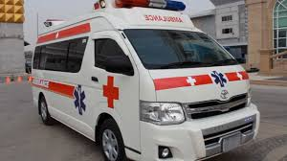
Ambulance Vans
(Rule 73-X)
Applicability | All factories carrying on hazardous process. Factory employing less than 200 workers may make arrangement for procuring such facility at short notice from nearby hospital or other places, to meet emergency.
Equipments required in Van | General - A wheeled stretcher with folding and adjusting devices with the head of the stretcher capable of being tilted upward; Fixed suction unit with equipment; Fixed oxygen supply with equipment, Pillow with case;-Sheets-Blankets;- Towels; Emesis bag, Bed pan,- Urinal, Glass. Safety equipment - Flaros with life of 30 minutes; Flash lights, Fire extinguisher dry powder type; Insulated gauntlets. Emergency care equipments - (i) Resuscitation, portable suction unit, portable oxygen units, Bag- Valve-mask, hand operated artificial ventilation unit, airways-mouth gags.- Tracheestomy adopters, short spine board-IV, fluids with administration unit, B.P. monometer.-Cugg-Stethoscope. Immobilization - Long and short padded boards,- Wire ladder splints; Triangular bandage-Long and short spine Boards. Dressings - Gauze pads.- 4" X 4" - Universal; dressing- 10" X 36"; Roll of aluminium foils-Soft roller bandages 6" X 5 yards- Adhesive tape in 3" roll-Safety pins; Bandage sheets; Burn Sheet. Poisoning - Syrup of Ipecae; Activated Charcoal Prepacketed in doses:- Snake bite kit, Drinking water. Emergency Medicines - As per requirement (under the advice of Medical Officer).

Slide 35

Safety Committee (Rule 73-J)
Applicability | If hazardous process or dangerous operation carried on – 50 or more workers Other cases – 250 or more workers
Constitution | Chairman – A senior official who can contribute effectively to the functioning Secretary – Safety Officer, if available Factory Medical Officer, if available Representative each from production, maintenance and purchase departments. Workers representatives – to be elected by workers.
Tenure | 2 years
Meetings | Min. 1 in every quarter
Functions | (a) assisting and co-operating with the management in achieving the aims and objectives outlined in the 'Health and Safety Policy' of the occupier; (b) dealing with all matters concerning health, safety and environment and to arrive at practicable solutions to problems encountered; (c) creating safety awareness amongst all workers; (d) undertaking educational, training and promotional activities; (e) deliberating on reports of safety, environmental and occupational health surveys, emergency plans safety audits, risk assessment and implementation of the recommendations made in the reports; (f) carrying out health and safety surveys and identify causes of accidents; (g) looking into any complaint made on the likelihood of an imminent danger to the safety and health of the workers and suggest corrective measures; and (h) reviewing the implementation of the recommendations made by it.

Slide 36

Health & Safety Policy (Rule 73-L)
Applicability | All factories. (Except factories employing less than 200 workers and not carrying on hazardous process or dangerous operations)
Contents of policy | It should deal with: (a) declared intention and commitment of the top management to health, safety and environment and compliance, with all the relevant statutory requirements; (b) organisational set-up to carry out the declared policy, clearly assigning the responsibility at different levels; and (c) arrangements for making the policy effective. In particular, the Policy should specify the following:- (a) arrangements for involving the workers; (b) intention of taking into account the health and safety performance of individuals at different levels while considering their career advancement; (c) fixing the responsibility of the contractor, sub-contractors, transporters and other agencies entering the premises; (d) providing a resume of health and safety performance of the factory in its Annual Report; (e) relevant techniques and methods, such as safety audits and risk assessment for periodical assessment of the status on health, safety and environment and taking all the remedial measures; (f) stating its intention to integrate health and safety in all decisions including those dealing with purchase of plant, equipment, machinery and material as well as selection and placement of personnel; (g) arrangements for informing, educating and training and retraining its own employees at different levels and the public, wherever required.
Display | At conspicuous places
Mandatory revision | Expansion/modification having implication on safety & health New articles introduced in manufacturing process

Slide 37

Safety Manual (CEA Regulations 2011)
Applicability | Reg. 4(2)(c) | All owners of electrical lines including Occupiers under Factories Act.
Contents of manual | Reg. 5, Sch.II | Common for electrical plants and electrical lines: Procedure for obtaining permission to work for carrying out operations and maintenance of equipment Safety in operation and maintenance of various electro-mechanical equipment as per recommendations of manufacturers Safety in workshops and garages Safe handling, collection and disposal of hazardous waste Safety in sub-station, switchyard and switchboards: Safe working clearance Guarding of live apparatus Operation on live apparatus General provisions relating to maintenance Working in areas containing exposed live high voltage and extra high voltage conductors Demarcation of work areas Working on remotely controlled and automatically controlled equipment Working on equipment operated by or containing compressed air Working on circuit breakers, transformers, isolators, surge arresters, instrument transformers, storage tanks etc. Handling failed SF6 circuit breaker Working on or near to low, medium,; high voltage and extra high voltage equipment Procedure for adding or removing equipment to or from the extra high voltage and high voltage system.

Slide 38
Safety Manual contd…
Contents of manual | Reg. 5, Sch.II | B) Additional requirements for electrical lines: Safety measures in overhead lines Inspections and maintenance of steel towers and structures Norms for patrolling of lines Classification of terrain of electric lines, i.e. normal terrain and vulnerable terrain Tower top patrolling Thermo vision scanning Punctured insulator detection Off line fault location, signature analysis Maintenance schedule of electric lines Safety in washing of live insulators and testing of insulators on live lines Hot line maintenance Safety in working in underground systems

Slide 39

Safety Audit – (Rules 2014)
Applicability | Employing >250 workers; or Hazardous process is carried out; or Toxic or highly inflammable or explosive or hazardous chemicals
Periodicity | Internally, once in a year by a team of plant personnel, except in the year of external audit; Externally by the Safety Auditor; Once in two years One month prior to any change, total or partial, in the manufacturing process.
Procedure | Occupier and Safety Auditor to inform DISH 15 days in advance of audit Safety Auditor to forward audit report within 1 month of completion of audit Occupier to give copy to DISH within 15 days of receipt alongwith action taken report
Standards for audit | IS 14489 : 1998 or the latest applicable standard
Qualification of auditor | i) degree in branch of Chemical, Mechanical, Electrical or Production Engineering and having five years’ experience in manufacturing, maintenance, design, project or safety department in the supervisory or above capacity in factories; or ii) diploma in branch of Chemical, Mechanical, Electrical or Production branch Engineering and having seven years’ experience in manufacturing, maintenance, design, project or safety department in the supervisory or above capacity in factories; or iii) degree of Bachelor of Science with Physics and/or Chemistry and having ten years’ experience in, manufacturing or safety Department of any factory in the supervisory or above capacity in factories, and one year full time Diploma in Industrial Safety recognized by the Board of Technical Education or All India Council of Technical Education or recognized University; or iv) ndegree or diploma in any branch of Engineering and having fifteen years of experience in Factory Inspectorate or Directorate of Industrial Safety and Health or fifteen years of experience in the Director General Factory Advisory Services and Labour Institute or Regional Labour Institute or National Safety Council in the capacity of Assistant Director or above.

Slide 40

Occupational Safety & Health Audit (Rules 2012)
Applicability | Category-I: Hazardous chemicals factories Category-II: All factories using power, excluding Category-I Category-III: Factories carrying on manufacturing process, excl. I & II Factories having valid OHSAS (18001:2007) certificate exempted.
Periodicity | Internally once in 12 months by factory staff, excluding within 12 months of external audit Externally by OSH auditor: At interval not exceeding 24 months Within 1 month of any change in manufacturing process affecting OSH.
Procedure | Auditor to inform DISH about audit to be conducted Forward report to Occupier within 1 month of completion of audit Occupier to submit to DISH within 1 month with action taken report
Standards for audit | IS 14489 : 1998 or applicable standard
Grade of auditors | Gr.I – Any category of factory Gr.II – Only Category-II and Category-III factories Gr.III – Only Category-III factories
Qualification of auditor | As per Schedule-II to the Rules. (Different qualifications for Gr.I, Gr.II and Gr.III)

Slide 41

Protection against lightning
[Rule 70(3)]
 | Mandatory provision for
a) | Building in which explosives or highly flammable substances are manufactured, used, handled or stored
b) | Storage tanks containing oils, paints or other flammable liquids
c) | Grain elevators
d) | Buildings, tall chimneys or stacks where flammable gases, fumes, dust or lint are likely to be present; and
e) | Sub-station buildings and outdoor transformers and switch yards.
As per Rule 9 of Indian Electricity Rules 1956 owner of every overhead line, sub-station or generating station which is so exposed as to be liable to injury from lightning shall adopt efficient means for diverting to earth any electrical surges due to lightning.

Slide 42
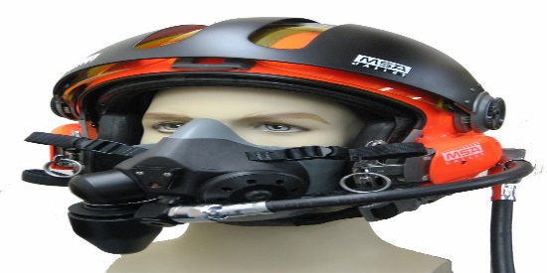

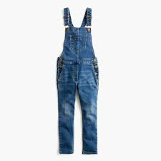
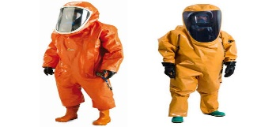

Personal Protective Equipments
Rule | Name | Sample | Use
Sch. VIII | Helmets |  | Shot blasting
 | Gauntlets |  | Shot blasting Ambulance
 | Overalls |  | Shot blasting
73 | Tight clothing |  | For machinery in motion (Sec.22)/prime mover (Rule 73) – a pair of closely fitting shorts and half-sleeve shirt or vest.
Sch. XVII | Protective clothing |  | Asbestos
67 | Screens or goggles

Slide 43
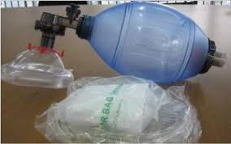
Other safety requirements
Rule | Name | Use
73-C | Work permit | Mandatory in case equipment or pipeline containing inflammable materials are operated.
44(4) IE Rules 1956 | Artificial respirator | In every manned high voltage or extra-high voltage generating station, sub-station or switch station
28(3) CEA Regu-lations 2010 | Artificial respirator | In every manned generating station, sub-station, or switching station of voltage exceeding 650 V

Slide 44
Maharashtra Factories (Control of Industrial
Major Accident Hazards) Rules 2003
Hazardous chemicals | a) As per Schedule-I
 | b) As per Schedule-2 Col.2
 | c) As per Schedule-2 to Factories Act 1948
Major accident hazards factory | Handling hazardous chemical equal to or in excess of threshold quantity specified in Sch.2 Col3
Action to be taken if qty. is equal to or more than threshold as per Col.3 of Sch.2
Notification of site | Min.90 days prior notification to Chief Inspector for commencing industrial activity
On site emergency plan | To be prepared before commencement of industrial activity – containing details as per Sch.VI Mock-drill to be conducted once in 6 months
Provisions relating to safety report and safety audit will apply if the quantity of chemicals is equal to or more than threshold as per Col.4 of Sch.2.

Slide 45

Training of workers
Rule
64 | Lifting machines | For driver of lifting machines
71B(9) | Fire | For proper maintenance and upkeep of fire fighting equipments
73 | Prime movers | Oiling or attending to prime movers
73C (viii) | Inflammable material | For opening equipment or pipeline
73H | Hazardous process | For operator in charge of plant & machinery or equipment
73W 71B | First aid | Minimum 5 persons in first aid procedures
 | Fire extinguishers | Fire fighting practices – sufficient no. of workers
 | Electric furnaces | Workers in charge of operation and maintenance to have minimum High School leaving certificate.

Slide 46

Health of workers

Slide 47
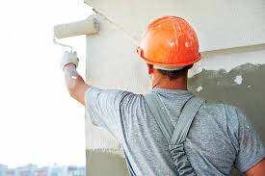
White-washing, painting etc.
Rule | Subject | Requirement | Periodicity
Sec. 11 | Floor of every workroom | Washing using disinfectant or by some other effective method | Once in very week
Sec.11 | All inside walls and partitions, all ceilings or tops of rooms and all walls, sides and tops of passages and staircase | a) If painted otherwise than with washable water paint or varnished – be repainted or revarnished | Once in 5 years
 |  | b) If painted with washable water paint – repainted with min. one coat of such paint | Once in 3 years (and washed in 6 months)
 |  | c) If painted or varnished or they have smooth impervious surfaces – be cleaned | Once in 14 months
 |  | d) In other cases – white washed or colour washed | Once in 14 months
Sec. 11 | Doors and window frames | Including other wooden or metallic framework and shutters – Painted or varnished | Once in 5 years
Rule 51 | Latrines & urinals | White-washed or colour-washed | Once in 4 months
Rule 79 | Canteen | Lime-washed or colour-washed or painted | Once in a year (3 years if painted)

Slide 48
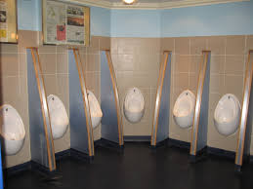
Health - Misc. requirements
Rule | Subject | Requirement
45 | No. of latrines | For females: Upto first 30 females: Min. 1 for every 10 females or part thereof. Thereafter: Min.1 for every 30 females or part thereof. For males: Upto first 100: Min. 1 for every 25 males or part thereof. Thereafter: Min.1 for every 50 males or part thereof.
48 | No. of urinals | Upto first 500: Min.1 for every 50 males or part thereof. Thereafter: Min.1 for every 100 males or part thereof.
53A | No. of sweepers | Upto 50 : 1 part-time 51-250 : 1 full time 251 – 500: 2 full time 501-1000 : 3 full time Above 1000: Extra 1 for every additional 500 or part thereof.
Sec. 16 | Minimum space per worker | 14.2 cubic metres (upto 4.2 metres above floor level)

Slide 49

welfare of workers

Slide 50

Welfare Officers
Maharashtra Welfare Officers (Duties, Qualifications
& Conditions of Service) Rules 1966
Subject | Rule | Provision in brief
Applicability | Sec.49, Rule 2 | 500 or more workers
No. of Welfare Officers required | Rule 2(2) | to 2,500 workers: – 1 Welfare Officer >2,500 workers – Additional as per Rule 2(2)
Qualifications | Rule 3 | Degree or diploma in social science recognized by the State Govt in this behalf Qualified viva voce test conducted by Chief Inspector of Factories, Mumbai Enrolled in list maintained by Chief Inspector of Factories, Mumbai Adequate knowledge of Marathi language
Manner of appointment | Rule 4 | Advertisement in at least 2 newspapers including English Selection to be made by a Committee Appointment when made to be notified
Vacancy in the post | Rule 6 | To be notified to Chief Inspector To be filled within 6 months
Reporting to | Rule 7 | Rank equal to Head of Department working under the Chief Head of the factory.
Duties | Rule 9 | 15 duties mentioned in the Rule

Slide 51

Arrangement for water
Rule | Purpose | Water required
39, 43, 47 | Drinking water | Min. 5 litres a day per worker as per BIS standards (stored water to be renewed on daily basis) Water to be cooled by ice or other effective hygienic method during March to November Min. one such water centre to be provided on each floor Water from well to be sterilized once a week or filtered and treated to the satisfaction of the Health Officer.
74(6) | Washing facility | Min. 30 litres a day for each person
70 | Fire fighting | (A+B+C+D)/20 litres per minute A= total area sq.mt. of all floors including galleries in all buildings of the factory; B= total area sq.mt. of all floors and galleries including open spaces in which combustible materials are handled or stored; C= total area sq.mt. of all floors over 15 metres above ground level D= total area sq.mt. of all floors of buildings other than those of fire resisting construction provided fire-resisting constructions of various floors is so certified by any Fire Association of Fire Insurance Company.

Slide 52
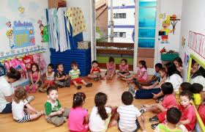
Creche (Sec.48)
Subject | Requirement
Applicability | If >30 women employed (For children under 6 years age)
Building | All walls and roofs to be heat resisting material and water proof Min. area of crèche 10 sq.mt. Min. height of building 3.75 metres from floor Min. floor area per child – 2 sq.mt. Furnished and equipped (one cot or cradle with bedding for each child Fenced and shady open air play ground for older children Wash room with one basin for every 4 children Water min. 25 litres per child per day Clean clothes, soap and towels
Creche staff | Woman incharge possessing qualification for mid-wife Clean clothes to be provided to them
Exemption (Rule 92) | If factory works for <190 days in a calendar year; or If No. of married women does not exceed 15; or Total No. of children <6 years of all women workers is not >4. Provided crèche room of min.10 sq.mt. area is provided.

Slide 53

Misc. welfare requirements
Rule | Subject | Requirement
76 | First aid boxes | For every 150 workers – 1 box containing 25 items as per Rule (Each box to be under separate trained person)
74 | Washing facilities | Upto first 200: Min.1 for every 20 or part thereof. Thereafter: Min.1 for every 50 or part thereof.
79 | Canteen (if >250 workers) | Building plan of canteen to be approved by Chief Inspector Floor area of dining hall min. 1 sq.mt. per dinner Dining hall to accommodate min.30% of workers working at a time. Min.15 metres away from latrines & urinals. Food to be served on no-profit basis. (Rule 85) Canteen Management Committee to be constituted – term 2 years (equal no. of workers, min. 2 workers) (Rule 84) - Accounts of canteen to be audited every year.
86 | Shelter, rest room & lunch room | Min. 11,000 sq.cm. of floor area for every person Height of every room – Min. 3.75 metres from floor level to lowest part of roof

Slide 54
Miscellaneous provisions

Slide 55

Testing to be done
Rule | What to be tested | When to be tested | By whom to be tested
43 | Drinking water | Once in every 6 months | Govt approved lab
65 | Pressure plant | Before first time use Externally every six months Internally every 12 months Hydraulic test once in 4 years | Competent person
64 | Lifting machines, chains, ropes and lifting tackles | Before first use Thereafter, every 12 months | Competent person
71B | Fire fighting apparatus | Periodically | As per maker’s recommendations
73-ZA | Heater coil of thermic fluid heater | Every 12 months by competent person | Competent person
73-ZB | Driers & ovens | Frequent intervals | Responsible person of factory
Sch.V | All instruments for extraction or suppression of dust | Once in 6 months | Competent person

Slide 56
Testing to be done contd…
Rule | What to be tested | When to be tested | By whom to be tested
Sch. VIII | Shot blasting | Once in a week – blasting enclosure and chamber Once in 3 months – ventilating plant | Competent person
Sch. XVI | Electrolytic process – Oxygen & hydrogen | Once in every shift | Competent person
Sch. XVII | Asbestos – Ventilating system for extracting and suppressing dust | Once in 12 months | Competent person
Sch. XV | Processing of cotton – Equipments for extraction of cotton dust or fluff | Once in 6 months | Competent person
61(5) IE Rules 1956 | Earthing system belonging to supplier | Once in 2 years
46 IE Rules | Electrical installation | Once in 5 years | Inspector

Slide 57

Written approvals required
Rule | Permission for | Permission from
40 | Source of supply of drinking water (if other than public water supply system) | Health Officer
44 | Source of supply of ice in drinking water | Health Officer
74 | Source of supply of water for washing facility | Health Officer
86(b) | If area of lunch room is <11,000 sq.cm. per person | Chief Inspector
Sec.2 (f) | If work begins at midnight on a day other than Saturday | Chief Inspector
Sec.18 (2) | If distance between drinking water and latrines & urinals is <6 metres | Chief Inspector

Slide 58
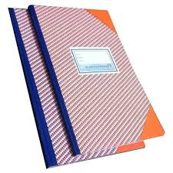
Registers to be maintained
Sec-tion | Rule | Form | Register
10 | 18 | 7 | Health Register (dangerous operations u/s 87)
11 | 20 | 8 | Register of lime washing, painting etc.
15 | 27 | 9 | Humidity register
21 | 58 | 10 | Register of workers attending to machinery
28 | 62 | 11 (exam report) | Register of examination of hoists or lifts
31, 41 | 65(7), 73A | 13 (exam report) | Register of pressure plant or pressure vessel/gas holder
62 | 99, 104 | 17, 104 | Register of workers (adult/child)
80 | 105, 106 | 20 | Register of leave with wages
112 | 122 | 29 | Muster roll
112 | 123 | 30 | Register of accidents and dangerous occurences
112 | 124 | 31 | Inspection book

Slide 59

Notices to be displayed
Sec-tion | Rule | Form | Notice
45 | 77 | - | Notice of first aid (giving specified particulars)
61 | 98 | 16 | Notice of period of work for adult/child workers
108 | 118 | 26 | Abstract of Factories Act and Rules
10 | 18 | 6 | Certificate of fitness
87 | 114 | 23 | Special certificate of fitness (dangerous operations)

Slide 60

Notices or returns to be filed
Sec. | Rule | Form | Details | Authority | Time limit
7(1) | 14 | 2 | Notice of occupation | Chief Inspector | 15 days before occupying premises or 30 days before commencement of work
7 (4) | 15 | 5 | Notice of change of Manager | Inspector (with copy to CI) | Within 7 days
41c | 73W (4) | - | Notice of appoint-ment of Factory Medical Officer | Chief Inspector | Within 1 month
88 | 115 | 24 | Report of accident by Manager | Inspector & others | Within 12 hours (Intimation within 4 hours in case of death or serious accident)
88A | 115 | 24A | Notice of dangerous occurences | Inspector & others | Within 12 hours (Intimation within 4 hours in case of death or serious accident)
89 | 116 | 25 | Notice of poisoning of disease | Adm Medical Officer ESIC | Forthwith (max.4 hours)
110 | 119 | 27 | Annual return (Year end 31st Dec.) | Inspector | On or before 1st Feb.
110 | 119 | - | Annual return of holidays | Inspector | Before end of each year (Exempted if Sunday or other fixed day is observed as holiday)

Slide 61

P C Agrawal
Cs.pcagrawal@gmail.com

