Slide 1
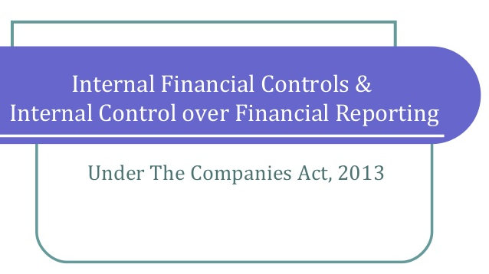

Slide 2
Table of Contents
S. No. | Contents | Page
1 | Introduction | 3
2 | Internal financial controls | 4
3 | Internal financial control over financial reporting | 5-7
4 | ICFR- Few key issues | 8-9
5 | IFC- Who all are responsible | 10-11
6 | Components of internal control | 12
7 | Gearing up for implementing section 134 | 13-16
8 | Conclusion | 17

Slide 3
Key questions
•What does the regulation say?
•Who should drive it? Whose involvement is needed?
•There is no guidance on implementation, where do we start?
•What is the approach and methodology to be followed?
What is the difference between Internal Control over Financial Reporting (ICFR) and Internal Financial Controls (IFC)?

Slide 4
Introduction
Globally, auditors report on both internal financial controls along with the reporting on the financial statements. Internal financial controls are designed to provide reasonable assurance about the efficient and orderly conduct of the business, accuracy and completeness of the accounting records and timely preparation of reliable financial information in accordance with the law.
Such controls gained currency after the Sarbanes-Oxley Act of 2002 added this requirement for most public companies in the US following accounting scandals at Enron, Tyco International and WorldCom in the early 2000.
In India, internal financial controls assumed importance after the Satyam scandal erupted in 2009.The provisions relating to internal financial controls have been included in the Companies Act because of the financial statement frauds witnessed in the last few years.
The concept of internal financial controls is not new in India for listed companies. Clause 49 IX(C) of the listing agreement requires certification by the CEO/CFO stating that they accept responsibility for establishing and maintaining internal controls for financial reporting and that they have evaluated the same for its effectiveness.
In USA, the requirement of ICFR applies only to companies listed on US-SEC. However, in India the intent of regulators was clear that they wanted to cover both listed as well as unlisted companies. The requirement of IFC is being viewed as an important barometer to comment upon the operating effectiveness of a company.

Slide 5
Internal Financial Controls (IFC)
Section 134(5)(e) requires the directors responsibility statement to state that the directors, in case of a listed company had laid down internal financial controls to be followed by the company and that such internal financial controls are adequate and were operating effectively.
The term internal financial controls has been defined as “the policies and procedures adopted by the company for ensuring the orderly and efficient conduct of its business, including adherence to company’s policies, the safeguarding of its assets, the prevention and detection of frauds and errors, the accuracy and completeness of the accounting records, and the timely preparation of reliable financial information.”
Decoding IFC:-
    The 2013 Act has significantly expanded the scope of internal controls to be considered by the management of companies to cover all aspects of the operations of the company.
    IFC includes policies and procedures adopted by the company for ensuring the orderly conduct of its business, thereby covering not only the controls pertaining to Financial statements but also strategic and operational controls.
    The inclusion of the matters relating to IFC in the directors responsibility statement are in addition to the requirement for the directors to state that they have taken proper care for the maintenance of adequate accounting records in accordance with law, for safeguarding assets of the company and for preventing and detecting frauds.

Slide 6
Internal Financial Controls over Financial Reporting (ICFR)
“A process designed to provide reasonable assurance regarding the reliability of financial reporting and the preparation of financial statements for external purposes in accordance with generally accepted accounting principles. A company’s internal financial control over financial reporting includes those policies and procedures that
    Pertain to the maintenance of records that, in reasonable detail, accurately and fairly reflect the transactions and dispositions of the assets of the company;
    Provide reasonable assurance that transactions are recorded as necessary to permit preparation of financial statements in accordance with generally accepted accounting principles, and that receipts and expenditures of the company are being made only in accordance with authorizations of management and directors of the company; and
    Provide reasonable assurance regarding prevention or timely detection of unauthorized acquisition, use, or disposition of company’s assets that could have a material effect on the financial statements.”
The auditor needs to obtain reasonable assurance to state whether an adequate internal financial controls system was in place and whether such internal financial control system operated effectively in the company in all material respects with respect to financial reporting only.

Slide 7
Internal Financial Controls over Financial Reporting (ICFR)
The auditors are required to express an opinion on the effectiveness of entity’s internal controls over financial reporting in addition to and distinct from the opinion expressed by the auditor on the financial statements.
With the introduction of section 143(3)(i), the auditors shall express opinion on the following aspects:-
    Opinion on internal control over financial reporting (ICFR)
    Opinion on the financial statements
The Guidance note issued by ICAI provides supplementary procedures that would need to be considered by the auditor for planning, performing and reporting in an audit of ICFR under section 143(3). It specifically states that since the audit of IFC is in relation to financial reporting, the concept of materiality will be applicable for such audits.
While the objectives of ICFR and audit of financial statements are not identical, the auditor shall plan and perform the work to achieve objectives of both the audits in an integrated manner.

Slide 8
Internal Financial Controls over Financial Reporting (ICFR)
The auditor should report if the company has an adequate internal financial controls system in place and whether the same was operating effectively as at the balance sheet date. The auditor shall also test the same during the financial year under audit and not just as at the balance sheet date , though the extent of testing at or near the balance sheet date may be higher.
In a nutshell,
IFC
ICFR
Operational controls
Fraud Prevention
=
+
+
Credit limit is defined and updated in system at the time of onboarding of new customer.
SOPs have been defined laying down authority matrix for approval of credit limits.
Unauthorized access to credit master

Slide 9
ICFR- A few key issues
Auditors responsibility for reporting in case of consolidated financial statements
As per section 129(4) of the Companies Act, the provisions applicable to the preparation, adoption and audit of the financial statements of a holding company, shall mutatis mutandis apply to the consolidated financial statements.
Thus, auditors of the parent company shall report on the adequacy and operating effectiveness of ICFR of the components of CFS. As per the guidance note issued by ICAI, the auditors shall opine on ICFR of components basis the reports submitted by their statutory auditors under section 143(3).
Auditors reporting on the adequacy and operating effectiveness of ICFR in case of interim financial statements
Reporting on ICFR is not applicable on interim financial statements since this requirement is applicable only in case of reporting on financial statements prepared under the act and reported under section 143.

Slide 10
ICFR- A few key issues
Relying on the work of internal auditor
Internal auditor, in Indian context is viewed as an extension of management, therefore the ability of statutory auditor to rely on the work of internal auditor is restricted. The statutory auditor can look on the output of internal auditor to determine his risks and plan further procedures based on his assessment of risks. Statutory auditor, however cannot completely rely on the work of internal auditor. (SA-610)

Slide 11
Internal Financial Controls- Who all are responsible?
Paradigm shift in the focus of ‘Internal controls’, with explicit responsibility of the Board and auditors to certify design and operating effectiveness of IFC
Section 134
(IFC)
Director’s Responsibility statement
In the case of a listed company, the Directors’ Responsibility states that directors, have laid down IFC to be followed by the company and that such controls are adequate and operating effectively.
Section 143
(ICFR)
Auditors Report
The auditor’s report should also state whether the company has adequate IFC system in place and the operating effectiveness of such controls.
As per guidance note issued by ICAI, auditor will opine only on ICFR.
Section 177
(IFC)
Audit Committee
Audit committee may call for comments of auditors about internal control systems before their submission to the Board and may also discuss any related issues with the internal and statutory auditors and the management of the company.
Schedule IV
(ICFR)
Independent Directors
The independent directors should satisfy themselves on the integrity of financial information and ensure that financial controls and systems of risk management are robust and defensible.

Slide 12




Internal Financial Controls- Who all are responsible?
Rule 8(5)(viii) of Companies (Accounts) Rules, 2014 (ICFR)
Board of Directors Report
In case of all companies, the board of directors report to state the details in respect of adequacy of internal financial controls with reference to the financial statements.
Responsibilities of stakeholders
Board of Directors
Audit Committee/ Independent Directors
Auditors
Would rely on the assessment and view of the Audit Committee
They may ask for additional information
Company
Management
Would like to see a robust framework that is aligned to acceptable standards
Review & question the basis of controls design and ongoing assessments
Focus on internal controls, to the extent these relate to the financial reporting (ICFR)
Responsibility limited to evaluation of “financial reporting controls”
Create & test the framework of internal controls
IFC (including operational and compliance)
Controls documentation

Slide 13
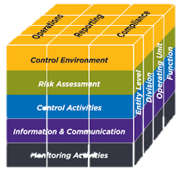
Components of internal control
Control environment
Demonstrates commitment to integrity and ethical values
Management, with board oversight, establishes structure, authority and responsibility
The organization establishes accountability
Board of directors demonstrate independence from management
Risk Assessment
Identifies and assesses risk
Considers the potential for fraud
specifies relevant objectives with sufficient clarity to enable identification of risks
Control activities
Selects and develop control activities
Deploys through policies and procedures
Information and communication
Obtains or generates relevant information
Communicates internally and externally
Monitoring
Evaluates and communicate deficiencies

Slide 14
Gearing up for implementing Section 134
The IFC framework to be adopted by the company will have to address combination of internal controls on financial reporting(ICFR) and other controls in order to align with the definition of IFC given under the act.
Implementation of internal financial controls by the management includes-
    Documentation of IFC
    Testing of IFC
    Forming opinion about IFC including identification of gaps, action plan for mitigation thereof
(Discussed in later slides)

Slide 15
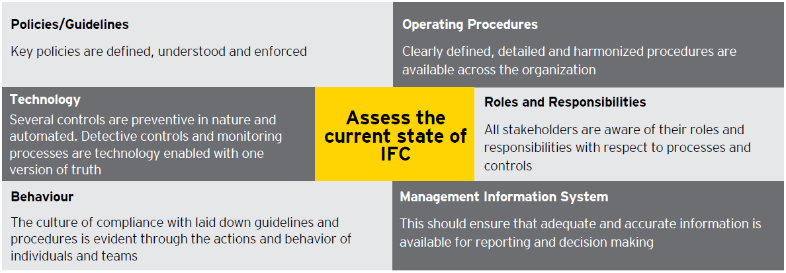
Gearing up for implementing Section 134
The expanded coverage and focus goes way beyond the financial reporting controls and the focus is on all the elements of a controls framework- policies and procedures, operating controls, controls monitoring , designing of controls to mitigate risks and testing of controls to ensure their operating effectiveness.

Slide 16
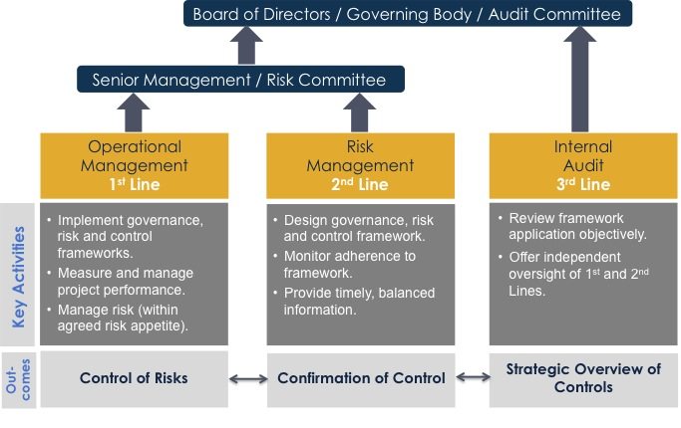
Gearing up for implementing Section 134
The approach of Companies Act is of self-governance. Management should therefore, take following steps to ensure that there exist a proper internal control system. The “Three Lines of Defence” model provides a simple and effective way to enhance communications on internal financial controls by clarifying roles and duties

Slide 17
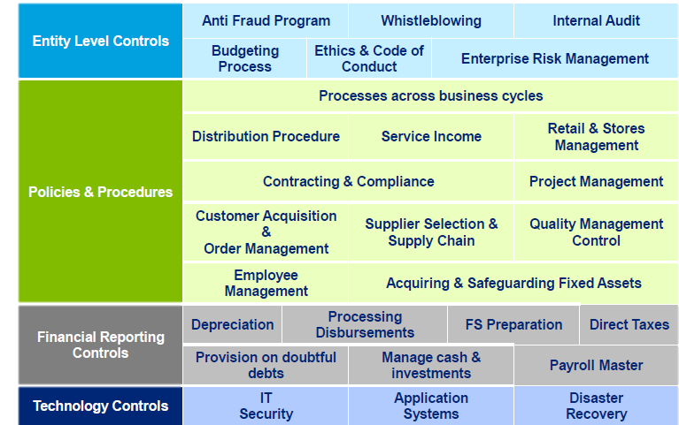
IFC – Key components

Slide 18
Conclusion
The requirement of internal control is now legally mandated. In respect of the listed companies, it is by virtue of Section 134(5) of the Companies Act, 2013. Unlisted and private limited companies are covered by virtue of rules and reporting requirement by auditors.
By placing more accountability and responsibility on the Board and Audit committee with respect to internal financial controls, the government is attempting to align the corporate governance and financial reporting standards with global best practices.
Due to enhanced reporting requirements, companies should first evaluate their present components of internal controls and ensure that they are robust and mitigate the risk of fraud.
To truly unlock the value of this legislation, management should step back and identify the risks to its organization in light of its size, complexity, nature of operations etc. and evaluate the existing controls as against those risks.
The introduction of IFC will help companies enhance their internal control environment. For the IFC framework to be sustainable, each stakeholder is expected to play an important role during its implementation.

Slide 19


