Slide 1
RAMA VITI TUTORIALS
free e-books , charts , notes , online quiz , scanned books of author , tips to remember section , scanner, various mnemonics to remember audit , direct tax tips and tricks , idt charts , prepration tips , exam prepration schedule , one day revision notes , examination trend , tips on how to write papers , tips on scoring good marks in isca , direct tax charts , easy language law interpretation , all amendments , important topics for nov 2016 exams etc
like us to motivate us!
For All Charts For Ca Final Law :- Visit Our Facebook Page

Slide 2
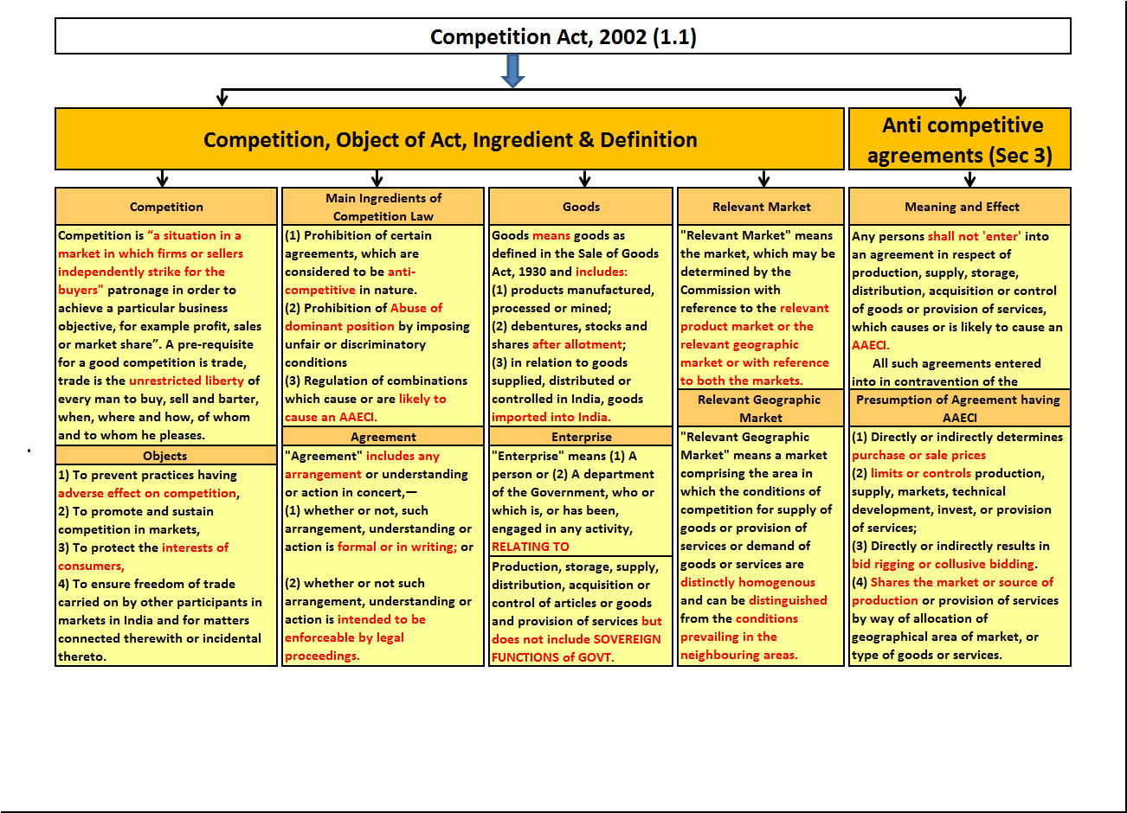

Slide 3
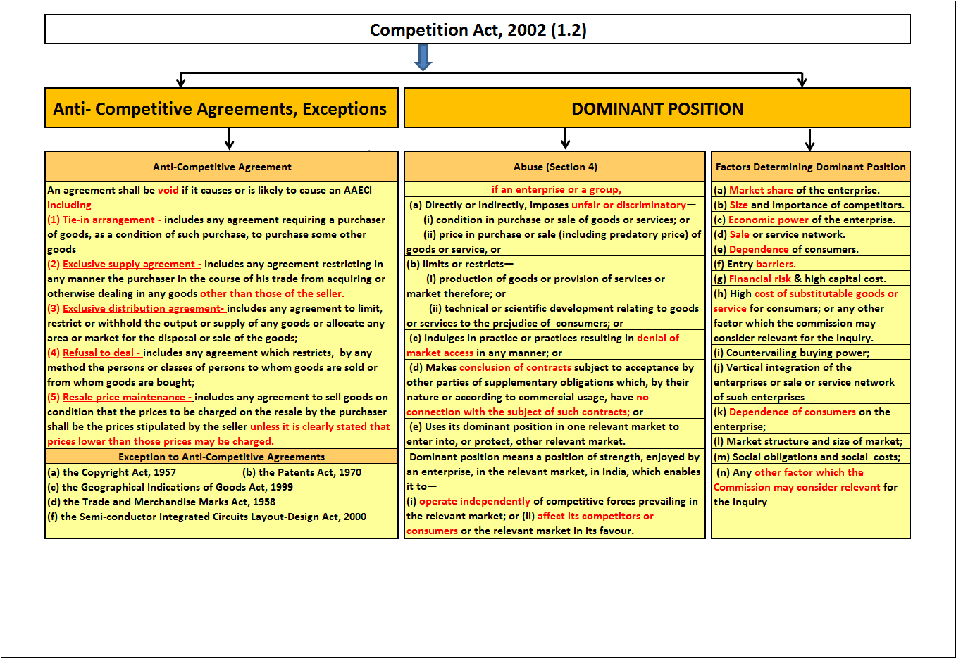

Slide 4
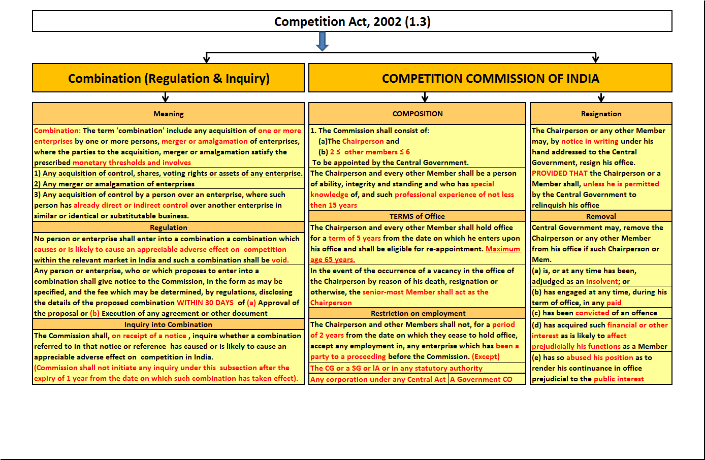

Slide 5
