Slide 1
THE REAL ESTATE (REGULATION AND DEVELOPMENT) ACT, 2016

Slide 2
Overview of the Act
The Real Estate (Regulation and Development) Act, 2016 will come into effect from 1st May 2016.
Notification for Section 2, Sections 20-29, Sections 41-58, Sections 71-78 and Sections 81-92 of the Act would come to force from 1st May, 2016
Real Estate Regulatory Authority will be formulated within one year by both state and central government.

Slide 3
Objective of the Act:
  Regulation and promotion of the real estate sector
  Sale of plot, apartment or building in an efficient and transparent manner
  Protect the interest of consumers in the real estate sector
  Speedy dispute redressal

Slide 4
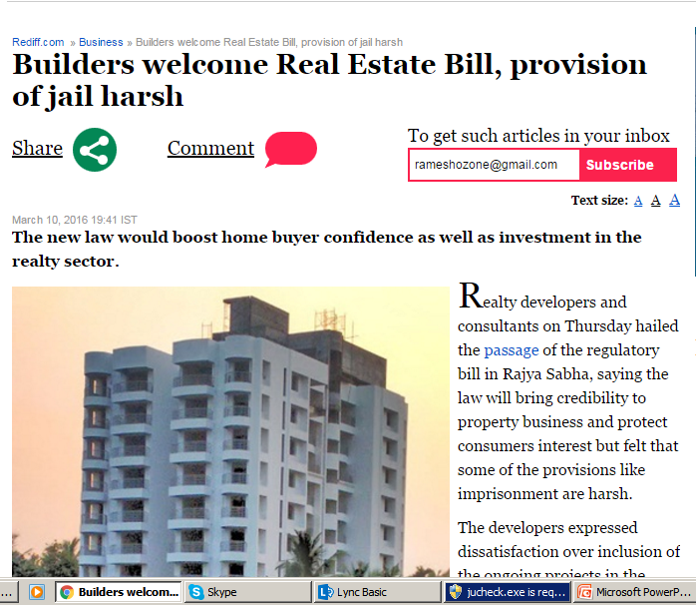
"Everyone welcomes the bill. We respect the wisdom of Parliament. There are some provisions like imprisonment which are harsh and may be with time they will be set right," Rajeev Talwar, chief executive, DLF told
Realtors' apex body CREDAI president Getamber Anand said the bill would "bring credibility to real estate business and endorse our demand of giving infra status to housing".
JLL chairman and country head Anuj Puri termed the passage of the bill as "unequivocal victory" for Indian realty sector.
Real Estate Bill could encourage FDI inflows: Nomura

Slide 5
My opinion on Real Estate Act
Act gives upper hand to the home buyers
Compliance under his act is so impractical that most of the small scale developers will disappear from the industry
This act may severally impact our economy as well, as it will curtail real estate activities
This may increase bank’s NPA provisioning for the short term
Builder may lose his profit towards penalties under this Act
Customer will have option of cancellation of his unit till the date of handing over as builder with or without his knowledge may violate some provision under this Act

Slide 6
What media reported on RERA
Not to sell any unit till the date of approval
70% of the collection to be deposited to escrow account, to be used only for construction purpose
Penalty for project delay
Approved plan can’t be modified without majority customers consent
Builder has to sell only carpet area

Slide 7
My observations on RERA:
Builder can’t sell units till commencement certificate
Builder can’t borrow money for new projects
Builder can’t repay existing loan on ongoing projects
Builder has to register sale agreement
Builder can’t collect more than 10% advance before sale agreement

Slide 8

Book on Real Estate Act

Slide 9
For purchasing this book, Please click on the below link:-
http://www.flipkart.com/realestate-magazines/p/itmegsz2xzw8akzu?pid=MAZEGSZ287H2TSZT&al=c5bitCj057IotdTzpU1X6sldugMWZuE7Qdj0IGOOVqvmeJbZachs2O2K1vWq071MeV9z6c0Aj2U%3D&ref=L%3A3523176562690507288&srno=p_1&otracker=from-search

Slide 10


