Slide 1
BLACK MONEY ACT & IMPOSITION OF TAX ACT, 2015
( Simplified )

Slide 2

APPLICABILITY OF TAX
APPLICABLE TO PERSONS RESIDING IN INDIA
HAVING BOTH UNDISCLOSED INCOME AND ASSET
INCLUDING FINANCIAL INTEREST IN ANY ENTITY

Slide 3
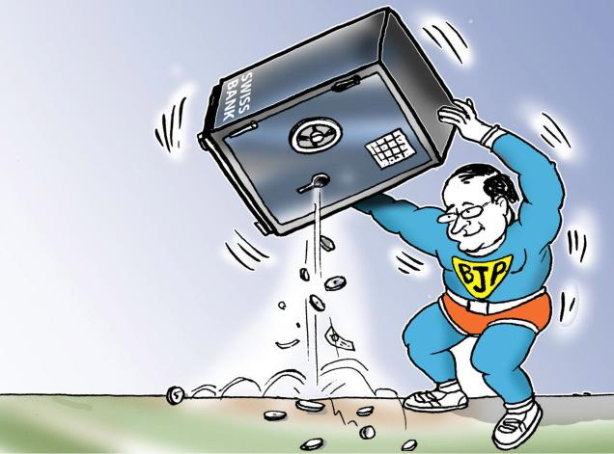

Slide 4

1.Title and Commencement
TITLE:-
The rules are known as “Black Money and Imposition of Tax Rules, 2015”
“BMIT” RULES,2015
COMMENCEMENT:-
It came into force on 2nd July, 2015.

Slide 5
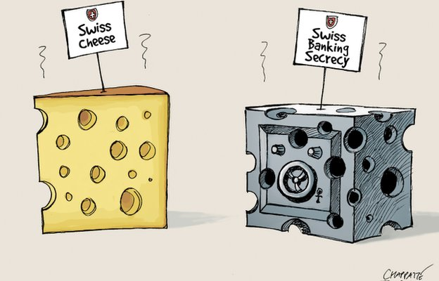

Slide 6

2.FAIR MARKET VALUE (FMV)
1.FMV OF BULLION, JEWELLERY OR PRECIOUS STONE IS HIGHER OF :-
COST OF ACQUISITION
OR
VALUE OF THE ASSET ORDINARILY FETCH IF SOLD IN THE MARKET ON THE VALUATION DATE, WHICH IS GIVEN IN THE REPORT ISSUED BY GOVERNMENT ORGANIZED VALUATION OFFICER

Slide 7
2. FMV OF ARCHAEOLOGICAL COLLECTIONS, DRAWINGS, PAINTINGS, SCULPTURES OR ANY WORK OF ART SHALL BE HIGHER OF:-
COST OF ACQUISITION
OR
VALUE OF ASSET ORDINARILY FETCH IF SOLD IN THE MARKET ON THE VALUATION DATE, WHICH IS GIVEN IN THE REPORT ISSUED BY GOVERNMENT ORGANIZED VALUATION OFFICER

Slide 8

3.FMV OF SHARES & SECURITIES SHALL BE HIGHER OF:-
(i) COST OF ACQUISITION
OR
(ii) (a) AVERAGE OF THE HIGHEST & LOWEST OF THE PRICE OF SUCH SHARE ON VALUATION DATE
(b) IF THERE IS NO TRADING ON VALUATION DATE, THEN AVERAGE OF VALUE OF SHARES IMMEDIATELY PRECEEDING THE DATE ON VALUATION ONWHICH SHARES ARE TRADED

Slide 9
4. FMV OF UNQUOTED EQUITY SHARES SHALL BE HIGHER OF:-
(i) COST OF ACQUISITION
OR
(ii) FMV OF UNQUOTED SHARES=(A+B-L)*(PV)
(PE)
Where, A= BOOK VALUE OF ALL ASSET*-
(a)(ANY AMOUNT OF INCOME TAX PAID-AMOUNT OF INCOME TAX REFUND CLAIMED)
(b) (ANY AMOUNT SHOWN AS ASSET WHICH DOES NOT REPRESENT THE VALUE OF ANY ASSET**)
Notes:
ASSET HERE IS REFERRED AS ASSET OTHER THAN BULLION, JEWELLERY, PRECIOUS STONE, ARTISTIC WORK, SHARES, SECURITIES AND IMMOVABLE PROPERTY
** ASSET LIKE UNAMORTISED AMOUNT OF DEFERRED EXPENDITURE

Slide 10
B= FMV OF BULLION, JEWELLERY, PRECIOUS STONE, ARTISTIC WORK, SHARES, SECURITIES AND IMMOVABLE PROPERTY AS DETERMINED IN MANNER PROVIDED IN THIS RULE;
L=BOOK VALUE OF LIABILITIES*
PE=TOTAL AMOUNT OF PAID UP EQUITY SHARE CAPITAL AS SHOWN IN THE BALANCE-SHEET;
PV=THE PAID UP VALUE OF SUCH EQUITY SHARES
Notes:
*IT DOES NOT INCLUDE,
THE PAID UP CAPITAL IN RESPECT OF EQUITY share
THE AMOUNT SET APART FOR PAYMENT OF DIVIDENDS
RESERVES & SURPLUS , OTHER THAN THOSE SET APART TOWARDS DEPRECIATION
PROVISION FOR TAXATION OTHER THAN TAX PAID-AMOUNT CLAIMED AS REFUND
PROVISION MADE FOR PAYMENT OF LIABILITIES, OTHER THAN ASCERTAINED LIABILITIES
CONTINGENT LIABILITIES OTHER THAN ARREARS OF DIVIDEND PAYABLE IN RESPECT OF CUMULATIVE PREFERENCE SHARES

Slide 11
5. FMV OF UNQUOTED SHARE & SECURITY OTHER THAN EQUITY SHARE IN A COMPANY SHALL BE HIGHER OF:-
COST OF ACQUISITION
OR
PRICE THAT THE SHARE OR SECURITY SHALL FETCH IF SOLD IN THE OPEN MARKET ON THE VALUATION DATE, WHICH IS GIVEN IN THE REPORT ISSUED BY GOVERNMENT ORGANIZED VALUATION OFFICER

Slide 12

6. FMV OF AN IMMOVABLE PROPERTY SHALL BE HIGHER OF :-
COST OF ACQUISITION
OR
VALUE OF THE ASSET ORDINARILY FETCH IF SOLD IN THE MARKET ON THE VALUATION DATE, WHICH IS GIVEN IN THE REPORT ISSUED BY GOVERNMENT ORGANIZED VALUATION OFFICER

Slide 13
7. VALUE OF AN ACCOUNT WITH BANK SHALL BE:-
SUM OF ALL THE DEPOSITS MADE IN THE ACCOUNT SINCE THE DATE OF OPENING THE ACCOUNT
OR
WHERE A DECLARATION HAS BEEN MADE UNDER CHAPTER VI & THE VALUE OF THE ACCOUNT HAS BEEN CHARGED TO TAX & PENALTY UNDER THE CHAPTER, THE SUM OF ALL THE DEPOSITS MADE IN THE ACCOUNT SINCE THE DATE OF SUCH DECLARATION*
Notes:
* ANY DEPOSIT MADE FROM PROCEEDS OF WITHDRWAL FROM THE ACCOUNT, IS NOT TAKEN INTO CONSIDERATION

Slide 14
8. VALUE OF AN INTEREST OF A PERSON IN A PARTNERSHIP FIRM OR IN AN ASSOCIATION OF PERSON OR A LIMITED LIABILITY PARTNERSHIP OF WHICH HE IS A MEMBER SHALL BE DETERMINED IN THE SPECIFIED IN CLAUSE (g)

Slide 15
CLAUSE(g)
NET
ASSET
AMOUNT EQUAL TO CAPITAL
REST OF NET ASSET
IN PROPORTION OF THE CAPITAL CONTRIBUTED
ALLOCATED IN ACCORDANCE OF THE AGREEMENT OF PARTNERSHIP OR IN ABSENCE OF SUCH AGREEMENT , IN PROFIT SHARING RATIO

Slide 16


Slide 17
RULE 2
NOTWITHSTANDING ANTHING CONTAINED IN THE RULE 1, WHERE AN ASSET (OTHER THAN BANK ACCOUNT) WAS TRANSFERRED BEFORE THE VALUATION DATE THE FAIR MARKET VALUE OF SUCH AN ASSET SHALL BE HIGHER OF ITS COST OF ACQUISITION AND THE SALE PRICE*
Notes:
* WHERE AN ASSET WAS TRANSFERRED WITHOUT ANY CONSIDERATION OR IN ADEQUATE CONSIDERATION BEFORE THE VALUATION DATE, THE FMV OF THE ASSET SHALL BE HIGHER OF ITS COST OF ACQUISITION & THE FMV ON THE DATE OF TRANSFER

Slide 18
RULE 3
WHERE AN ASSET HAS BEEN ACQUIRED OR MADE OUT OF CONSIDERATION RECEIVED ON ACCOUNT OF TRANSFER OF AN OLD ASSET OR WITHDRAWL FROM A BANK ACCOUNT , THEN THE FMV OF OLD ASSET OR BANK , DETERMINED IN ACCORDANCE WITH SUB RULE (1) & (2) SHALL BE REDUCED BY THE AMOUNT OF CONSIDERATION INVESTED IN THE NEW ASSET

Slide 19
RULE 4
THE FMV OF AN ASSET DETERMINED IN THE CURRENCY OTHER THAN ONE OF THE CURRENCIES DESIGNATED BY THE RESERVE BANK OF INDIA , THEN SUCH VALUATION SHALL BE CONVERTED INTO INDIAN CURRENCY AS PER THE REFERENCE RATE OF RESERVE BANK OF INDIA ON THE DATE OF VALUATION

Slide 20
RULE 5
WHERE FMV IS DETERMINED IN CURRENCY OTHER THAN ONE OF THE PEMITTED CURRENCIES DESIGNATED BY THE R.B.I., THEN SUCH VALUE SHALL BE CONVERTED INTO US DOLLARS ($) ON THE DATE OF VALUATION AS PER THE RATE SPECIFIED BY THE CENTRAL BANK OF COUNTRY IN WHICH ASSET IS LOCATED AND SUCH VALUE SHALL BE CONVERTED INTO INDIAN CURRENCY AS PER RATE ON THE DATE OF VALUATION
Notes:
* IF CENTRAL BANK OF THE COUNTRY OR JURISDICTION DOES NOT SPECIFY THE RATE OF CONVERSION THEN RATE SHALL BE THE ONE SPECIFIED BY ANY OTHER BANK REGULATED UNDER THE LAWS OF THAT COUNTRY OR JURISDICTION

Slide 21
3. APPEAL
AN APPEAL SHALL BE MADE IN THE FORM 3
MEMORANDUM OF CROSS-OBJECTIONS SHALL BE MADE IN THE FORM 4
EVERY SHALL BE ACCOMPANIED BY A FEE OF 25,000 RUPEES.
A STATEMENT OF TAX ARREARS SHALL BE DRAWN IN THE FORM 5.

Slide 22
4. DECLARATION OF UNDISCLOSED ASSET OUTSIDE INDIA (SECTION 59)
DECLARATION MADE IN FORM 6
COMMISSIONER SHALL GRANT ACKNOWLEGMENT IN FORM 7 WITHIN FIFTEEN DAYS OF SUBMISSION OF TAX ALONG WITH PENALTY

Slide 23
SOME IMPORTANT POINTS

Slide 24
1. FLAT 30% TAX WITHOUT ANY EXEMPTION, DEDUCTION, SET OFF OR CARRY FORWARD (+)
EQUAL AMOUNT BY WAY OF PENALTY
2. FAILURE TO FILE RETURNS OF FOREIGN INCOME WILL ATTRACT A PENALTY OF Rs. 10 LAKH
3. ALONG WITH ENHANCED PUNISHMENT OF JAIL FOR 3-10 YEARS WITH PENALTY EQUAL TO 3 TIMES OF TAX EVADED OR 90% OF UNDISCLOSED INCOME WHICH IS ADDITION OF TAX OF 30%

Slide 25
SECOND AND SUBSEQUANT OFFENCE WILL BE PUNISHABLE WITH IMPRISONMENT OF 3-10YEARS AND FINE OF Rs. 1 CRORE
5.
UNDISCLOSED HOLDINGS OF Rs. 5LAKH OR LESS ANY TIME DURING A YEAR NOT REPORTED OUT OF OVERSIGHT OR IGNORANCE SHALL NOT ATTRACT ANY PENALTY
6.
BILL EMPOERS THE CENTER TO ENTER INTO AGREEMENT WITH FOREIGN COUNTRIES FOR EXCHANGE OF INFORMATION FOR RECOVERY OF TAX AND AVOIDANCE OF DOUBLE TAXATION
4.

Slide 26

THANK YOU
BY:
KANIKA SINGH

