Slide 1
The Negotiable Instruments Act 1881
By CA. SAYANTAN BASU

Slide 2
Introduction
The word negotiable means transferable from one person to another and the term instrument means any written document by which a right is created in favour of some person. Thus the negotiable instrument is a document by which the right vested in a person can be transferred to another person in accordance with the Negotiable Instruments Act 1881.

Slide 3
The term Negotiable Instrument has been defined as “Negotiable Instrument means a promissory note, bill of exchange, or cheque payable either to order or to the bearer”

Slide 4
An instrument may be negotiable either by
Statute or
By Usage

Slide 5
Statute :
Promissory Notes , bills of exchange and cheques are negotiable instruments under Negotiable Instruments Act 1881 OR
By Usage : Bank Notes , Bank Drafts , scripts, treasury Bills etc

Slide 6
Main Features of Negotiable Instrument
An instrument is called negotiable if it possesses the following characteristic features:
Freely Transferable :
Transferability may be by
Delivery
By endorsement and Delivery

Slide 7
Holder’s Title must be free from Defects:
The Holder of the negotiable instrument in due course acquires a good title not withstanding any defect in previous holder’s title. A holder in due course is one who receives the instrument for value and without any notice as to the defect in title of the transferor

Slide 8
The holder can sue in his own name
Another chracteristic of a negotiable instrument is that the holder can sue on the instrument in his own name

Slide 9
4. A negotiable instrument can be transferred infinitium ie can be transferred any number of times till its maturity
5. A negotiable instrument is subject to certain presumptions :

Slide 10
Presumptions :
Consideration :
Every negotiable instrument is deemed to have been drawn and accepted , endorsed, negotiated, or transferred for consideration
Date :
Every negotiable instrument must bear the date on which it is made or drawn

Slide 11
Presumptions
Acceptance : Every Bill of exchange was accepted within a reasonable time after the date mentioned therein and before the date of its maturity
Transfer :
Every transfer should be made before the expiry

Slide 12
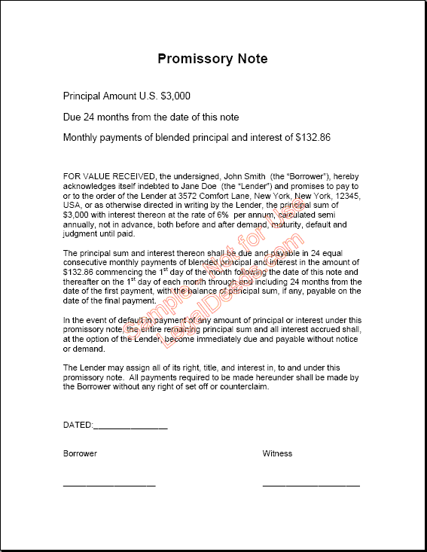
Promissory Note

Slide 13
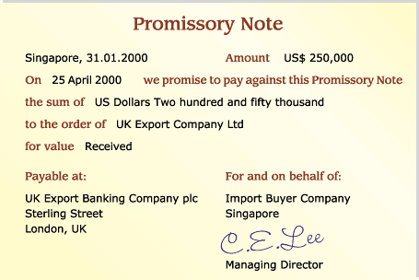
Egs of Promissory Note

Slide 14
Promissory Note
A promissory note is an instrument in writing (not being a part of a bank note or a currency – note) containing an unconditional undertaking, signed by the maker to pay a certain sum of money to, or to the order of a certain person or to the bearer of the instrument

Slide 15
Examples :
“ I promise to pay B or order Rs 500/-”
“I promise to pay Rs 500 and all other sums which shall be due to him”
“I promise to pay Rs 500 on D’s death , provided D leaves me enough to pay that sum”.
“ I promise to pay Rs 500/- and to deliver to him my black horse on 1st January next”

Slide 16
Essentials of Promissory Note
Writing : A promissory note must be in writing. Writing includes print and typewriting
Promise to pay:
It must contain an Undertaking or promise to pay. Thus a mere acknowledgement of debt is not sufficient. Notice that the use of the word ‘promise’ is not essential to constitute an instrument as a promissory note . Promise should be to pay money only and that should be certain

Slide 17
Essentials of Promissory Note (Contd)
Signed by the maker :
The promissory note must be signed by the maker otherwise it has no effect
Parties :
There are 2 parties involved ie maker and the payee

Slide 18
Essentials of Promissory Note (Cond)
It must be duly stamped under the Indian Stamp Act
It means that the stamps of the requisite amount must have been affixed on the instrument . A promisory note which is not so stamped is a nullity

Slide 19
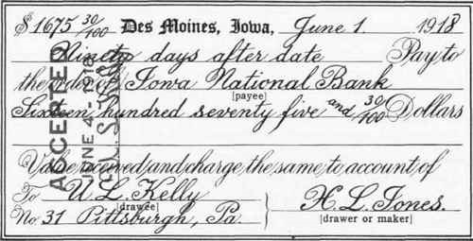
Bill of Exchange

Slide 20
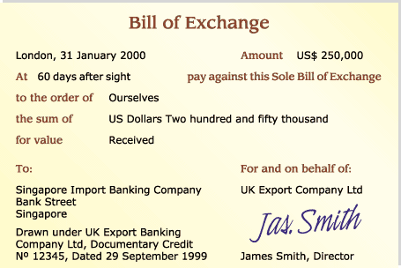
Bill of Exchange

Slide 21
Bill of Exchange
A bill of exchange is defined as an instrument in writing containing an unconditional order signed by the maker, directing a certain person to pay a certain sum of money only to or to the order of a certain person or to the bearer of the instrument

Slide 22
Characteristic of Bills of Exchange
It must be in writing
It must contain an order to pay and a promise or request
The order must be unconditional
There must be 3 parties ie : drawer, drawee, and payee
The parties must be certain
It must be signed by the drawer
Number, date and place are not essential

Slide 23
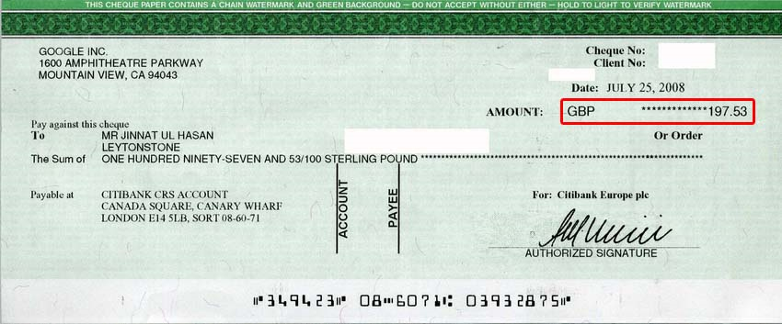
Cheque

Slide 24
Cheque
A cheque is defined as a bill of exchange drawn on a specified banker and not expressed to be payable otherwise than on demand
Thus a cheque is a bill of exchange with 2 added features:
It must be drawn on a specified banker &
It is always payable on demand and not otherwise

Slide 25
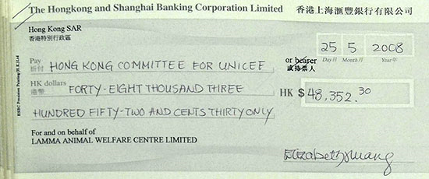
Crossed Cheque

Slide 26
Crossing of the Cheque
Crossing of a cheque is a unique feature associated with a cheque affecting to a certain extent the obligation of the paying Banker and also its negotiable Character.
Crossing of a Cheque is a direction to a particular Banker by the Drawer that Payment should not be made across the Counter. The payment on the crossed Cheque can be collected only through a Banker.

Slide 27
Crossing of the Cheque is affected by drawing two parallel Transverse lines .
The Cheque that is not crossed is an open Cheque

Slide 28
Who can cross a Cheque
1. The drawer of a Cheque
2. Holder of the Cheque
3.The Banker in whose favour the cheque has been crossed specially

Slide 29
A Crossed Cheque is Safer Than A Bearer Cheque
When a cheque is crossed, the holder thereof cannot encash it at the counter of the bank. Encashment at the counter of the bank is possible only in the case of an open cheque, i.e. a bearer cheque or an uncrossed cheque.
The holder of a crossed cheque has to present the same to his bank for collecting its amount from the drawee bank. When the amount of the cheque is collected, the account of the holder is credited. Thus, it is possible to trace the party receiving the amount of the cheque. This is not so in the case of a bearer cheque because a bearer cheque can be encashed by anybody who presents it at the counter of the bank. Crossing, therefore, gives protection against payment of a cheque to wrong parties.

Slide 30
Dishonour of the Cheque on the grounds of Insufficiency of Funds :
Section 138 to 142 of the Negotiable Instruments Act provide for Criminal Penalties in event of Dishonour of Cheques for Insufficiency of Funds. The drawer under Section 138 may be punished with imprisonment upto 2 years or with a fine twice the amount of the Cheque or with Both.

Slide 31
Distinction
It must be drawn only on Banker
The amount is always payable on demand
The Cheque is not entitled to days of grace
Cheque can be crossed
It can be drawn on any person including a Banker
The amount may be payable on demand or after a specified time
A usance ( time) bill is entitled to 3 days of grace.
Crossing of Bill of Exchange is not possible
Cheque
Bill of exchange

Slide 32
Distinction
There are 2 parties – Maker (Debtor) and the payee (Creditor)
A note contains an unconditional promise by maker to pay the payee
There are 3 parties – The Drawer , the drawee, and the payee
It contains an unconditional order to the drawee to pay according to the drawer’s directors
Promissory Note
Bill of Exchange

