Slide 1


Intergenerational Equity -Need for Development on Sustainable Basis
In the ambit of Developing nexus between Trade Liberalization and Environment Protection
By: Madhura Ubale
2nd Semester, L.L.B (3 Years)
Dr. B. A. College of Law(Main Branch)

Slide 2
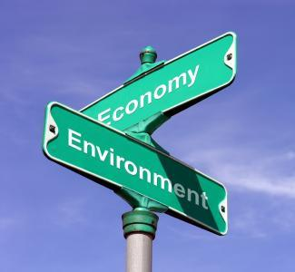
Developing nexus between Trade Liberalization and Environment Protection
Trade liberalization is increasing in all countries by lessening strict rules for international trades.
Hazardous industries are essential constituent of developmental procedure.
In earlier days, it was assumed that in procedure of industrial growth, environmental damage is incidental and no efforts were taken to minimize the same.

Slide 3
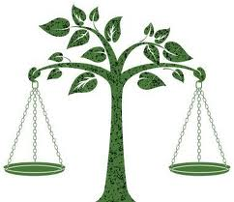
Now it is accepted that development shall be carried out uniformly and in environment friendly manner.
As Hazardous Industries are inevitable part of development, special regimes are applied on them through following:
  Factories Act 1948
  Environment (Protection) Act 1986
  Union Carbide Corporation V. Union of India
  Environmental Impact Assessment (EIA)
  Environmental Audit

Slide 4
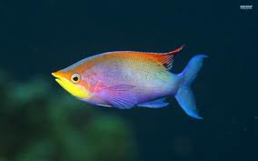

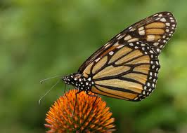
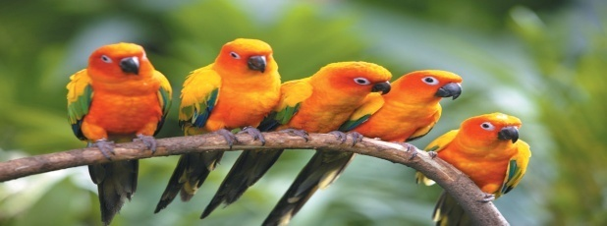
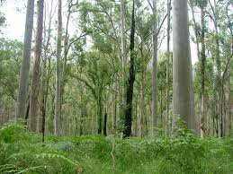
It is evident from the above facts that special reforms for hazardous industries are paving way for Environmental Protection along with Trade liberalization in India. Intergenerational Equity and Sustainable development are some of the principles discovered to achieve object of Trade Liberalization along with Environmental Protection.

Slide 5
Intergenerational Equity – Definition
The Intergenerational equity can be defined as endowed institution’s spending rate must not exceed its after inflation rate of compound return, so that investment gains are spent equally on current and future constituents of the endowed assets.
Equity signifies impartiality in availability of resources as well as treats natural resources as funds for development of generations to come.

Slide 6
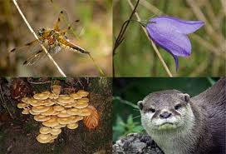
Need For Intergenerational Equity
Pollution disturbing Ecological Balance : Ecological Balance is must for smooth procedure of recreation of natural resources by nature. Which is disturbed by various industrial as well as household activities.
Loss of Biodiversity: Bio diversity helps in protection of water resources, nutrient storage and cycling, climate stability, maintenance of ecosystem but as no efforts were taken for its preservation many species are diminished.
Excessive and Reckless Use of Natural Resources is also contributing in worsening situation.

Slide 7
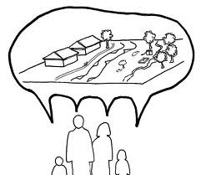
Sustainable Development
The intergenerational equity explored in field of environment by introducing the concept of saving resources for future generation which paved path for Sustainable Development.
Sustainable development is defined by the Brundtland Commission as development that meets the needs of the present without compromising the ability of future generations to meet their own needs.

Slide 8
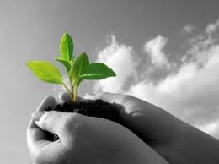
Sustainable Development – Need Of Hour
All the demands of developing and developed nations require the manipulation of natural resources.
The future of our planet depends on our use of the available resources.
It is imperative that our fragile environment suffers the least damage possible.

Slide 9
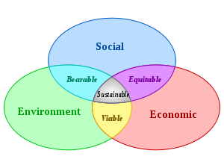

Slide 10

Steps Taken Towards Sustainable Development
United Nations Conference on Human Environment initiated formation of environmental laws in many countries.
Rio Summit popularly known as Earth Summit led to formation of Agenda 21 consisting of principles such as Polluter pays, Equitable utilization of resources were agreed to be followed by countries in the summit.
WWF (World Wide Foundation) is formed for protecting the world’s wildlife, endangered species, etc. They are conservation leaders for more than 39 years.

Slide 11
Kyoto Protocol was adopted in 1997 by 37 countries. It sets binding targets for 37 countries for reducing greenhouse gas emission. Protocol places a heavier burden on developed nations. Market based mechanism allow developed parties to earn and trade emission credits.
Recently a summit was held in new Delhi Sustainable Development to discuss the issues of renewable energy, biodiversity, water and climate change, etc.

Slide 12

Apart from this many conventions on issues such as Preservation of Wetlands, Sea Water, Marine lives, Trail Smelter Arbitration were passed which focused on root causes of need of sustainable development such as bio diversity conservation, ecological system’s balance, etc.

Slide 13
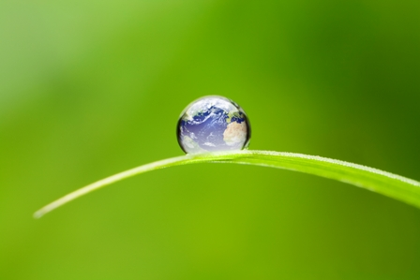
Conclusion
Increased Human interference in Nature caused problems and need for Intergenerational Equity arose.
Sustainable Development is guiding principle for Intergenerational Equity.
Trade tools could be instrumental in making tangible progress towards more sustainable consumption and production patterns.

Slide 14
Awareness among Consumers is necessitating Companies to have Sustainable Development as their motive along with economical benefits.
Sustainable Reporting which is included as part of Companies Annual Report to attract consumers is benchmarked by formation of many treaties internationally.
Elimination of Environment damaging developmental activities and promotion of synergy between Trade, environment and Development.

Slide 15

Thank
You!
We the members of present generation, we hold the earth in trust for future generations and sustainable development will help us achieve the same.

