Slide 1


Time Management
By- Rameshwar Patel

Slide 2
Why Time Management..??
It has Value (Can U Measure..?)
Year
Month
Day
Hour
Minute
Second
Mili-second

Slide 3
Obstacles to effective time management
Unclear objectives
Disorganization
Inability to say “no”

Slide 4
Cont…
Interruptions
More interruptions

Slide 5
Cont…
Too many things at once
Stress and fatigue
All work and no play

Slide 6
What can we do..??
?
?
Recognize that obstacles exist
Identify them
Employ strategies to overcome

Slide 7
Set _{“SMART”} goals
Specific
Measurable
Achievable
Realistic
Time-based

Slide 8
RPM-Philosophy
Resulted- Target
Purpose
Map Plan (Action Plan)
It makes Difference B/W Success & Failure

Slide 9
Prioritize
Do
Delegate
Delay
Delete

Slide 10
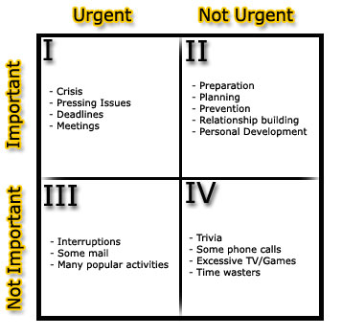
Prioritize

Slide 11
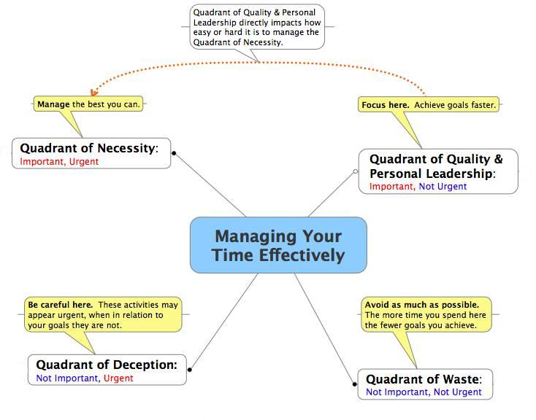

Slide 12
Consider your personal prime time
Early Morning
Evening
Late night
……?.?

Slide 13
Other Strategies..
Learn when to say “NO”
Use your waiting time
Apply the 80/20 rule of “Perito” to everything.
Concentrate on the task at hand
Plan every day in advance.
Get an extra hour every day
(1Hour= 57.6 Minutes Theory)

Slide 14

Thank U
www.rameshwarpatel.blogspot.com

