Slide 1
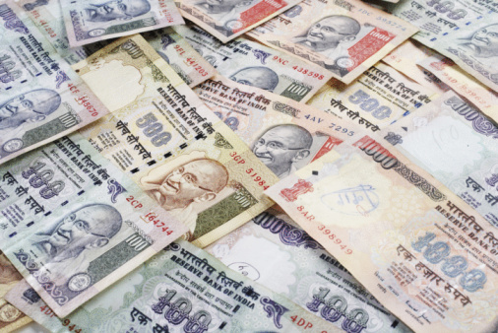


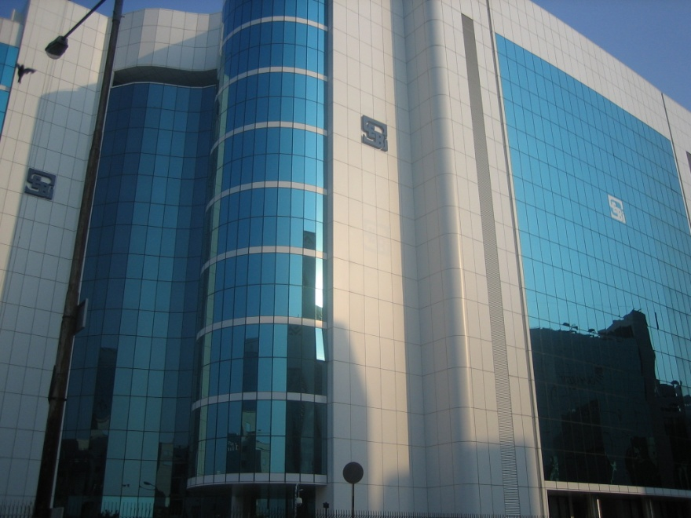
By: SAYANTAN BASU

Slide 2
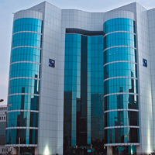

Contents
Establishment
Organization’s Structure
Objectives of SEBI
Functions of SEBI
Powers of SEBI
Various Departments & their functions
Current Board Members
SEBI & Central Government
Few Cases

Slide 3
Establishment
It was in the 1980s that India witnessed a phenomenal growth and development of the securities market. During the phase, India was entering into the period of liberalization and decontrol which was to accelerate and gather momentum in the 1990s.
In order to sustain the growth of the market and form the growing awareness and interest in investment opportunities.

Slide 4
Establishment
The regulatory function should have a Sharp objective of fostering fair competition and correcting market deficiencies and irregularities with a view to bringing about health growth of the sector and the protection of participants.
It autonomous and fragmentation of regulating agencies and laws should be avoided.
The practices of regulations as well as the organization of the regulatory body are much more so.

Slide 5
Establishment
On April 12, 1988 the Securities and Exchange Board of India (SEBI) was established by the Government of India through an executive resolution, and was subsequently upgraded as a fully autonomous body (a statutory Board) in the year 1992 with the passing of the Securities and Exchange Board of India Act (SEBI Act) on 30th January 1992.
INTRODUCTION
The introduction of the Securities and Exchange Board of India describes the basic functions of the Securities and Exchange Board of India as
“…..to protect the interests of investors in securities and to promote the development of, and to regulate the securities market and for matters connected therewith or incidental thereto”

Slide 6
Reason for the establishment of SEBI
6
The capital market had witnessed a tremendous growth during the 1980·s characterized by the increasing participation of the public.
This ever expanding investor population and market capitalization led to a variety of malpractices on the part of companies, brokers, merchant bankers, investment consultants and others involved in the securities market.

Slide 7
Organization’s Structure
Management of the Board
The Board shall consist of the following members, namely:-
  A Chairman
  Two members, One from amongst the officials of the Ministry of the Central Government dealing with Finance and second from administration of the Companies Act, 1956.
  One member from amongst the officials of the Reserve Bank of India.
  Five other members of whom at least three shall be the whole-time members to be appointed by the central Government .

Slide 8
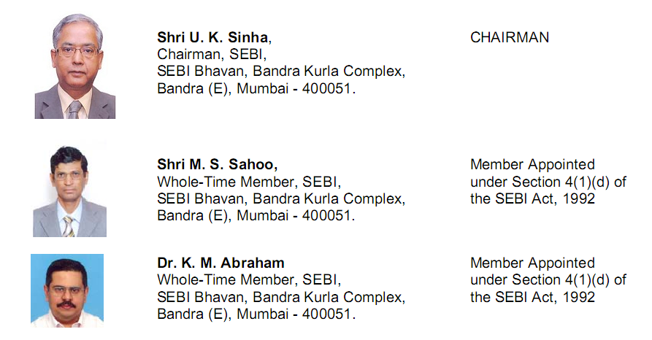
Current board members

Slide 9
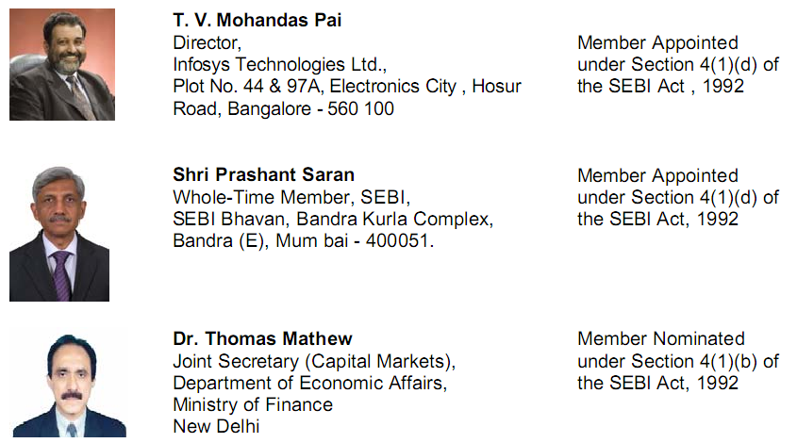
Current board members continue..

Slide 10
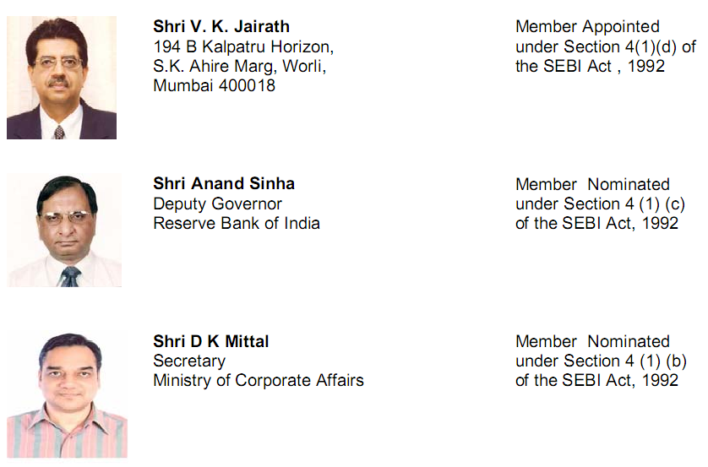
Current board members continue..

Slide 11
Objectives of SEBI
The primary objective of SEBI is to promote healthy and orderly growth of the securities market and secure investor protection. The objectives of SEBI are as follows:
To protect the interest of investors, so that, there is a steady flow of savings into the capital market.
To regulate the securities market and ensure fair practices.
To promote efficient services by brokers, merchant bankers, and other intermediaries, so that, they become competitive and professional.

Slide 12
Functions of SEBI
The SEBI Act, 1992 has entrusted with two functions, they are
  Regulatory functions And
  Developmental functions

Slide 13
Regulatory Functions
Regulation of stock exchange and self regulatory organizations.
Registration and regulation of stock brokers, sub-brokers, Registrars to all issues, merchant bankers, underwriters, portfolio managers etc.
Registration and regulation of the working of collective investment schemes including mutual funds.
Prohibition of fraudulent and unfair trade practices relating to securities market.
Prohibition of insider trading
Regulating substantial acquisition of shares and takeover of companies.

Slide 14
Developmental Functions
Promoting investor’s education
Training of intermediaries
Conducting research and publishing information useful to all market participants.
Promotion of fair practices
Promotion of self regulatory organizations

Slide 15
SEBI’S Universe
Stock exchanges | 23 | Depository participants | 377
Subsidiaries | 12 | Accounts (million) | 3.9
Broking terminals | 450 | Companies under compulsory demat | 3441
Stock brokers | 9658 | Portfolio managers | 46
Sub-brokers | 13195 | Bond trustees | 39
Listed companies | 10000 | Registrars and transfer agents | 126
Depositories | 2 | Bankers to issue | 81
Credit rating agencies | 4 | Foreign venture capital funds | 6
Domestic venture capital funds | 39 | Mutual funds | 39
Schemes | 417 | Foreign institutional investors | 488
Sub-accounts of FIIs | 1336

Slide 16
Job Entrusted to SEBI
SEBI shall create a proper and conductive atmosphere require for raising money from the capital market.
SEBI shall educate investors and make them aware of their rights in clear and specific terms.
SEBI shall create a proper investment climate and enable the corporate sector to raise industrial securities easily, efficiently and at affordable minimum cost.

Slide 17
Job Entrusted to SEBI
SEBI shall develop a proper infrastructure so that the market automatically facilitates expansion and growth of business to middlemen like brokers, jobbers, commercial banks, merchant bankers, mutual funds, etc.
SEBI shall make more effective the law in the existing status as far as they relate to the industrial securities, mutual finds, investments in units, LIC savings plan, Chit-fund companies and securities issued by housing/ industrial and corporations with the purpose of making investment in housing/ industrial projects.

Slide 18
Job Entrusted to SEBI
SEBI shall create the framework for more open, orderly and unprejudiced conduct in relation to takeovers and mergers in the corporate sector to ensure fair and equal treatment to all the security holders, and to facilitate such takeovers and mergers.

Slide 19
Powers of SEBI
Power to call periodical returns from recognized stock exchanges.
Power to compel listing of securities by public companies.
Power to levy fees or other charges for carrying out the purposes of regulation.
Power to call information or explanation from recognized stock exchanges or their members.
Power to grant approval to bye-laws of recognized stock exchanges.

Slide 20
Powers of SEBI continue..
Power to control and regulate stock exchanges.
Power to direct enquiries to be made in relation to affairs of stock exchanges or their members.
Power to make or amend bye-laws of recognized stock exchanges.
Power to grant registration to market intermediaries.
Power to declare applicability of Section 17 of the Securities Contract (Regulation) Act 1956, in any State or area, to grant licenses to dealers in securities.

Slide 21
Guidelines to Investors
Deal with a registered member of the stock exchange.
Insist that all your deals are done in the trading ring.
Give specific orders to buy or sell within the fixed price limits and/or time periods within which orders have to be executed.
Insist on contract notes to be passed on to you on the dates, when the orders are executed.

Slide 22
Guidelines to Investors
Make sure that your deal is registered with the stock exchange in a Trade book.
Collect a settlement table from the stock exchange mentioning the pay-in and pay-out days.
Keep separate records of dealings in specified shares and non-specified share.
Execute period settlements of dues and delivery of shares to avoid accumulation of transactions.

Slide 23
Guidelines to Investors
Insist on delivery.
Ensure that shares bought are transferred in your name before the company’s book closure date.
Complain if the broker does not deliver the shares bought in your name.
Do not sell shares that are not transferred in your name after the book closure as these are not valid in the market.

Slide 24
Guidelines to Investors
Do not sell/deal in shares where any one of the holders has passed away.
Do not expect the money for share to come immediately.
Unless you have a special arrangement with the broker, do not expect the adjustment of purchases and sales against one another.
You have to complain to the Grievance Cell of the stock exchange or the SEBI for any type of delay.

Slide 25
Legislative Protection to Investors
Complaints | Relief Provided
Delay in refund of excess application money or allotment letters | Payment of interest for the delayed period beyond 30 days from the closure of issue at 15%
Delay in transfer of shares | As per listing agreement, the time limit is only one month from the lodgement of shares.
Refusal to transfer shares | Transfer can be refused only for specified and valid reasons given in the act and not otherwise.
Problem of odd lots | Need for consolidation of odd lots and ensuring the issue of shares.

Slide 26
Legislative Protection to Investors
Complaints | Relief Provided
Takeover bids | Purchases or acquisition of shares beyond 5% to be notified to the stock exchange.
Insider trading | The investors have to guard themselves regarding the price and their investment.
Delay and non-payment of interest/ fixed deposits by companies | Complain to the company law board.
Delay and non-payment of dues or non-delivery of shares, etc. by brokers | Complain to the Grievance Cell of the concerned Stock Exchange and to SEBI

Slide 27
Limitations
Limited transparency
Lack of professionalism
Long and complex procedures
Lack of serious approach to investor’s needs
Weak legislation
Too mechanical procedures

Slide 28
Various departments under SEBI
S. No. | Name of Dept.
1. | MARKET INTERMEDIARIES REGULATION AND SUPERVISION DEPARTMENT (MIRSD)
2. | DERIVATIVES AND NEW PRODUCTS DEPARTMENT (DNPD)
3. | INVESTMENT MANAGEMENT DEPARTMENT (IMD)
4. | INVESTIGATIONS DEPARTMENT (IVD)
5. | LEGAL AFFAIRS DEPARTMENT (LAD)
6. | OFFICE OF INVESTOR ASSISTANCE & EDUCATION (OIAE)
7. | DEPARTMENT OF ECONOMIC & POLICY ANALYSIS (DEPA)
8. | INFORMATION TECHNOLOGY DEPARTMENT (ITD)

Slide 29
Various departments under SEBI continue…
S. No. | Name of Dept.
9. | MARKET REGULATION DEPARTMENT (MRD)
10. | CORPORATION FINANCE DEPARTMENT (CFD)
11. | INTEGRATED SURVEILLANCE DEPARTMENT (ISD)
12. | ENFORCEMENT OF DEPARTMENT (EFD)
13. | ENQUIRIES & ADJUDICATION DEPARTMENT (EAD)
14. | GENERAL SERVICES DEPARTMENT (GSD)
15. | OFFICE OF THE CHAIRMEN (OCH)
16. | THE REGIONAL OFFICES (RO’s)

Slide 30
SEBI
THANK YOU ……………..

