Slide 1
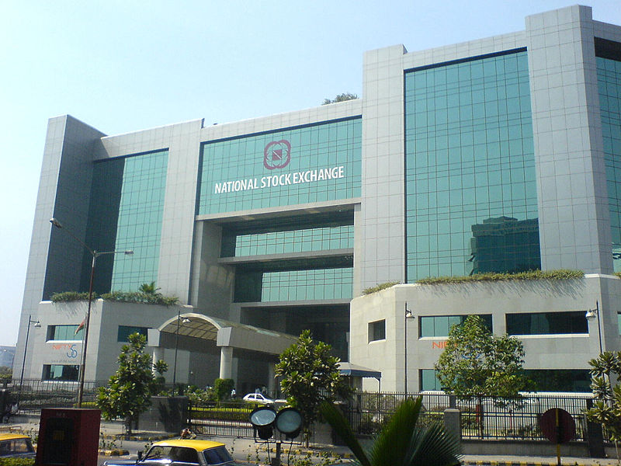

National Stock Exchange
By
CA. SAYANTAN BASU

Slide 2
What is NSE?
The National Stock Exchange (NSE) (Hindi: राष्ट्रीय शेअर बाज़ार Rashtriya Śhare Bāzaār) is a stock exchange located at Mumbai, India. It is the 9th largest stock exchange in the world by market capitalization and largest in India by daily turnover and number of trades, for both equities and derivative trading.

Slide 3
Origin of NSE
The National Stock Exchange of India was promoted by leading Financial institutions at the behest of the Government of India.
It was incorporated in November 1992 as a tax-paying company.
In April 1993, it was recognized as a stock exchange under the Securities Contracts (Regulation) Act, 1956

Slide 4
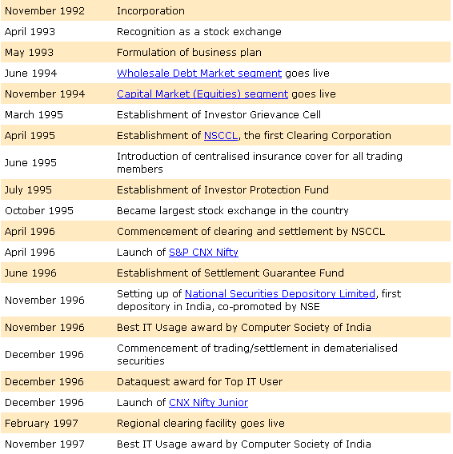
NSE Milestones

Slide 5
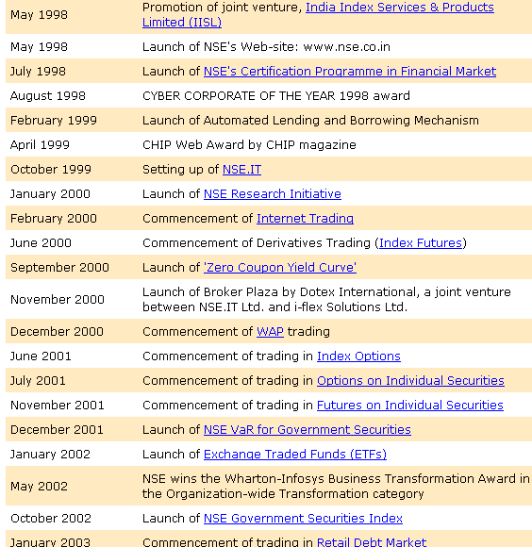
NSE milestones

Slide 6
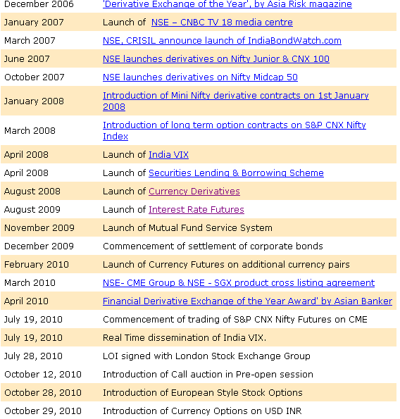
NSE milestones

Slide 7

Line of Business in NSE

Slide 8
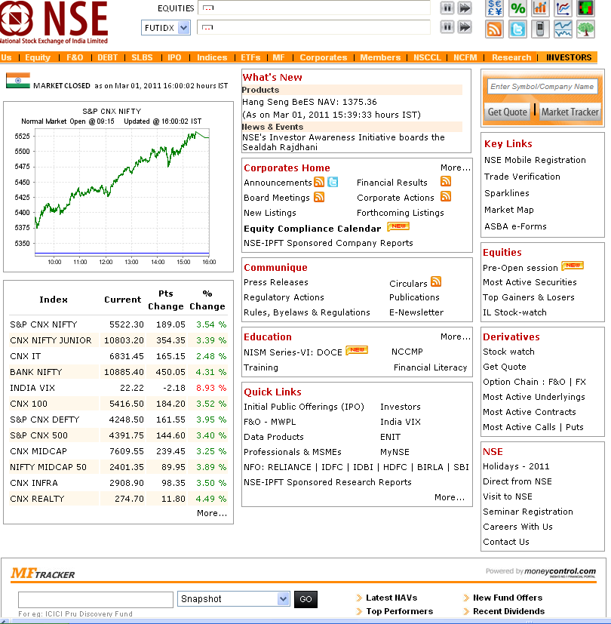
www.nseindia.com

Slide 9
NCFM – NSE’s Certification in Financial Markets
NSE also conducts online examination and awards certification, under its programmes of NSE's Certification in Financial Markets (NCFM). Currently, certifications are available in 19 modules, covering different sectors of financial and capital markets. Branches of the NSE are located throughout India.
Taking into account international experience and the needs of the Indian financial markets, National Stock Exchange introduced in 1998 a facility for testing and certification by launching NSE's Certification in Financial Markets (NCFM).
NCFM is an online testing and certification programme. It tests the practical knowledge and skills required to operate in the financial markets. Tests are conducted in a secure and unbiased manner and certificates awarded based on merit of the candidate to qualify the on-line test.

Slide 10
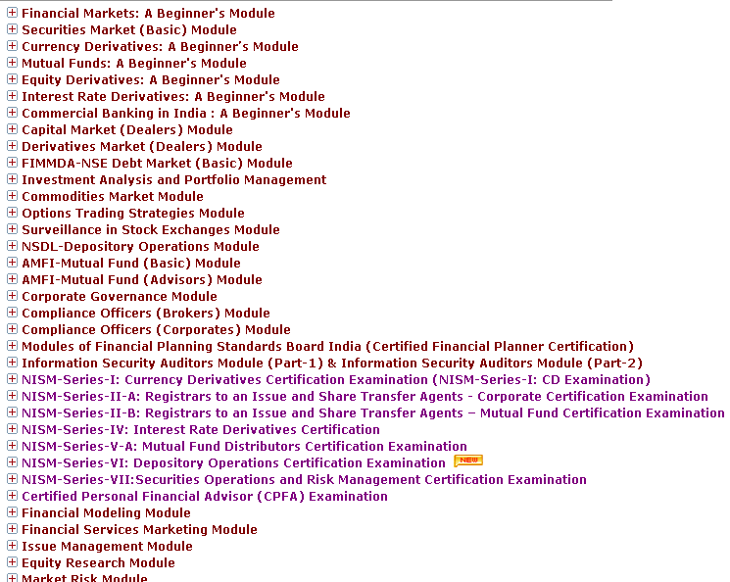
NCFM modules

Slide 11


