Slide 1
The Business of Investment banking
BY
CA
SAYANTAN BASU

Slide 2
History
Banks have been around since the first currencies were minted .
Coins could be stored more easily than other commodities.
These coins, however, needed to be kept in a safe place.
Ancient homes didn't have the benefit of a steel safe.
So most wealthy people held accounts at their temples.
Most temples were also the financial centers of their cities.
That is why they were ransacked during wars.
Gradually there emerged a class of wealthy merchants that took to lending these coins, with interest to people in need.
Temples generally handled large loans as well as loans to various sovereigns, and these new money lenders took up the rest.
The Romans took banking out of the temples and formalized it within distinct buildings.

Slide 3
Julius Caesar allowed bankers to confiscate land in lieu of loan payments.
This was a monumental shift of power in the relationship of creditor and debtors.
Landed noblemen were untouchable through most of history.
They passed debts off to descendants until either the creditor's or debtor's lineage died out.
The Roman Empire eventually crumbled, but some of its banking institutions lived on .
Eventually, the various monarchs that reigned over Europe noted the strengths of banking institutions.
Royal powers began to take loans to make up for hard times at the royal treasury - often on the king's terms.
This easy finance led kings into unnecessary extravagances, costly wars and an arms race with neighboring kingdoms that led to crushing debt.

Slide 4
Banking in USA
In the early years of the nation, the average life for an American bank was five years, after which most bank notes from the defaulted banks became worthless.
These state-chartered banks could only issue bank notes against gold and silver coins they had in reserve.
Alexander Hamilton, the Secretary of the Treasury, established a national bank that would accept member bank notes at par, thus floating banks through difficult times.
This national bank created a uniform national currency and set up a system by which national banks backed their notes by purchasing Treasury securities - thus creating a liquid market.
Through the imposition of taxes on the relatively lawless state banks, the national banks pushed out the competition.

Slide 5
The financial engines during the 18th and 19th centuries were European merchant banks, such as Hope & Co., Baring Brothers and Morgan Grenfell.
The merchant banking model then crossed the Atlantic and served as the inspiration for the financial firms founded by prominent families in the United States.
The structure and activities of early U.S. firms such as JP Morgan & Co. and Dillon Read and Drexel & Co. reflected those of their European counterparts.
These included financing new business opportunities through raising and deploying investment capital.

Slide 6
J.P. Morgan and Company emerged at the head of the merchant banks during the late 1800s.
It was connected directly to London, then the financial center of the world, and had considerable political clout in the United States.
Morgan played a key role in the creation of U.S. Steel, AT&T and International Harvester, and other monopolies through the revolutionary use of trusts and a disdain for the Sherman Anti trust Act.
Although the dawn of the 1900s had well-established merchant banks, it was difficult for the average American to get loans from them.
Racism was also widespread.
Even though the Jewish and Anglo-American bankers had to work together on large issues, their customers were split along clear class and race lines.
These banks left consumer loans to the lesser banks that were still failing at an alarming rate.

Slide 7
Meanwhile, early legislation, such as the 1863 National Bank Act, prohibited nationally chartered commercial banks from engaging in corporate securities activities such as underwriting and distributing of corporate bonds and equities.
In the l880s, private banks in the United States became closely involved in the financing of railroads and then, from the l890s, in the financing of the new industrial companies.
As the United States industrialized, the demand for corporate finance increased
The largest banks found ways around this restriction by establishing state-chartered affiliates to do the underwriting.
In 1927, the Comptroller of the Currency formally recognized such affiliates as legitimate banking activities.

Slide 8
Two Models
Over time, two somewhat distinct banking models evolved.
The old merchant banking model was largely a private affair conducted among the privileged members of the clubby world of old European wealth.
The merchant bank typically put up sizable amounts of its own (family-owned) capital along with that of other private interests that came into the deals as limited liability partners.
Over the 19th century, a new model came into popular use, particularly in the U.S.
Firms seeking to raise capital would issue securities to third-party investors, who would then have the ability to trade these securities in organized securities exchanges.
The role of the financial firm was that of underwriter - representing the issuer to the investing public, obtaining interest from investors and facilitating the details of the issuance.
Firms engaged in this business became known as investment banks.

Slide 9
The Panic of 1907
The collapse in shares of a copper trust set off a panic that had people rushing to pull their money out of banks and investments.
This caused shares to plummet.
In the absence of a central bank, the task of calming people fell on J.P. Morgan .
He tried to stop the panic by using his considerable clout to gather all the major players on Wall Street to maneuver the credit and capital they controlled.
But J.P. Morgan was disliked by much of America for being one of the robber barons along with Carnegie and Rockefeller.
The government decided to form the Federal Reserve Bank, in 1913.

Slide 10
Even with the establishment of the Federal Reserve, financial power, and residual political power, was concentrated in Wall Street.
When the First World War broke out, America became a global lender.
World War II saved the banking industry from complete destruction.
For the banks and the Federal Reserve, the war required financial maneuvers using billions of dollars.
Companies were created with huge credit needs that in turn spurred banks into mergers to meet the new needs.
These huge banks spanned global markets.
Domestic banking in the United States finally reached a point where, with the advent of deposit insurance and mortgages, an individual had reasonable access to credit.
The US replaced London as the center of the financial world by the end of the war.

Slide 11
Glass Steagall and the rise of investment banking
By 1929, private banks and chartered commercial banks were combining commercial banking with the securities business.
Meanwhile, the government insisted that all debtor nations must pay back their war loans before any American institution would extend them further credit.
This slowed down world trade and caused many countries to become hostile toward American goods.
When the stock market crashed on Black Tuesday in 1929, the already sluggish world economy was knocked out.
The Federal Reserve couldn't contain the crash.
After the crash, the United States entered a major recession, and approximately 10,000 banks failed between 1930 and 1933.
The U.S. government realised that financial markets needed to be more closely regulated in order to protect the financial interests of the common man.

Slide 12
This resulted in the separation of investment banking from commercial banking through the 1933 Glass Steagall Act.
A clear line was drawn between being a bank and being an investor.
Banks could no longer speculate with deposits.
Commercial banks were required to divest themselves of existing securities operations.
Private banks wishing to engage in securities business (to be investment banks) were to divest themselves of their commercial banking affiliates.
FDIC (Deposit insurance) regulations were enacted to convince the public it was safe to come back.
The firms on the investment banking side of this separation - such as Morgan Stanley, Goldman Sachs, Lehman Brothers and First Boston - went on to take a prominent role in the underwriting of corporate America during the postwar period.

Slide 13
IB continues to flourish
The separation of commercial banking from the securities business was not complete, however.
The Glass-Steagall restrictions applied only to corporate securities.
Subsidiaries of bank holding companies were always allowed to deal in Treasury securities and to underwrite municipal bonds.
Moreover, Glass-Steagall related only to publicly traded securities.
Banks were quite active in the private placement market.
Finally, the Glass-Steagall Act did not apply outside the US.
American commercial banks engaged in the securities business overseas and U.S. securities firms (investment banks) had overseas subsidiaries engaged in commercial banking.

Slide 14
Between 1963 and 1987, banks challenged restrictions on their municipal bond underwriting activities, commercial paper underwriting activities, discount brokerage activities, and advising activities, including open and closed end mutual funds, the underwriting of mortgage-backed securities, and selling annuities.
In most cases, the courts eventually permitted these activities for commercial banks.
With this onslaught, and the de facto erosion of the Glass- Steagall Act by legal interpretation, the Federal Reserve Board in April 1987 allowed commercial bank holding companies such as J.P. Morgan & Company to establish separate securities affiliates as investment banks.
In 1986, the Fed ruled that brokerage subsidiaries of bank holding companies could sell mutual funds.
Deregulation of underwriting services happened in 1989.
Banks could undertake debt underwriting provided they had capital and necessary management capabilities.
A ceiling was, however, imposed on debt underwriting.

Slide 15
Using affiliates
Through affiliates, commercial banks began to do commercial paper underwriting, mortgage-backed securities underwriting, and municipal revenue bond underwriting.
These affiliates did not violate the Glass-Steagall Act, since the revenue generated from securities underwriting activities amounted to less than 5 percent (increased later to 10 percent and then 25 percent) of the total revenues generated.
In 1995, the Supreme Court ruled that national banks could issue annuities.
Significant changes occurred in 1997 as the Federal Reserve and the Office of the Comptroller of the Currency (OCC) took actions to expand bank holding companies' permitted activities.
The Federal Reserve allowed commercial banks to acquire directly existing investment banks rather than establish completely new investment banking subsidiaries.

Slide 16
Mergers and acquisitions
In 1998, Citicorp – Travellers merger was allowed.
More mergers and acquisitions between commercial and investment banks took place between 1997 and 2000.
One motivation for these acquisitions was the desire to establish a presence in the securities business .
Another motivation was the opportunity to expand business lines, taking advantage of economies of scale and scope to reduce overall costs and merge the customer bases of the respective commercial and investment banks involved in the acquisition.

Slide 17
The Mega mergers
Chase Manhattan/Chemical, 1996 for $ 11.36 billion
Bankers Trust's April 1997 acquisition of Alex Brown for $1.7 billion.
Citicorp's $83 billion merger with Travelers Group (which owned Smith Barney and Salomon Brothers) in April 1998.
Bank America/Nations Bank, for $66.62 billion in 1998.
Deutsche Bank's $9.7 billion purchase of Banker's Trust in 1999.
UBS's $12.0 billion purchase of Paine Webber in 2000.
Credit Suisse First Boston's purchase of Donaldson Lufkin Jenrette for $11.5 billion in 2000.
JP Morgan/Chase for $33.5 billion in 2000

Slide 18
Financial Services Modernization Act
Finally, in 1999, the U.S. Congress passed the Financial Services Modernization Act (Gramm-Leach_Blilely), which removed the barriers between commercial banking and investment banking.
The bill, probably the biggest change in the regulation of financial institutions in nearly 70 years, allowed for the creation of a "financial services holding company" that could engage in banking activities and securities underwriting.
The Financial Services Modernization Act opened the door for the creation of full-service financial institutions in the United States similar to those that existed in the United States pre-1933 and that exist in many other countries today.

Slide 19
The act has created two new frameworks under which banks can engage in new types of financial activity or integrate with other types of financial company.
A "financial holding company" (FHC) can conduct new activities through a holding company affiliate of the bank regulated by the Federal Reserve Board.
A "financial subsidiary" permits new activities to be conducted through a subsidiary of the bank regulated by that bank's normal regulator.
For example, to engage in the securities business or in insurance, a bank can set up, or purchase, a securities firm or an insurance company.

Slide 20
An FHC may engage in any type of financial activity and even, in some circumstances, in non financial activities.
Explicitly permitted are securities activities, insurance, and equity investment in financial and non financial companies.
The FHC does not need to ask permission to do any of these things: it merely has to inform its regulator, the Fed, after the fact.
Financial subsidiaries of banks are more restricted.
They may not, for example, engage in underwriting insurance, in real estate development, or in equity investment.

Slide 21
Summing up
Four big structural changes have threatened to make earlier models of commercial banking obsolete:
First, the growth of the capital markets, gathering pace through the 1980s; this has led to disintermediation.
Second, the arrival over the same period of powerful new information technologies.
Third, the deregulation of interstate banking by the Riegle-Neal act of 1994.
This resulted in elimination of restrictions on interstate bank mergers
Commercial banks were allowed to open branches countrywide.
Fourth, the removal of barriers between banks, insurance companies and securities companies by the Gramm-Leach-Bliley act of 1999, allowing the formation of diversified financial groups.

Slide 22
As a result of the easing of regulatory barriers in the United States, beginning with the barriers to branching within states, there has been a considerable consolidation of the banking industry.
In the period 1991-1998, there were 5,686 mergers and acquisitions involving banks; the total value of these transactions was $589 billion.
Between 1980 and 1999 the number of commercial banks fell by over 40% from 14,406 to 8,505.
Since Riegle-Neal, multibank holding companies have been restructuring, consolidating 90% of their subsidiary banks into single-branch networks.
There was a wave of big mergers among American banks from the mid-1990s onward.
Only now (2006), after 30 years of structural change, during which the total number of bank holding companies and thrifts (or mortgage companies) has halved, has the pace of consolidation slowed.

Slide 23
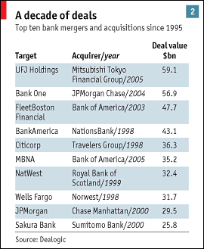
A decade of deals

Slide 24
Blurring lines
Each of the big banks at the top of the industry has its own distinctive mix of businesses;
All have moved away from the traditional banking strategy of holding assets on the balance sheet.
They securitise loans and sell them on in the capital markets, or syndicate them to other banks.
This is blurring the distinction between bank as lender and bank as trader.
.

Slide 25
Securitisation
Process by which individual assets that are difficult to trade on their own are aggregated into securities that can be traded in financial markets.
First the asset is created.
An investment bank sets up a trust.
The trust owns the assets being securitised.
Usually each trust is related to a single pool of assets.
The trust will purchase the pool of assets from the firm that created them
The trust will raise money by selling asset backed securities.
The owners of the securities receive the income generated by the trust.
The diversity of assets underlying an asset backed security provides safety to investors.

Slide 26
Benefits of securitisation
Specialisation and focus.
Risk profile
Capital requirement
Trading and liquidity

Slide 27
Fixed income, currencies and commodities
For the five big Wall Street firms (Goldman Sachs, Morgan Stanley, Merrill Lynch, Lehman Brothers and Bear Stearns) taken together, FICC, fixed income, currencies and commodities. revenues have quadrupled since the start of this decade.
FICC encompasses a range of assets, from American subprime mortgages to Japanese yen, copper futures to catastrophe insurance, General Motors bonds to Zambian debt. S
Some of the fastest growth has been in tried-and-tested asset-backed securities such as commercial and residential mortgages, which have soared since 2000 whereas straight company debt issuance has stagnated .
But the most profitable area has been the growth of derivative and structured credit products, such as CDOs.

Slide 28
These have enabled banks to separate credit risk from interest rates and trade that risk among those who want to hold it and those who don't.
This process has freed credit risk from the underlying bonds, leading to an explosion of secondary-market activity.
The cornerstone of the new market is the CDS, a form of insurance contract linked to underlying debt that protects the buyer in case of default.
The market has almost doubled in size every year for the past five years, reaching $20 trillion in notional amounts outstanding in June 2006.
That makes it far bigger than the underlying debt markets.

Slide 29
Investment bankers have found ways of bundling indexes of CDSs together and slicing them into tranches, based on riskiness and return.
The most toxic tranche lies at the bottom where risks and returns are high.
At the top, the risks and returns are much smaller—unless there is a systemic failure.

Slide 30
The rise of CDOs
CDOs grew out of the market for asset-backed securities which took off in the 1970s and encompassed mortgages, credit-card receivables, car loans and even recording royalties.
The structured CDO is a more complex variation, bundling bonds, loans and CDSs into securities that are sold in tranches.
According to the Bond Market Association, $489 billion-worth of CDOs were issued in 2006, twice the level in 2005.
One-third were based on high-yield loans and are known as collateralised loan obligations (CLOs).
The rest involved mortgage-backed securities, CDSs and even other CDOs

Slide 31
Understanding CDOs
CDO is an investment-grade security backed by a pool of bonds, loans and other assets.
CDOs do not specialize in one type of debt but are often non-mortgage loans or bonds.
CDOs represent different types of debt and credit risk.
These different types of debt are often referred to as 'tranches' or 'slices'.
Each slice has a different maturity and risk associated with it.
The higher the risk, the more the CDO pays.
CDOs are similar in structure to a collateralized mortgage obligation (CMO) or collateralized bond obligation (CBO),
A CDO may be called a collateralized loan obligation (CLO) or collateralized bond obligation (CBO) if it holds only loans or bonds respectively.

Slide 32
Multiple tranches of securities are issued by the CDO, offering investors various maturity and credit risk characteristics.
Tranches are categorized as senior, mezzanine, and subordinated/equity, according to their degree of credit risk.
If there are defaults or the CDO's collateral otherwise underperforms, scheduled payments to senior tranches take precedence over those of mezzanine tranches, and scheduled payments to mezzanine tranches take precedence over those to subordinated/equity tranches.
Senior and mezzanine tranches are typically rated by agencies.
The ratings reflect both the credit quality of underlying collateral as well as how much protection a given tranch is afforded by the subordinate tranches.
A CDO has a sponsoring organization, which establishes a special purpose vehicle to hold collateral and issue securities. Sponsors can include banks, other financial institutions or investment managers.
Expenses associated with running the special purpose vehicle are subtracted from cash flows to investors.
Often, the sponsoring organization retains the most subordinate equity tranch of a CDO.

Slide 33
New structured products
Investment bankers are offering structured products, in various ways for their clients to manage risks.
Some are working on risk-transfer instruments that deal with weather, freight, emissions, mortality and longevity.
The most immediate opportunities, though, may be in asset classes—such as property derivatives—that have already proven successful in America but are still emerging in Europe and barely exist in developing countries.

Slide 34
Basle 2 and CDOs
Demand for CDOs was probably stimulated by the approaching implementation of the Basel 2 capital accord, which encourages banks to swap risky loans on their books for CDO tranches to avoid high capital charges.
Banks have been increasingly willing to sell loans into the capital markets in order to diversify their portfolios.
Some 78% of senior secured loans in America have now been sold in this way, compared with 29% in 1995.
In Europe 53% are now securitised, up from 12% in 1999, still leaving considerable room for expansion.

Slide 35
Collateralised Mortgage Obligation:
A type of mortgage-backed security that creates separate pools of pass-through rates for different classes of bondholders with varying maturities, called tranches.
The repayments from the pool of pass-through securities are used to retire the bonds in the order specified by the bonds' prospectus.
Here is an example how a very simple CMO works.
The investors in the CMO are divided up into three classes : A, B, C.
Each class differs in the order they receive principal payments, but receives interest payments as long as it is not completely paid off.
Class A investors are paid out first with prepayments and repayments until they are paid off.
Then class B investors are paid off, followed by class C investors.
Class A investors bear most of the prepayment risk, while class C investors bear the least.
CMOs have traditionally offered low returns because they are very low risk and are sometimes backed by government securities.

Slide 36
Asset backed commercial paper
A short-term investment vehicle with a maturity that is typically between 90 and 180 days.
The security itself is typically issued by a bank or other financial institution.
The notes are backed by physical assets such as trade receivables, and are generally used for short-term financing needs.
A company or group of companies looking for liquidity may sell receivables to a bank or other conduit, which, in turn, will issue them to its investors as commercial paper.
The commercial paper is backed by the expected cash inflows from the receivables.
As the receivables are collected, the originators are expected to pass the funds to the bank or conduit, which then passes these funds on to the note holders.

Slide 37
Risk and capital
The biggest Investment banks have been investing hundreds of millions of dollars a year in technologies to measure risk and stress-test it.
Regulators who scrutinise the banks' risk-weighted capital seemed happy till a few months back ( early 2007).
But it is becoming clear that capital is only one line of defence.
The banks' ability to cope with liquidity crises and credit crunches is harder to gauge.
Taking risks and managing them is an investment bank's core business.
But new risks are almost invariably taken before there is a good way to measure them.
Ultimately, business and credit cycles tend to reveal which risks are excessive.
We are certainly seeing this today.

Slide 38
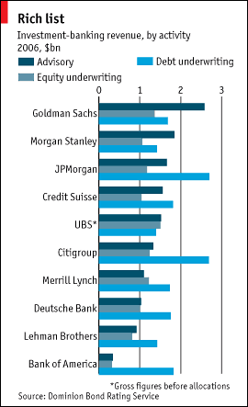
Investment banking revenue by activity

Slide 39
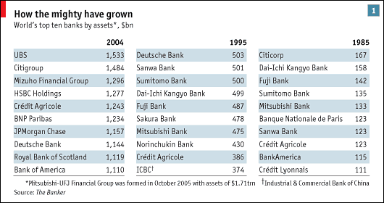
The top investment banks by assets

Slide 40
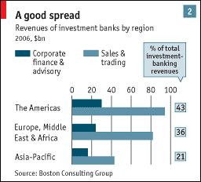
Revenues of investment banks by region

Slide 41
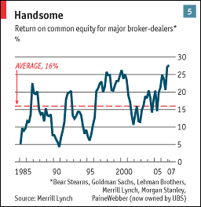
Return on equity

Slide 42
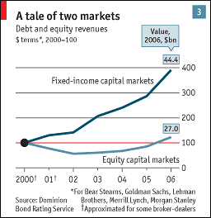
Debt and equity markets

Slide 43
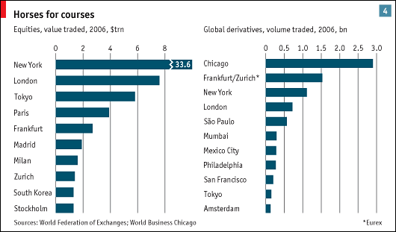
Major financial centres

Slide 44
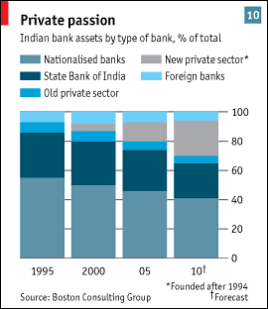
The Indian scenario

Slide 45
Investment banking activities
Underwriting
Acting as an intermediary between an issuer of securities and the investing public
Facilitating mergers and other corporate reorganizations
Broker for institutional clients.

Slide 46
What is merchant banking?
The term "merchant bank" came back into vogue in the late 1970s with the nascent private equity business of firms like Kohlberg, Kravis & Roberts (KKR).
Merchant banking in its modern context refers to using one's own equity (often accompanied by external debt financing) in a private transaction, as opposed to underwriting a public issue.

Slide 47
Bulge bracket Investment banks
The group of firms in an underwriting syndicate who sold the largest amount of the issue.
Tombstone is a written advertisement placed by investment bankers in a public offering of a security.
It gives basic details about the issue and, in order of importance, the underwriting groups involved in the deal.
This advertisement gets its name from its black border and heavy black print.
The tombstone provides investors with basic information, usually directing prospective investors to where they can find a red herring/prospectus.
In practice, the tombstone is sometimes made after the issue has been sold.
The bulge bracket is usually the first group listed on the tombstone.

Slide 48
Gun jumping
The illegal practice of soliciting orders to buy a new issue before registration of the initial public offering (IPO) has been approved by the Securities and Exchange Commission (SEC).
Trading securities on the basis of information that has not yet been disclosed to the public.
The theory behind gun jumping is that investors should make decisions based on the full disclosure in the prospectus, not on the information disseminated by the company that has not been approved by the SEC.
If a company is found guilty of "jumping the gun", the IPO will be delayed.

Slide 49
Prospectus
A formal legal document, which is required by and filed with the Securities and Exchange Commission, that provides details about an investment offering for sale to the public.
A prospectus should contain the facts that an investor needs to make an informed investment decision.
Also known as an "offer document".
There are two types of prospectuses for stocks and bonds: preliminary and final.
The preliminary prospectus is the first offering document provided by a securities issuer and includes most of the details of the business and transaction in question.
Some lettering on the front cover is printed in red, which results in the use of the nickname "red herring" for this document.
A passage in red states the company is not attempting to sell its shares before the registration is approved by the SEC.
There is no price or issue size stated in the red herring.

Slide 50
The Red Herring is sometimes updated several times before being called the final prospectus.
The final prospectus is printed after the deal has been made effective and can be offered for sale, and supersedes the preliminary prospectus.
It contains such details as the exact number of shares/certificates issued and the precise offering price.
In the case of mutual funds, which, apart from their initial share offering, continuously offer shares for sale to the public, the prospectus used is a final prospectus.
A fund prospectus contains details on its objectives, investment strategies, risks, performance, distribution policy, fees and expenses, and fund management.

Slide 51
Underwriting
The process by which investment bankers raise investment capital from investors on behalf of corporations and governments that are issuing securities (both equity and debt).
The word "underwriter" came from the practice of having each risk-taker write his or her name under the total amount of risk that he or she was willing to accept at a specified premium.
In a way, this is still true today.
New issues are usually brought to market by an underwriting syndicate in which each firm takes the responsibility (and risk) of selling its specific allotment.

Slide 52
Greenshoe
A provision contained in an underwriting agreement that gives the underwriter the right to sell investors more shares than originally planned by the issuer.
Legally referred to as an over-allotment option.
Greenshoe options typically allow underwriters to sell up to 15% more shares than the original number set by the issuer, if demand conditions warrant such action.
The Green Shoe Company was the first to issue this type of option.

Slide 53
IPO Lock up
A contractual caveat referring to a period of time after a company has initially gone public, usually between 90 to 180 days.
During these initial days of trading, company insiders or those holding majority stakes in the company cannot sell any of their shares.
An IPO lock-up is also done so that the market is not flooded with too much supply of a company's stock too quickly.
A single large shareholder trying to unload all of his holdings in the first week of trading could send the stock downward, to the detriment of all shareholders.
Empirical evidence suggests that after the end of the lock-up period, stock prices experience a permanent drop of about 1-3%.

Slide 54
Book building
Book building is the process by which an underwriter attempts to determine at what price to offer an IPO based on demand from institutional investors.
An underwriter "builds a book" by accepting orders from fund managers indicating the number of shares they desire and the price they are willing to pay.
Book runner is the managing or lead underwriter who maintains the books of securities sold for a new issue.
In other words, this person is the underwriter who "runs" the books.
Often the book runner is given credit for the total size of the deal.

Slide 55
Buy and sell side
The investment banks represent the "sell side" (as they are mainly in the business of selling securities to investors), while mutual funds, advisors and others make up the "buy side".

Slide 56
End of Presentation

