Slide 1
Indian Stock Exchanges and how their indices are calculated
by:
CA. SAYANTAN BASU

Slide 2
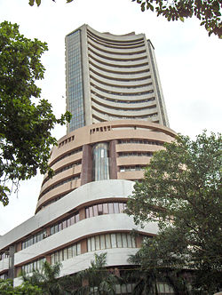
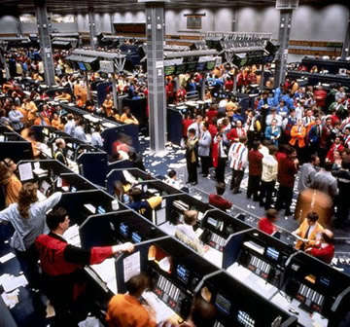
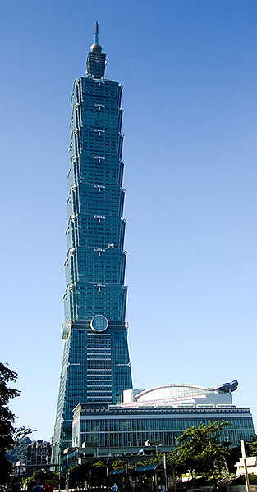
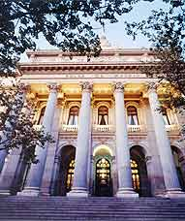
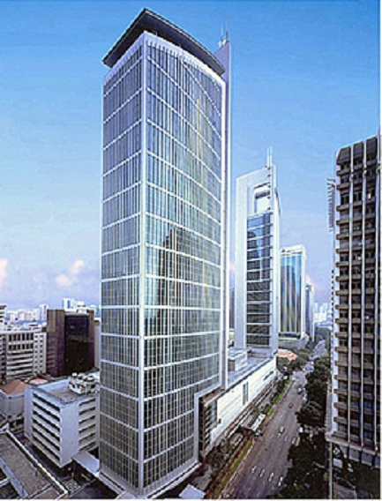
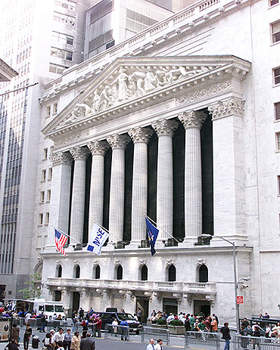


What is a Stock Exchange?
Stock exchange is that place where trading of shares is done in terms of sale and purchase.

Slide 3
Indian Stock Exchanges and their Indices

Slide 4
BSE: The Bombay Stock Exchange
There are 23 stock exchanges in the India. Mumbai's (earlier known as Bombay), Bombay Stock Exchange is the largest, with over 6,000 stocks listed. The BSE accounts for over two thirds of the total trading volume in the country. Established in 1875, the exchange is also the oldest in Asia. Among the twenty-two Stock Exchanges recognized by the Government of India under the Securities Contracts (Regulation) Act, 1956, it was the first one to be recognized and it is the only one that had the privilege of getting permanent recognition ab-initio.
Notes:
A stock exchange, (formerly a securities exchange) is a corporation or mutual organization which provides "trading" facilities for stock brokers and traders, to trade stocks and other securities. Stock exchanges also provide facilities for the issue and redemption of securities as well as other financial instruments and capital events including the payment of income and dividends.

Slide 5
Scrip’s at BSE
ACC
AIRTEL
BHEL
DLF
GRASIM
GUJRAT AMBUJA
HDFC
HDFC BANK
HINDALCO
HUL
ICICI BANK
INFOSYS
SUN Pharma IND. LTD
ITC
L&T
MARUTI
MAHINDRA & MAHINDRA
NTPC
ONGC
RANBAXY
RELIANCE COMMUNICATION
RELIANCE INFRASTRUCTURE
RIL
STERLITE INDUSTIES LTD
SBI
TCS
TATA MOTERS
TATA STEEL
TATA POWER COMPANY LTD
WIPRO

Slide 6
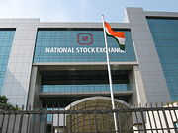
NSE: National Stock Exchange
The National Stock Exchange (NSE), located in Bombay, is India's first debt market. It was set up in 1993 to encourage stock exchange reform through system modernization and competition. It opened for trading in mid-1994. It was recently accorded recognition as a stock exchange by the Department of Company Affairs. The instruments traded are, treasury bills, government security and bonds issued by public sector companies

Slide 7
Indices: SENSEX & NIFTY
Stock Market performance is quantified by calculating an index using the benchmark scrip’s and as known to all SENSEX (Sensitive Index) is associated with Bombay Stock Exchange and S&P CNX NIFTY is associated with National Stock Exchange

Slide 8
HOW ARE INDICES OF SENSEX AND NIFTY CALCULATED???

Slide 9
How are the SENSEX 30 Stocks are selected?
Listing History
Trading Frequency
Rank based on the Market Cap (Should be Among top 100)
Market Capitalization weight
Industry / sector they belong
Historical Record
Notes:
SENSEX - Scrip Selection Criteria
The general guidelines for selection of constituents in SENSEX are as follows:
Listed History:The scrip should have a listing history of at least 3 months at BSE. Exception may be considered if full market capitalization of a newly listed company ranks among top 10 in the list of BSE universe. In case, a company is listed on account of merger/ demerger/ amalgamation, minimum listing history would not be required.
Trading Frequency:The scrip should have been traded on each and every trading day in the last three months at BSE. Exceptions can be made for extreme reasons like scrip suspension etc.
Final Rank:The scrip should figure in the top 100 companies listed by final rank. The final rank is arrived at by assigning 75% weightage to the rank on the basis of three-month average full market capitalization and 25% weightage to the liquidity rank based on three-month average daily turnover & three-month average impact cost.
Market Capitalization Weightage:The weightage of each scrip in SENSEX based on three-month average free-float market capitalization should be at least 0.5% of the Index.
Industry/Sector Representation:Scrip selection would generally take into account a balanced representation of the listed companies in the universe of BSE.
Track Record:In the opinion of the BSE Index Committee, the company should have an acceptable track record.

Slide 10
SENSEX
SENSEX has been calculated since 1986 and initially it was calculated based on the Total Market Capitalization methodology and the methodology was changed in 2003 to Free Float Market Capitalization.
Hence, these days, the SENSEX is based on the Free Floating Market cap of 30 SENSEX Stocks traded on the BSE relative to the base value which is 100(1978-79) and it is calculated for every 15 seconds.

Slide 11
Free Float Market Capitalization??
The value of all the shares available for public trading excluding the promoter equity, holdings through FDI Route, Holdings by private corporate, and holdings by Employee Welfare Funds.

Slide 12
Why Free Flow Market Cap?
It depicts the market more rationally
It removes undue influence of government or promoter share holding, there by giving the equal opportunity for companies to be in the SENSEX
Almost all the Indices world over are calculated by this methodology
It gives Fund managers more authentic information for benchmark comparisons.

Slide 13
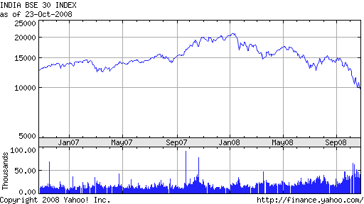
SENSEX Calculation Methodology

Slide 14
SENSEX is calculated using the "Free-float Market Capitalization" methodology, wherein, the level of index at any point of time reflects the free-float market
It reflects value of 30 component stocks relative to a base period.
The market capitalization of a company is determined by multiplying the price of its stock by the number of shares issued by the company.
This market capitalization is further multiplied by the free-float factor to determine the free-float market capitalization.

Slide 15
The base period of SENSEX is 1978-79 and the base value is 100 index points. ( notation 1978-79=100).
The calculation of SENSEX involves dividing the free-float market capitalization of 30 companies in the Index by a number called the Index Divisor.
The Divisor is the only link to the original base period value of the SENSEX. It keeps the Index comparable over time and is the adjustment point for all Index adjustments arising out of corporate actions, replacement of scrip’s etc.
During market hours, prices of the index scrip's, at which latest trades are executed, are used by the trading system to calculate SENSEX every 15 seconds. The value of SENSEX is disseminated in real time.

Slide 16
How SENSEX is calculated?
The formula for calculating the SENSEX = (Sum of free flow market cap of 30 benchmark stocks)*Index Factor
where,
Index Factor = 100/Market Cap Value in 1978-79.
100 is the Index value during 1978-79.

Slide 17
Example:
Assume SENSEX has only 2 stocks namely SBI and RELIANCE. Total shares in SBI are 500 out of which 200 are held by Government and only 300 are available for public trading. RELIANCE has 1000 shares out of which 500 are held by promoters and 500 are available for trading. Assume price of SBI Stock is Rs.100 and Reliance is Rs.200. Then "free-Floating Market Cap" of these 2 companies =

Slide 18
(300*100+500*200) = 30000+100000 = Rs. 130000
Assume Market Cap during the year 1978-79 was Rs.25000
Then SENSEX = 130000*100/25000 = 520.
The methodology in the example is exactly followed to calculate the SENSEX, only difference being the inclusion of 30 stocks.

Slide 19
Index Closure Algorithm
The closing SENSEX on any trading day is computed taking the weighted average of all the trades on SENSEX constituents in the last 30 minutes of trading session.
If a SENSEX constituent has not traded in the last 30 minutes, the last traded price is taken for computation of the Index closure.
If a SENSEX constituent has not traded at all in a day, then its last day's closing price is taken for computation of Index closure.
The use of Index Closure Algorithm prevents any intentional manipulation of the closing index value.

Slide 20
NIFTY
The National Stock Exchange (NSE) is associated with NIFTY and it is also calculated by the same methodology but with two key differences.
1. Base year is 1995 and base value is 1000.
2. NIFTY is calculated based on 50 stocks.
Everything else remains the same in NIFTY Index calculation as well.

Slide 21
Benefits of Stock Exchanges to Community
1. It assist the economies development by providing a body of interested investors.
2. It uploads the position of superior enterprises and assist them in raising further funds.
3. It encourages capital formation
4. Government can undertake projects of national importance and social value raising funds through the sale of its securities on the stock exchange.
5. It is the stock exchanges that central bank of a country can control credit by undertaking open market operations (purchase and sale of securities)

Slide 22
Benefits to Investor
1. Liquidity of the investment is increased
2. The securities dealt on a stock exchange are good collateral security for loans.
3. The stock exchange safeguards interests of investors through strict enforcement of rules and regulations.
4. The present net worth of investments can be easily known by the daily quotations.
5. The risk is considerably less when investor holds or purchases listed securities.

Slide 23
Benefits to the company
A company whose shares quoted on stock exchange they enjoy better reputation and credit.
The market for the shares of such a company is naturally widened.
3. The market price of securities is likely to be higher in relation to its earnings, dividends and property values. This raises the bargaining power of the company in the event of a takeover, merger or amalgamation.

Slide 24
Adjustments for Bonus, Rights and Newly Issued Capital

Slide 25
Adjustment for Bonus, Rights and Newly Issued Capital
SENSEX calculation needs to be adjusted for issue of Bonus or Rights shares, If no adjustments are made, a discontinuity would arise between the current value of the index and its previous value despite the non-occurrence of any economic activity of substance
At the BSE Index Cell , the base value is adjusted, which is used to alter market capitalization of the component stocks to arrive at the SENSEX value.

Slide 26
Adjustments for Rights Issues
When a company, included in the compilation of the index, issues right shares, the free-float market capitalization of that company is increased by the number of additional shares issued based on the theoretical price.
An offsetting or proportionate adjustment is then made to the Base Market capitalization (see 'Base Market capitalization Adjustment' below).

Slide 27
Adjustments for Bonus Issue
When a company, included in the compilation of the index, issues bonus shares, the market capitalization of that company does not undergo any change. Therefore, there is no change in the Base Market capitalization, only the 'number of shares' in the formula is updated.
Other Issues
Base Market capitalization adjustment is required when new shares are issued by way of conversion of debentures, mergers, spin-offs etc. or when equity is reduced by way of buy-back of shares, corporate restructuring etc.

Slide 28
Base Market capitalization Adjustment
The formula for adjusting the Base Market capitalization is as follows:
To illustrate, suppose a company issues right shares which increases the market capitalization of the shares of that company by say, Rs.100 crores. The existing Base Market capitalization (Old Base Market capitalization), say, is Rs.2450 crores and the aggregate market capitalization of all the shares included in the index before the right issue is made is, say Rs.4781 crore
=
Old Base Mkt. cap. x
New Market capitalization
New Base Mkt. cap.
-------------------------------
Old Market capitalization

Slide 29
2450 x (4781+100)
-------------------------- =Rs.2501.24crores
4781
This figure of Rs. 2501.24 crore will be used as the Base Market capitalization for calculating the index number from then onwards till the next base change becomes necessary.

Slide 30

THANK YOU

