Slide 1
WELCOME
TO KURNOOL ITT CENTRE

Slide 2
GOOD MORNING
TO EVERY BODY

Slide 3
STOCK EXCHANGE
STOCK EXCHANGE
DEFINITION
FEATURES
SENSEX
NIFTY
REASONS FOR UPS AND DOWNS
INVESTOR VS. SPECULATORS
TYPES OF SPECULATORS

Slide 4
STOCK EXCHANGE
IT IS A MARKET FOR SECOND HAND SECURITIES
ACCORDING TO SECURITIES CONTRACTS REGULATION ACT 1956,DEFINEDA “STOCK EXCHANGE AS AN ASSOCIATION OR BODY OF INDIVIDUALS WHETHER INCORPORATED OR NOT ESTABLISHED OR NOT ESTABLISHED FOR PURPOUSE OF ASSISTING REGULATING AND CONTROLLING BUSINESS IN BUYING SELLING AND DEALING IN SECURITIES”

Slide 5


Slide 6
FUNCTIONS OF STOCK EXCHANGE
PROVIDES REGULAR AND CONTINOUS MARKET
FACILITATES REGULAR VALUATION OF SHARES
ECONOMIC BAROMETER
ENCOURAGES CAPITAL FORMATON
ENSURES SAFETY OF FUNDS
FACILITATES DISTRIBUTION OF NEW SHARES

Slide 7
SENSEX
SENSEX MEANS SENSITIVE INDEX OF BOMBAY STOCK EXCHANGE
IT REPRESENTS CHANGES IN THE VALUES OF30 STOCKS CONSTITUTING THE INDEX WITH BASE YEAR 1978-79 WITH BASE VALUE 100

Slide 8
NIFTY
IT IS THE INDEX OF NATIONAL STOCK EXCHANGE
IT IS MADE UP OF 50STOCKS
BASE YEAR IS 1995-96
BASE VALUE WAS 1000

Slide 10
REASONS FOR CHANGES IN INDICES
PROSPECTIVE RETURN IN FUTURE THAN ANTICIPATED
PESSIMISTIC RETURN IN FUTURE
NEWS ABOUT COMPANY (PRODUCT LAUNCH CLOSURE)
NEWS ABOUT COUNTRY(BUDGET)
CHANGES IN ECONOMIES OF OTHER COUNTRIES DUE TO LPG POLICY ADAPTION

Slide 11
PURCHASERS AND SELLERS IN A STOCK EXCHANGE ARE CLASSIFIED AS INVESTORS AND SPECULATORS

Slide 12
INVESTOR
they buy securities in order to earn a fair return
They hold securities permanently
they are interested in
safety of capital
constant yield

Slide 13
speculator
THEY DEAL IN SECURITIES IN ORDER TO EARN PROFITS OUT OF PRICE DIFFERENTIALS
THEY DO NOT EVEN TAKE DELIVERY OF SECURITIES
THEY PAY OR RECEIVE ONLY PRICE DIFFERENTIALS

Slide 14
INVESTOR VS SPECULATOR
INVESTOR
SPECULATOR
LONG TERM
STABLE INCOME
LOW RISK
AIM FOR CAPITAL APPRECIATION AND DIVIDEND
SHORT TERM
VARIATION IN INCOMES
HIGH RISK
HOPES FOR PRICE CHANGES

Slide 15
TYPES OF SPECULATORS
THEY ARE NAMED AFTER ANIMALS AS THEY BEHAVE LIKE WILD ANIMALS
BEAR
BULL
LAME DUCK
STAG

Slide 16
BULL
HE EXPECTS RUSE IN PRICES
ALSO CALLED OPTIMIST OR TEJIWALA
HE PURCHASES SHARES WITH A VIEW TO SELL THEM IN FUTURE AT HIGHER PRICES
THE DIFFERENCE WILL BE HIS GAIN

Slide 17
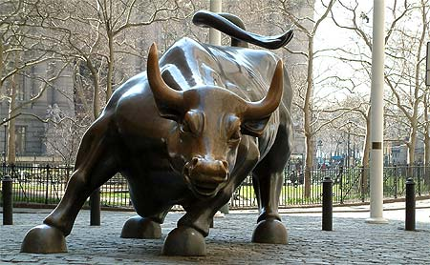

Slide 18
BEAR
HE EXPECTS FALL IN PRICES
ALSO CALLED MANDIWALA OR PESSIMIST
HE SELLS SHARES WHICH HE DOES NOT POSSESS
TO PURCHASE THEM IN FUTURE AT LOWER PRICES

Slide 19
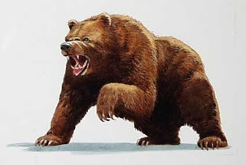

Slide 20
STAG
HE IS A CAUTIOUS SPECULATOR
CONCENTRATES ON PRIMARY MARKET
HE APPLIES FOR SHARES WHICH ARE ISSUED AT PREMIUM
HE BEHAVES IN A MANNER SIMILAR TO BULL

Slide 21
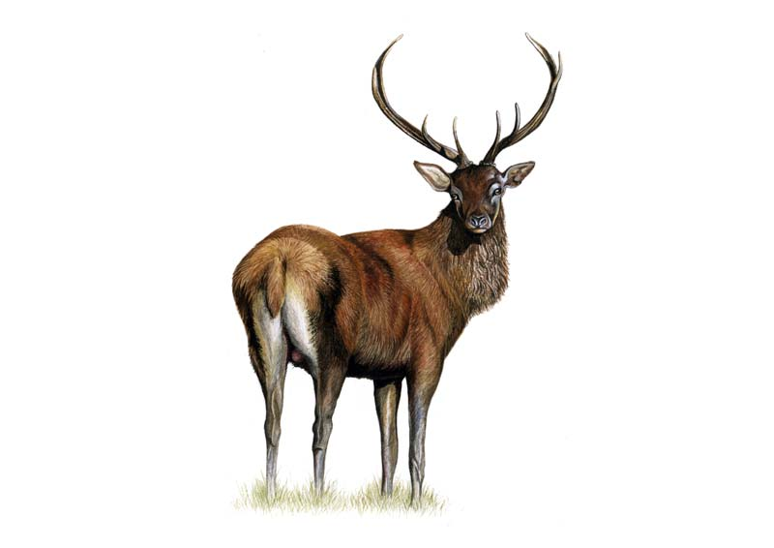

Slide 22
LAME DUCK
IF A BEAR FAILS TO FULFILL HIS COMMITMENTS HE IS CALLED LAME DUCK

Slide 23
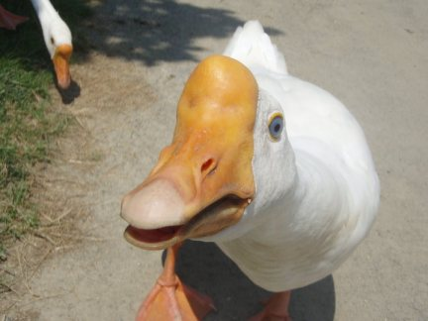

Slide 24
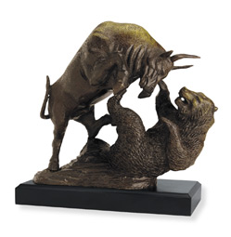

Slide 25
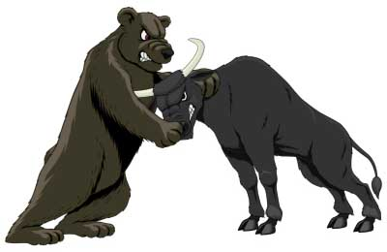

Slide 26
SHOULD A PERSON BE INVESTOR OR SPECULATOR
AS THE STOCK EXCHANGE REACTS TO EVERY SCENARIO
A SPECULATOR SHOULD ANALYSE EVERY SCENARIO AND REACT ACCORDINGLY
AN INVESTOR WILL BE INTERESTED IN COMPANY AND ITS PROSPECTUS

Slide 27
Thank you
a
Presentation by
manoj

