Slide 1
DERIVATIVES
INTRODUCTION

Slide 2
Derivatives
Financial Instruments which derive its value from an underlying asset.
Such contracts are created on the underlying asset.

Slide 3
Features of Derivatives
Derivatives
Contract
Derived Value
Exchange Traded/ OTC
Settlement by Delivery/ Price Difference
Carried off Balance Sheet

Slide 4
Types of Derivative Markets
Exchange Traded Markets
Over The Counter (OTC) Markets
  Trading between financial institutions who also act as market makers to provide double barreled quotes.
  Tailor made contracts which can be negotiated.
  Very large in size in comparison to exchange traded markets.

Slide 5
Types of Derivatives
Forwards
Agreement to sell/ buy an asset on a predetermined price on a specified date.
Generally settled by delivery and are entered into outside an exchange.
Options
Tradable at exchange and OTC Markets.
Option not obligation.
Futures
Standardised forward contracts traded on stock exchanges.
Settled by price difference and not by actual delivery.
Option have a cost.

Slide 6
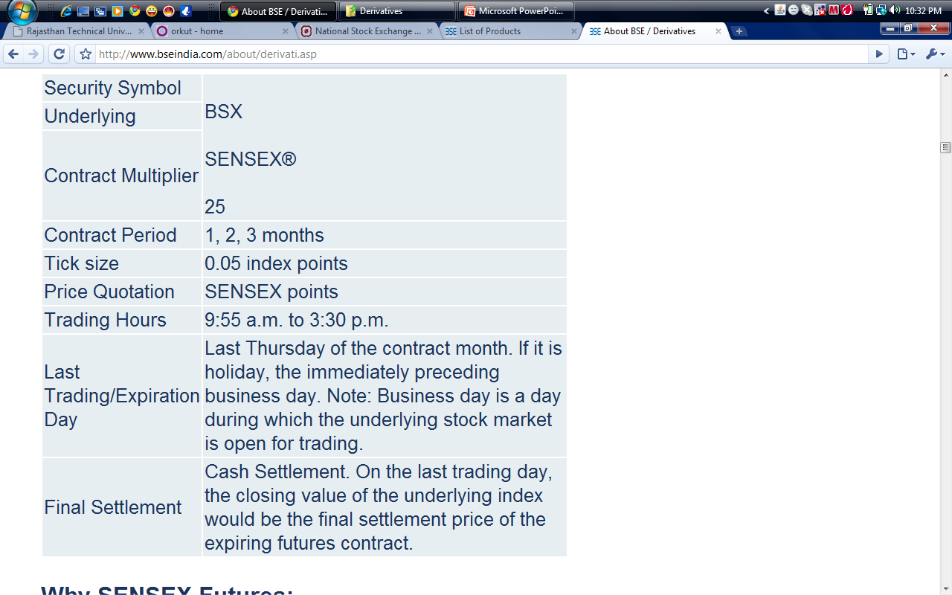
Contract Specifications

Slide 7
Some other types of derivatives
Warrants:
A coupon attached to senior securities such as bonds, which entitle the holder to acquire shares of a company at a specified price. These warrants can be detached and traded.
Convertibles:
A bond which is convertible into equity after a specified period.

Slide 8
Some other types of derivatives
Swaps:
Contract to exchange future cash flows.
For example to exchange swapping of interest flow from fixed interest rate bearing fund with flexible interest flow on same debt.

Slide 9
Uses of Derivatives
Risk Management.
Price Discovery.
Leveraging.
Smoothens out volatility.
Provides investment alternatives.

Slide 10
Criticism of Derivatives
Promotes speculation and gambling.
Increases risk with increase in leveraging and also the OTC trades. (Also, circuit limits removed in F & O Stocks)
Malpractices may destabilize financial system.
Displacement effect (investors may shift from primary market to derivative market thus leading to capital drought for small companies).
Increased regulatory burden.

Slide 11
Something more about options
Put and Call Option.
Strike Price – Price of option.
American Options/ European Options.
Option writing cost.

Slide 12
Simple Option Strategy
Spot Price of a share of L & T is Rs.650
Lot Size of L & T is 100 shares.
Following options are available for L&T:
Suppose after one month spot price of share of L&T is Rs.700 and an investor has a call option of Rs.450, he will buy at Rs.450 and sell at Rs.650, thereby earning profit of Rs.200 and after deducting Rs.150 as option charges, net profit earned is Rs.50.
Call Option | Put Option | Strike Price
Rs.150 | Rs.30 | Rs.450
Rs.90 | Rs.80 | Rs.680

Slide 13
Call Option – 450, Option Cost 150

Slide 14
Types of Traders
Hedgers.
Speculators.
Arbitrators.

Slide 15
Hedging Strategy through options
Buy 1000 shares of RIL @1200/= per share with an anticipation of price reaching to Rs.1,700. Pay brokerage of .3% thereon.
Total Cost = (1,000 X 1200) = 12,00,000
Add: Brokerage .3% of 17,00,000 = 3,600
Total Cost 12,03,600

Slide 16
Hedging Strategy through options
Buy a Put Option of 1000 RIL shares @ Rs.1,000 @ Rs.100.
Therefore, cost of option = Rs.1,00,000
Now the total cost = Rs.12,03,600 + Rs.1,00,000 = Rs.13,03,600.

Slide 17
Hedging Strategy through options
Outcome 1:
RIL spot price reaches Rs.1,700.
Sell the shares @ Rs.1,700
Do not exercise the option.
Total Profit = (17,00,000 – 13,03,600) = 3,96,400.

Slide 18
Hedging Strategy through options
Option 2:
RIL Spot Price reaches Rs.800.
Sell Spot and book loss of Rs.4,03600
Profit on exercise of Put [(1000 – 800) X 1000] – Rs.1,00,000. Profit = Rs.1,00,000
Therefore, a net loss of Rs.3,03,600.

Slide 19
Hedging Strategy through options
Scenerio 3
RIL price reaches to Rs.400.
Sell RIL @ Rs.400 and book loss of Rs.800. Total Loss (12,03,600 – 4,00,000) = 8,03,600
Gain on sale of Put (600*1000) – Rs.1,00,000 = Rs.5,00,000.
Thus, net loss = 8,03,600 – 5,00,000 = 3,03,600.

Slide 20
To hedge or not to hedge

Slide 21
Speculators
Hedgers avoid risks whereas speculators take positions for that risk for earning short term gains.
Loss of hedgers become gain for speculators and vice versa.
Gain or loss in case of futures can be unlimited.

Slide 22
Arbitrageurs
Aim to book riskless profits by trading in two different markets simultaneously.
For large trades only. As for small investors, transaction costs will wipe out the gains on arbitrage.

Slide 23
A new category
Spreaders:
Creating two separate positions, offsetting each other, to earn risk less profits.

Slide 24
Concept of Hedge Funds
Similar to mutual funds.
Accepts funds from sophisticated individuals and does not raise funds publicly.
Thus, these are least regulated and are not required to be registered under US Laws.
There are no restrictions on leverage positions or short positions, disclosures are not mandatory, flexible redemption strategy.
Thus, there is freedom to develop sophisticated, unconventional and proprietary investment strategies.
Fees charged is generally high and shares some profit along with fixed commission charges.

Slide 25
Strategy of a Fund Manager
Risk Identification
Evaluate the risks to which fund is exposed
Risk Assessment
Acceptable
Unacceptable
Hedge the Risks
Derive strategy to hedge unacceptable risks

Slide 26
Types of Hedge Funds
Convertible Arbitrage Funds (for making profits on difference between price of a share and the price of convertible bond)
Take long position in Convertible Bond and actively manage short position in underlying equity)
Distressed Securities Funds invest in securities of companies in bankruptcy or close to bankruptcy.
Emerging Markets Funds
Growth Stocks
Interest Rate Funds
Market Neutral: Buys overvalued stocks and sell undervalued stocks to neutralise the movement of market.

