Slide 1
Presentation Name :
Psychology of Trader & Short Term Investor about Share Market
Description :
This presentation provides you an insight to the Traders & Short term investors on share market.
Prepared By : Niranjan Modi
Email ID : niranjan.modi@marketmis.com
Prepared on : 25th July 2011

Slide 2
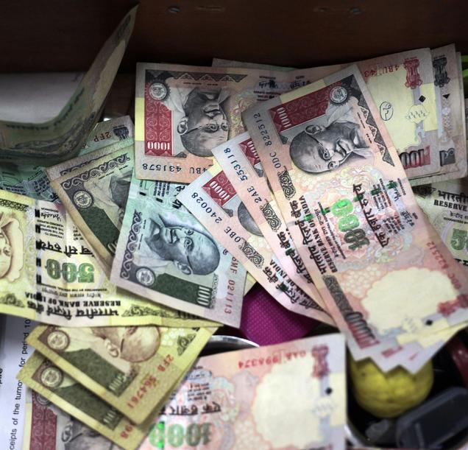
Two Motto of Trading in Stock Market . . .
Earn Money from dividend (by investing in fundamentally strong scrips)
Earn Profit in short period may be intraday.
What do you need to Earn from Stock Market . . .
Appropriate Know-how of Stock Market
Fund requirement for trading in Stock Market
Management of Fund
Appropriate Planning for investing in Stock Market
Scrip Selection
  Which script to select ?
  What is the good time to enter or exit from the script ?
  What is the Trend of the shortlisted Script ?

Slide 3

Do we have Knowledge on Stock Market ?
We all know how to Trade in Stock Market.
But, does anyone know how Stock Market Operates ?
We are aware of Open, High, Low & Close price.
But, does anyone know the Importance of this 4 Prices ?
Trader was reluctant to buy Reliance Industries @ 857.55 on 21st July 2011.
Then why there is still buying happening @ 877.00 on 22nd July 2011.
We are always aware the Up & Down positions of SENSEX & Index (BSE, Nifty, etc)
But does anyone know which stocks are driving Sensex up & down ?

Slide 4



Fund Management
Mr. A is new comer to Market. He has Rs.50,000/-.
Broker has allowed him limit of Rs.2,00,000/- for Intraday & Rs.1,00,000/- for short term trading.
He analysis scrip and choose to buy with Rs.25,000/- against his expectation price fall down, but he waited and exit with profit. He starts believing he understands market & then increase his risk appetite.
He started trading with Rs.50,000/-. He made profit and confidence was high.
He started then utilizing limit available to him to make MORE profit.
He LOST his Holding capacity, IMAGINE what went wrong ?

Slide 5
Here is what we think would have went wrong with Mr. A ?
There are 3 Key reasons behind the failure of Mr. A
Lack of appropriate planning.
Lack of knowledge on selection of scrips with how much risk appetite.
Lack of Decision taking power, due to lack awareness on stock market.

Slide 6

Planning
Planning → Selection of Scrips → Decision taking ability
works hand in hand. None of this can work independently.
We all know that appropriate planning helps us to
Avoid Mistakes &
Recognize Hidden Opportunities
In Stock Market you need to Plan Today for what you are going to take decision tomorrow.
Here Planning means :-
Scrips Selection in advance
Knowledge on Scrips & Market movement
Decision taking Power through Knowledge

Slide 7
Market MIS Offers to Stock Traders
Market MIS is pleased to offer a new Dimension to look @ Stock Market.
Get the knowledge of Stock Market both NSE & BSE.
Get the in depth know how of what’s happening on various Stocks.
In-depth know how will cover :
  Med Term Target Movement
  Short Term Target Movement
  Trend movement of Stocks
  Stocks impacting SENSEX & Index
Advices generated by the System on various Stocks & Strike rates of those advices.
Prepare yourself for what is going to happen tomorrow in Stock Market.

Slide 8
Market MIS Offers to CA Club Members
Market MIS has decided to give 50 Monthly activation Codes to those who registers with us.
This offer closes on 31st July 2011.
Steps to Register & Activate :-
Open the website http://www.marketmis.com
Register using New User Link.
Login using the Email ID & Password provided.
You will be able to see 7 days previous data for NSE & BSE.
With Activation code you will be able to see current Data.
For Activation code Send Email to niranjan.modi@marketmis.com with the same email id as registered.
We would be glad to here from you soon.

