Slide 1
Anti-Money Laundering
Business Requirements

Slide 2
Introduction:
  Anti Money Laundering system provides a means to prevent or report money laundering activities in the form of suspicious transactions by the clients
  A financial institution can monitor, investigate and report patterns of transactions of a suspicious nature
  A financial institution can perform due diligence which is required to ensure smooth and safe business
  A financial institution can also comply with various SEBI as well as Exchange specific rules and regulations
  TSS AML is a unique and comprehensive system which ranks Clients by assigning points based on multiple criteria
  The summary provides an easy means to get a "Big picture" of Clients who are found to violate multiple rules

Slide 3
Key features:
  Watch list from multiple sources - SEBI, BSE, UN Security Council (Al Queda and Taliban)
  Advanced scenarios based on the transactional data
  Comprehensive reports with details about suspicious transactions of Clients
  Reports based on Client's trades, Order Logs, Income, volume in Exchange, Illiquid scrips etc
  Risk Categorization of Clients allows you to highlight high risk Clients
  Track Clients classified in Special Categories like NRI, Trust, Charity, Politically Exposed, Non face-to-face clients, clients with dubious public reputation etc
  User friendly system that allows you to define your own weightings for different reports
  Suspicious transaction register allows you to save and track suspicious transactions as required by regulations of the exchange and SEBI, by maintaining comment log and status (Closed after investigation / Reported to Exchange) for each suspicious transaction

Slide 4
Benefits:
  Help financial institutions meet regulatory requirements
  Improve risk protection, streamline compliance operations, reduce costs
  Deliver better detection by combining behavioral profiling and rules management
  Improve efficiency through a configurable and robust workflow and alerts management system that allows compliance teams to process cases faster
  Application ranks Clients based on smart detection of potentially fraudulent transactions and trading patterns
  Big Picture summary provides quick view of most suspicious Clients
  Improve accuracy of alerts and focus on high-risk clients and events, rather than chasing all simple alerts based on one single criterion

Slide 5
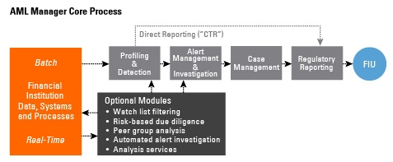
Architecture:

Slide 6
Thank You
Presentation Created by,
Ankur Shah
7738068279

