Slide 1

Option Dérivatives
Rajesh kr. Paul
International Institute For Learning In Management

Slide 2


Options
Features
Importance
Call option
Pay off diagram
Put option
Pay off diagram
Types of option
Option strategy
Option @ NSE
The Binomial pricing model
Today’s Topics
International Institute For Learning In Management

Slide 3

Options
A contract that gives a buyer a right not an obligation to buy or sell certain underlying assets after certain period of time at certain price.
Underlying assets can be stocks, indices, commodities etc.
All options are standardized in nature, as they are exchange traded.
Option can be exercised at the time of maturity( European option), or any time before maturity (American option).
Maximum loss a buyer can suffer is his premium amount with unlimited profit opportunity.
With unlimited loss probability seller only has limited profit (only premium amount) opportunity.
International Institute For Learning In Management

Slide 4
Features
No mandatory execution.
Standardized in nature.
Buyers buy the right of execution from seller.
Long position has limited risk with unlimited profit earning opportunity.
Short position has limited profit opportunity with unlimited risk of loss.
Seller or writers charges premium to buyer at the time of entering into a option contract.
International Institute For Learning In Management

Slide 5
Importance
Execution at the convenient of buyer.
Used to hedge risk.
To take advantage of price difference.
Used as instruments of speculation.
Opportunity of earning unlimited profit.
Its profitable in bull as well as bear market.
Buyer has limited loss if any.
International Institute For Learning In Management

Slide 6
Call option
A contract that gives a right not an obligation to buy the underlying at a certain price after certain period of time.
Buyer has unlimited profit potential if price rises above strike price.
The maximum loss, one buyer can suffer is the premium amount, if paid any.
Buyer has the right to buy, but seller has obligation to sell.
The buyer’s position is known as long position & seller’s position is known as short position.
Buyer of call has to pay premium to seller.
International Institute For Learning In Management

Slide 7
Pay off diagram
Profit
Strike price
Spot price
Loss
Long call
International Institute For Learning In Management

Slide 8
Pay off diagram
Profit
Strike price
Spot price
Loss
Short call
International Institute For Learning In Management

Slide 9
Pay off diagram
Profit
Strike price
Spot price
Loss
International Institute For Learning In Management

Slide 10
Put option
Gives a right not an obligation to sell underlying at a certain price on or before a specified time.
The buyer has unlimited profit if price falls below strike price.
Maximum loss one buyer can suffer is premium paid if any.
Seller or writer has obligation if buyer agrees to execute.
Used as mitigate downward risk if bearish trend is seen.
Buyer enters into put option with perception that price will go down.
Seller enters into put option with perception that price will go up.
International Institute For Learning In Management

Slide 11
Pay off diagram
Profit
Strike price
Spot price
Loss
Long Put
International Institute For Learning In Management

Slide 12
Pay off diagram
Profit
Strike price
Spot price
Loss
Short Put
International Institute For Learning In Management

Slide 13
Pay off diagram
Profit
Strike price
Spot price
Loss
International Institute For Learning In Management

Slide 14
Types of Option
American Option: option that matures any time before maturity. All the stock options traded in NSE are American option in nature.
European Option: option that mature only on the date of maturity. All Index options traded in NSE are European option in nature.
In the money option: (ITM): option that gives positive cash inflow if the option matures at the time of contract.
Out of the money option : (OTM): option that gives negative cash flow if it matures at the time of contract.
At the money contract: (ATM): option that gives no cash inflow if matures at the time of contract.
International Institute For Learning In Management

Slide 15
Option | Call option | Put option
In the money option(ITM) | Spot price>strike price | Spot price<strike price
Out of money option(OTM) | Spot price<strike price | Spot price> strike price
At the money option(ATM) | Spot price=strike price | Spot price=strike price
International Institute For Learning In Management

Slide 16

Strategies of option
International Institute For Learning In Management

Slide 17
 | Call |  | Put
 | Long | Short | Long | Short
Profit | unlimited | limited | Unlimited | limited
Sentiment | extremely bullish | short term neutral to moderately bullish | Extremely bearish | Short term neutral to moderately bearish
International Institute For Learning In Management

Slide 18
Synthetic long call
Buy stock + long put
Bullish strategy.
Break even: stock price + put premium
Maximum loss= stock price + put premium – strike price
Maximum profit: unlimited
International Institute For Learning In Management

Slide 19
Covered call
Buy stock + short call
Short term neutral to moderately bullish strategy
Break even: stock price - premium
Maximum loss: stock price- premium
Reward: premium+ (call strike – stock price paid)
International Institute For Learning In Management

Slide 20
Long combo
Buy call + sell put
Extremely bullish strategy
Break even: higher strike + net debit.
Risk : unlimited
Return : unlimited
International Institute For Learning In Management

Slide 21
Synthetic long put
Sell stock + buy call
Bearish strategy
Break even : stock price – call premium.
Risk: strike price – stock price + call premium.
Return: stock price – call premium.
International Institute For Learning In Management

Slide 22
Covered put
Sell stock + short put
Bearish strategy
Break even: stock price + put premium received
Risk: unlimited if stock price rises
Reward: max ( sale price – strike price) + put premium
International Institute For Learning In Management

Slide 23
Long sraddle
Buy call + buy put
Strategy for volatile market
Long call & put position with same underlying, same time & same strike price.
Unlimited reward
Risk : limited to total premium.
Break even: upper: (strike price – total premium), lower: (strike price – total premium)
International Institute For Learning In Management

Slide 24
Short straddle
Sell call + sell put
Stagnate market strategy
Break even: lower: (strike price – total premium); upper: (strike price +total premium)
Reward: total premium received.
Risk: total premium.
International Institute For Learning In Management

Slide 25
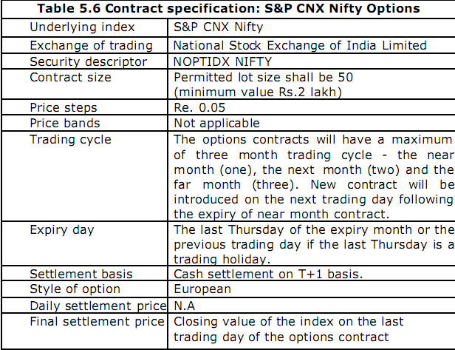
Option @ NSE
International Institute For Learning In Management

Slide 26
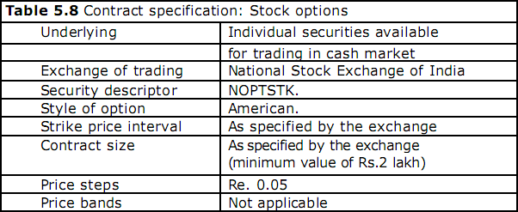
Option @ NSE
International Institute For Learning In Management

Slide 27
The Binomial pricing model
Based on assets price process, in which at any point of time asset price can move two possible price.
50
S is current price with p, (1-p) probability to increase price @ su & down @ sd.
Cerate a “ Replicating portfolio” that has same cash flow as option being valued with underlying assets & risk free borrowing , lending interest rate .
Call price
t=2
100
50
t=1
t=0
70
0
50
35
25
0
International Institute For Learning In Management

Slide 28
Value of call= current value of underlying* option delta – borrowing needed to replicate the option.
Value of put= current value of underlying * option delta- lending needed to replicate the option.
Price of call option @ t=1
  (70*1 – 45)= Rs. 25
Call price
Replicating portfolio
t=2
100 * D – (1.11* B)=50
50* D – ( 1.11* B ) = 0
Now: D & B is 1 & Rs. 45.
100
50
t=1
70
0
50
International Institute For Learning In Management

Slide 29
Thank you!
International Institute For Learning In Management

