Slide 1
Simple
Presentation
on
INTERVIEW SKILLS

Slide 2
“The goal of an interview is to get you a job offer or at
least another interview. If you handle the interview
well you will show the employer that, in addition to
your outstanding technical qualifications and
background, you are a good communicator, an
organized, prepared, and logical thinker, and
someone who would add value to the organization.”
- Peter Fiske

Slide 3
INTERVIEWING SKILLS
What is an interview?
Preparing for your interview
The day of the interview
During the interview
Following up

Slide 4
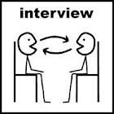
1. WHAT IS AN INTERVIEW
An Opportunity to "sell" your abilities, interests and career objectives.
An Opportunity to ask questions and learn more about the position and career offered by a particular company.

Slide 5
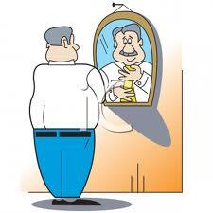
2. PREPARING FOR YOUR INTERVIEW
Common questions
Develop your own questions
Research

Slide 6
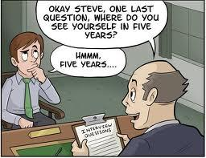
a. Common Interview Questions
Tell me about yourself.
What are your strengths and weaknesses?
Why this organization? Why this job?
What can you do for us?
Some common sense questions
Why did you leave your last job?

Slide 7
b. Develop your own Questions
What does the job entail?
What are the opportunities for advancement?
What about your professional development?
What are the future goals for the organization?
What are the roles of different team members?
What is the culture like in the organization?

Slide 8
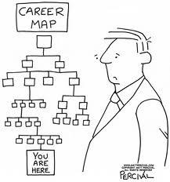
c. Research
Find out:
The vital facts of the organization
The corporate culture
Vision, Mission of the organization
Competitors
Salary structure

Slide 9
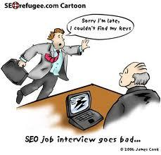
3. THE DAY OF YOUR INTERVIEW
Show up with energy
Dress appropriately
(Even if you don’t want to)
Bring Certificates & related Documents
Be Punctual

Slide 10
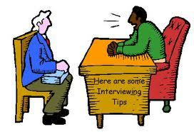
4. DURING THE INTERVIEW
Promote yourself and your strengths
Answer questions as best you can
Find out more
Be mindful of nonverbal communication
Preparation for following-up

Slide 11
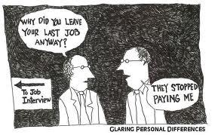
a. Promote Yourself and your Strength:
Don’t assume that the interviewer has gone through your Documents
Mind your manners
Be enthusiastic
Never talk negatively about prior jobs or employers

Slide 12
b. Answer questions as best you can
If needed, pause for thought
Ask for clarification
Stay in the moment
Be mindful of how long your answers to questions are
Never lie. About anything. Really.
Illegal questions

Slide 13
c. Find out more
Have a conversation
Ask your prepared questions
Check-in with yourself

Slide 14
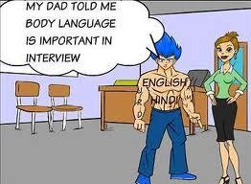
d. Be Mindful of Nonverbal Communication
Handshakes
Eye contact
Stay focused
Posture
Speak clearly

Slide 15
e. Preparation for Follow-Up
How will the Job Confirmation process proceeds?
Get business cards
Person In-Charge

Slide 16

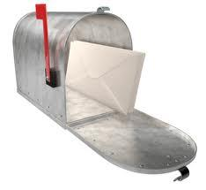

5. Following Up
Follow up, if needed through
E-mails
Telephone

Slide 17
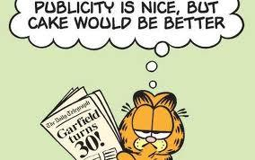
Conclusion
Be confident
Be Yourself
Be +ve
You learn from each interview
Show your Best and leave the rest

Slide 18

K. Bhavesh Jain
bhaveshjain7790@gmail.com

