Slide 1

CAREER IN COMMERCE STREAM
CA Surendra Kumar Rakhecha

Slide 2
When you select a particular stream say Commerce; you are passing through golden years of your career i.e. 18 to 25
Either you make it bright or you waste it for life

Slide 3

Why Studying is a Tough Task ?
Notes:
CORPORATE REPORTING IS A TOUGH TASK FOR MANAGEMENT

Slide 4

Dark Side of Getting Degree Only

Slide 5

How to Make Subjects Interesting?

Slide 6
How Many Careers are available to a Commerce Graduate ?
5
25
50 or
100

Slide 7
What is more important ?
A Graduation Degree
A Professional Qualification or
Practical Application

Slide 8
What if you don’t have a degree but have practical exposure ?

Slide 9

The need of the Hour is to

Slide 10

Do students have proper discussion on the subjects to improve their knowledge of subjects ?

Slide 11
Do the students really know the importance of the subjects included in their syllabus when they take COMMERCE STREAM as their career ?
Subjects like -
Accountancy
Statistics
Cost Accountancy
Economics
Law
Company Law
Management
Income Tax

Slide 12
Accountancy : Vast Areas
Data Entry of Day-to-Day Transactions
Finalization of Books
Finalization with Income Tax Regulations
Getting books audited
Finalization of Limited Companies Books
Amalgamations and Mergers
IFRS

Slide 13
What is Practical use of Statistics ?
Students score 90 plus marks in Statistics easily but unable to explain practical application thereof.
Why ?
What is practical use of Standard Deviation ?

Slide 14
Cost Accountancy : Areas covered
Cost Ascertainment
Cost Control
Cost Reduction
During slack market circumstances (like now); cost accountants’ services become more important.
Do you buy a milk-packet which is costlier by just 50 paise ?

Slide 15
Economics :
1. How share market reacts ?
2. How GDP is important ?
3. Why US $ is strong against Indian Rupee despite there is no slack in Indian Industry.
4. What does it mean other things being equal in the Economic theory ?

Slide 16
Accounting, Cost Accounting, Reporting with the help of Statistics and Management Accounting is possible through SAP run ERP
What is SAP : System, Application & Products
What is ERP : Enterprise Resource Planning
With the help of Information Technology; Realtime Reporting becomes possible where various factories and departments are functioning across the country/world of a company.

Slide 17
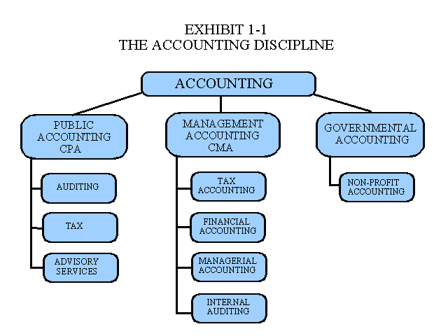

Slide 18
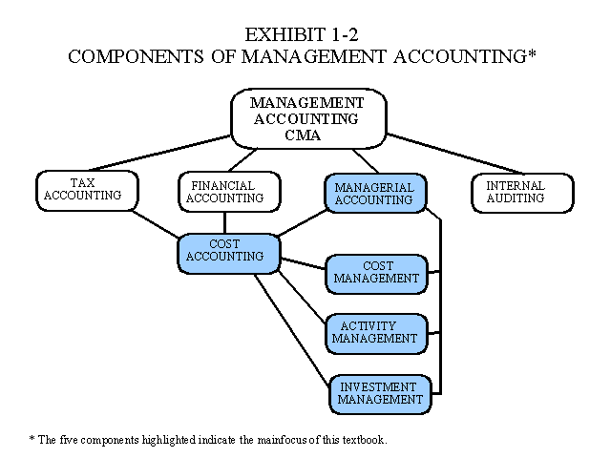

Slide 19
LAW
Is it a Theory Subject ?
Is it of no use ?
IMPORTANT :
Learn Basic Concepts
Example : Partnership : Unlimited Liability
Limited Liability Partnership (LLP) :
- Recent Development : Due to limitation of Partnership Firms

Slide 20
COMPANY LAW
Don’t you think you should own a company in the future ?
Don’t you think you should acquire a sick business where you see immense possibilities ?
IMPORTANT :
Learn about Corporate Governance
Learn about Legal Compliances to run a Company
Directors not knowing implications to comply the provisions of Company Law are subject to imprisonment !

Slide 21
Income Tax :
1. Return Filing
2. Tax Administration
3. Tax Planning
4. Assessment Proceedings
5. Appeals
6. International Taxation

Slide 22
MANAGEMENT
Is it a Theory Subject just to pass in exams ?
Do you agree that you apply Management Principles in your day to day activities ?
What is difference between Management Theory & Management Practice ?
Can you imagine that in future you will be able to run an organization without applying Management Principles ?

Slide 23

You are too Lucky : Just Compare the cost of Higher Education in Commerce: India Vs.Abroad

Slide 24

You can go ahead when you take further steps : Just study 7 Hours Daily to make a Bright Career for Life

Slide 25
CONCLUSION
FOR THE BEST CAREER; THESE ARE REQUIRED
Understanding of Concepts of the Subjects
Practical Application of the Subject
Analytical Study of Books
Know about Recent Developments
Regular Discussion on the Subject

Slide 26
Latest Development To Know About
Thank You
CA Surendra Kumar Rakhecha
E-mail : carakhecha@yahoo.com
E-Invoicing :
Next Step for
New Age CFOs

