Slide 1
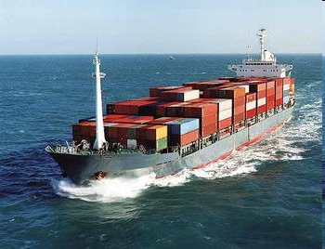

BILL OF LADING
BY CA .SAYANTAN BASU

Slide 2
DEFINITION
A document issued by a carrier, or its agent, to the shipper as the contract carriage of goods. It is also receipt for cargo accepted for transportation, and must be presented for taking delivery at the destination.

Slide 3
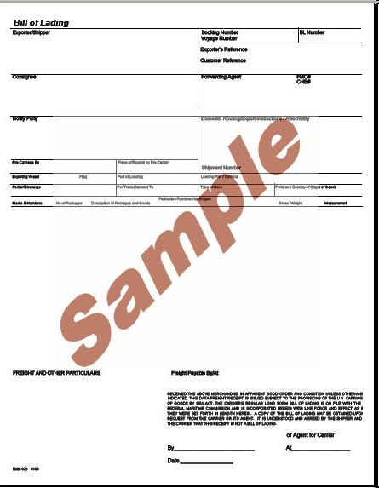
BILL OF LADING SAMPLE

Slide 4
CHARACTERISTICS
It is receipt of goods, signed by the master other duly authorized person on the behalf of the carriers
It is documentary evidence of the contract of the carriage between the shipper and the carrier
It is the document of title to goods described therein

Slide 5
TYPES OF BILL OF LADING
Received for Shipment B/L: A shipping company issues it when goods have been given to the custody of the shipping company, but they have not been placed on board.
On Board Shipped B/L: The shipping company certifies that the cargo has been received on board the ship.

Slide 6
Clean B/L: It indicates a clean receipt. In other words, it implies that there has been no defect in the apparent order or condition of goods at the time of receipt or shipment of goods by the shipping company.
Claused or Dirty B/L: It shows that the B/L is qualified which expressly declares a defective condition of goods. The clause may state “bale number 5 hook-damaged" or “package number 10 broken”.

Slide 7
Transhipment or Through B/L: When the journey covers several modes of transport from the place of starting to the place of destination, this type of B/L is taken. It indicates that transshipment would be en route. For example, part of the journey is by ship and the rest of journey may be by road, rail and air.

Slide 8
Stale B/L: According to international commercial practice, B/L along with other documents must be presented to the bank not later than twenty one days of the date of shipment as given in the B/L. In some cases, the importer may indicate the number of days within which the documents are to be presented from the date of shipment.

Slide 9
ADVATAGES
Prices of the goods at their final destination can be easier determined, inclusive of transport costs
A CIF-price can be determined
By simple endorsement of the Multi doc, the goods can easily be transferred to the third party.

Slide 10
CONCLUSION
Hence, bills of lading play a very important part in international trade. Depending upon the rules, which are followed, there are different implications for different parties, which are involved. This article gives a very brief description of the nature and functions of the bill of lading.

Slide 11


